Slide 1
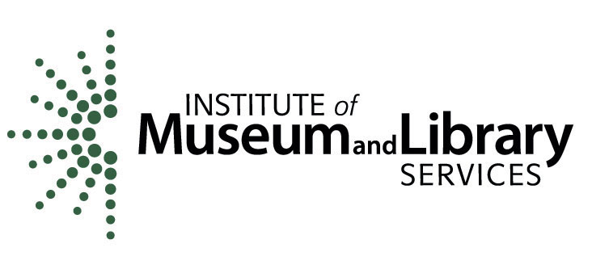
HathiTrust’s Copyright Review Management System
From Theory to Practice
Metropolitan New York Library Council
Melissa Levine
Lead Copyright Officer
University of Michigan & PI
June 5, 2014
CRMS-World, IMLS National Leadership Grant LG-05-11-0150-11
Notes:
Thematically its about making the promise of the public domain real and having tangible contours to the public domain that make it tangible in the policy wars. People can argue about orphans, but its harder to argue about the public domain (though sometimes as hard to know it when you see it!). I would:
Overview
What we set out to do - the context in 2006-2008 before the first IMLS grant
How CRMS relates to and relies on HathiTrust - the importance of shared effort
How it works
How reviewers are trained and participate
How it is, we hope, a platform for other kinds of material (say, serials)
Things we are thinking about for further research and projects, hopes for more international participation
Plans for formal work with HathiTrust for a business plan to make this work sustainable (project to program transition)

Slide 2
The HathiTrust Digital Library Today
11,115,843 total volumes
5,795,278 book titles
290,156 serial titles
3,890,545,050 pages
498 terabytes
132 miles
9,032 tons
3,704,201 volumes in the public domain (~33% of total)
Statistics as of 2014-2-8 from http://www.hathitrust.org/statisics_info
Notes:
When did the HathiTrust begin? Major events when it formed (ONLY major ones—keep it very brief).
Format shape > background fill
Stats updated on 2013-03-18 from http://www.hathitrust.org/
~31% of the total is about ~3,313,600 volumes
GET THESE NUMBERS FOR SEVERAL POINTS IN TIME TO SEE IF IT’S A USEFUL IMAGE*

Slide 3
Copyright Determination: Why Now?
A response to “bibliographic indeterminacy” (Wilkin, 2011)
High investment in our collections
Low certainty about the rights status of volumes in those collections
United States: 1923-1963
Australia (before 1955), Canada: 1894-1964
Australia (after 1954), United Kingdom: 1874-1944
Fulfilling the promise of the public domain
Notes:
Updated 2014-04-08.
The first CRMS project began in 2008 as a response to the problem of “bibliographic indeterminacy,” which is to say, “the dearth of reliable bibliographical information about books in research and academic library collections, especially in regard to the rights status of those books.” (“Bibliographic Indeterminacy and the Scale of Problems and Opportunities of “Rights” in Digital Collection Building,” John Wilkin, 2011)
Indeterminate rights status is a particular concern for works published in the United States between 1923 and 1963. Copyright law outside the US is primarily determined by author death dates, but estimates based on typical lifespans suggest that works published in the United Kingdom between1874 and 1944 or in Australia or Canada between 1894 and 1964 will also need copyright determinations.
(The difference between Australia/Canada and the United Kingdom is due to a “life plus 50 years” rule being followed in Australia and Canada, while the United Kingdom follows a “life plus 70 years” rule. One further complication is that works published after 1954 in Australia also follow a “life plus 70 years” rule.)
Our goal is to fulfill the promise of the public domain as part of our professional commitment to foster open access to knowledge, accessibility for the disabled, and maximum use of library collection resources.

Slide 4
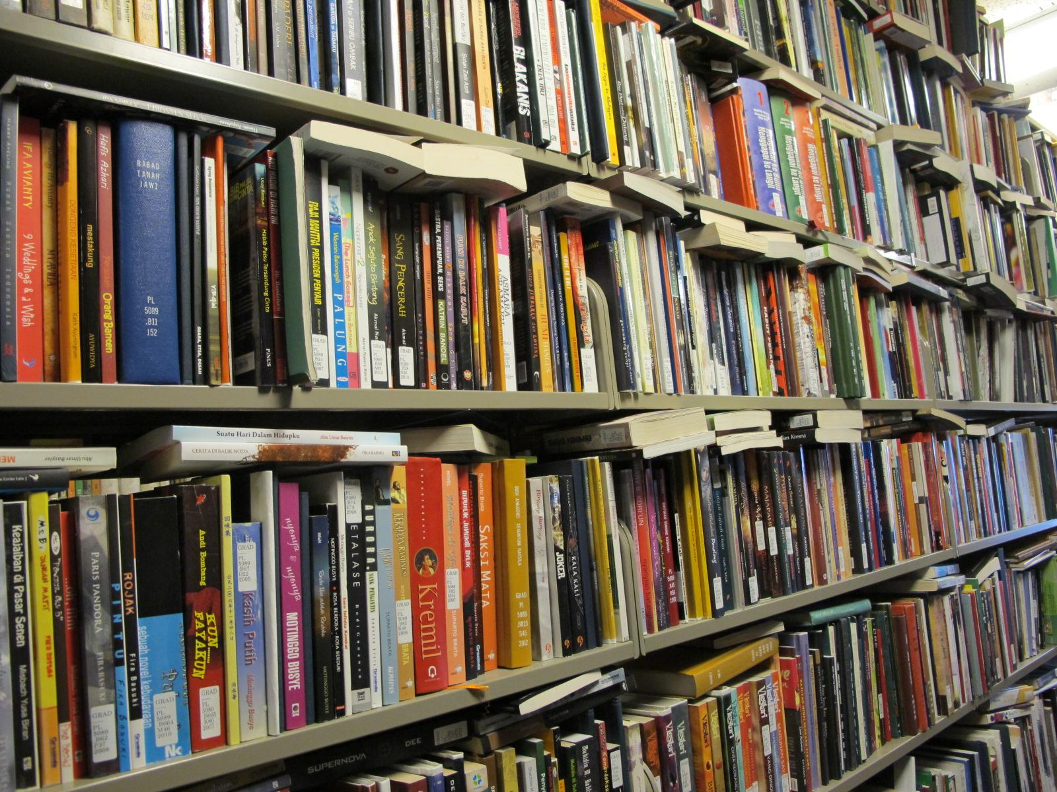
Public domain?
Notes:
The public domain is a vast social bargain that is intended to benefit the public after a copyright term has expired. Much of this bargain has not been realized because of the time-consuming research and legal knowledge required to determine when and where copyright terms have expired.
We, as libraries, remain uncertain which of the books on our shelves are in fact public domain and how that affects what we are able to do with them. Identification of public domain books in our collections has often been approached in small projects based on local need: an upcoming exhibit, interest in a rare collection, a digitization project...

Slide 5
Notes:
Justin’s slide from the “Accessing the Public Domain” panel discussion with him, Melissa, Jack, and Jessica.
For non-lawyers: “pma” refers to “post-mortem auctoris” (“after the death of the author”).
The point of the slide being that in a future world where heads are kept alive in jars, there might never be an author death date.
Image from http://en.wikipedia.org/wiki/Politics_in_Futurama

Slide 6
CRMS Today
CRMS-US
2008 – March 2014
CRMS-World
2012 – March 2014
Total: 304,801 determinations Total: 74,418 determinations

Slide 7
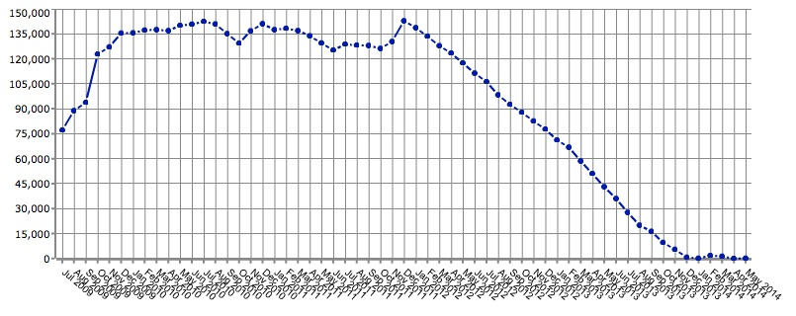
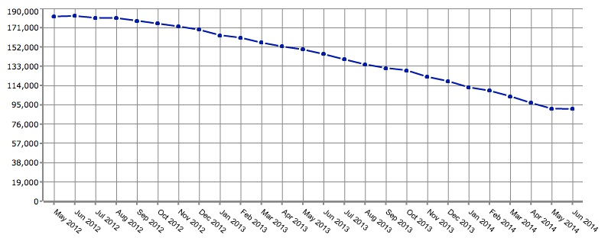
The CRMS Projects… So Far
CRMS-US
2008 – Jan 2014
CRMS-World
2012 - present
Current as of 2014-06-03.
Notes:
Updated 2014-06-03. These two charts are from the CRMS-US and CRMS-World Dashboards.

Slide 8
Partners Indiana University • University of Minnesota • University of Wisconsin
Baylor University
University of California, Irvine
University of California, Los Angeles
University of California, San Francisco
California Digital Library
Columbia University
Dartmouth College
Duke University
Univ. Of Illinois, Urbana-Champaign
Johns Hopkins University
University Of Maryland
Northwestern University
Penn State University
Princeton University
Ohio State University
McGill
Notes:
Partners for world – cost share plus others
Value of that? Time committed for 3 years – commitment of x,000 hours of labor over 3 years
Key staff at umlibrary
Over 30 reviewers now

Slide 9
Advisory group
Jack Bernard
Georgia Harper
Kenneth Crews
Peter Hirtle
Kevin Smith
Jessica Litman
Bobby Glushko
Sharon Farb

Slide 10
CRMS-US IMLS National Leadership Grant 2008-2011
Works published in the United States
1923-1963
Formalities (registration and renewal)
Well-established resources
Stanford renewal database, VIAF, LoC Authority, etc.
Reviews performed by catalogers
Two independent reviews
Expert resolution of conflicting reviews
Complex or unresolvable items set aside (“Undetermined”)
Notes:
Only those works in HathiTrust, so there may be many more, the remainder of the 500,000 thought to have been published during that time.
Roughly about 170,000 volumes.
Do NOT get into weeds on review process here. Move quickly through bullet points—review process comes later.

Slide 11
CRMS-World IMLS National Leadership Grant 2011-2014
Australia, Canada, and the United Kingdom
Response to Berne Convention
1870s – 1940s
Author death dates
Well-established resources
VIAF, LoC, Archives Canada, NGCOBA, etc.
Two independent reviews
Expert resolution of conflicting reviews
Complex or unresolvable items set aside (“Undetermined”)
Notes:
Lots of work yet to be done.
Second grant applied for in 2010?
130,000 left in US? (nail this down) and another 170,000 volumes from a/c/uk
Do NOT get into weeds on review process here. Move quickly through bullet points—review process comes later.

Slide 12
What we do.
Narrow the legal framework
Translate that to an algorithm
Express that as a working interface - candidates viewed in interface with resources
Two independent reviewers:
Confirm accuracy of the catalog record
Assess front matter
Consult resources for relevant data (author death date, etc.)
Render a judgment
If judgments conflict, an expert reviewer renders a final determination
Notes:
Look at logic
Resources consulted and documented
Interface
Results in Rights Database distinct from HathiTrust.
Results accepted by HT

Slide 13
Legally reliable results because…
Practical scope of inquiry
Proven and auditable methods
Standardized training – consistent assumptions
Set aside anything out of scope
Notes:
What language reviewers can read?
Variety of legal regimes
Impractical to do books from across countires of origin (eg a collection from a donor from all over world)
Mixing jurisdictions
Serials, conference proceedings, multiple contributors
Life +
Formalities
Exceptions
**create system that allows for facutual evaluation not legal evaluation – non lawyers can id designated facts.

Slide 14
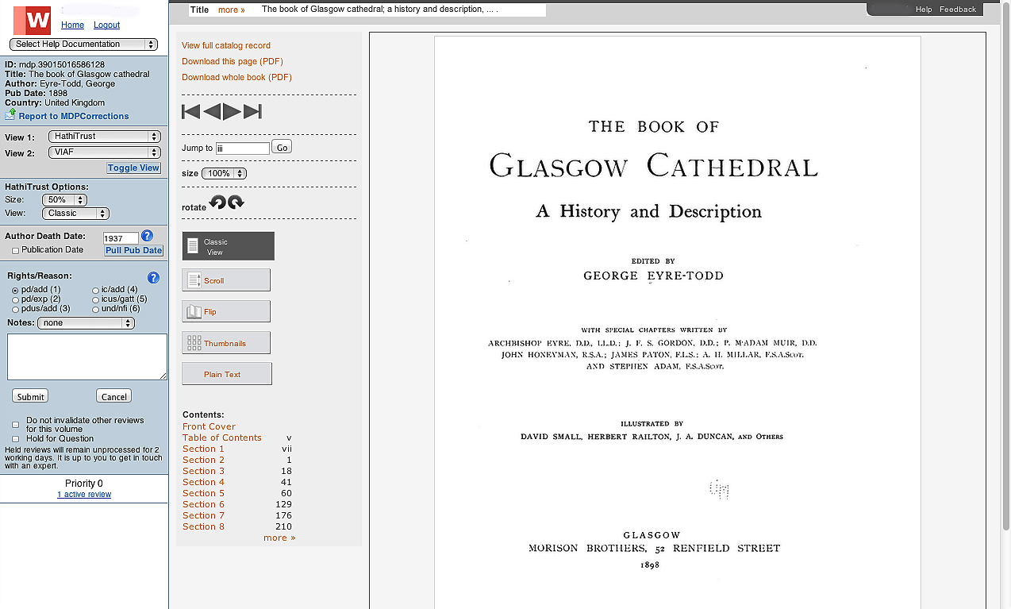
This is what the interface looks like. Secure.
Notes:
Talk through logic and resources

Slide 15
Reviews Across Multiple Institutions US to World
Notes:
With funding from the Institute for Museum and Library Services in the form of two National Leadership Grants, we’ve been able to bring together seventeen partner institutions - primarily university libraries - for an unprecedented approach to systematically checking the copyright of books. This project is formally known as the Copyright Review Management System or CRMS. Over the past five years we’ve developed experience in managing a collaborative copyright project of this nature that I want to share with you today.

Slide 16
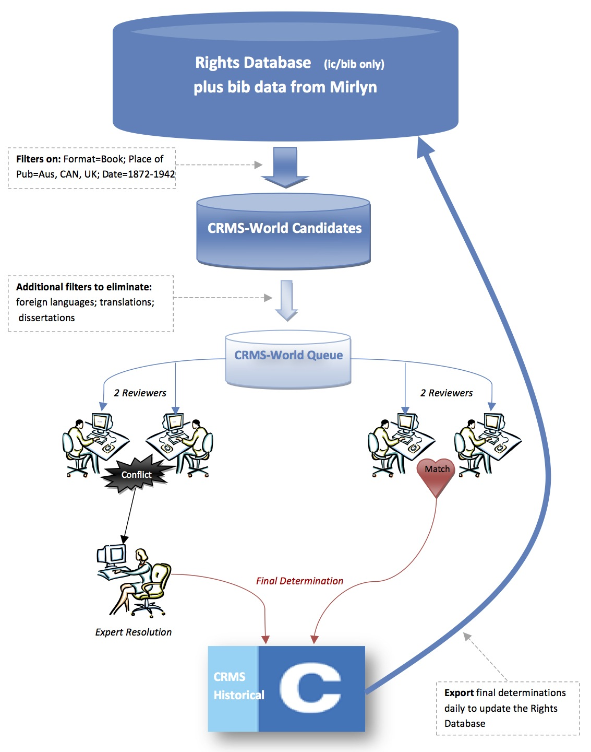
The CRMS Review Process
Notes:
Updated 2014-04-08.
This diagram is an illustration of the review workflow described in the previous slide.
The HathiTrust Rights Database includes metadata on all the volumes in HathiTrust. When the CRMS project team queried these metadata in 2008 and 2011, they were able to create two pools of candidates, including over 300,000 volumes for CRMS-US and over 170,000 volumes for CRMS-World.
Given the large number of volumes in both of these candidate pools, the project team also created “queues.” The queues filter the two pools down to more manageable lists of 800 volumes each, and its from these two queues that volumes are drawn for reviewers to examine.
Once the reviewers have made their determination on a volume, the volume can be exported from CRMS, and the revised metadata can be sent back to the HathTrust Rights Database in order to update that volume’s record.

Slide 17
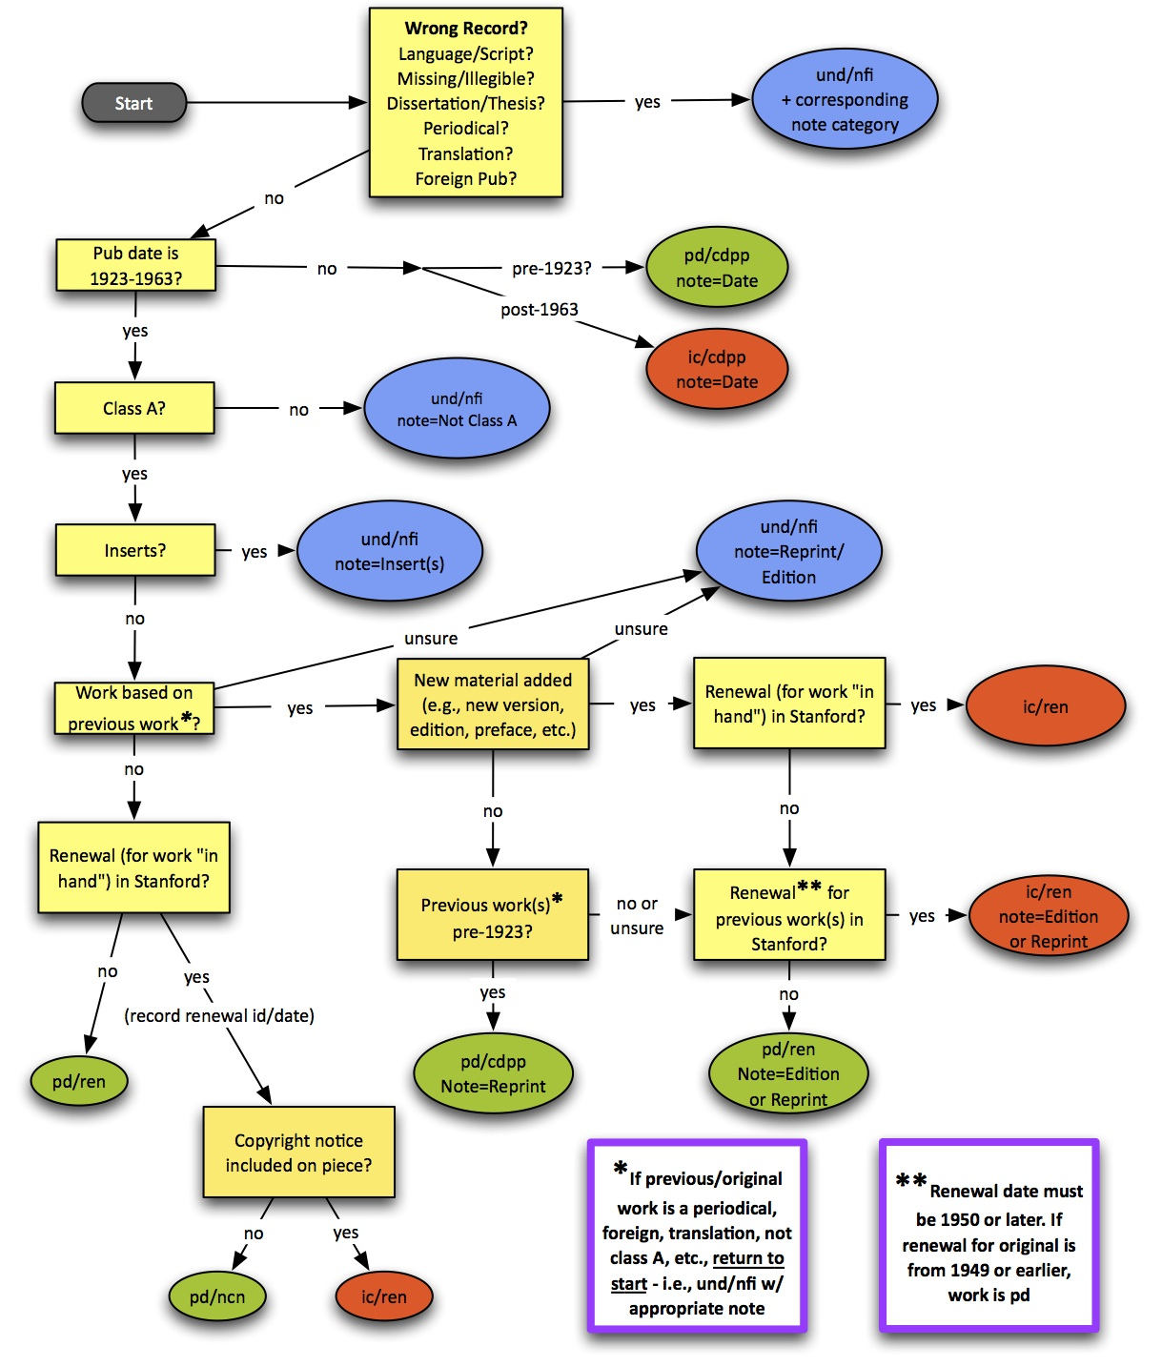
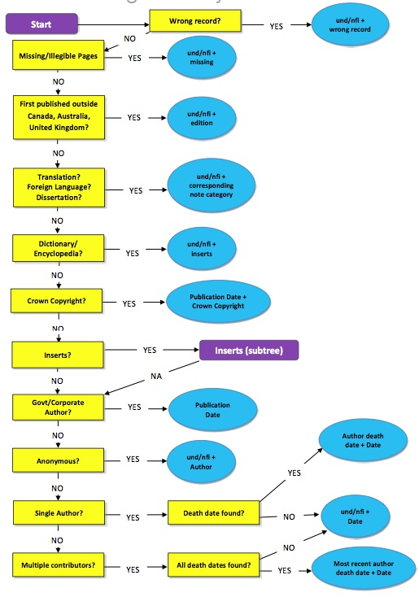
CRMS-US Decision Tree
CRMS-World Decision Tree
Notes:
Updated 2014-04-08.
The CRMS decision trees reflect the complexity of copyright law and the many factors relevant to making a rights determination.
CRMS training emphasizes the importance of following the decision trees closely.
For example, assume that two reviewers agree that a given volume should be “undetermined,” and that they also agree about the reason for giving it that status, then the volume will go on to overnight processing that evening and be exported to HathiTrust.
But say the two reviewers agree that a volume is in the public domain. If they then disagree about the reasons for that judgment, then the system will see that as a conflict and will still send that volume to an expert reviewer. This creates unnecessary work for the expert. Considering the high ratio of reviewers to expert reviewers, and the likelihood of a scenario like this happening frequently, this situation could easily create a “bottleneck” in the review process.
Strict adherence to the order of decision tree prevents this possibility because moving step-by-step through the tree means the two reviewers should consider each possible reason in the same order, and therefore, they should both be likely to select the same reason first, even if other reasons might apply to that given volume. That way the research process should result in the same status and reasons being applied, even in the cases that are more complex.

Slide 18
The CRMS Wiki
Notes:
Updated 2014-04-08.
Reviewers frequently contact the project team with questions about copyright law and how to apply it when making determinations. Normally this communication takes place via email. While this works and allows us to provide quick responses, it also risks “losing” substantive responses that might be needed again if other reviewers ask the same question.
The CRMS Wiki allows the project team to share answers with all of the CRMS-World reviewers at once and to ensure that those answers will remain available to the reviewers whenever they might need them.
The wiki can also help new reviewers navigate their way through some of the more complex issues in rights determination

Slide 19
Changes in the training model
Travel to institutions
Fly them to us
Train the trainer
Centralized training
Notes:
We’ve been growing and refining a training process for five years. What methods did we find that enabled us to expand institutional collaboration?
Read sections on training models A, B, C: pages 5-7.

Slide 20
Video tutorials
Notes:
Some additional learning aids are a series of screencast videos demonstrating the interface and common situations. This has improved our ability to demonstrate the interface while people before they have authorized access to the Production system.
The wiki is a place for questions to be documented and answered, particularly if they arise more than once. Reviewers frequently go here to search for recommended responses to unusual problems.

Slide 21
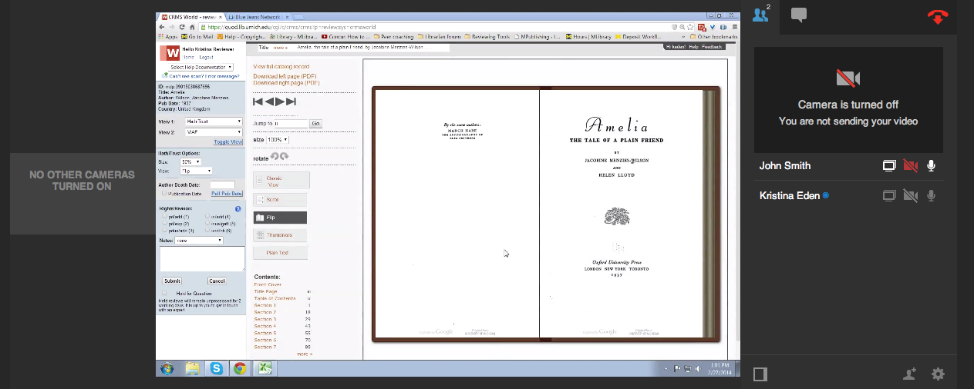
Screensharing programs
Bluejeans.com
Notes:
Screensharing has proven an effective way to substitute for travel or to hold in-person training events. We first started testing this method with a free service, Skype. Upon realizing that personal screensharing sessions were going to be a foundation of our training program, we began using BlueJeans. It was technically friendlier for other institutions to connect without needing a computer administrator.

Slide 22
What makes the best reviewer?
Rank
AUL
Librarian
Resource assistant Graduate student
Level of education
Ph.D
M.L.I.S.
B.A.
Sweet spot
Time commitment
5%, 10%, 25%, 33%, 50%
Other factors
Dedicated hours
Limited interruption
Notes:
Several factors contribute to the development of a successful CRMS reviewer. By saying “best” I mean that we’re primarily looking at quantitative measurements of productivity. Since reviewers must meet a certain level of accuracy to be allowed into the ‘live’ system, there is not a noticeable difference in error rates as related to these factors - merely productivity.
Productivity does not correlate to rank. All four levels have good workers. Productivity also does not correlate to level of education. People with Ph.D’s do equally well as those with a B.A.
The most notable influence on productivity is the percentage of their total work hours committed to this project. Review productivity tends to be highest for those reviewers who devote between 15-25% of their work time, with diminishing returns for those reviewers who commit a greater percentage of their time.
Reviewers contributing 10% of their time or less, on average, were less likely to achieve or maintain a sufficient level of expertise and familiarity with the interface and the review process. This proved to be particularly true for those who contributed 5% or less of their time. They were simply not spending enough time working with the CRMS process to retain the skills necessary to perform reviews efficiently and reliably. This has consequences for reviewer retention as well. Many reviewers in the 5% bracket have been more likely to disengage from the CRMS review process and simply stop altogether.
One of the most surprising realizations for us was that those who self-identified as having dedicated work hours for this project - primarily graduate information school students, hired solely for the purpose of doing copyright reviews - had astounding productivity levels. That goes hand in hand with other anecdotes we heard from reviewers who had senior level job responsibilities - that competing job priorities often make it difficult to put in their dedicated hours.

Slide 23
Problem: vulnerability to staffing changes
Documentation
Cross training
Need depth of staffing for sustainability
Identify secondary responders
Notes:
In the process of seeking out and training four new Experts we realized that having only one person do what is essentially a bottleneck in the workflow created a vulnerability to staffing changes. We examined what was necessary to survive and continue the work should one person be hired away or even be away on vacation for a week - that the work wouldn’t be negatively impacted by their absence.
We began improving documentation, both of training and of systems development. We began cross training people to cover for other responsibilities and looked for areas that had become knowledge silos. We identified secondary responders in case the system went down while someone was out of the office. When you’ve got the work of over thirty people dependent upon the presence of one, you really cross your fingers that the software doesn’t start acting up when he’s on vacation which is why we joke that our developer can never take vacation time.

Slide 24
Foundations for any new projects
QUICK
INEXPENSIVE
Two review process
Expert adjudicators
15-25% time commitment
Centralized training using a combination of static materials and interactive tools
RELIABLE
Notes:
In summary,
we’ve gained experience in working with seventeen other institutions to identify public domain books in our combined library collections. We believe in these core foundations for expanding to new collaborative copyright projects in a way that would continue to be (comparatively) inexpensive, quick to onboard new institutions, and achieve reliable results.
A multi-institutional workflow should highly value the two review process, should identify capable people to be “Expert adjudicators”, should highly recommend a time commitment of 15-25% for any individuals being assigned to the project, should consider using a combination of centralized training using documentation and personal communication and interactive tools such as screensharing programs.
This CRMS project has been highly successful to a much greater extent than any of us could have accomplished on our own. We have identified public domain books and where possible, made them openly viewable in HathiTrust. We have reviewed an astounding number of books and truly made this a collaboration of libraries working for the public good.

Slide 25
What we are learning.
Crowd sourcing (Author Death Dates?) – not as easy as we thought
Ongoing improvements to training – online, 7 to 54 reviewers, central quality control and training
Requirements for reviewers - .25 time – real commitment
Copyright country-by-country
Notes:
Updated 2014-04-08.
We have learned several things as the CRMS projects have evolved since 2008:
In the past year we’ve discussed the possibility of a crowdsourced effort to identify author death dates. The idea is appealing because the search for author death dates is relatively easy to define as an isolated effort, but the data gathered would be very useful to our researchers. It could also be done without having to provide access to scans of potentially copyrighted material. However, there are still questions about how we would preserve the data retrieved; how we would vet the quality of that data; and how we could make it available efficiently and reliably to our researchers within the existing CRMS interface. So more work will be needed on this before it could be considered a serious project.
We have made continuing improvements to our training material and tools for new reviewers. (Much of this work was done by Kristina Eden and Heather Shoecraft.) Training documents are available online on the project website, and we have also had success with online training sessions. Qualtrix surveys have also been surprisingly successful as tools for testing.
Our experience has shown that certain factors are preferable in CRMS reviewers:
They should be trained librarians or staff. In some cases, graduate students, but only if they are able to make long-term commitments to the project and will not be pre-occupied with their classwork or other obligations.
Reviewers should devote no less than 15% and no more than 35% of their time. 20-25% is strongly encouraged.
Less than 15% means the reviewer will not gain, or be able to maintain, sufficient familiarity with the system and the decision tree
More than 35% each week usually results in burn out. This work requires sustained focus and is not necessarily the most exciting thing a person can do.
The first Experts were all located at UM, but we have had great success with two Expert reviewers at our partners—one at Princeton and the other at Johns Hopkins.
This is especially desirable because it means CRMS-style research can be spread out to multiple HathiTrust partners, giving them an opportunity to take a larger role in the effort. The more collaboration the better.
We are also exploring other resources to add to the review process. When the OCLC began to offer the Virtual International Authority File (VIAF) in 2012, we included it in the CRMS interface. We prefer to use open sources whenever possible, but will also consider licensed resources if they seem likely to make important contributions to the project. In practice, though, the major factor determining whether we will adopt a resource or not is whether they have an API (Application Programming Interface) that will allow us to import their data automatically into the CRMS interface.
All copyright law is complex, but its especially so when taking an international perspective. It’s not just the Berne convention (more on that in a moment). There are also relevant laws on a country-by-country basis to consider. Some of them are relevant only between two nations or among a small group. And some may be decades old, requiring additional, in-depth research.

Slide 26
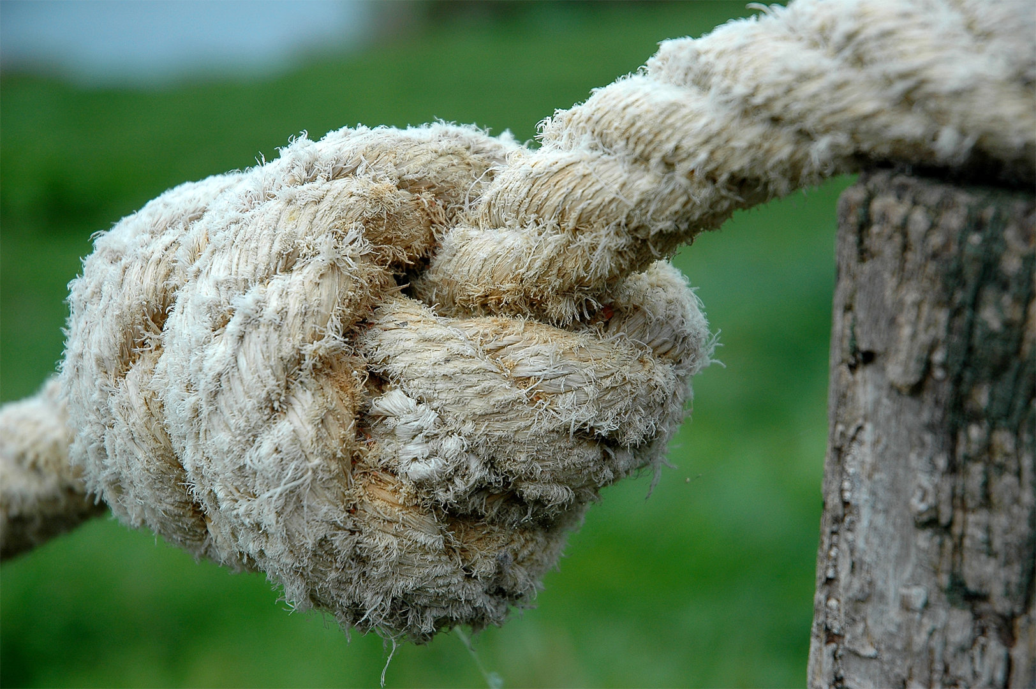
Issues…UND Inserts GATT – General Agreement on Tariffs and Trade Dissertations Dictionaries
http://images.cdn.fotopedia.com/anboto-TEaP7qN--yk-original.jpg
Notes:
Updated 2014-04-08.
Result: “GATT Restoration”
Effective January 1, 1996
Restored copyright period extends for the term the work would have had if it had not gone into the public domain.
Applies to published works if:
A work published in an eligible country more than 30 days before its US publication.
At least one author who is a citizen or resident of non-US country (that is a member of Berne, signed WIPO, etc.)
Still in copyright in its source country in 1996.
Fell out of copyright in the US due to noncompliance with formalities.
The Uruguay round of the General Agreement on Tariffs and Trade restored the copyrights of certain foreign titles in the United States on January 1, 1996. These works have required special provisions in CRMS and HathiTrust, and will require continued attention as the projects move forward.
Sources: http://williampatry.blogspot.com/2007/10/gatt-restoration-teaser.html and http://www.copyright.gov/gatt.html and http://www.copyright.gov/fedreg/1995/60fr50414.html and
Copyright and the Public Domain, Stephen Fishman, Chapter 8 (including notes below):
Year Work Lost Copyright and US Copyright Term Protection (from Fishman 8.04)
1921-1922: 75 years from publication
1923-1977: 95 years from publication
1978-now: life + 70 years; or 95 years from publication for works for hire, anonymous, or pseudonymous works

Slide 27
Pilots under consideration
CRMS “Toolkit” (already underway!)
Expand our scope to works beyond English
Spain
Germany
US State Documents
Tackle the undetermined (UND) volumes.
Can we identify patterns?
Start with “easier” sub-categories?
Linked data initiatives
Sharing metadata with USCO, WATCH
http://images.cdn.fotopedia.com/flickr-2711579609-original.jpg
Notes:
As we look to the future, the CRMS project team is considering several potential projects.
A CRMS “Toolkit” will be a guide on how to create a CRMS-like project. It will address every aspect of CRMS, including technical considerations and what kinds of resources an institution must have readily available in order to undertake such a project. We hope to include as much of our hard-won knowledge in the final work as we can.
Currently we review only works in English, but we have begun to exploring the possibility of establishing partnerships with institutions in other countries that would allow us to review works in other languages. Thanks to our relationship with Complutense University in Madrid, we have already experimented with a slightly modified interface for researching works in Spanish. We hope to build on that first effort in coming months.
At some point the works that are ending up in the “undetermined” category will need to be revisited. We hope to identify patterns and sub-categories in that group in order to make a plan of action for reviewing them easier to undertake.
The US Copyright Office, the Harry Ransom Center’s WATCH file, and others use metadata similar to that used by CRMS and HathiTrust. We suspect that a linked data solution may be possible that would support the sharing of this metadata and allow us to create a large and diverse resource that would give scholars greater access to the works in these collections.
Identifying women authors who have changed their names at marriage has been a real challenge. There is a good research project here, and one that would have practical benefit to CRMS and HathiTrust. (As well as anyone who might join us in that linked-data proposal just mentioned.)

Slide 28
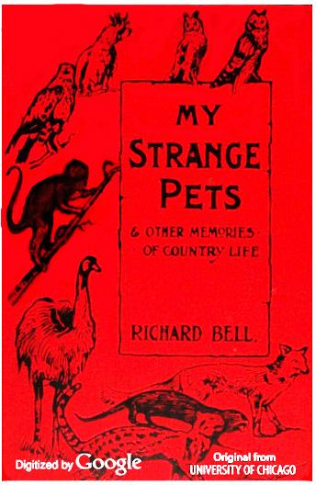
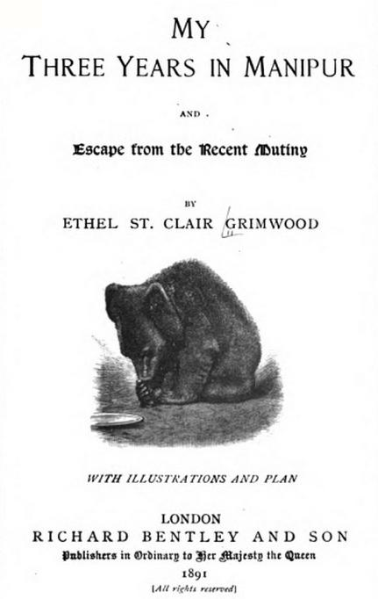
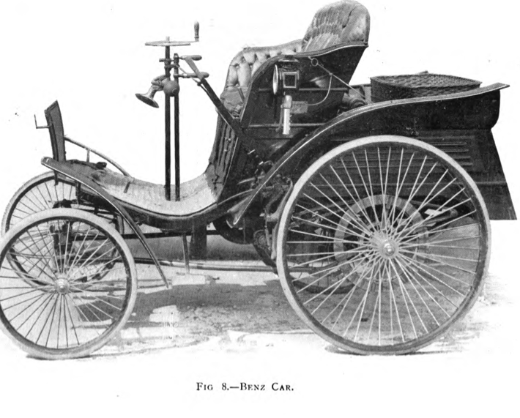
Recommended reading…
HathiTrust collection: Copyright Review project (CRMS) little gems
Notes:
At the end of all this, we get some really interesting works open. We appreciate the support of IMLS in funding this copyright review work and the dedicated time and commitment of our 17 partners. This is making the public domain real for all libraries.
Light cars and voiturettes

Slide 29
Thank you!
Copyright Review Management System-US
https://www.lib.umich.edu/imls-national-leadership-grant-crms
Copyright Review Management System-World
https://www.lib.umich.edu/imls-national-leadership-grant-crms-world
Melissa Levine mslevine@umich.edu
Richard Adler rcadler@umich.edu
Kristina Eden keden@umich.edu
Creative Commons CC-BY

Slide 30
Illustrative examples
Notes:
As Melissa mentioned, my name is Justin Bonfiglio and I’m the Copyright Specialist for the CRMS project.
My intention here is to provide all of you with a few examples of copyright complexities that we work with regularly. We do our best to simplify copyright review whenever possible – I’ll primarily highlight those times when things get complicated, with the hope that it might give you all some understanding of the challenges inherent in this type of work.

Slide 31
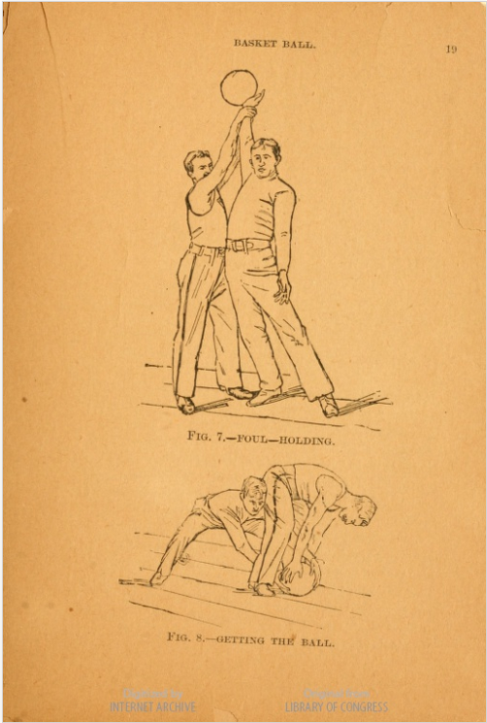
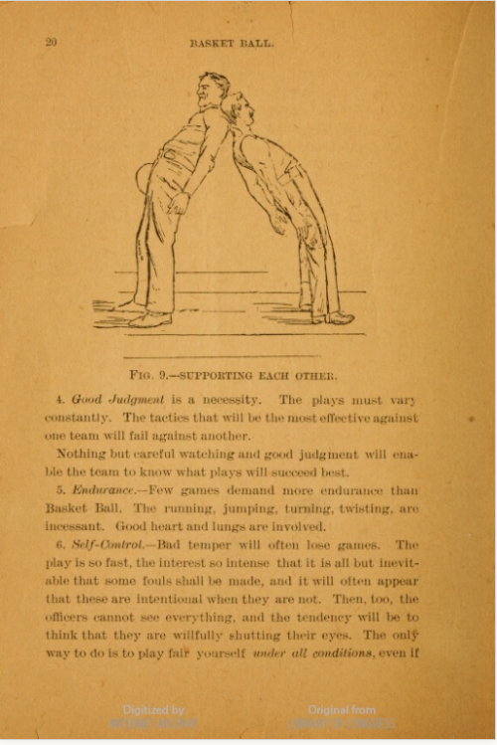
Basket ball. (1894)
Notes:
These are three pages from a HathiTrust volume published in the United States in 1894. One of the authors of the work was James Naismith, the inventor of basketball. I wanted to show this volume for three reasons.
First, because it’s basketball and that’s in the air right now. (and I think these images are pretty fun).
Second, this is a relatively “easy” case – it’s a work that was determined to be in the public domain bibliographically, based on its publication date (1894) and the fact that it was first published in the United States.
My third reason for showing this volume is that I think this is what people often think of when they think of the public domain – a work of sufficient age that it just is in the public domain, period. While that type of public domain work does exist, my next examples will highlight times when the inquiry is more complicated than that.
https://babel.hathitrust.org/cgi/pt?id=loc.ark:/13960/t7tm7p59w

Slide 32
GATT Restoration
Notes:
The first issue I’d like to take on is GATT restoration. Essentially, many foreign authors lost their copyright within the United States due to failure to comply with US copyright formalities, such as registration, renewal and publication with notice. A major part of our copyright review process for US works has been to look and see if the copyright in a work was renewed – we do this using the Stanford Copyright Renewal Database, which has renewal records for all Class A works (books) published from 1923 through 1963.
When the United States signed an international treaty called the General Agreement on Tariffs and Trade, in 1994, the restoration of copyright in the works of foreign authors was set in motion. Because of GATT restoration, codified in Section 104A of the Copyright Act, we can’t always rely on the absence of a copyright renewal to determine the copyright status of a work published between 1923 and 1963.
Instead, we anticipate that GATT restoration does apply to many works authored by non-US authors. Here, we consider four factors, all of which must be met, in order for GATT restoration to apply to a given work.

Slide 33
GATT factors
At the time the work was created, at least one author…must have been a national or domiciliary of an eligible source country. An eligible source country is a country, other than the United States, that is a member of the WTO , a member of the Berne Convention…
AND
The work is not in the public domain in the eligible source country through expiration of the term of protection.
AND
The work is in the public domain in the United States because it did not comply with formalities imposed at any time by U. S. Law.
AND
If published, the work must have been first published in an eligible country and not published in the United States during the 30-day period following its first publication in the eligible country.
Notes:
For those of you Boolean logic fans out there (and I know you’re there), you’ll note the ANDs between each of these factors - all four factors must apply for GATT restoration to take effect. I KNOW that this slide has a lot of information on it, but I’d like to focus on a few key elements.
The key points I’d like you to take away from this slide is that we tend to focus on author nationality (FACTOR 1) and we also look at the author’s death date, combined with the relevant national laws of the source country, to determine whether the work had entered the public domain in the source country (FACTOR 2). For example, if a work was published in the UK, we would look to UK copyright law and consider the work’s copyright status there. (usually as of January 1, 1996).
I think factor four is interesting in that it could provide us with the possibility of removing works from GATT restoration consideration but, to date, we haven’t discovered a robust mechanism for answering the question – “Was this work published in the United States less than 30 days after it was published abroad?” This is an issue I’ll discuss in the next slide.
1. At the time the work was created, at least one author…must have been a national
or domiciliary of an eligible source country. An eligible source country is a country, other than
the United States, that is a member of the WTO , a member of the Berne
Convention…
2. The work is not in the public domain in the eligible source country through
expiration of the term of protection.
3. The work is in the public domain in the United States because it did not
comply with formalities imposed at any time by U. S. Law…
4. If published, the work must have been first published in
an eligible country and not published in the United States
during the 30-day period following its first publication in
the eligible country.

Slide 34
Arthur C. Clarke INTERPLANETARY FLIGHT (1951)
Published in the United States in 1950.
Published in London in 1950.
No copyright renewal record in the Stanford Renewal Database.
Clarke died in 2008 and was not a US citizen.
Conclusion: GATT restoration probably applies – we close the work worldwide.
Notes:
In this example, Clarke’s book, Interplanetary Flight, was published in 1950, both in London and the United States.
We know that Arthur C. Clarke was not a United States citizen and he passed away very recently – while there is not a renewal for his 1950 US publication, the complicating factor is that there was also a publication of the work in the UK in 1950.
Here, we suspect GATT restoration applies to his work, even though it is possible that restoration does not apply.
Going back to factor four, if Interplanetary Flight was published in the United States within 30 days of its publication in the UK, then GATT restoration would not apply. “Simultaneous publication,” regrettably, is a factual inquiry that we cannot easily assess at this time.
Here, we simply don’t have enough information. We can’t say, for example, that his work was published in the UK on December 15, 1950 and on January 1, 1951 in the United States. If we did have that information, we could say GATT restoration does not apply in this case.
That’s fact intensive research that is not easily automated or always available, to our knowledge.

Slide 35
Notes:
Here’s what a Stanford renewal record actually looks like. This record shows a 1960 registration and 1988 renewal for “New Matter” in Interplanetary Flight.
I find this renewal record interesting because it’s for later additions to Interplanetary flight, even though there isn’t a renewal record for the earlier work.
It makes the lack of renewal in the 1950 publication a little more curious, but I don’t think it affects the final GATT analysis for the work.

Slide 36
A child’s good morning – Margaret Wise Brown (1952)
Notes:
Here’s a work by Margaret Wise Brown, who was a popular author of children’s books. She’s probably most famous for Goodnight Moon. I came across this book within the last few days and I’ve reached some tentative conclusions, though I want to preface this by saying that the work is currently closed in HathiTrust.
I believe that this work is in the public domain in the United States, due to failure to renew. I don’t think GATT restoration applies.
On the next slide I’ll try to give you sense of what I’m considering here.
http://catalog.hathitrust.org/Record/001032258

Slide 37
No renewal record.
First published in the US.
Margaret Wise Brown was a US citizen.
Illustrator, Jean Charlot, dual French and US citizen, and died in 1979.
Conclusion: “Open in the United States for failure to renew”
Notes:
First off, there was no copyright renewal record for this work.
Second, the main author, Margaret Wise Brown, was a U.S. Citizen. And the book was first published in the United States – based on first publication of the work in the United States, I’m pretty certain GATT restoration does not apply to this work (confirm this with panel).
Here, the illustrator, Jean Charlot, is the complicating factor.
Charlot appears to have been a dual French-US citizen as of 1940 (per http://libweb.hawaii.edu/libdept/charlotcoll/J_Charlot/charlotthompson.html article). He was a professor at the University of Hawaii for about 30 years and they have a pretty extensive biographical article on his life, including the fact that he retained dual citizenship.
To me, Charlot’s citizenship raises the possibility of GATT restoration and, had the work been first published outside of the United States, I think his citizenship could have been a very real issue in the GATT Restoration inquiry. Again, as I’ve said, further digging makes me pretty certain that the book was first published in the United States (which eliminates the GATT restoration issue)
With no copyright renewal and no GATT restoration issue, I think the work can be considered to have entered the public domain in the United States.

Slide 38
Additional authored content
Notes:
I’d also like to talk a little bit about additional authored content in the works we review.
This is a copyright renewal record for a volume which actually isn’t in HathiTrust but is still a good example of a reason we sometimes can’t “open” works which might in large part have entered the public domain. In this case, we have Nathaniel Hawthorne’s Scarlet Letter, which is definitely in the public domain worldwide. But we also have a renewal for a foreword to the book, written by Leo Marx, and registered on July 27, 1959 and renewed on August 10, 1987.
Whenever we come across additional authored content in works, such as this, we often rely on a “und/nfi” category for the work – undetermined/needs further investigation. This allows us to set the work aside for future, more time intensive research. The und/nfi category has proven especially helpful for our CRMS-World reviews, which focus on the UK, Canada and Australia, where registration and renewal of copyright was not a requirement.
Keeping an entire work closed because of an often short introduction can be frustrating – sometimes we see introductions by authors who are genuinely excited that the main work will be read and enjoyed by the public – in those cases especially, it feels unfortunate that such an introduction may keep a work “closed” in a digital library for many years after the rest of the work has entered the public domain. However, in an abundance of caution, we currently presume that additional authored content may be in copyright.

Slide 39
Der Orchideengarten (1919-1921)
Notes:
Additional authored content is especially problematic with regard to works like serials.
Here, we have a German magazine published before 1923, which means we open it in the United States. It’s called Der Orchideengarten and it’s described on wikipedia as the world’s “first fantasy magazine.”
I think it’s wonderful that this magazine is publicly available in the United States – it’s often gruesome and intense imagery but it’s also, from my perspective, fascinating. The wide range of graphic art in the magazine is really impressive.
I also want to highlight this magazine because HathiTrust received a request to open it in Germany, from a German user. It couldn’t be opened. Throughout its pages, you find artwork and text authored by many different individual authors. Several of them died in the latter half of the twentieth century – two examples are Karl Rabus, who appears to have died in 1983 and Max Rohrer, who died in 1966. In Germany, copyright duration in works of this time period is based on the life of the author + 70 years. Karl Rabus’s copyright in the work would therefore not expire until 2054.
This is a reality we grapple with on a daily basis – in this case, it’s historical chance that this work was published prior to 1923, otherwise it would be closed in the United States as well, primarily for reasons related to the death dates of the authors who contributed to the magazine.
I wanted to conclude this by saying that, in some ways, for me, Der Orchideengarten represents the difficult terrain our current copyright law presents for works currently being written. For new works, formalities like registration, renewal and notice are not requirements for copyright in the United States.
With modern day works authored by multiple authors (I can think of many examples), and copyright based on the life of the author + 70 years, I think it will be often quite difficult to make public domain determinations in the future. For me, this is most certainly something to consider as we move forward and think about copyright, libraries, and accessing the public domain. Thank you.

