Slide 1



HathiTrust Research Center: An Update for the HT Members Meeting
HATHI TRUST RESEARCH CENTER
10.10.14
J. Stephen Downie – Co-Director HTRC
GSLIS
University of Illinois
Tweet us - @HathiTrust #HTRC

Slide 2


Many thanks …
HTRC IU Team
Beth Plale (PI)
Robert H. McDonald
Miao Chen
Guangchen Ruan
Zong Peng
Milinda Pathirage
Samitha Liyanage
Leena Unnikrishnan
Nicholae Cline
HTRC UIUC Team
J. Stephen Downie (PI)
Beth Namachchivaya
Megan Senseney
Sayan Bhattacharyya
Colleen Fallaw
Loretta Auvil
Boris Capitanu
Harriet Green
Sara Shreeves

Slide 3
Mission of the HT Research Center
Research arm of HathiTrust
Established: July, 2011
Collaborative center: Indiana University & University of Illinois
Mission: Enable researchers world-wide to accomplish tera-scale text data-mining and analysis
  Develop cyberinfrastructure to enable HPC access to the HathiTrust Digital Library
  Develop cutting-edge software tools for processing, analyzing text
  Develop translational tools and data that can be used to enhance HathiTrust Digital Library services to users

Slide 4

HTRC Governance
Reports to the HathiTrust Board of Governors
HTRC Executive Committee
  J. Stephen Downie (Co-director), Professor and Associate Dean for Research, University of Illinois GSLIS
  Beth Plale (Co-director and Chair), Director Data To Insight Center and professor in the School of Informatics and Computing at Indiana University
  Robert H. McDonald, Associate Dean of Libraries/Deputy Director Data to Insight Center at Indiana University
  Beth Sandore Namachchivaya, Associate University Librarian for Information Technology Planning & Policy at the University of Illinois
  John Unsworth, Vice Provost for Library & Technology Services and Chief Information Officer at Brandeis University

Slide 5
Goals for HTRC
Provide a persistent and sustainable structure to enable original and cutting edge research.
      Leverage data storage and computational infrastructure at Indiana & Illinois
      Stimulate community development of new functionality and tools
      Use tools to enable discoveries that would not be possible without the HTRC
Enable scholars to fully utilize content of HathiTrust Library while preventing intellectual property misuse within U.S. copyright law.
      Provision secure computational and data environment for scholars to perform research using HathiTrust Digital Library.

Slide 6
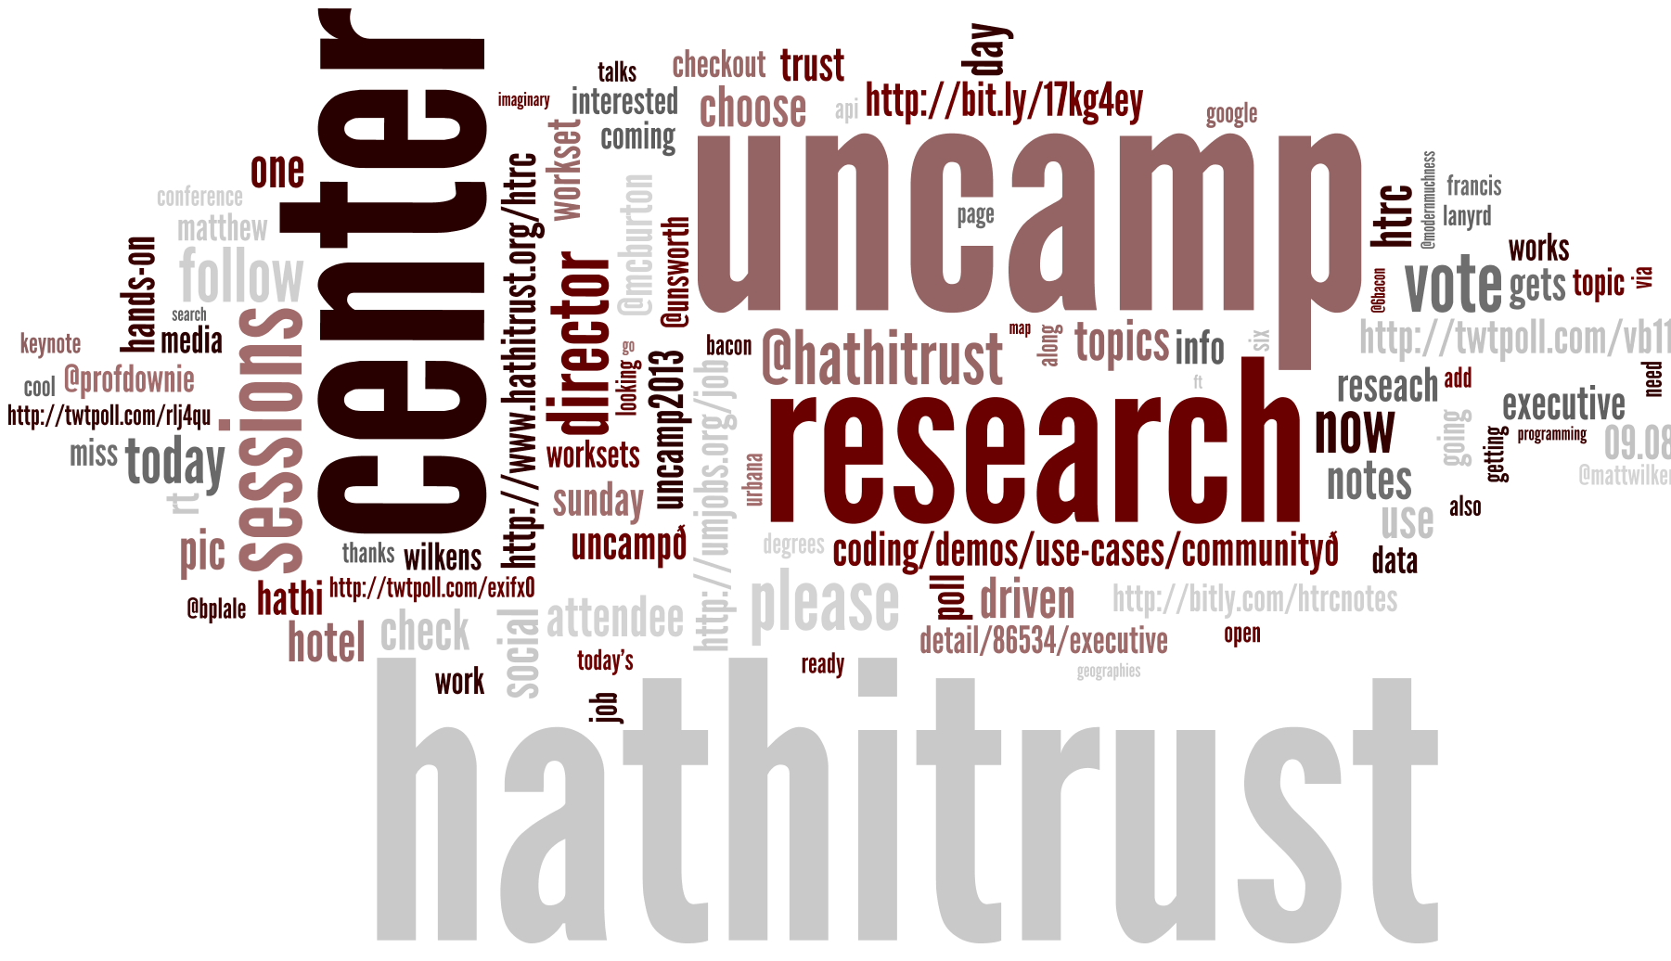
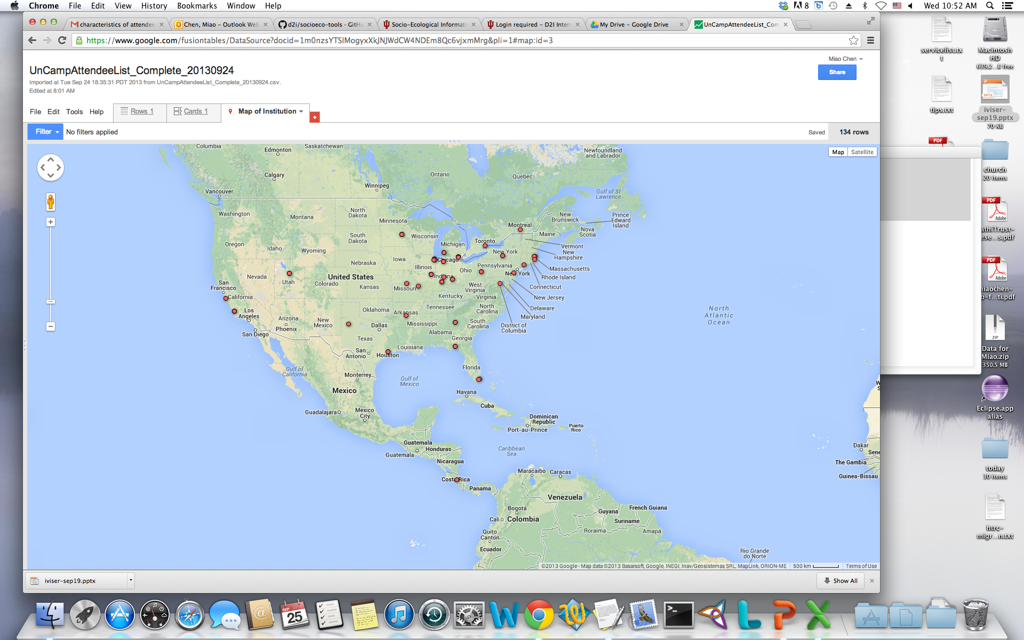
HTRC Timeline
Phase I: Development 01 Jul 2011 – 31 Mar 2013
  HTRC software and services release v1.0 https://github.com/htrc
Phase II: Outreach, 01 Apr 2013 – 30 June 2014
  2nd HTRC UnCamp Sep ’13
Phase III: Operations, 01 July 2014 – June 2018

Slide 7
HTRC 2014-2018 org chart

Slide 8
Core Development
Controls releases
Implements new features
System auditing, incident response
Manages bug queue
Oversees translational research process
At 2 FTE + UI specialist + minor roles
HTRC System Managers belong to this group

Slide 9
Advanced Collaborative Support
Pairs HT institution researchers with expert staff for an extended period during which they work together to address a particularly vexing issue (e.g., efficient parallelization and optimization of a machine learning algorithm)
20 hours/week available: example: at any one time 4 active projects, each receiving 5 hours a week for up to 2 months.
Resourced at 1.25 FTE
Staffed by HTRC Staff who have signed the staff agreement

Slide 10
Advanced Research
Grant funded
May include people designated as HTRC Staff
Activity that is not immediately intended for production availability
Activity from this group has to pass translational evaluation to be incorporated as production service

Slide 11
Scholarly Commons
User Support Service
Develop training materials
Educational workshops
Tool and workset creation
Collaborate with librarians and DH centers at HT institutions
Assist researchers in HTRC text data mining research projects
Led out of University of Illinois Library; smaller group at IU
Resourced at 2.7 FTE.

Slide 12
HT Members Engaged
Allegheny College
American University of Beirut
Arizona State University
Baylor University
Boston College
Boston University
Brandeis University
Brown University
California Digital Library
Carnegie Mellon University
Colby College
Columbia University
Committee on Institutional Cooperation
Cornell University
Dartmouth College
Duke University
Emory University
Florida State University
Harvard University
Indiana University
Iowa State University
Johns Hopkins University
Kansas State University
Lafayette College
Library of Congress
Massachusetts Institute of Technology
McGill University
Montana State University
Mount Holyoke College
Michigan State University
New York University
New York Public Library
North Carolina Central University
North Carolina State University
Northeastern University
Northwestern University
The Ohio State University
The Pennsylvania State University
Princeton University
Purdue University
Rutgers University
Stanford University
Syracuse University
Temple University
Texas A&M University
Tufts University
Universidad Complutense de Madrid
University of Alabama
University of Arizona
University of California
University of California Berkeley
University of California Davis
University of California Irvine
University of California Los Angeles
University of California Merced
University of California Riverside
University of California San Diego
University of California San Francisco
University of California Santa Barbara
University of California Santa Cruz
The University of Chicago
University of Connecticut
University of Delaware
University of Florida
University of Houston
University of Illinois at Urbana-Champaign
University of Illinois at Chicago
The University of Iowa
University of Kansas
University of Maine
University of Maryland
University of Massachusetts Amherst
University of Michigan
University of Minnesota
University of Missouri
University of Nebraska-Lincoln
University of New Mexico
The University of North Carolina at Chapel Hill
University of Notre Dame
University of Oklahoma
University of Pennsylvania
University of Pittsburgh
University of Tennessee, Knoxville
University of Utah
Vanderbilt University
University of Virginia
University of Washington
University of Wisconsin-Madison
Utah State University
Virginia Tech
Wake Forest University
Washington University
Yale University Library

Slide 13
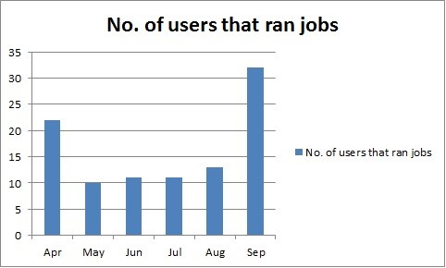
Growing Use

Slide 14
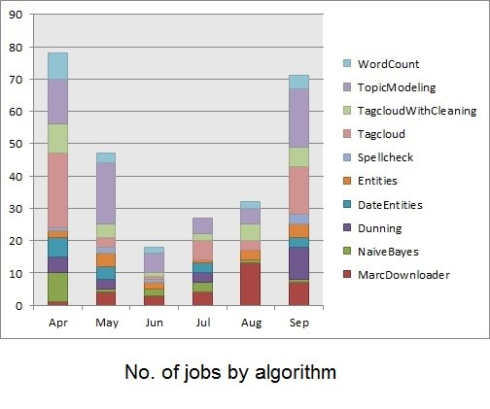
User-Generated Analytics

Slide 15
Current Grants
Data Capsule
  Alfred P. Sloan Foundation
Workset Creation for Scholarly Analysis
  Andrew W. Mellon Foundation
Exploring the Billions and Billions of Words in the HathiTrust Corpus with Bookworm
  National Endowment for the Humanities

Slide 16
In the Grant Pipeline
Secure Data Capsules for Computational Linguistics
  Unsworth (Brandeis)
Repository Services for Accessible Course Content
  Wood (Tufts)
Digging Deeper, Reaching Further: Libraries Empowering Users to Mine the HathiTrust Digital Library Resources
  Green (Illinois)

Slide 17
HTRC Future Work
Copyrighted content in progress
Advanced Collaborative Support
  The award model
  Award content is HTRC ACS staff time
  Collaborate with scholars on addressing their research needs related to HTRC
  E.g. prototyping, running text analysis
  Advocate open source; encourage extending the work to a grant submission
  Call for proposals is Mid-October 2014
Scholars Commons
  Interaction with scholars to help using HTRC tools and services
  An interface to interact with HTRC users via the channel of scholars commons
  Series of workshops at IU and UIUC

Slide 18
Future Events
DHCS 2014
  Oct 22, 2014 at Evanston, IL
SuperComputing 2014
  Nov 17-19, 2014 at Indiana University Booth
HTRC UnCamp 2015
  March 30-31, 2015 at Ann Arbor, MI
DH 2015
  June 29-3 July, 2015 at Sydney, Australia

Slide 19
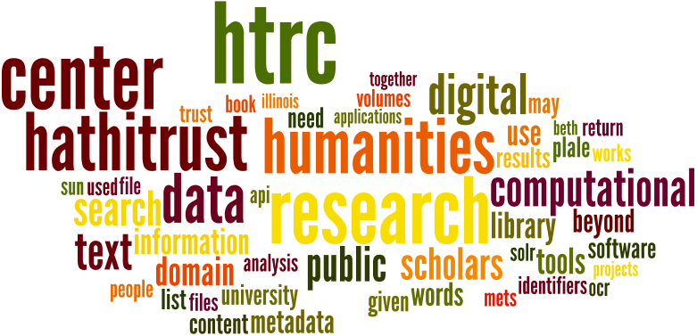
For details: http://www.hathitrust.org/htrc/faq
Portal: https://htrc2.pti.indiana.edu/HTRC-UI-Portal2/
Sandbox: http://sandbox.htrc.Illinois.edu
General contact info
  J. Stephen Downie, Co-Director HTRC, jdownie@Illinois.edu
  Beth Plale, Co-Director HTRC, plale@indiana.edu
Requests for capability, interest
  Miao Chen, Asst. Director for Outreach HTRC
  miaochen@indiana.edu

