Slide 1

Digital Humanities At Scale: Hathi Trust Research Center
CNI Project Briefing, December 2012
John Unsworth, Brandeis University
Beth Sandore Namachchivaya
University of Illinois at Urbana-Champaign

Slide 2
HTRC Mission
Public research arm of the HathiTrust
Help researchers world-wide to accomplish tera-scale text data-mining and analysis
  Develop cutting-edge software tools for processing, analyzing text
  Develop cyberinfrastructure to enable HPC access to the HathiTrust Digital Library
Established: July, 2011
Collaborative center: Indiana University & University of Illinois
1/10/13
CNI Fall 2012 Membership Meeting
#CNI12F #HTRC #HathiTrust

Slide 3

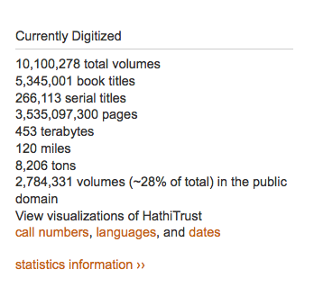
HathiTrust is large corpus providing opportunity for new forms of computation investigation.
The bigger the data, the less able we are to move it to a researcher’s desktop machine
Future research on large collections will require computation moves to the data, not vice versa

Slide 4
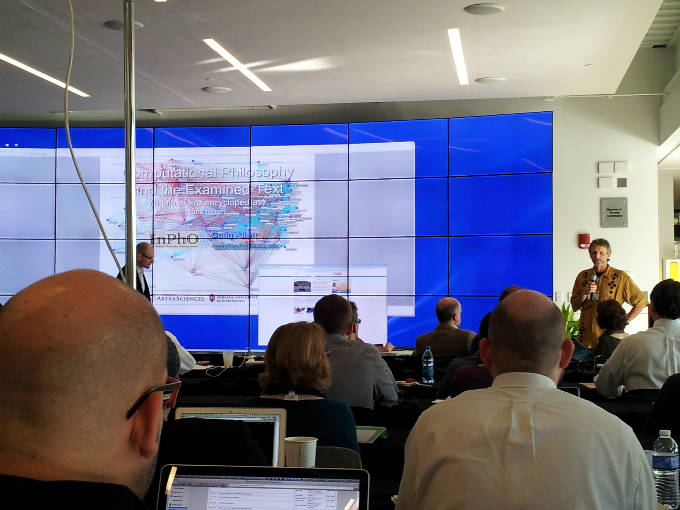

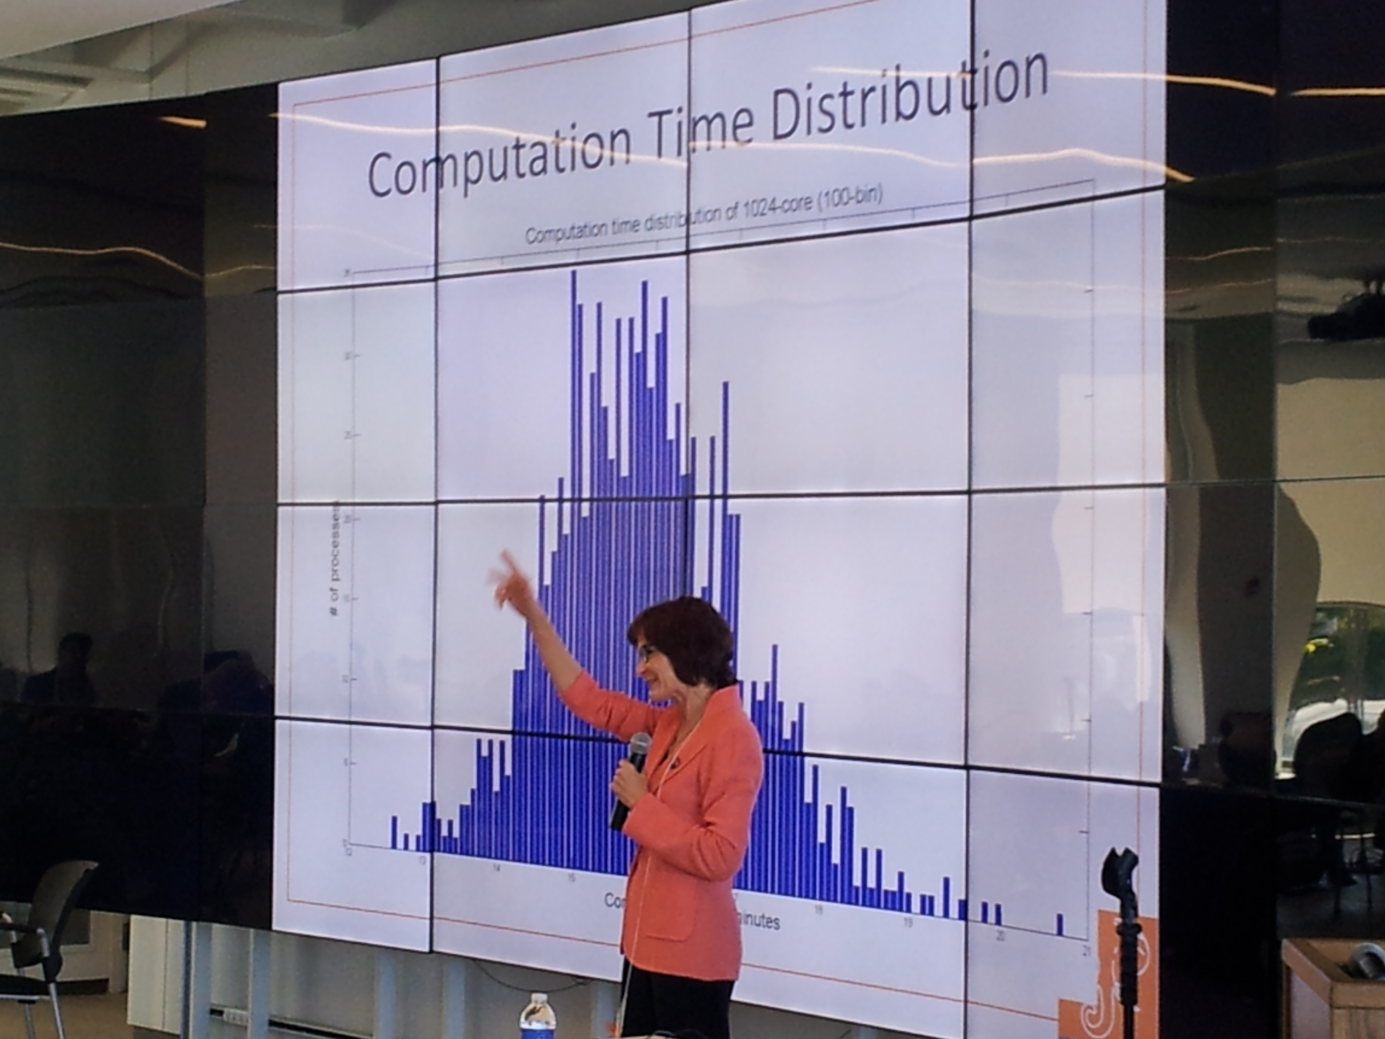
HTRC Next Steps
Phase 2 availability of resource planned for 31 March 2013
Thanks to:
Photos from HTRC UnCamp 9.10.12
at Indiana University

Slide 5
HTRC Non-Consumptive Research Paradigm
No action or set of actions on part of users, either acting alone or in cooperation with other users over duration of one or multiple sessions can result in sufficient information gathered from collection of copyrighted works to reassemble pages from collection.
Definition disallows collusion between users, or accumulation of material over time. Differentiates human researcher from proxy which is not a user. Users are human beings.
1/10/13
CNI Fall 2012 Membership Meeting
#CNI12F #HTRC #HathiTrust

Slide 6
GOOGLE DIGITAL HUMANITIES AWARDS RECIPIENT INTERVIEWS REPORT
PREPARED FOR THE HATHITRUST RESEARCH CENTER VIRGIL E. VARVEL JR.
ANDREA THOMER
CENTER FOR INFORMATICS RESEARCH IN SCIENCE AND SCHOLARSHIP
UNIVERSITY OF ILLINOIS AT URBANA-CHAMPAIGN
Initial Requirements Gathering: 2010-11
Fall 2011

Slide 7
The study
John Unsworth invited all 22 researchers with Google Digital Humanities Research Awards to participate in study
Interviews were conducted via telephone, Skype®, or face-to-face, and all were audio recorded. All participants agreed to IRB permission statement via email.
A semi-structured interview protocol was developed with input from HTRC to elicit responses from participants on primary goals of project.

Slide 8
Select findings
Optical Character Recognition
  Improve OCR quality where possible
  Enhance scanned image views for OCR reference and correction
  Metadata should expose the quality of OCR
Need better, granular metadata about languages (human correction preferred)
Need Bibliographic records in useable form
Notes:
Unpacking points #3 & 4:
“Would like better metadata about text languages, particularly in multi-text documents and on language by sections within text. Automatic language identification functions would be helpful, but human-created metadata is preferred, particularly for documents with low OCR quality.”
“primary issue was retrieving the bibliographic records in usable form, unparsed by Google. […] process took 10 months to design the queries and get the data.”

Slide 9
Goals for HTRC
Provide a persistent and sustainable structure to enable original and cutting edge research.
      Leverage data storage and computational infrastructure at Indiana & Illinois
      Stimulate community development of new functionality and tools
      Use tools to enable discoveries that would not be possible without the HTRC
Enable scholars to fully utilize content of HathiTrust Library while preventing intellectual property misuse within U.S. copyright law.
      Provision secure computational and data environment for scholars to perform research using HathiTrust Digital Library.

Slide 10
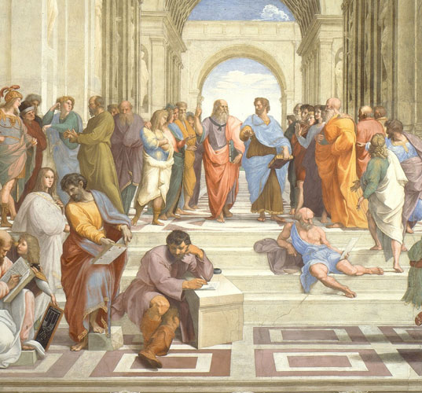

New Questions
Identify all 18th century published books in HathiTrust corpus, and apply topic modeling to create consistent overall subject metadata
Ted Underwood et al., University of Illinios

Slide 11
Exemplar HTRC Research:
The task of cleaning and enriching large collections: what aspects can we share?
UIUC English Dept.:
Ted Underwood
Jordan Sellers
Mike Black
UIUC Library: Harriett Green
I3: Loretta Auvil, Boris Capitanu
Supported by: The Andrew W. Mellon Foundation

Slide 12
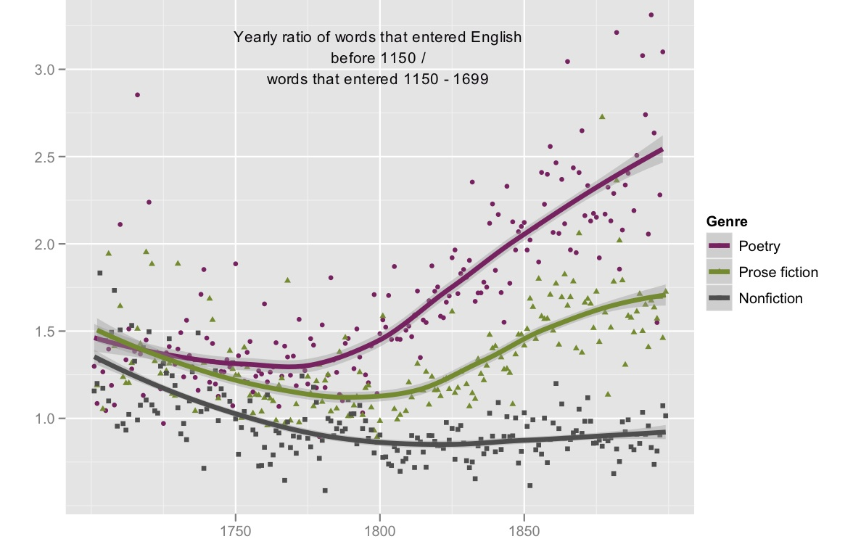
Yearly values of a ratio between two wordlists in three different genres. 4,275 volumes. 1700-1899.
Underwood et al. Research

Slide 13
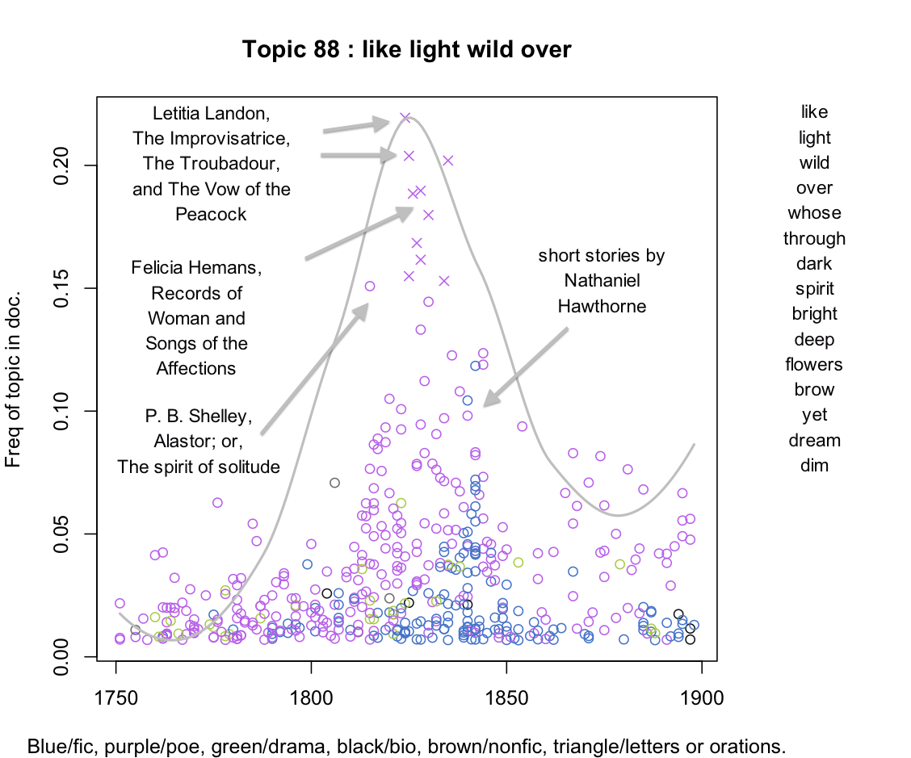
Underwood et al. Research

Slide 14
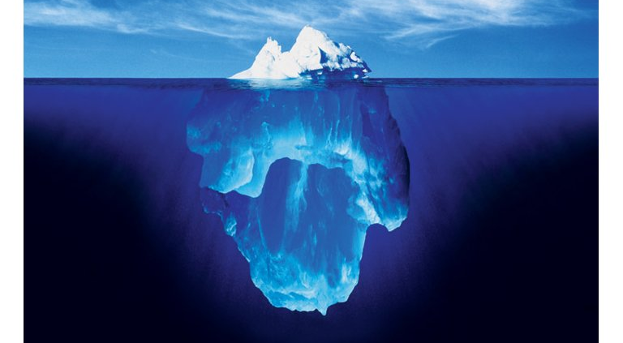
analyzing the data
cleaning the data
Underwood et al. Research
Notes:
Through their work with a subset of the HT corpus of texts, Ted Underwood and his collaborators have experienced the positive results of metadata and data remediation
Their takeaways include:
Metadata (i.e., cataloging information) is not always correct—they found a number of volumes that were not classified as the correct genre, or not classified at all—this makes a strong case for metadata remediation

Slide 15
Cleaning the data
Clean up the OCR / assess error.
Identify parts of a volume (e.g., articles in a serial, poetry/prose).
Remove library bookplates and running headers — after using them for (3).
Underwood et al. Research

Slide 16
Cleaning/enriching the metadata
“18??”
Discard duplicate volumes / select early editions?
Add metadata that you need for interpretive purposes, like
  — gender (see Ben Schmidt’s technique),
  — genre.
Underwood et al. Research

Slide 17
Things we could share
period lexicons / variant spellings
gazetteers of proper nouns
OCR correction rules for a period
document segmentation and/or cleaned and segmented text
ferberization
cleaned / enriched metadata
code to do all of the above
Underwood et al. Research

Slide 18
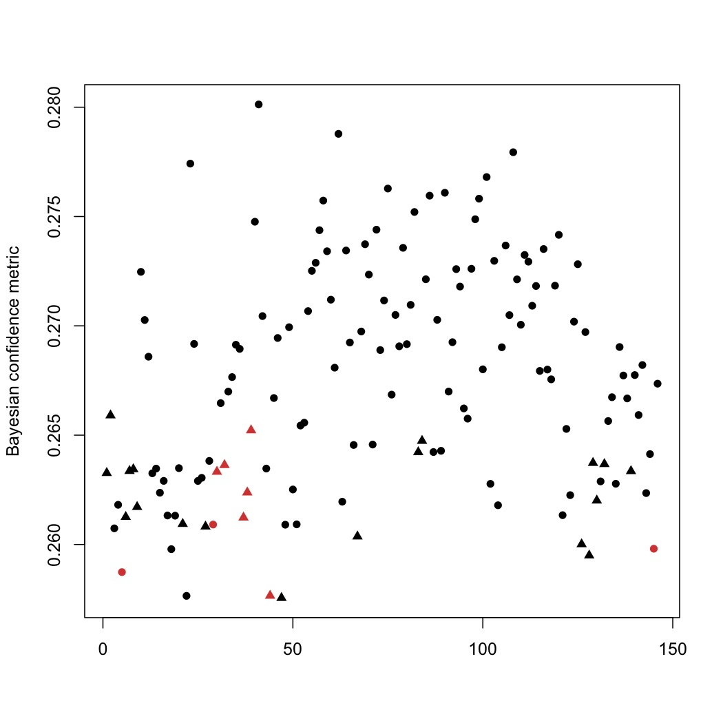
active learning: documents classified as “fiction,” plotted by confidence in classification (y axis). Red points are misclassified.
Underwood et al. Research

Slide 19




Corpus Usage Patterns
Chapter 1
Chapter 1
Access by chapter
Chapter 1
Page IV
Page IV
Access by page
Page IV
Access by special contents (table of contents, index, glossary)
Table of Contents
1………….#
2…………##
Table of Contents
1………….#
2…………##
Table of Contents
1………….#
2…………##
Notes:
== Corpus Usage Patterns (cont'd) === 1) In this use case, the user may wish to select a chapter from each book in the collection he/she assembled and perform analysis over these chapters2) In this use case, analysis only on some special pages of each book (e.g. foreword, or first page of each chapter) in his/her collection.3) in this case, analysis on special contents of each book (e.g. table of contents, indices, glossaries

Slide 20
HTRC architecture
Philosophy: computation moves to data
Web services architecture and protocols
Registry of services and algorithms
Solr full text indexes
noSQL store as volume store
openID authentication
Portal front-end, programmatic access
SEASR mining algos

Slide 21
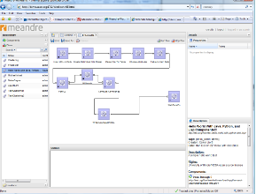
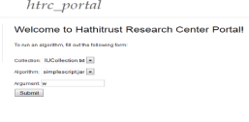




Web portal
Desktop SEASR client
CI logon
(NCSA)
Agent framework
SEASR analytics service
WSO2 registry services, collections, data capsule images
Blacklight
Access control (e.g. Grouper)
Agent instance
Agent instance
Agent instance
Agent instance
Solr index
Programmatic access e.g.,
Task deployment
Meandre
Orchestration
HTRC Data API v0.1
Volume store
(Cassandra)
Non-consumptive
Data capsules
Volume store
(Cassandra)
Volume store
(Cassandra)
NCSA local resources
Future
Grid
NCSA HPC resources
HathiTrust corpus
Page/volume tree (file system)
rsync
NSF XSEDE
Penguin on Demand
University of Michigan

Slide 22
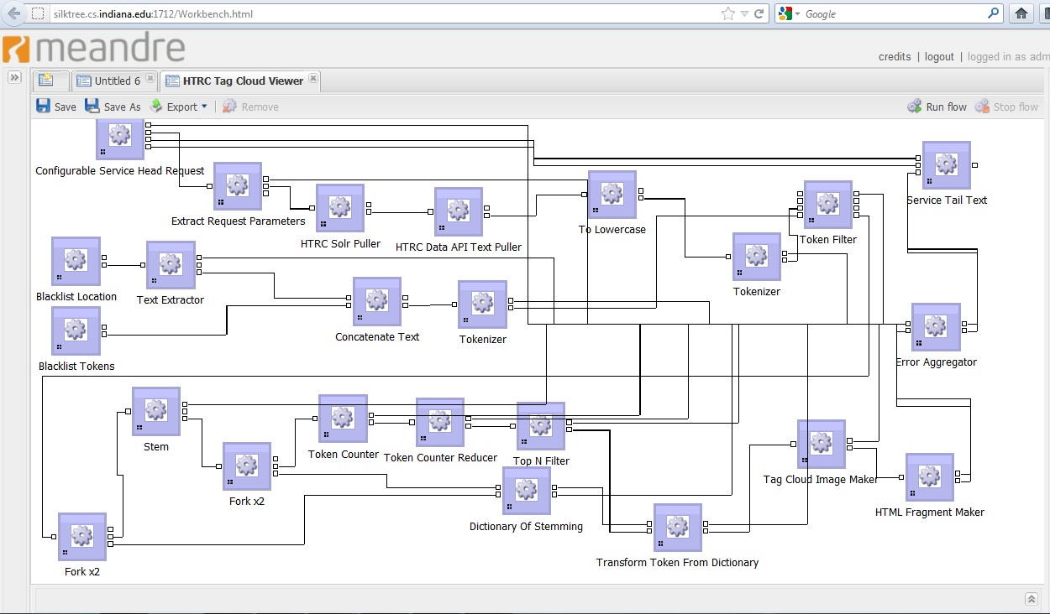
Example access point: SEASR

Slide 23
Algorithms
Computational analysis is accomplished through algorithms
  An algorithm carries out one coherent analysis task: sort list of words, compute word frequency for text
Researcher’s computational analysis often requires running sequence of algorithms. Important distinction for implementing non-consumptive research is “who owns the algorithm”?

Slide 24
Infrastructure for computational analysis
When needing to support computation over 10+M volume corpus, algorithms must be co-located with data.
That is, algorithms must be located where repository is located, and not on user’s desktop.
When computational analysis is to be non-consumptive, likely one location for the data.

Slide 25
Who owns algorithm?
HTRC owns the algorithms,
  use Software Environment for Advancement of Scholarly Research (SEASR) suite of algorithms
  we are examining security requirements of users, algorithms, and data

Slide 26
User owns and submits their algorithms
HTRC recently received funding from Alfred P. Sloan foundation to prototype “data capsule framework” that provisions for non-consumptive research.
Founded on principle of “trust but verify”. Informatics-savvy humanities scholar is given freedom to experiment with new algorithms on protected information, but technological mechanisms in place to prevent undesirable behavior (leakage.)

Slide 27
Non-consumptive, user-owned algorithms infrastructure; requirements:
Implements non-consumptive
Openness – users not limited to using known set of algorithms
Efficiency – Not possible to analyze algorithms for conformance prior to running
Low cost and scale – Run at large-scale and low cost to scholarly community of users
Long term value –adoption for other purposes

Slide 28
Categories of algorithms. Can fair use be determined based on categorization of algorithm? Or is all computational use fair use?

Slide 29
Algo results fair use?
Center supplied
  Easier because we know category of algorithm
User supplied
  HTRC is not examining code, so open question

Slide 30
Parting philosophy
Finally, results of computational research that conforms to restrictions of non-consumptive research must belong to researcher

Slide 31
How to Engage
Building partnership with researchers and research communities is key goal of the HathiTrust Research Center
HTRC can give technical advice to researchers as they look for funding opportunities involving access to research data
Upcoming “Fix the OCR and Metadata Shortage Community Challenge” : help us address couple key weaknesses of HT corpus

Slide 32
Contact Information
John Unsworth, Brandeis University
  unsworth@brandeis.edu
Beth Sandore Namachchivaya, University of Illinois
  sandore@illinois.edu
1/10/13
CNI Fall 2012 Membership Meeting
#CNI12F #HTRC #HathiTrust

Slide 33
Thank You
This presentation was made possible with content provided by many HTRC colleagues Beth Plale, Marshall Scott Poole, John Unsworth, J. Stephen Downie, Stacy Kowalczyk, Yiming Sun, Guangchen Ruan, Loretta Auvil, Kirk Hess, and many others…
The HTRC Non-Consumptive Research Grant is graciously funded by the Alfred P. Sloan Foundation
IU D2I-PTI is graciously funded by The Lilly Endowment, Inc.
HTRC - http://www.hathitrust.org/htrc
IU D2I Center - http://d2i.indiana.edu/
UIUC GSLIS - http://www.lis.illinois.edu/
1/10/13
CNI Fall 2012 Membership Meeting
#CNI12F #HTRC #HathiTrust

