Slide 1
Elephant in the Room: Scaling Storage for the HathiTrust Research Center
Robert H. McDonald | @mcdonald
Associate Dean for Library Technologies
Deputy Director Data to Insight Center (D2I)
Indiana University
PASIG 2015
#PASIG2015
UC San Diego
March 12, 2015
@hathitrust

Slide 2
Mission of the HT Research Center
Research arm of HathiTrust
Established: July, 2011
Collaborative center: Indiana University & University of Illinois
Mission: Enable researchers world-wide to accomplish tera-scale text data-mining and analysis
Develop cyberinfrastructure to enable HPC access to the HathiTrust Digital Library
Develop cutting-edge software tools for processing, analyzing text
Develop translational tools and data that can be used to enhance HathiTrust Digital Library services to users

Slide 3
HathiTrust and HTRC
HathiTrust
University of Michigan
Board of Governors
Executive Committee
Executive Director
HathiTrust Research Center
Indiana University
University of Illinois

Slide 4
Working with HTRC Staff
Workshops, tutorials, and
guidance for using HTRC
Scholarly Commons
One-on-one research support
provided through a competitive
awards process
Advanced Collaborative Support
Advanced Research
Collaborative research
partnership with HTRC

Slide 5
HathiTrust “Wow” Numbers
13,284,163 total volumes
6,742,394 book titles
352,534 serial titles
4,649,457,050 pages
595 terabytes
157 miles
10,793 tons
4,979,599 volumes in the public domain

Slide 6
Non-Consumptive Research Paradigm
No action or set of actions on part of users, either acting alone or in cooperation with other users over duration of one or multiple sessions can result in sufficient information gathered from collection of copyrighted works to reassemble pages from collection.
Definition disallows collusion between users, or accumulation of material over time. Differentiates human researcher from proxy which is not a user. Users are human beings.

Slide 7
DATA LEVELS FOR HTRC
Level 0
Derived Factual Data or Supplementary Bibliographic Data; Publicly available in US and worldwide (bulk download permitted)
Level 1A
Page text or Page images that are in public domain in US only and not subject to third party restrictions; Publicly available to everyone in the US (no bulk download)
Level 1B
Page text or Page images that are in the public domain worldwide and not subject to third party restrictions; Publicly available to everyone worldwide (no bulk download)
Level 3
Level 1C
Level 2A
Level 2B
Primary Bibliographic Metadata; Publicly available in US and worldwide (no bulk download)
Page text or Page images that are in public domain in US only and are subject to third party restrictions; Publicly available to everyone in the US (no download)
Page text or Page images that are in public domain worldwide and are subject to third party restrictions; Publicly available to everyone worldwide (no download)
Restricted in-copyright data; may or may not be subject to additional third- party restrictions (no download)
Notes:
Level 0 – Derived Factual Data or Supplementary Bibliographic Data; Publicly available in US and worldwide (bulk download permitted)
Level 1.A – Page text or Page images that are in public domain in US only and not subject to third party restrictions; Publicly available to everyone in the US (no bulk download)
Level 1.B – Page text or Page images that are in the public domain worldwide and not subject to third party restrictions; Publicly available to everyone worldwide (no bulk download)
Level 1.C – Primary Bibliographic Metadata; Publicly available in US and worldwide (no bulk download)
Level 2.A – Page text or Page images that are in public domain in US only and are subject to third party restrictions; Publicly available to everyone in the US (no download)
Level 2.B – Page text or Page images that are in public domain worldwide and are subject to third party restrictions; Publicly available to everyone worldwide (no download)
Level 3 – Restricted in-copyright data; may or may not be subject to additional third- party restrictions (no download)

Slide 8
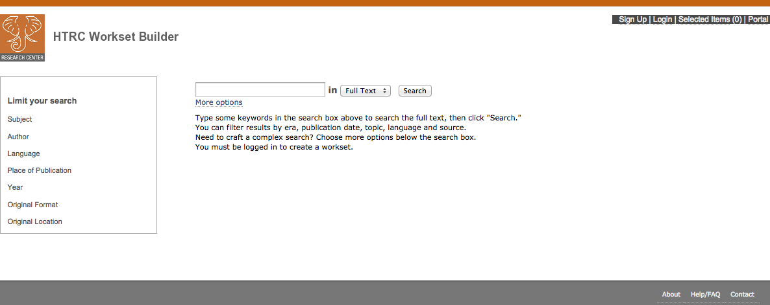
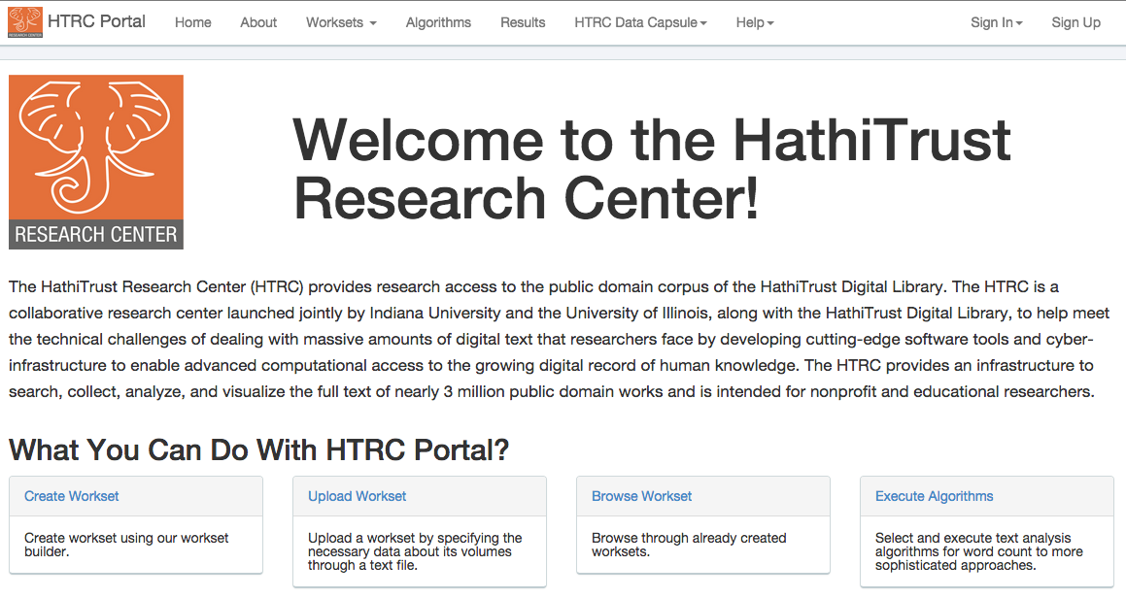
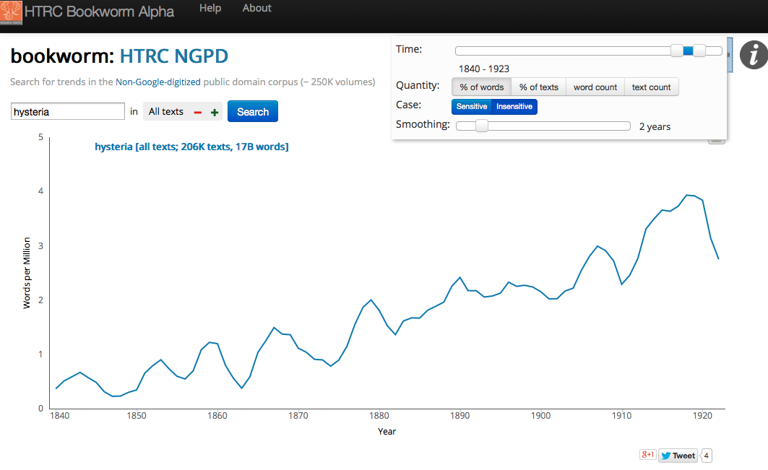
Working with HTRC Tools Get started at: https://htrc2.pti.indiana.edu/
Build Worksets
Execute Algorithms
Visualize Term Frequency
http://sandbox.htrc.illinois.edu/bookworm/

Slide 9
HTRC Architecture
Portal Access
Blacklight
Direct programmatic access (by programs running on HTRC machines)
Agent
Job Submission
Collection building
Security (OAuth2)
Data API access interface
Solr Proxy
Registry (WSO2)
Audit
Algorithms
Meandre Workflows
Cassandra cluster volume store
Result Sets
Collections
Solr index
Compute resources
Storage resources
Notes:
Registry – agent can deploy any service listed in this digram and can run with the computational resources –
Original Plan iis to use XSEDE – not using this on IIS machine but are using ODIN (128 node cluster each core has 4Gb memory and 4 computation cores)– smoketree (D2I server)(24 cores physical 48 loical cores 128 GB memory) – these are not long term just using for now -

Slide 10
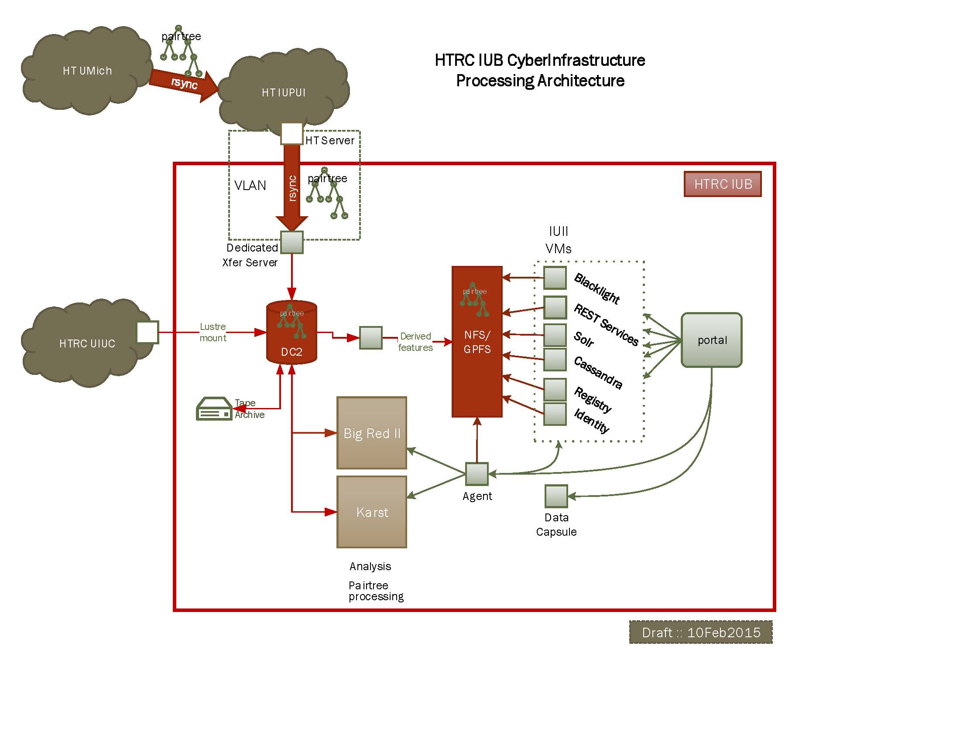
HTRC Storage Layer Ingest

Slide 11
HTRC Shared IU Systems
Data Systems
Data Capacitor II (Lustre)
NetApp NFS (18 TB)
GPFS/Data Direct Networks (28 TB
Current Storage (18 TB > 30 TB)
MARC – 15 GB
R – 5 TB
iPython – 5 TB
Bookworm – 5 TB
Public Domain BW – 3 TB
OCR Data - 5 TB
OCR Index – 2.3 TB
Audit Logs – 44 GB
User created MD – 15 GB
Blacklight – 20 GB
IU Pairtree – 2.65. TB
Compute Systems
KARST (high-throughput cluster)
Big Red 2 (Cray XE6/XK7)

Slide 12
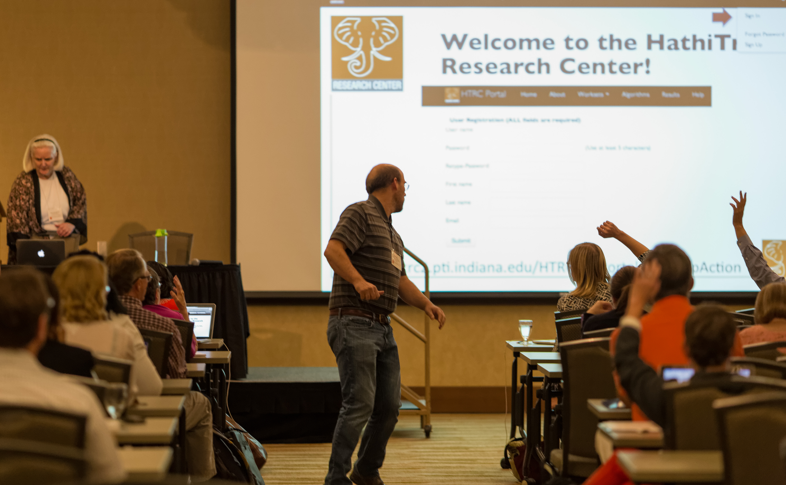
Want More HTRC?
3rd Annual HTRC UnCamp!
March 30-31, 2015 in Ann Arbor, Michigan
DH 2015
June 29-3 July, 2015 in Sydney, Australia
http://www.hathitrust.org/htrc_uncamp2015

Slide 13
Thank You
This presentation was made possible with content provided by many HTRC colleagues John Unsworth, J. Stephen Downie, Beth Plale, Beth Namachchivaya, Dirk Herr-Hoyman, Milnda Pathirage, Samitha Liyanage, Miao Chen, Guangchen Ruan, Jiaan Zeng, Loretta Auvil, Boris Capitanu, and many others…
The HTRC Non-Consumptive Research Grant was graciously funded by the Alfred P. Sloan Foundation
THE HTRC WCSA grant is graciously funded by the Andrew W. Mellon Foundation.
HTRC - http://www.hathitrust.org/htrc
IU D2I Center - http://d2i.indiana.edu/
UIUC GSLIS - http://www.lis.illinois.edu/

