Slide 1
HathiTrust Research Center Tools SHARC: Secure HathiTrust Analytics Research Commons
Dirk Herr-Hoyman
HTRC Operations Manager + Architect
Indiana University
Research Technologies
Pervasive Technology Institute
Data to Insight Research Center
dherrhoy@indiana.edu
April 17, 2015

Slide 3
What is HathiTrust?
HathiTrust
Digital Library
13 Million Volumes
3.8 Billion Pages
Big
Data
Shared
Digital Library
Member
Libraries
Scan
collection

Slide 4
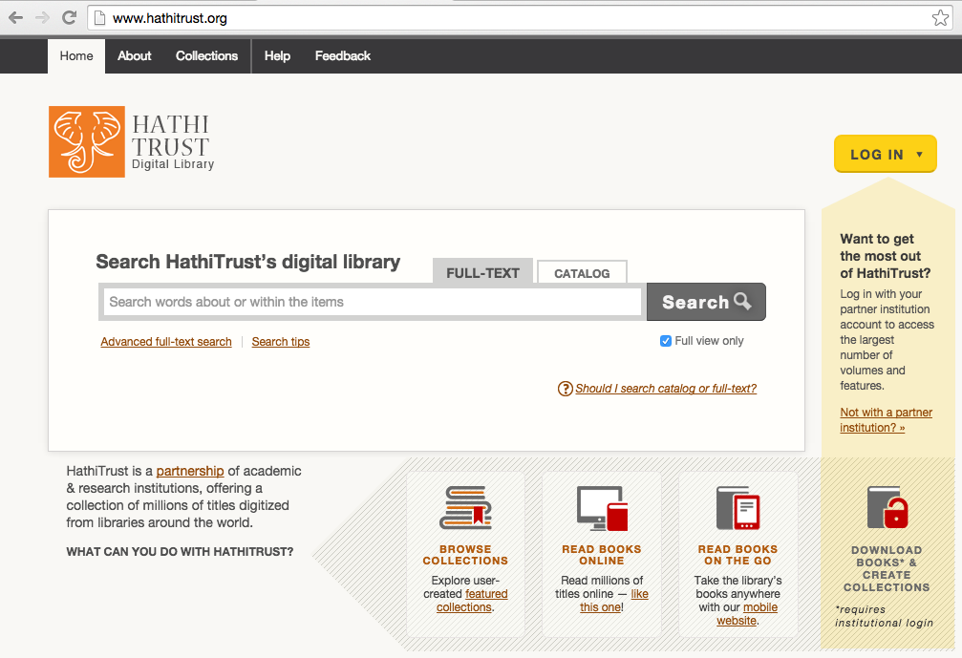

Slide 5
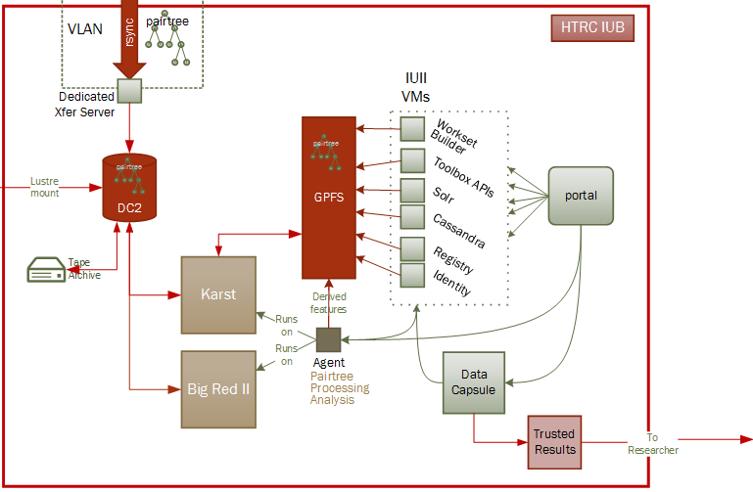
What is SHARC?
HathiTrust
Digital Library
Shared
Digital Library
Member
Libraries
Scan
collection
Computational Analysis
Derived facts (pages, words …)
Text data mining on OCR
Data visualization
More coming from HTRC and you!
Search and view

Slide 6
Non-consumptive Research
Fair Use of Copyrighted Material
Must preserve owners rights
Research cannot disclose in-copyright works
Computational analysis challenge of non-disclosure.
Coming to SHARC this Fall!

Slide 7
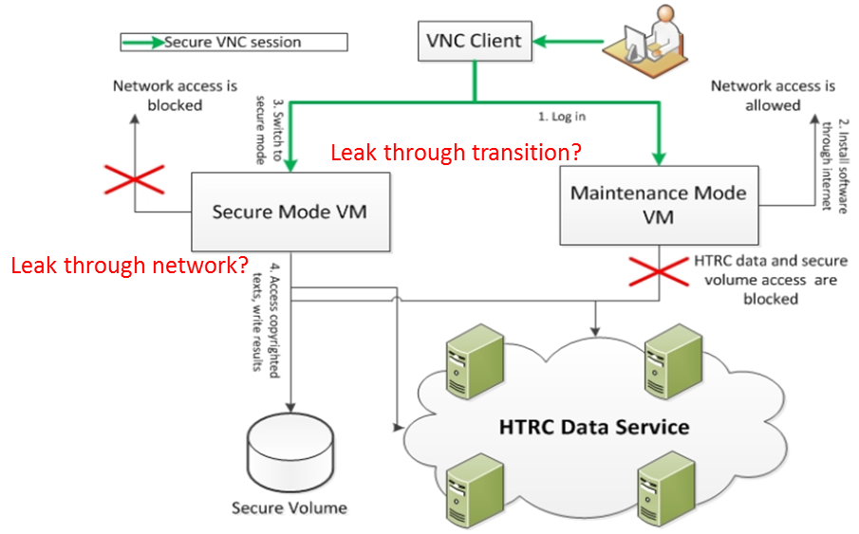
SHARC: Secure HathiTrust Analytics Research Commons
Problem 2:
HT Digital Lib Data Protection Levels
Problem 1:
HathiTrust Digital Library
No personal copies for Researchers
Level | Content | Login | Download | Provenance
0 | Derived Factual Data |  | Bulk
1 | In public domain No 3rd party restrictions | X | Volume
2 | In public domain With 3rd party restrictions | X | None
3 | In Copyright | X | None | Required
Solution:
SHARC Tools and APIs which honor the Data Protection Levels
Problem 3:
How can I use
my own Analytic Tools?
Solution:
Data
Capsule
Solution:
Bring your Computation to the HathiTrust Digital Library
Within the SHARC Ring of Trust

Slide 8
What you can do in SHARC
Worksets: create a collection of HT volumes
Algorithms: run analytics on text in workset
Extracted Features: download derived data including counts unigrams, metadata, etc
Data Capsule: run your own software on in-copyright data

Slide 9
Login to SHARC https://htrc2.pti.indiana.edu

Slide 10
Create a login id (i.e. username)

Slide 11
How to create a workset

Slide 12
Log In Again to Workset Builder

Slide 13
Workset Builder
Currently contains non-copyrighted material not digitized by Google

Slide 14
Build a workset
Search the corpus’ metadata and on full text to gather volumes for your workset

Slide 15
Select desired items

Slide 16
Compile a workset
Notes:
“Put them in a workset,” as the selected items can be put either in a brand-new workset (i.e. by creating a new workset), or put in an existing workset.

Slide 17
Analysis in the HTRC Portal

Slide 18
Choose Algorithm
Note: Click on desired algorithm from the previous screen. Enter a name of your choosing in the blank field for “Job Name.” This is the same name that will show up later as “Job Title” when looking at the results.
Notes:
Make sure to mention that the user should enter a name of their choosing in the blank field for “input job name”, and that this is the same name that will show up later as “Job Title” when looking at results.

Slide 19
Choose Collection(s) for Analysis

Slide 20
Run the Analysis…

Slide 21
Results!

Slide 22
View Results
Notes:
We should mention to them that we are just showing the generic example of a result, i.e. the result shown here is that of running a different algorithm (TagCloud) than the algorithm (OpenNLP_Entities_List) that was shown as running in the previous slides.

Slide 23
Text Mining Methods: The Big Two
Topic modeling vs. Dunning log-likelihood
Topic modeling is useful for getting a sense of the contents of your workset.
The Dunning log-likelihood algorithm is useful for a focused comparison/contrast between two worksets.
[If interested in the gory details of how the Dunning log-likelihood algorithm works, see this blog post by the researcher Ben Schmidt of Northeastern University.]

Slide 24
Example: Comparing (contrasting) two novels by Charles Dickens: Little Dorrit and Bleak House
Little Dorrit as the “analysis” workset and Bleak House as the reference workset.
( Words that are more represented in Little Dorrit than in Bleak House. )

Slide 25
An example: Comparing (contrasting) two novels by Charles Dickens [contd.] Switch the “analysis” and “reference” worksets
Bleak House as the “analysis” workset and Little Dorrit as the reference workset.
( Words that are more represented in Bleak House than in Little Dorrit.)

Slide 26
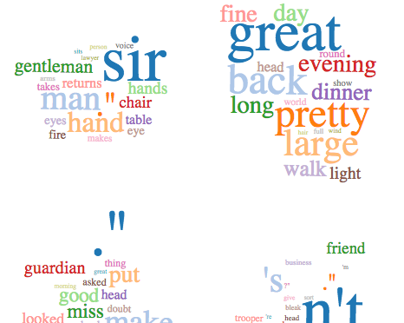
Topic modeling Bleak House
For reference, here is a partial snapshot of the results of topic modeling Bleak House (number of tokens/topic = 20):

Slide 27
Making sense of the results
Based on what we know of the plots of these two novels, do the generated results make sense?
Plot summaries (abbreviated, from the Dickens Fellowship website):
Bleak House: A prolonged law case concerning the distribution of an estate, which brings misery and ruin to the suitors but great profit to the lawyers, is the foundation for this story. Bleak House is the home of John Jarndyce, principal member of the family involved in the law case.
Little Dorrit: Here Dickens plays on the theme of imprisonment, drawing on his own experience as a boy of visiting his father in a debtors' prison. William Dorrit is locked up for years in that prison, attended daily by his daughter, Little Dorrit. Her unappreciated self-sacrifice comes to the attention of Arthur Clennam, recently returned from China, who helps bring about her father's release but is himself incarcerated for a time.

Slide 28
SHARC for research on In-copyright data
Level | Content | Login | Download | Provenance
0 | Derived Factual Data |  | Bulk
1 | In public domain No 3rd party restrictions | X | Volume
2 | In public domain With 3rd party restrictions | X | None
3 | In Copyright | X | None | Required
Derived data: Extracted Features
Data Capsule

Slide 29
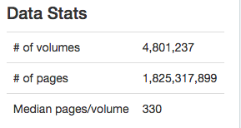
Extracted Features
Page level features from 4.8M volumes, 1.8 B pages
Unigram
count of each word per volume or per page. See Wikipedia N-gram
General counts
# Pages per volume
# words per page
Metadata
Language
URI Handle
Imprint: publisher, date etc
Download EF for all volumes in JSON from
http://htrc2.pti.indiana.edu
Algorithm > EF Rsync for a Workset EF

Slide 30
Data Capsule
Ubuntu VM within the SHARC Ring of Trust
Upload software, close the “door”/turn off Internet, do research
Results are checked by a person

Slide 31
HTRC Data Capsule > Show Virtual Machines
See Data Capsule Tutorial for step-by-step instructions:
https://wiki.htrc.illinois.edu
Community > HTRC Data Capsule > HTRC Data Capsule Tutorial

Slide 32
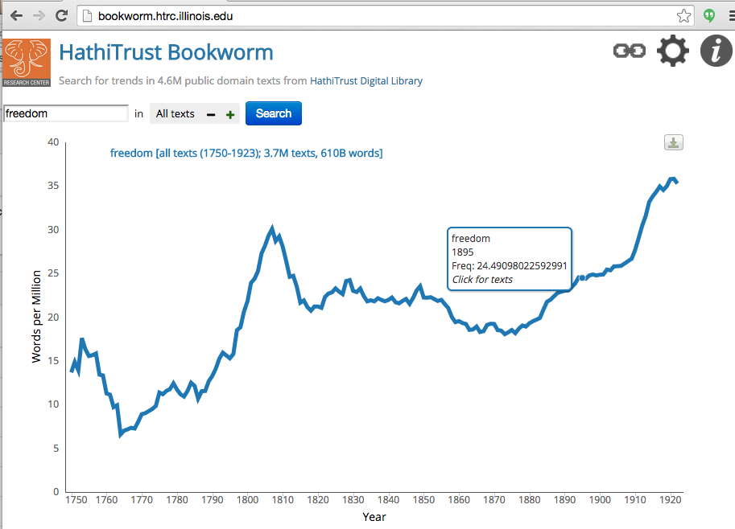
Coming: HT Bookworm

Slide 33
HTRC Advanced Collaborative Support
Awards for HTRC developer time
1st round awards:
Detecting Literary Plagiarisms: The Case of Oliver Goldsmith
Taxonomizing the Texts: Towards Cultural-Scale Models of Full Text
The Trace of Theory
Tracking technology diffusion thru time using HT Corpus
Coming: call for 2nd round Proposals.
http://hathitrust.org/htrc for details
… or Dr. Miao Chen, miaochen@indiana.edu

Slide 34
SHARC Developers
Open Source community for development of
Tools and APIs for SHARC
HT Digital Lib
SHARC Solr
SHARC Tool
Derived Data
Researcher Computer
Download
Contact Dirk Herr-Hoyman, if interested
dherrhoy@indiana.edu

