Slide 1
Introduction to the HathiTrust Research Center: A Briefing

Slide 2
Introduction to the HathiTrust Research Center: A Not-So-Brief Briefing

Slide 3
Presented by
J. Stephen Downie
University of Illinois at Urbana-Champaign

Slide 4
Acknowledgements
Today’s slides are directly drawn (aka copied) from the slides recently presented at the HTRC UnCamp in Bloomington, Indiana.
Todays’s talk summarizes 2 days of excellent presentations and demonstrations!
We thank the HTRC team and the UnCamp presenters for the use of their very informative slides.

Slide 5
Introducing the HathiTrust

Slide 6
Partnership
Arizona State University
Baylor University
Boston College
Boston University
California Digital Library
Columbia University
Cornell University
Dartmouth College
Duke University
Emory University
Florida State University
Getty Research Institute
Harvard University Library
Indiana University
Johns Hopkins University
Lafayette College
Library of Congress
Massachusetts Institute of Technology
McGill University`
Michigan State University
New York Public Library
New York University
North Carolina Central
University
North Carolina State
University
Northwestern University
The Ohio State University
The Pennsylvania State
University
Princeton University
Purdue University
Stanford University
Texas A&M University
Universidad Complutense
de Madrid
University of Arizona
University of Calgary
University of California
Berkeley
Davis
Irvine
Los Angeles
Merced
Riverside
San Diego
San Francisco
Santa Barbara
Santa Cruz
The University of Chicago
University of Connecticut
University of Delaware
University of Florida
University of Illinois
University of Illinois at Chicago
The University of Iowa
University of Maryland
University of Miami
University of Michigan
University of Minnesota
University of Missouri
University of Nebraska-Lincoln
The University of North
Carolina at Chapel Hill
University of Notre Dame
University of Pennsylvania
University of Pittsburgh
University of Utah
University of Virginia
University of Washington
University of Wisconsin- Madison
Utah State University
Washington University
Yale University Library

Slide 7
Mission
To contribute to the common good by collecting, organizing, preserving, communicating, and sharing the record of human knowledge

Slide 8
HathiTrust
Universal Library
Common Goal
Single Entity, Many Partners

Slide 9
Digital Repository
Launched 2008
Initial focus on digitized book and journal content
  10.6 million total volumes
  5.6 million book titles
  270,000 serial titles
  3.3 million public domain (~30%)

Slide 10
HathiTrust “Wow” Numbers
10,599,044 total volumes
5,573,443 book titles
276,107 serial titles
3,709,665,400 pages
475 terabytes
125 miles
8,612 tons
3,276,345 volumes(~31% of total) in the public domain

Slide 11
Goals
Reliable and comprehensive archive of materials converted from print…co-owned
Improve access …to meet the needs of the co-owning institutions
Ensure the long-term preservation of content
Coordinate shared storage strategies
“public good” …sustaining the historical record
Simultaneously …centralized …open

Slide 12
Content Distribution
Notes:
12

Slide 13
Content Sources
Notes:
13

Slide 14

Dates
Notes:
14

Slide 15
Language Distribution (1)
The top 10 languages make up ~86% of all content
Notes:
15

Slide 16
Language Distribution (2)
The next 40 languages make up ~13% of total
Notes:
16

Slide 18
Services
Long-term preservation
  Bit-level and migration
Bibliographic search
Full-text search
Reading and download capabilities
Print on demand
Collections
Datasets, Research Center

Slide 19
Collection Management, Development
Overlap
  More than 50% median overlap with ARL institutions; higher for small liberal arts colleges
Pricing model based on Print holdings
  Requires print holdings database
  Also support expansion of legal uses, efforts in de-duplication
  Facilitate individual and collaborative collection development and management operations
Print monographs archiving

Slide 20
Discovery and Use
Search, collections, online access
APIs and data feeds
  Data API
  Bibliographic API
  “Hathifiles” inventory files
  OAI
Computational Research
  Distribution of datasets
  Protocol-based access
  Research Center

Slide 21
Research Center in Context

Slide 22
Constitutional Convention
October 2011
52 partners
3-year review overseen by SAB
Ballot Proposals
  Print monograph storage
  Approval Process for development initiatives
  U.S. Government Documents
  Fee-for-service content deposit
  Governance

Slide 23
Strategic Advisory Board
Guidance on Policy, Planning
12-member Board of Governors
Executive Committee
Executive Director
Executive Committee
HathiTrust
Budget/Finances
Decision-making

Slide 24
Collaborative Support
New pricing model
Base infrastructure costs
  Public domain
  In-copyright/undetermined
Funds for programmatic initiatives

Slide 25
HathiTrust Data Overview
September 10, 2012
Jeremy York
Project Librarian, HathiTrust

Slide 26
Content and Metadata

Slide 27
General
Content (images, text)
  Object and information to render object, including structural information
Bibliographic metadata
  Marc or MarcXML

Slide 28
Content
Books and journals
  Pilots around images, audio, born-digital
Digitization sources
  Google (96.8%, 10,162,104)
  Internet Archive (2.9%, 301,972)
  Local (0.3%, 31,840)

Slide 29

Content Package
images
text
Source METS
Zip
HT
METS
bib
data
bib
data

Slide 30
Content Package
images
text
Source METS
Zip
HT
METS
bib
data
bib
data

Slide 31
Repository Organization

Slide 32
Source
Data Management
Access
Bib Data
Rights Data
Catalog
Ingest
Full-text Search
Holdings Data
Bibliographic Data
PageTurner
Content Package
Collections
Storage
Indiana
APIs
Michigan
Datasets

Slide 33
File System
../uc1/pairtree_root/b3/54/34/86/b34543486
images
text
Source METS
b34543486.zip
HT
METS
b34543486.mets.xml
Example ids:
wu.89094366434
mdp.39015037375253
uc2.ark:/1390/t26973133
miua.aaj0523.1950.001
bib
data
bib
data

Slide 34
Data Availability

Slide 35
Information sheet
http://www.hathitrust.org/documents/hathitrust-data-api-web-client.pdf

Slide 36
Outline
Content and Metadata
Repository Organization
Data availability
  Rights and agreements

Slide 37
Content
Books and journals
  Pilots around images, audio, born-digital
Digitization sources
  24 Institutions
  Google (96.8%, 10,162,104)
  Internet Archive (2.9%, 301,972)
  Local (0.3%, 31,840)

Slide 38
Digitization Sources
Id | Name | Description
1 | google | Google
2 | lit-dlps-dc | Library IT, DLPS, DC
3 | ump | University of Michigan Press
4 | ia | Internet Archive
5 | yale | Yale University
6 | umn | University of Minnesota
7 | mhs | Minnesota Historical Society
8 | usup | Utah State University Press
9 | ucm | Universidad Complutense de Madrid
10 | purd | Purdue University
11 | getty | Getty Research Institute
12 | um-dc-mp | University of Michigan, Duderstadt Center, Millenium Project

Slide 39
Content
Largely uniform in technical characteristics
3 formats
  ITU G4 TIFF
  JP2
  Unicode (with and without coordinates)

Slide 40
Examples
Images
OCR
Coordinate OCR

Slide 41
What is METS?
Metadata Encoding and Transmission Standard
Administrative (including preservation), Technical, and Structural metadata

Slide 42
Why METS
Can serve as Archival Information Package and a Dissemination Information Package
Designed to record the relationship between pieces of complex digital objects
Can be created automatically as texts are loaded or reloaded
Preservation actions (PREMIS)

Slide 43
Metadata Framework
Details and specifications at repository level
  Object specifications / Validation criteria
  Page-tagging
Variations at object level
  Files missing
  Non-valid files
  Incorrect file checksums
http://www.hathitrust.org/digital_object_specifications

Slide 44
Content Package
images
text
Source METS
Zip
HT
METS
bib
data
bib
data

Slide 45
Source METS (1)
Record of objects prior to ingest into HathiTrust
Information valuable for preservation or archaeology, but subjective (descriptive, e.g., bibliographic data, page-tags), idiosyncratic, or use not clear.
“Parking lot” for information we are getting that may be useful in the future.

Slide 46
Source METS (2)
What’s there?
  dmdSec(s)
  amdSec
    Technical and preservation metadata
  fileSec (images, coordOCR, OCR, …)
    Mime Type, checksums, file size
  Physical structMap tying together files with metadata (pg. numbers and features)

Slide 47
HathiTrust METS (1)
Active record Regularized information generally applicable across the repository
  Not specific to a particular source
  Current or near-term use
Information fundamentally valuable for understanding or using the preserved object in preservation activities after deposit, or in the access and display environments, including the APIs.

Slide 48
HathiTrust METS (2)
What’s there?
  dmdSec(s)
  amdSec
  fileSec with 4 fileGrps (zip, images, OCR, coordOCR)
    Mime Type, checksums, file size
  Physical structMap tying together files with metadata (pg. numbers and features)
HathiTrust METS Profile

Slide 49
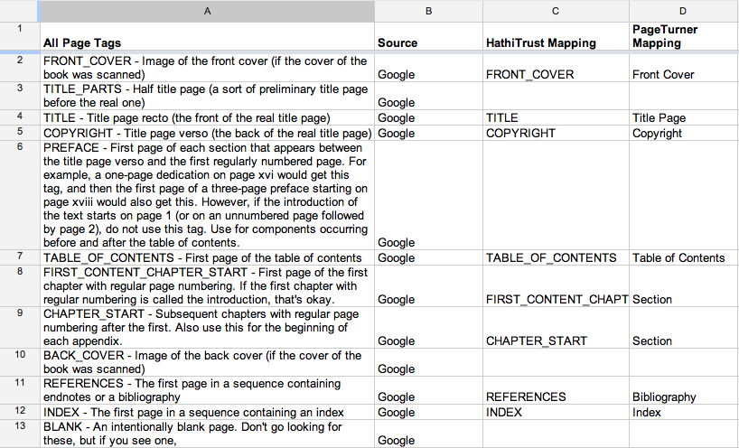
Page Feature Mapping (Google)

Slide 50
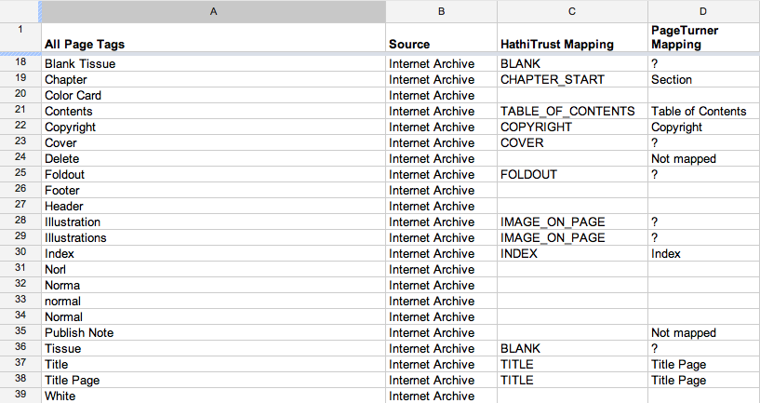
Pagetag Mapping (IA)

Slide 51
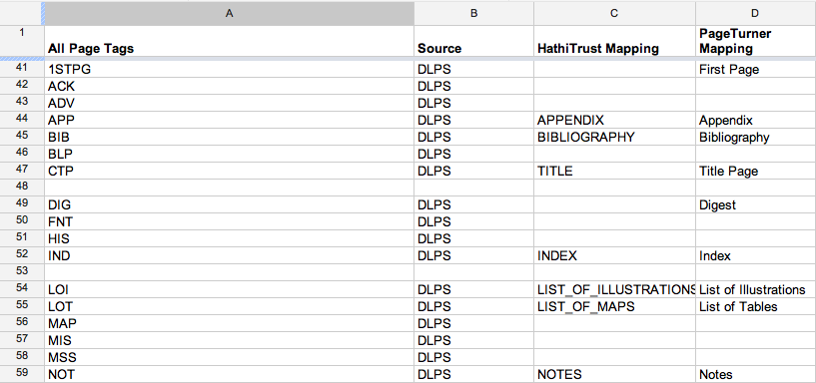
Pagetag Mapping (DLPS)

Slide 52
Namespaces
Namespace
  1-4 alphanumeric chars; selected by institution
  Delineates contributor and unique identifier scheme
  Example IDs:
mdp.39015037375253
miua.aaj0523.1950.001
uc1.b34543486
uc2.ark:/1390/t26973133

Slide 53
Institution | Namespace
Boston College | bc
Columbia University | nnc1, nnc2
Cornell University | coo
Duke University | dul1
Harvard University | hvd
Indiana University | inu
Library of Congress | loc
New York Public Library | nyp
North Carolina State University | ncs1
Northwestern University | ien
Pennsylvania State University | pst
 | psia
Princeton University | njp
Purdue University | pur1
 | pur2
Institution | Namespace
Universidad Complutense de Madrid | ucm
University of California | uc1, uc2
University of Chicago | chi
University of Illinois | uiuo, uiug
University of Michigan | mdp, miua, miun
University of Minnesota | umn
Minnesota Digital Library | mdl
UNC, Chapel Hill | nc01
University of Pittsburgh | pitt
University of Virginia | uva
University of Wisconsin | wu
Utah State University | usu
Yale University | yale

Slide 54
Identifiers
Prefer identifier used for original object
  Often barcode
  Good identifier properties
    Guaranteed uniqueness
    Deterministic process for creating new identifiers
    Internal check scheme
    Accurate correlation or no correlation to existing names or characteristics (no implied relationships)
  Facilitate reference
  Avoid mapping to HathiTrust-generated IDs

Slide 55
Identifier Examples
mdp.39015037375253
miua.aaj0523.1950.001
uc1.b34543486
uc2.ark:/1390/t26973133
ucm.5329487288

Slide 56
Google-digitized
chi - University of Chicago
coo - Cornell
hvd - Harvard
ien - Northwester
inu - Indiana University
mdp - University of Michigan
njp - Princeton
nnc1 - Columbia
nyp - NYPL
pst - Penn State
pur1 - Purdue
uc1 - University of California
ucm - Madrid
uiug - University of Illinois
umn - University of Minnesota
uva - University of Virginia
wu - University of Wisconsin
IA-digitized
bc - Boston College
dul1 - Duke
loc - Library of Congress
nc01 - UNC - Chapel Hill
ncs1 - North Carolina State
nnc2 - Columbia
psia - Penn State
uc2 - University of California
uiuo - University of Illinois
Locally-digitized
miua - Michigan
miun - Michigan
mdp - Michigan
ucm - Madrid
usu - Utah State
yale - Yale

Slide 57
Google-digitized
chi - University of Chicago
coo - Cornell
hvd - Harvard
ien - Northwester
inu - Indiana University
mdp - University of Michigan
njp - Princeton
nnc1 - Columbia
nyp - NYPL
pst - Penn State
pur1 - Purdue
uc1 - University of California
ucm - Madrid
uiug - University of Illinois
umn - University of Minnesota
uva - University of Virginia
wu - University of Wisconsin
IA-digitized
bc - Boston College
dul1 - Duke
loc - Library of Congress
nc01 - UNC - Chapel Hill
ncs1 - North Carolina State
nnc2 - Columbia
psia - Penn State
uc2 - University of California
uiuo - University of Illinois
Locally-digitized
miua - Michigan
miun - Michigan
mdp - Michigan
ucm - Madrid
usu - Utah State
yale - Yale

Slide 58
Source
Data Management
Access
Bib Data
Rights Data
Catalog
Ingest
Full-text Search
Holdings Data
Bibliographic Data
PageTurner
Content Package
Collections
Storage
Indiana
APIs
Michigan
Datasets

Slide 59
Copyright
Bibliographic metadata
Automatic and manual rights determination

Slide 60
Automatic Rights Determination
Conducted on all works at time of ingest and when records are modified
  Public domain worldwide
    US works published before 1923, US federal government publications, non-US works published prior to 1872
  Public domain in the United States
    Non-US works published prior to 1923

Slide 61
Manual Rights Determination
IMLS-funded CRMS project
  US-published works 1923-1963
  Conformance with formalities
  Expanding to non-US works
  Double-blind review with expert review for conflicts
  Staff at 4 HathiTrust partner institutions (15 will take part in non-US)
  As of February 2012 ~190,000 reviewed, more than 100,000 opened
Rights Holder Permissions

Slide 62
Rights Database
System of Precedence
Manual
Bibliographic (automatic)

Slide 63
Rights Attributes
id | name | type | dscr
1 | pd | copyright | public domain
2 | ic | copyright | in-copyright
3 | opb | copyright | out-of-print and brittle (implies in-copyright)
4 | orph | copyright | copyright-orphaned (implies in-copyright)
5 | und | copyright | undetermined copyright status
6 | umall | access | available to UM affiliates and walk-in patrons (all campuses)
7 | world | access | available to everyone in the world
8 | nobody | access | available to nobody; blocked for all users
9 | pdus | copyright | public domain only when viewed in the US
10 | cc-by | copyright | Creative Commons Attribution
11 | cc-by-nd | copyright | Creative Commons Attribution-NoDerivatives
12 | cc-by-nc-nd | copyright | Creative Commons Attribution-NonCommercial-NoDerivatives
13 | cc-by-nc | copyright | Creative Commons Attribution-NonCommercial
14 | cc-by-nc-sa | copyright | Creative Commons Attribution-NonCommercial-ShareAlike
15 | cc-by-sa | copyright | Creative Commons Attribution-ShareAlike
16 | orphcand | copyright | orphan candidate - in 90-day holding period (implies in-copyright)
17 | cc-zero | copyright | Creative Commons Zero license (implies pd)
18 | und-world | copyright | Undetermined copyright status and permitted as world-viewable by the depositor
19 | Ic-us | copyright | In copyright in the US

Slide 64
Rights Determination Reason Codes
id | name | dscr
1 | bib | bibliographically-derived by automatic processes
2 | ncn | no printed copyright notice
3 | con | contractual agreement with copyright holder on file
4 | ddd | due diligence documentation on file
5 | man | manual access control override; see note for details
6 | pvt | private personal information visible
7 | ren | copyright renewal research was conducted
8 | nfi | needs further investigation (copyright research partially complete; an ambiguous, unclear, or other time-consuming situation was encountered)
9 | cdpp | title page or verso contain copyright date and/or place of publication information not in bib record
10 | cip | condition review and in-print status research was conducted
11 | unp | unpublished work
12 | gfv | Google viewability set at VIEW_FULL
13 | crms | derived from multiple reviews in the Copyright Review Management System (CRMS) via an internal resolution policy; consult CRMS records for details
14 | add | author death date research was conducted or notification was received from authoritative source
15 | exp | expiration of copyright term for non-US work with corporate author
16 | Del | Deleted from repository; see note for details
17 | Gatt | Non-US public domain work restored to in-copyright in the US by GATT

Slide 65
Source
Data Management
Access
Bib Data
Rights Data
Catalog
Ingest
Full-text Search
Holdings Data
Bibliographic Data
PageTurner
Content Package
Collections
Storage
Indiana
APIs
Michigan
Datasets

Slide 66
Data Availability
Via HathiTrust

Slide 67
What is available?
images
text
Source METS
Zip
HT
METS
Bibliographic metadata
Rights metadata
bib
data
bib
data

Slide 68
How is it available?
Web interfaces
APIs
  Data API
  Bib API
Data feeds and distribution
  Hathifiles
  OAI
  Datasets

Slide 69
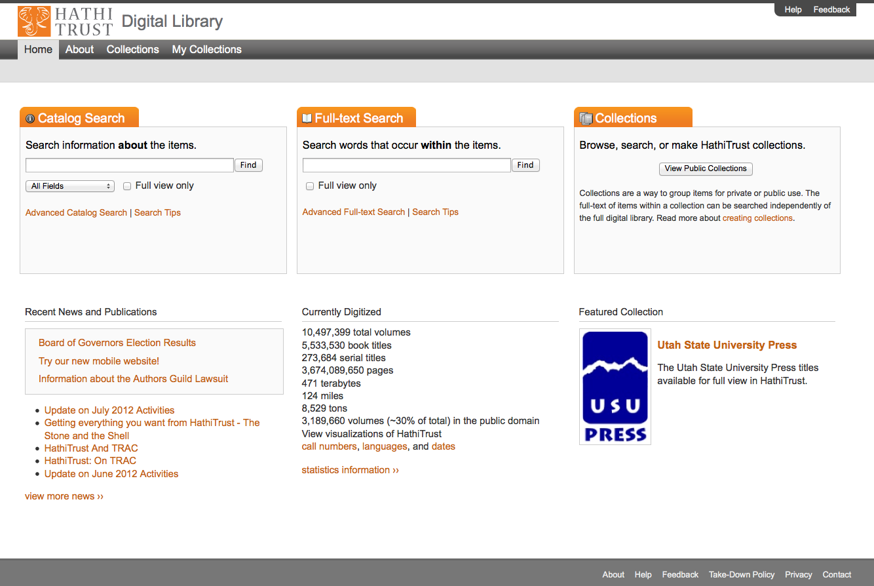

Slide 70
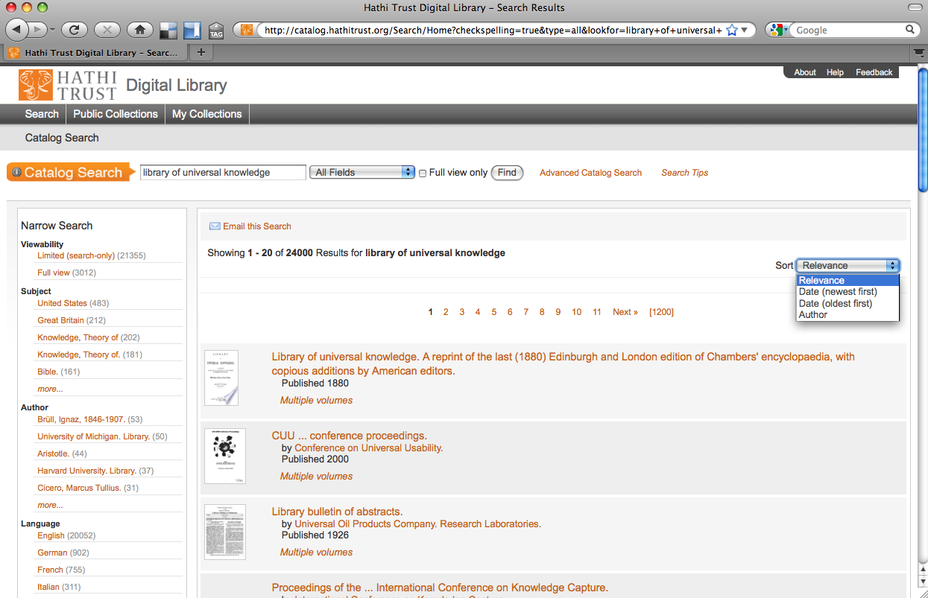

Slide 71
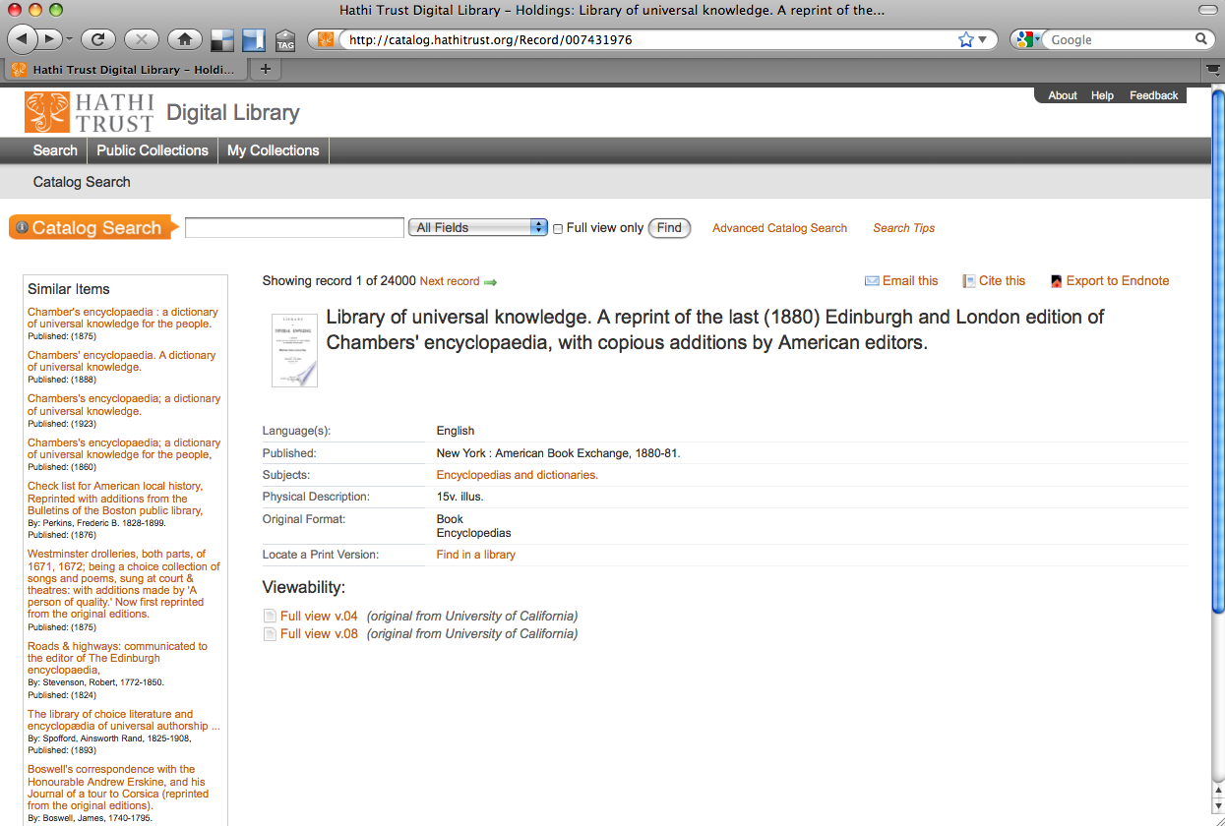

Slide 72
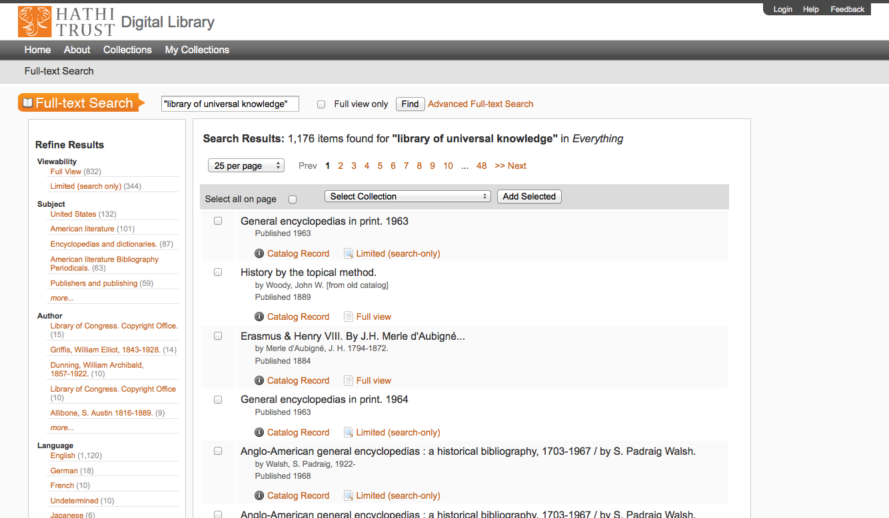

Slide 73
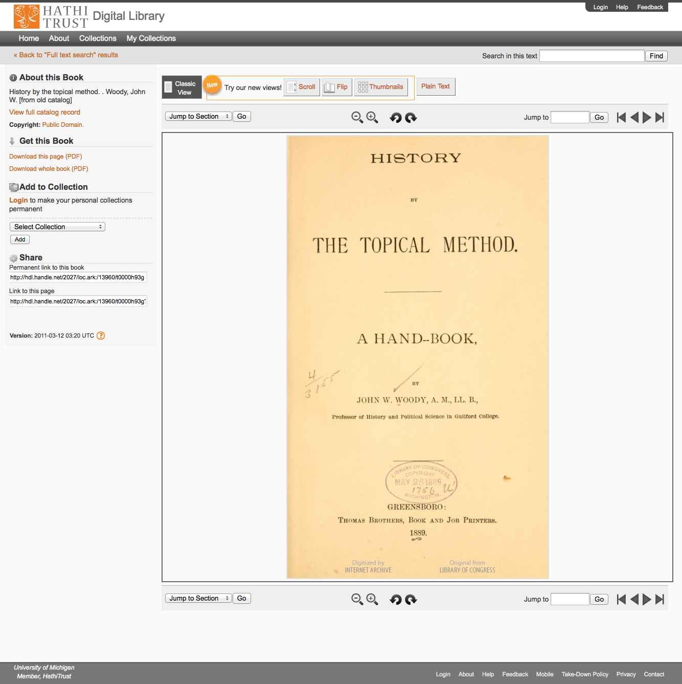

Slide 74
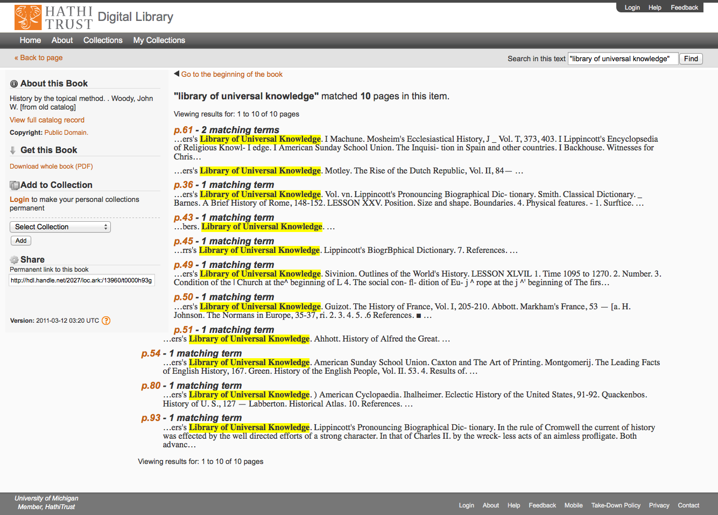

Slide 75
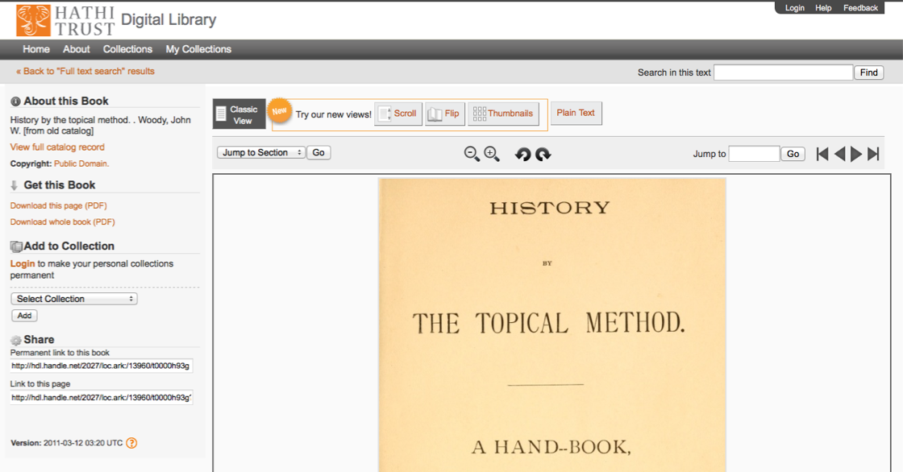

Slide 76
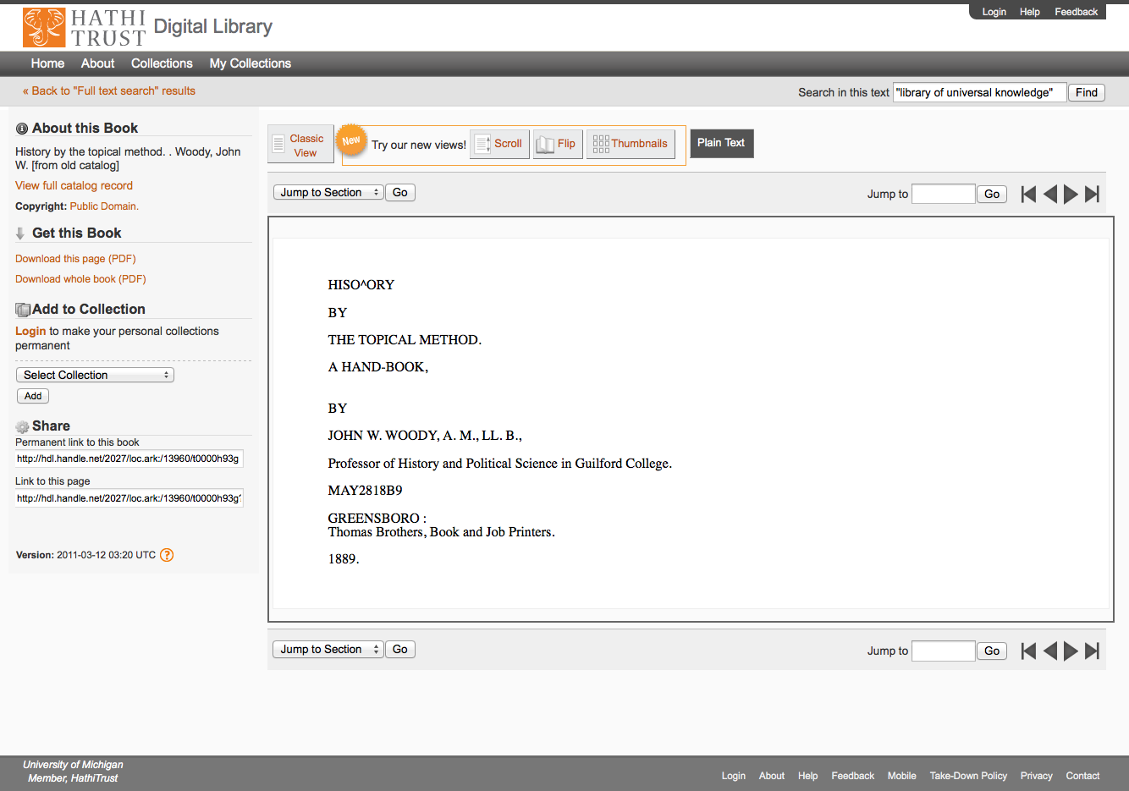

Slide 77
How is it available?
Web interfaces ✔
APIs
  Data API
  Bib API
Data feeds and distribution
  Hathifiles
  OAI
  Datasets

Slide 78
Data API Demonstration
http://babel.hathitrust.org/cgi/kgs/portal
Examples
  mdp.39015071393550 (seq 7)
  loc.ark:/13960/t0000h93g (seq 7)
Page Image
Page OCR
Page Coordinate OCR
METS
Object Metadata
  Rights, page numbers and features
Page Metadata
  Rights, page sequence and number, format

Slide 79
Bib API
Gives bibliographic, volume, rights information
When supplied with
  OCLC, LCCN, LSSN, ISBM, HTID, Record ID
Returns “brief” and “full” results
  Full includes MARCXML in JSON wrapper
http://catalog.hathitrust.org/api/volumes/brief/<id type>/<id value>.json
http://catalog.hathitrust.org/api/volumes/full/<id type>/<id value>.json
Examples: mdp.39015071393550; loc.ark:/13960/t0000h93g

Slide 80
How is it available?
Web interfaces ✔
APIs ✔
  Data API
  Bib API
Data feeds and distribution
  Hathifiles
  OAI
  Datasets

Slide 81
OAI
OAI sets (MARC21 or Dublic Core)
  Public domain and open access (set=hathitrust:pd)
  Public domain in the United States (set=hathitrust:pdus)
  All (PD, OA, PDUS) (set=hathitrust)
http://quod.lib.umich.edu/cgi/o/oai/oai?verb=ListRecords&metadataPrefix=marc21&set=hathitrust

Slide 82
Hathifiles
Tab-delimited inventory files
Aggregated monthly
Daily incremental files
Contain
  Identifiers
  Limited bibliographic information
  Rights, language, gov docs status information

Slide 83
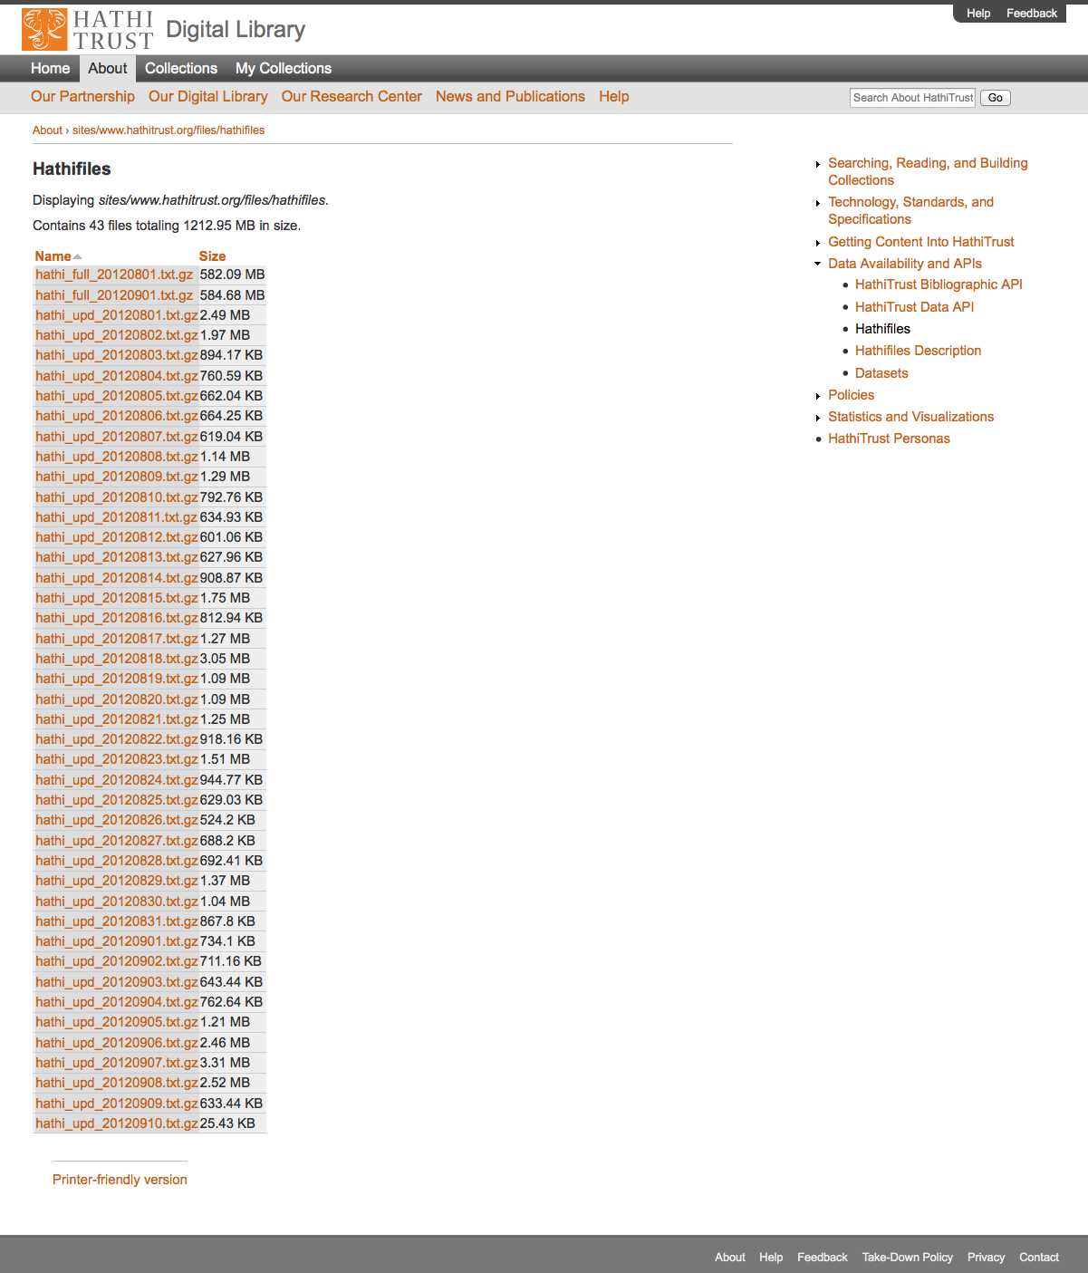

Slide 84
Data Element | Example
Volume identifier | coo.31924003924275
Access | deny
Rights | ic
University of Michigan Record # | 002052896
Enumeration/Chronology | Band I
Source | COO
Source Institution Record # | 17132
OCLC numbers | 62370740
ISBNs
ISSNs | gs 12000204
LCCNs

Slide 85
Data Element | Example
Title | Anleitung zur bestimmung der karbonpflanzen…
Imprint | Kommissionsverlag von Craz & Gerlach (J. Stettner) 1911-
Rights determination reason code | bib
Date of last update | 2011-04-11 20:32:41
Government document | 0
Publication date | 1911
Publication place | gw
Language | ger
Bibliographic format | BK

Slide 86
Datasets
Non-Google-digitized Dataset (300,000+)
  PD, PDUS, Open Access
  Signed researcher statement
Google-digitized (2.2 million+)
  PD, PDUS, Open Access
  Agreement between institution and Google
  Brief proposal
    Characterize texts
    Provide ids (custom sets possible)
    Research, results, use of results
  Signed researcher statement

Slide 87
Digitization Sources
Id | Name | Description
1 | google | Google
2 | lit-dlps-dc | Library IT, DLPS, DC
3 | ump | University of Michigan Press
4 | ia | Internet Archive
5 | yale | Yale University
6 | umn | University of Minnesota
7 | mhs | Minnesota Historical Society
8 | usup | Utah State University Press
9 | ucm | Universidad Complutense de Madrid
10 | purd | Purdue University
11 | getty | Getty Research Institute
12 | um-dc-mp | University of Michigan, Duderstadt Center, Millenium Project

Slide 88
Dataset structure
id (list of ids in dataset)
meta.tar.gz (bibliographic data)
loc
mdp
uc1
text
b34543486.zip
HT
METS
b34543486.mets.xml

Slide 89
How is it available?
Web interfaces ✔
APIs ✔
  Data API
  Bib API
Data feeds and distribution ✔
  Hathifiles
  OAI
  Datasets

Slide 90
Which Bibliographic Data?
Bibliographic data from Dataset
  One record per item; enum/chron as appears in record; dates not normalized
Bib API
  Dates at bib level; if no date in Date1 of 008, returns 260|c; can query to determine if multiple copies or items
Hathifiles
  Dates extracted per-item; no date information if bib for item has no Date1 in 008 or enum/chron

Slide 91
Rights and Agreements

Slide 92
Content Distribution
Notes:
92

Slide 93
Lawful uses
Access to users who have print disabilities
Section 108 uses of materials
Access to orphan works

Slide 94
Terms of Access
Available to students, faculty, staff of partnering institutions
  On library premises or authenticated into HathiTrust
Partner libraries own a print copy
  One simultaneous user per print copy owned
Users must be on U.S. soil
One page at a time download

Slide 95
Vendor Agreements
Agreements with vendors common
Largest impact for HathiTrust is agreement with Google
  Receive digital copy from Google
  Share digital copy with partner libraries
  Prevent download for commercial purposes, redistribution of files, automated or systematic download
Able to make datasets for research purposes to institutions that sign an agreement with Google

Slide 96
Type of work | Searchable (bibliographic and full-text) | Viewable* | Full-PDF download (Data API) | Print on Demand | Print disabilities* | Preservation uses (Section 108)*
Public domain worldwide | Worldwide | Worldwide | Partners only if scanned by Google, if not, worldwide. | Worldwide | Partners worldwide | N/A
Public domain (US) – Non-US works published between 1872 and 1923. | Worldwide | When accessed from with the United States | Partners in the US if scanned by Google, if not, anyone US | Available within the United States | Partners in the US; partners worldwide where similar laws in effect | N/A
Works that rights holders have opened access to in HathiTrust | Worldwide | Worldwide | Worldwide (if digitized by Google, full-PDF only available if opened with CC license) | Worldwide with permission | Partners worldwide | N/A
Works that are in-copyright or of undetermined status | Worldwide | Not available | Not available | Not available | Partners in the US; partners worldwide where similar laws in effect | Partners in the US; partner worldwide where similar laws in effect
Orphan works | Worldwide | To participating partners | Not available | Not available | Partners in the US | Partners in the US; partners worldwide where similar laws in effect
* Note: Access to in-copyright works is subject to conditions on Terms of Access slide. See here also.

Slide 97
Key URLs
Home page – http://www.hathitrust.org
Data Distribution (including OAI) – http://www.hathitrust.org/data
Data API – http://www.hathitrust.org/data_api
Bib API – http://www.hathitrust.org/bib_api
Hathifiles - http://www.hathitrust.org/hathifiles
Copyright – http://www.hathitrust.org/copyright
Access and Use Policies – http://www.hathitrust.org/access_use
Monthly Updates – http://www.hathitrust.org/updates

Slide 98
HathiTrust Research Collection Overview
Stacy Kowalczyk

Slide 99
The HTRC Collection
Public Domain Materials of the HatihTrust
  2,592,097 Volumes
  Gigabytes
    2.3 TB in raw OCR’d text
    3.7 TB of managed OCR’d text
    1.85 TB solr Index
  Monthly Updates
    And irregular data ‘take down’ requests

Slide 100
Exploring the Collection
Publication Data
  Date of publication
  Country
  Publisher
Language
Topical Coverage
Authors

Slide 101
Publication Dates
2,562,283 Bib records with pub dates
Notes:
19th Century 49%
20th Century - Pre1923 30%
20th Century - Post1923 14%
18th Century 5%
17th Century 1%
Pre16th Century 1%
16th Century 0%

Slide 102
Country of Publication
Country of Publication
  244 different countries of publication
  2,578,341 bib records
  400,000 records have more than one country of publication
  The top 11 countries accounted for nearly 90%
  229 counties accounted for 6%
  Unknown country indicated 5%

Slide 103
Country of Publication
Notes:
United States 39%
United Kingdom 12%
England 11%
Germany 9%
France 9%
Spain 2%
Italy 2%
Netherlands 1%
Scotland 1%
Austria 1%
Belgium 1%
Switzerland 1%
Canada 1%
Russia (Federation) 1%

Slide 104
Language Coverage
111,544 records with 275 different languages
Notes:
English 31%
French 18%
German 14%
Others 11% -- 265 languages in this category
Latin 9%
Spanish 5%
Italian 8291 4%
Ancient Greek 3%
Russian 2%
Greek 1%
Dutch 1%

Slide 105
Topical Coverage
Call numbers
  335,446 unique call numbers
  691,131 bib records
Topic Strings
  589,428 unique subject headings
  1,948,999 bib records
  2,315,070 occurrences
Notes:
Topic string – subject headings are too stratified for meaningful collection analysis. The largest high level node in the collection is – United States. The total number of all subtopics under United States is jut 5% of the collection.

Slide 106
Call Number Distribution

Slide 107
Standard Numbers
SuDocs
  117,095 unique SuDoc numbers
  259,718 bib records
ISBN
  23,765 ISBN numbers
  34,855 bib records
ISSN
  8,658 unique ISSN numbers
  234,554 bib records
OCLC numbers
  434,589 unique OCLC number
  1,112,499 bib records
LCCN
  432,563 unique LCCN
  1,104,696 bib records

Slide 108
Authors
849,753 unique author strings
2,41,0,788 bibliographic records
Organized into subcategories
  US governmental agencies
  US state and local governments
  Foreign country and city governments
  Companies
  Associations/societies
  Academic Institutions, Libraries, Museums
  Individual Authors

Slide 109
Authors
Notes:
Individual Authors 57%
US Federal Government 31%
Associations 5%
Academic Institutions, Libraries, Museums 18 4%
Foreign Cities and Countries 2%
US State and Local Governments 1%
Companies 0%

Slide 110
Corpus of Texts in Japanese History and Culture
Top Ten Subject Areas
Total Japanese language texts in Hathi Trust Digital Library: 96,489
Full Text: 4,474
Subject Area | Number of Texts
Japan | 41452
World War, 1939-1945 | 2455
United States | 2392
China | 2344
Japan Politics and government 1945- | 2017
Education | 1893
Women | 1666
Agriculture | 1423
Industries | 1318
Japan Description and travel | 1295

Slide 111

Japanese texts in the HTRC Collections Builder
Total Japanese Language Texts : 802
Spans eras from the 17th through the early 20th century as well as the:
  Qin dynasty, 221-207 B.C.
  Han dynasty, 202 B.C.-220 A.D.
  Three kingdoms, 220-265.
  Chosŏn dynasty, 1392-1910.
  Meiji period, 1868-1912
Notes:
interested in creating interfaces and systems that harvest concepts that cross domains; for example, they want to investigate the process by which concepts in one domain, such as philosophy, are used in another domain, such as physics.

Slide 112
Japanese Texts in the HTRC Collections Builder
Selected Topics Include
Art
Buddhism
China History
Chinese Classics
East Asia Economic Conditions Periodicals
Engineering Periodicals
Geography/ Geology Periodicals
Japan Commerce Statistics Periodicals
Japanese Literature Periodicals
Mathematics Periodical
Meteorology Periodicals
Motion Pictures Periodicals
Ophthalmology Periodicals
Pharmacy Periodicals
Science

Slide 113
Japanese Texts in the HTRC Collections Builder
Total Japanese language texts : 802
Spans eras from the 17th through the mid-20th century as well as:
  Qin dynasty, 221-207 B.C.
  Han dynasty, 202 B.C.-220 A.D.
  Three kingdoms, 220-265.
  Chosŏn dynasty, 1392-1910.
  Meiji period, 1868-1912

Slide 114
HTRC Architecture Group
Indiana University
Beth Plale, Lead
Yiming Sun
Stacy Kowalczyk
Aaron Todd
Jiaan Zeng
Guangchen Ruan
Zong Peng
Swati Nagde
University of Illinois
J. Stephen Downie
Loretta Auvil
Boris Capitanu
Kirk Hess
Harriett Green

Slide 115
Main Case – Data Near Computation
HTRC Volume Store and Index (IUB)
HT Volume Store (UM)
HT Volume Store
(IUPUI)
XSEDE Compute Allocation
FutureGrid
Computation Cloud
UIUC Compute Allocation
IU
Compute Allocation

Slide 116
Non-Consumptive Research Paradigm
No action or set of actions on part of users, either acting alone or in cooperation with other users over duration of one or multiple sessions can result in sufficient information gathered from collection of copyrighted works to reassemble pages from collection.
Definition disallows collusion between users, or accumulation of material over time. Differentiates human researcher from proxy which is not a user. Users are human beings.

Slide 117
Amicus Brief and NCR
Jockers, Sag, Schultz –
http://tinyurl.com/cy34hhr

Slide 118
Use Cases for Phase 1 Architecture
Use Case #1 - Previously registered user submitted algorithm retrieved and run with results set
Use Case #2 - HTRC applications/portal access (SEASR)
Use Case #3 – Blacklight Lucene/Solr faceted access
Use Case #4 - Direct programmatic access through Secure Data API (right now only for UnCamp and open content)

Slide 119
HTRC Current Infrastructure
Servers
  14 production-level quad-core servers
    16 – 32GB of memory
    250 – 500GB of local disk each
  6-node Cassandra cluster for volume store
  Ingest service and secure Data API access point
Storage (IU University Infrastructure)
  13TB of 15,000 RPM SAS disk storage
  Increase up to 17TB by end of 2012
  500TB available in late year 2-year 3

Slide 120
Key Components of Architecture
Portal Access
Blacklight Access
Agent
Registry
Secured Data API Access
Solr Proxy

Slide 121

HTRC Architecture
Portal Access
Blacklight
Direct programmatic access (by programs running on HTRC machines)
Agent
Job Submission
Collection building
Security (OAuth2)
Data API access interface
Solr Proxy
Registry (WSO2)
Audit
Algorithms
Meandre Workflows
Cassandra cluster volume store
Result Sets
Collections
Solr index
Compute resources
Storage resources
Notes:
Registry – agent can deploy any service listed in this digram and can run with the computational resources –
Original Plan iis to use XSEDE – not using this on IIS machine but are using ODIN (128 node cluster each core has 4Gb memory and 4 computation cores)– smoketree (D2I server)(24 cores physical 48 loical cores 128 GB memory) – these are not long term just using for now -

Slide 122
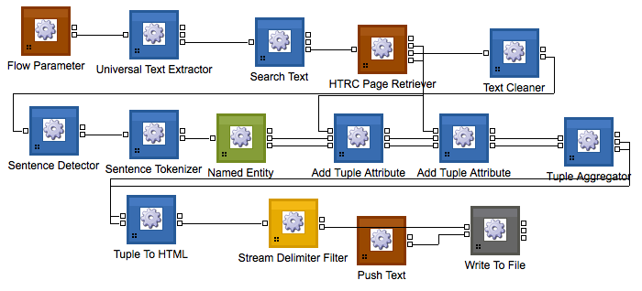

HTRC Architecture
Portal Access
Portal Access
HTRC Portal
Blacklight
Direct programmatic access (by programs running on HTRC machines)
Agent
Blacklight
Job Submission
Collection building
Security (OAuth2)
App SEAR
App Blacklight
Data API access interface
Solr Proxy
Registry (WSO2)
Audit
Algorithms
Meandre Workflows
Cassandra cluster volume store
Result Sets
Collections
Solr index
Compute resources
Storage resources
Notes:
Registry – agent can deploy any service listed in this digram and can run with the computational resources –
Original Plan iis to use XSEDE – not using this on IIS machine but are using ODIN (128 node cluster each core has 4Gb memory and 4 computation cores)– smoketree (D2I server)(24 cores physical 48 loical cores 128 GB memory) – these are not long term just using for now -

Slide 123
HTRC Architecture
Agent
Portal Access
HTRC Agent
Blacklight
Direct programmatic access (by programs running on HTRC machines)
Job
Submission
Collection building
Agent
Job Submission
Collection building
Security (OAuth2)
Data API access interface
Solr Proxy
Registry (WSO2)
Audit
Algorithms
Meandre Workflows
Cassandra cluster volume store
Result Sets
Collections
Solr index
Compute resources
Storage resources
Notes:
Registry – agent can deploy any service listed in this diagram and can run with the computational resources –
Original Plan iis to use XSEDE – not using this on IIS machine but are using ODIN (128 node cluster each core has 4Gb memory and 4 computation cores)– smoketree (D2I server)(24 cores physical 48 loical cores 128 GB memory) – these are not long term just using for now -

Slide 124

HTRC Architecture
1
HTRC Registry
Portal Access
Registry (WSO2)
Blacklight
Algorithms
Meandre Workflows
Direct programmatic access (by programs running on HTRC machines)
Agent
Job Submission
Collection building
Result Sets
Collections
Security (OAuth2)
Data API access interface
Solr Proxy
Registry (WSO2)
Audit
Algorithms
Meandre Workflows
Cassandra cluster volume store
Result Sets
Collections
Solr index
Compute resources
Storage resources
Notes:
Registry – agent can deploy any service listed in this diagram and can run with the computational resources –
Original Plan iis to use XSEDE – not using this on IIS machine but are using ODIN (128 node cluster each core has 4Gb memory and 4 computation cores)– smoketree (D2I server)(24 cores physical 48 loical cores 128 GB memory) – these are not long term just using for now -

Slide 125

HTRC Architecture
Secure Data API
Portal Access
Blacklight
RESTful Web Service
  Language agnostic
  Clients don’t have to deal with Cassandra
Simple OAuth2 authentication
HTTP over SSL
Audits client access
Protected behind firewall, accessible only to authorized IPs
Direct programmatic access (by programs running on HTRC machines)
Agent
Job Submission
Collection building
Security (OAuth2)
Data API access interface
Solr Proxy
Registry (WSO2)
Audit
Algorithms
Meandre Workflows
Cassandra cluster volume store
Result Sets
Collections
Solr index
HTRC
Compute resources
Storage resources
Notes:
Registry – agent can deploy any service listed in this digram and can run with the computational resources –
Original Plan iis to use XSEDE – not using this on IIS machine but are using ODIN (128 node cluster each core has 4Gb memory and 4 computation cores)– smoketree (D2I server)(24 cores physical 48 loical cores 128 GB memory) – these are not long term just using for now -

Slide 126
HTRC Architecture
Solr Proxy
Portal Access
Blacklight
Direct programmatic access (by programs running on HTRC machines)
Agent
Solr proxy
Job Submission
Collection building
Security (OAuth2)
Solr service
Data API access interface
Solr Proxy
Registry (WSO2)
Audit
Algorithms
Meandre Workflows
Cassandra cluster volume store
Result Sets
Collections
Solr index
RFS distributed file system
Compute resources
Storage resources
Notes:
Registry – agent can deploy any service listed in this digram and can run with the computational resources –
Original Plan iis to use XSEDE – not using this on IIS machine but are using ODIN (128 node cluster each core has 4Gb memory and 4 computation cores)– smoketree (D2I server)(24 cores physical 48 loical cores 128 GB memory) – these are not long term just using for now -

Slide 127
NoSQL Methodology
Currently HT content is stored in a pair-tree file system convention (CDL)
Moving these files into a NoSQL store like Cassandra enabled HTRC to aggregate them into larger sets of files for use in retrieval
Use of Cassandra enabled HTRC to share content over a commodity based Cassandra cluster of virtual machines
Originally investigated use of MongoDB, CouchDB, Hbase and Cassandra

Slide 128
HTRC Solr Proxy + Solr Service
Preserves all query syntax of original Solr
Prevents user from modification
Hides the host machine and port number HTRC Solr is actually running on
Creates audit log of requests
Provides filtered term vector for words starting with user-specified letter
Filters out “dangerous” requests to Solr
Adds additional features to Solr
  E.g. Term Vectors

Slide 129


Data Capsules VM Cluster
HTRC Volume Store and Index
Remote Desktop
Or VNC
Provide secure
VM
FutureGrid
Computation Cloud
Submit secure capsule map/reduce Data Capsule images to FutureGrid. Receive and review results
Scholars
Non-Consumptive Research-Secure Data Capsule

Slide 130
SEASR Analytics for HTRC
Loretta Auvil
University of Illinois
Notes:
Software Environment for the Advancement of Scholarly Research

Slide 131
What is SEASR?
This project focus on
  developing,
  integrating,
  deploying, and
  sustaining
a set of reusable and expandable software components and a supporting framework,
to benefit a broad set of data mining applications for scholars in humanities.
Notes:
collective effort in improving access to data and algorithms,

Slide 132
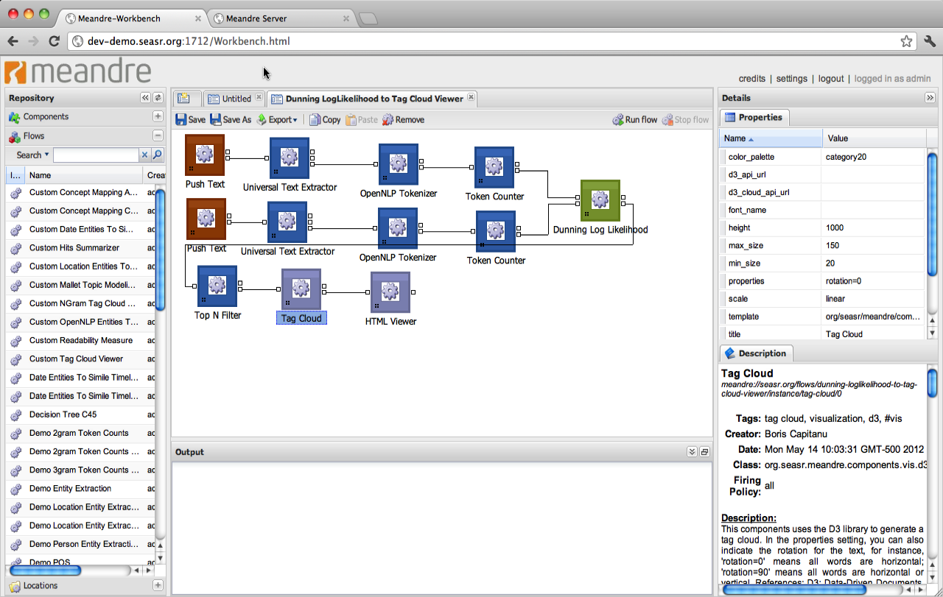
Meandre: Workbench Existing Flow
Web-based UI
Components and flows are retrieved from server
Additional locations of components and flows can be added to server
Create flow using a graphical drag and drop interface
Change property values
Execute the flow

Slide 133
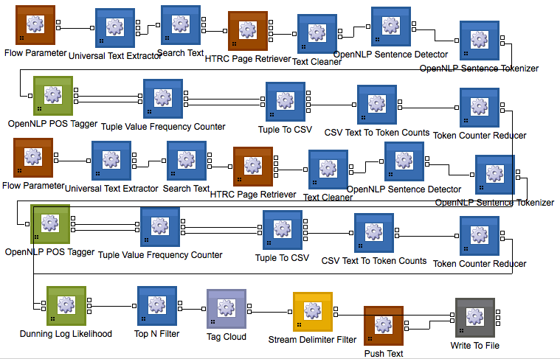
Meandre Flow

Slide 134
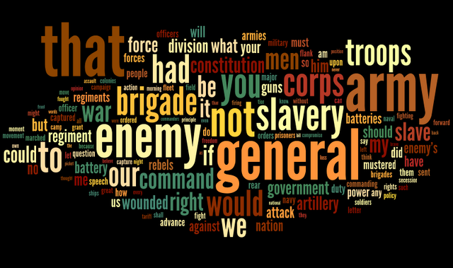
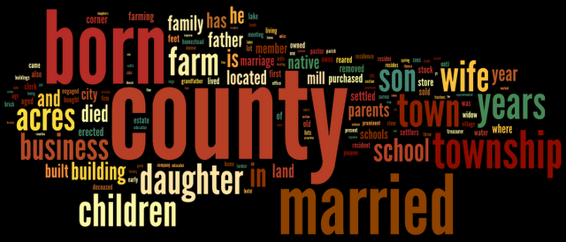
Dunning Loglikelihood Tag Clouds
Significantly overrepresented in E, in order:
"that" "general" "army" "enemy"
"not" "slavery" "to" "you"
"corps" "brigade" "had" "troops"
"would" "our" "we" "men"
"war" "be" "command" "if"
"slave" "right" "it" "my"
"could" "constitution" "force" "what"
"wounded" "artillery" "division" "government"
Significantly overrepresented in F, in order:
"county" "born" "married" "township"
"town" "years" "children" "wife"
"daughter" "son" "acres" "farm"
"business" "in" "school" "is"
"and" "building" "he" "died"
"year" "has" "family" "father"
"located" "parents" "land" "native"
"built" "mill" "city" "member”
http://sappingattention.blogspot.com/2011/10/comparing-corpuses-by-word-use.html

Slide 135
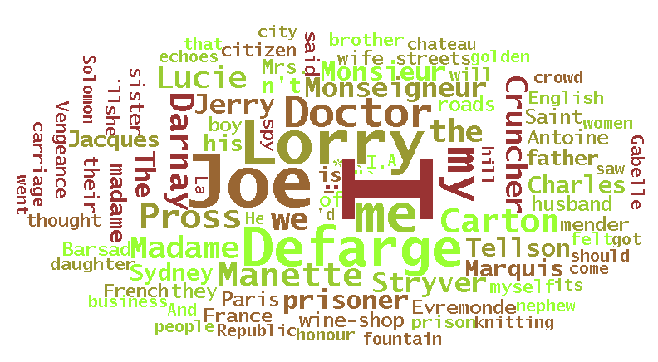
SEASR @ Work – Dunning Loglikelihood
Find what words are overused or underused in your 'analysis corpus' when compared with your 'reference corpus'.
Feature comparison of token counts
Two sets of works
  Specify an analysis document/collection
  Specify a reference document/collection
Perform statistics comparison using Dunning Loglikelihood
Example showing over-represented words
Analysis Set: The Project Gutenberg EBook of A Tale of Two Cities, by Charles Dickens
Reference Set: The Project Gutenberg EBook of Great Expectations, by Charles Dickens
Improvement by removing Proper Nouns

Slide 136
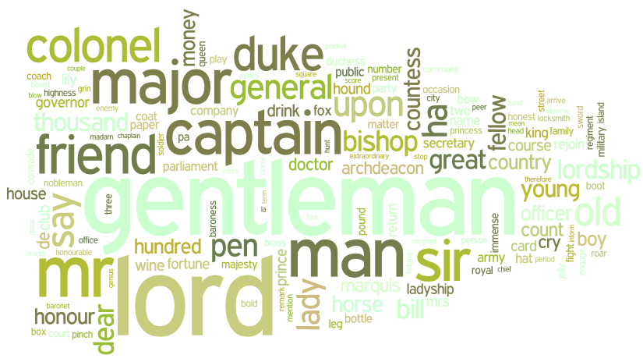
Dunning Loglikelihood Tag Cloud
Words that are under-represented in writings by Victorian women as compared to Victorian men.
Results are loaded into Wordle for the tag cloud
—Sara Steger (Monk Project)

Slide 137
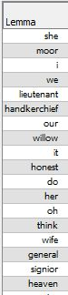
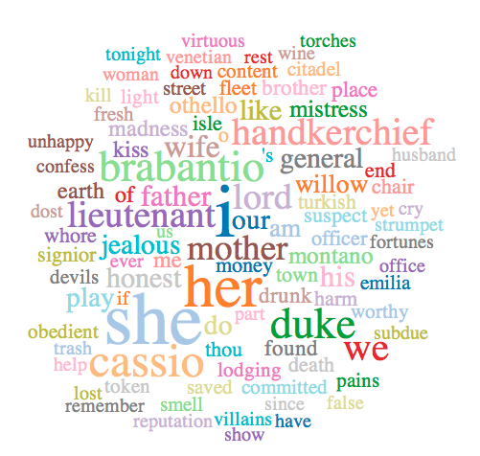
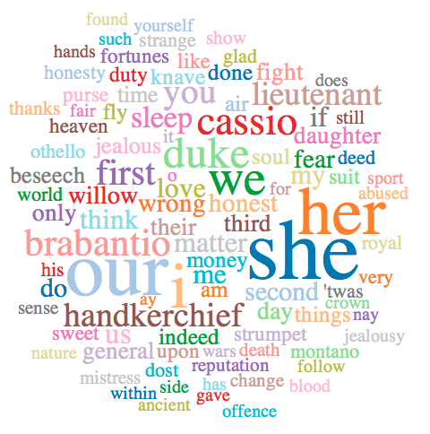
Dunning Loglikelihood Comparisons
Othello – Shakespeare Tragedies
Comparisons ran in SEASR with words (not lemmas) ignoring proper nouns, not equal comparison, but individual documents instead of the collection.
Tagclouds show words more common in Othello
Othello – Hamlet
Othello – MacBeth

Slide 138
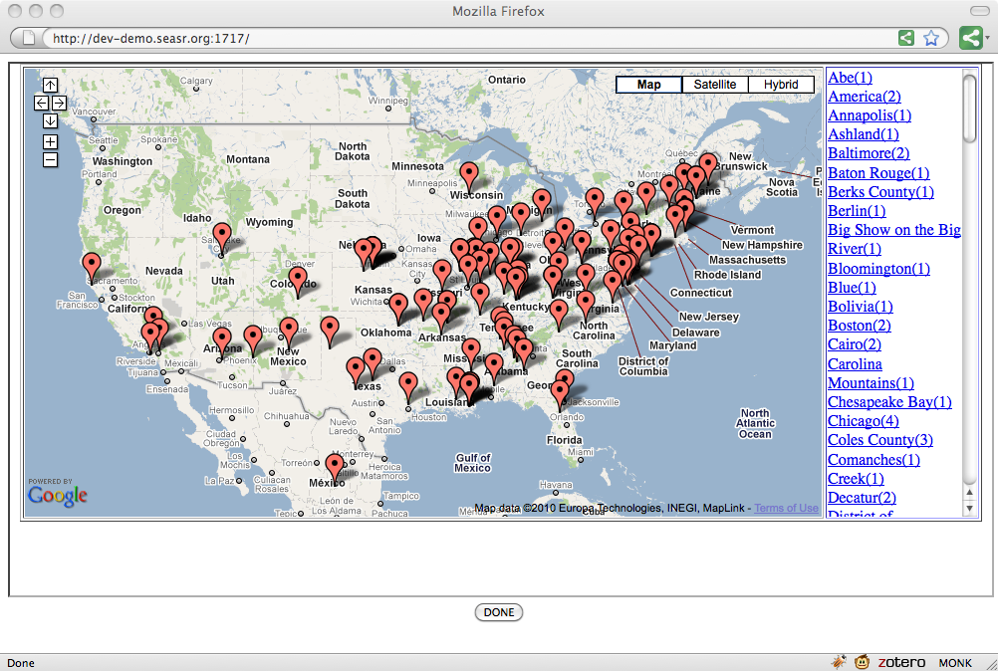
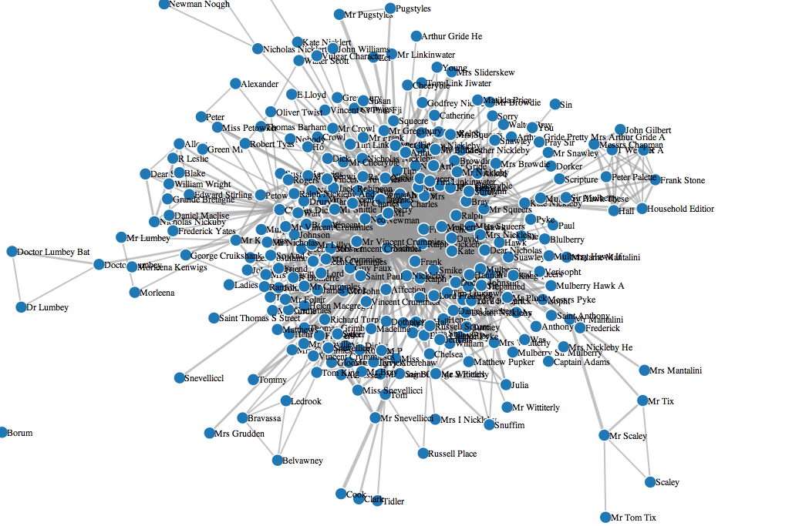
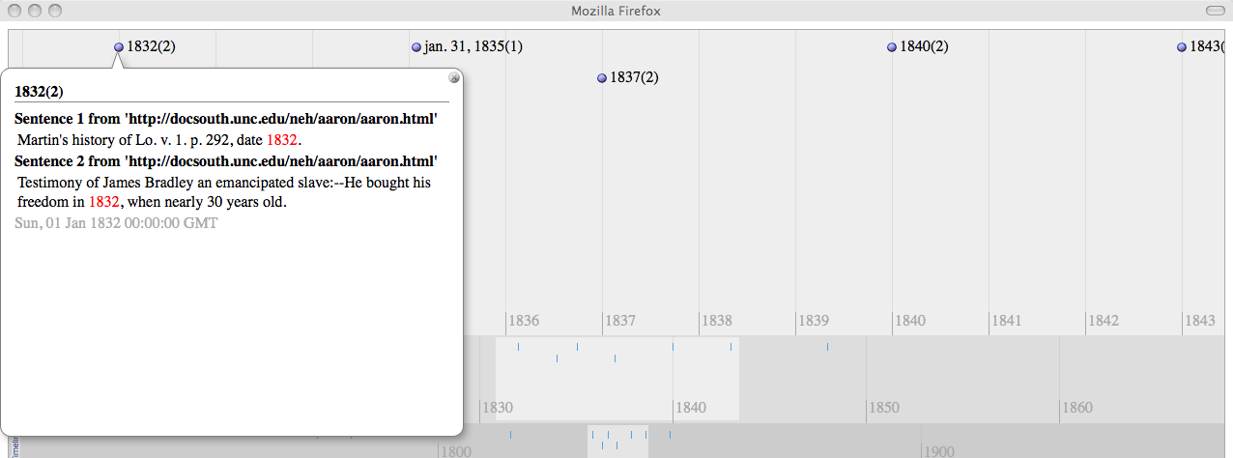
SEASR @ Work – Entity Mash-up
Entity Extraction
  Locations viewed on Google Map
  Dates viewed on Simile Timeline
  Entities in social network

Slide 139
Text Preprocessing
Syntactic analysis
  Tokenization
  Lemmitization
  Ngrams
  Part Of Speech (POS) tagging
  Stop Word Removal
  Shallow parsing
  Custom literary tagging
Semantic analysis
  Information Extraction
    Named Entity tagging
    Unnamed Entity tagging
  Co-reference resolution
  Ontological association (WordNet, VerbNet)
  Semantic Role analysis
  Concept-Relation extraction

Slide 140
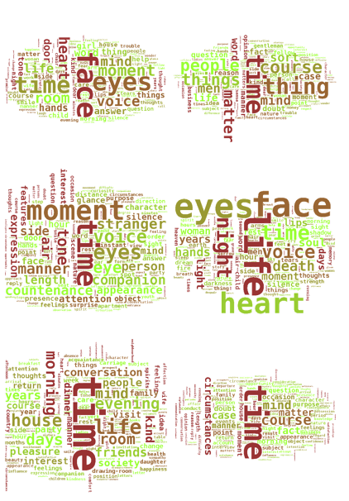
Text Analytics: Topic Modeling
Given: Set of documents
Find: To reveal the semantic content in large collection of documents
Usage: Mallet Topic Modeling tools
Output:
  Shows the percentage of relevance for each document in each cluster
  Shows the key words and their counts for each topic

Slide 141
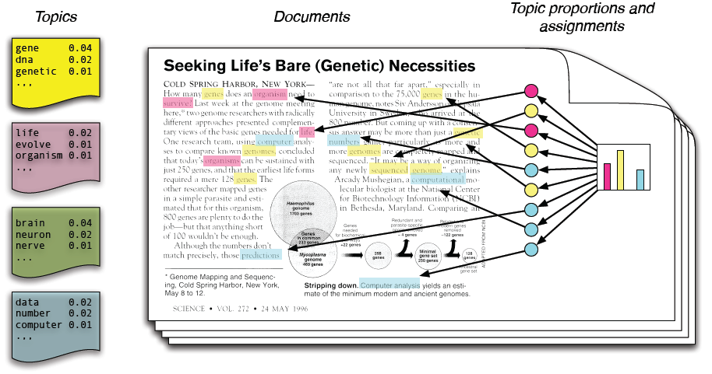
Topic Modeling: LDA Model
LDA assumes that there are K topics shared by the collection.
Each document exhibits the topics with different proportions.
Each word is drawn from one topic.
We discover the structure that best explain a corpus.
LDA Model from Blei (2011)
Notes:
Each topic is a distribution over words
Each document is a mixture of corpus-wide topics
Each word is drawn from one of those topics
First, assume that each document is made up of a random mixture of categories, or topics.
Second, suppose each category is defined by its preference for some words over others.
Third, let’s pretend we’re going to generate each word in each document from scratch. Over and over again, we randomly choose a category, then we randomly choose a word based on the preferences of that category.

Slide 142
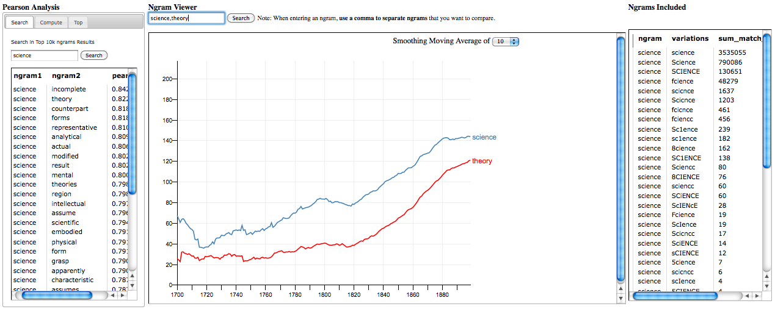
Correlation-Ngram Viewer
Pearson Correlation Algorithm

Slide 143
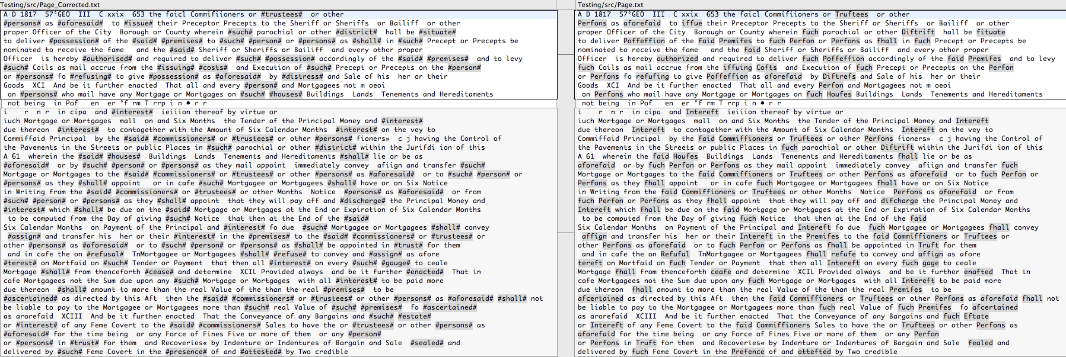
OCR Correction
HTRC Example of one of the worst pages of text based on number of corrections per word rate = 0.1994

Slide 144
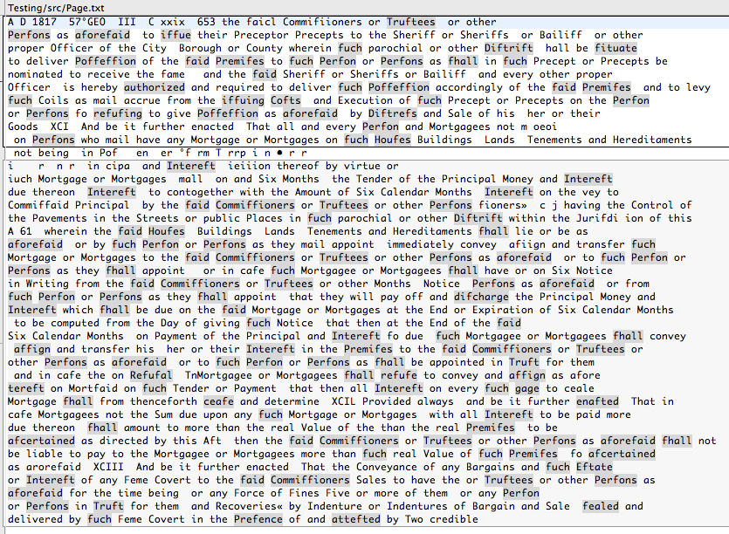
Worst Page

Slide 145
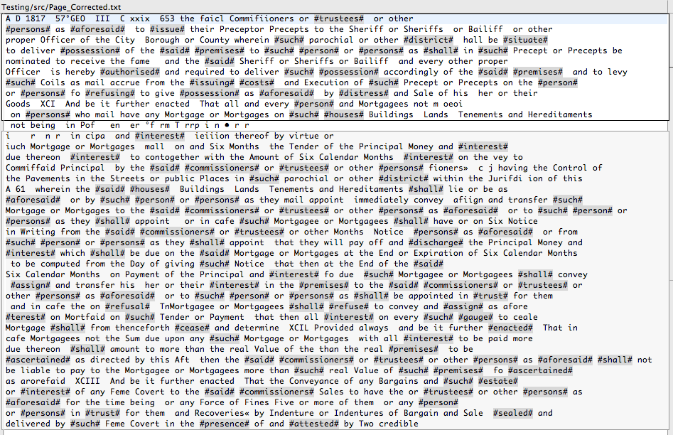
Corrected Page

Slide 146
Toward the Future

Slide 147
Personal Goals for HTRC
Work with entire HathiTrust collection
Engage in more collaborative projects
Expand to have truly international partnerships
Make sure to move beyond text
Make sure to move beyond humanites!

Slide 148
HathiTrust Non-Consumptive
Evaluation Challenge Ideas
Optical character recognition (OCR) error identification and correction
Metadata error identification and correction (and possible enhancement Work with entire HathiTrust collection
Genre detection (e.g. fiction, non-fiction)
Author gender identification.

Slide 149
Questions? Comments? Suggestions?

