Slide 1
HathiTrust and the Future of Research Libraries
American Antiquarian Society
March 31, 2012
Jeremy York, Project Librarian, HathiTrust

Slide 2
Partnership
Arizona State University
Baylor University
Boston College
Boston University
California Digital Library
Columbia University
Cornell University
Dartmouth College
Duke University
Emory University
Florida State University
Getty Research Institute
Harvard University Library
Indiana University
Johns Hopkins University
Lafayette College
Library of Congress
Massachusetts Institute of Technology
McGill University`
Michigan State University
New York Public Library
New York University
North Carolina Central
University
North Carolina State
University
Northwestern University
The Ohio State University
The Pennsylvania State
University
Princeton University
Purdue University
Stanford University
Texas A&M University
Universidad Complutense
de Madrid
University of Arizona
University of Calgary
University of California
Berkeley
Davis
Irvine
Los Angeles
Merced
Riverside
San Diego
San Francisco
Santa Barbara
Santa Cruz
The University of Chicago
University of Connecticut
University of Florida
University of Illinois
University of Illinois at Chicago
The University of Iowa
University of Maryland
University of Miami
University of Michigan
University of Minnesota
University of Missouri
University of Nebraska-Lincoln
The University of North
Carolina at Chapel Hill
University of Notre Dame
University of Pennsylvania
University of Pittsburgh
University of Utah
University of Virginia
University of Washington
University of Wisconsin- Madison
Utah State University
Washington University
Yale University Library

Slide 3
Digital Repository
Launched 2008
Initial focus on digitized book and journal content
10,110,910 total volumes
5,373,507 book titles
266,577 serial titles
2,803,585 public domain (~28%)
“Light” archive
As accessible as possible within bounds of law

Slide 4
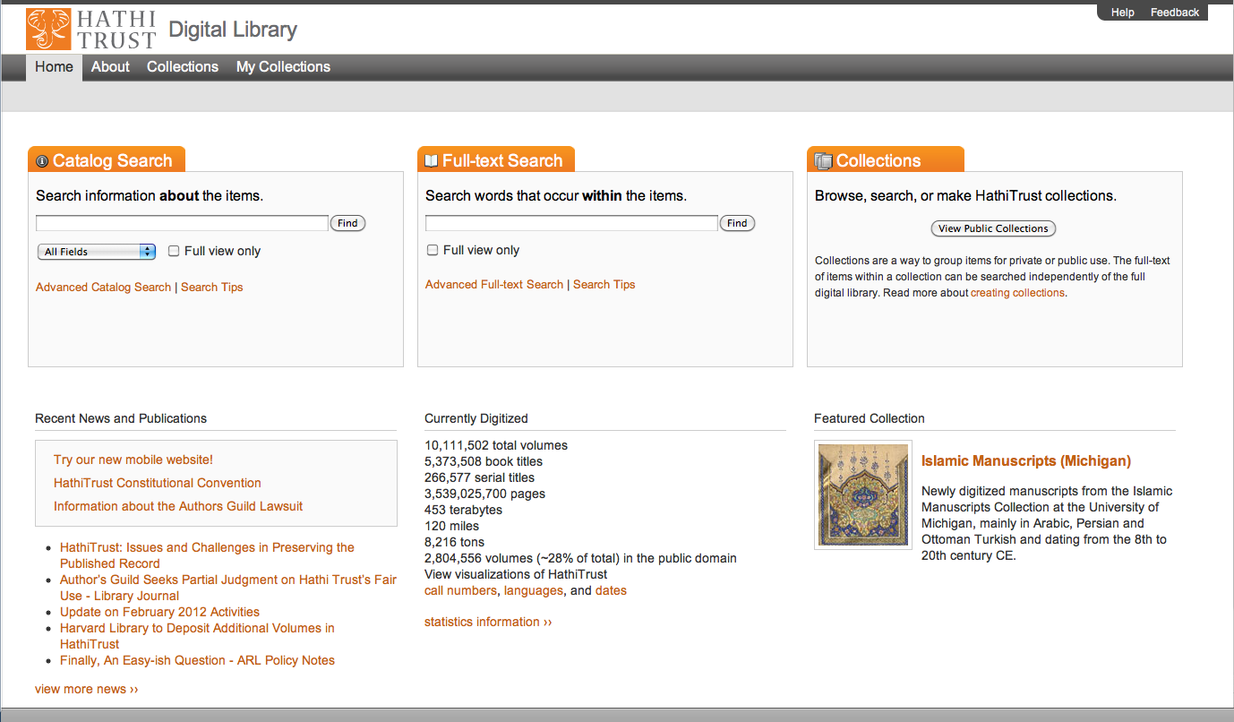

Slide 5
The Name
The meaning behind the name
Hathi (hah-tee)--Hindi for elephant
Big, strong
Never forgets, wise
Secure
Trustworthy

Slide 6
Mission
To contribute to the common good by collecting, organizing, preserving, communicating, and sharing the record of human knowledge

Slide 7
HathiTrust
Universal Library
Common Goal
Single Entity, Many Partners

Slide 8
Collections and Collaboration
Comprehensive collection
Preservation…with Access
Shared strategies
Copyright
Collection management, development
Preservation
Discovery / Use
Bibliographic Indeterminacy
Efficient user services
Public Good

Slide 9
Strategies
Use Digital as a hub
Overlap
Print archiving
Collaborative digitization
Collaborate globally, plan locally

Slide 12
Research Libraries
Facilitate access to what is of current value
Facilitate access to and preserve what is of enduring value
Support mission of institution

Slide 13
Institution and Library Functions
Teaching, Learning, Mentoring
Courses, fellowships, research
Offer resources that facilitate discovery, use, and reuse of materials
Preservation infrastructure
Search functionality
Datasets for research
Librarians
Resource centers
Produce materials
Student papers and projects
Faculty papers, books, research outputs
Lectures, exhibits, performances
Publish outputs of other faculty and researchers
Make sense of materials
Course reading lists and resources
Library guides, bibliographies
Assembling meaningful collections
Acquire materials
Purchase books and journals
Harvest from Web
Archive institutional content
Acquire other archives

Slide 14
Library of Congress Prints and Photographs Online Catalog
http://www.loc.gov/pictures/item/2001700115/

Slide 15
Research Libraries of the Future
Won’t go it alone
Sourcing and scaling (Dempsey)
Collaborate with others for some things, others do locally
How to do this?
Baseline of reliable, long-term access to core materials
Look at the way needs that are being fulfilled; which are best met collaboratively, which locally
Evaluating and assessing services in relation to use
Secure infrastructure as needed to enable that use

