Slide 1
Collective Stewardship through HathiTrust Digital Library
African Studies in the Digital Age
November 12, 2014
Mike Furlough, Executive Director
Jeremy York, Assistant Director
Unless otherwise noted, these slides and their contents are licensed under a Creative Commons Attribution Unported License.

Slide 2
Roadmap
What is HathiTrust?
What does it do for you?
Who are we and how do we work?
What will you find in HathiTrust?
How do we preserve them?
Where is HathiTrust going?

Slide 3
What is HathiTrust?

Slide 4
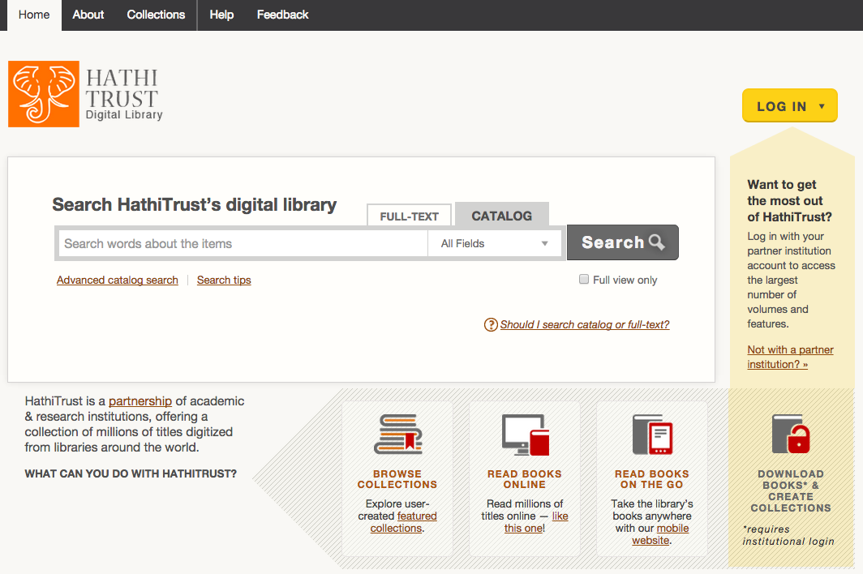
HATHITRUST.ORG

Slide 5
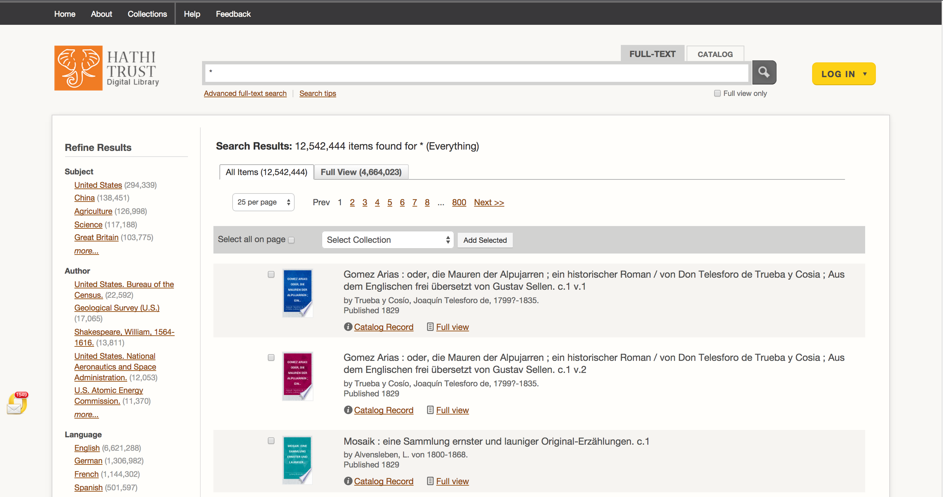
12.9 million total volumes
6.6 million book titles
340,000 serial titles
576,000 US government publications
4.8 million volumes in the public domain (~37%)

Slide 6
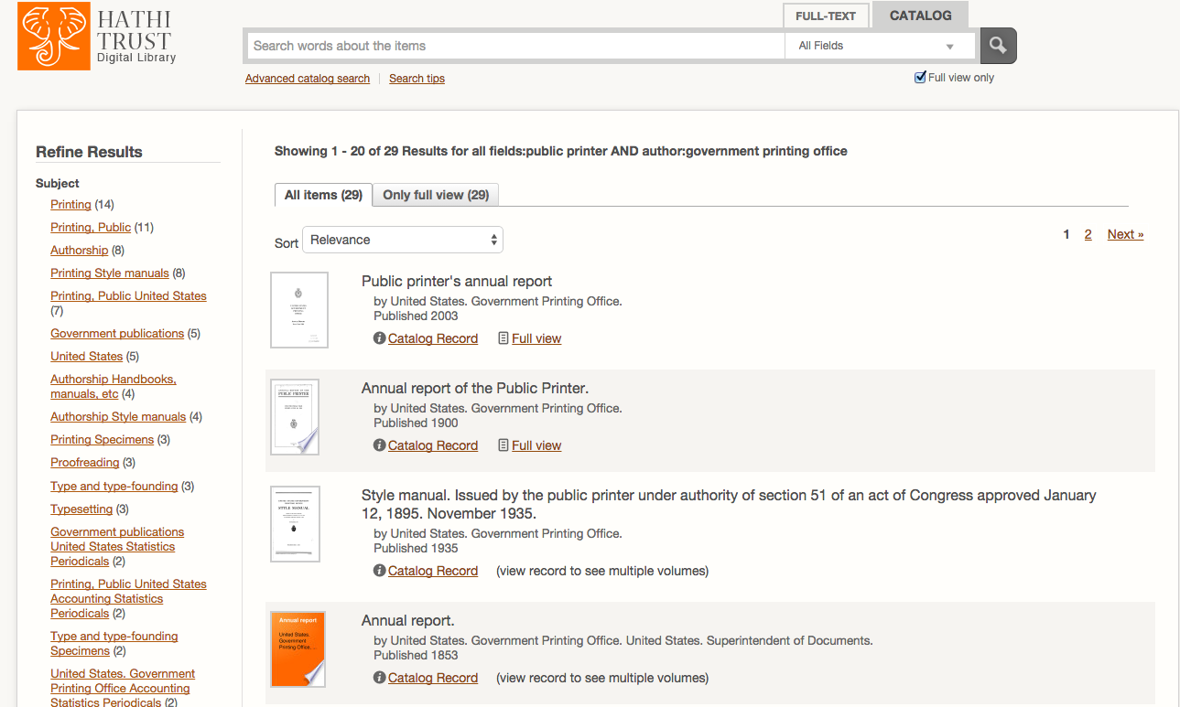
Full text and catalog search

Slide 7
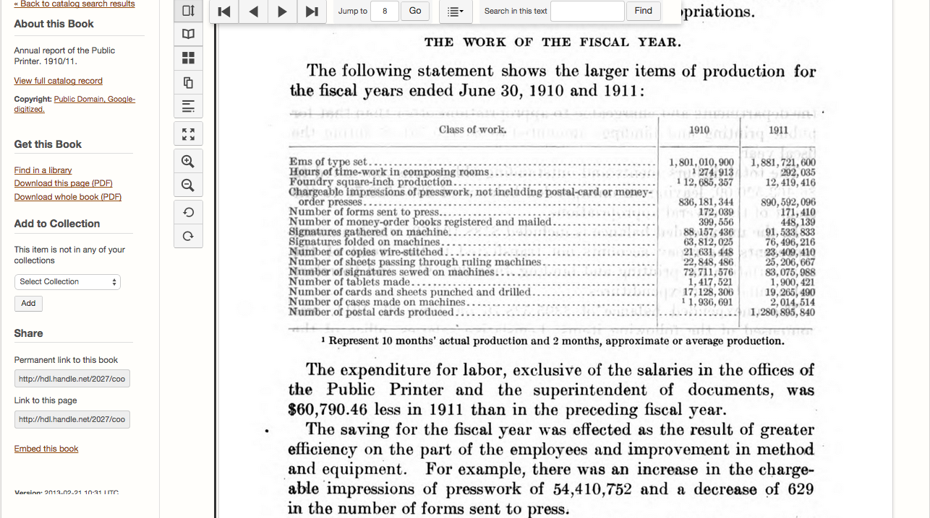
Read on-screen or download

Slide 8
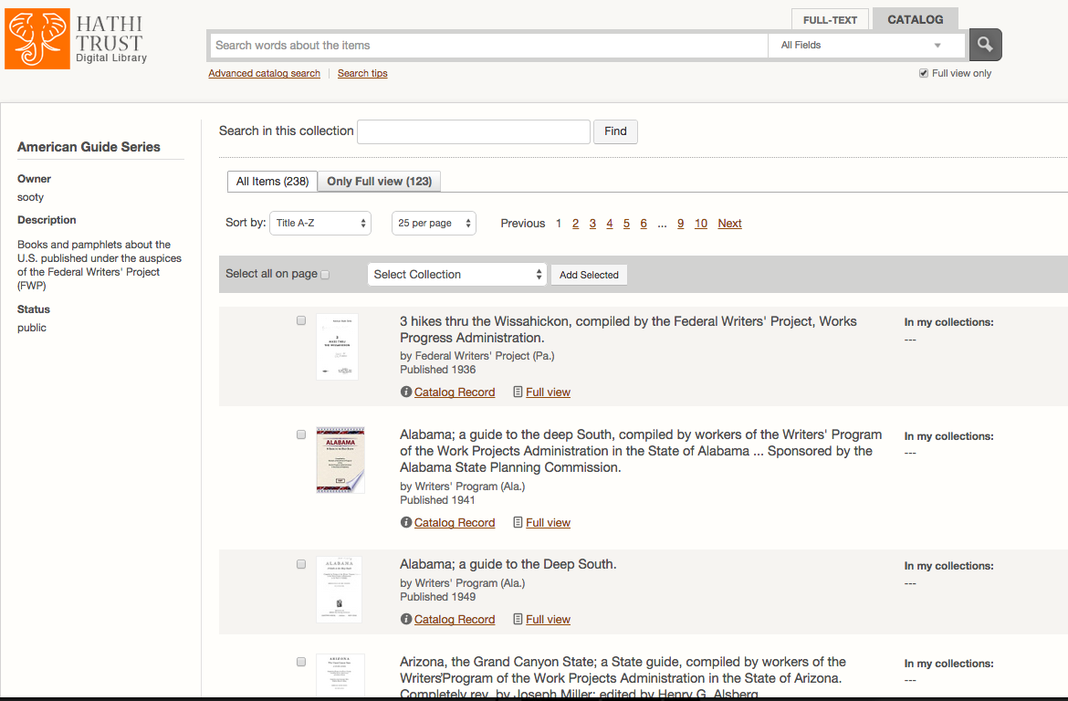
Build and share a collection

Slide 9
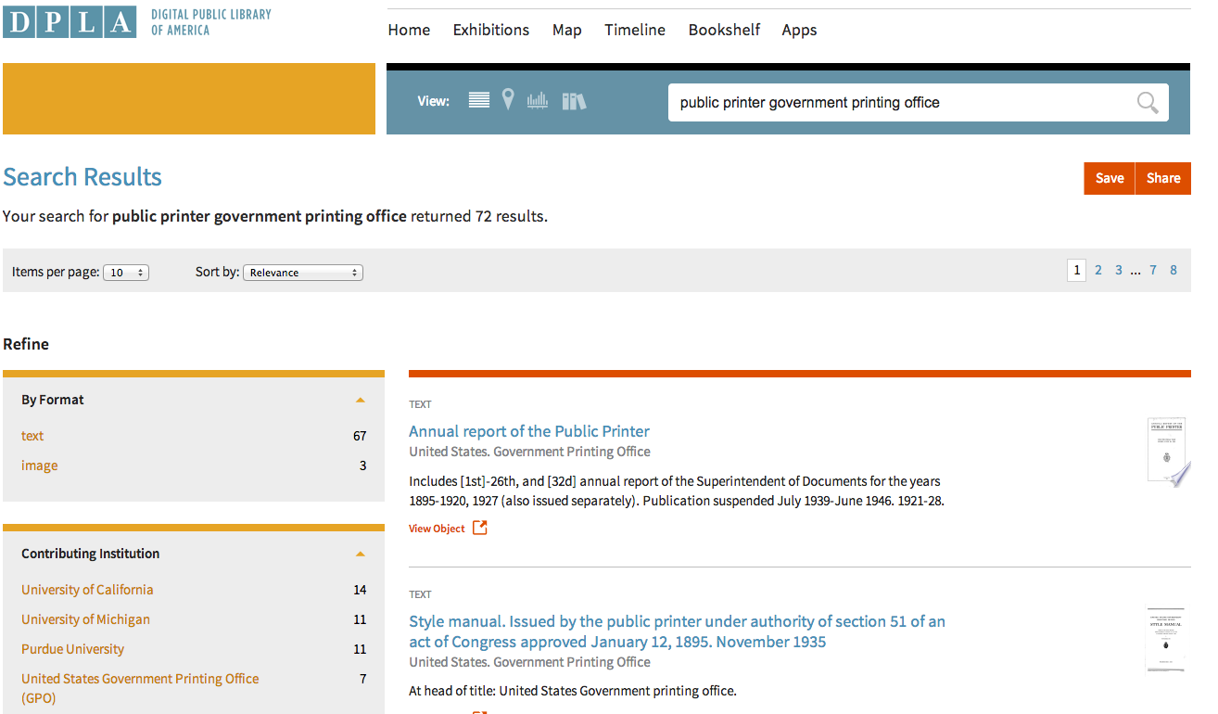
Link takes you to HathiTrust
Records loaded into DPLA, local library catalogs, and commercial databases

Slide 10
HathiTrust Mission
To contribute to research, scholarship, and the common good by collaboratively collecting, organizing, preserving, communicating, and sharing the record of human knowledge.
Efforts include, but are not limited to
…building comprehensive collections co-owned and managed by partners.
…enabling access by users with print disabilities.
…supporting computational research with the collections.
…stimulating shared collection storage strategies among libraries.

Slide 11
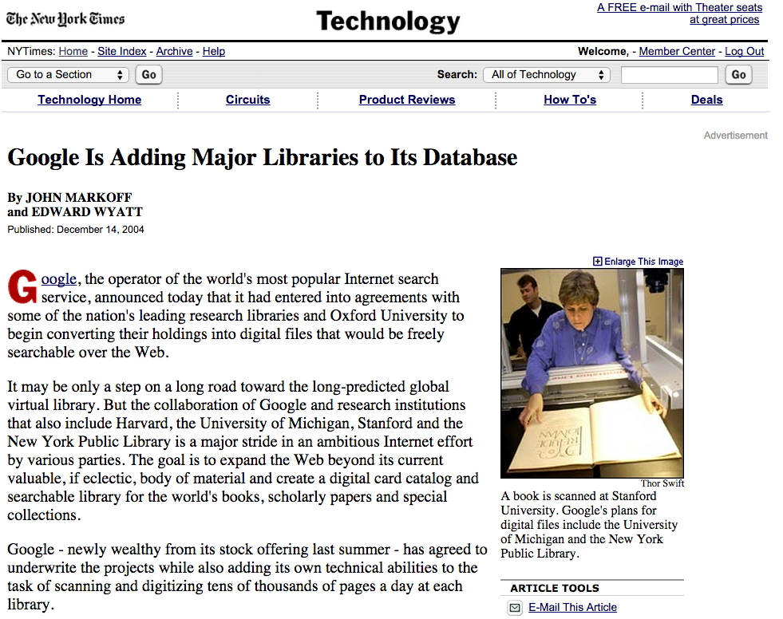

Slide 12
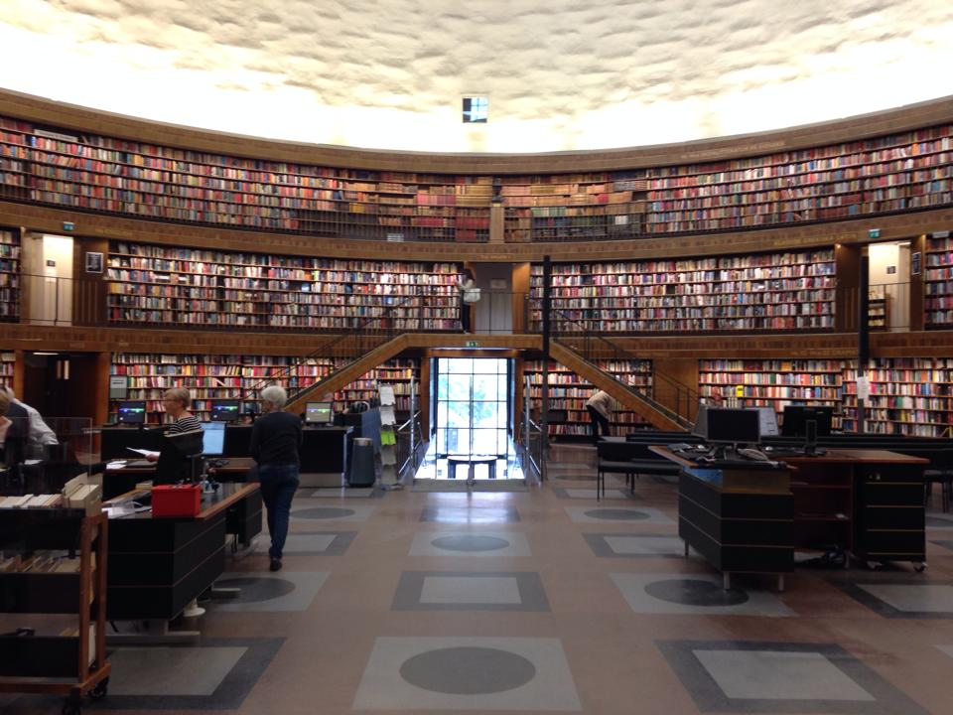
≠

Slide 13
Collective Stewardship
Draw upon knowledge across institutions
Distributed Functions and Services
Preservation repository and access services
University of Michigan
Mirror site: Indiana University
Metadata management services
California Digital Library
HathiTrust Research Center
Indiana University and University of Illinois

Slide 14
HathiTrust Members
Allegheny College
Arizona State University
Baylor University
Boston College
Boston University
Brandeis University
Brown University
California Digital Library
Carnegie Mellon University
Colby College
Columbia University
Cornell University
Dartmouth College
Duke University
Emory University
Florida State University
Getty Research Institute
Harvard University Library
Indiana University
Iowa State University
Johns Hopkins University
Kansas State University
Lafayette College
Library of Congress
Massachusetts Institute of Technology
McGill University`
Michigan State University
Montana State University
Mount Holyoke College
New York Public Library
New York University
North Carolina Central
University
North Carolina State
University
Northwestern University
The Ohio State University
The Pennsylvania State
University
Princeton University
Purdue University
Rutgers University
Stanford University
Syracuse University
Temple University
Texas A&M University
Texas Tech
Tufts University
Universidad Complutense
de Madrid
University of Alabama
University of Alberta
University of Arizona
University of British Columbia
University of Calgary
University of California
Berkeley
Davis
Irvine
Los Angeles
Merced
Riverside
San Diego
San Francisco
Santa Barbara
Santa Cruz
The University of Chicago
University of Connecticut
University of Delaware
University of Florida
University of Houston
University of Illinois
University of Illinois at Chicago
The University of Iowa
University of Kansas
University of Maine
University of Maryland
University of Massachusetts, Amherst
University of Miami
University of Michigan
University of Minnesota
University of Missouri
University of Nebraska-Lincoln
University of New Mexico
The University of North
Carolina at Chapel Hill
University of Notre Dame
University of Oklahoma
University of Pennsylvania
University of Pittsburgh
University of Queensland
University of Tennessee, Knoxville
University of Texas
University of Utah
University of Vermont
University of Virginia
University of Washington
University of Wisconsin- Madison
Utah State University
Vanderbilt University
Virginia Tech
Wake Forest University
Washington University
Yale University Library

Slide 15
HathiTrust Collections and Services

Slide 16
Growth of Collection

Slide 17
http://www.hathitrust.org/visualizations_languages
Dates

Slide 18
Trustworthy Digital Repository
TRAC
“…a mission to provide reliable, long-term access to managed digital resources to its designated community, now and into the future”
Encompasses
Organizational Infrastructure
Mission statement, succession plan, staff, assessment, accountability, business plan, agreements
Digital Object Management
Properties preserved, SIP, AIP, validation, naming conventions, identifiers, understandability, preservation strategies, logging, access policies
Technologies Technical Infrastructure Security
Hardware, software, error-handling, change management, security, staff roles, disaster preparedness

Slide 19
Access and Preservation
Meet needs of designated community
Check on integrity of content
Content that is accessible is more likely to be valued and preserved in the future

Slide 20
Source
Data Management
Access
Bib Data
Rights Data
Catalog
Ingest
Full-text Search
Holdings Data
Bibliographic Data
PageTurner
Content Package
Collections
Storage
Michigan
APIs
Indiana
Datasets
Research Center

Slide 21
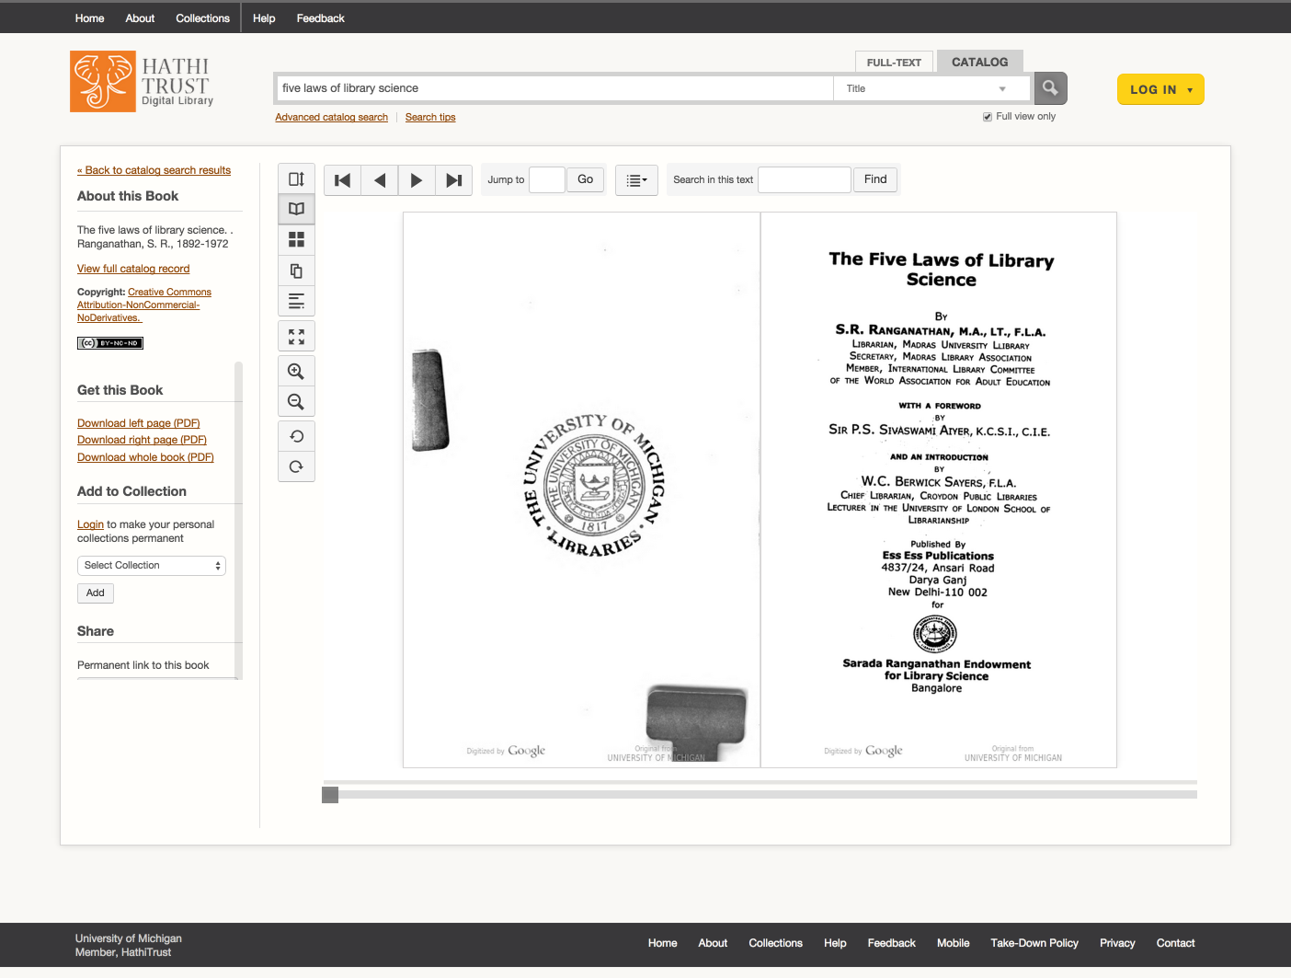
<datafield tag="100" ind1="1" ind2=" ">
<subfield code="a">Ranganathan, S. R., 1892-1972</subfield>
</datafield>
<datafield tag="245" ind1="1" ind2="4">
<subfield code="a">The five laws of library science.</subfield>
</datafield>
<datafield tag="260" ind1=" " ind2=" ">
<subfield code="a">New Delhi :</subfield>
<subfield code="b">Ess Ess Publication,</subfield>
<subfield code="c">2006</subfield>
id | name | dscr
1 | pd | public domain
2 | ic | in-copyright
3 | op | out-of-print (implies in-copyright)
7 | world | world access
8 | nobody | blocked for all users
9 | pdus | public domain in the US
10 | cc-by | Creative Commons Attribution
19 | Ic-us | In copyright in the US
OCLC # | System # | Status | Enum/Chron | GovDoc
100000753 | .b5123614x | CH | v.22 | 0
10001226 | .b37564055 | CH | v.1-2 | 0
10001226 | .b37564055 | CH | v.3-4 | 0
1000161 | .b12642666 | CH | v.1:1 | 0
1000161 | .b12642666 | CH | v.3:1 | 0
1000161 | .b12642666 | CH | v.3:2 | 0

Slide 22
Lawful uses of in-copyright works
Sensitive to international legal regimes
Full-text search (everyone everywhere)
Access to users who have print disabilities (through member proxy in US, and where law permits)**
Access works that are damaged or missing and also out of print and unavailable (members in US only)
**Terms and conditions at http://www.hathitrust.org/access_use#ic-access

Slide 23
HathiTrust Research Center
http://www.hathitrust.org/htrc
Developed collaboratively by Indiana University and University of Illinois; launched July 2011
Provide infrastructure and tools to enable researchers world-wide to accomplish tera-scale text data-mining and analysis
3rd UnCamp: March 30-31, 2015, University of Michigan
Photo by Nocolas Nova CC-BY-NC https://www.flickr.com/photos/nnova/3455992927

Slide 24
Using the HTRC
Portal: sign up, browse volume lists and algorithms, execute algorithms, view results
https://htrc2.pti.indiana.edu/HTRC-UI-Portal2/
Workset Builder
https://htrc2.pti.indiana.edu/blacklight
Sandbox: run own algorithms
Getting Started with the HTRC [Google doc]
http://bit.ly/1hCnyzX

Slide 25
Current and Future Programs

Slide 26
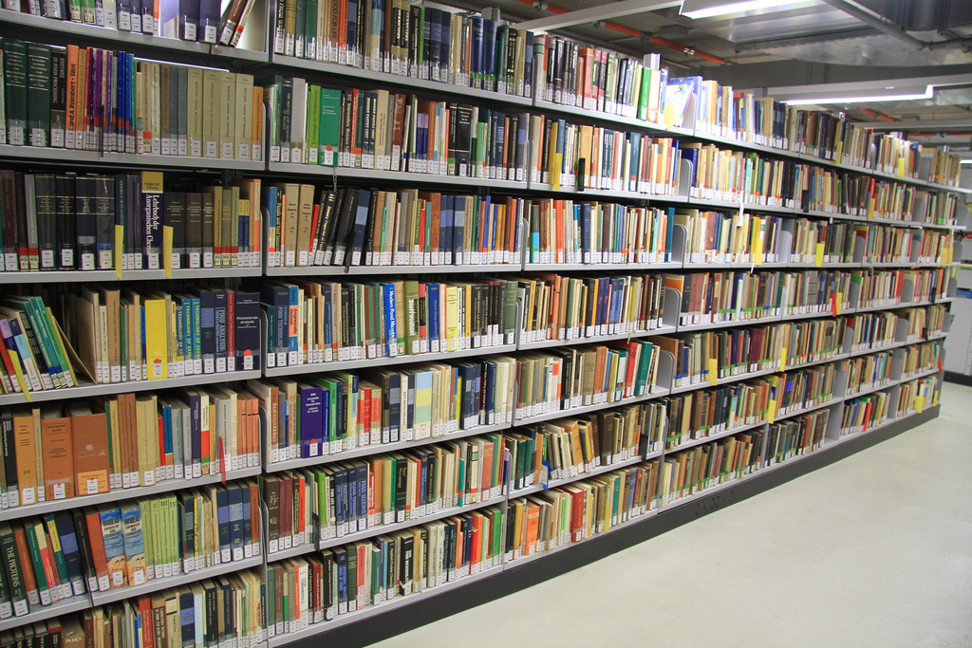
Shared Print Monographs Archive
Ballot Initiative passed at the 2011 HT Constitutional Convention (Con-Con)
“To develop a print monographs archive corresponding to volumes represented within the HathiTrust”
Focus
Ensure preservation of print and digital collections
Catalyze national/continental collective management of collections
Photo by Mal BooTH CC-BY-NC-ND https://www.flickr.com/photos/malbooth/5100435988

Slide 27
Government Documents Initiative
Ballot Initiative: provide “expanded coverage & enhanced access to U.S. Government Documents.”
Activities:
Developing a registry of US Federal Government Documents
Locate materials for inclusion in the collections
Develop specialized modes of access
Photo detail from http://babel.hathitrust.org/cgi/pt?id=mdp.39015087610286;view=1up;seq=14

Slide 28
How are we positioned?
Our mission, collection, and the repository operations are all strong.
Our brand reputation is outstanding.
Our work is solidly supported by the law.
We have expanded access in unprecedented ways.
The partnership provides a solid base for action.
We have very important programs underway.

Slide 29
What needs thought?
Strategy, mission, and role in the future
Membership growth
Collections program
Public policy
(Inter)National digital infrastructure
Services for members and the public
Organizational
Engagement with researchers and libraries
Enabling more participation in plans and action
Standing on our own

Slide 30
Assumptions
The key to our work is alignment in mission, goals, and purpose across our membership.
A few additional assumptions
We will pursue complementarity and cooperation, not competition and duplication.
Scale will continue to drive our strategies
Potential partners are not only other libraries and library organizations, but also the entire public: readers, authors, publishers.

Slide 31
How to find out more
About: http://www.hathitrust.org/about
Resources: http://www.hathitrust.org/resources
Twitter: http://twitter.com/hathitrust
Facebook: http://www.facebook.com/hathitrust
Monthly newsletter:
http:www.hathitrust.org/updates
RSS http://www.hathitrust.org/updates_rss
Contact us: feedback@issues.hathitrust.org
Blogs: http://www.hathitrust.org/blogs
Large-scale Search
Perspectives from HathiTrust

Slide 32
Thank you! furlough@hathitrust.org jjyork@hathitrust.org

