Slide 1
HathiTrust: Issues and Challenges in Preserving the Published Record
Amigos Online
February 8, 2012
Jeremy York, Project Librarian, HathiTrust

Slide 2
Partnership
Arizona State University
Baylor University
Boston College
Boston University
California Digital Library
Columbia University
Cornell University
Dartmouth College
Duke University
Emory University
Florida State University
Getty Research Institute
Harvard University Library
Indiana University
Johns Hopkins University
Lafayette College
Library of Congress
Massachusetts Institute of Technology
McGill University`
Michigan State University
New York Public Library
New York University
North Carolina Central
University
North Carolina State
University
Northwestern University
The Ohio State University
The Pennsylvania State
University
Princeton University
Purdue University
Stanford University
Texas A&M University
Universidad Complutense
de Madrid
University of Arizona
University of Calgary
University of California
Berkeley
Davis
Irvine
Los Angeles
Merced
Riverside
San Diego
San Francisco
Santa Barbara
Santa Cruz
The University of Chicago
University of Connecticut
University of Florida
University of Illinois
University of Illinois at Chicago
The University of Iowa
University of Maryland
University of Miami
University of Michigan
University of Minnesota
University of Missouri
University of Nebraska-Lincoln
The University of North
Carolina at Chapel Hill
University of Notre Dame
University of Pennsylvania
University of Pittsburgh
University of Utah
University of Virginia
University of Washington
University of Wisconsin- Madison
Utah State University
Washington University
Yale University Library

Slide 3
Digital Repository
Launched 2008
Initial focus on digitized book and journal content
  10,028,324 total volumes
  5,315,009 book titles
  264,490 serial titles
  2,741,589 public domain (~27%)

Slide 4
Mission
To contribute to the common good by collecting, organizing, preserving, communicating, and sharing the record of human knowledge

Slide 5
HathiTrust
Universal Library
Common Goal
Single Entity, Many Partners

Slide 6
Collections and Collaboration
Comprehensive collection
  Preservation…with Access
Shared strategies
  Copyright, lawful uses of materials
  Collection management, development
  Efficient user services
Public Good

Slide 7
Primary Issues
Copyright
Vendor agreements

Slide 8
Content Sources
* As of January 2012
Notes:
8

Slide 9

Dates
* As of January 2012
Notes:
9

Slide 10
Language Distribution (1)
The top 10 languages make up ~86% of all content
* As of January 2012
Notes:
10

Slide 11
Language Distribution (2)
The next 40 languages make up ~13% of total
* As of January 2012
Notes:
11

Slide 12
Services: Preservation with Access
TRAC-certified
Discovery
  Bibliographic and full-text search of all materials
  Extended discovery (ProQuest, EBSCO, OCLC, Ex Libris)
  Mechanisms for local loading of records
Access and Use
  Public domain and open access works
  Full download of materials where possible
  Print on demand
  Research Center
  Lawful uses of in-copyright works

Slide 13
Scope of the Issue: Dates
* As of January 2012
Notes:
13

Slide 14
Scope of the Issue: Dates
73%
* As of January 2012
Notes:
14

Slide 15
Content Distribution
* As of January 2012
Notes:
15

Slide 16
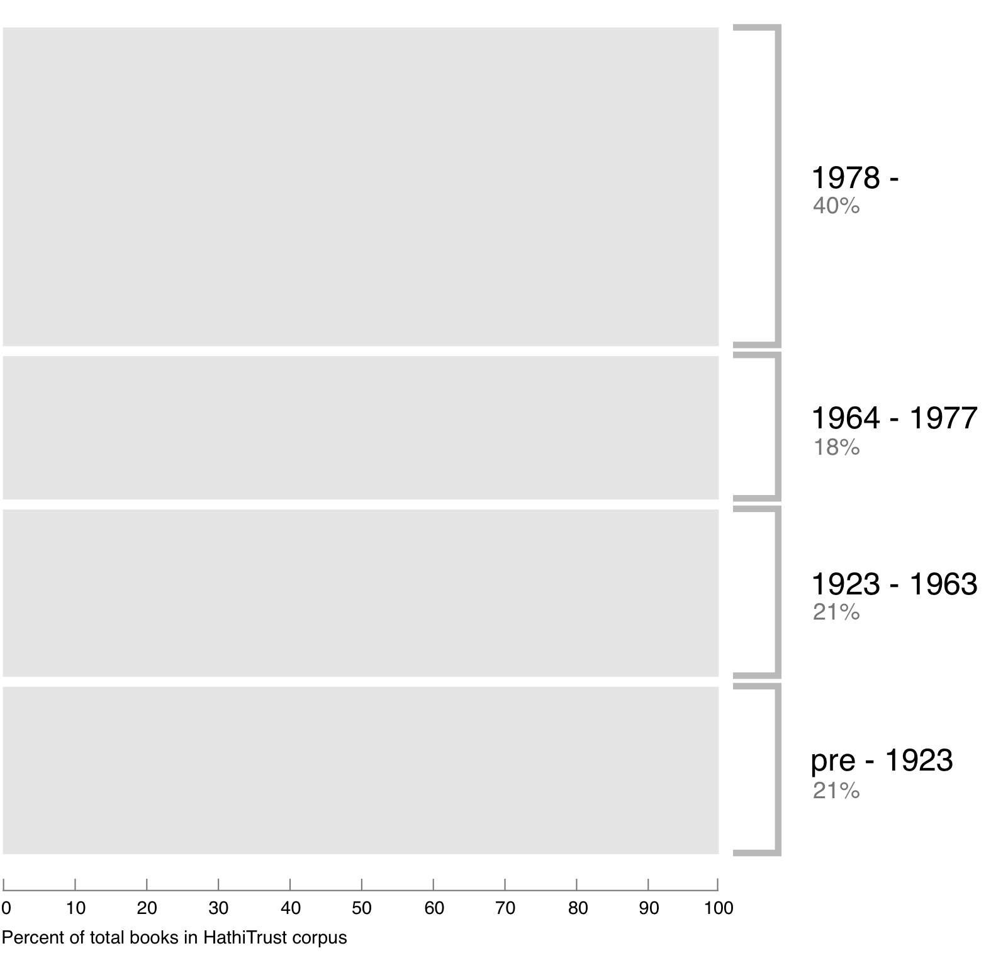
Breakdown of HathiTrust book corpus by publication date
42%
19%
20%
19%
Bibliographic Indeterminacy and the Scale of Problems and Opportunities of "Rights" in Digital Collection Building – 2/2011

Slide 17
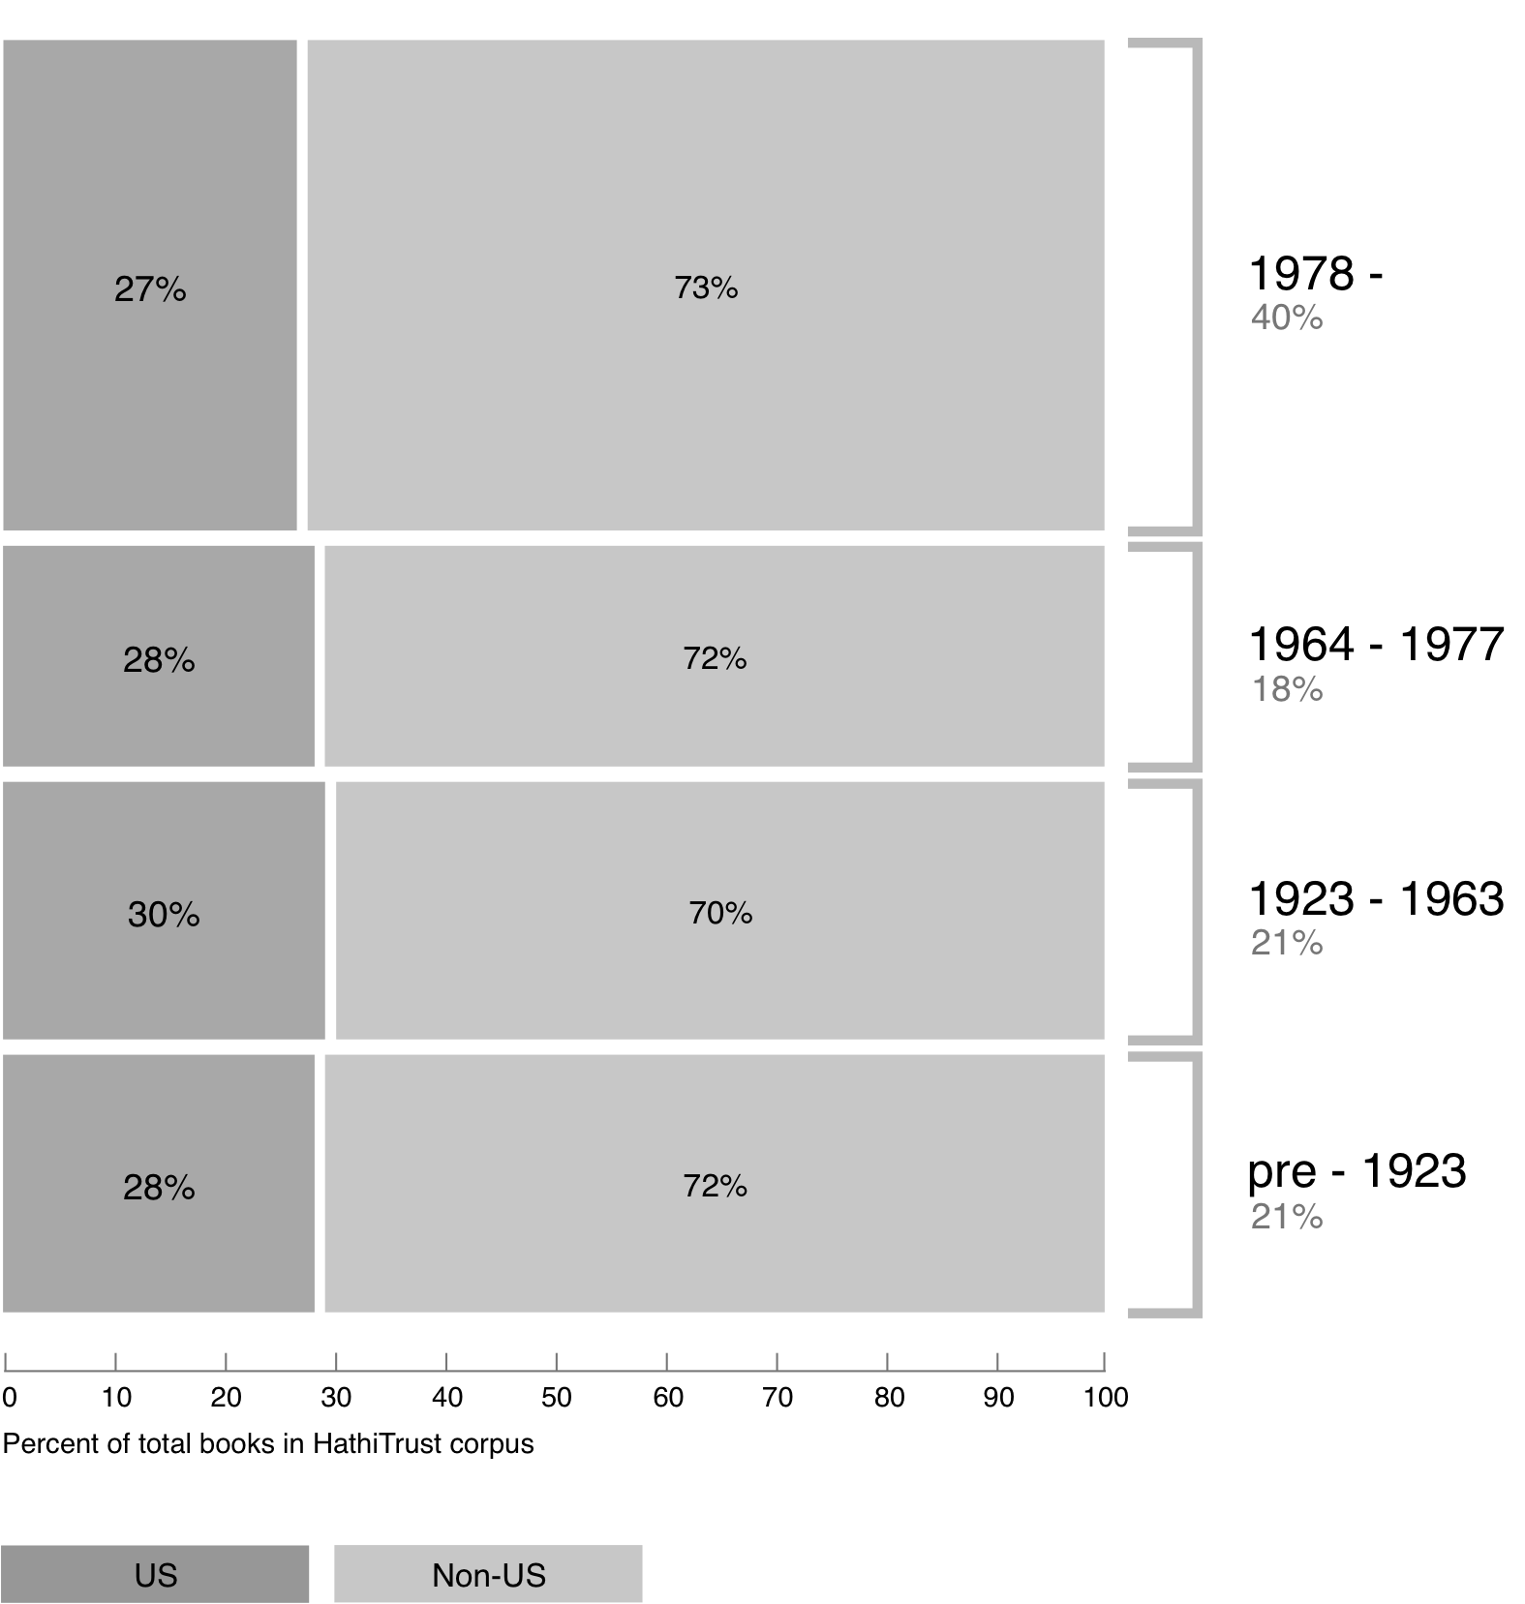
Breakdown of HathiTrust book corpus by publication date
42%
19%
20%
19%

Slide 18
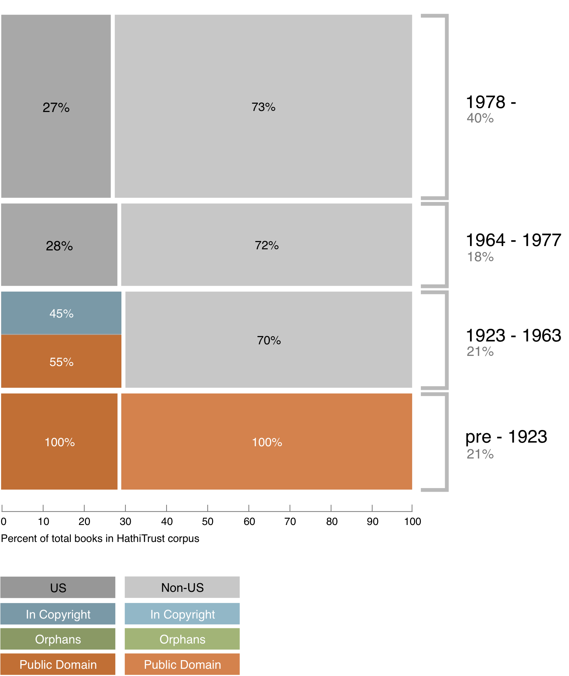
Copyright status of books published pre-1923 and US works published 1923-1963
42%
19%
20%
19%

Slide 19
Copyright status of books published pre-1923 and US works published 1923-1963
42%
19%
20%
19%
Pre-1872 ~ 5%

Slide 20
Copyright status of books published pre-1923 and US works published 1923-1963
42%
19%
20%
19%
Pre-1872 ~ 5%
Public Domain worldwide

Slide 21
Copyright status of books published pre-1923 and US works published 1923-1963
42%
?
19%
20%
19%
Pre-1872 ~ 5%
Public Domain worldwide

Slide 22
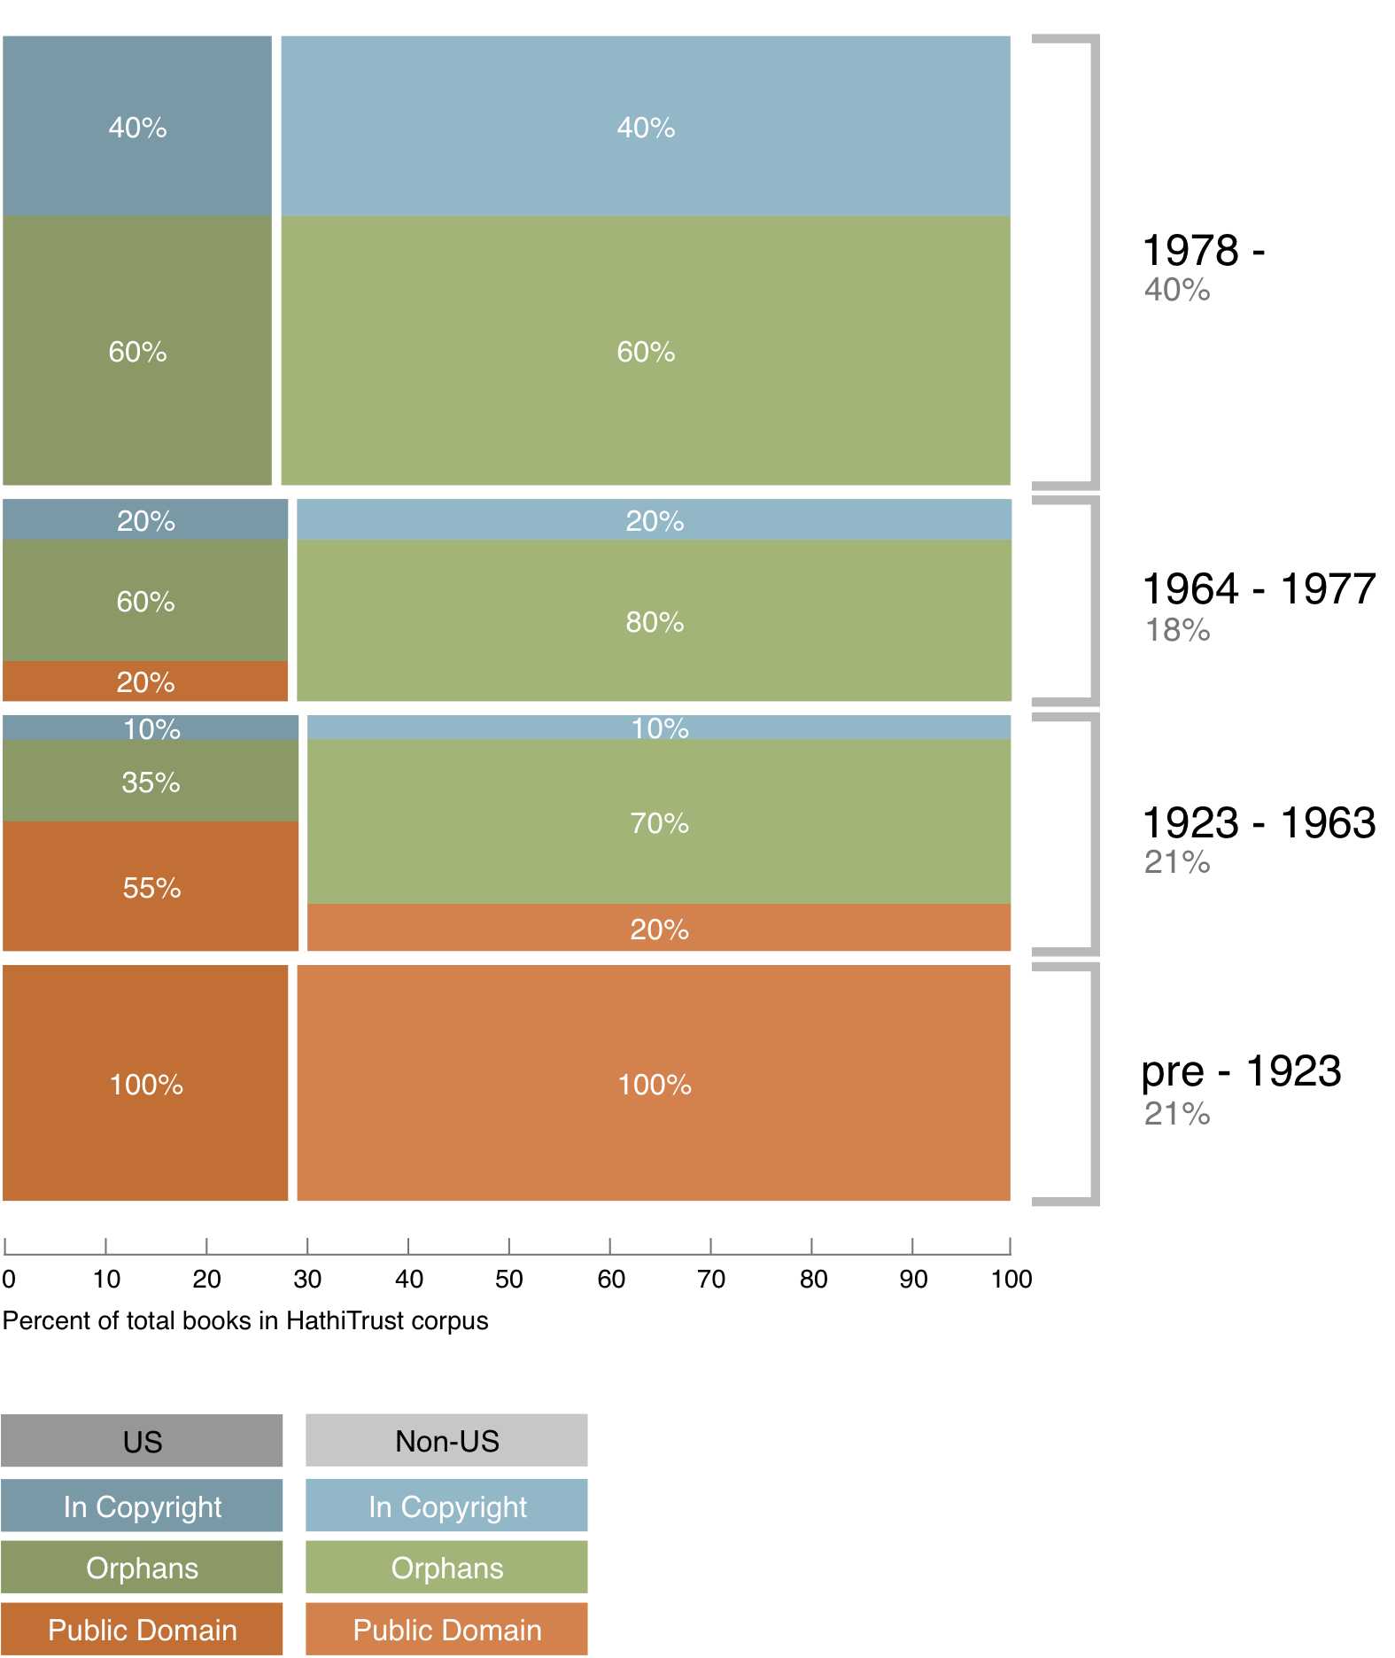
Copyright status of books published pre-1923 and US works published 1923-1963
42%
19%
20%
19%

Slide 23
Copyright status of books published pre-1923 and US works published 1923-1963
42%
In Print ?
19%
20%
19%

Slide 24
Identification
Bibliographic metadata
Automatic and manual rights determination

Slide 25
Automatic Rights Determination
Conducted on all works at time of ingest and when records are modified
  Public domain worldwide
    US works published before 1923, US federal government publications, non-US works published prior to 1872
  Public domain in the United States
    Non-US works published prior to 1923

Slide 26
Manual Rights Determination
IMLS-funded CRMS project
  US-published works 1923-1963
  Conformance with formalities
  Expanding to non-US works
  Double-blind review with expert review for conflicts
  Staff at 4 HathiTrust partner institutions (15 will take part in non-US)
  As of November 2011 ~170,000 reviewed, 87,000 opened

Slide 27
Rights Database
System of Precedence
Manual
Bibliographic (automatic)

Slide 28
Rights Attributes
id | name | type | dscr
1 | pd | copyright | public domain
2 | ic | copyright | in-copyright
3 | opb | copyright | out-of-print and brittle (implies in-copyright)
4 | orph | copyright | copyright-orphaned (implies in-copyright)
5 | und | copyright | undetermined copyright status
6 | umall | access | available to UM affiliates and walk-in patrons (all campuses)
7 | world | access | available to everyone in the world
8 | nobody | access | available to nobody; blocked for all users
9 | pdus | copyright | public domain only when viewed in the US
10 | cc-by | copyright | Creative Commons Attribution
11 | cc-by-nd | copyright | Creative Commons Attribution-NoDerivatives
12 | cc-by-nc-nd | copyright | Creative Commons Attribution-NonCommercial-NoDerivatives
13 | cc-by-nc | copyright | Creative Commons Attribution-NonCommercial
14 | cc-by-nc-sa | copyright | Creative Commons Attribution-NonCommercial-ShareAlike
15 | cc-by-sa | copyright | Creative Commons Attribution-ShareAlike
16 | orphcand | copyright | orphan candidate - in 90-day holding period (implies in-copyright)
17 | cc-zero | copyright | Creative Commons Zero license (implies pd)

Slide 29
Rights Determination Reason Codes
id | name | dscr
1 | bib | bibliographically-derived by automatic processes
2 | ncn | no printed copyright notice
3 | con | contractual agreement with copyright holder on file
4 | ddd | due diligence documentation on file
5 | man | manual access control override; see note for details
6 | pvt | private personal information visible
7 | ren | copyright renewal research was conducted
8 | nfi | needs further investigation (copyright research partially complete; an ambiguous, unclear, or other time-consuming situation was encountered)
9 | cdpp | title page or verso contain copyright date and/or place of publication information not in bib record
10 | cip | condition review and in-print status research was conducted
11 | unp | unpublished work
12 | gfv | Google viewability set at VIEW_FULL
13 | crms | derived from multiple reviews in the Copyright Review Management System (CRMS) via an internal resolution policy; consult CRMS records for details
14 | add | author death date research was conducted or notification was received from authoritative source
15 | exp | expiration of copyright term for non-US work with corporate author

Slide 30
Lawful uses
Access to users who have print disabilities
Section 108 uses of materials
Access to orphan works

Slide 31
Terms of Access
Available to students, faculty, staff of partnering institutions
  On library premises or authenticated into HathiTrust
Partner libraries own a print copy
  One simultaneous user per print copy owned
Users must be on U.S. soil
One page at a time download

Slide 32
Possibilities / Opportunities
Computational research, text mining
Print on demand
Opening access to materials

Slide 33
Vendor Agreements
Agreements with vendors common
Largest impact for HathiTrust is agreement with Google
  Receive digital copy from Google
  Share digital copy with partner libraries
  Prevent download for commercial purposes, redistribution of files, automated or systematic download
Able to make datasets for research purposes to institutions that sign an agreement with Google

Slide 34
Type of work | Searchable (bibliographic and full-text) | Viewable* | Full-PDF download | Print on Demand | Print disabilities* | Preservation uses (Section 108)*
Public domain worldwide | Worldwide | Worldwide | Partners only if scanned by Google, if not, worldwide. | Worldwide | Partners worldwide | N/A
Public domain (US) – Non-US works published between 1872 and 1923. | Worldwide | When accessed from with the United States | Partners in the US if scanned by Google, if not, anyone US | Available within the United States | Partners in the US; partners worldwide where similar laws in effect | N/A
Works that rights holders have opened access to in HathiTrust | Worldwide | Worldwide | Worldwide (if digitized by Google, full-PDF only available if opened with CC license) | Worldwide with permission | Partners worldwide | N/A
Works that are in-copyright or of undetermined status | Worldwide | Not available | Not available | Not available | Partners in the US; partners worldwide where similar laws in effect | Partners in the US; partner worldwide where similar laws in effect
Orphan works | Worldwide | To participating partners | Not available | Not available | Partners in the US | Partners in the US; partners worldwide where similar laws in effect
* Note: Access to in-copyright works is subject to conditions on Terms of Access slide. See here also.

Slide 35
How to find out more
Web site “About” section: http://www.hathitrust.org/about
Twitter: http://twitter.com/hathitrust
Monthly newsletter: http://www.hathitrust.org/updates
  RSS: http://www.hathitrust.org/updates_rss
Contact us: feedback@issues.hathitrust.org

Slide 36
Thank you very much!

