Slide 1
HathiTrust: Reviewing Goals, Accomplishments, and Opportunities for Collective Action
CNI Fall 2011
December 13, 2011
Jeremy York
Project Librarian, HathiTrust

Slide 2
Short-term objectives (1)
 | Then | Now
PageTurner | Yes | Multiple views, embeddable
Branding | Yes (capability there) | Yes
Format validation, migration, and error-checking | On ingest, parity bit validation by system (one instance of storage) | Quarterly audits of all content (two instances with balancing and failover)
APIs (access and integrate information) | OAI | OAI, Bib API, Data API, “hathifiles”
Users who have print disabilities | UM-only | All institutions, keyed off of holdings database

Slide 3
Short-term objectives (2)
 | Then | Now
Public Discovery Interface | No | Bibliographic Catalog (April 2009)
Virtual Collections | Yes | Much improved interface, collections of arbitrary size
Mechanisms for direct ingest of non-Google content | No | Yes, IA + framework for scalable ingest of non-Google

Slide 4
Long-term objectives
 | Then | Now
Compliance with TRAC | No | Yes!
Robust discovery like full-text search | No | Full-text search (November 2009)
Open service definition (for development of access and discovery tools) | No | Data API + Development environment
Support beyond books and journals | No | Pilots with images, audio, MLibrary working system for born-digital
Development of data mining tools | Plans for Data distribution SEASR integration Research Center | Data Distribution Research Center (July 2011)

Slide 5
Goals
 | Then | Now
Reliable and increasingly comprehensive digital archive | ~2 million (MLibrary, Wisc) | ~ 10 million, approaching 50% overlap with ARL institutions
Co-owned | 24 partners | 66 partners (23 institutions depositing, 26 “sustaining” members)
Dramatically improve access…first and foremost meet needs of partners | See above | See above
Preserve materials | Digital materials | All materials
Coordinated print storage | No | Plans
Create and sustain “public good”… mitigate free riders | - | New pricing model, limited access to IC materials
Technical framework…centralized…open | Modular infrastructure | Modular infrastructure + APIs

Slide 6
More
 | Then | Now
Bibliographic Data Management | Yes | New system under development by CDL
Rights determination | Yes bibliographically- and manually-determined | CRMS
Holdings database | No | Structure in place, gathering data

Slide 7
Constitutional Convention (1)
7 ballot initiatives
5 passed
  Print monograph storage
    To establish a print monograph archiving program
  Approval Process for development initiatives
    To invite, evaluate, rank, launch development initiatives
  Governance
    Establishes a 12-member Board of Governors
  U.S. Government Documents
    Coordinated and collective action to expand and enhance access to U.S. federal publications
  Fee for service content deposit

Slide 8
What’s next?
What problems?
  Identification
  Description
  Rights
  Preservation
  Discovery and use

Slide 9
Approach
Collective problems as collective
Web of relationships
Rights
Records
Digital Volumes
Libraries
Print Volumes

Slide 10
Bibliographic Data
Normalization of bibliographic data
  University of Michigan
    Efficiency
  California Digital Library

Slide 11
Copyright Review
IMLS Grant awarded to University of Michigan 2008 to determine copyright status of books published in US between 1923 and 1963
  18 staff members, 4 institutions
    Indiana University
    University of Michigan
    University of Minnesota
    University of Wisconsin
  170k reviewed through CRMS (as of November 2011)
  87,000 (51%) in public domain
Second grant to investigate non-U.S. works
  15 partner institutions involved

Slide 12
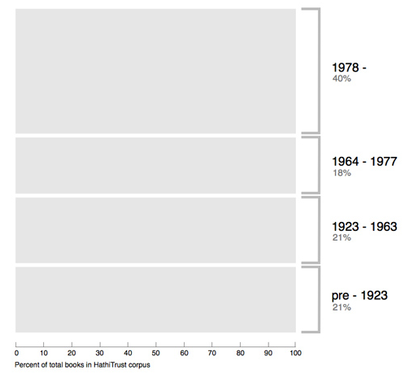
Breakdown of HathiTrust book corpus by publication date
Bibliographic Indeterminacy and the Scale of Problems and Opportunities of "Rights" in Digital Collection Building – 2/2011

Slide 13
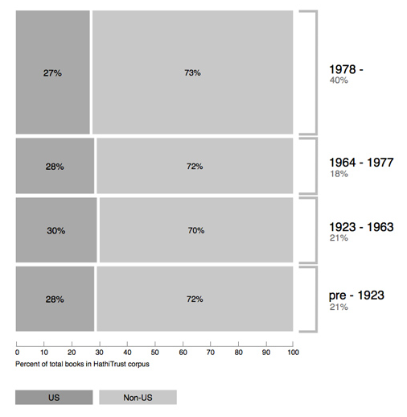
Breakdown of HathiTrust book corpus by publication date

Slide 14
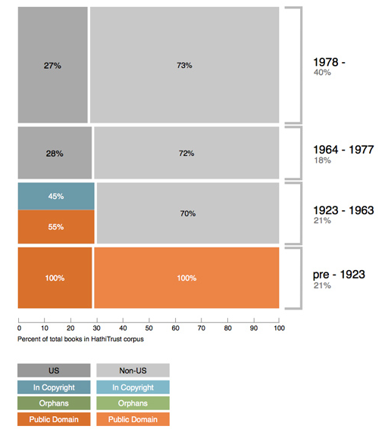
Copyright status of books published pre-1923 and US works published 1923-1963

Slide 15
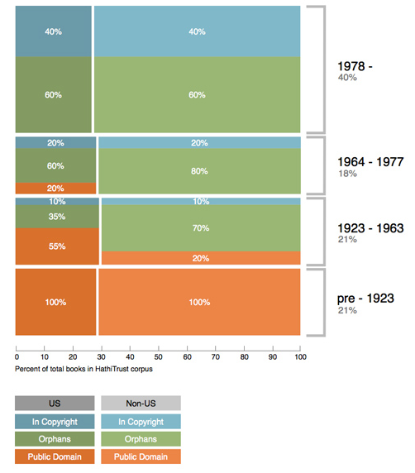
Copyright status of books published pre-1923 and US works published 1923-1963

Slide 16
Holdings Database
Database will
  Serve as basis for new pricing model
  Support expansion of legal uses of materials: preservation uses, access for users who have print disabilities, access to orphan works
  Facilitate individual and collaborative collection development and management operations
  Will also benefit efforts in de-duplication

Slide 17
Print Holdings Database
Volumes institutions own or have owned
  For monographic holdings
    Only print volumes (not microform, etc.)
    OCLC number [required]
    Bib record ID [required]
    Enumeration/chronology, if available
    Condition (e.g., brittle) [optional]
    Holding Status (e.g., current holding, withdrawn, missing, etc.) [optional]
  For serial holdings
    OCLC number [required]
    Bib record ID [required]
    ISSN, if available

Slide 18
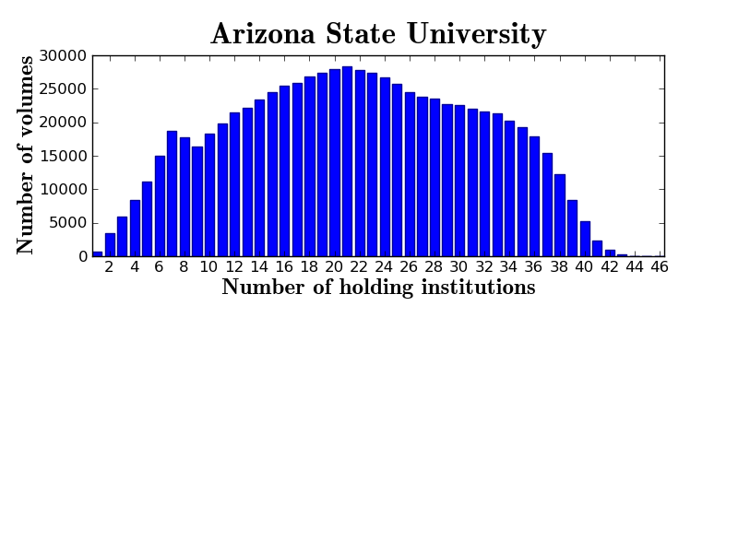

Slide 19
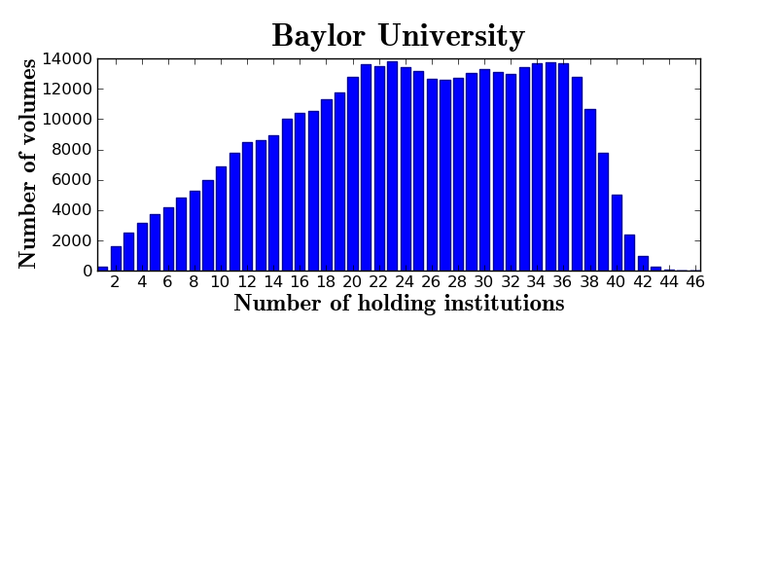
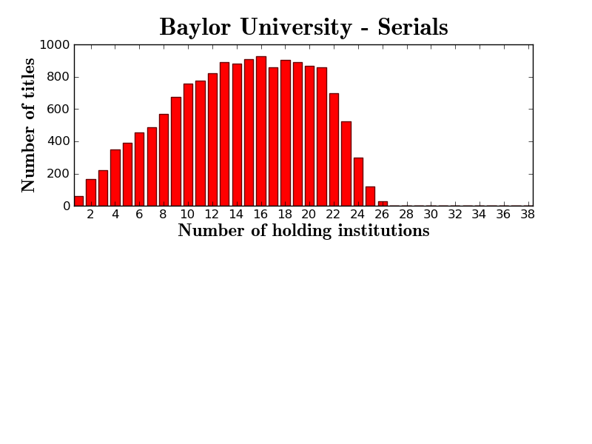

Slide 20
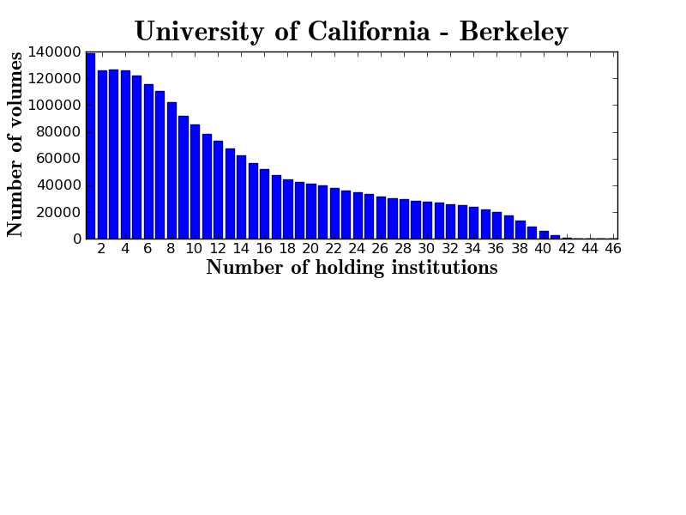

Slide 21
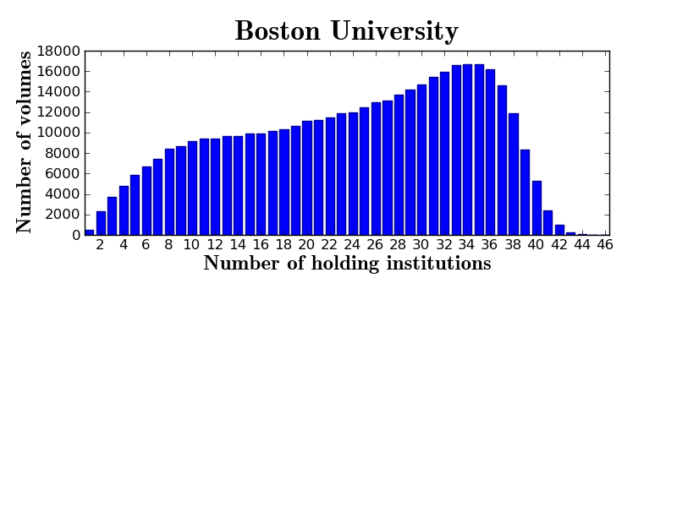

Slide 22
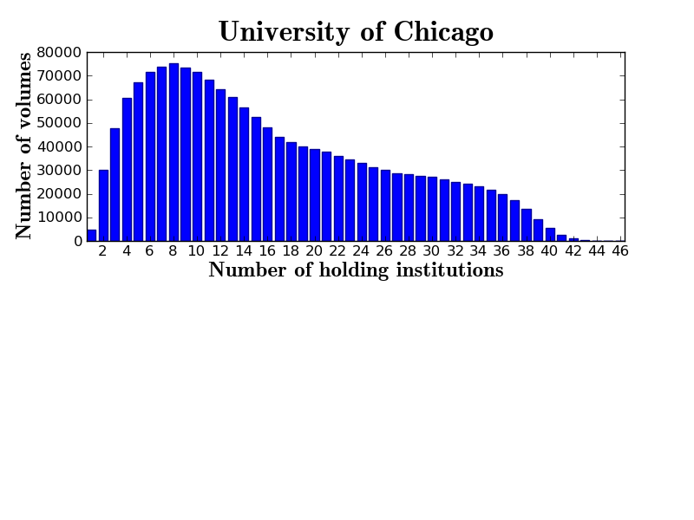
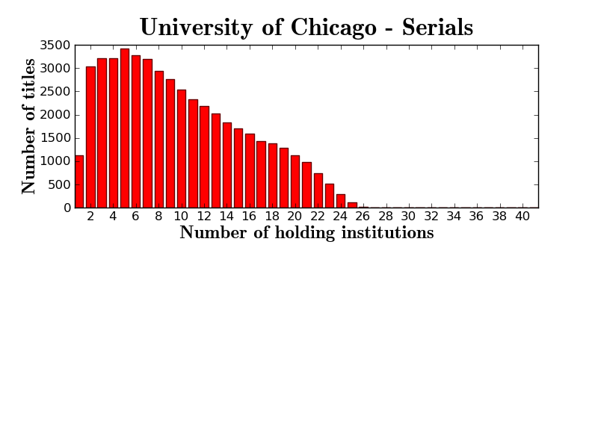

Slide 23
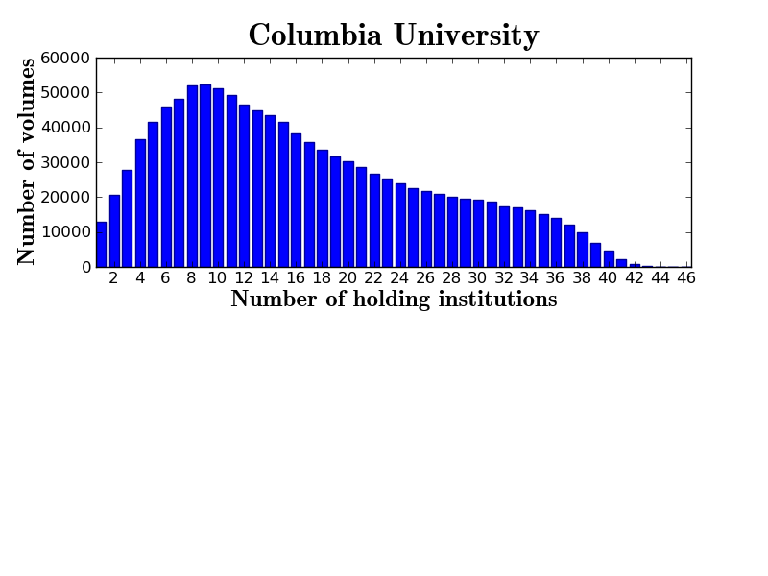
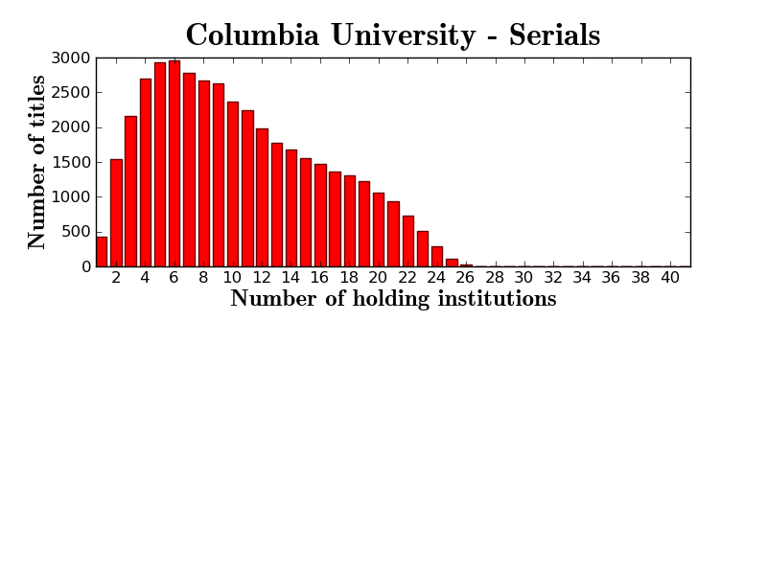

Slide 24
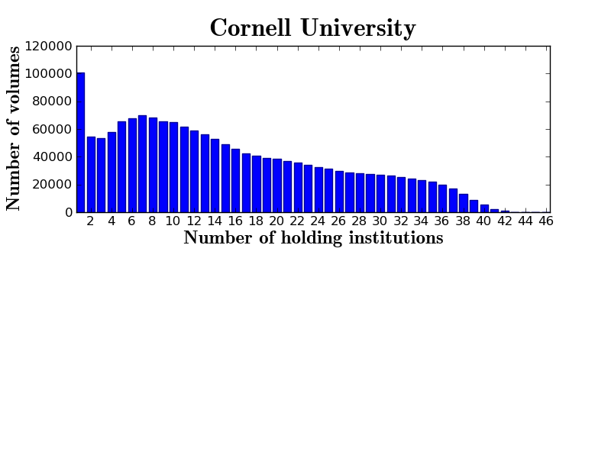
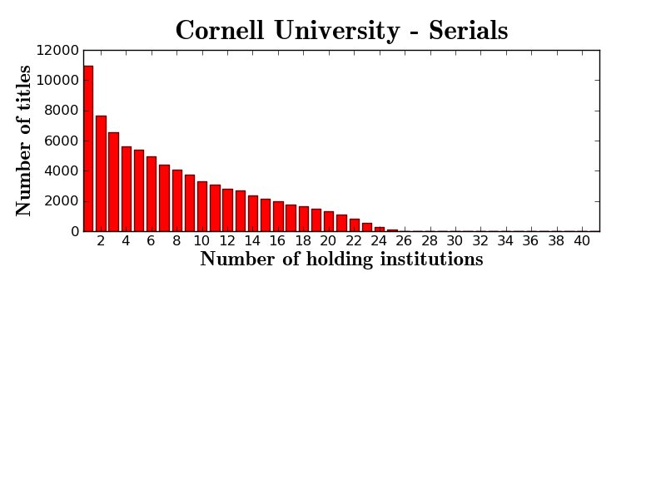

Slide 25
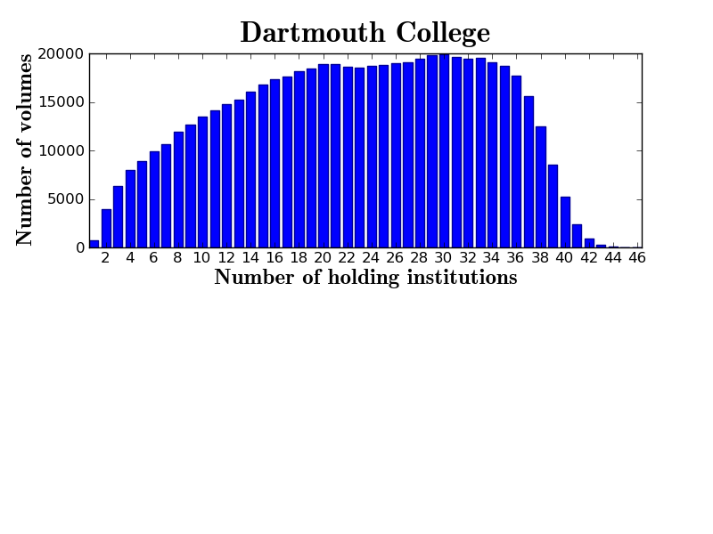
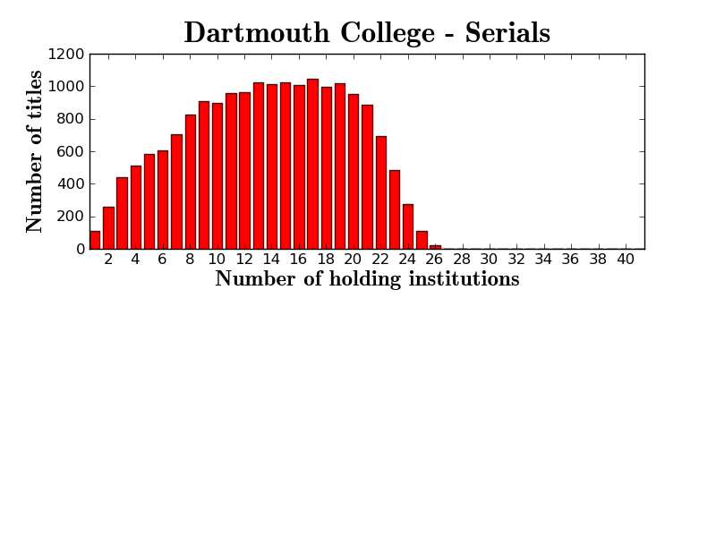

Slide 26
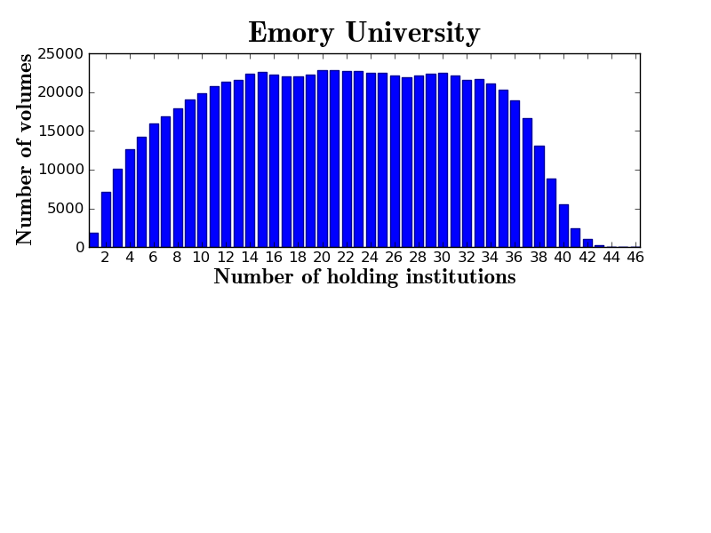

Slide 27
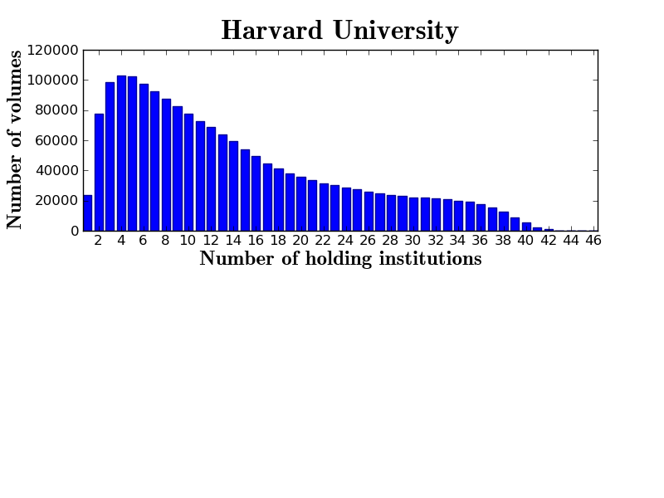
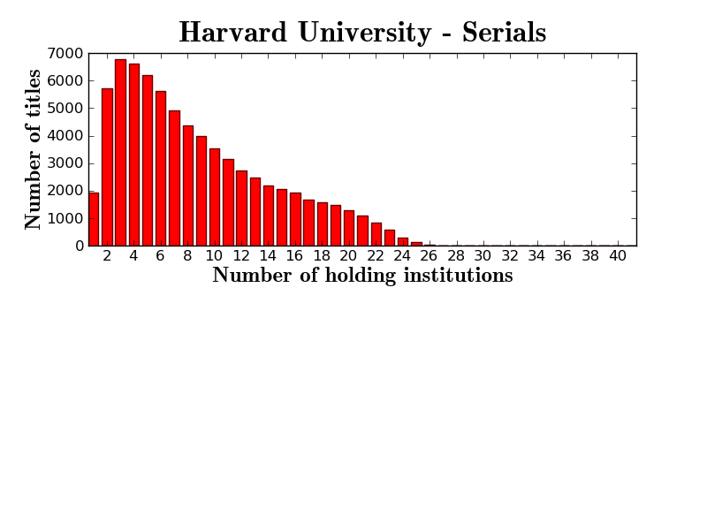

Slide 28
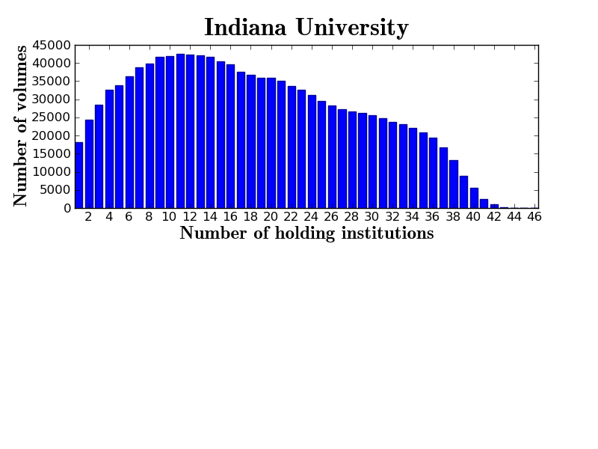
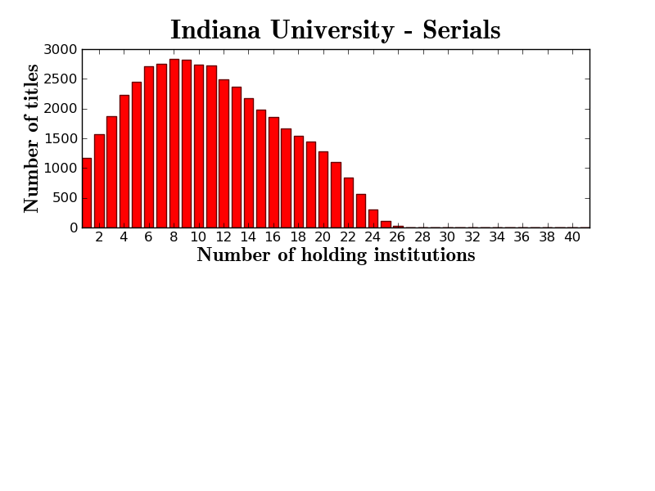

Slide 29
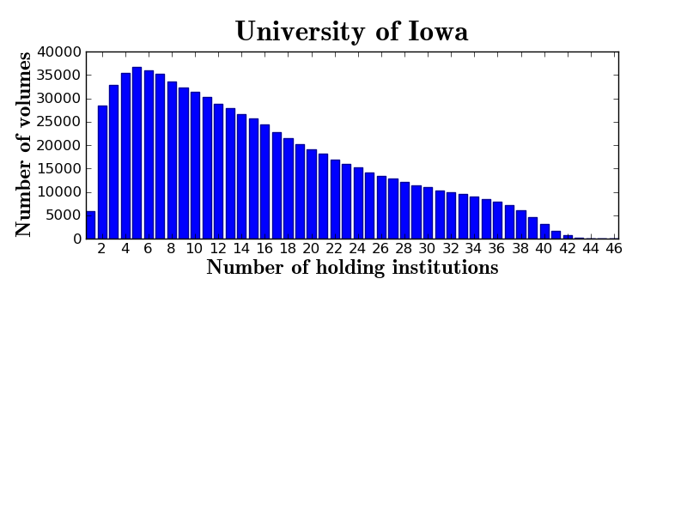

Slide 30
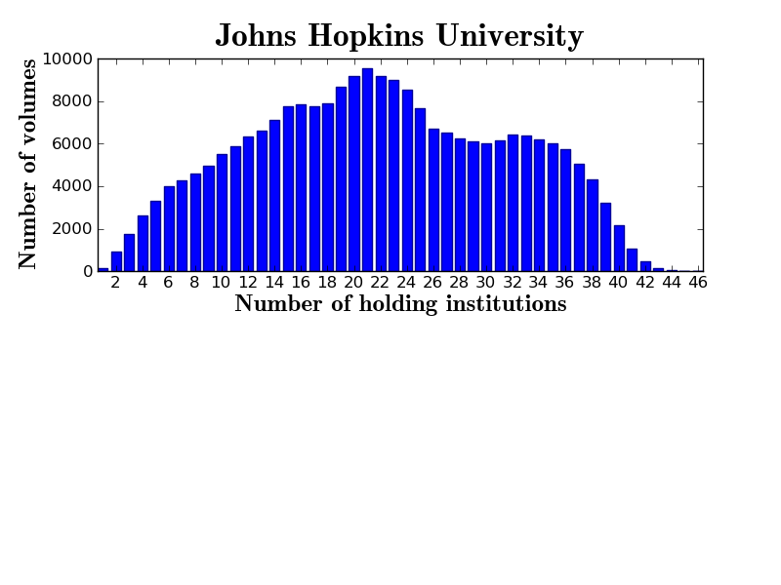
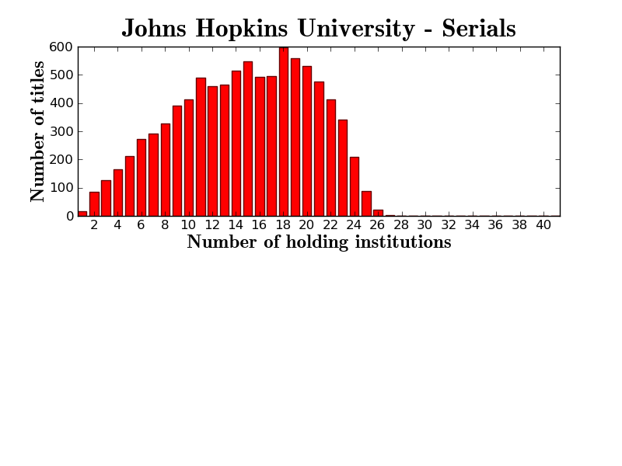

Slide 31
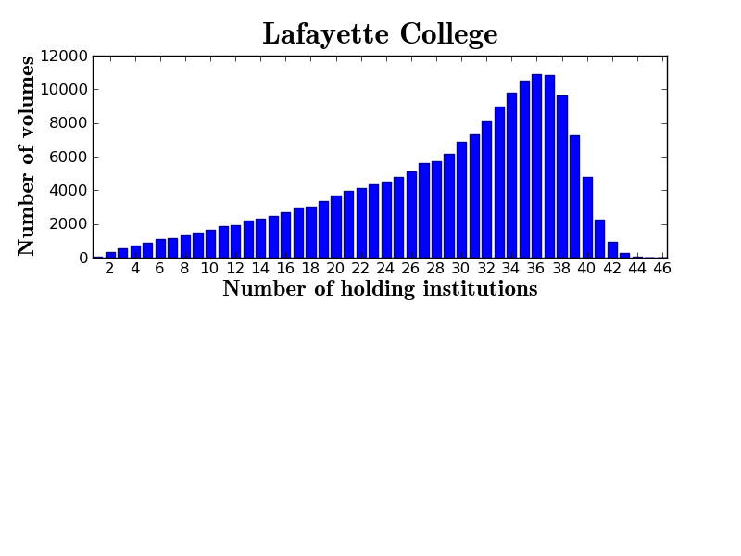
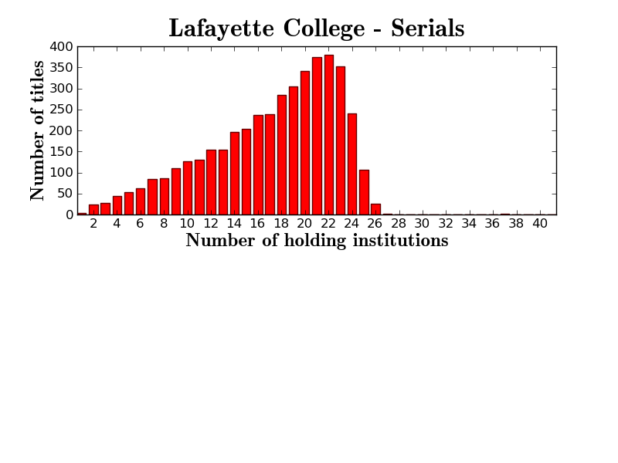

Slide 32
Preservation Infrastructure
Digital and print materials
Definitional elements
Relationships

Slide 33
A global change in the library environment
Academic print book collection already substantially duplicated in mass digitized book corpus
June 2010
Median duplication: 31%
June 2009
Median duplication: 19%
Notes:
33

Slide 34
Digitized Books in Shared Repositories
~3.5M titles
~75% of mass digitized corpus is ‘backed up’ in one or more shared print repositories
~2.5M
Notes:
34

Slide 35
Discovery and Use
Ability to find materials
Situating HathiTrust holdings in broader landscape, working with OCLC
APIs
Assembling corpus for computational research

Slide 36
How does work get done?
Collective work
  e.g., working groups
  Perform the work of the partnership
  Now 40+ people across partner institutions
Distributed work
  Driven by needs of institutions – able to leverage across the partnership
  Projects, e.g. grant work, ingest specifications, page-turner, bibliographic data management
Leverage expertise across institutions

Slide 37
Emerging Governance
Elections Committee (January 1)
Nominations
  Elections Committee select 12 (for 6 seats)
Voting (March 1 – March 15)
6 seats to founding institutions
  2 California, 2 CIC (minus Indiana and Michigan)
  1 Indiana, 1 Michigan
Begin work April 15, 2012

Slide 38
Work going forward
Definitional elements
  Identification
  Description
  Rights
  Holdings
Print archiving, management
Government documents
Discovery and use
  Lawful uses
Quality
Research Center
Beyond books and journals
Publishing
Transitioning to next phase of partnership

Slide 39
How to find out more
Web site “About” section: http://www.hathitrust.org/about
Twitter: http://twitter.com/hathitrust
Monthly newsletter: http://www.hathitrust.org/updates
  RSS: http://www.hathitrust.org/updates_rss
Contact us: feedback@issues.hathitrust.org
Soon: Facebook, blog

Slide 40
Thank you very much!

