Slide 1
HathiTrust Large Scale Search: Scalability meets Usability
wwww.hathitrust.orgww.hathitrust.org
Tom Burton-West
Information Retrieval Programmer
Digital Library Production Service
University of Michigan Library
www.hathitrust.org/blogs/large-scale-search
Code4lib
February 7, 2012

Slide 2
HathiTrust
HathiTrust is a shared digital repository
50+ member libraries
Large Scale Search is one of many services built on top of the repository
Currently about 10 million books
450 Terabytes
Preservation page images;jpeg 2000, tiff (438TB)
OCR and Metadata about (12TB)

Slide 3
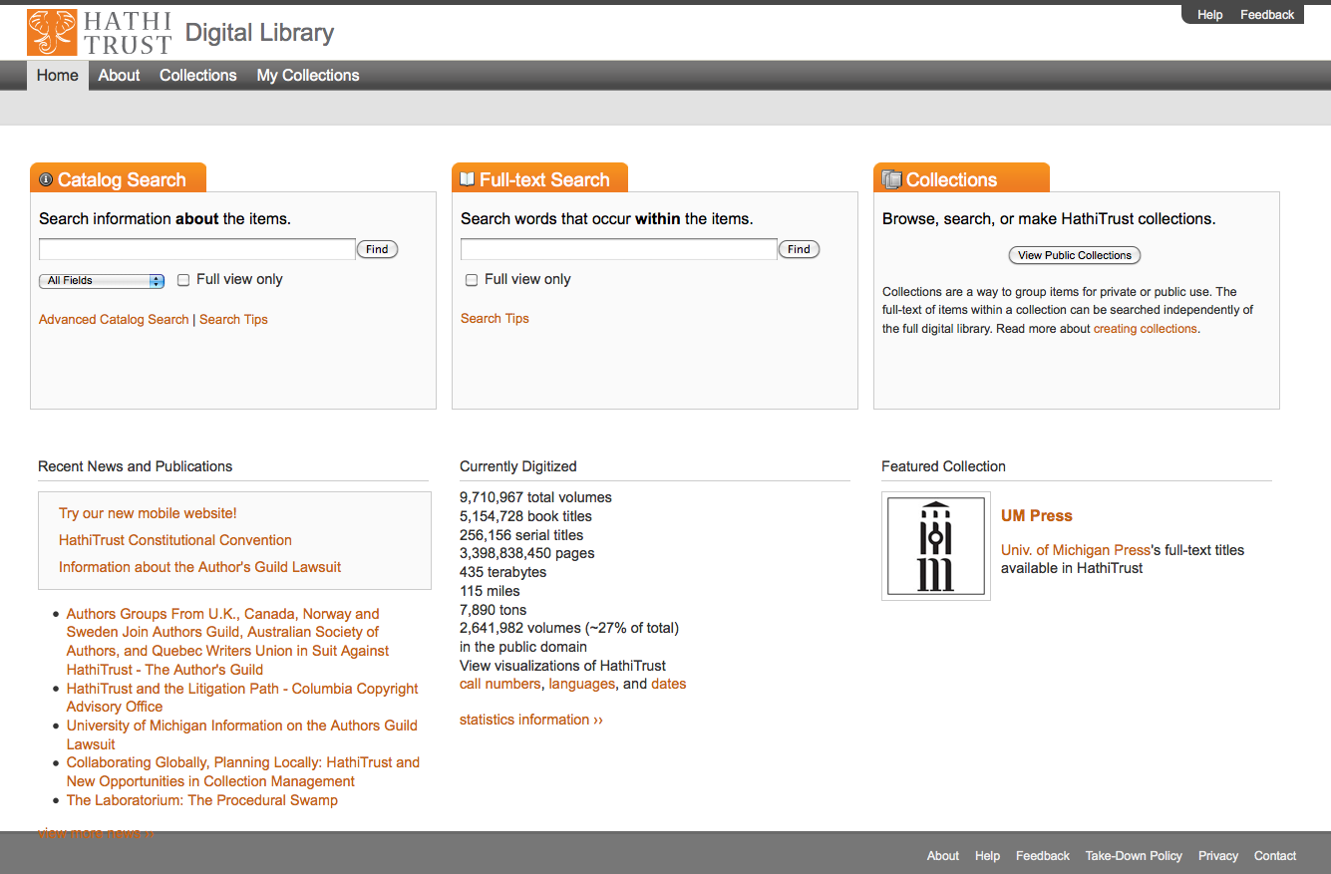

Slide 4
Large Scale Search Challenges
Goal: Design a system for full-text search that will scale to 10 million -20 million volumes (at a reasonable cost.)
Challenges:
Must scale to 20 million full-text volumes
Very long documents compared to most large-scale search applications
Multilingual collection (400+ languages)
OCR quality varies

Slide 5
Long Documents
Average HathiTrust document is 700KB containing over 100,000 words.
Estimated size of 10 million Document collection is 7 TB.
Average HathiTrust document is about 38 times larger than the average document size of 18KB used in Large Research test collections
2 quadrillion words in corpus
Collection | Size | Documents | Average Doc size
HathiTrust | 7 TB | 10 million | 700 KB
TREC GOV2 | 0.456 TB | 25 million | 18 KB
SPIRIT | 1 TB | 94 million | 10 KB
NW1000G-04 | 1.3 TB* | 100 million | 16 KB

Slide 6
Multilingual
400+ languages, 50 languages with over 1,000 volumes.
About 500,000 (5% )of volumes in multiple languages
Currently all languages in one index
Lowest common denominator tokenizing
Some languages are challenging for Information Retrieval
CJK
Arabic
Finnish, Turkish, German

Slide 7
Language Distribution (1)
The top 10 languages make up ~86% of all content
* As of January 4, 2012
Notes:
7

Slide 8
Language Distribution (2)
The next 40 languages make up ~13% of total
(percentages shown are percentage of the 13%)
* As of January 4, 2012
Notes:
8

Slide 9
“Dirty” OCR
The OCR varies in quality
Dirty OCR results in large terms index, and high memory consumption
Dirty OCR affects term statistics and makes some volumes difficult to find
Example: Hebrew characters not recognized

Slide 10
OCR from discolored text

Slide 11
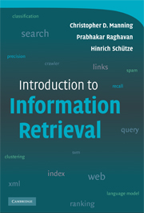
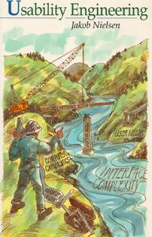
Scalability meets Usability : Challenges
Must have reasonable response time as collection scales to 20 million volumes
Provide good results on the first result page (relevance ranking)
Provide good results for non-English searching
Help users manage large result sets or drill down within them
All the usability issues for search interfaces apply regardless of scale

Slide 12
Response time and scalability
Ideally response time should be under 1 second*
Response time of over 10 seconds distracts users from their tasks*
Early scalability tests with 1 million volumes showed the slowest 1% of queries took from 10 seconds to two minutes
*See: http://www.useit.com/papers/responsetime.html

Slide 13
Response Time Varies with Query
Average: 673
Median: 91
90th: 328
99th: 7,504

Slide 14
Slowest 5% of queries
Slowest 1%

Slide 15
Performance problem: phrase queries too slow
Slowest query: “The lives and literature of the beat generation” took 2 minutes
Cause of slow queries is high disk I/O
Phrase queries require reading the “positions index” from disk
Common words such as “the” occur so frequently that reading their positions list requires many GB of disk I/O

Slide 16
Stop Words
The word “the” occurs 40 billion times in the corpus or about 4 billion times per million documents.
Removing “stop” words (“the”, “of” etc.) not desirable
Couldn’t search for many phrases
“to be or not to be”
“the who”
“man in the moon” vs. “man on the moon”

Slide 17
Stop Words
Stop words in one language are content words in another language
German stopwords “war” and “die” are content words in English
English stopwords “is” and “by” are content words (“ice” and “village”) in Swedish

Slide 18
CommonGrams
Instead of stop words, create bi-grams for common words
Example: Slowest query: “The lives and literature of the beat generation”
“the-lives” “lives-and”
“and-literature” “literature-of”
“of-the” “the-beat” “generation”

Slide 19
Standard index vs. CommonGrams (500,000 document index)
Common Grams
Standard Index
WORD | TOTAL OCCURRENCES IN CORPUS (MILLIONS) | NUMBER OF DOCS (THOUSANDS)
the | 2,013 | 386
of | 1,299 | 440
and | 855 | 376
literature | 4 | 210
lives | 2 | 194
generation | 2 | 199
beat | 0.6 | 130
TOTAL | 4,176
TERM | TOTAL OCCURRENCES IN CORPUS (MILLIONS) | NUMBER OF DOCS (THOUSANDS)
of-the | 446 | 396
generation | 2.42 | 262
the-lives | 0.36 | 128
literature-of | 0.35 | 103
lives-and | 0.25 | 115
and-literature | 0.24 | 77
the-beat | 0.06 | 26
TOTAL | 450

Slide 20
CommonGrams Comparison of Response time (ms)
 | average | median | 90th | 99th | slowest query
Standard Index | 459 | 32 | 146 | 6,784 | 120,595
Common Grams | 68 | 3 | 71 | 2,226 | 7,800
http://www.hathitrust.org/blogs/large-scale-search/slow-queries-and-common-words-part-2
http://www.hathitrust.org/blogs/large-scale-search/slow-queries-and-common-words-part-1

Slide 21
Good Response Time with Large Indexes: Tuning Caching and Memory
Our 10 million document index is about 7 terabytes.
About 700 GB per million documents
Large index means disk I/O is bottleneck
Tradeoff JVM vs OS memory
Solr uses OS memory (disk I/O caching) for caching of postings
Tests showed memory available for disk I/O caching has most impact on response time (assuming adequate cache warming)
Performance tuning
Reduce memory needed by Solr ( 16GB for 3 shards)
termInfosIndexDivisor and termIndexInterval
Leave a large amount of free OS memory for caching (about 50GB per server)
Run cache-warming queries every morning

Slide 22
Full-text search and “search within a book”: Tuning for response time
Full-text search of 10 million books uses the whole book as a Solr document.
Size about 7 TB, so we need to optimize the index for minimal query latency.
We index off-line
We optimize off-line before putting the index into production for searching
“search within a book” indexes a book on-the fly and indexes each page of a book as a Solr document.
Each page has a “book id” field so a search within the book includes a filter query: q1=bacon&fq= book_id=12345
It is optimized for minimal latency between the time the book is sent for indexing and the time the book is available for searching
We keep the index small by deleting it nightly. Average size is about 4GB
We index and serve queries in the same Solr instance
We configure the index to minimize merging
We store the pages so that we can display and highlight snippets

Slide 23
Good Results and Relevance
System magic
query processing
Field weighting 1 (add boosts for matches in author/title/subject metadata)
Query normalization (lower casing, diacritic normalization)
Query expansion (synonyms, stemming, added phrase queries)
Field weighting 2 , weighted query expansion/normalization
query intent guessing
Help users refine their search
user query reformulation (UX issues)
Advanced search including MARC metadata
faceting

Slide 24
Relevance: Recall and Precision
Recall = how many of the relevant results in the collection are returned
Precision = the ratio of relevant results to the total number of results.
Normally for relevance ranking these are measured at some number of results for example p@10 is the precision at 10 results

Slide 25
Precision, Recall and Performance
Generally there is an inverse relationship between precision and recall
Different types of queries favor recall or precision
Compare these queries:
dog OR food (4,431,164) hits
dog AND food (2,006,995) hits
“dog food” (52,784 ) hits

Slide 26
For large-scale search, favor precision over recall
With the full text of over 10 million very long documents large result sets can be a problem
We changed the default Solr Boolean operator from “OR” to “AND”
We allow phrase queries so users can enter very precise queries
We don’t use stop words
We don’t do stemming or use synonyms*

Slide 27
Weighted query expansion to boost recall without hurting precision. (Scalable?)
User query: [ dog food]
Boost query: (“dog food”)^100 OR (“dog food”~200) ^50 OR(dog AND food)^10 OR ( dog OR food) ^1
Dismax query: _query_:"{!edismax
qf='ocr^500+marcfields^10+
pf =ocr^5000+marcfields^40+
pf2=ocr^2500+marcfields^20

Slide 28
Usability v. Scalability: Relevance v.s. performance
Stopwords
(solved with CommonGrams and cache warming)
Adding weighted phrases (dismax pf,pf2,pf3 )
(High disk I/O for OCR phrase searches)
Proximity (words on same page/within 200 words)
(High disk I/O for OCR phrase searches)

Slide 29
Usability v. Scalability: Relevance v.s. performance complicated by multiple languages
truncation operator
3+ billion unique words make truncation computationally intractable
Fuzzy search (helps with dirty OCR)
3+ billion unique words=intractable
Character ngrams (language independent stemming/helps with dirty OCR)
Index size increase of 5-20x not scalable

Slide 30
Stemming and synonyms
Stemming conflates different forms of the same word to increase recall.
cat, cats
organized, organizer, organizing, organization
However over-stemming leads to loss of precision by conflating words with different meanings
Organize, Organic, Organ =>Organ

Slide 31
Stemming and synonyms
Solution: create separate field and combine unstemmed and stemmed field with lower weight for stemmed field
<copyField source=“unstemmed” dest=“stemmed”>
Boost: q=unstemmed^1000+stemmed^50
Problems
Stemming is language-specific
Copying the OCR field would double the index size from 6TB to 12TB
Current hack
Use copyfield stategy with English stemmer for MARC fields only.
Synonyms have similar issues

Slide 32
Normalization, diacritics and thé
We normalize both text and queries. Words are lower-cased and diacritics are removed
Removing diacritics allows searching for non-English words without special keyboard mappings
The French word for tea is thé
This gets normalized to “the” resulting in millions of hits.
The term statistics (idf) and relevance ranking are also affected as thé would normally occur much less frequently than “the”
Copyfield solution would double size of index

Slide 33
Normalization, diacritics and thé
Copyfield solution would double size of index
<copyField source=“diacritics” dest=“noDiacritics”>
Boost: q=diacritics^1000+noDiacritics^50
Possible alternative: create filter that outputs token both with and without diacritics as if they were synonyms (only when there is a diacritic in input)
Search for thé would only match docs containing thé
Search for the would match both the and thé
Index size increase proportional to number of tokens with diacritics

Slide 34
Tokenization and other language-specific issues
With over 400 languages, using language detection and putting each language in a separate field is not feasible
What to do with 500,000 volumes in multiple languages?
We put all languages in one field
Need to use analyzer that works ok for all languages: ICUFilters

Slide 35
Tokenization and other language-specific issues
Some languages such as Chinese, Japanese, Thai, and Vietnamese don’t use spaces to separate words*
Language-specific solutions (SmartChineseAnalyzer)
Script based solutions (CJK tokenizer, ICUTokenizer)
For Chinese there are two character sets: Traditional and Simplified. Users expect to enter terms in one character set and get results in both.
Japanese uses 4 different scripts, the same word may be written in numerous ways
* http://www.hathitrust.org/blogs/large-scale-search/multilingual-issues-part-1-word-segmentation

Slide 36
Tokenization and other language-specific issues
Arabic has very large number of word forms and needs stemming for effective retrieval.
Solr has a very good light stemmer for Arabic
Problem is that other languages such as Urdu use the Arabic script
Other languages (German for example )need decompounding
We can implement script-specific processing but not yet language specific processing

Slide 37
New Features
Help users with large result sets
Facets based on MARC metadata
Advanced search based on MARC metadata
Improve relevance ranking
Use added weight for matches in MARC metadata
“Search within a book” back-end moved to Solr: Relevance ranked results when searching within a book

Slide 38
Facets based on MARC Metadata
1.6 million hits for Bacon!
Bacon the food?
Francis Bacon?
Roger Bacon?

Slide 39
Facets: Scalability and Usability
Facets work best with small value sets of 10-30 values. LCSH provides millions of values!
Solr will show the top N facet values by facet count
The facet counts are based on all the results
In HT full-text search large result sets (over 10,000 records) are common, the facet counts are based on the entire result set, not the most relevant of those 10,000+ records

Slide 40
Irrelevant Facets Jaguar car, Jaguar animal, Jaguar OS?

Slide 41
Relevant facets
http://lucene.472066.n3.nabble.com/Getting-facet-counts-for-10-000-most-relevant-hits-td3363459.html

Slide 42
Advanced search based on MARC metadata and OCR

Slide 43
Advanced search based on MARC metadata and OCR

Slide 44
Relevance ranking with MARC Metadata
Example (simplified)
q= _query_:"{!edismax
qf='ocr^5000
+AnyMARCField^2
+TitleField^50
+AuthorField^80
+SubjectField^50
+mm='100%'
tie='0.9' } bacon“
mm = minimum must match
tie = weight of all fields other than the field with maximum score
* see: http://wiki.apache.org/solr/DisMaxQParserPlugin

Slide 45
Relevance ranking with MARC Metadata
Example (actually used)
q= _query_:"{!edismax qf='ocr^50000+allfieldsProper^2+allfields^1+titleProper^50+title_topProper^30+title_restProper^15+title^10+title_top^5+title_rest^2+series^5+series2^5+author^80+author2^50+issn^1+isbn^1+oclc^1+sdrnum^1+ctrlnum^1+id^1+rptnum^1+topicProper^2+topic^1+hlb3^1+fullgeographic^1+fullgenre^1+era^1+'
pf='title_ab^10000+titleProper^1500+title_topProper^1000+title_restProper^800+series^100+series2^100+author^1600+author2^800+topicProper^200+fullgenre^200+hlb3^200+allfieldsProper^100+' mm='100%25'
tie='0.9' } bacon"
qf = query
pf = query words as a phrase query
pf2 and pf3 = disjunction of 2 and 3 word combinations as phrases
mm = minimum must match
tie = weight of all fields other than the field with maximum score

Slide 46
Tuning Relevance Ranking
How should we adjust the relative weight between OCR (full-text) and MARC fields?
What are the Solr settings affecting ranking?
How do you tell when one group of settings provides more relevant results than another
Need to test against some set of queries to insure that improving results for one query doesn’t make results for other queries worse

Slide 47
Solr relevance knobs
Query expansion
Field weighting
Boost queries or dismax queries
Expert
length normalization
SweetSpotSimilarity
Solr relevance formula tf *idf
write custom Similarity class or use Solr 4.0/Trunk

Slide 48
Testing Relevance
Use test collection and relevance judgements
TREC/XML book track*
Are queries similar to your user’s queries?
Is collection similar to your collection?
What is the appropriate metric (P@10) other real-world issues?
Relevance is complicated and different users will consider different sets of documents relevant
Ambiguous queries
*https://inex.mmci.uni-saarland.de/tracks/books/

Slide 49
Testing Relevance
Use clickthrough logs and A/B testing*
clickthrough not always measure of relevance
A/B testing controversial in library settings
Use interleaving to overcome order effects
Usability testing?
Beta testers ?
*Radlinski, F., Kurup, M., & Joachims, T. (2008). How does clickthrough data reflect retrieval quality? In Proceeding of the 17th ACM conference on Information and knowledge management, CIKM '08 (pp. 43–52). New York, NY, USA: ACM. doi:10.1145/1458082.1458092

Slide 50
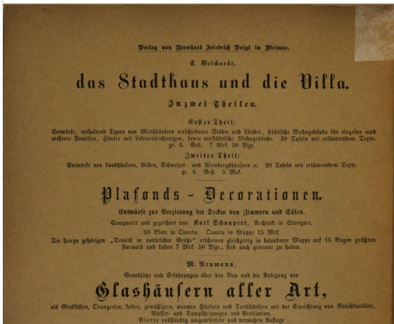
“Dirty” OCR: Causes
noise, varible ink, bleedthrough, markings by users
tight bindings affect scanning, words near binding or edge can be distorted
background color, fading, water or mold damage/stains
bad scanning, blurred, operator scanning
400+ languages (x volumes in more than one language)
* Feng and Manmatha (2010?)

Slide 51
“Dirty” OCR: Effects on OCR
OCR engine produces no OCR for page or volume
OCR engine misrecognizes language/script and produces garbage
OCR engine interprets images as text and produces garbage

Slide 52
“Dirty” OCR: Effects on Search
Large number of garbage terms result in over 3 billion unique terms per index.
blew up lucene *
increased memory requirement to 32GB until we changed termIndexInterval
MultiTerm queries (wildcard, prefix/truncation) performance unusable
Problem for spelling suggestion
Documents with lots of garbage from images have incorrect document length normalization
* http://www.hathitrust.org/blogs/large-scale-search/too-many-words-again

Slide 53
“Dirty” OCR: Effects on Search
Missing OCR text not retrievable, some volumes not searchable
Incorrectly recognized text not retrievable
Term statistics and relevance ranking skewed
If students underline important parts and underlines cause misrecognition, important parts less retrievable

Slide 54
“Dirty” OCR:Solutions?
IR techniques for retrieving dirty OCR such as ngrams, fuzzy matching, error correction and query garbling have disappointing performance or are not scalable (TREC 4&5 and Savoy 20xx)
Removing hapax (terms that occur only once) will likely remove huge amount of real words including proper names
Correction algorithms are designed for single language
heuristics will remove some fraction of bad words but must work with 400 languages
Google improves OCR engine and re-OCR’s in a 2 year cycle

Slide 55
Collection Builder

Slide 56
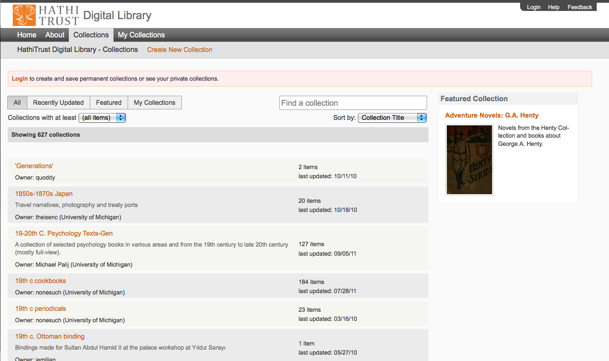
Collection Builder

Slide 57
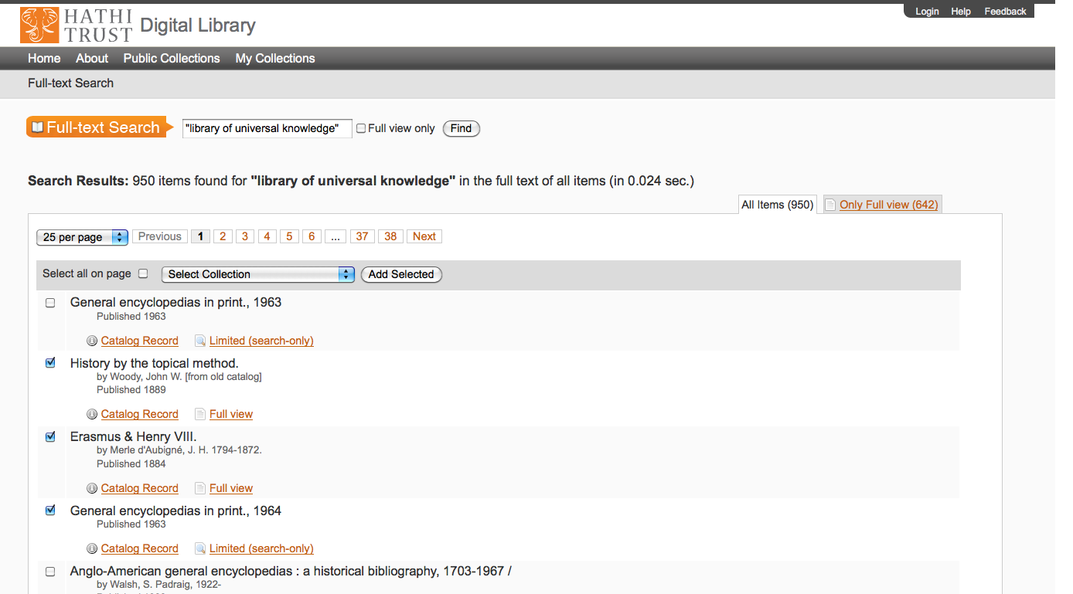
Collection Builder

Slide 58
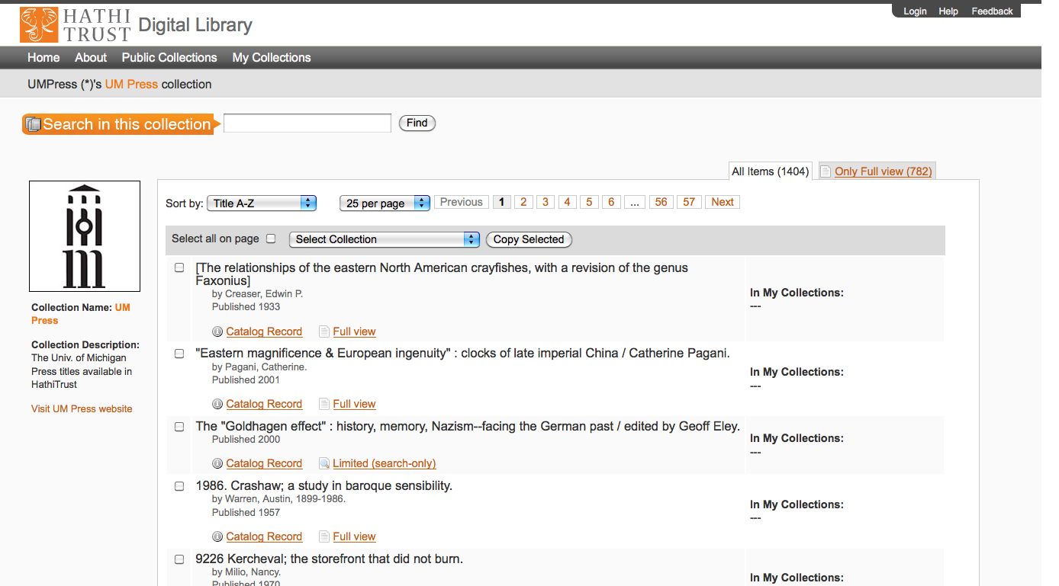

Slide 59
Collection Builder
http://babel.hathitrust.org/cgi/mb
Need to update one field, i.e. add user’s collection number to the collection field
Solr needs to re-index whole record including 800MB+ of OCR
Solution #1 Keep collection-unique id table in database send query with ids in collection to Solr
q1=ocr:bacon AND id:(2 OR 5 …or 1023)
not scalable
This is one of many use cases for the ability to merge a list of ids from the result of a database or other external system search into a Solr query.
See: http://lucene.472066.n3.nabble.com/filter-query-from-external-list-of-Solr-unique-IDs-tc1709060.html#a1709716
https://issues.apache.org/jira/browse/SOLR-139
https://issues.apache.org/jira/browse/LUCENE-1879

Slide 60
Collection Builder
Solution 2
Bite the bullet and update the entire record every time someone add a record to their collection. i.e. update the coll_ids field
To minimize the latency between updating a record and having it be available for searching we needed a separate small Solr index configured/optimized for minimal update latency

Slide 61
Collection Builder
New requirement: medium to large collections i.e. 10,000 – 100,000 volumes
Solution 3/Current hack
Eliminate small Solr and use same Solr as full-text search
If collection is under 1000 (1024) items in size store list of unique ids in database and send id list to Solr. Collection update just changes a row in the database and requires no Solr re-indexing so immediate collection update
If collection is over 1000 items, add the items to the nightly indexing queue with an update to the coll_ids field. Message to user saying they will have to wait overnight to be able to search new items

Slide 62
Thank You !
Tom Burton-West
tburtonw@umich.edu
www.hathitrust.org/blogs/large-scale-search

