Slide 1
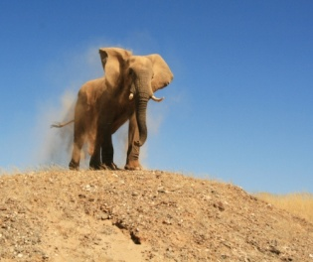
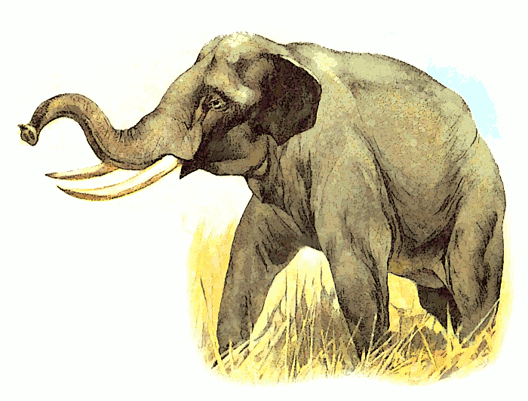
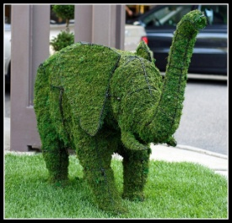
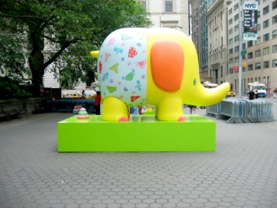
HathiTrust Constitutional Convention Session #2: Report on 3-year review and Q & A
HATHITRUST
A Shared Digital Repository
Ed Van Gemert, Chair, Strategic Advisory Board
Patricia Cruse, Member, Strategic Advisory Board

Slide 2
Roadmap for session #2
SAB role in the Constitutional Convention
HathiTrust’s governance today
Methodology
Three strands of inquiry
Inquiry 1: short-term functional objectives (value today)
Inquiry 2: .looking forward
Inquiry 3: the value to non-members
Potential next steps and discussion

Slide 3
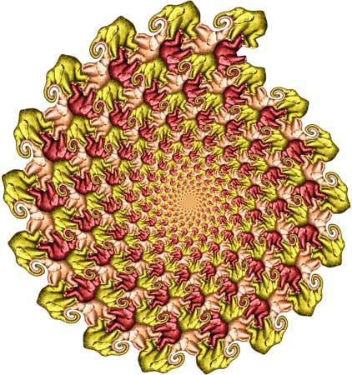
Strategic Advisory Board’s (SAB) role in the Constitutional Convention
Review the HathiTrust effort in preparation for the proposed October 2011 meeting of members
Conduct review so SAB can produce a formal analysis in early 2011 and prior to March 2011
Report conducted to shape constitutional convention
http://www.polytess.info/

Slide 4
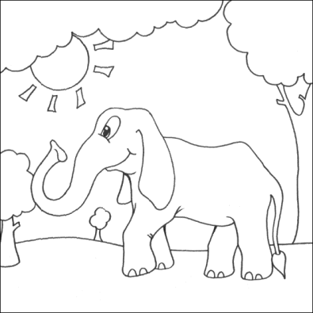
Governance: Executive Committee, charge
Defines mission, goals, and objectives
Reviews recommendations of the Strategic Advisory Board
Manages budget and finances
Determines strategic directions
Demonstrates leadership
Communicates about HathiTrust
Oversees HathiTrust operations through the appointment of an Executive Director
In coordination with the Executive Director, establishes operational working groups
Oversees… the HathiTrust Research Center
http://www.myfreecolouringpages.com

Slide 5
Governance: Executive Committee, membership
Composition
Members
senior officers from the founding institutions:
Indiana University (two members)
University of California (two members)
University of Michigan (two members)
Committee on Institutional Cooperation (CIC) (one member)
HathiTrust Executive Director.
Strategic Advisory Board chair (ex officio)
each member is appointed for the duration of the first five-year
subsequent governance will be determined through the Constitutional Convention
Paul Courant, University of Michigan
Laine Farley, California Digital Library
Brenda Johnson, Indiana University
Paula Kaufman, University of Illinois
John Leslie King, University of Michigan
Brian Schottlaender, University of California, San Diego
Ed Van Gemert (ex officio, as Chair of the Strategic Advisory Board), University of Wisconsin, Madison
Brad Wheeler, Indiana University
John Wilkin (as Executive Director), University of Michigan

Slide 6
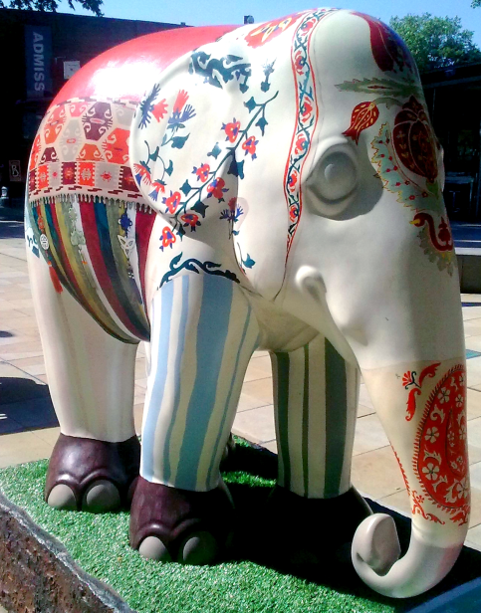
Governance: Strategic Advisory Board charge
Reviews the HathiTrust development agenda and considers implications
Reports to the Executive Committee recommended alterations to the development agenda
Develops position papers for the academic library community
Works with the Executive Committee to develop policies for HathiTrust and its partners
http://lachatnoir.wordpress.com/tag/asian-elephants/

Slide 7
Governance: Strategic Advisory Board membership
Composition
Members
Senior professional staff
four representatives from the CIC and
three representatives from the University of California
HathiTrust Executive Director (ex officio)
Internal CIC and UC bodies appoint and review on an annual basis
Ed Van Gemert (chair), University of Wisconsin, Madison
John Butler, University of Minnesota
Patricia Cruse, California Digital Library
Todd Grappone, University of California, Los Angeles
Julia Kochi, University of California, San Francisco
Sarah Pritchard, Northwestern University
Paul Soderdahl, University of Iowa
John Wilkin, Executive Director (ex officio)
Bob Wolven, Columbia University

Slide 8
HathiTrust’s goals - refresher
To contribute to the common good by collecting, organizing, preserving,
communicating and sharing the record of human knowledge
build a reliable and increasingly comprehensive digital archive of library materials converted from print that is co-owned and managed by a number of academic institutions.
improve access to these materials in ways that, first and foremost, meet the needs of the co-owning institutions.
preserve these important human records by creating reliable and accessible electronic representations.
stimulate redoubled efforts to coordinate shared storage strategies among libraries, thus reducing long-term capital and operating costs of libraries associated with the storage and care of print collections.
create and sustain this “public good” in a way that mitigates the problem of free-riders.
create a technical framework that is simultaneously responsive to members through the centralized creation of functionality and sufficiently open to the creation of tools and services not created by the central organization.

Slide 9
SAB review activities – the process
A subset of the SAB interviewed a slate of consultants
SAB recommended Ithaka S+R to the Executive Committee
Ithaka S+R was contracted to perform the research and to write the report
http://www.elfwood.com/~mcdonald2/Pink-Elephants-Road-Rage.3481277.html

Slide 10
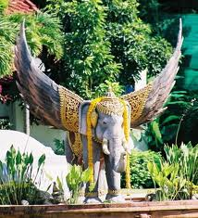
We asked Ithaka S+R to challenge our thinking
Is there a segment of the work that particularly exemplifies effective collaboration?
Is there an opportunity that HathiTrust should not let slip away?
Is there a correction that should be made promptly?
Where do we see the “value” of HathiTrust?
Is HathiTrust a mechanism for shared library planning today?

Slide 11
Ithaka’s research methods
Quantitative
Qualitative
Ithaka S+R conducted a web based survey of the membership
attitudinal and factual questions
46 out of 52 libraries responded = 88%
Survey open 18 May – 3 June
Followed up with in-depth interviews with members, non-members and scholars
clarify responses and follow-up questions
8 survey respondents and 14 of 25 non-participants

Slide 12
Ithaka S+R: three strands of inquiry
How participating libraries perceive the value of HathiTrust (short-term functional objectives)
Participating libraries’ expectations for operating and governing the initiative moving forward
The views of libraries that do not yet participate in HathiTrust
We did not ask Ithaka S+R to examine HathiTrust’s technical infrastructure

Slide 13
Roadmap for session #2
SAB role in the Constitutional Convention
HathiTrust’s Governance today
Methodology
Three strands of inquiry
Inquiry 1: Short-term functional objectives (value today)
Inquiry 2: Looking forward
Inquiry 3: the value to non-member
Potential next steps and discussion

Slide 14
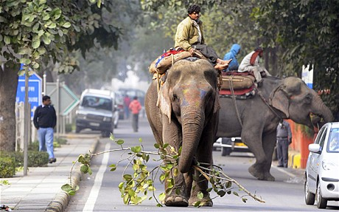
Inquiry 1: The value of HathiTrust
HathiTrust is valued as a preservation service
An alternative that is “growing from, and led by the research community”
Goodwill and enthusiasm for the HathiTrust initiative and mission
http://www.telegraph.co.uk/news/worldnews/asia/india/8259869/Calls-for-elephants-to-be-banned-in-New-Delhi.html

Slide 15
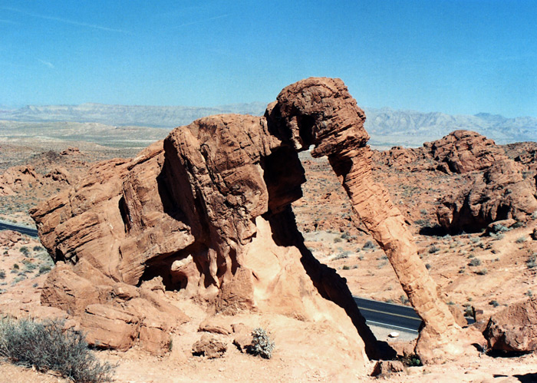
Inquiry 1: The value examined further
HathiTrust’s progress in meeting objectives:
The importance of branding – there is no place like home
The user interface needs a few tweaks
The promise/expectation of realizing cost savings and/or cost avoidance
The potential -- can HathiTrust help manage print collections?
http://www.americansouthwest.net/nevada/valley_of_fire/elephant-rock2_l.html

Slide 16
Inquiry 2: Looking forward and member expectations
Getting the right mix of local and centralized staffing is crucial
High-level of resource contribution
Is it sustainable to build an organization based on volunteer effort?
How best to govern HathiTrust
Desire for consultation and input
Establish a process for nominating and selecting representatives
The fundamental governance issues are:
More contribution – should have more weight
Role of smaller contributors

Slide 17
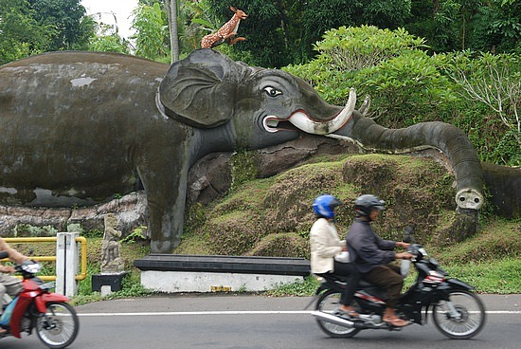
Inquiry 2: Looking forward and member expectations
Need to better define objectives for 3-5 years
Clear communication about strategic objectives
Cost model is complicated
Need for more discussion
Need to define intersections with other digital library initiatives

Slide 18
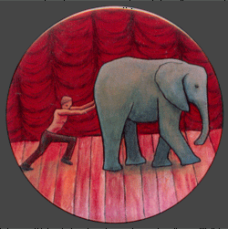
Inquiry 3: the value to Non-members
Strong interest in the mission and preservation function of HathiTrust from libraries with rare and unique collections
There is a perception that HT does not have an effective ingest method for special collections
International libraries are hesitant to join a U.S. based initiative
Costs: regional and consortial digital library projects see HT as duplicative
Pushing the Elephant
Faculty Award, English Department Dr Thomas Batt

Slide 19
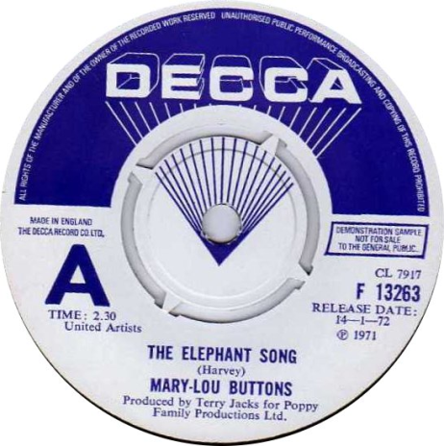
Building on the value of HathiTrust
More actively pursue permissions from publishers
Possibly focus on ingesting special collections materials
Develop a strategy for tangible materials
Demonstrate the sustainability and feasibility of the new cost model
Needs for tools for scholars to use curated collections
http://www.polytess.info/

Slide 20
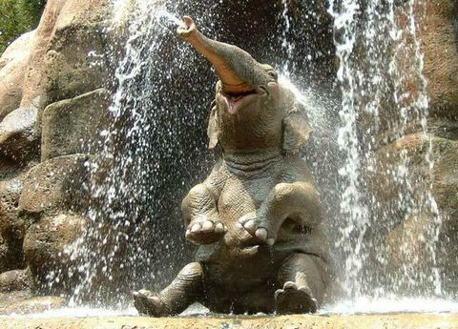
Potential next steps and discussion
Strength is our membership
To move beyond foundational activities the organization will require fully leveraging all of its shared resources
The viability of HathiTrust is dependent upon the expertise and the resources of its members
Clearly define objectives for the next 3-5 years
Enhance the pipeline of information to partner libraries
Examine the governance structure

