Slide 1
Big Collections in an Era of Big Copyright: Practical Strategies for Making the Most of Digitized Heritage
Jeremy York
DLF Fall Forum
October 28, 2014
Unless otherwise noted, these slides and their contents are licensed under a Creative Commons Attribution Unported License.

Slide 2
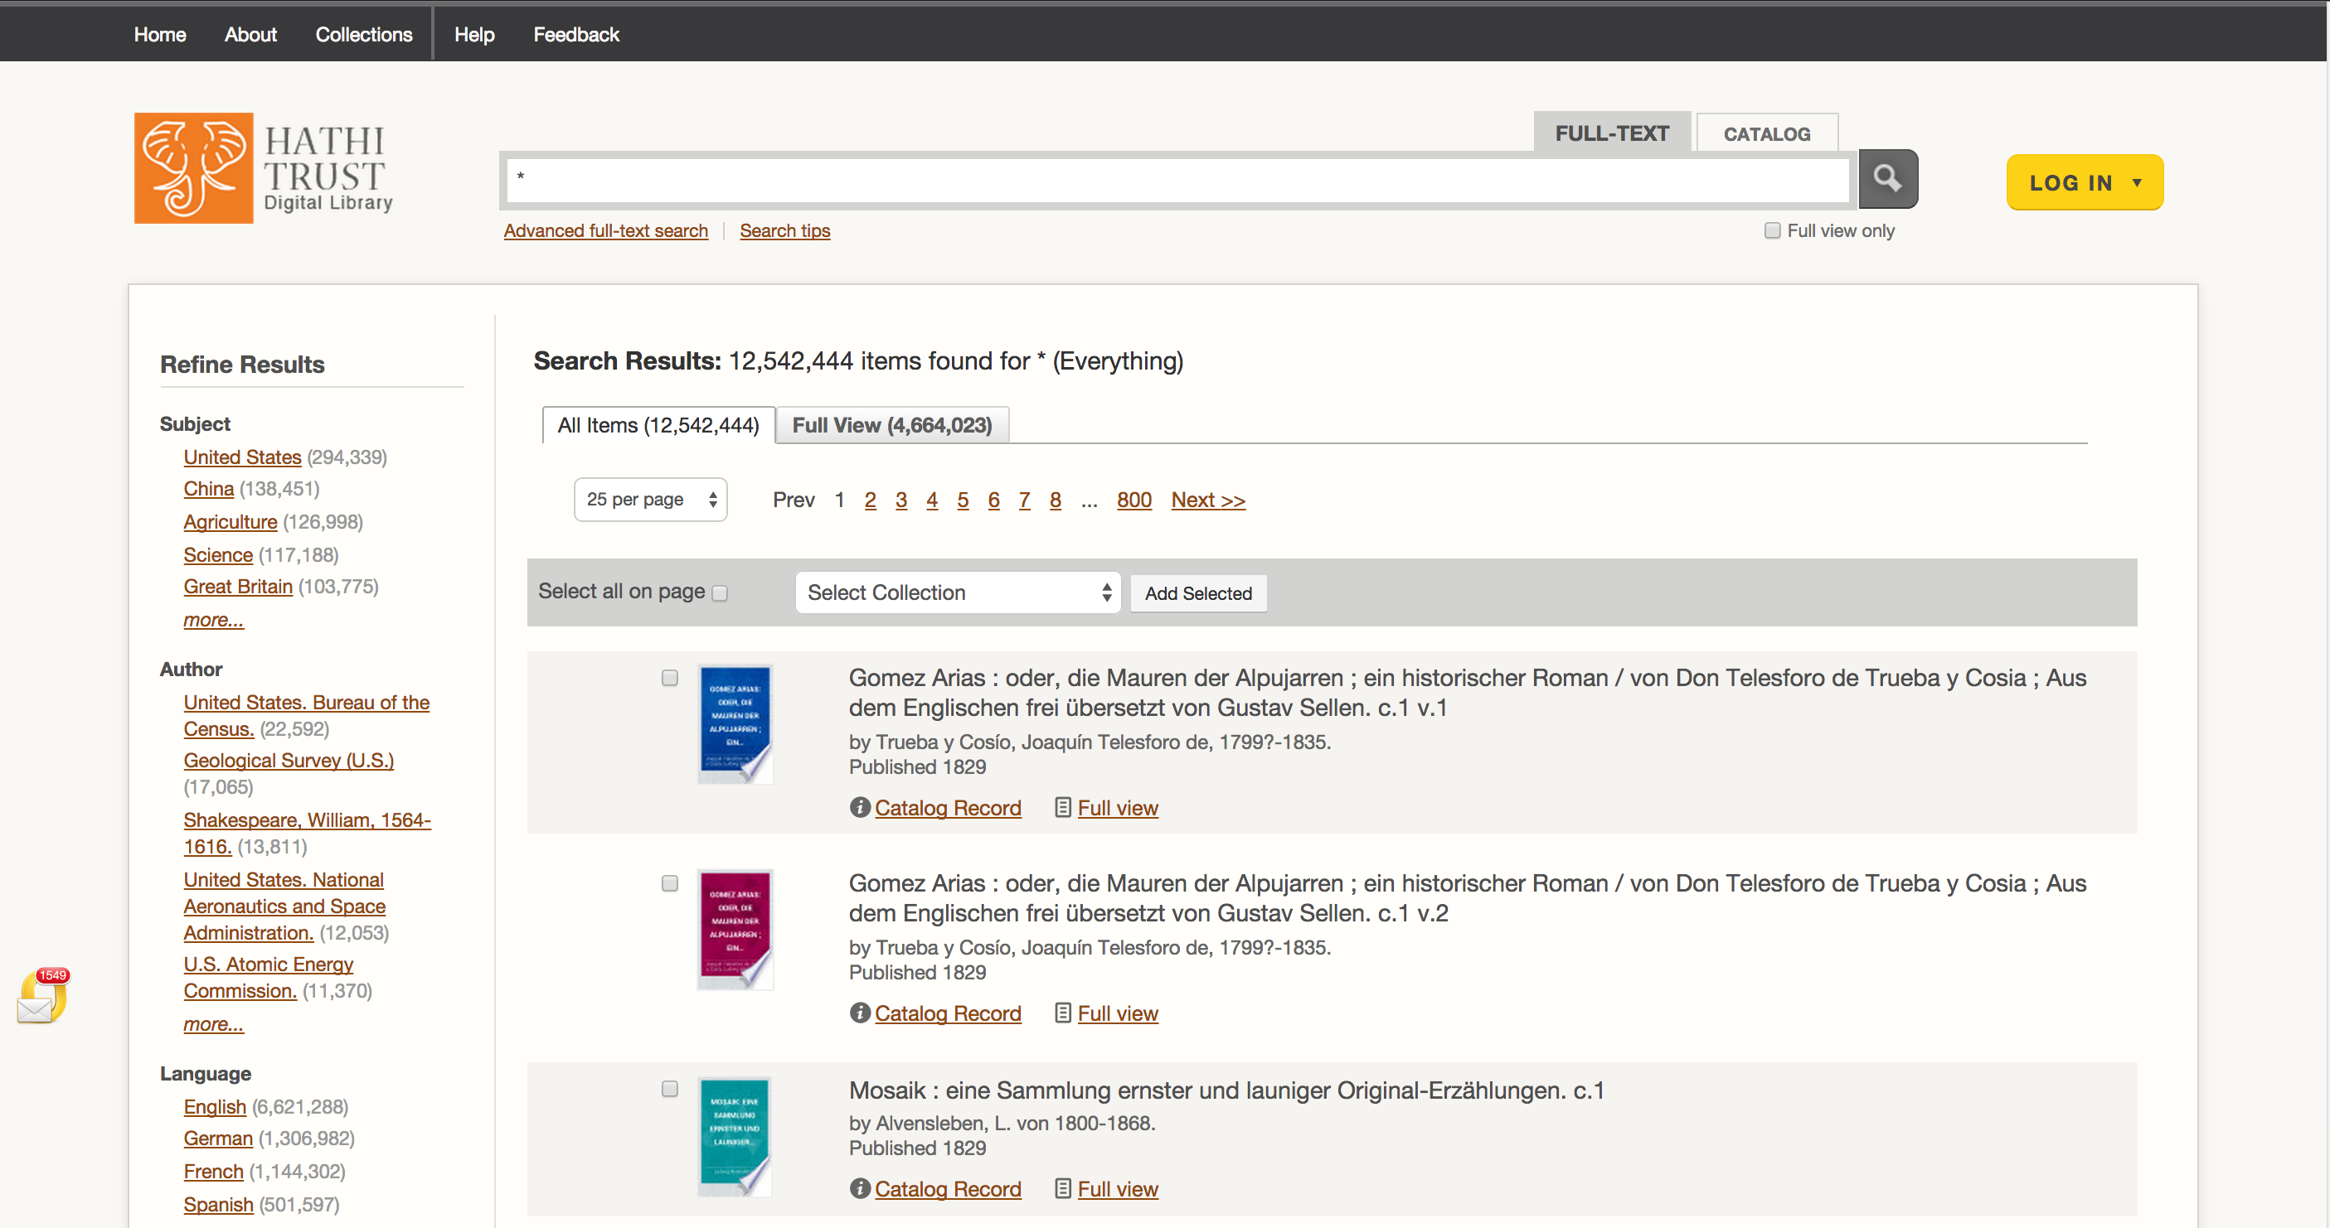
12.5 million total volumes
6.4 million book titles
327,000 serial titles
4.6 million volumes in the public domain (~37%)

Slide 3
Dates

Slide 4
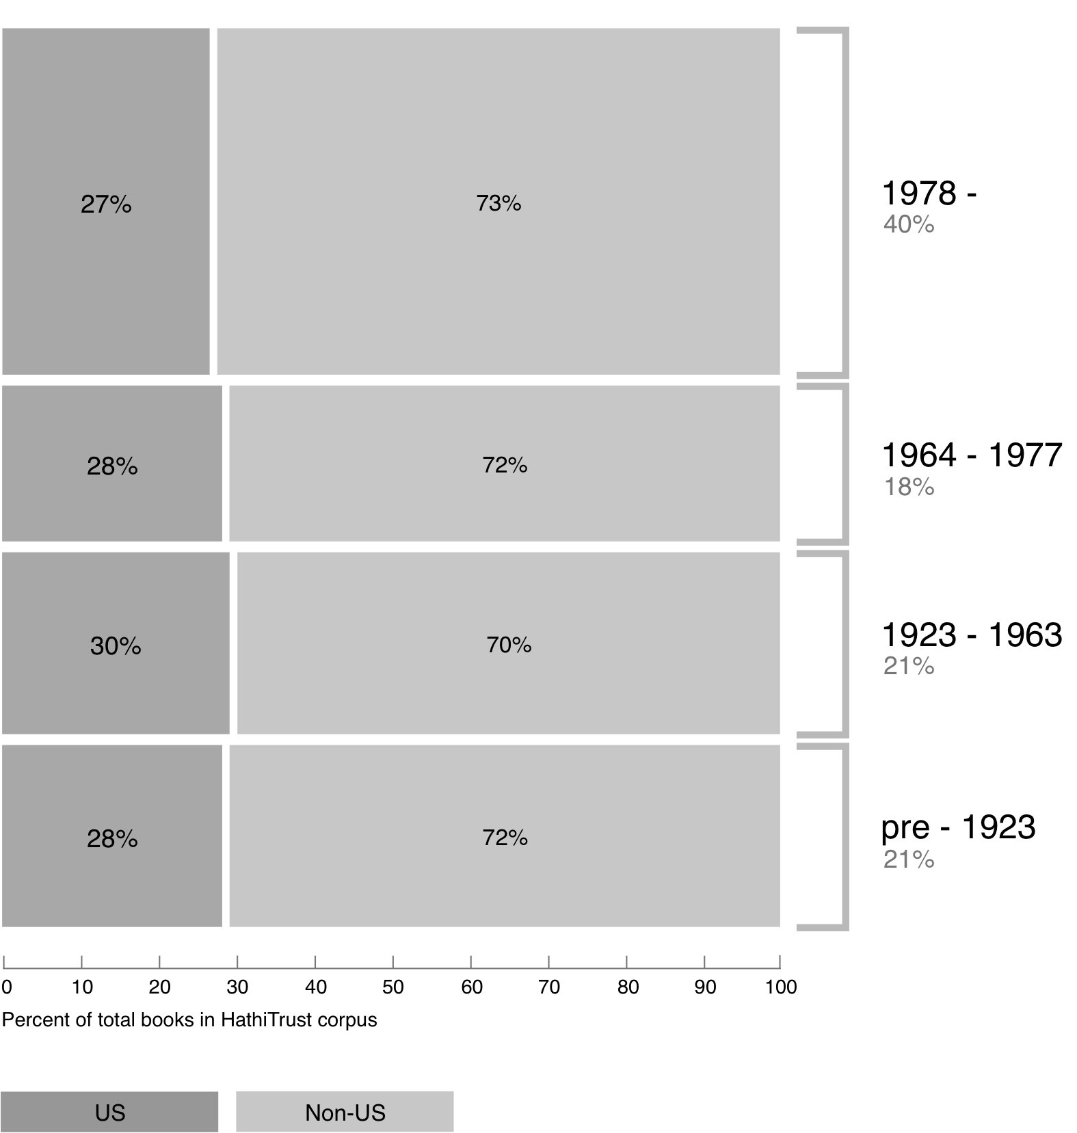
Breakdown of HathiTrust book corpus by publication date
Diaries
Correspondence
Reports
Newspapers
Memoirs
Books
Encyclopedias
Archival materials
Directories
Periodicals
Maps
Musical scores
Statistics
Visual Materials
42%
19%
20%
Bibliographic Indeterminacy and the Scale of Problems and Opportunities of "Rights" in Digital Collection Building – Wilkin, Feb 2011
19%

Slide 5
The Challenge
Preserve materials
Enable the fullest possible use of materials for scholarship and research, and as a public good to the community
Bibliographic and Full-text Search
Viewing and Download of public domain and open access volumes
Collections and APIs
Computational Research
Print on demand

Slide 6
The Strategy
Take full advantage of the abilities we have to make collections accessible within the scope of the law
Public domain
Lawful uses of in-copyright materials

Slide 7
Framework
The law
Identification / Copyright determination
Access policies
Technical infrastructure

Slide 8
The Law
If we understand and accept the reasons works should be opened according to the applicable laws, we are willing to open them.

Slide 9
Identification / Copyright Determination
Automated rights determination
http://www.hathitrust.org/bib_rights_determination
Manual rights determinations
DateType | 008:06
Date1 | 008:07-10
Date2 | 008:11-14
PubPlace | 008:15-17
PubPlace17 | 008:17 (last byte of pub place. “u” indicates published in the US, otherwise non-US)
GovPub | 008:28
VolDate | Latest year parsed from z30_description field. Set to null if nothing could be parsed or if no z30_description.
BibFmt | Bibliographic record format (BK, SE, etc.)
Imprint field | 260 or 264 ind2=1

Slide 10
Access Policies
Public Domain
Public Domain in the US
Open Access (including Creative Commons)
In copyright or Undetermined
In copyright in the United States
Nobody (deletions, rights investigations)

Slide 11
Copyright Distribution

Slide 12
Lawful Uses
Full-text search
Access for users who have print disabilities:
Print copy owned currently or previously; User certified by the partner institution; Accessible to authenticated proxies
Section 108 (17 USC §108) replacement, preservation, and distribution uses of digital materials:
Print copy owned currently or previously; Located within the United States; Replacement copies; access from library premises; Simultaneous accesses determined by print copies held
Computational Research

Slide 13
Take-downs and Deletions
Take-down
Remove access immediately
Investigate rights
Re-open or keep closed with new status
Deletion
Rights holder request (contractual obligation)
Wholly unusable or superior copy available

Slide 14
Technical Infrastructure
Strategy for addressing shared problems
Infrastructure allows/enables
Robust discovery
Rights determination: automated; distributed manual review
Sensitivity to diverse copyright regimes and access policies
Storage and management of rights information; availability of information to access systems
Rights attributes, and reason codes; system of precedence
http://www.hathitrust.org/rights_database
Availability of rights information
http://www.hathitrust.org/data

Slide 15
Framework
The law ✔
Identification / Copyright determination ✔
Access policies ✔
Technical infrastructure ✔

Slide 16
How to find out more
About: http://www.hathitrust.org/about
Resources: http://www.hathitrust.org/resources
Twitter: http://twitter.com/hathitrust
Facebook: http://www.facebook.com/hathitrust
Monthly newsletter:
http:www.hathitrust.org/updates
RSS http://www.hathitrust.org/updates_rss
Contact us: feedback@issues.hathitrust.org
Blogs: http://www.hathitrust.org/blogs
Large-scale Search
Perspectives from HathiTrust

