Slide 1
Collaborating Globally, Planning Locally
HathiTrust and New Opportunities in Collection Management
GWLA/UNM: Emerging Collection Management Opportunities
September 26, 2011
Jeremy York
Project Librarian, HathiTrust

Slide 2
Partnership
Arizona State University
Baylor University
Boston University
California Digital Library
Columbia University
Cornell University
Dartmouth College
Duke University
Emory University
Getty Research Institute
Harvard University Library
Indiana University
Johns Hopkins University
Lafayette College
Library of Congress
Massachusetts Institute of Technology
McGill University
Michigan State University
New York Public Library
New York University
North Carolina Central
University
North Carolina State
University
Northwestern University
The Ohio State University
The Pennsylvania State
University
Princeton University
Purdue University
Stanford University
Texas A&M University
Universidad Complutense
de Madrid
University of Calgary
University of California
Berkeley
Davis
Irvine
Los Angeles
Merced
Riverside
San Diego
San Francisco
Santa Barbara
Santa Cruz
The University of Chicago
University of Connecticut
University of Florida
University of Illinois
University of Illinois at Chicago
The University of Iowa
University of Maryland
University of Miami
University of Michigan
University of Minnesota
University of Missouri
University of Nebraska-Lincoln
The University of North Carolina at Chapel Hill
University of Notre Dame
University of Pennsylvania
University of Pittsburgh
University of Utah
University of Virginia
University of Washington
University of Wisconsin- Madison
Utah State University
Yale University Library

Slide 3
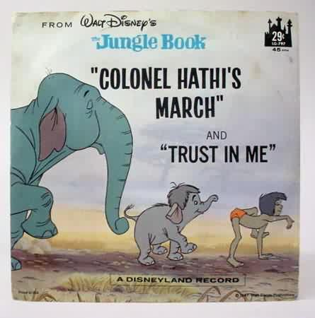
The Name
The meaning behind the name
Hathi (hah-tee)--Hindi for elephant
Big, strong
Never forgets, wise
Secure
Trustworthy

Slide 4
Mission
To contribute to the common good by collecting, organizing, preserving, communicating, and sharing the record of human knowledge

Slide 5
Collections and Collaboration
Comprehensive collection
Preservation…with Access
Shared strategies
Collection management, development
Copyright
Preservation (digital and print)
Bibliographic Indeterminacy
Discovery / Use
Efficient user services
Public Good

Slide 6
Governance
Strategic Advisory Board
Guidance on Policy, Planning
Budget/Finances
Decision-making
Executive Committee
HathiTrust

Slide 7
How does work get done?
Collective work
e.g., working groups
Perform the work of the partnership
Now 40+ people across partner institutions
Distributed work
Driven by needs of institutions – able to leverage across the partnership
Projects, e.g. grant work, ingest specifications, page-turner, bibliographic data management
Leverage expertise across institutions

Slide 8
How is work prioritized?
Initial functional objectives
Collective processes
Working groups and committees
Constitutional Convention
Ballot Proposals

Slide 9
Partnership
Who can become a partner?
Institutions worldwide
Libraries with print holdings

Slide 10
What are the benefits? (1)
Cost-effective long-term preservation and access services for digitized content
Commitments on digital content facilitate decisions about digitization efforts and print collection management
For those with content, immediately offering long-term preservation, bibliographic and full-text search, collection-building
With content or not, full viewing and downloading capabilities for public domain materials and materials for which we have received permissions

Slide 11
What are the benefits? (2)
Specialized access to public domain and in-copyright materials for users with print disabilities
Other lawful uses of in copyright materials such as Section 108 uses (print replacement copies, digital access to applicable works), orphan works
HathiTrust encourages participation in initiatives and resources geared toward
Shared collection development and management (e.g., copyright review work, print holdings database, de-duplication, collaboration with other organizations and initiatives)
Participation in governance and collaborative initiatives
Defining directions for the shared library.

Slide 12
What’s involved?
Contract
Sustaining
Content-Contributing
Yearly fees
Commitment
5-year periods
Shibboleth
Print Holdings

Slide 13
Consortial Membership?
No pricing benefit for consortia
Benefits from where consortia can offer services to reduce costs for members
Coordinating ingest, print holdings, other?

Slide 14
Collections: what we have

Slide 15
Content Distribution
9,706,923 Total volumes
2,636,483 “Public domain”
5,153,036 Book titles
255,907 Serial titles
* As of September 24, 2011
Notes:
15

Slide 16
Content Distribution
* As of September 24, 2011
Notes:
16

Slide 17
Dates
* As of September 24, 2011
Notes:
17

Slide 18
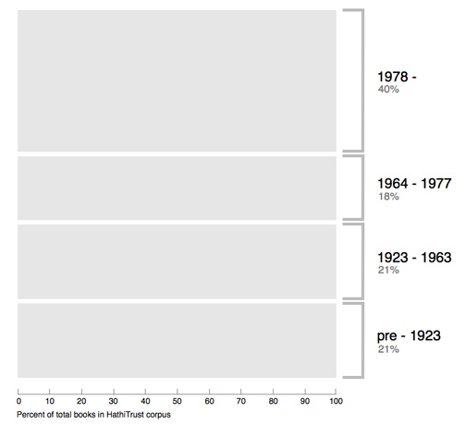
Breakdown of HathiTrust book corpus by publication date
Bibliographic Indeterminacy and the Scale of Problems and Opportunities of "Rights" in Digital Collection Building – 2/2011

Slide 19
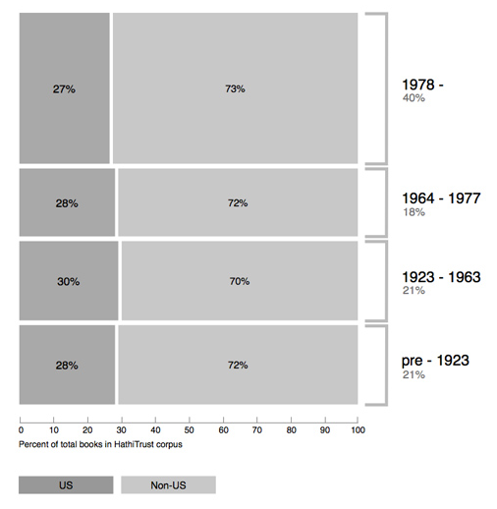
Breakdown of HathiTrust book corpus by publication date

Slide 20
Language Distribution (1)
The top 10 languages make up ~86% of all content
* As of September 24, 2011
Notes:
20

Slide 21
Language Distribution (2)
The next 40 languages make up ~13% of total
* As of September 24, 2011
Notes:
21

Slide 22
Content over time
* As of September 24, 2011
Notes:
22

Slide 23
HathiTrust Content Growth
Notes:
23

Slide 24
Collaboration: Collection Management

Slide 25
The Cloud Library
Toward a Cloud Library
CLIR, Mellon Foundation
OCLC Research, NYU, HathiTrust, Recap Libraries
Objective: Characterize the near-term opportunity for externalizing management of academic research collections leveraging capacity of large-scale shared print and digital repositories
Outcomes: opportunity and risk assessment based on aggregate collection analysis; draft service agreement enabling generic consumer library to selectively outsource preservation and access of low-use research collections to large-scale print and digital repositories (Malpas, RLG Partner Update, January 2010)

Slide 26
A global change in the library environment
Academic print book collection already substantially duplicated in mass digitized book corpus
June 2010
Median duplication: 31%
June 2009
Median duplication: 19%
Notes:
26

Slide 27
Continuing growth of overlap …
ARL overlap
31% in June 2010
33% in Dec (adjustment: adding little-held works)
~ 1% per 225,000 vols
45% by December, 2011
Oberlin Group overlap
Close to 9% points higher
41% in December, 2010
Close to 50% in May, 2011
Higher rate of overlap per added volume?

Slide 28
Digitized Books in Shared Repositories
~3.5M titles
~75% of mass digitized corpus is ‘backed up’ in one or more shared print repositories
~2.5M
Notes:
28

Slide 29
New Cost Model
Original model based on GB contributed
New model based on overlap of print collections with HathiTrust digital collections
Supported by print holdings database
Database will
Support expansion of legal uses of materials: preservation uses, access for users who have print disabilities, access to orphan works
Facilitate individual and collaborative collection development and management operations
Will also benefit efforts in de-duplication

Slide 30
Print Holdings Database
Volumes institutions own or have owned
For monographic holdings
Only print volumes (not microform, etc.)
OCLC number [required]
Bib record ID [required]
Enumeration/chronology, if available
Condition (e.g., brittle) [optional]
Holding Status (e.g., current holding, withdrawn, missing, etc.) [optional]
For serial holdings
OCLC number [required]
Bib record ID [required]
ISSN, if available

Slide 31
Every library is different
Our median rate of overlap may be the same
But our overlap profiles will differ by library

Slide 32
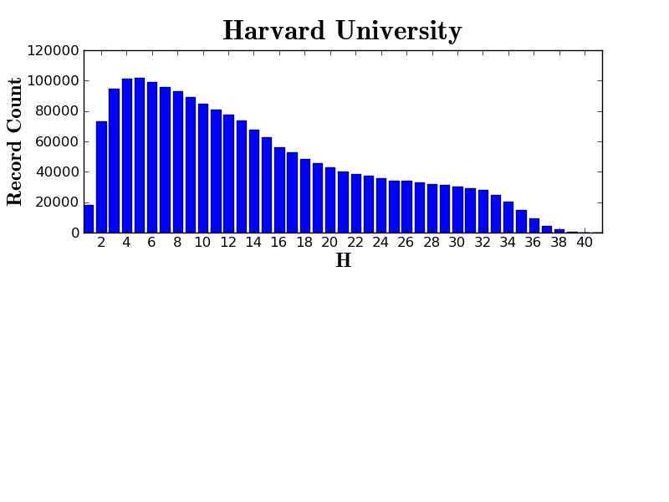
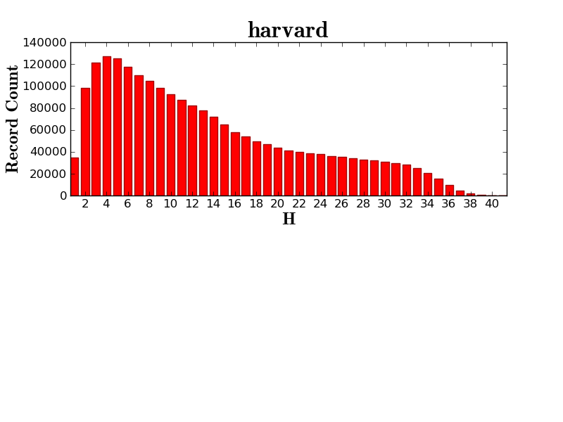

Slide 33
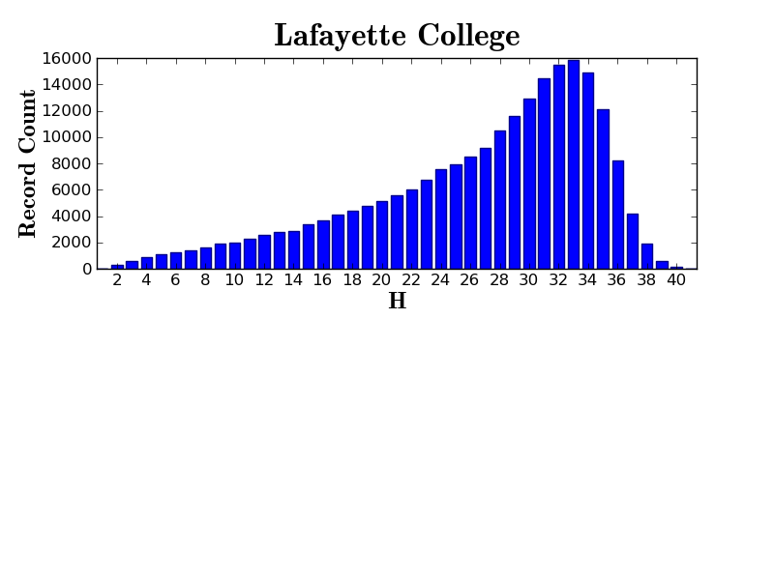

Slide 34
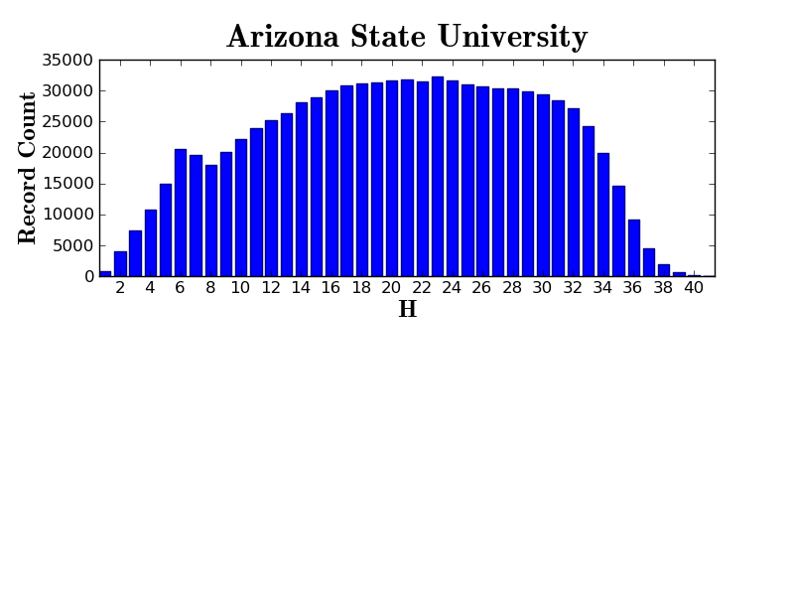

Slide 35
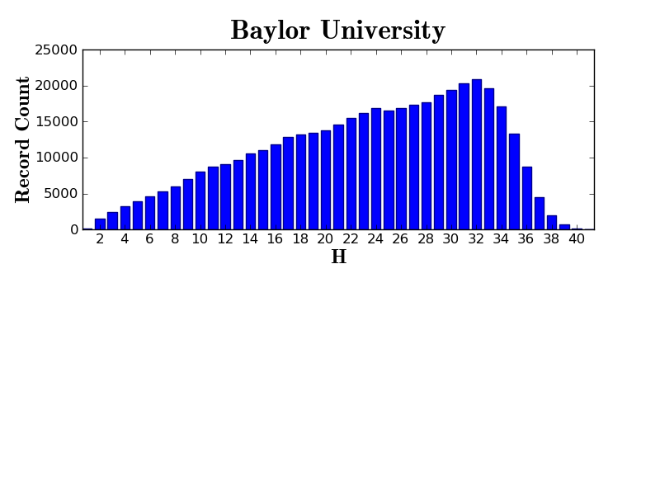

Slide 36
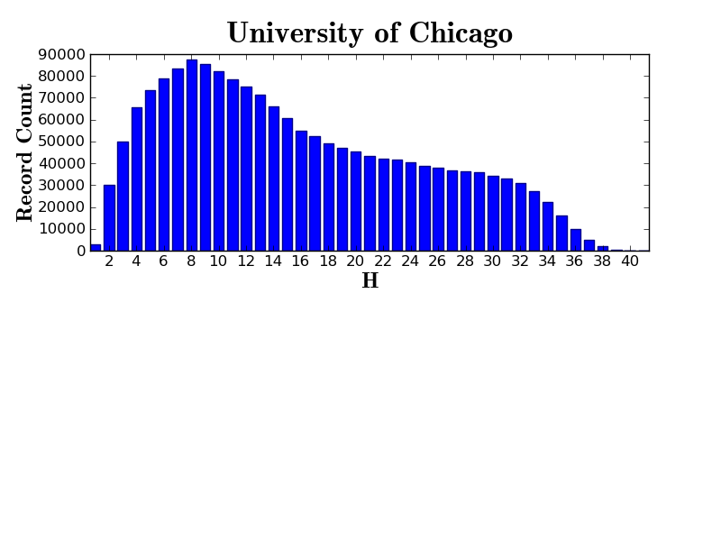

Slide 37
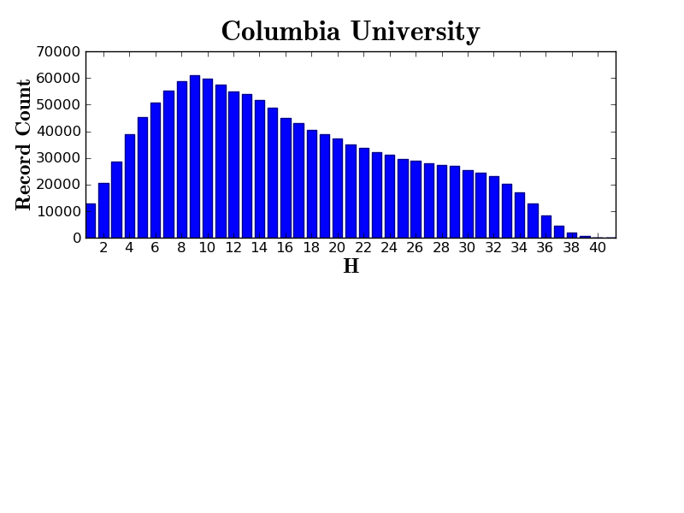
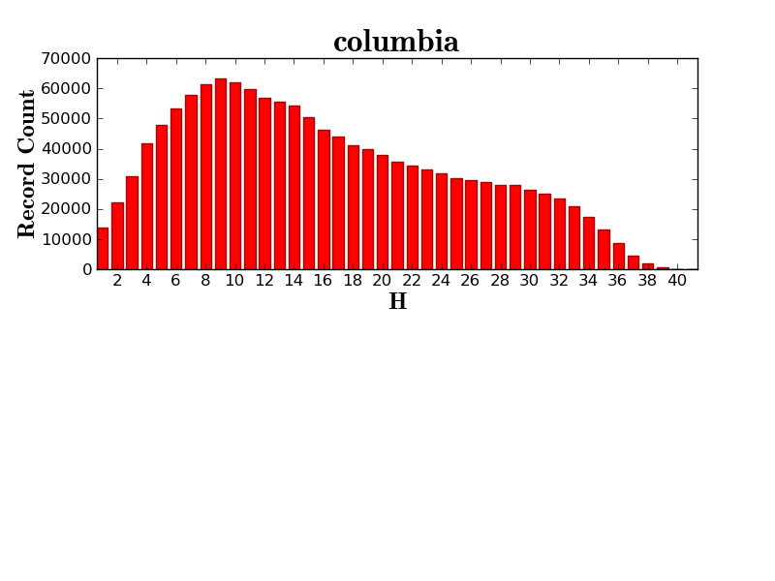

Slide 38
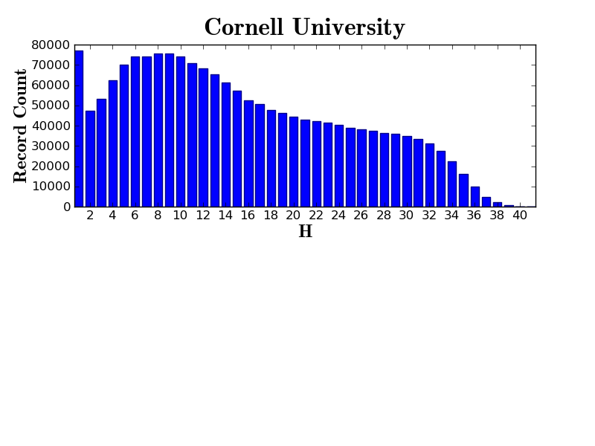

Slide 39
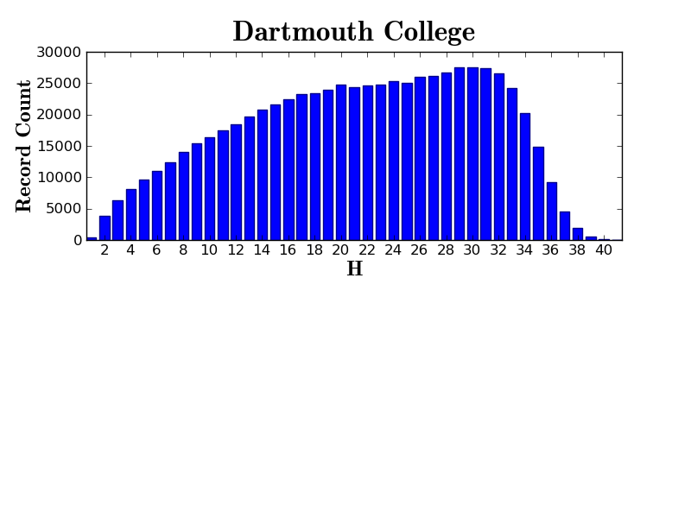

Slide 40
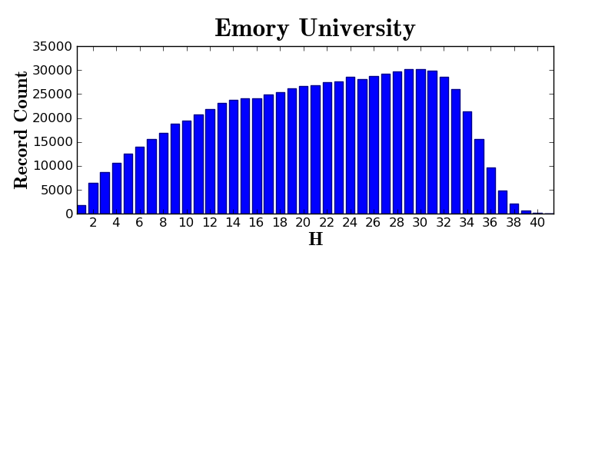

Slide 41
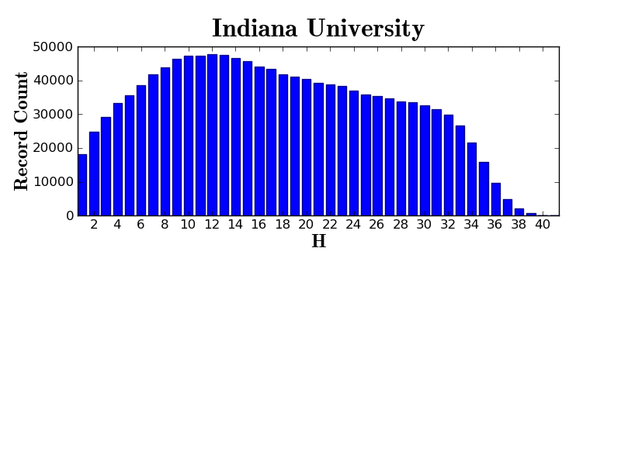

Slide 42
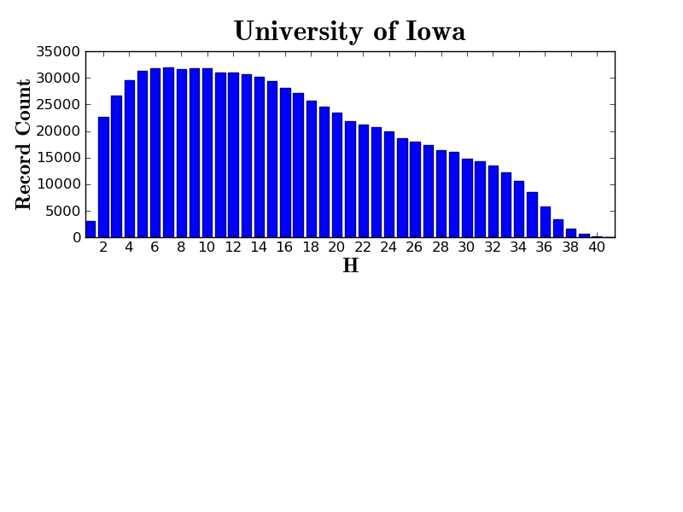

Slide 43
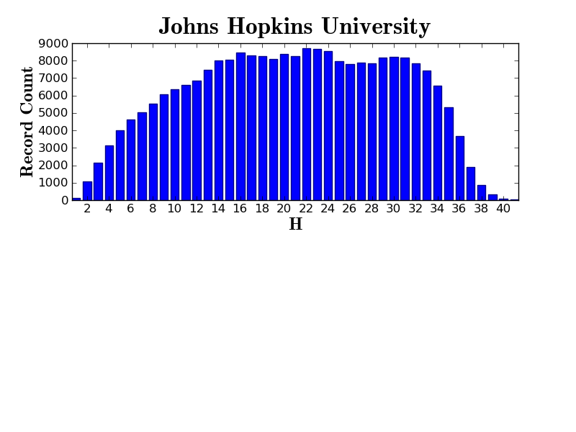
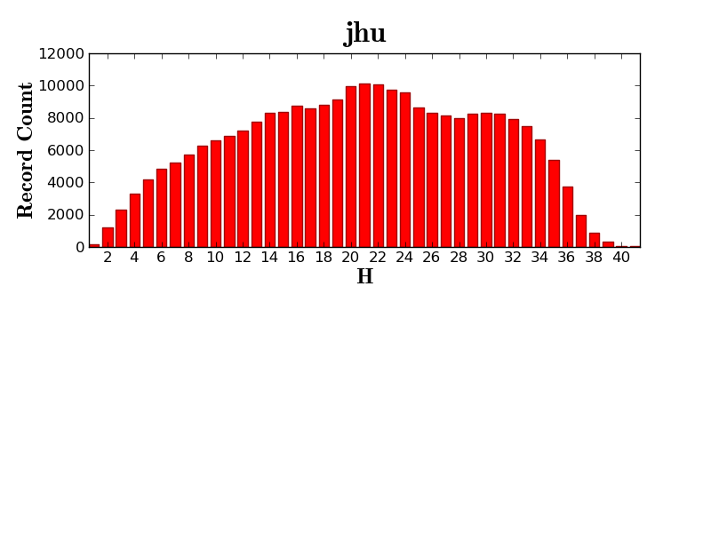

Slide 44
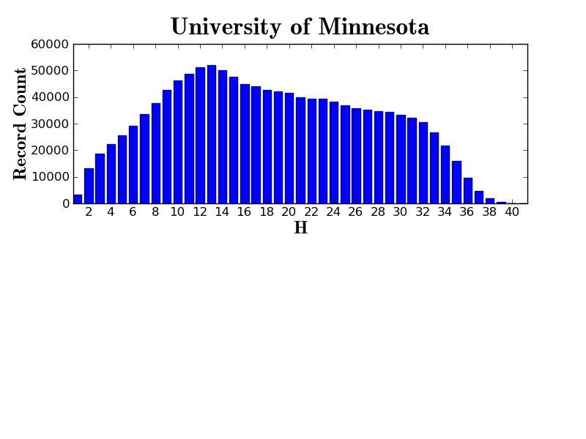

Slide 45
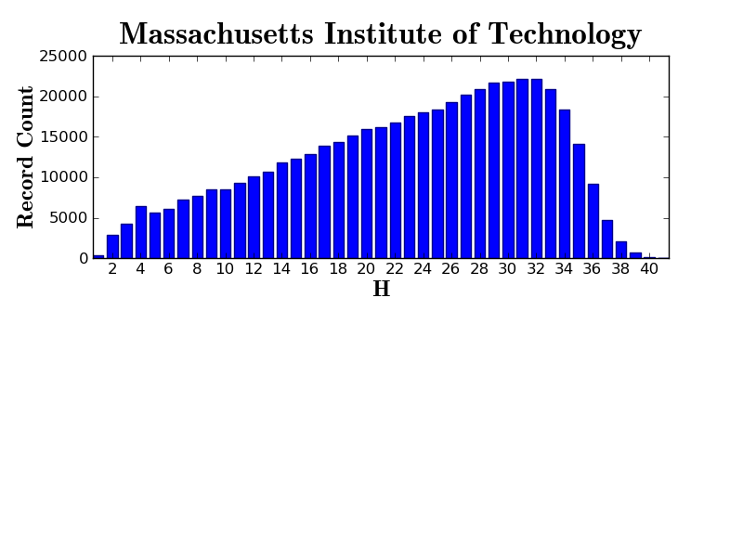

Slide 46
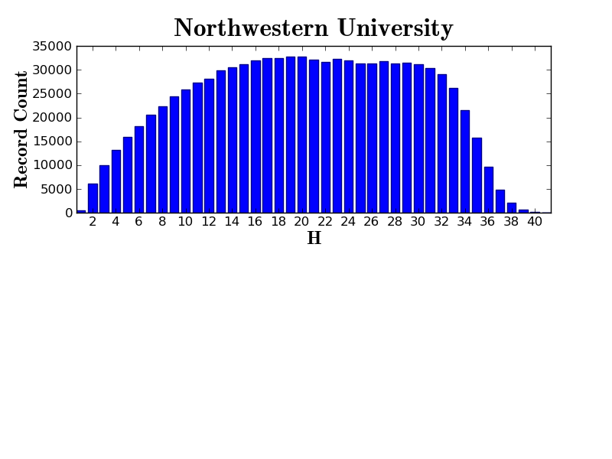

Slide 47
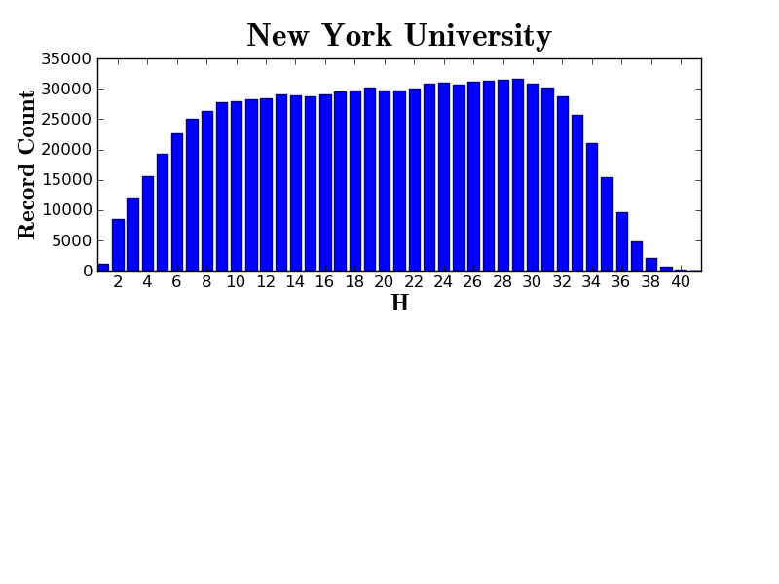

Slide 48
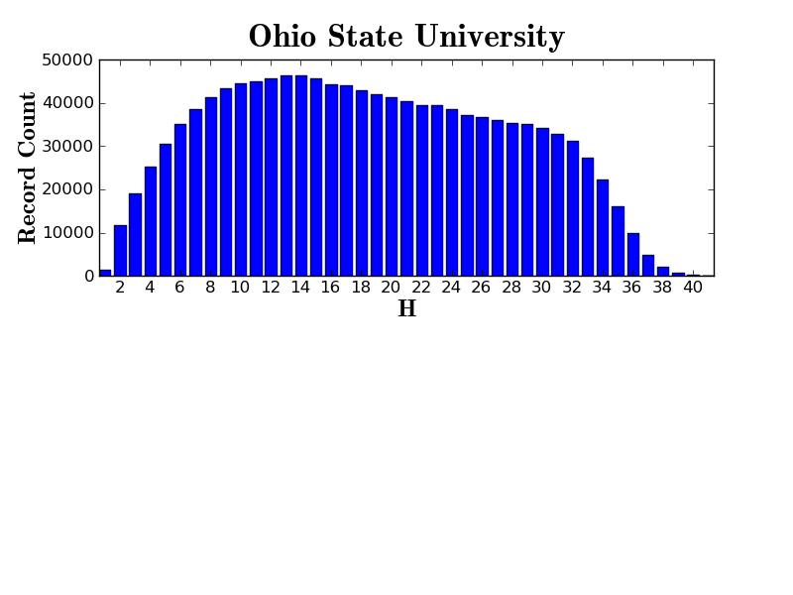

Slide 49
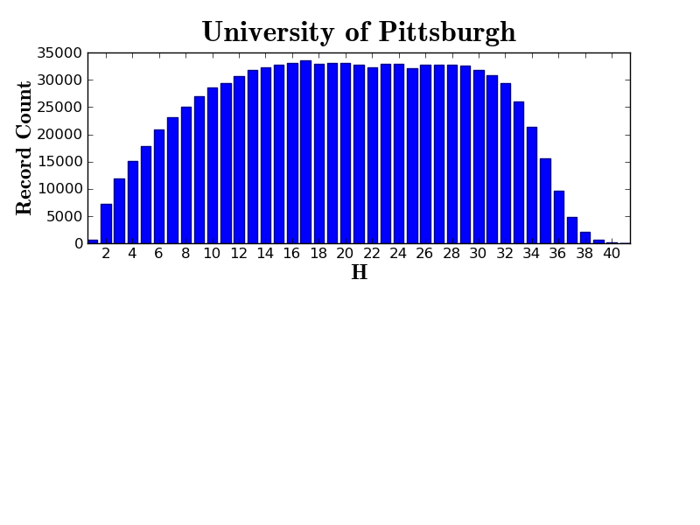
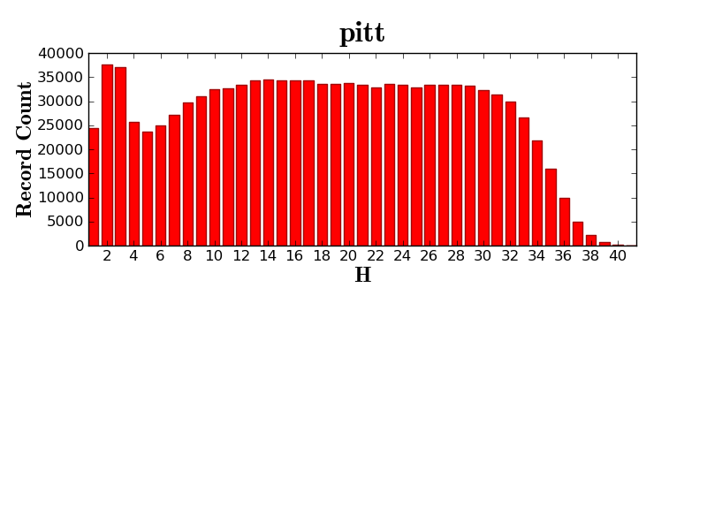

Slide 50
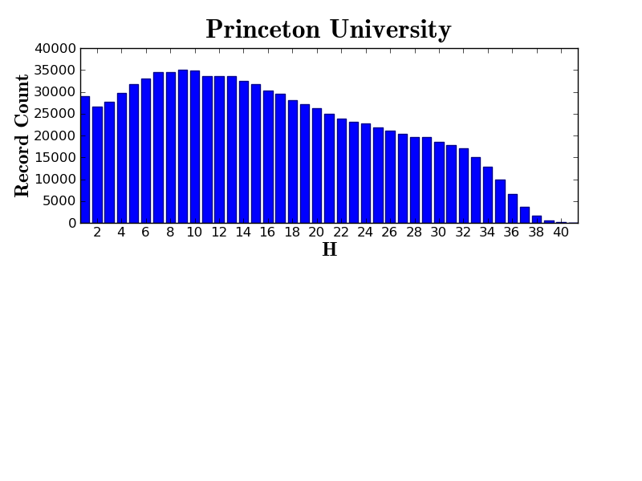

Slide 51
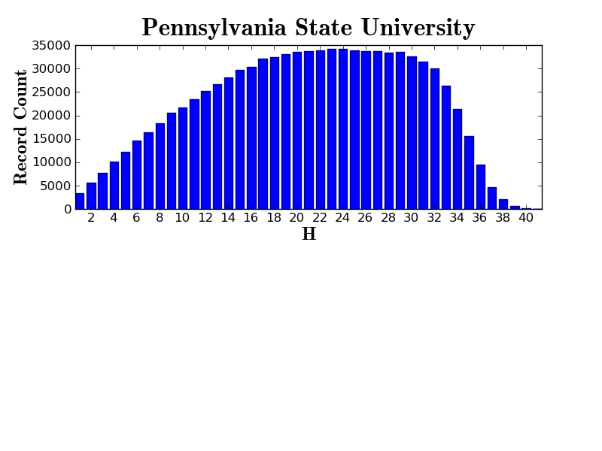

Slide 52
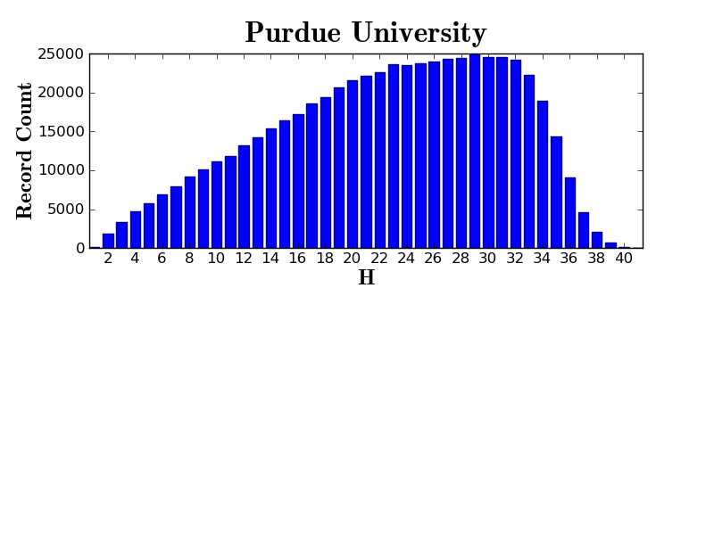

Slide 53
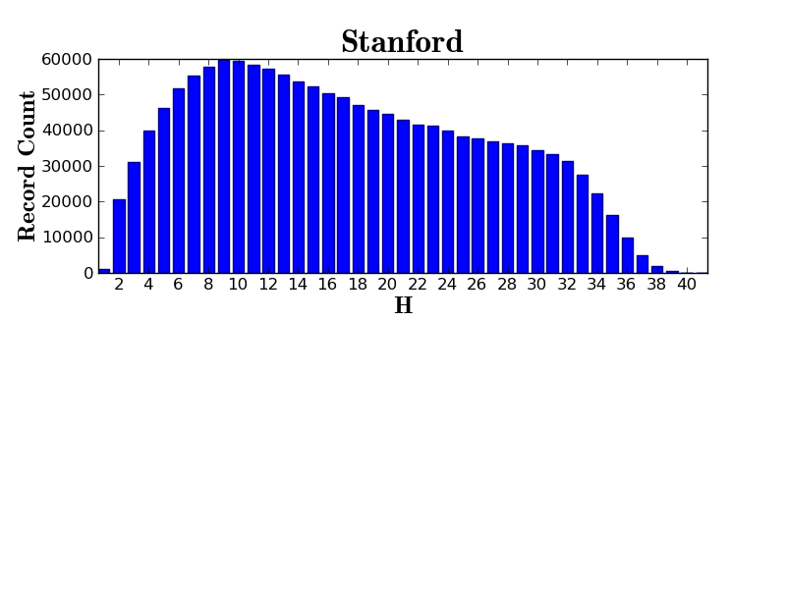

Slide 54
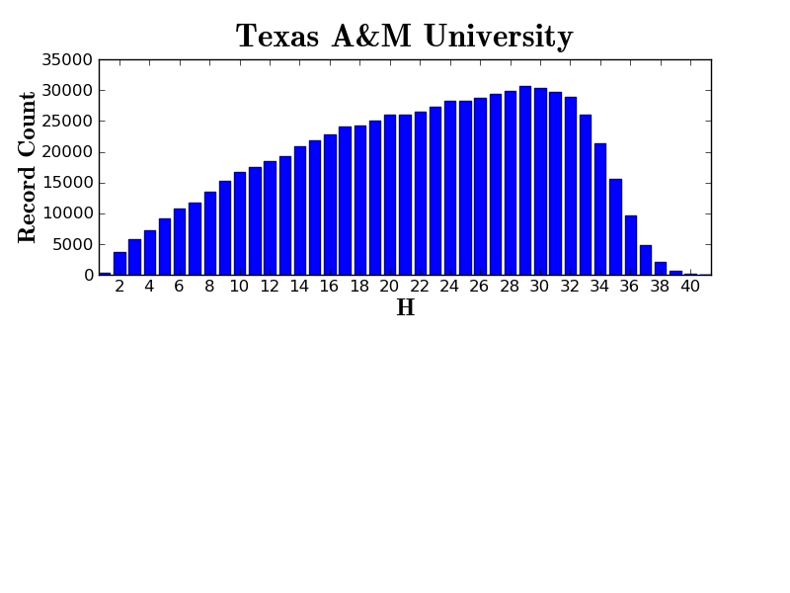

Slide 55
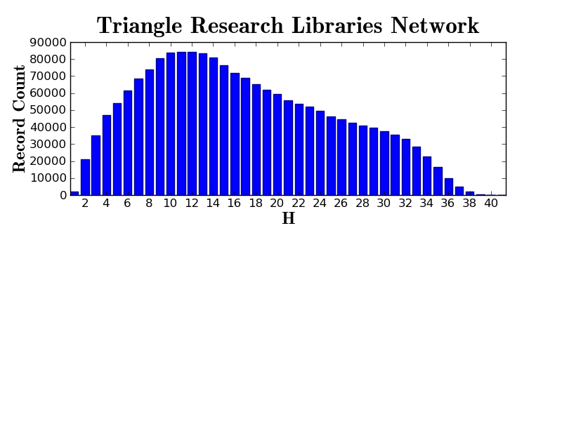

Slide 56
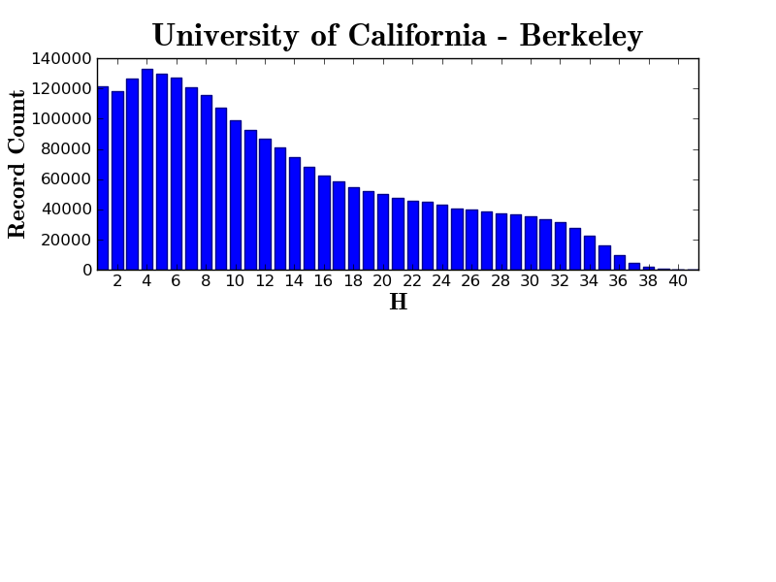

Slide 57
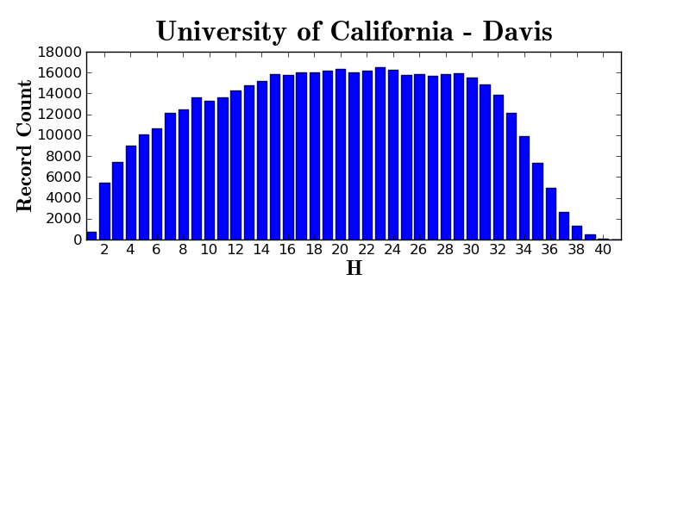

Slide 58
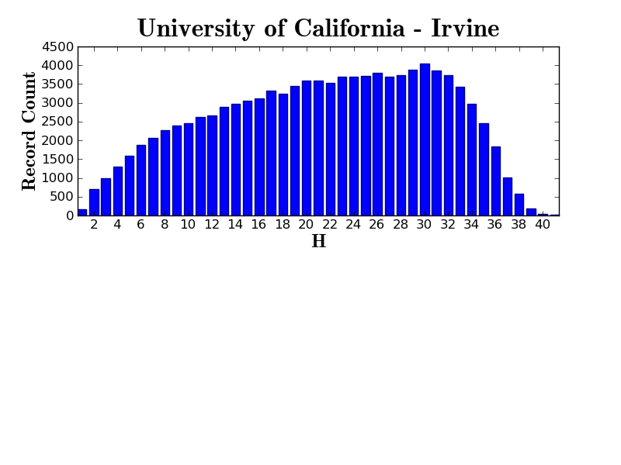

Slide 59
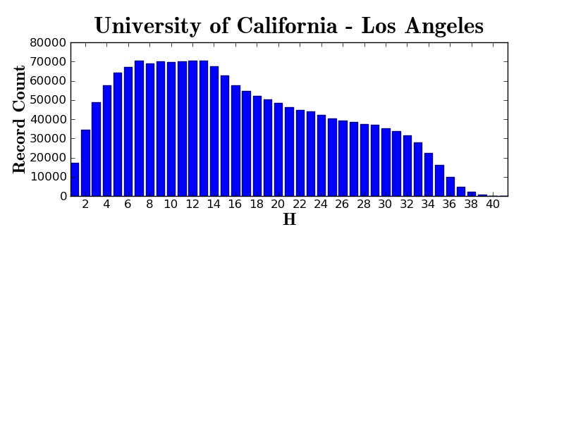

Slide 60
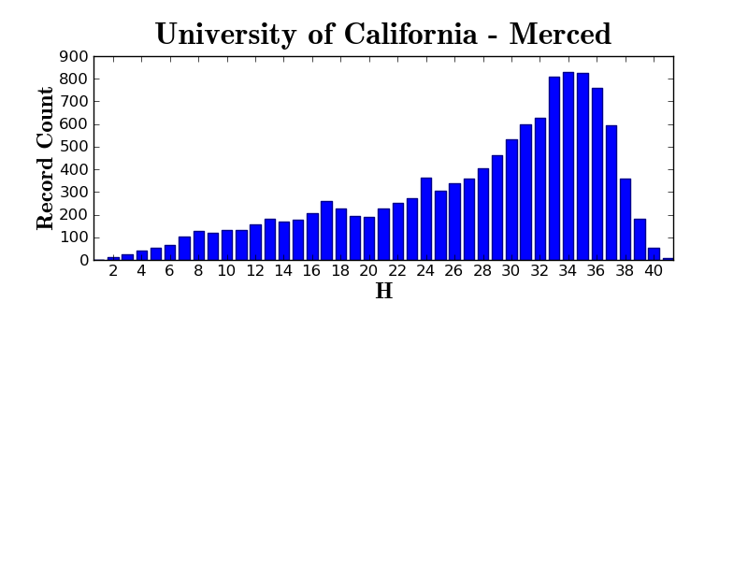

Slide 61
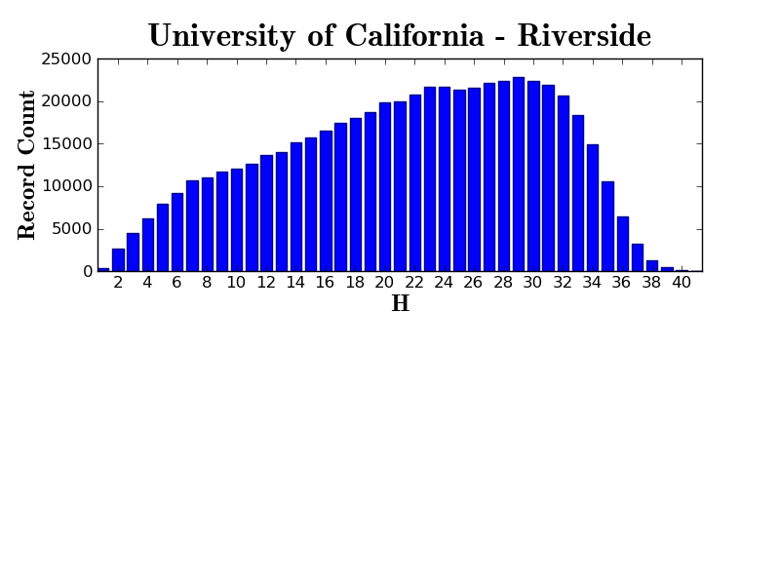

Slide 62
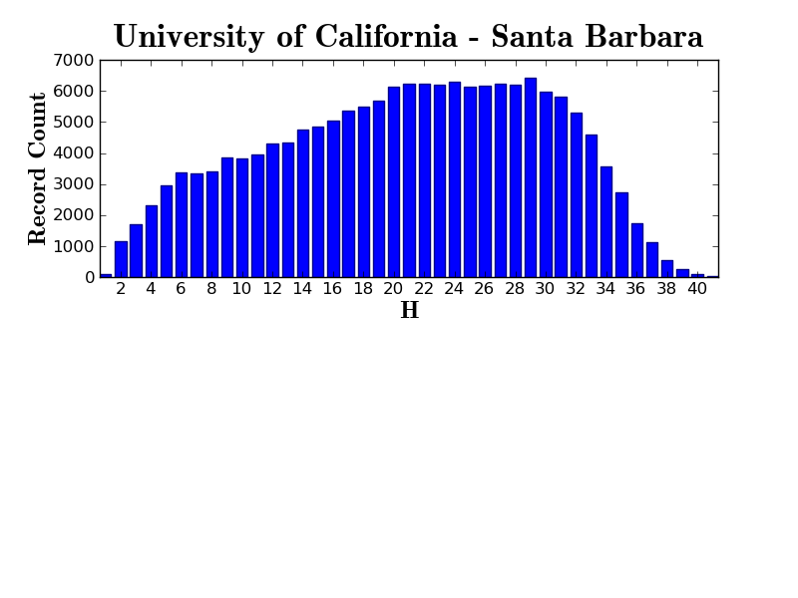

Slide 63
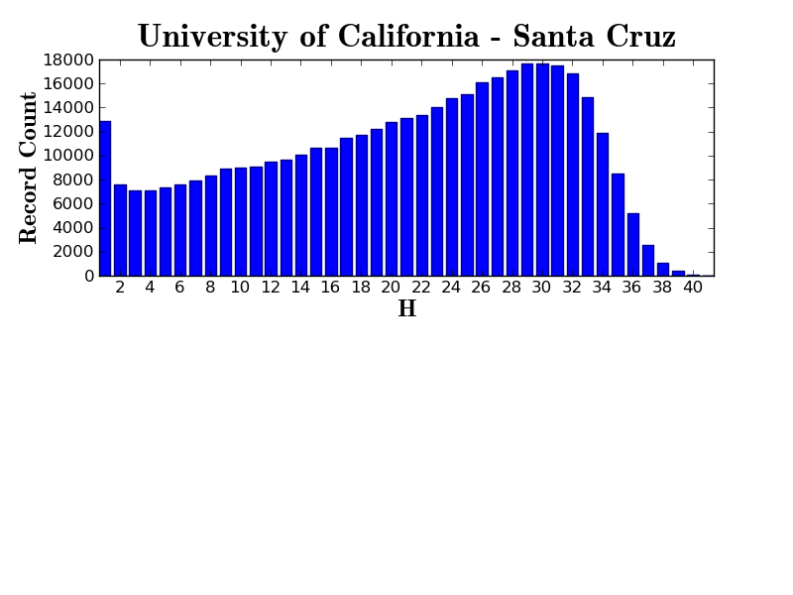

Slide 64
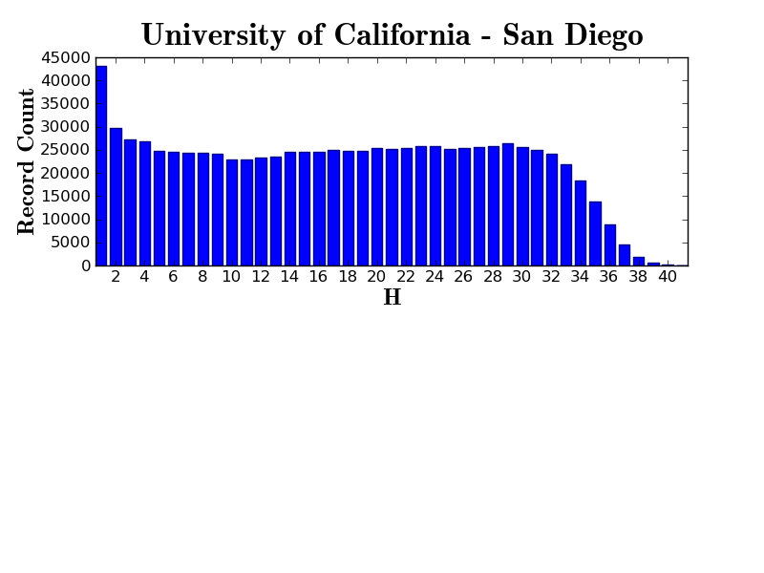

Slide 65
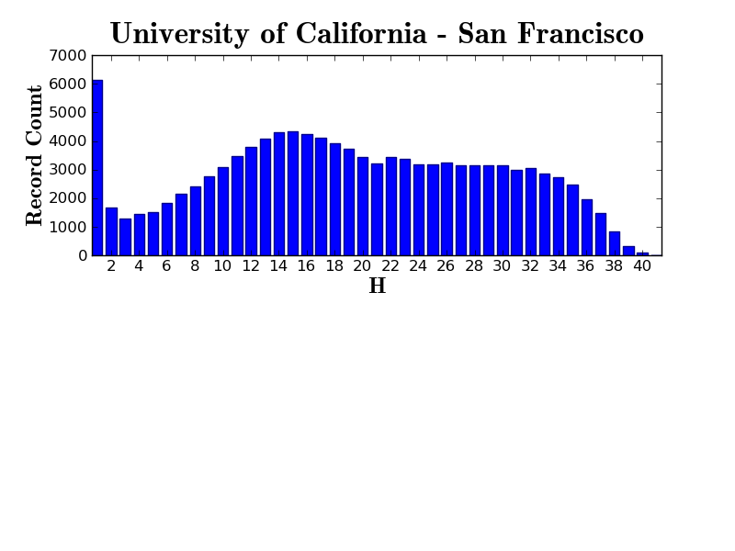

Slide 66
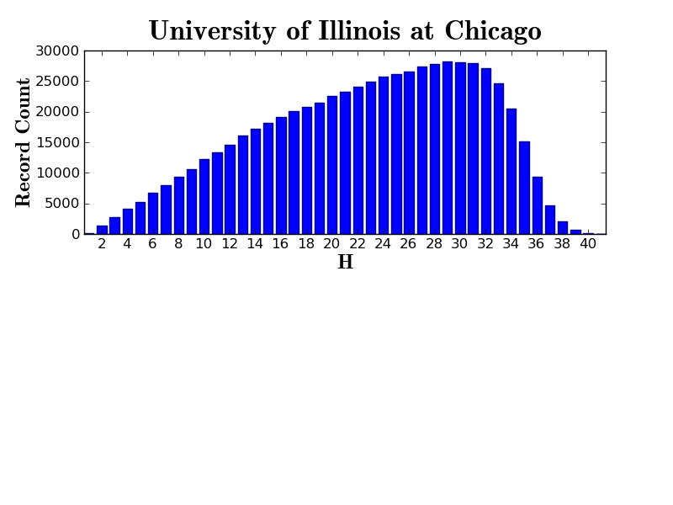

Slide 67
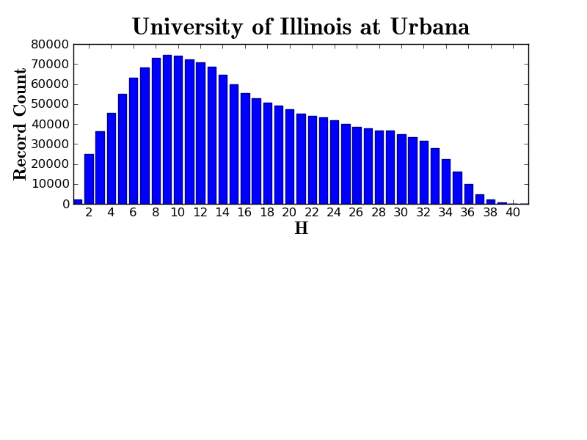

Slide 68
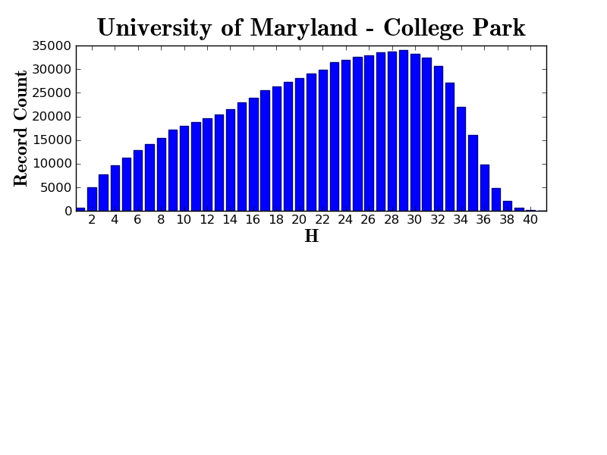

Slide 69
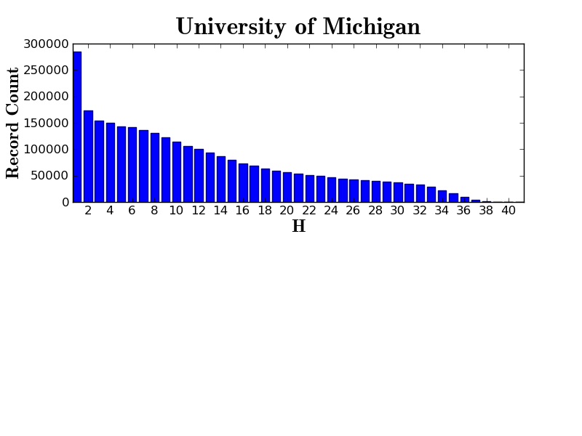

Slide 70
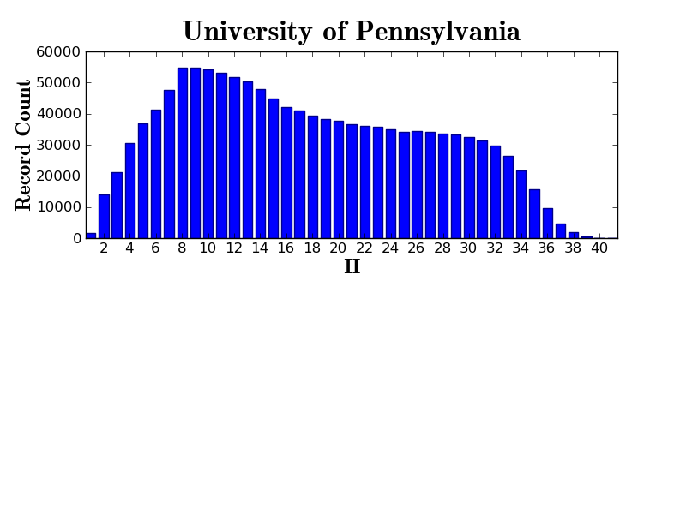

Slide 71
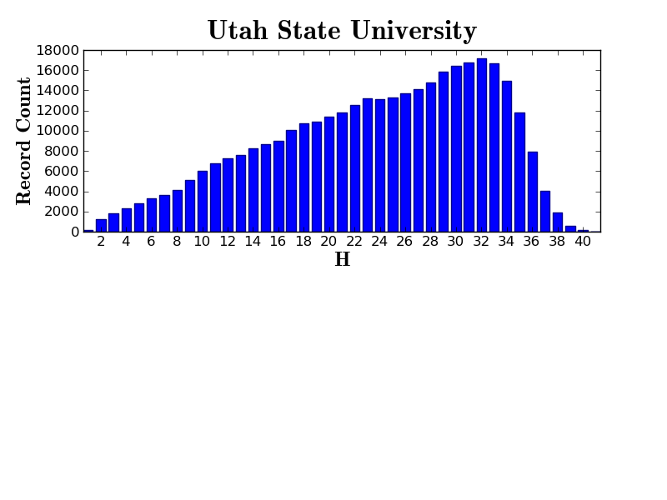

Slide 72
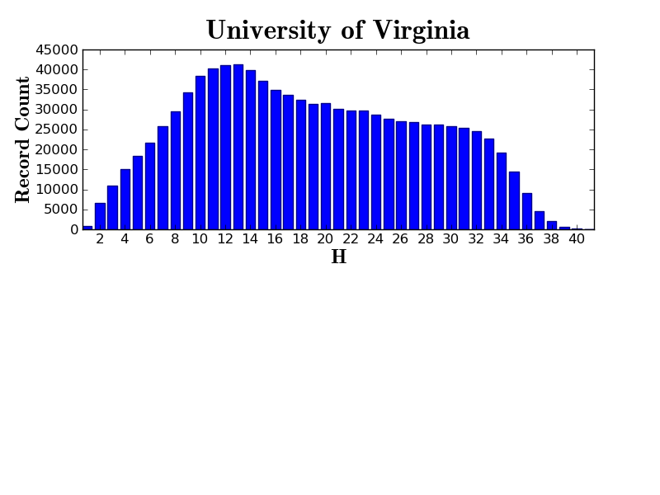

Slide 73
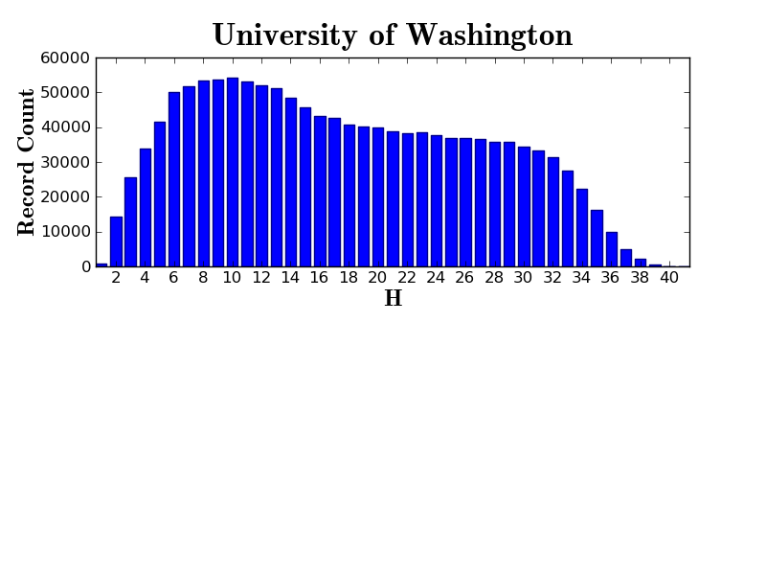

Slide 74
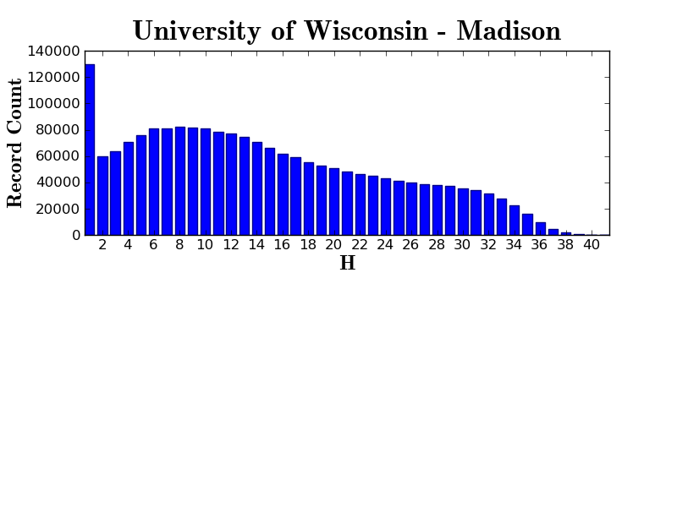

Slide 75
Every library is different
Our median rate of overlap may be the same
But our overlap profiles will differ by library
Our use patterns differ
Our risk profiles differ
Our roles vis-à-vis our constituencies differ
Thus, the need to act independently on common data

Slide 76
Cooperative Print Monograph Archive
Print monograph storage proposal
Enable partners to register commitments
Establish definitions (e.g., environment, use and condition)
Build in cost-sharing: collectively fund those that make commitments
Communicate information to partners to facilitate decision-making
http://www.hathitrust.org/constitutional_convention2011

Slide 77
Quality
IMLS grant led by Paul Conway
Metrics and measures of quality
Certification
Quality

Slide 78
Changing Library Landscape
Print Monograph Archive Proposal (HathiTrust Collections Committee):
“…the potential for ubiquitous information access…challenges the very foundation underlying the development of vast collections of printed literature in our nation’s libraries.”
“This model for collection development and access…is today becoming less and less relevant to our core mission”
“From its inception, HathiTrust has aspired to reshape the landscape of research libraries. This landscape includes the management of vast, highly-redundant collections of printed resources for which readily accessible digital instantiations are increasingly available.”
“With the advent of HathiTrust…the opportunity exists for our institutions to not only work together to profoundly influence the landscape in which we provide access to cultural resources but to profoundly influence the mechanisms by which we ensure the persistence of the printed record”

Slide 79
Thank you!

Slide 80
How to find out more
Web site “About” section: http://www.hathitrust.org/about
Twitter: http://twitter.com/hathitrust
Monthly newsletter: http://www.hathitrust.org/updates
RSS: http://www.hathitrust.org/updates_rss
Contact us: feedback@issues.hathitrust.org

