Slide 1
HathiTrust: Key Concepts and Issues in Managing the Digital Archive
ICPSR Summer Workshop
“Curating and Managing Research Data for Re-use”
August 1, 2013
Jeremy York, Project Librarian, HathiTrust
Unless otherwise noted, these slides and their contents are licensed under a Creative Commons Attribution Unported License.

Slide 2
Outline
What is HathiTrust / What are we trying to accomplish
Repository management
What keeps us running
Assessment

Slide 3
What is HathiTrust

Slide 4
Partnership
Arizona State University
Baylor University
Boston College
Boston University
Brandeis University
Brown University
California Digital Library
Carnegie Mellon University
Columbia University
Cornell University
Dartmouth College
Duke University
Emory University
Florida State University
Getty Research Institute
Harvard University Library
Indiana University
Iowa State University
Johns Hopkins University
Kansas State University
Lafayette College
Library of Congress
Massachusetts Institute of Technology
McGill University`
Michigan State University
New York Public Library
New York University
North Carolina Central
University
North Carolina State
University
Northwestern University
The Ohio State University
The Pennsylvania State
University
Princeton University
Purdue University
Stanford University
Syracuse University
Texas A&M University
Tufts University
Universidad Complutense
de Madrid
University of Alberta
University of Arizona
University of Calgary
University of California
Berkeley
Davis
Irvine
Los Angeles
Merced
Riverside
San Diego
San Francisco
Santa Barbara
Santa Cruz
The University of Chicago
University of Connecticut
University of Delaware
University of Florida
University of Houston
University of Illinois
University of Illinois at Chicago
The University of Iowa
University of Kansas
University of Maryland
University of Miami
University of Michigan
University of Minnesota
University of Missouri
University of Nebraska-Lincoln
The University of North
Carolina at Chapel Hill
University of Notre Dame
University of Oklahoma
University of Pennsylvania
University of Pittsburgh
University of Utah
University of Vermont
University of Virginia
University of Washington
University of Wisconsin- Madison
Utah State University
Vanderbilt University
Virginia Tech
Wake Forest University
Washington University
Yale University Library

Slide 5
Digital Repository
Launched 2008
Initial focus on digitized book and journal content
10.7 million total volumes
5.6 million book titles
281,000 serial titles
3.4 million public domain (~31%)

Slide 6
Mission
To contribute to the common good by collecting, organizing, preserving, communicating, and sharing the record of human knowledge

Slide 7
HathiTrust
Universal Library
Common Goal
Single Entity, Many Partners

Slide 8
Collections and Collaboration
Comprehensive collection
Preservation…with Access
Shared strategies
Copyright
Collection management, development
Preservation
Discovery / Use
Bibliographic Indeterminacy
Efficient user services
Public Good

Slide 9
Repository Management

Slide 10
Underlying ideas
Community
Scale
Access and Preservation
Openness

Slide 11
Community

Slide 12
Community

Slide 13
Community
OAIS
TRAC
METS and PREMIS
Repository Practices
Content package
Validation
Identification
Scale

Slide 14
Scale
Mission
To contribute to the common good by collecting, organizing, preserving, communicating, and sharing the record of human knowledge
Strategy
“Co-owned and managed”

Slide 15
Preservation and Access
“Light” archive benefits
Access to materials
Checks on integrity
Best chance for content to be used and valued, preserved

Slide 16
Openness
Repository centralized...open
Formats
Software
Organizational structure

Slide 17
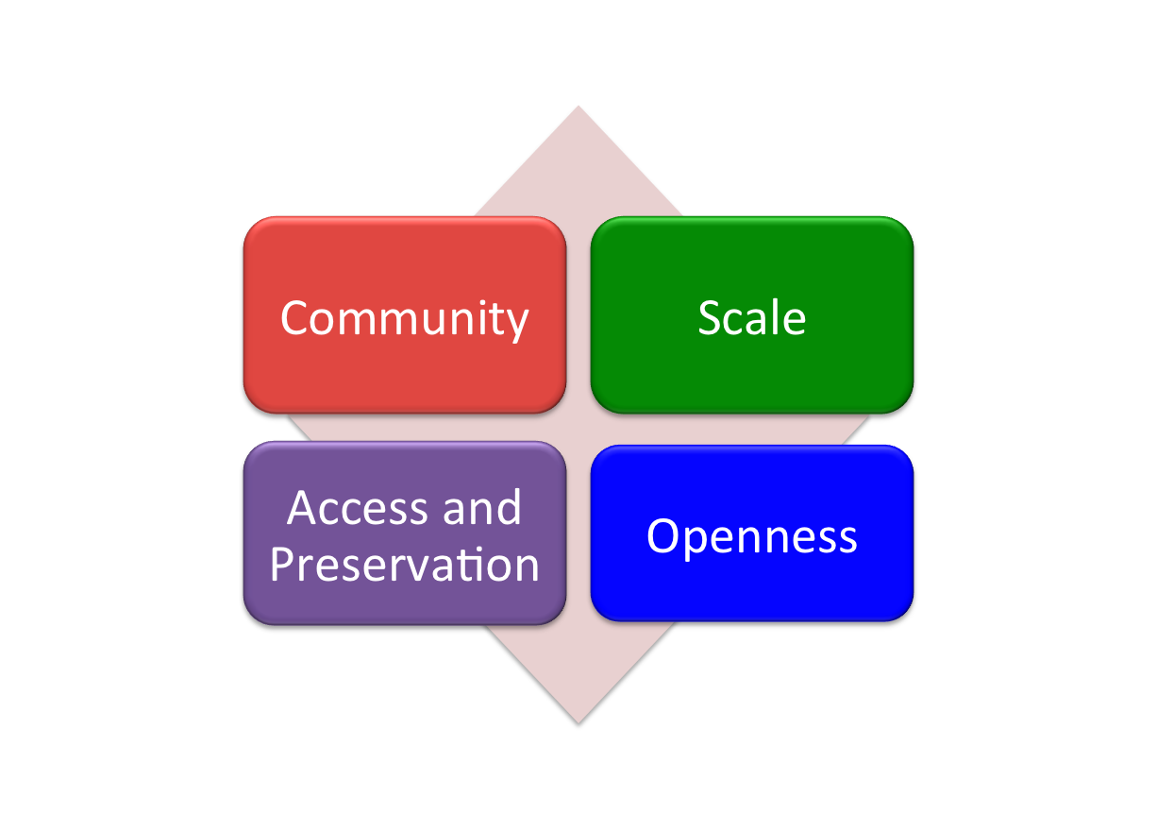
Underlying ideas

Slide 18
Underlying ideas
Experience

Slide 19
Repository Philosophy/Design
OAIS/TRAC
Consistency
Standardization
Simplicity (in design, not function)
Practicality
Sustainability

Slide 20
Source
Data Management
Access
Bib Data
Rights Data
Catalog
Ingest
Full-text Search
Holdings Data
Bibliographic Data
PageTurner
Content Package
Collections
Storage
Michigan
APIs
Indiana
Datasets

Slide 21
Source
Data Management
Access
Bib Data
Rights Data
Catalog
Ingest
Full-text Search
Holdings Data
Bibliographic Data
PageTurner
Content Package
Collections
Storage
Michigan
APIs
Indiana
Datasets

Slide 22
Content
Types and number of formats
ITU G4 TIFF
JP2
Unicode (with and without coordinates)
Open, meet community standards
Widely supported on a number of platforms
Confidence in preservation and migration
Transform to access formats

Slide 23
Content Package
images
text
Source METS
Zip
HT
METS

Slide 24
Source
Data Management
Access
Bib Data
Rights Data
Catalog
Ingest
Full-text Search
Holdings Data
Bibliographic Data
PageTurner
Content Package
Collections
Storage
Michigan
APIs
Indiana
Datasets

Slide 25
Source
Data Management
Access
Bib Data
Rights Data
Catalog
Ingest
Full-text Search
Holdings Data
Bibliographic Data
PageTurner
Content Package
Collections
Storage
Michigan
APIs
Indiana
Datasets

Slide 26
Storage
Reliability – ensure integrity
Redundancy – in single and multiple sites
Scalability – including ease of management
Accessibility – for repository processes and services
Platform-independence – for data/object management

Slide 27
Architecture & Management
../uc1/pairtree_root/b3/54/34/86/b34543486
images
text
Source METS
b34543486.zip
HT
METS
b34543486.mets.xml
bib
data
bib
data

Slide 28
Source
Data Management
Access
Bib Data
Rights Data
Catalog
Ingest
Full-text Search
Holdings Data
Bibliographic Data
PageTurner
Content Package
Collections
Storage
Michigan
APIs
Indiana
Datasets

Slide 29
Assessment

Slide 30
CRL Audit
Why
Value Community Standards
Accountability, Openness, Transparency
Desire to know how we were doing, and let the community know
Audit
Guided by criteria included in TRAC, as well as other metrics developed by CRL
HathiTrust’s practices are sound…appropriate to the content being archived and the general needs of the CRL community.

Slide 31
What was involved?
Timeline
Data gathering: November 2009 - December 2010
Site visit May 2010
Results in March 2011
Logistics
Question by email, documentation
Phone conversations
Staff: Project Librarian, Digital Preservation Librarian, Executive Director

Slide 32
Results
Organizational Infrastructure (2)
Mission statement, succession plan, staff, assessment, accountability, business plan, agreements
Digital Object Management (3)
Properties preserved, SIP, AIP, validation, naming conventions, identifiers, understandability, preservation strategies, logging, access policies
Technologies Technical Infrastructure Security (4)
Hardware, software, error-handling, change management, security, staff roles, disaster preparedness

Slide 33
Key Issues
Rights and ownership of HathiTrust enterprise assets
Succession plan
Clarify and strengthen quality assurance and print archiving components of the HathiTrust program

Slide 34
Future Work
Disaster Recovery
Change Management
Moving to new formats: image, audio, born-digital
Certification updates
Documentation
http://www.hathitrust.org/trac

Slide 35
Thank you!

Slide 36
How to find out more
About: http://www.hathitrust.org/about
Twitter: http://twitter.com/hathitrust
Facebook: http://www.facebook.com/hathitrust
Monthly newsletter:
http:www.hathitrust.org/updates
RSS http://www.hathitrust.org/updates_rss
Contact us: feedback@issues.hathitrust.org
Blogs: http://www.hathitrust.org/blogs
Large-scale Search
Perspectives from HathiTrust

