Slide 1
HathiTrust as a Model for Preservation and Access
Jeremy York
Media Preservation Conference
April 17, 2013

Slide 2
Does HathiTrust have plans to expand into storage and delivery of AV material?
If so, on what timetable?
What about cost models? Current costing for books may not be appropriate for large AV files.
What can CIC preservation officers and libraries do to help make this happen?
Copyright issues. Can HT provide preservation storage for files that, for now, we can't permit streaming delivery (much as in-copyright books can't be made available full-text)?

Slide 3
Does HathiTrust have plans to expand into storage and delivery of AV material? | TBD through shared governance
If so, on what timetable? | TBD
What about cost models? Current costing for books may not be appropriate for large AV files. | TBD
What can CIC preservation officers and libraries do to help make this happen? | Recommendation to to the Board
Copyright issues. Can HT provide preservation storage for files that, for now, we can't permit streaming delivery (much as in-copyright books can't be made available full-text)? | Issues of access TBD

Slide 4
Partnership
Arizona State University
Baylor University
Boston College
Boston University
Brandeis University
Brown University
California Digital Library
Carnegie Mellon University
Columbia University
Cornell University
Dartmouth College
Duke University
Emory University
Florida State University
Getty Research Institute
Harvard University Library
Indiana University
Iowa State University
Johns Hopkins University
Kansas State University
Lafayette College
Library of Congress
Massachusetts Institute of Technology
McGill University`
Michigan State University
New York Public Library
New York University
North Carolina Central
University
North Carolina State
University
Northwestern University
The Ohio State University
The Pennsylvania State
University
Princeton University
Purdue University
Stanford University
Syracuse University
Texas A&M University
Tufts University
Universidad Complutense
de Madrid
University of Alberta
University of Arizona
University of Calgary
University of California
Berkeley
Davis
Irvine
Los Angeles
Merced
Riverside
San Diego
San Francisco
Santa Barbara
Santa Cruz
The University of Chicago
University of Connecticut
University of Delaware
University of Florida
University of Houston
University of Illinois
University of Illinois at Chicago
The University of Iowa
University of Kansas
University of Maryland
University of Miami
University of Michigan
University of Minnesota
University of Missouri
University of Nebraska-Lincoln
The University of North
Carolina at Chapel Hill
University of Notre Dame
University of Pennsylvania
University of Pittsburgh
University of Utah
University of Vermont
University of Virginia
University of Washington
University of Wisconsin- Madison
Utah State University
Vanderbilt University
Virginia Tech
Wake Forest University
Washington University
Yale University Library

Slide 5
Digital Repository
Launched 2008
Initial focus on digitized book and journal content
10.6 million total volumes
5.6 million book titles
277,000 serial titles
3.3 million public domain (~31%)

Slide 6
Copyright Distribution
Notes:
6

Slide 7
Mission
To contribute to the common good by collecting, organizing, preserving, communicating, and sharing the record of human knowledge

Slide 8
Goals
Reliable and comprehensive archive of materials converted from print…co-owned
Improve access …to meet the needs of the co-owning institutions
Ensure the long-term preservation of content
Enable the digital archive to be accessible to users who have print disabilities
Coordinate shared storage strategies
“public good” …sustaining the historical record
Simultaneously …centralized …open

Slide 9
Short-term Objectives
PageTurner
Branding
Format validation, migration, error-checking
APIs (access and integrate information)
Accessible to users who have print disabilities
Public discovery interface
Virtual Collections
Mechanisms for direct ingest of non-Google-digitized content

Slide 10
Long-term Objectives
Compliance with TRAC
Robust discovery mechanism (full-text search)
Open service definition (development of access and discovery tools)
Support beyond books and journals
Development of data mining tools

Slide 11
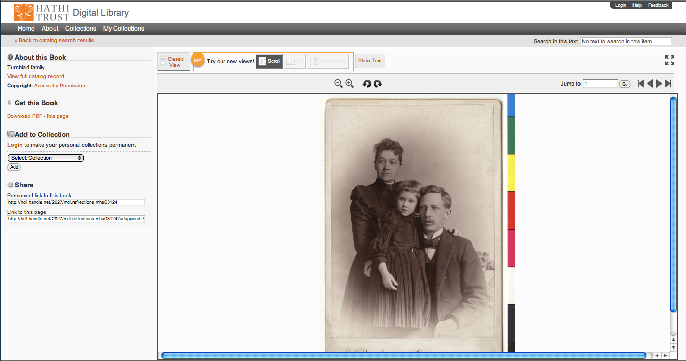
Support Beyond Books and Journals
University of Minnesota and statewide partners
~60,000 images
~20,000 currently accessible

Slide 12
Audio
Voice of American African Music Collection (Leo Sarkissian)
360 objects in HathiTrust
Production WAVE files
Mechanisms for packaging (specifications for METS and PREMIS), ingest
Rossiter collection
Oral histories: Women in the resistance, WWII
68 objects total
10 currently in HathiTrust

Slide 13
Collective Governance
Strategic Advisory Board
Guidance on Policy, Planning
Executive Committee
12-member Board of Governors
Chief Executive Officer
Executive Committee
Program Steering Committee Chair
HathiTrust
Budget/Finances
Decision-making

Slide 14
HathiTrust Board of Governors
Five year terms (beginning April, 2012):
Betsy Wilson (University of Washington)
Robert Wolven (Columbia University)
Four year terms:
Richard Clement (Utah State University)
Patricia Steele (University of Maryland)
Three year terms:
Carol Mandel (New York University)
Sarah Michalak (University of North Carolina-Chapel Hill)
Members appointed by the founding institutions:
Paul Courant (University of Michigan)
Carol Diedrichs (Ohio State University)
Laine Farley (California Digital Library)
Wendy Lougee (University of Minnesota)
Brian Schottlaender (University of California, San Diego)
Bradley Wheeler (Indiana University)

Slide 15
Program Steering Committee
Reviews development agenda
Shapes initiatives and strategies for Board discussion and decision-making
Considers implications of initiatives for the future
May appoint and charge working to assist with its work.
Reports to the Board of Governors recommended alterations in the development agenda based on reviews.
Based on its reviews, develops position papers for the member community to encourage debate or mobilize discussion with regard to particular issues.
Works with the Board of Governors to develop policies for HathiTrust and its members.

Slide 16
Executive Committee
Strategic Advisory Board
Budget/Finances Decision-making
Guidance on Policy, Planning
Collective Work: Working Groups and Committees
Operational
Communications
User Support
User Experience
Strategic
Collections
Discovery Interface
Full-text Search
Operational
Communications
User Support
User Experience
Distributed work
Driven by needs of institutions
Leverage across the partnership
Projects, Grant Work, Ingest Specifications, PageTurner, Bibliographic Data Management
HathiTrust

Slide 17
Costs
Partners share in infrastructure costs for public domain volumes:
(PD*C*X)/N
Share in infrastructure costs for in copyright volumes based on holdings
For a given in­copyright volume:
IC=(C*X)/H

Slide 18
Lawful Uses
Access to users who have print disabilities
http://www.hathitrust.org/accessibility
Access to materials that fall under Section 108
http://www.hathitrust.org/out-of-print-brittle
Under specific conditions
http://www.hathitrust.org/access_use#ic-access

Slide 19
Does HathiTrust have plans to expand into storage and delivery of AV material? | TBD through shared governance
If so, on what timetable? | TBD
What about cost models? Current costing for books may not be appropriate for large AV files. | TBD
What can CIC preservation officers and libraries do to help make this happen? | Recommendation to to the Board
Copyright issues. Can HT provide preservation storage for files that, for now, we can't permit streaming delivery (much as in-copyright books can't be made available full-text)? | Issues of access TBD

