Slide 1
Access Services in the Age of Mass Digitization
Ivies+ Symposium
April 20, 2012
Jeremy York, Project Librarian, HathiTrust

Slide 2
To what extent will digitization drive the use of print collections, and to what extent will it obviate the need for access to print?
How will services such as circulation, interlibrary loan, and course reserves be changed or transformed by mass digitization of print collections?
What new services may arise as a result of digitization?
How will libraries function as physical spaces as content increasingly moves online?
How will user expectations of instant, online access to resources shape the future of Access Services?
To what extent will shared print repositories or cooperative collection development change what we do and how we think about Access Services
Use of Print
Circulation, ILL, Reserves
New Services
Physical spaces
User expectations
Collaboration

Slide 3
  What are we trying to accomplish?
  What changes are occurring?
  Why are we digitizing?
  What HathiTrust is doing
  What implications for Access Services

Slide 4
What has made our universities the greatest in the world has not been the transmission of knowledge…but the ability to support the creation of new knowledge and change the world through our discoveries
  Jonathan Cole
    John Mitchell Mason Professor of the University and Provost and Dean of Faculties, Emeritus at Columbia University

Slide 5
This is what we are here to support
…but changes

Slide 6
Universities are:
Providing resources to others than themselves
  lectures, course materials, collections
Using resources from others than themselves
  Sharing resources, managing resources collaboratively
  Shared print storage, UBorrow, university publication, HathiTrust
Acquiring resources in different forms and formats
  Electronic vendors and platforms, the Web, datasets of different kinds
Producing resources that libraries have not traditionally handled
  Digital humanities projects, datasets

Slide 7
Other changes:
Teaching and learning
  Relationship between teacher and student (mentorship)
  Approaches to learning – entrepreneurial, playful, interdisciplinary, collaborative; “active learning classrooms”, students helping to design learning experience, peer critique
Data-driven infrastructure
  Ben Showers of JISC: rivers of data we collect, make available for reuse; think of data rather than discovery systems; focus on use-cases for data
  Managing data, facilitating reuse, becomes asset

Slide 8
Changing roles of librarians
In data-driven environment, it is not data retrieval (a transaction), but ability to answer questions (an experience) that make libraries valuable – Stephen Abram
  Designing an experience around the data

Slide 9
Embedded librarian
  “…reposition library and information tools, resources, and expertise so that they are embedded into the teaching, learning, and research enterprises.” – David Lewis (from New Roles for New Times)
Blended librarian
  Integrating instructional design and technology into librarian skill set; better serve faculty and students through deeper engagement in teaching and learning – Stephen Bell and John Shank (summary from Paul Zenke)

Slide 10
Where does digitization fit in?
Provision of scholarly record
  Access
  Preservation
    Recognizing digitization as a preservation reformatting method, ARL, 2004
Hub around which to organize activities

Slide 11
What is HathiTrust

Slide 12
Partnership
Arizona State University
Baylor University
Boston College
Boston University
California Digital Library
Columbia University
Cornell University
Dartmouth College
Duke University
Emory University
Florida State University
Getty Research Institute
Harvard University Library
Indiana University
Johns Hopkins University
Lafayette College
Library of Congress
Massachusetts Institute of Technology
McGill University`
Michigan State University
New York Public Library
New York University
North Carolina Central
University
North Carolina State
University
Northwestern University
The Ohio State University
The Pennsylvania State
University
Princeton University
Purdue University
Stanford University
Texas A&M University
Universidad Complutense
de Madrid
University of Arizona
University of Calgary
University of California
Berkeley
Davis
Irvine
Los Angeles
Merced
Riverside
San Diego
San Francisco
Santa Barbara
Santa Cruz
The University of Chicago
University of Connecticut
University of Delaware
University of Florida
University of Illinois
University of Illinois at Chicago
The University of Iowa
University of Maryland
University of Miami
University of Michigan
University of Minnesota
University of Missouri
University of Nebraska-Lincoln
The University of North
Carolina at Chapel Hill
University of Notre Dame
University of Pennsylvania
University of Pittsburgh
University of Utah
University of Virginia
University of Washington
University of Wisconsin- Madison
Utah State University
Washington University
Yale University Library

Slide 13
Digital Repository
Launched 2008
Initial focus on digitized book and journal content
  10,203,436 total volumes
  5,419,737 book titles
  268,872 serial titles
  2,887,976 public domain (~28%)

Slide 14
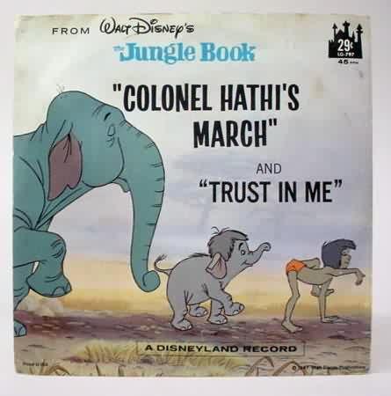
The Name
The meaning behind the name
  Hathi (hah-tee)--Hindi for elephant
  Big, strong
  Never forgets, wise
  Secure
  Trustworthy

Slide 15
Mission
To contribute to the common good by collecting, organizing, preserving, communicating, and sharing the record of human knowledge

Slide 16
Collections and Collaboration
Comprehensive collection
  Preservation…with Access
Shared strategies
  Copyright
  Collection management, development
  Preservation
  Discovery / Use
  Bibliographic Indeterminacy
  Efficient user services
Public Good

Slide 17
Preservation and Access

Slide 18
Preservation with Access
Cost effective preservation and access services
Preservation
  TRAC-certified
  Robust infrastructure
  Long-term commitments on digital content facilitate planning, decision-making

Slide 19
Preservation with Access (2)
Discovery
  Bibliographic and full-text search of all materials
  Extended discovery (ProQuest, EBSCO, OCLC, Ex Libris)
  Mechanisms for local loading of records

Slide 20
Preservation with Access (3)
Access and Use
  Public domain and open access works
  Full download of materials where possible*
  Print on demand
  Building Services on top of the repository
    Collections and APIs
  Research Center*
  Lawful uses of in-copyright works*

Slide 21
Lawful uses
Access to users who have print disabilities
Section 108 uses of materials
Access to orphan works

Slide 22
Terms of Access
Available to students, faculty, staff of partnering institutions
  On library premises or authenticated into HathiTrust
Partner libraries own a print copy
  One simultaneous user per print copy owned
Users must be on U.S. soil
One page at a time download

Slide 23
How do we facilitate uses?
Fundamental issues of
  Identification
  Description
  Rights

Slide 24
Copyright

Slide 25
Automatic Rights Determination
Conducted on all works at time of ingest and when records are modified
  Public domain worldwide
    US works published before 1923, US federal government publications, non-US works published prior to 1872
  Public domain in the United States
    Non-US works published between 1872 and 1923

Slide 26
Manual Rights Determination
IMLS-funded CRMS project
  US-published works 1923-1963
  Conformance with formalities
  Expanding to non-US works
  Double-blind review with expert review for conflicts
  Staff at 4 HathiTrust partner institutions (15 will take part in non-US)
  As of February 2012 ~190,000 reviewed, more than 100,000 opened
Rights Holder Permissions

Slide 27
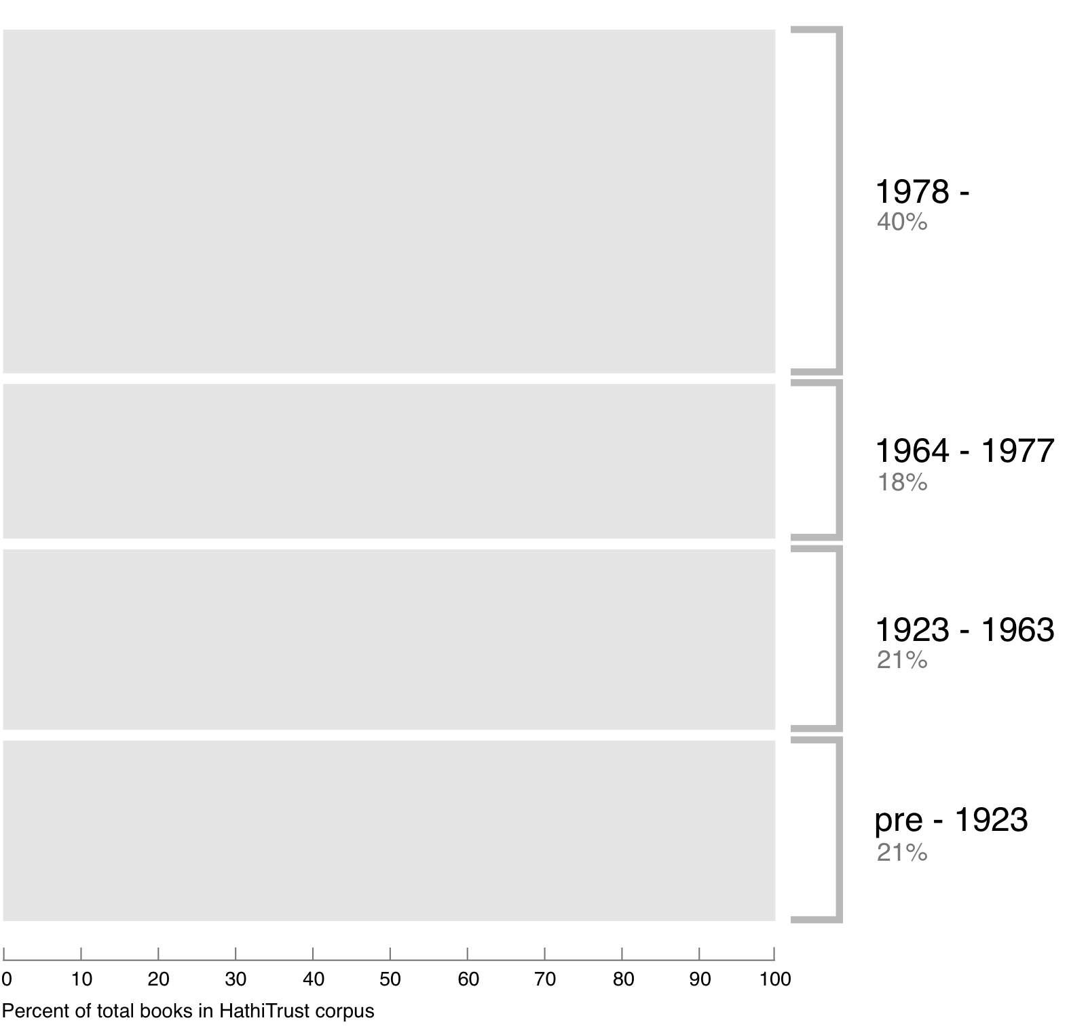
Breakdown of HathiTrust book corpus by publication date
Bibliographic Indeterminacy and the Scale of Problems and Opportunities of "Rights" in Digital Collection Building – 2/2011

Slide 28
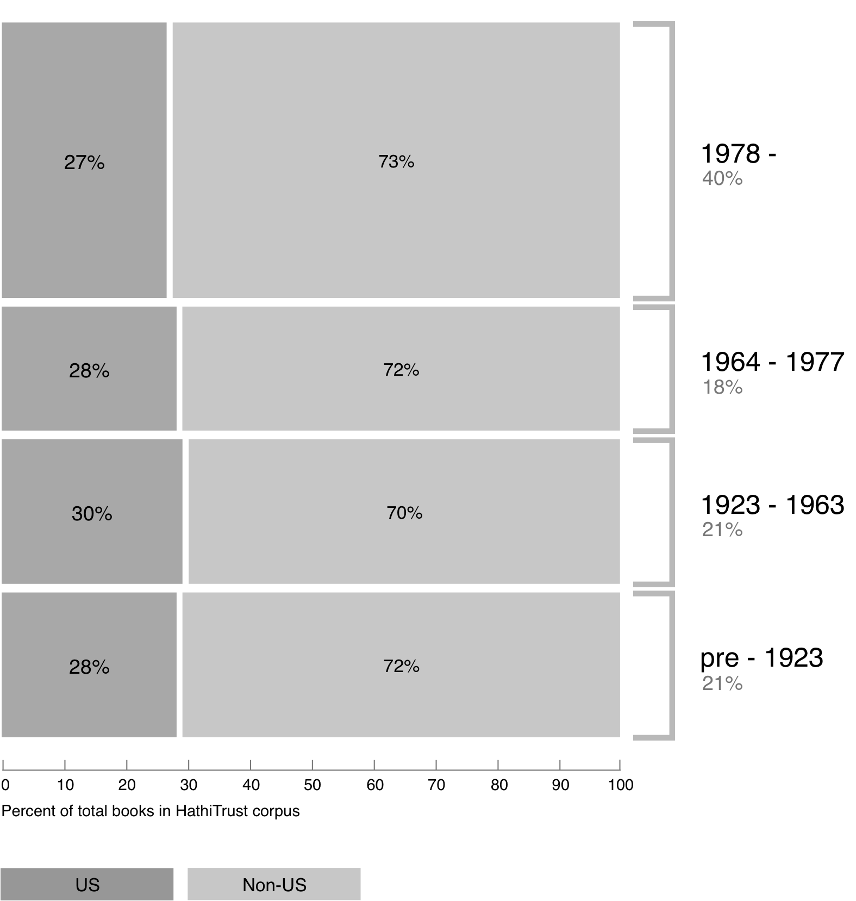
Breakdown of HathiTrust book corpus by publication date

Slide 29
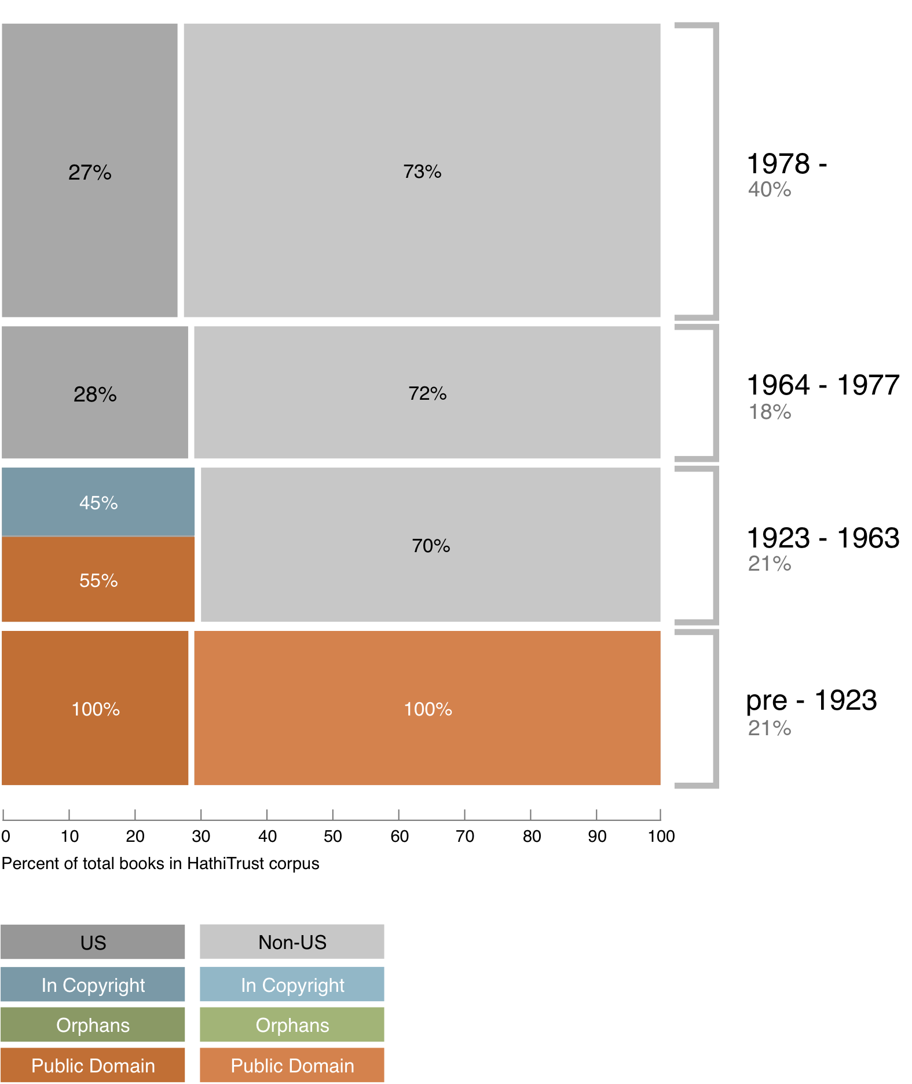
Copyright status of books published pre-1923 and US works published 1923-1963

Slide 30
Copyright status of books published pre-1923 and US works published 1923-1963
?

Slide 31
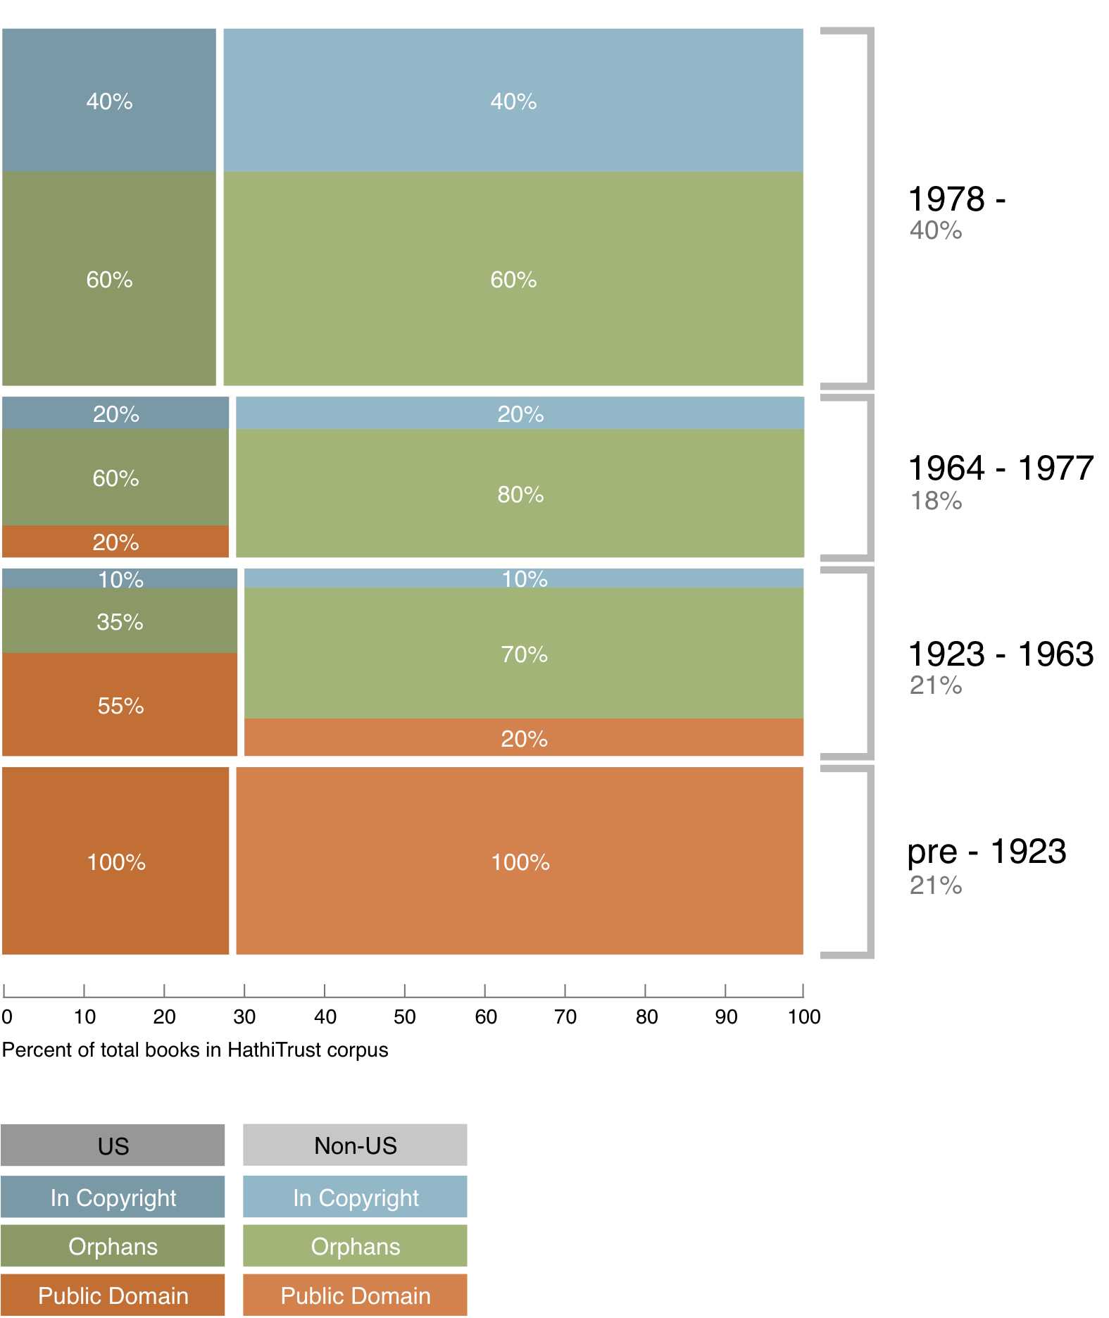
Copyright status of books published pre-1923 and US works published 1923-1963

Slide 32
Copyright status of books published pre-1923 and US works published 1923-1963
In Print ?

Slide 33
Collection Management, Development

Slide 34
A global change in the library environment
Academic print book collection already substantially duplicated in mass digitized book corpus
June 2010
Median duplication: 31%
June 2009
Median duplication: 19%
Notes:
34

Slide 35
Digitized Books in Shared Repositories
~3.5M titles
~75% of mass digitized corpus is ‘backed up’ in one or more shared print repositories
~2.5M
Notes:
35

Slide 36
Collection Management, Development
Overlap
  More than 50% median overlap with ARL institutions; higher for small liberal arts colleges
Pricing model based on Print holdings
  Requires print holdings database
  Also support expansion of legal uses, efforts in de-duplication
  Facilitate individual and collaborative collection development and management operations
Print monographs archiving

Slide 37
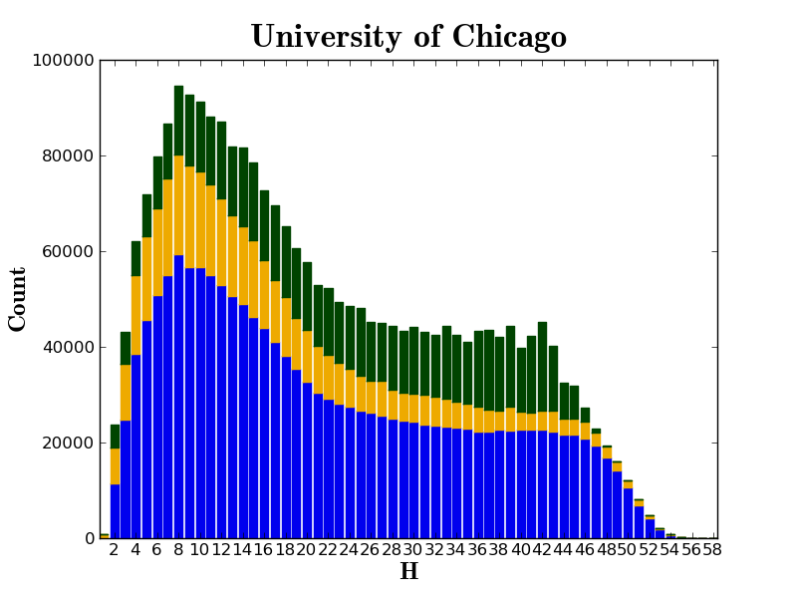

Slide 38
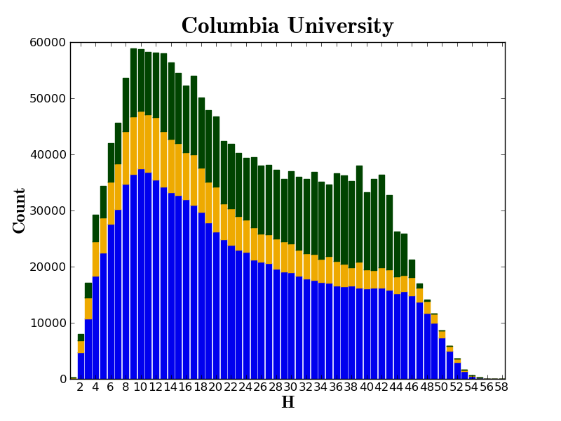

Slide 39
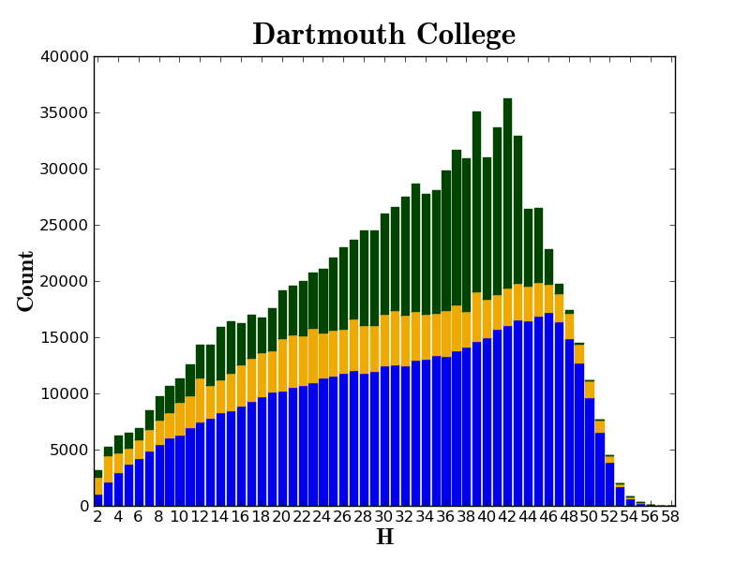

Slide 40
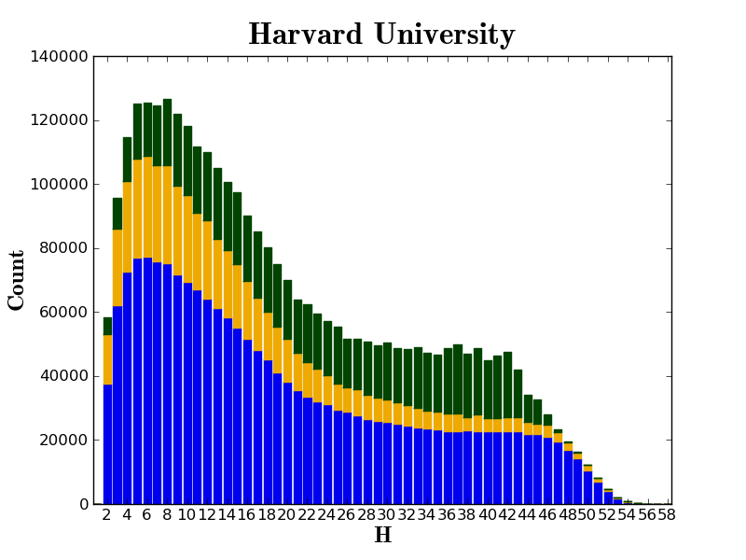

Slide 41
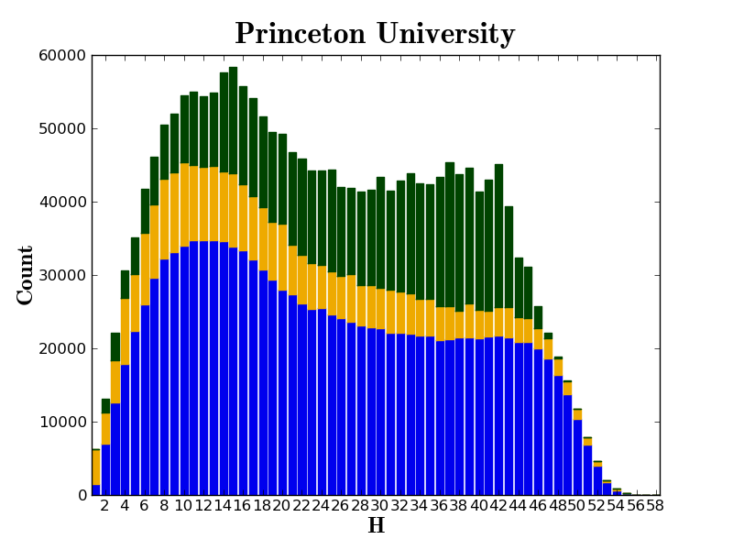

Slide 42
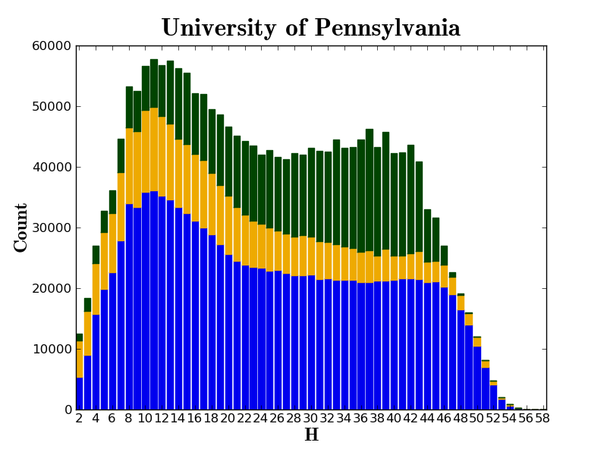

Slide 43
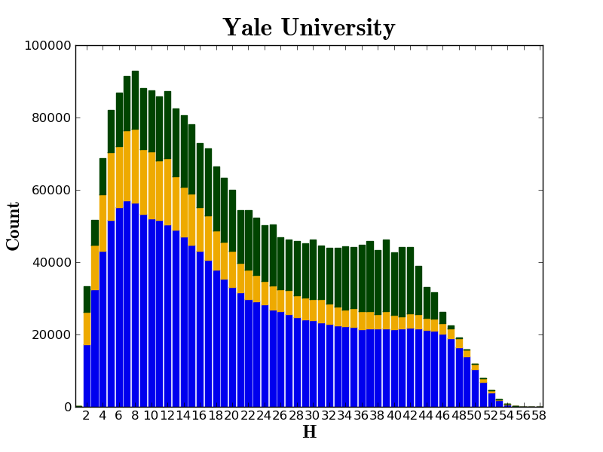

Slide 44
What does this mean for access services?
  What happens if we succeed

Slide 45
Do we know what effect digitization is having currently?
Columbia
University of Michigan

Slide 46
Issues:
  What does usage mean (comparing digital accesses with requests)
  Accessibility of the print and digital materials
  Habits; what disciplines the volumes are from and how likely those people are to use digital; effect over time?
  Usefulness of digital copies (interface, quality)

Slide 47
Inter-library loan
Direct Lending
Shared services related to print management

Slide 48
“…cooperative access and preservation agreements that address the ongoing need for a library print supply chain for in-copyright, digitized books are an essential part of the emerging shared service environment.”
- Constance Malpas, “Cloud-sourcing Research Library Collections: Managing Print in the Mass-digitized Library Environment”

Slide 49
Digitization is changing things, but…
  Back end
    Identification/description
    Copyright
    Third-party agreements
    Service agreements
  Front end
    User needs/preferences

Slide 50
To what extent will digitization drive the use of print collections, and to what extent will it obviate the need for access to print?
How will services such as circulation, interlibrary loan, and course reserves be changed or transformed by mass digitization of print collections?
What new services may arise as a result of digitization?
How will libraries function as physical spaces as content increasingly moves online?
How will user expectations of instant, online access to resources shape the future of Access Services?
To what extent will shared print repositories or cooperative collection development change what we do and how we think about Access Services
Use of Print
Circulation, ILL, Reserves
New Services
Physical spaces
User expectations
Collaboration
Notes:
What are some things to consider, then, in getting handle on some of these other questions?

Slide 51
Consider digital collections in relation to needs:
  What does a generalized, shared collection of materials mean in a more collaborative environment?

Slide 52
Support inquiry and
creation of new knowledge
How do we…
Using…
Generalized, shared collection of digital materials
Increasingly interconnected collections of print materials
Special collections
Physical spaces

Slide 53
In an environment that is…
Increasingly collaborative
Institution to institution
In the classroom
Data-driven
Use and Reuse of materials
Bits of data
  Text of these volumes on reserve for analysis
  All of the place names in a group of texts
  Assisting with marking up materials
How do we design an experience around the data?
User-Driven
How will users use our data?
What will our role be in delivering services?
User outputs drive the data we make available for use and reuse

Slide 54
Support inquiry and
creation of new knowledge
Resources
Services
Generalized, shared collection of digital materials
Increasingly collaborative
Data-driven
Increasingly interconnected collections of print materials
Special collections
User-Driven
Physical spaces
Availability of resources
Determined by how we manage them; impacted by collaboration (local and global) to meet shared challenges (preservation, copyright, collection management)
Effects what is available to users

Slide 55
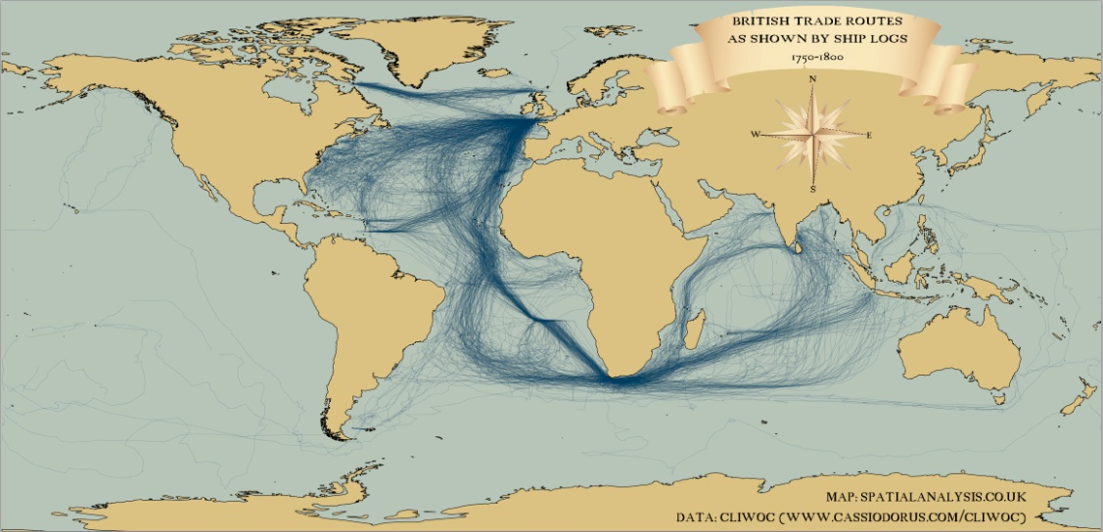
18th Century British Shipping 1750-1800
- James Cheshire, Centre for Advanced Spatial Analysis, University College London
http://spatialanalysis.co.uk/2012/03/mapped-british-shipping-1750-1800/

Slide 56
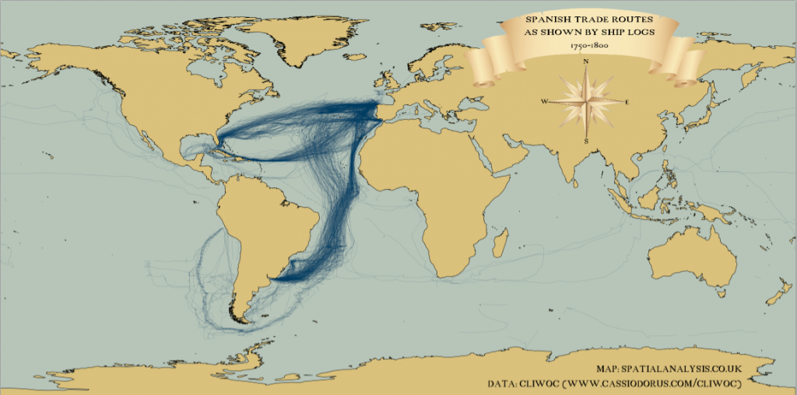
18th Century Spanish Shipping 1750-1800
- James Cheshire, Centre for Advanced Spatial Analysis, University College London

Slide 57
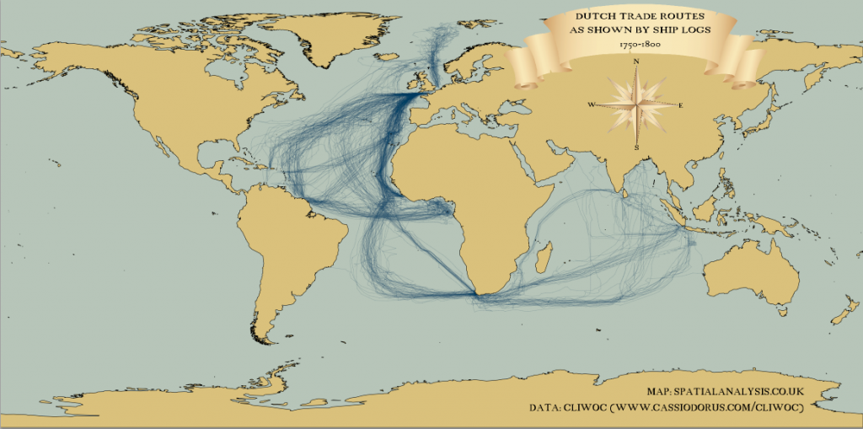
18th Century Dutch Shipping 1750-1800
- James Cheshire, Centre for Advanced Spatial Analysis, University College London

Slide 58
References
Association of Research Libraries. ARL 2030 Scenarios: A User’s Guide for Research Libraries, October, 2010. http://www.arl.org/rtl/plan/scenarios/usersguide/index.shtml.
Bell, Stephen. “‘Design Thinking’ and Higher Education.” Inside Higher Ed, March 2, 2010. http://www.insidehighered.com/views/2010/03/02/bell.
Bell, Stephen, and John Shank. “Blended Librarian.” Blended Librarian, n.d. http://blendedlibrarian.org/overview.html.
Burn-Murdoch, John. “18th Century Shipping Mapped Using 21st Century Technology.” The Guardian, April 13, 2012, sec. News. http://www.guardian.co.uk/news/datablog/2012/apr/13/shipping-routes-history-map.
Cheshire, James. “Mapped: British, Spanish, and Dutch Shipping 1750-1800.” Spatial Analysis, March 30, 2012. http://spatialanalysis.co.uk/2012/03/mapped-british-shipping-1750-1800/.
Cole, Jonathan. “Can Graduate Education Survive As We Know It?”, University of Michigan, April 5, 2012.
Courant, Paul. Testimony of Dean Paul Courant at February 18, 2010 Fairness Hearing on Proposed Settlement, 2010. http://www.lib.umich.edu/michigan-digitization-project/fairness-hearing-testimony-of-dean-paul-courant.
DeBonis, Laura. “Defending the Future of Books.” Google, February 8, 2006. http://googleblog.blogspot.com/2006/02/defending-future-of-books.html.

Slide 59
Delbanco, Andrew. “College at Risk.” The Chronicle of Higher Education, February 26, 2012, sec. The Chronicle Review. http://chronicle.com/article/College-at-Risk/130893/.
Desantis, Nick. “Online-Education Start-Up Teams With Top-Ranked Universities to Offer Free Courses.” The Chronicle of Higher Education. The Wired Campus, April 18, 2012. http://chronicle.com/blogs/wiredcampus/online-education-start-up-teams-with-top-ranked-universities-to-offer-free-courses/36048?sid=at&utm_source=at&utm_medium=en.
Look, Helen. “Mass Digitization: Analyzing Online Vs. Print Usage at a Large Academic Research Library”, n.d. http://www.arl.org/bm~doc/LookPoster.pdf.
Malpas, Constance. Cloud-sourcing Research Collections: Managing Print in the Mass-digitized Library Environment, January 2011. http://www.oclc.org/research/publications/library/2011/2011-01.pdf.
Showers, Ben. “Data-driven Library Infrastructure” presented at the UKSG Annual Conference, Glasgow, Scotland, March 26, 2012. http://infteam.jiscinvolve.org/wp/2012/03/29/data-driven-library-infrastructure-uksg-2012-presentation/.
Spiro, Lisa. “Imagining the Future of the University.” The Chronicle of Higher Education. ProfHacker, March 15, 2012. http://chronicle.com/blogs/profhacker/imagining-the-future-of-the-university/39021?sid=at&utm_source=at&utm_medium=en.
Staley, David, Kara Malenfant, and Association of College and Research Libraries. Futures Thinking for Academic Librarians: Higher Education in 2025, June 2010. http://www.ala.org/acrl/sites/ala.org.acrl/files/content/issues/value/futures2025.pdf.

Slide 60
Sullivan, Brian. “Academic Library Autopsy Report”, January 2, 2011. http://chronicle.com/article/Academic-Library-Autopsy/125767/.
Summers, Lawrence H. “What You (Really) Need to Know.” The New York Times, January 20, 2012, sec. Education / Education Life. http://www.nytimes.com/2012/01/22/education/edlife/the-21st-century-education.html.
Walters, Tyler, and Katherine Skinner. Digital Curation for Preservation. New Roles for New Times. Association of Research Libraries, March 2011. http://www.arl.org/bm~doc/nrnt_digital_curation17mar11.pdf.
Zenke, Paul. “The Emerging and Future Roles of Academic Libraries.” Education Futures, March 28, 2011. http://www.educationfutures.com/2011/03/28/the-emerging-and-future-roles-of-academic-libraries/.
———. “The Future of Academic Libraries: An Interview with Steven J Bell.” Education Futures, March 26, 2012. http://www.educationfutures.com/2012/03/26/the-future-of-academic-libraries-an-interview-with-steven-j-bell/.

