Slide 1
HathiTrust: Strategies and Challenges in Consolidating the Published Record
National Diet Library
August 2, 2012
John Wilkin, Executive Director, HathiTrust
Unless otherwise noted, these slides and their contents are licensed under a Creative Commons Attribution Unported License.

Slide 2
Partnership
Arizona State University
Baylor University
Boston College
Boston University
Brandeis University
California Digital Library
Carnegie Mellon University
Columbia University
Cornell University
Dartmouth College
Duke University
Emory University
Florida State University
Getty Research Institute
Harvard University Library
Indiana University
Johns Hopkins University
Kansas State University
Lafayette College
Library of Congress
Massachusetts Institute of Technology
McGill University`
Michigan State University
New York Public Library
New York University
North Carolina Central
University
North Carolina State
University
Northwestern University
The Ohio State University
The Pennsylvania State
University
Princeton University
Purdue University
Stanford University
Syracuse University
Texas A&M University
Universidad Complutense
de Madrid
University of Arizona
University of Calgary
University of California
Berkeley
Davis
Irvine
Los Angeles
Merced
Riverside
San Diego
San Francisco
Santa Barbara
Santa Cruz
The University of Chicago
University of Connecticut
University of Delaware
University of Florida
University of Illinois
University of Illinois at Chicago
The University of Iowa
University of Kansas
University of Maryland
University of Miami
University of Michigan
University of Minnesota
University of Missouri
University of Nebraska-Lincoln
The University of North
Carolina at Chapel Hill
University of Notre Dame
University of Pennsylvania
University of Pittsburgh
University of Utah
University of Vermont
University of Virginia
University of Washington
University of Wisconsin- Madison
Utah State University
Virginia Tech
Washington University
Yale University Library

Slide 3
Digital Repository
Launched 2008
Initial focus on digitized book and journal content
  10.6 million total volumes
  5.5 million book titles
  275,000 serial titles
  3.2 million public domain (~31%)

Slide 4
Services
Long-term preservation
  Bit-level and migration
Bibliographic search
Full-text search
Reading and download capabilities
Print on demand
Collections
Datasets, Research Center

Slide 5
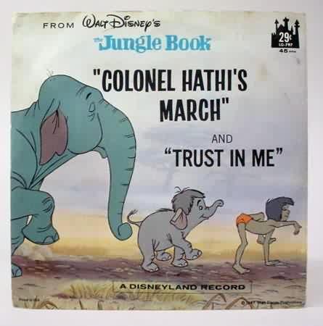
The Name
The meaning behind the name
  Hathi (hah-tee)--Hindi for elephant
  Big, strong
  Never forgets, wise
  Secure
  Trustworthy

Slide 6
Mission
To contribute to the common good by collecting, organizing, preserving, communicating, and sharing the record of human knowledge

Slide 7
HathiTrust
Universal Library
Common Goal
Single Entity, Many Partners

Slide 8
Goals
Reliable and comprehensive archive of materials converted from print…co-owned
Ensure the long-term preservation of content
Improve access …to meet the needs of the co-owning institutions
Coordinate shared storage strategies
“public good” …sustaining the historical record
Simultaneously …centralized …open

Slide 9
Strategies and Challenges

Slide 10
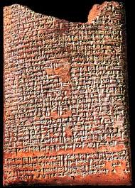
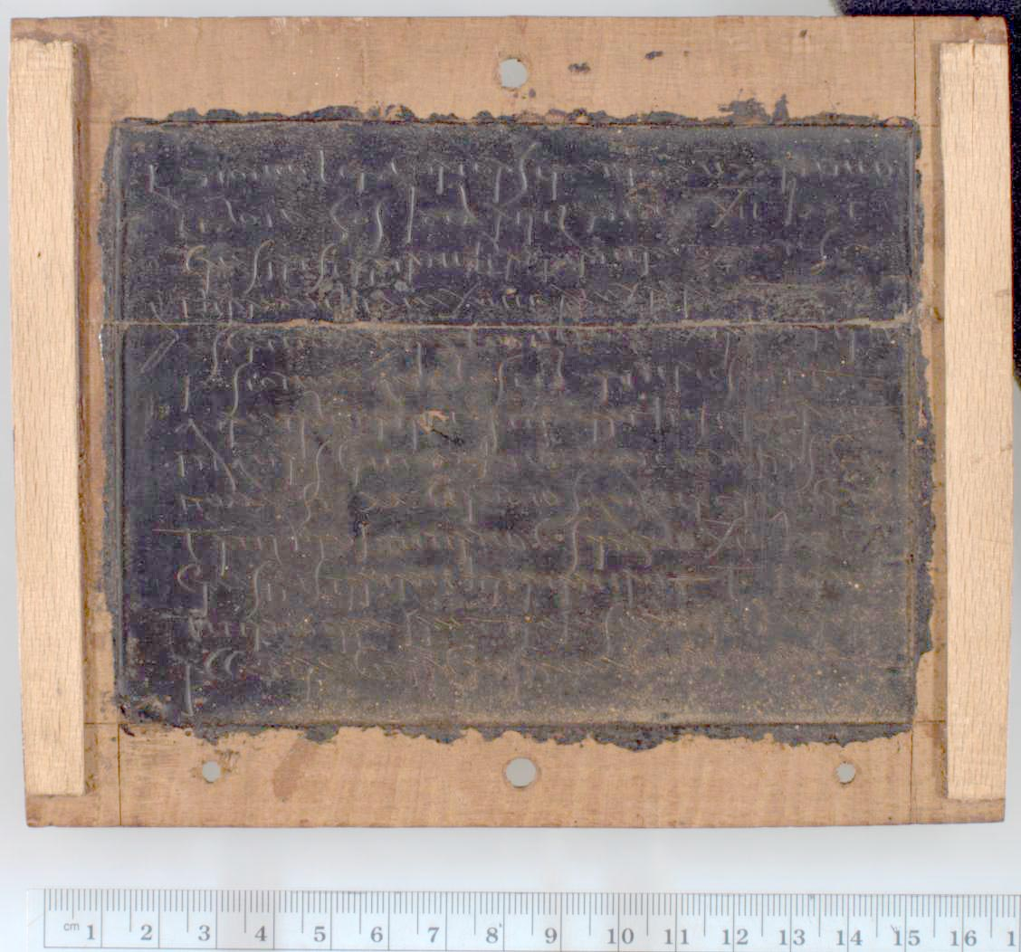
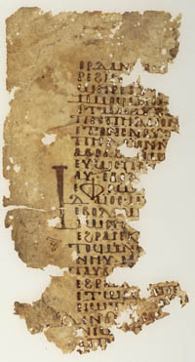
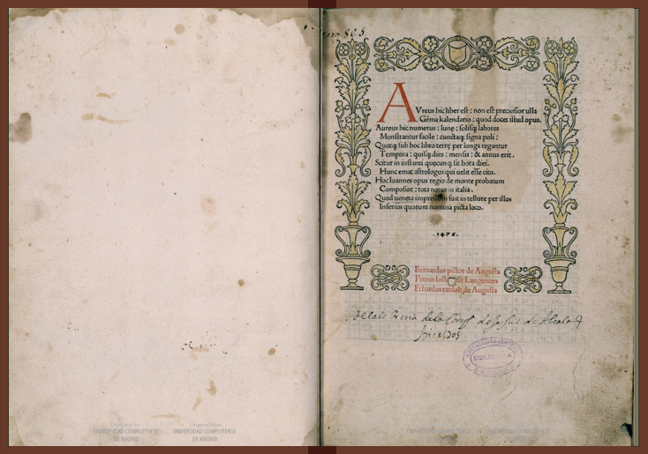
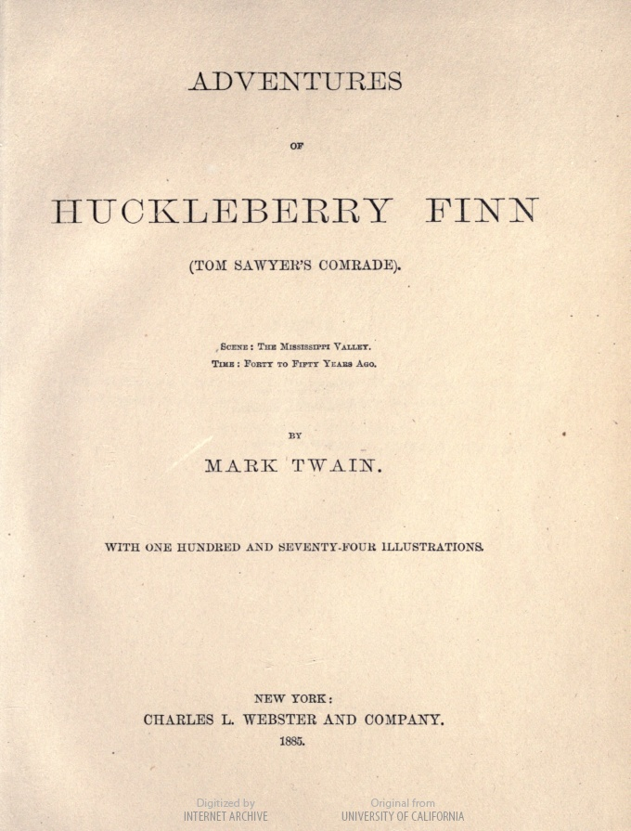
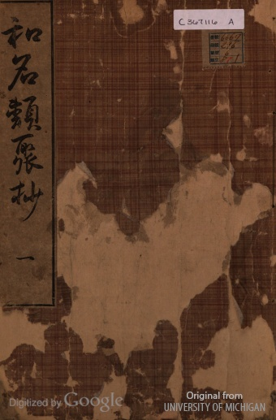
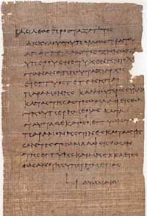
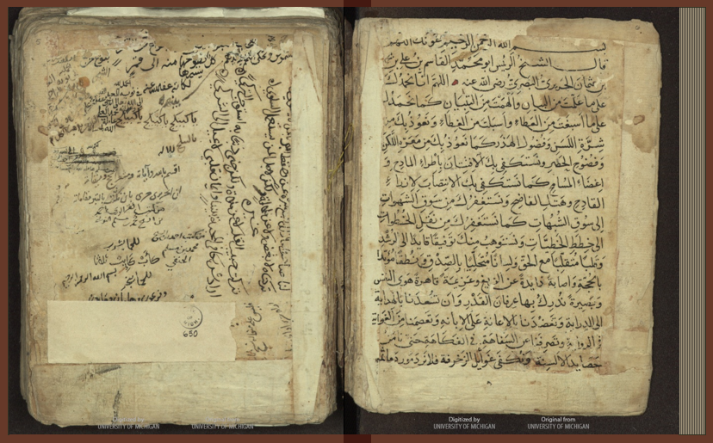
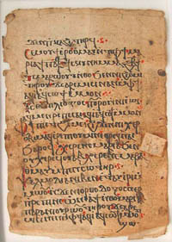
What is the published record?

Slide 11
Published Record
Currently published literature
  print and digital
Published literature already owned by libraries
  print
Special Collections
  rare, unique, often unpublished, various types
New genres of scholarly communication
  databases, data, collaborative authorship

Slide 12
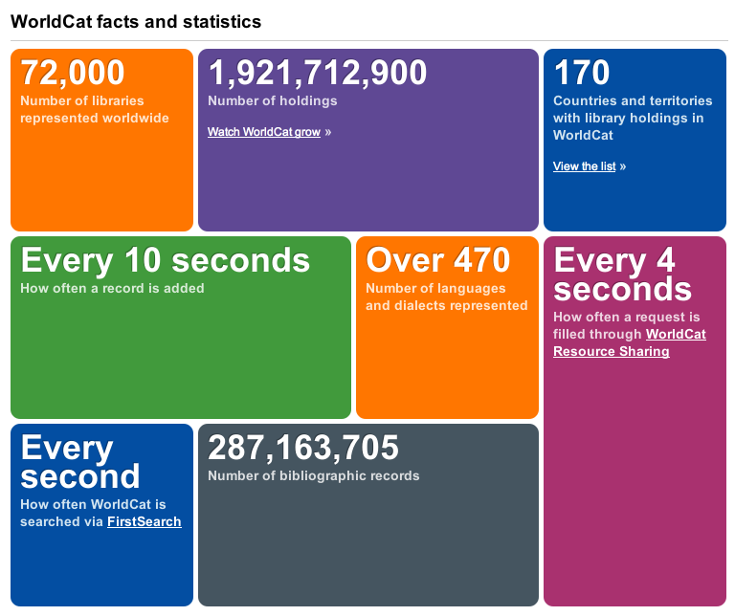
* As of December 2012

Slide 13
Japan
United States
 | Libraries | Volumes
Academic Libraries | 1,357 | 307,267,000
National Libraries | 1 | 9,698,593
Public Libraries | 3,126 | 372,862,000
School Libraries | 40,639 | 400,973,468
Special Libraries | 584 | 33,007,593
Total | 45,707 | 1,123,808,654
 | Libraries | Volumes
Academic Libraries | 3,689 | 1,076,027,407
National Libraries | 4 | 75,150,000
Public Libraries | 9,225 | 815,909,000
School Libraries | 81,920 | 399,918,034
Special Libraries | 8,819 | 229,161,950
Total | 103,657 | 2,596,166,391
http://www.oclc.org/globallibrarystats/default.htm

Slide 14
What do we mean by consolidation?
Shared infrastructure
  Centralized
    Administration: Ingest, validation, content integrity
    Functionality: full-text search, viewing print on demand
  Geographically distributed
    In terms of backup, disaster recovery, digitization, content preparation

Slide 15
Strategies and Challenges: Reliable, Comprehensive, Co-owned Archive

Slide 16
Reliable and comprehensive archive of materials converted from print…co-owned
Objectives/Challenges
  Mechanisms for direct ingest of non-Google-digitized content
  Support beyond books and journals
  Compliance with TRAC
    Organizational model

Slide 18
Mechanisms for Direct Ingest

Slide 19

Dates
Notes:
19

Slide 20
Language Distribution (1)
The top 10 languages make up ~86% of all content
Notes:
20

Slide 21
Language Distribution (2)
The next 40 languages make up ~13% of total
Notes:
21

Slide 22

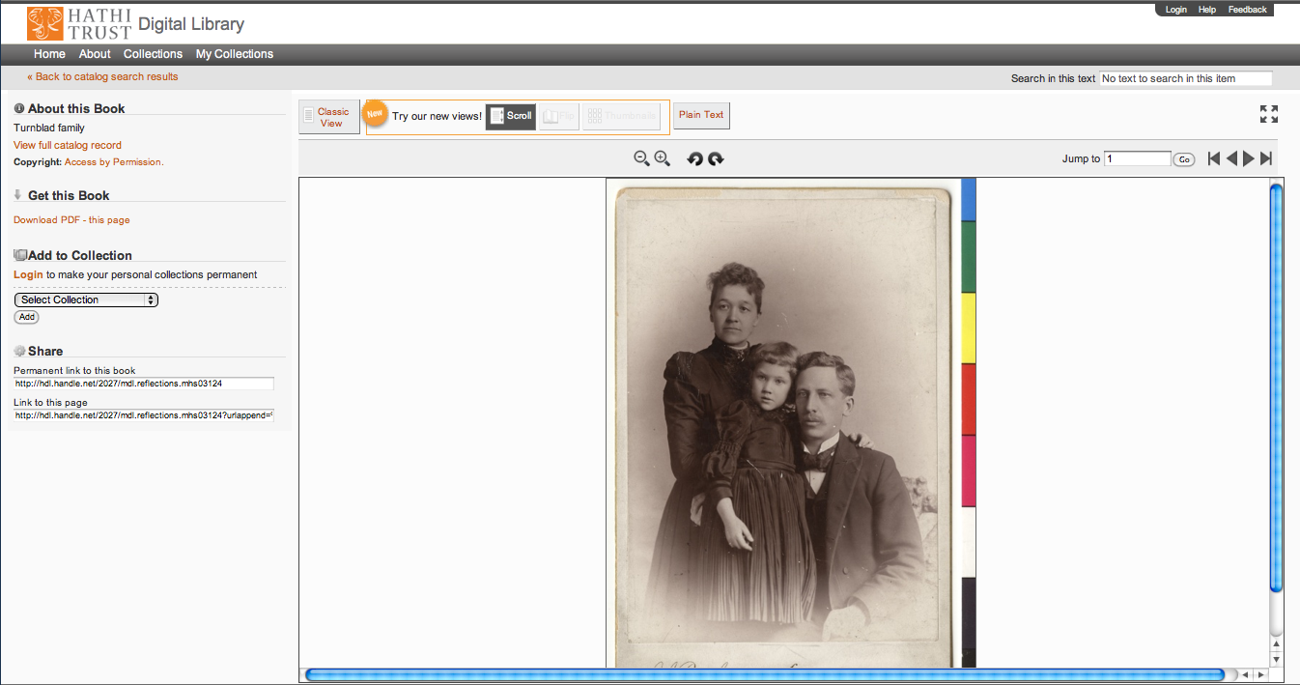
Support Beyond Books and Journals

Slide 23
Compliance with TRAC

Slide 24
Executive Committee
Strategic Advisory Board
Budget/Finances Decision-making
Guidance on Policy, Planning
Collective Work: Working Groups and Committees
Operational
  Communications
  User Support
  User Experience
  Strategic
  Collections
  Discovery Interface
  Full-text Search
Operational
Communications
User Support
User Experience
Distributed work
Driven by needs of institutions
Leverage across the partnership
Projects, Grant Work, Ingest Specifications, PageTurner, Bibliographic Data Management
HathiTrust

Slide 25
Governance
Budget, Finances
Decision-making
Policy
Planning
Repository Administration
Web and application server configuration and maintenance
Security
Permissions
Logging
Repository Administration
Data management (content storage, backup, integrity checks, deletion)
Content and Metadata specifications
Disaster Recovery
Processes for ensuring content integrity
Rights Management
Copyright determination
Copyright review
Copyright information management (database)
Rightsholder permissions
Bibliographic Data Management
Entity description (record-level)
Object identification (item-level)
Collection Development
Digital
Expansion beyond books and journals (born-digital, images and maps, audio)
Selection of content (for non-Google volume ingest and pilots projects)
Print
Cloud Library (effect of digital on print)
Hardware selection and replacement
Enterprise Management
Communication and Coordination with partner institutions
Hardware configuration and maintenance
Project management
Data availability
e-Commerce
Content Access
PageTurner
Collection Builder
Large-scale Search
Bibliographic Catalog
Research Center
APIs
Quality Assurance
Quality Review
Content Certification
User Services
Usability
User support (helpdesk)
Outreach
Project website
Monthly newsletter
Papers and presentations
Communication with potential partners
Surveys, general inquiries
Repository evaluation and audit (e.g., DRAMBORA, TRAC)
Legal
Risk management (use of materials)
Partner agreements
Advocacy
Content Ingest
Transformation
Validation
Print on Demand
Financial contributions of partners
HathiTrust Functional Framework

Slide 26
Constitutional Convention
October 2011
52 partners
3-year review overseen by SAB
Ballot Proposals
  Print monograph storage
  Approval Process for development initiatives
  U.S. Government Documents
  Fee-for-service content deposit
  Governance

Slide 27
Strategic Advisory Board
Guidance on Policy, Planning
12-member Board of Governors
Executive Committee
Executive Director
Executive Committee
HathiTrust
Budget/Finances
Decision-making

Slide 28
Strategies and Challenges: Preservation, Print Storage, Public Good

Slide 29
Ensure the long-term preservation of content
Coordinate shared storage strategies
“public good” …sustaining the historical record
  Challenges
    Infrastructure, Scalability
    Pricing Model
    Member services

Slide 30
Preservation

Slide 31
Repository Philosophy/Design
OAIS/TRAC
Consistency
Standardization
Simplicity (in design, not function)
Practicality
Sustainability

Slide 32
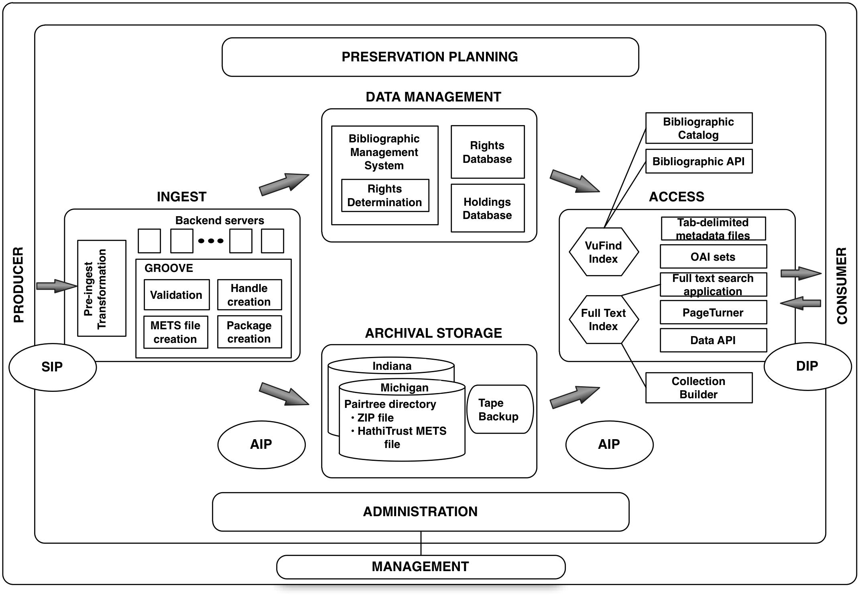

Slide 37
Content
Largely uniform in technical characteristics
3 formats
  ITU G4 TIFF
  JP2
  Unicode (with and without coordinates)

Slide 38

Architecture & Management
../uc1/pairtree_root/b3/54/34/86/b34543486
images
text
Source METS
b34543486.zip
HT
METS
b34543486.mets.xml
Example ids:
wu.89094366434
mdp.39015037375253
uc2.ark:/1390/t26973133
miua.aaj0523.1950.001
bib
data
bib
data

Slide 39
Coordinate Storage Strategies

Slide 40
A global change in the library environment
Academic print book collection already substantially duplicated in mass digitized book corpus
June 2010
Median duplication: 31%
June 2009
Median duplication: 19%
Courtesy of Constance Malpas, OCLC Research
Notes:
40

Slide 41
Digitized Books in Shared Repositories
~3.5M titles
~75% of mass digitized corpus is ‘backed up’ in one or more shared print repositories
~2.5M
Courtesy of Constance Malpas, OCLC Research
Notes:
41

Slide 42
Collection Management, Development
Overlap
  More than 50% median overlap with ARL institutions; higher for small liberal arts colleges
Pricing model based on Print holdings
  Requires print holdings database
  Also support expansion of legal uses, efforts in de-duplication
  Facilitate individual and collaborative collection development and management operations
Print monographs archiving

Slide 43
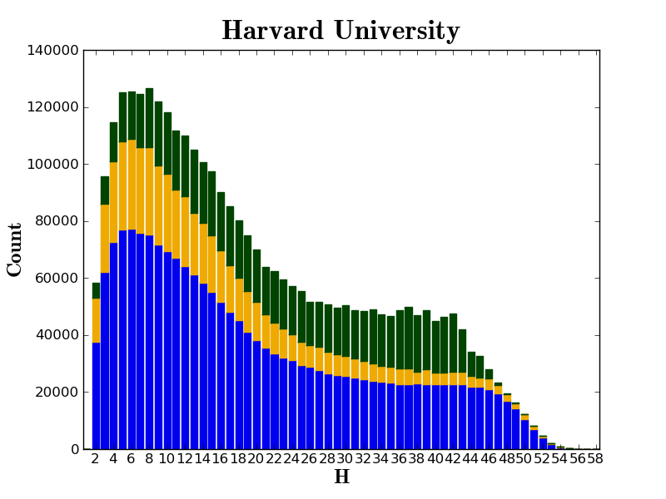

Slide 44
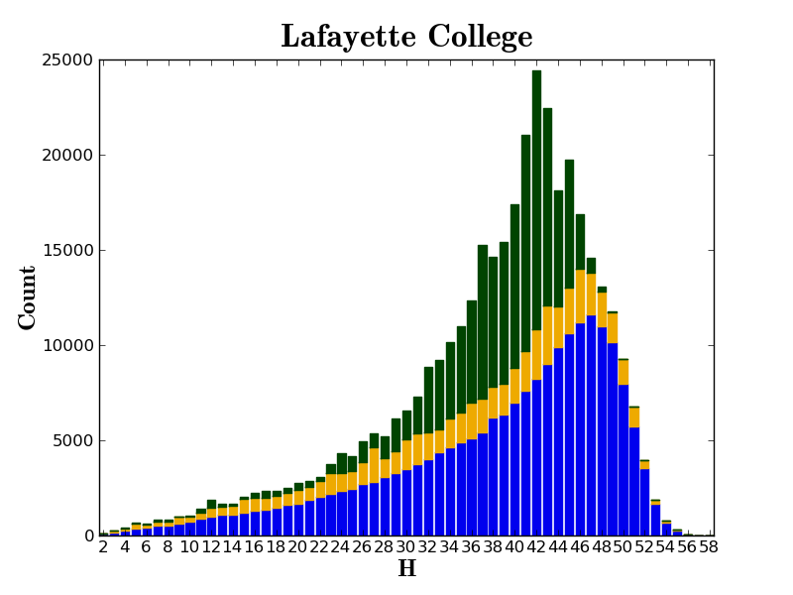

Slide 45
Public Good: offer greatest availability of Materials while offering value to members

Slide 46
Strategies and Challenges: Improve Access

Slide 47
Improve access …to meet the needs of the co-owning institutions
Objectives/Challenges
  PageTurner
  Institutional branding
  Public discovery Interface
  Robust discovery such as full-text search
  Virtual collections
  Data distribution
  Improved discovery and use in general
  Lawful uses of in-copyright materials

Slide 48
Copyright Distribution
Notes:
48

Slide 49
Automatic Rights Determination
Conducted on all works at time of ingest and when records are modified
  Public domain worldwide
    US works published before 1923, US federal government publications, non-US works published prior to 1872
  Public domain in the United States
    Non-US works published prior to 1923

Slide 50
Manual Rights Determination
IMLS-funded CRMS project (grant funding concluded December 2011)
  Second stage, CRMS-world began in December 2011
  US-published works 1923-1963
  Conformance with formalities
  Expanding to non-US works
  Double-blind review with expert review for conflicts
  Staff at 4 HathiTrust partner institutions (15 will take part in non-US)
  As of February 2012 ~190,000 reviewed, more than 100,000 opened
Rights Holder Permissions

Slide 51
How do we facilitate uses of materials?
Fundamental issues of
Identification
Description
Rights

Slide 52
Strategies and Challenges: Centralized…Open

Slide 53
Simultaneously …centralized …open
Objectives/Challenges
  APIs (access and integrate information)
  Open service definition (for development of access and discovery tools)

Slide 55
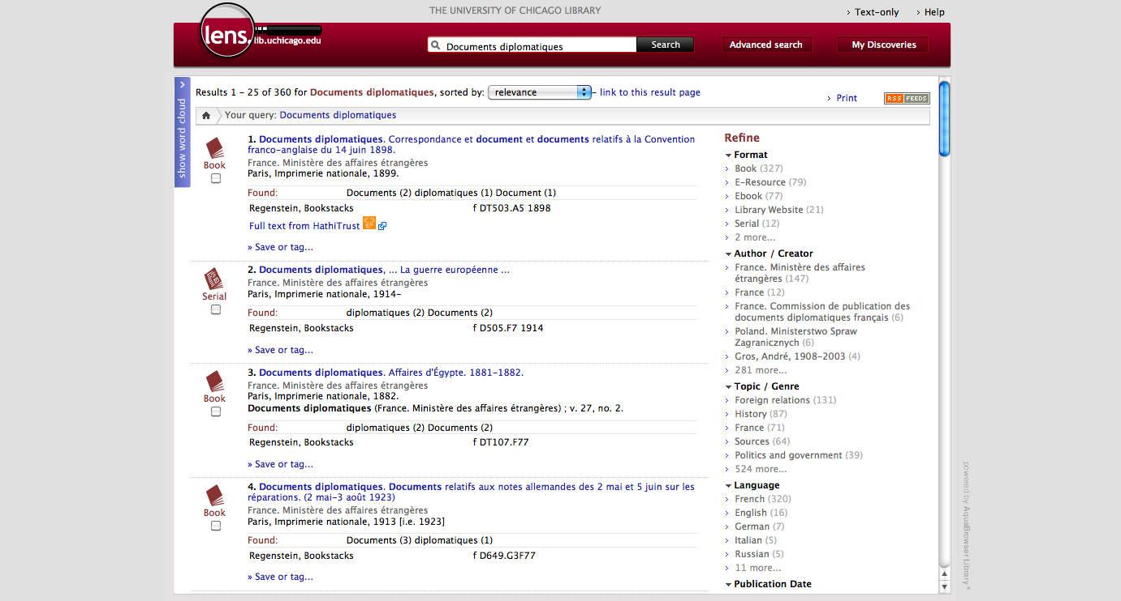
Screenshot of University of Chicago Lens Catalog

Slide 56
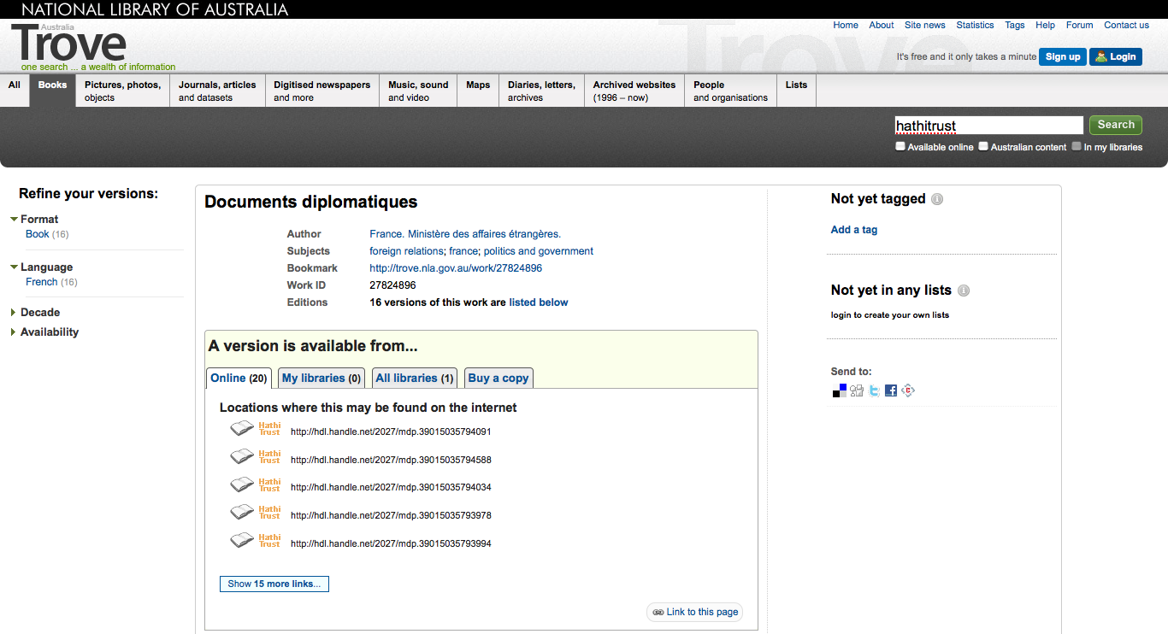
Screenshot of National Library of Australia Trove Catalog

Slide 57
Conclusions and
Future Work

Slide 58
How can we make a difference?
Collective Digital Curation
  Drive costs down
  Reduce bibliographic indeterminacy
  Facilitate meaningful decisions about formats and quality
  Increase discoverability
  Consolidate development talent
  Improve strength of archiving
Print Curation
  Means to associate our print holdings
  Perform record-keeping in a coordinated way
Subsidiary benefits
  Improve description
  Quantify problems, clarifying issues about our collections
  Collective attention to solving shared problems

Slide 59
Work going forward
Definitional elements
Print archiving, management
Collection management, development
Preservation (digital and print)
Discovery and use
  Finding
  Relating (APIs and integration)
  Using (Reading, computational activities, lawful uses)
Research Center
Quality
Government documents
Beyond books and journals
Publishing
Transitioning to next phase of partnership

Slide 60
How to find out more
About: http://www.hathitrust.org/about
Twitter: http://twitter.com/hathitrust
Facebook: http://www.facebook.com/hathitrust
Monthly newsletter:
  http:www.hathitrust.org/updates
  RSS http://www.hathitrust.org/updates_rss
Contact us: feedback@issues.hathitrust.org
Blogs: http://www.hathitrust.org/blogs
  Large-scale Search
  Perspectives from HathiTrust

Slide 61
Thank you!

Slide 62
References
Association of Research Libraries. (2004). Recognizing Digitization as a Preservation Reforatting Method. Retrieved from http://www.arl.org/bm~doc/digi_preserv.pdf
Babylonian Creation Myth Clay Tablet. (n.d.). Retrieved July 14, 2012, from http://www.bible-history.com/past/babylonian_creation_myth_clay_tablet.html
Bibliographic Indeterminacy and the Scale of Problems and Opportunities of “Rights” in Digital Collection Building — Council on Library and Information Resources. (n.d.). Retrieved July 13, 2012, from http://www.clir.org/pubs/ruminations/01wilkin
Birth certificate on a wax tablet. (128AD). Retrieved July 14, 2012, from http://www.lib.umich.edu/files/collections/papyrus/exhibits/images/tablet_lg.jpg
Coptic manuscript on vellum (Old Testament). (10th Century AD). Retrieved July 14, 2012, from http://www.lib.umich.edu/files/collections/papyrus/exhibits/images/vellum_lg.jpg
Coptic manuscript, written on paper. (n.d.). Retrieved July 14, 2012, from http://www.lib.umich.edu/files/collections/papyrus/exhibits/images/paper(1)_lg.jpg
dishongj. (n.d.). Global Library Statistics. Retrieved July 14, 2012, from http://www.oclc.org/globallibrarystats/default.htm

Slide 63
Google: 129 Million Different Books Have Been Published. (2010, August 6).PCWorld. Retrieved July 12, 2012, from http://www.pcworld.com/article/202803/google_129_million_different_books_have_been_published.html
Ḥarīrī, حريري., Muḥammad al-ʻAlamī, محمد العلمي،, Aḥmad ibn al-Shaykh Muḥammad ibn Muslim al-Tūnisī al-Ḥanafī, احمد بن الشيخ محمد بن مسلم التونسي الحنفي،, Zayn al-Dīn Abū Bakr al-Ḥalabī, et al. ([12-- or 13--?].). Kitāb Maqāmāt al-Ḥarīrī, [late 13th or 14th century?]. 02مقامات. Retrieved from http://hdl.handle.net/2027/mdp.39015081446489?urlappend=%3Bseq=6
Heritage Health Index. (n.d.). Retrieved July 14, 2012, from http://www.heritagepreservation.org/hhi/
Heritage Preservation and Institution for Museum and Library Services. (2005). A Public Trust at Risk: The Heritage Health Index Report on the State of America’s Collections. Washington, D.C. Retrieved from http://www.heritagepreservation.org/hhi/HHIfull.pdf
Coptic manuscript, written on paper. (n.d.). Retrieved July 14, 2012, from http://www.lib.umich.edu/files/collections/papyrus/exhibits/images/paper(1)_lg.jpg
dishongj. (n.d.). Global Library Statistics. Retrieved July 14, 2012, from http://www.oclc.org/globallibrarystats/default.htm
Ḥarīrī, حريري., Muḥammad al-ʻAlamī, محمد العلمي،, Aḥmad ibn al-Shaykh Muḥammad ibn Muslim al-Tūnisī al-Ḥanafī, احمد بن الشيخ محمد بن مسلم التونسي الحنفي،, Zayn al-Dīn Abū Bakr al-Ḥalabī, et al. ([12-- or 13--?].). Kitāb Maqāmāt al-Ḥarīrī, [late 13th or 14th century?]. 02مقامات. Retrieved from http://hdl.handle.net/2027/mdp.39015081446489?urlappend=%3Bseq=6

Slide 64
Heritage Health Index. (n.d.). Retrieved July 14, 2012, from http://www.heritagepreservation.org/hhi/
Heritage Preservation and Institution for Museum and Library Services. (2005). A Public Trust at Risk: The Heritage Health Index Report on the State of America’s Collections. Washington, D.C. Retrieved from http://www.heritagepreservation.org/hhi/HHIfull.pdf
Introduction to history of Japan’s Literature. (n.d.). Retrieved July 14, 2012, from http://www.kanzaki.com/jinfo/jliterature.html
Lynch, C. A. (1998). The Role of Digitization in Building Electronic Collections. Collection Management, 22(3-4), 133–141. doi:10.1300/J105v22n03_12
Minamoto, S. (1667). Wamyō ruijushō. Retrieved from http://hdl.handle.net/2027/mdp.39015080037156?urlappend=%3Bseq=170
Preserving Research Collections: A Collaboration between Librarians and Scholars. (n.d.). Retrieved July 13, 2012, from http://www.arl.org/preserv/presresources/Research_Collections~print.shtml
Regiomontanus, J., Pictor, B., Loeslein, P., Ratdolt, E., & Colegio Menor de la Compañía de Jesús (Alcalá de Henares). (1476). Calendarium. Venetiis: Bernardus Pictor, Petrus Loeslein et Erhardus Ratdolt. Retrieved from http://hdl.handle.net/2027/ucm.5316855684?urlappend=%3Bseq=8
Responses to the Preservation Challenge. (n.d.). Retrieved July 12, 2012, from http://www.mla.org/resources/documents/rep_preserving_collections/repview_preservingcol/preserving_col4

Slide 65
Royal Decree (Papyrus); University of Michigan Library P.Mich.Inv 3106. (n.d.). Retrieved July 14, 2012, from http://www.lib.umich.edu/files/collections/papyrus/exhibits/images/papyrus_lg.jpg
Selected Speeches & Commentary > Archive > Google, the Khmer Rouge and the Public Good | President Mary Sue Coleman. (n.d.). Retrieved July 14, 2012, from http://president.umich.edu/speech/archive/060206google.php
Waters, D. J. (1998). Transforming Libraries Through Digital Preservation. Collection Management, 22(3-4), 99–111. doi:10.1300/J105v22n03_09
Wikipedia contributors. (2012, July 7). History of books. Wikipedia, the free encyclopedia. Wikimedia Foundation, Inc. Retrieved from http://en.wikipedia.org/w/index.php?title=History_of_books&oldid=498147258
williaml. (n.d.). Facts and statistics. Retrieved July 12, 2012, from http://www.oclc.org/worldcat/statistics/default.htm

