Slide 1
Digital Humanities in HathiTrust: Research At Any Scale
Jeremy York
Digital Humanities and the Futures of Japanese Studies
University of Michigan
March 13, 2015

Slide 2
Outline
About
Partnership
Collections
Small and Large Scale Use

Slide 3
HathiTrust Members
Allegheny College
American University of Beirut
Arizona State University
Baylor University
Boston College
Boston University
Brandeis University
Brown University
California Digital Library
Carnegie Mellon University
Case Western Reserve
Colby College
Columbia University
Cornell University
Dartmouth College
Duke University
Emory University
Getty Research Institute
Georgetown University
Georgia Tech
Harvard University Library
Indiana University
Iowa State University
Johns Hopkins University
Kansas State University
Lafayette College
Library of Congress
Massachusetts Institute of Technology
McGill University`
Michigan State University
Montana State University
Mount Holyoke College
New York Public Library
New York University
North Carolina Central
University
North Carolina State
University
Northeastern University
Northwestern University
The Ohio State University
Oklahoma State University
Penn State
Princeton University
Purdue University
Rutgers University
Stanford University
State University System of Florida
Syracuse University
Temple University
Texas A&M University
Texas Tech
Tufts University
Universidad Complutense
de Madrid
University of Alabama
University of Alberta
University of Arizona
University of British Columbia
University of Calgary
University of California
Berkeley
Davis
Irvine
Los Angeles
Merced
Riverside
San Diego
San Francisco
Santa Barbara
Santa Cruz
The University of Chicago
University of Connecticut
University of Delaware
University of Houston
University of Illinois
University of Illinois at Chicago
The University of Iowa
University of Kansas
University of Maine
University of Maryland
University of Massachusetts, Amherst
University of Miami
University of Michigan
University of Minnesota
University of Missouri
University of Nebraska-Lincoln
University of New Mexico
The University of North
Carolina at Chapel Hill
University of Notre Dame
University of Oklahoma
University of Pennsylvania
University of Pittsburgh
University of Queensland
University of Tennessee, Knoxville
University of Texas
University of Utah
University of Vermont
University of Virginia
University of Washington
University of Wisconsin- Madison
Utah State University
Vanderbilt University
Virginia Tech
Wake Forest University
Washington University
Yale University Library

Slide 4
Partnership
Preserve and expand access to library collections
Leverage collection action
Shared Print Monographs Archive
US Federal Government Documents
Rights and Access
Discovery and Use

Slide 5
Digital Repository
Launched 2008
Initial focus on digitized book and journal content
13.2 million total volumes
6.7 million book titles
350,000 serial titles
4.9 million volumes in the public domain (~37%)

Slide 6
The Name
The meaning behind the name
Hathi (hah-tee)--Hindi for elephant
Big, strong
Never forgets, wise
Secure
Trustworthy

Slide 7
What is in HathiTrust?

Slide 8
Libraries in US by # Volumes
ALA - Nation’s Largest Libraries: http://www.ala.org/tools/libfactsheets/alalibraryfactsheet22; Data from 2010-2011.

Slide 9
1. Michigan | 4,712,752
2. California | 3,612,596
3. Harvard | 838,115
4. Wisconsin | 561,094
5. Indiana | 529,601
6. Cornell | 510,286
7. Penn State | 388,713
8. Illinois | 329,136
9. NYPL | 294,883
10. Princeton | 252,837
11. Minnesota | 193,124
12. Madrid | 117,291
13. Library of Congress | 108,892
14. Keio University | 90,112

Slide 10
HathiTrust contains materials in all disciplines…
HathiTrust by call number
http://www.hathitrust.org/visualizations_callnumbers
and includes a wide range of primary source materials, such as:
Diaries
Correspondence
Reports
Newspapers
Memoirs

Slide 11
HathiTrust covers a wide range of formats, such as
Books
Encyclopedias
Archival materials
Directories
Periodicals
Maps
Musical scores
Statistics
Visual Materials

Slide 12
Dates
Notes:
12

Slide 13
Dates – Materials in Japanese
~227,000 Titles
~495,000 Volumes

Slide 14
Language Distribution (1)
The top 10 languages make up ~87% of all content

Slide 15
Language Distribution (2)
The next 40 languages make up ~12% of total

Slide 16
Small-Scale Use

Slide 17
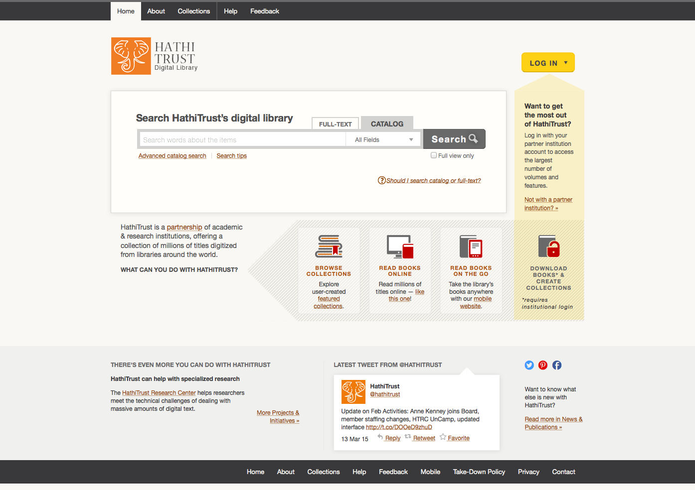

Slide 20
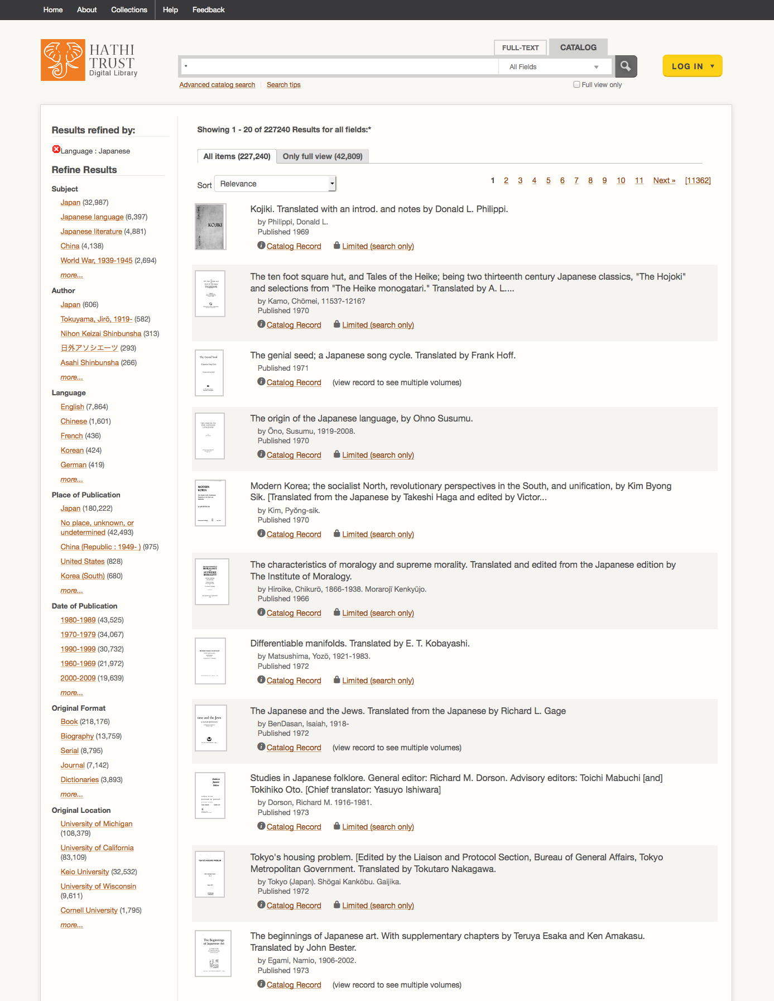
Catalog Search:
All Materials in Japanese
Notes:
Talk about layout, facets

Slide 21
Catalog Search:
All Materials in Japanese
All: 227,240

Slide 22
Catalog Search:
All Materials in Japanese
All: 227,240
Full-view: 42,809

Slide 23
Determinants of Access
Copyright determination / Permissions
Public Domain Worldwide
Public Domain in the United States
Open Access
Notes:
Going to talk about first two

Slide 24
Content Distribution – All Materials
Notes:
24

Slide 25
Content Distribution – Japanese Language Materials
Notes:
25

Slide 26
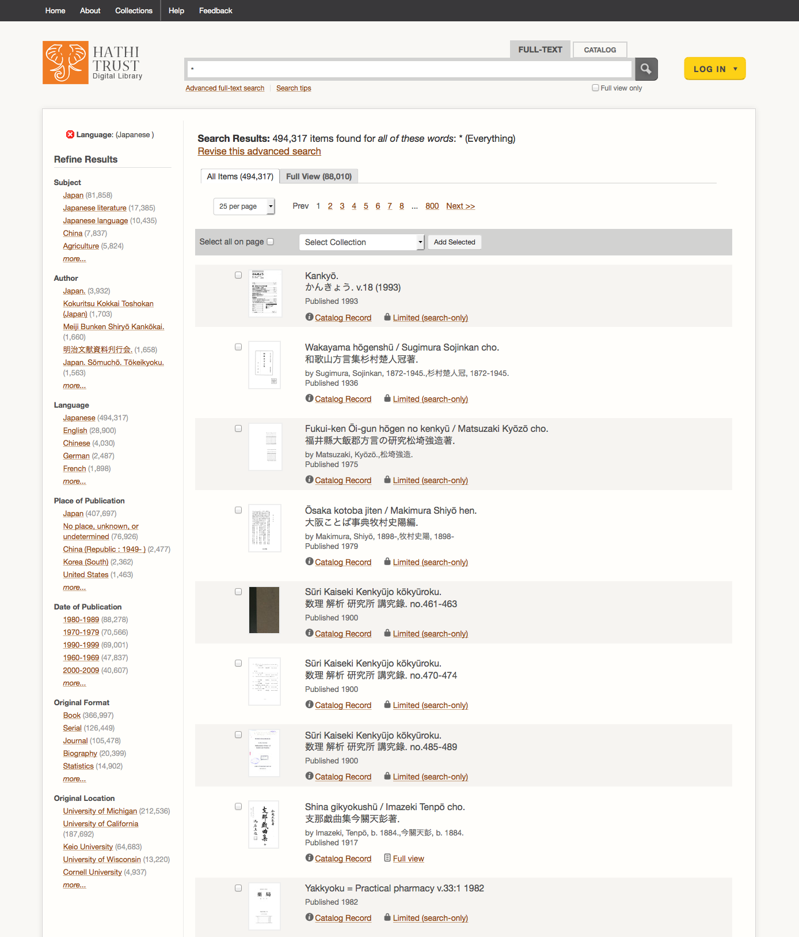
Full-text Search:
All materials in Japanese
All: 494,317
Full-view: 88,010
Notes:
Before I go further, want to show a comparison of full-text search

Slide 27
Full-text Search:
All materials in Japanese
All: 494,317
Full-view: 88,010
Catalog
All: 227,240
Full-view: 42,809
Notes:
Before I go further, want to show a comparison of full-text search

Slide 28
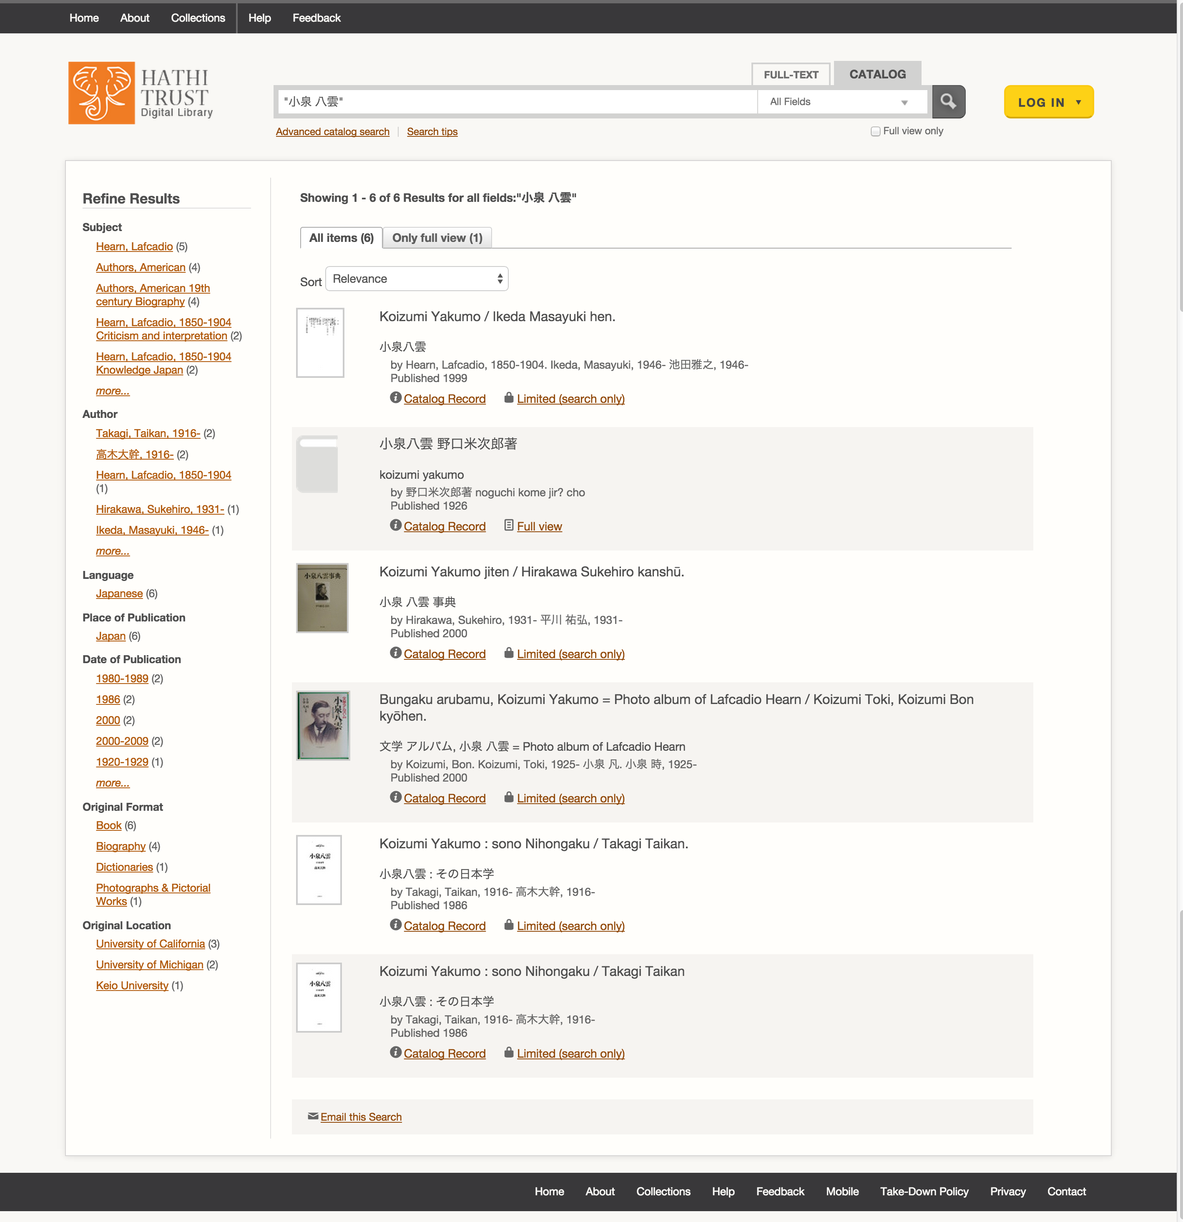
Catalog Search
小泉 八雲 Koizumi Yakumo
All: 6
Full-view: 1
Notes:
Demonstrate full-text search

Slide 29
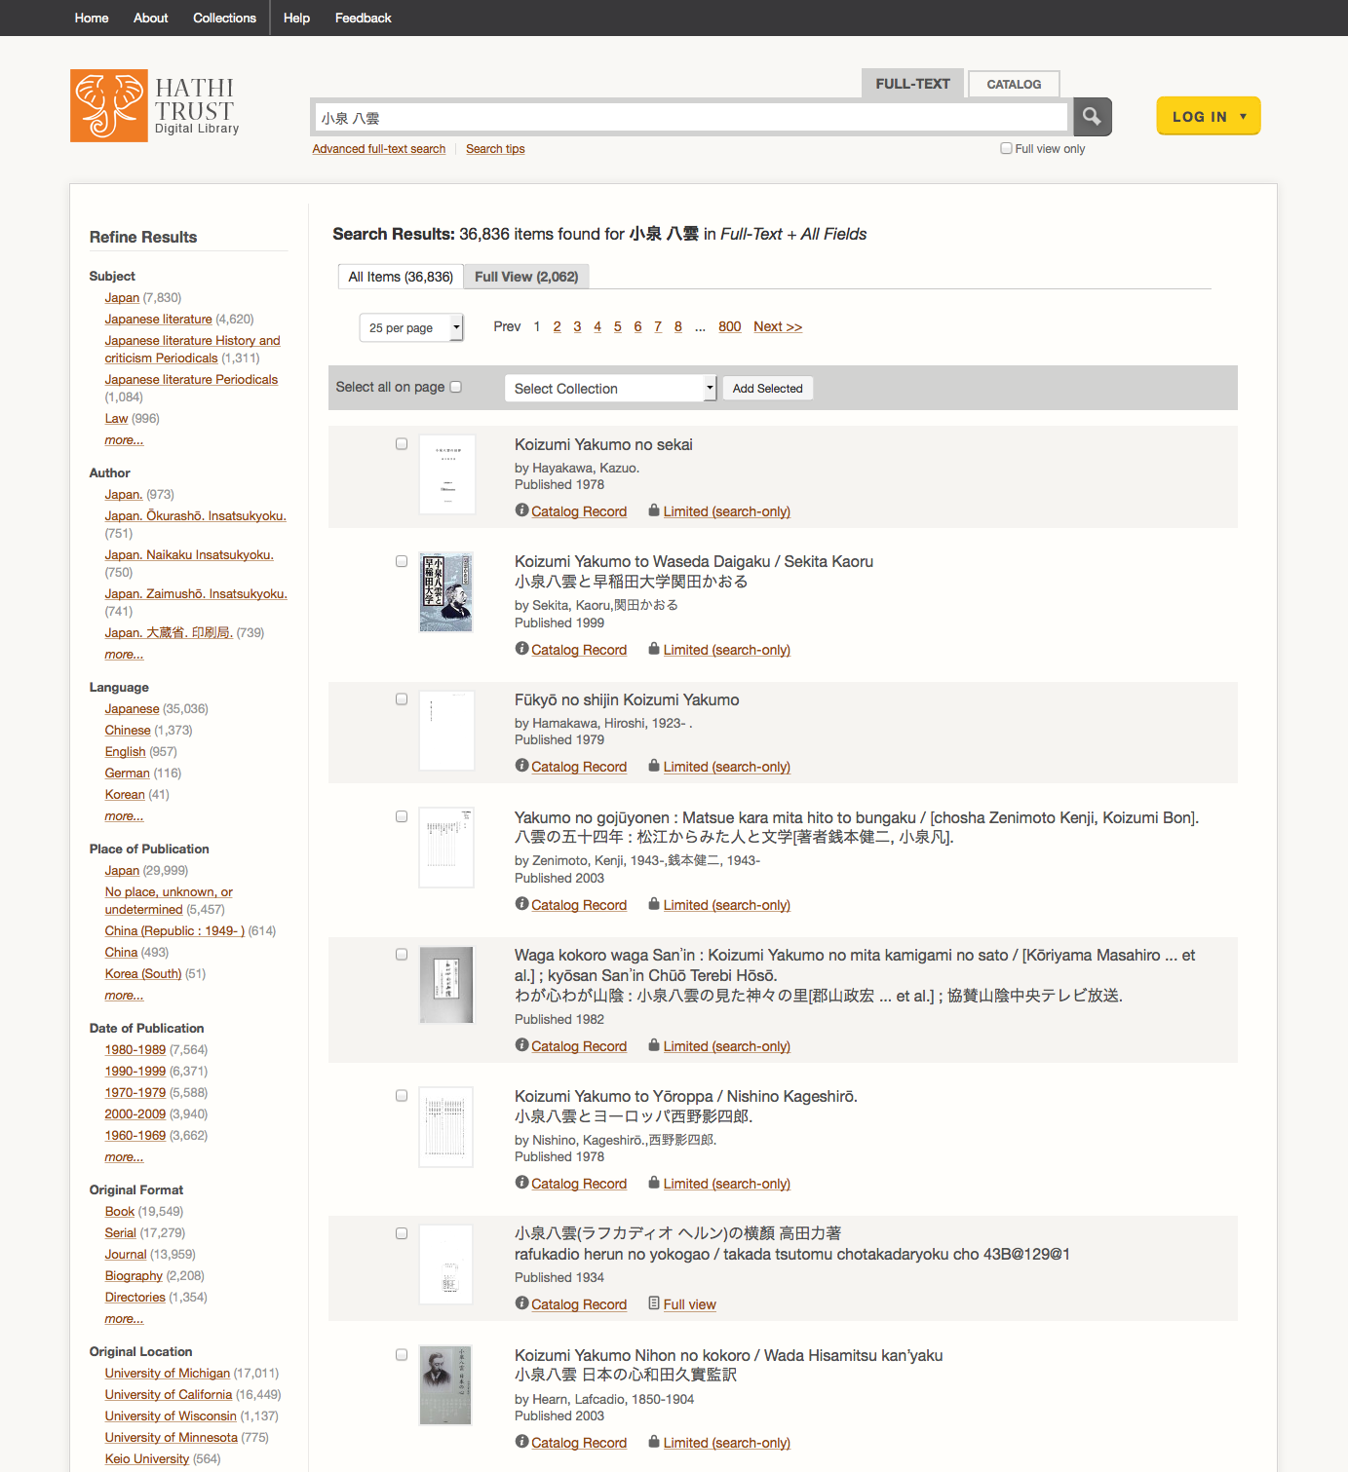
Full-text Search
小泉 八雲 Koizumi Yakumo
All: 36,836
Full-view: 2,062

Slide 30
Full-text Search
小泉 八雲 Koizumi Yakumo
All: 36,836
Full-view: 2,062

Slide 31
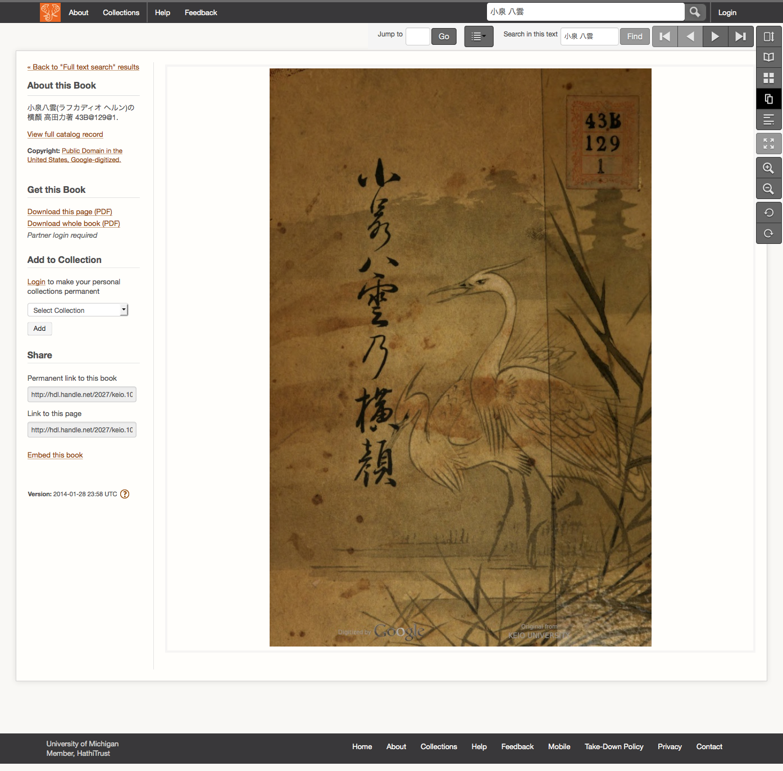

Slide 33
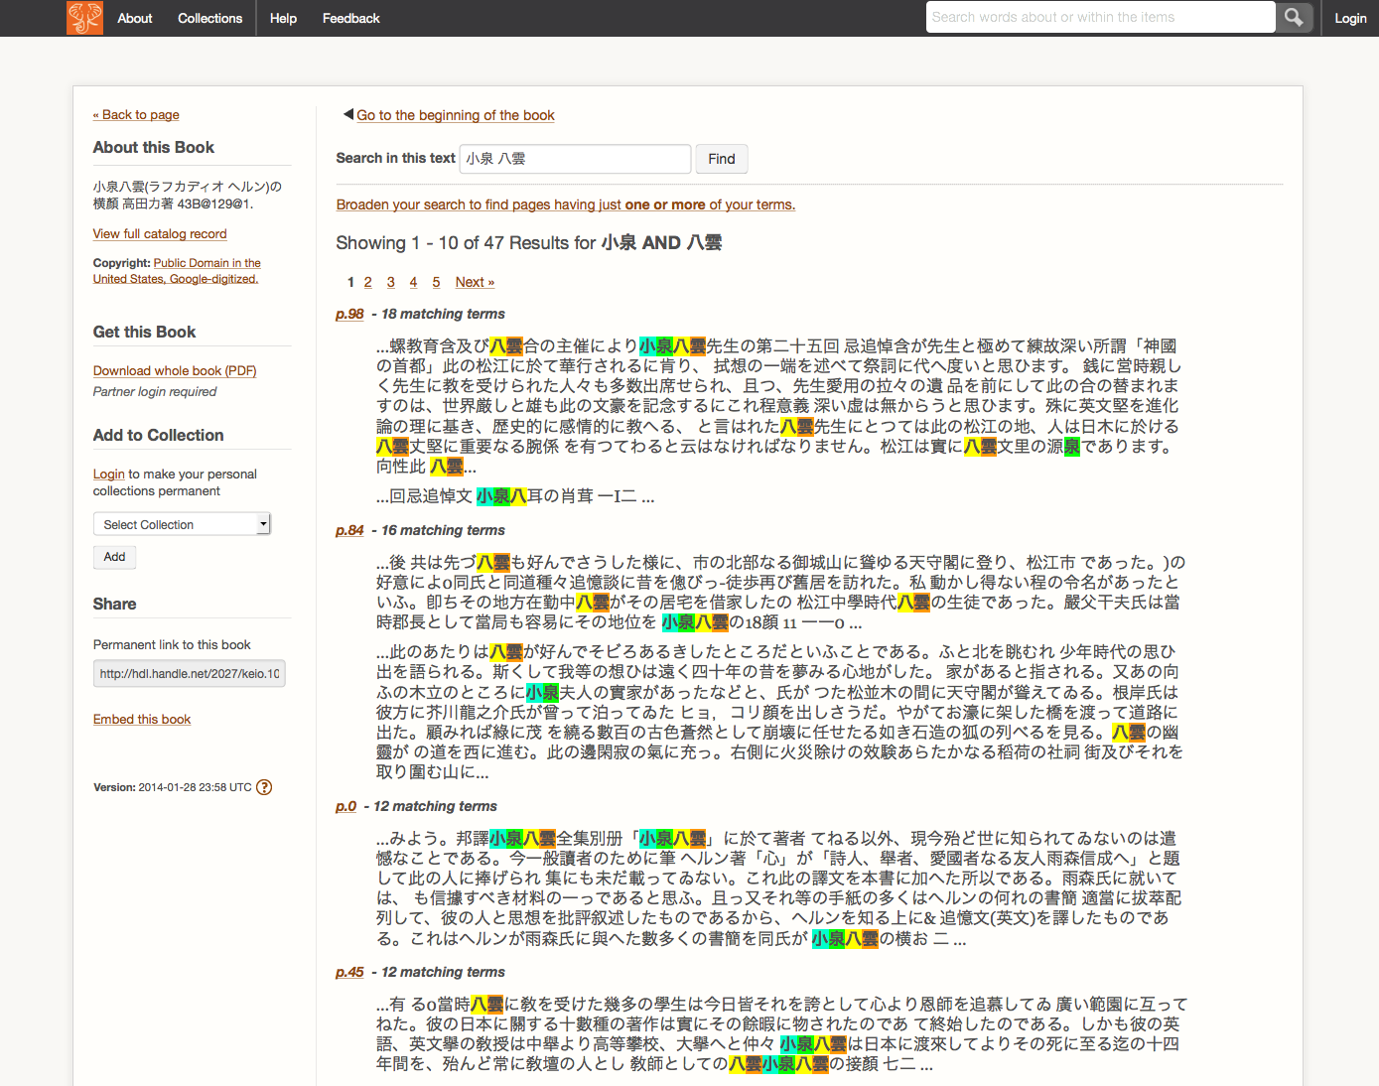

Slide 34
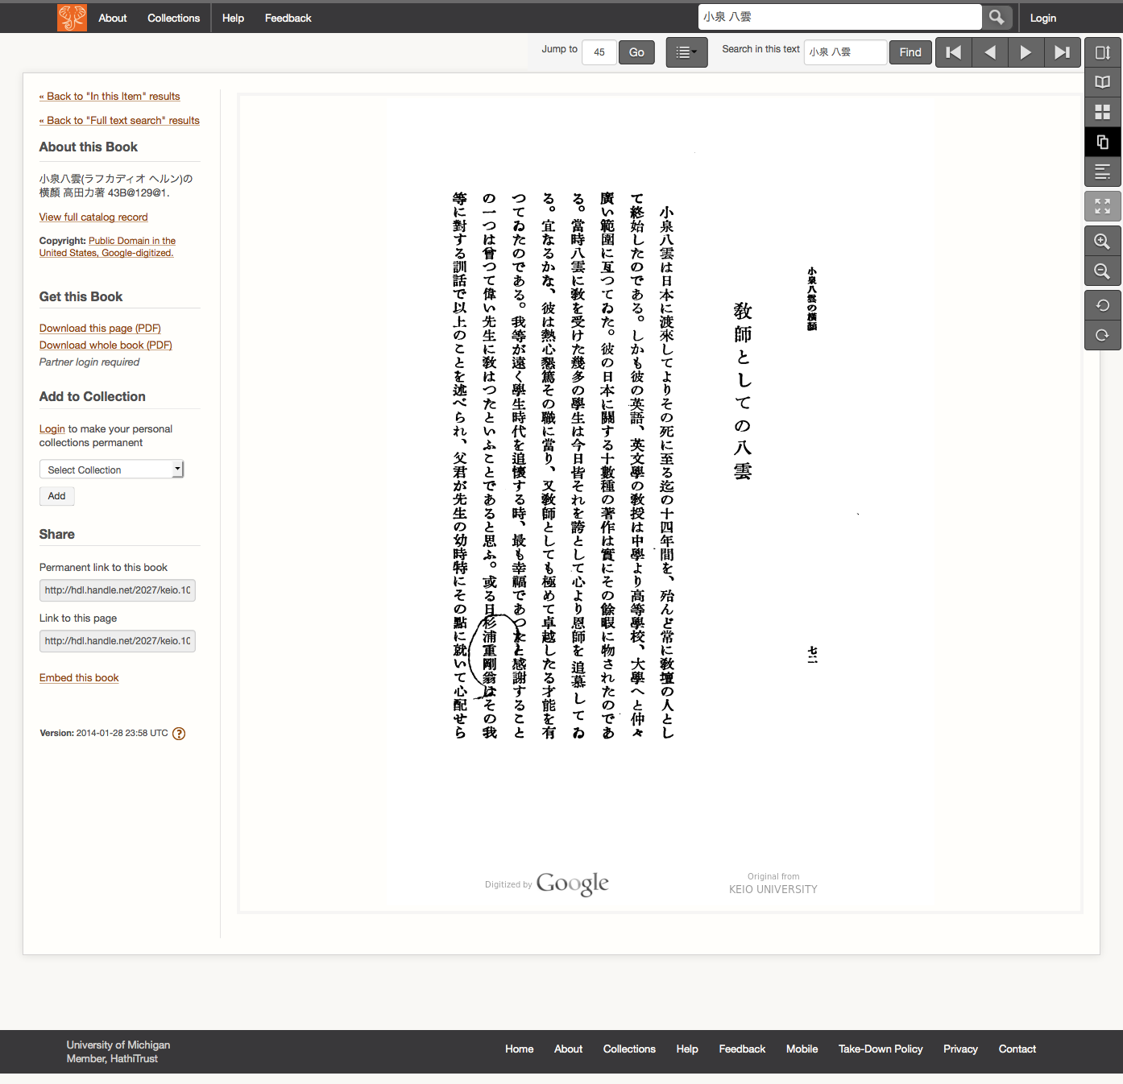

Slide 36
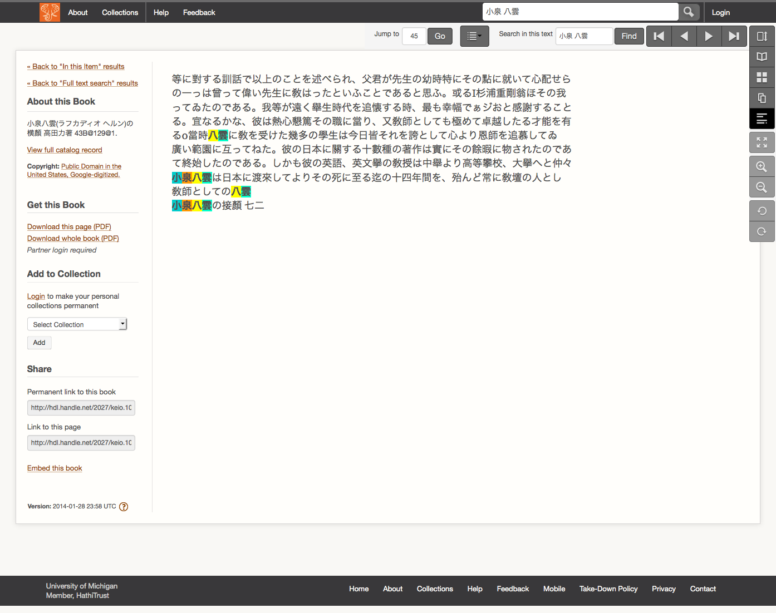

Slide 37
Full-text Search
小泉 八雲 Koizumi Yakumo
All: 36,836
Full-view: 2,062

Slide 38
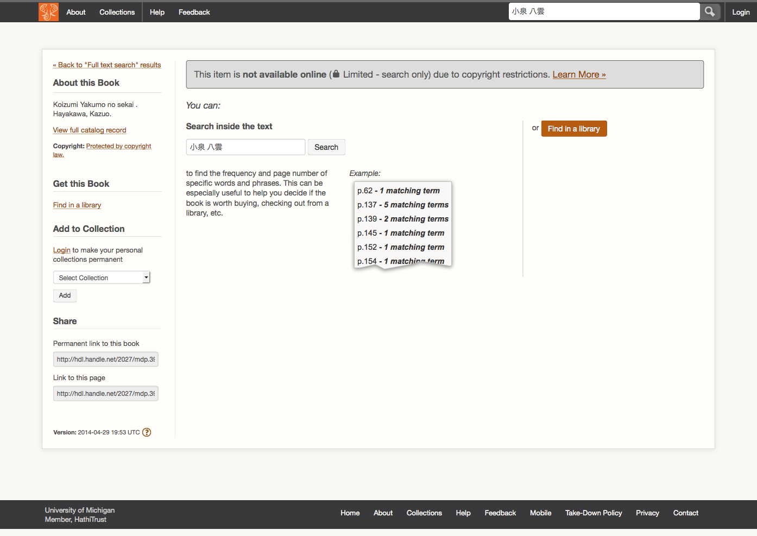

Slide 40
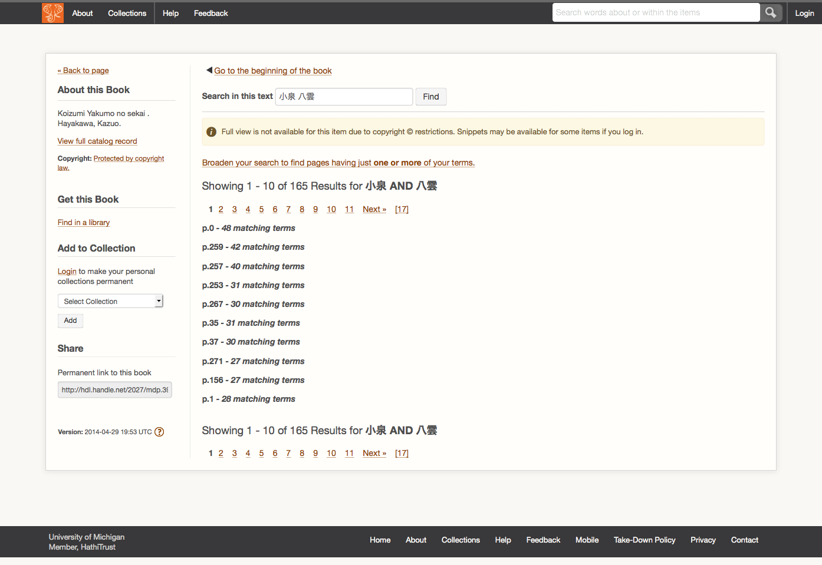

Slide 41
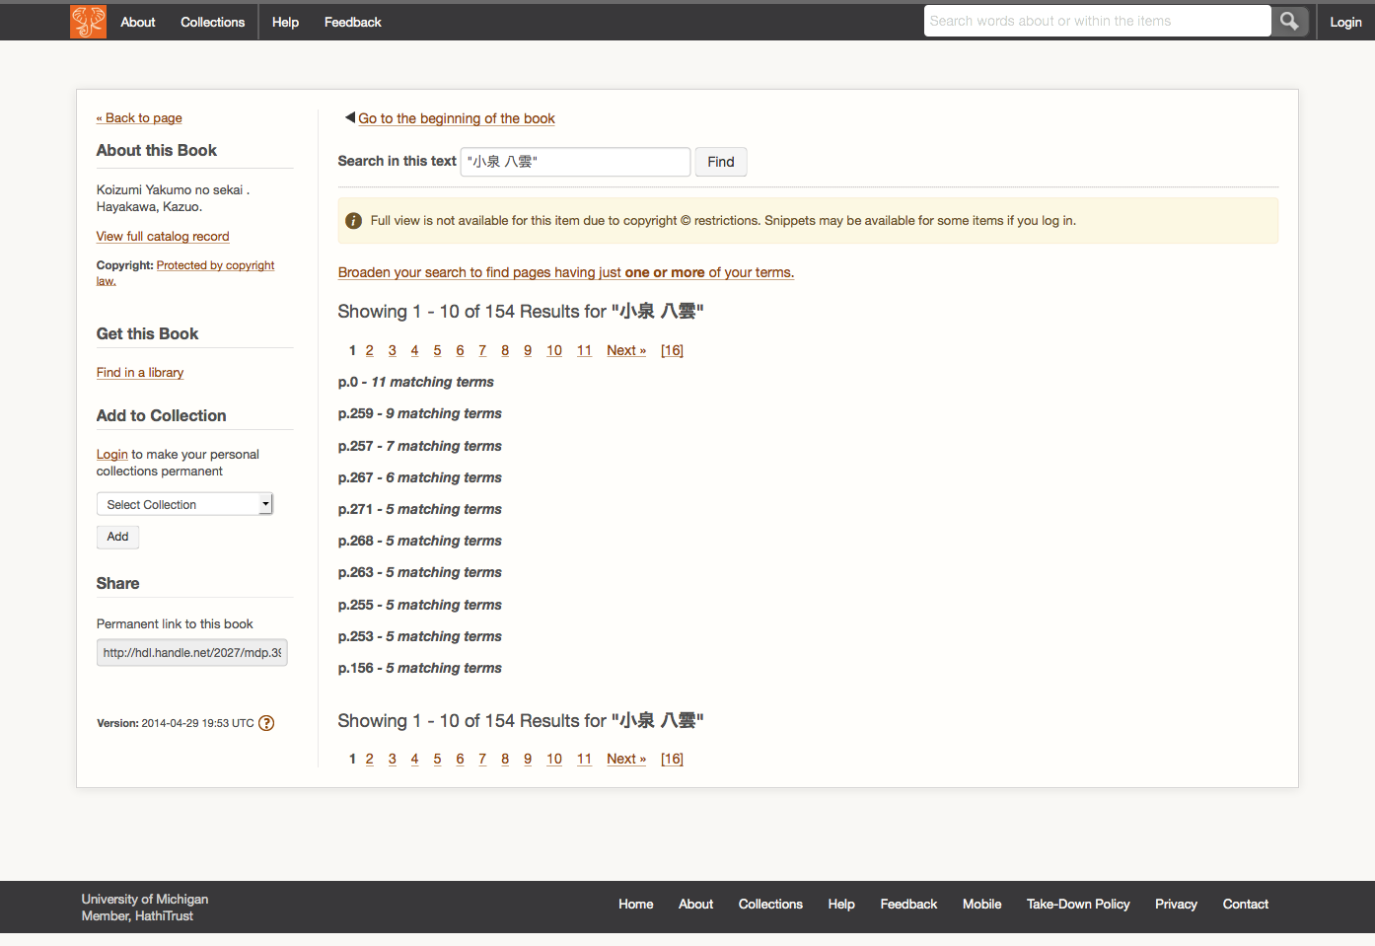

Slide 45
Determinants of Access
Copyright determination / Permissions
Public Domain Worldwide
Public Domain in the United States
Open Access
Third-party agreements
Notes:
Going to talk about first two

Slide 46
Best way to ensure you are getting full access: LOGIN

Slide 47
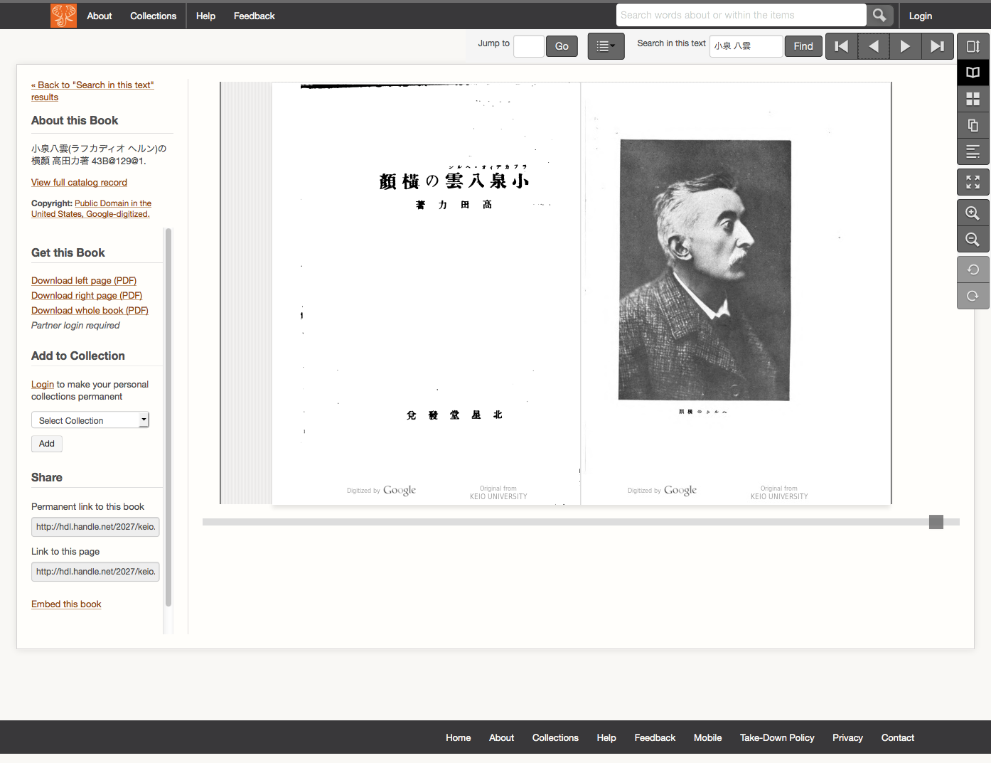

Slide 48
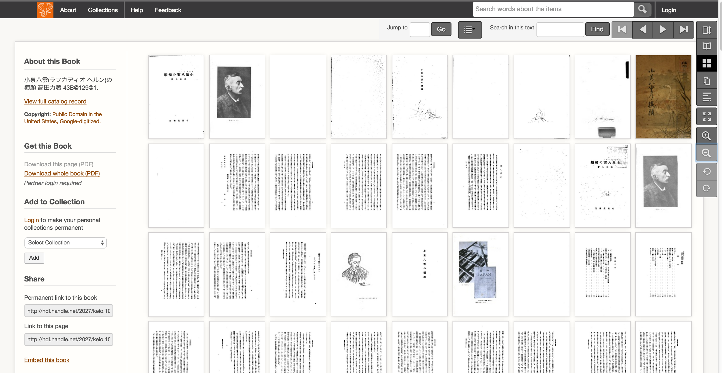

Slide 50
User Collections
Featured Collections:
https://babel.hathitrust.org/cgi/mb?colltype=featured
All Collections with at least 250 items
https://babel.hathitrust.org/cgi/mb?colltype=all

Slide 51
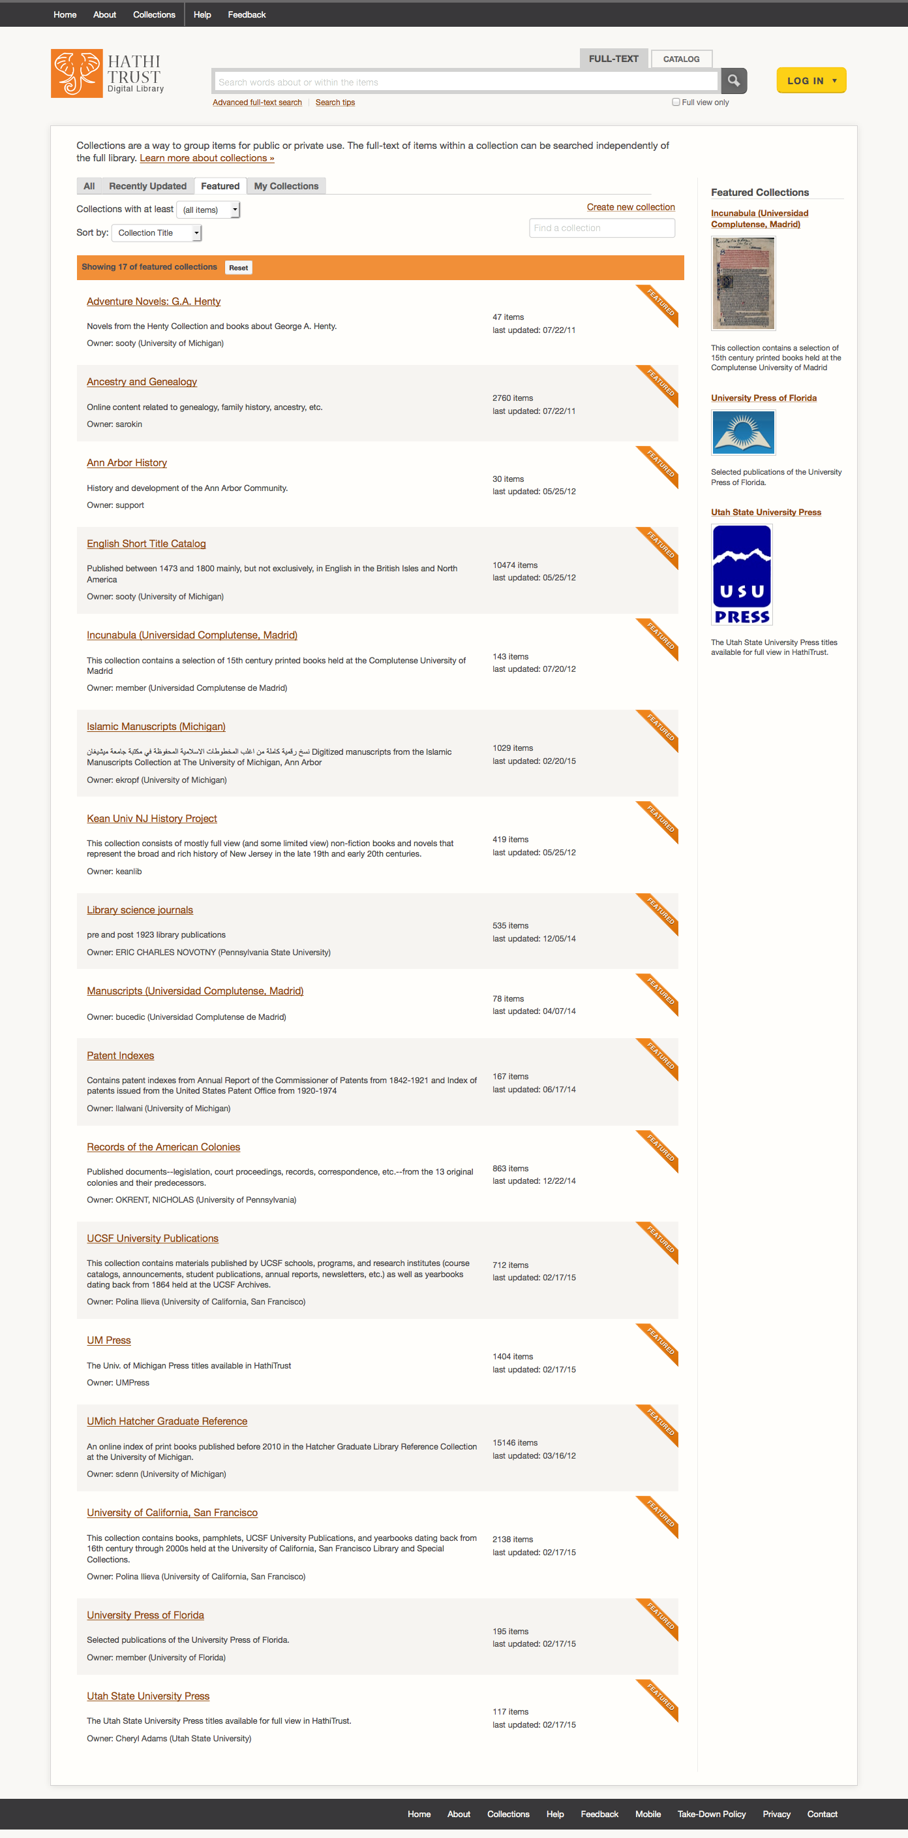
Adventure Novels: G. A. Henty
Ancestry and Genealogy
Ann Arbor History
English Short Title Catalog
Incunabula (Universidad Complutense de Madrid)
Islamic Manuscripts
Kean University NJ History Project
Library Science Journals
Manuscripts (Universidad Complutense de Madrid)
Patent Indexes
Records of the American Colonies
UCSF University Publications
UM Press
UMich Hatcher Reference
University of California, San Francisco
University Press of Florida
Utah State University Press

Slide 52
Large-Scale Use

Slide 53
HTRC
http://www.hathitrust.org/htrc
HathiTrust Research Center
Developed collaboratively by Indiana University and University of Illinois; launched July 2011
Enables computational access to public domain and open access materials; working to support in-copyright materials as well
Secure Environment – bring researchers to the data
Build services and tools that facilitate research by digital humanities and informatics communities

Slide 54
Using the HTRC
Portal: sign up, browse volume lists and algorithms, execute algorithms, view results
https://htrc2.pti.indiana.edu/HTRC-UI-Portal2/
Workset Builder
https://htrc2.pti.indiana.edu/blacklight
Sandbox: run own algorithms
Data Capsule
https://wiki.htrc.illinois.edu/display/COM/HTRC+Data+Capsule+Hands-on+Tutorial
Getting Started with the HTRC
https://wiki.htrc.illinois.edu/display/COM/HTRC+User+Getting+Started+FAQ
Notes:
Mention email lists also

Slide 55
Additional Services
Scholarly Commons User Support Services
Training, Educational materials, Research Assistance
Advanced Collaborative Support
RFP: http://www.hathitrust.org/htrc/acs-rfp
Awards: http://www.hathitrust.org/htrc_acs_awards_spring2015

Slide 56
Dataset Distribution
Distribution of datasets
http://www.hathitrust.org/datasets
Non-Google-digitized Dataset (540,000+)
Google-digitized (4.4 million+)

Slide 57
HTRC UnCamp
Ann Arbor, Michigan
March 30-31, 2015
Keynotes, demos, “unconference” sessions
Registration, Agenda, Logistics:
http://www.hathitrust.org/htrc_uncamp2015
Email lists
http://www.hathitrust.org/htrc

Slide 58
Projects (1)
Detecting Literary Plagiarisms: The Case of Oliver Goldsmith.
Douglas Duhaime. University of Notre Dame.
Taxonomizing the Texts: Towards Cultural-Scale Models of Full Text. Colin Allen, Jaimie Murdock. Indiana University Bloomington.
Allen and Murdock will carry out a cultural-scale investigation and topic modeling on HT public-domain full text through random sampling to select collections
Topic modeling to select collections according to the Library of Congress Subject Headings (LCSH).
The Trace of Theory.
Geoffrey Rockwell, Laura Mandell, Stefan Sinclair, Matthew Wilkens, Susan Brown. University of Alberta, Texas A&M University, University of Notre Dame.
Topic modeling; tools and methods to track the concept of “theory”.
Dr. Michelle Alexopolous, University of Toronto
Tracking technology diffusion through time using the HT corpus.

Slide 59
Projects (2)
Burton, Vernon. “The South as ‘Other,’ the Southerner as ‘Stranger.’”
Explore how attitudes expressed in print about slavery, southerners, and non-southerners have changed over both time and space.
Ted Underwood, Associate Professor of English at the University of Illinois, Urbana-Champaign.
Using public domain texts received from HathiTrust to explore changing relationships in literary genres from 1700-1899.
Andrew Piper, Associate professor of German literature at McGill University.
Analyzing linguistic patters in German texts from 1700-1900
Amanda Watson, librarian at New York University.
Studying How poetry anthologies in selected texts reflect the rise and fall of poets’ reputations over the course of the 19th century.
Glenn Worthey, Digital Humanities Librarian at Stanford University Libraries.
Performing spatio-temporal investigation into the history of Brazilian Portuguese, to be accomplished by text-mining methods (n-gram analysis, etc.).
Matthew Wilkens, Assistant professor of English, University of Notre Dame.
American Council of Learned Societies (ACLS) fellowship for project “Literary Geography at Scale.”

Slide 60
Services
Public domain and open access works
Full download of materials where possible*
Print on demand
Collections and APIs
Computational Access
Lawful uses of in-copyright works*

Slide 61
How to find out more
About: http://www.hathitrust.org/about
Resources: http://www.hathitrust.org/resources
Twitter: http://twitter.com/hathitrust
Facebook: http://www.facebook.com/hathitrust
Monthly newsletter:
http:www.hathitrust.org/updates
RSS http://www.hathitrust.org/updates_rss
Contact us: feedback@issues.hathitrust.org
Blogs: http://www.hathitrust.org/blogs
Large-scale Search
Perspectives from HathiTrust

