Slide 1
Your Library, Now Online! Putting HathiTrust in the Context of Traditional (and New) Library Services
MCLS Webinar
February 6, 2012
Jeremy York, Project Librarian, HathiTrust
Unless otherwise noted, these slides and their contents are licensed under a Creative Commons Attribution Unported License.

Slide 2
Outline
The Big Idea
  Mission and Goals
What we’re doing to get there
  Repository and Content
  Making content available
  Organizational structure
How HathiTrust can change the way we work

Slide 3
The Big Idea

Slide 4
Partnership
Arizona State University
Baylor University
Boston College
Boston University
Brandeis University
California Digital Library
Carnegie Mellon University
Columbia University
Cornell University
Dartmouth College
Duke University
Emory University
Florida State University
Getty Research Institute
Harvard University Library
Indiana University
Iowa State University
Johns Hopkins University
Kansas State University
Lafayette College
Library of Congress
Massachusetts Institute of Technology
McGill University`
Michigan State University
New York Public Library
New York University
North Carolina Central
University
North Carolina State
University
Northwestern University
The Ohio State University
The Pennsylvania State
University
Princeton University
Purdue University
Stanford University
Syracuse University
Texas A&M University
Universidad Complutense
de Madrid
University of Arizona
University of Calgary
University of California
Berkeley
Davis
Irvine
Los Angeles
Merced
Riverside
San Diego
San Francisco
Santa Barbara
Santa Cruz
The University of Chicago
University of Connecticut
University of Delaware
University of Florida
University of Illinois
University of Illinois at Chicago
The University of Iowa
University of Kansas
University of Maryland
University of Miami
University of Michigan
University of Minnesota
University of Missouri
University of Nebraska-Lincoln
The University of North
Carolina at Chapel Hill
University of Notre Dame
University of Pennsylvania
University of Pittsburgh
University of Utah
University of Vermont
University of Virginia
University of Washington
University of Wisconsin- Madison
Utah State University
Vanderbilt University
Virginia Tech
Wake Forest University
Washington University
Yale University Library

Slide 5
Digital Repository
Launched 2008
Initial focus on digitized book and journal content
  10.6 million total volumes
  5.58 million book titles
  276,000 serial titles
  3.2 million public domain (~31%)

Slide 6

The Name
The meaning behind the name
  Hathi (hah-tee)--Hindi for elephant
  Big, strong
  Never forgets, wise
  Secure
  Trustworthy

Slide 7
Mission
To contribute to the common good by collecting, organizing, preserving, communicating, and sharing the record of human knowledge

Slide 8
HathiTrust
Universal Library
Common Goal
Single Entity, Many Partners

Slide 9
Collections and Collaboration
Comprehensive collection
  Preservation…with Access
Shared strategies
  Copyright
  Collection management, development
  Preservation
  Discovery / Use
  Bibliographic Indeterminacy
  Efficient user services
Public Good

Slide 10
What we are doing to get there

Slide 11
Cost-effective long-term preservation and access for digitized content

Slide 12
Facilitate decision-making about digitization and print collection management
Facilitate activities such as discovery, copyright review, use of materials

Slide 13
Repository and Content

Slide 14
Content Sources

Slide 15
Language Distribution (1)
The top 10 languages make up ~86% of all content
Notes:
15

Slide 16
Language Distribution (2)
The next 40 languages make up ~13% of total
Notes:
16

Slide 17

Dates
Notes:
17

Slide 18
Copyright Distribution
Notes:
18

Slide 20
Source
Data Management
Access
Bib Data
Rights Data
Catalog
Ingest
Full-text Search
Holdings Data
Bibliographic Data
PageTurner
Content Package
Collections
Storage
Michigan
APIs
Indiana
Datasets

Slide 21
Source
Data Management
Access
Bib Data
Rights Data
Catalog
Ingest
Full-text Search
Holdings Data
Bibliographic Data
PageTurner
Content Package
Collections
Storage
Michigan
APIs
Indiana
Datasets

Slide 22

Source
Data Management
Access
Bib Data
Rights Data
Catalog
Ingest
Full-text Search
Holdings Data
Bibliographic Data
PageTurner
Content Package
Collections
Storage
Michigan
APIs
Indiana
Datasets
TDR

Slide 23
Source
Data Management
Access
Bib Data
Rights Data
Catalog
Ingest
Full-text Search
Holdings Data
Bibliographic Data
PageTurner
Content Package
Collections
Storage
Michigan
APIs
Indiana
Datasets

Slide 24
Source
Data Management
Access
Bib Data
Rights Data
Catalog
Ingest
Full-text Search
Holdings Data
Bibliographic Data
PageTurner
Content Package
Collections
Storage
Michigan
APIs
Indiana
Datasets

Slide 25
Source
Data Management
Access
Bib Data
Rights Data
Catalog
Ingest
Full-text Search
Holdings Data
Bibliographic Data
PageTurner
Content Package
Collections
Storage
Michigan
APIs
Indiana
Datasets

Slide 26
Source
Data Management
Access
Bib Data
Rights Data
Catalog
Ingest
Full-text Search
Holdings Data
Bibliographic Data
PageTurner
Content Package
Collections
Storage
Michigan
APIs
Indiana
Datasets

Slide 27
We engage in preservation
for purposes of access

Slide 28
Source
Data Management
Access
Bib Data
Rights Data
Catalog
Ingest
Full-text Search
Holdings Data
Bibliographic Data
PageTurner
Content Package
Collections
Storage
Michigan
APIs
Indiana
Datasets

Slide 29
Making Content Available

Slide 30
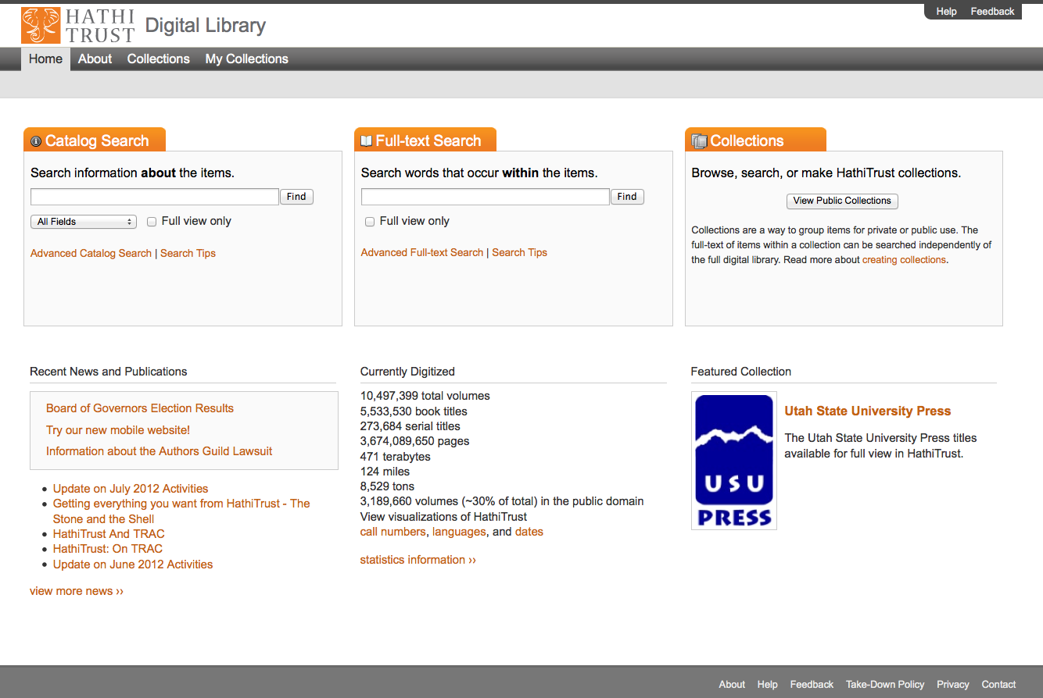
Access
Catalog
Full-text Search
PageTurner
Collections
APIs
Datasets

Slide 31
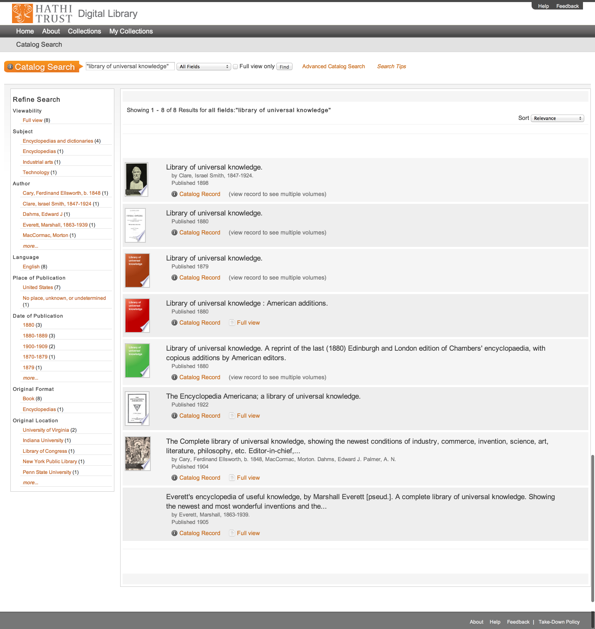
Access
Catalog
Full-text Search
PageTurner
Collections
APIs
Datasets

Slide 32
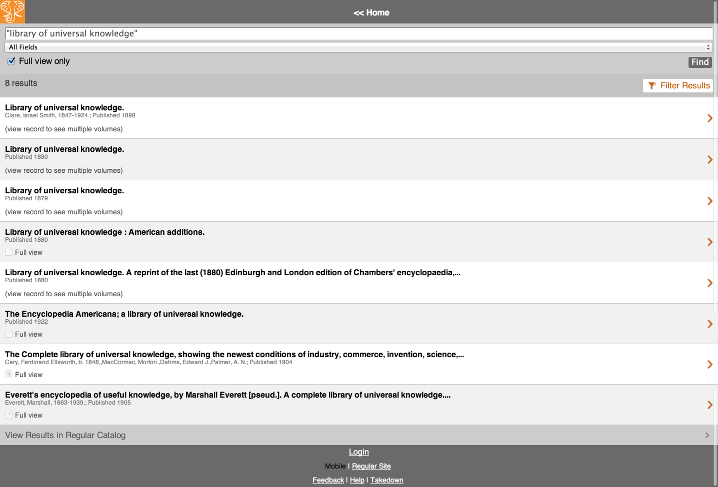
Access
Catalog
Full-text Search
PageTurner
Collections
APIs
Datasets

Slide 33
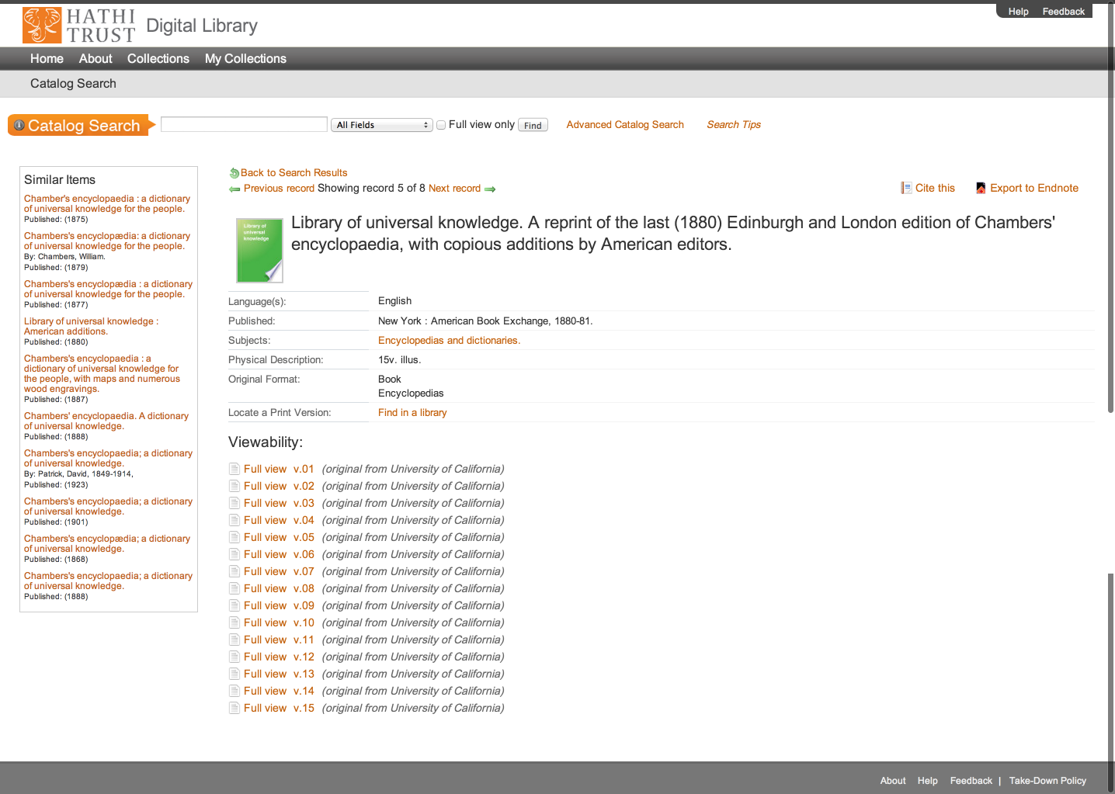
Access
Catalog
Full-text Search
PageTurner
Collections
APIs
Datasets

Slide 34
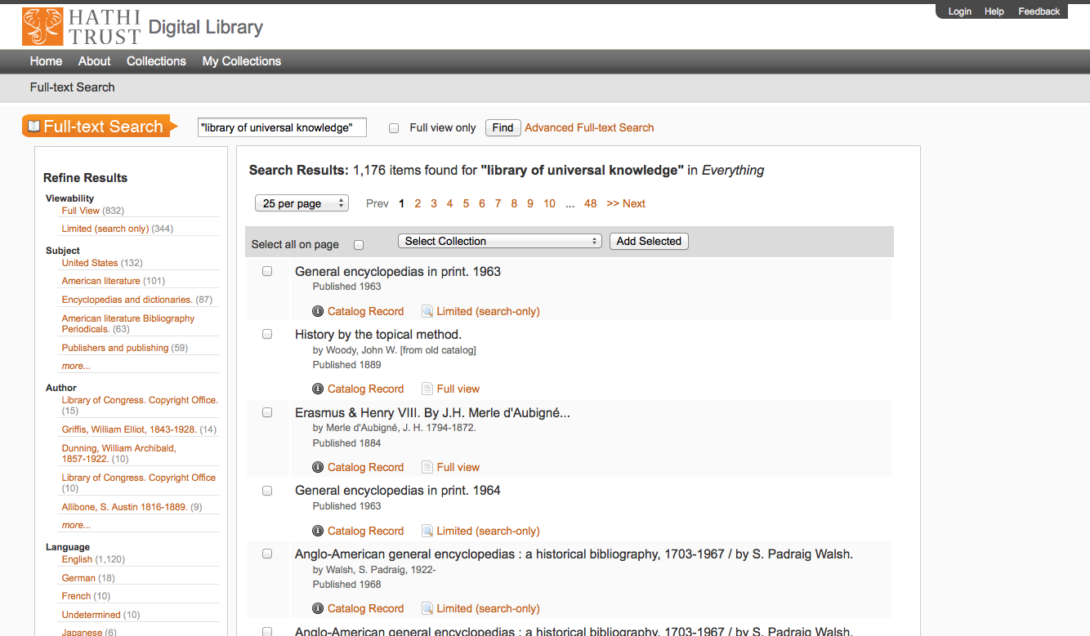
Access
Catalog
Full-text Search
PageTurner
Collections
APIs
Datasets

Slide 35
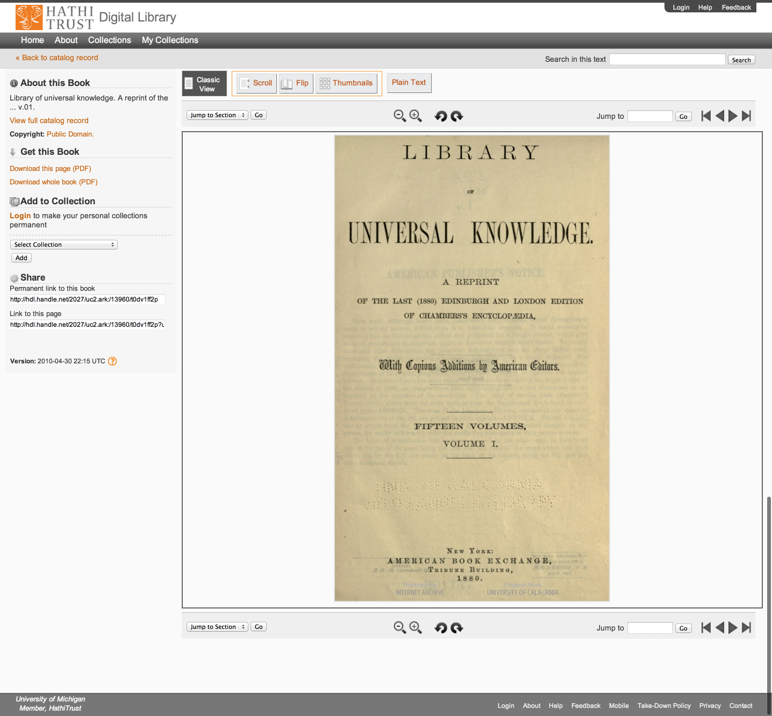
Access
Catalog
Full-text Search
PageTurner
Collections
APIs
Datasets

Slide 36
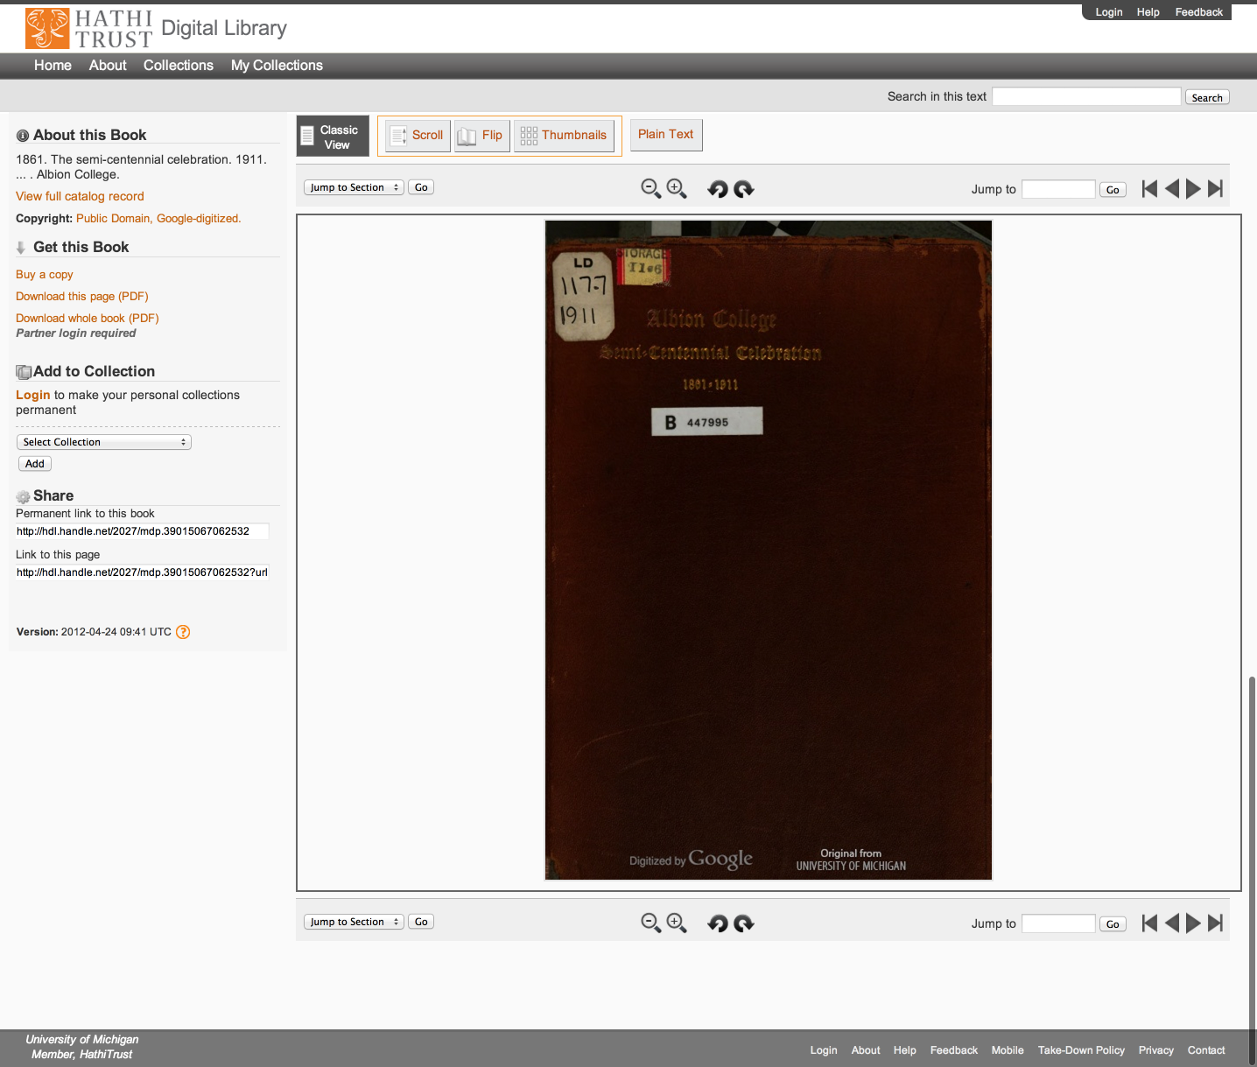
Access
Catalog
Full-text Search
PageTurner
Collections
APIs
Datasets

Slide 37
Access
Catalog
Full-text Search
PageTurner
Collections
APIs
Datasets

Slide 38
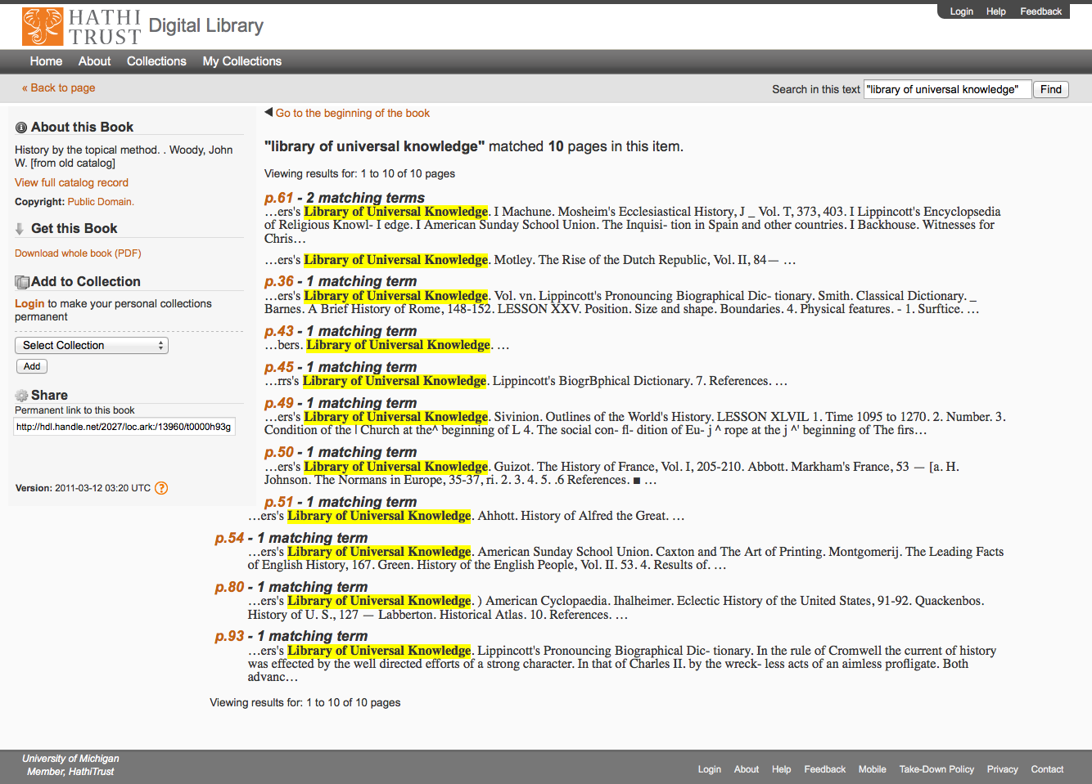
Access
Catalog
Full-text Search
PageTurner
Collections
APIs
Datasets

Slide 39
Access
Catalog
Full-text Search
PageTurner
Collections
APIs
Datasets

Slide 40
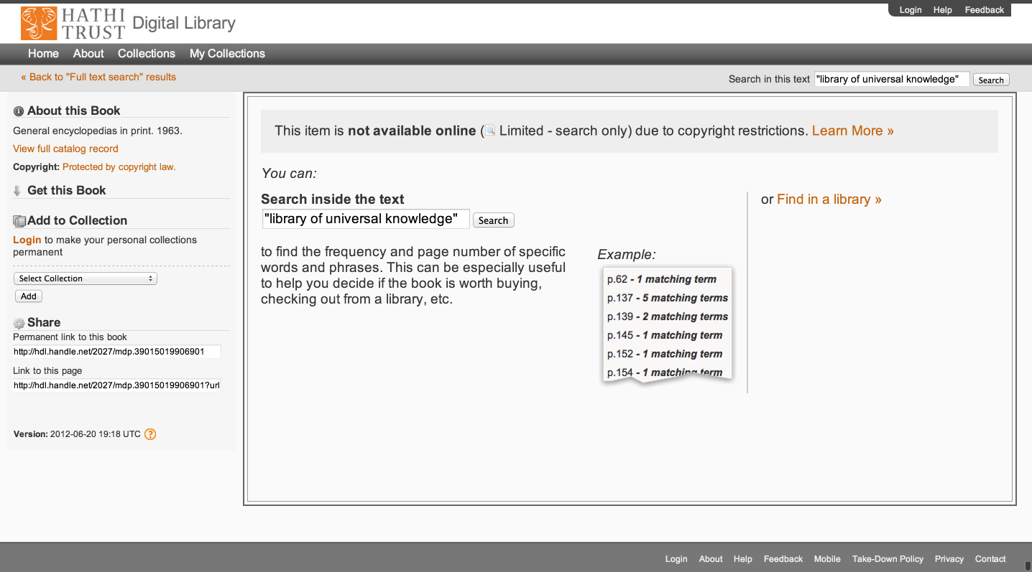
Access
Catalog
Full-text Search
PageTurner
Collections
APIs
Datasets

Slide 41
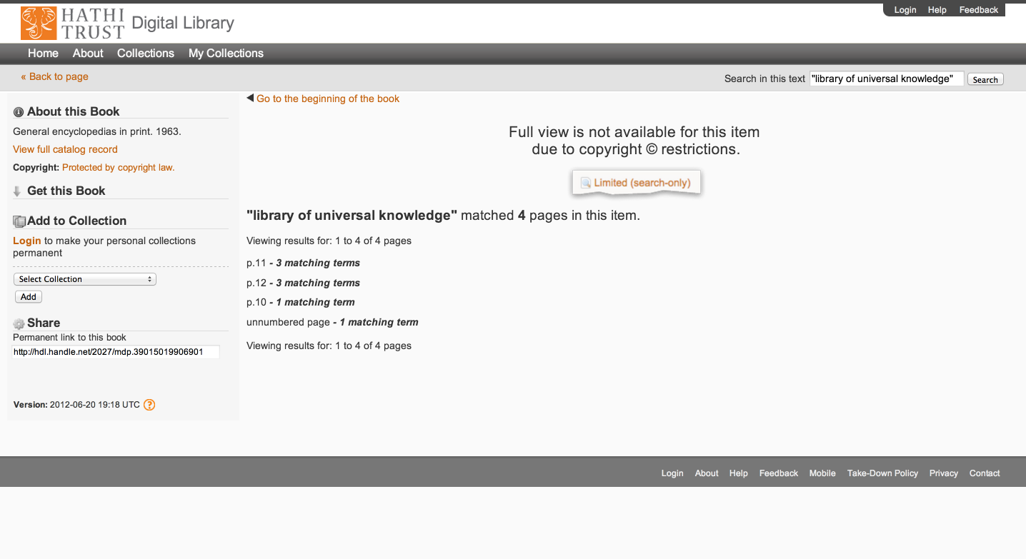
Access
Catalog
Full-text Search
PageTurner
Collections
APIs
Datasets

Slide 42
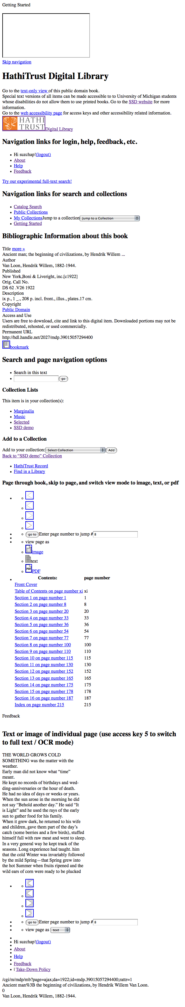
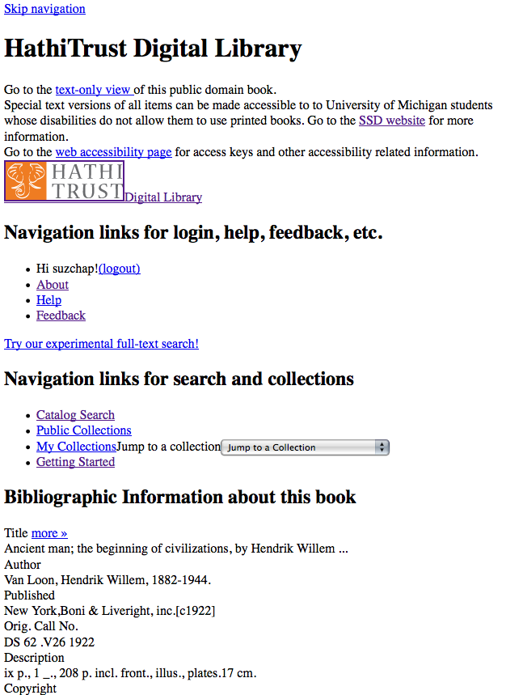
Skip navigation link
Info about SSD service & link to accessibility page
Descriptive headings added (hidden from GUI with CSS)
Added labels & descriptive titles to forms & ToC table
Access keys for navigating pages with keyboard
Images used for style are in css so no need to use alt tags

Slide 43
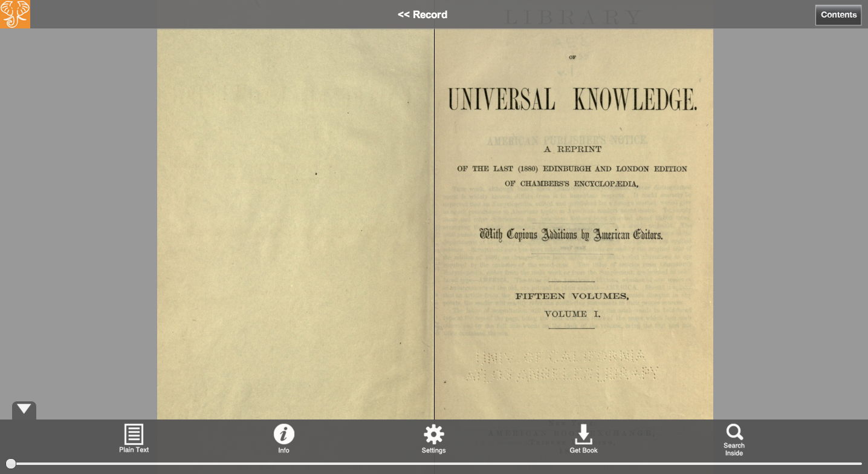
Access
Catalog
Full-text Search
PageTurner
Collections
APIs
Datasets

Slide 44
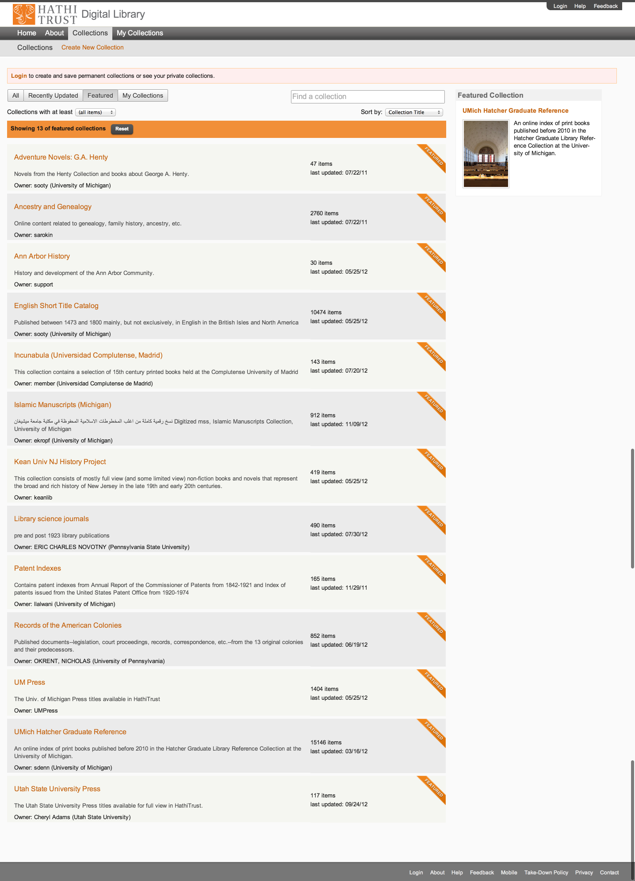
Access
Catalog
Full-text Search
PageTurner
Collections
APIs
Datasets

Slide 45
Access
Catalog
Full-text Search
PageTurner
Collections
APIs
Datasets

Slide 46
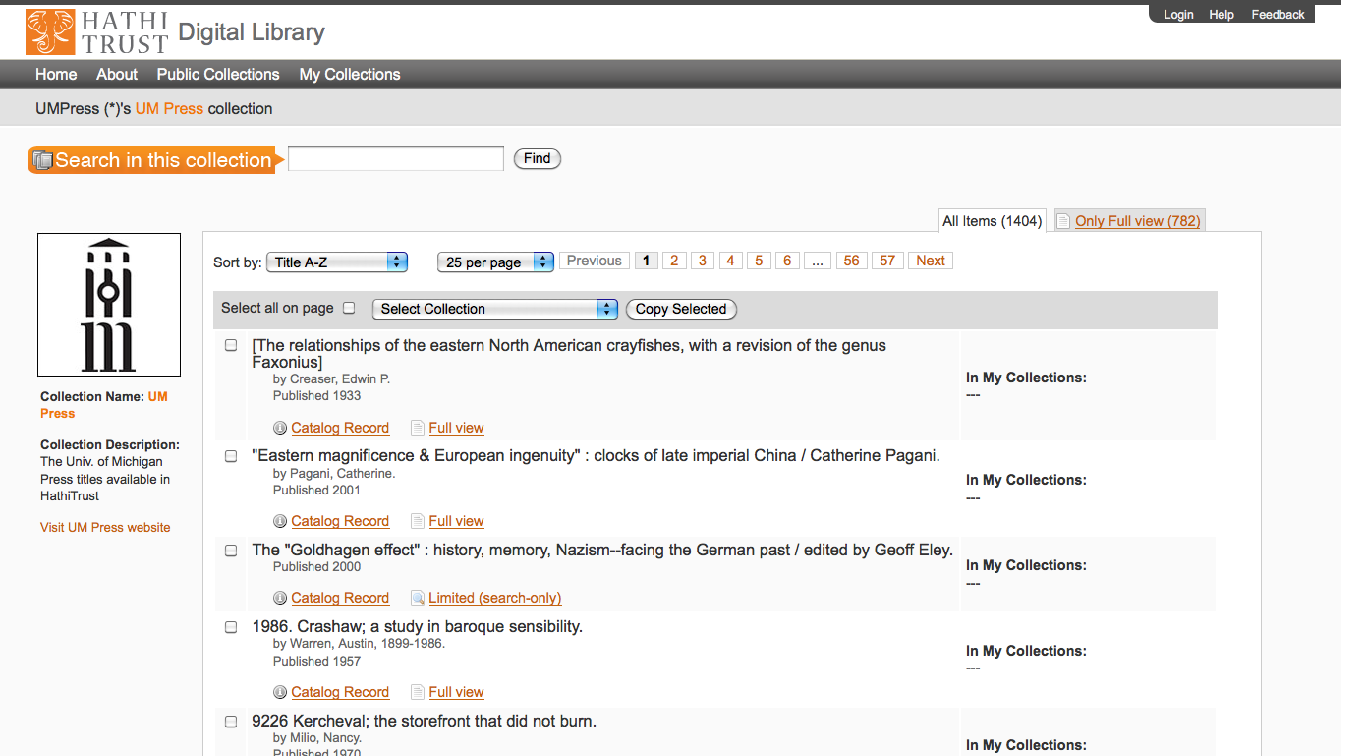
Access
Catalog
Full-text Search
PageTurner
Collections
APIs
Datasets

Slide 47
APIs
Data API
  Volume and rights information
  Page images
  OCR
Bibliographic API
  Volume and rights information
  MARC records
OAI
“Hathifiles”

Slide 48
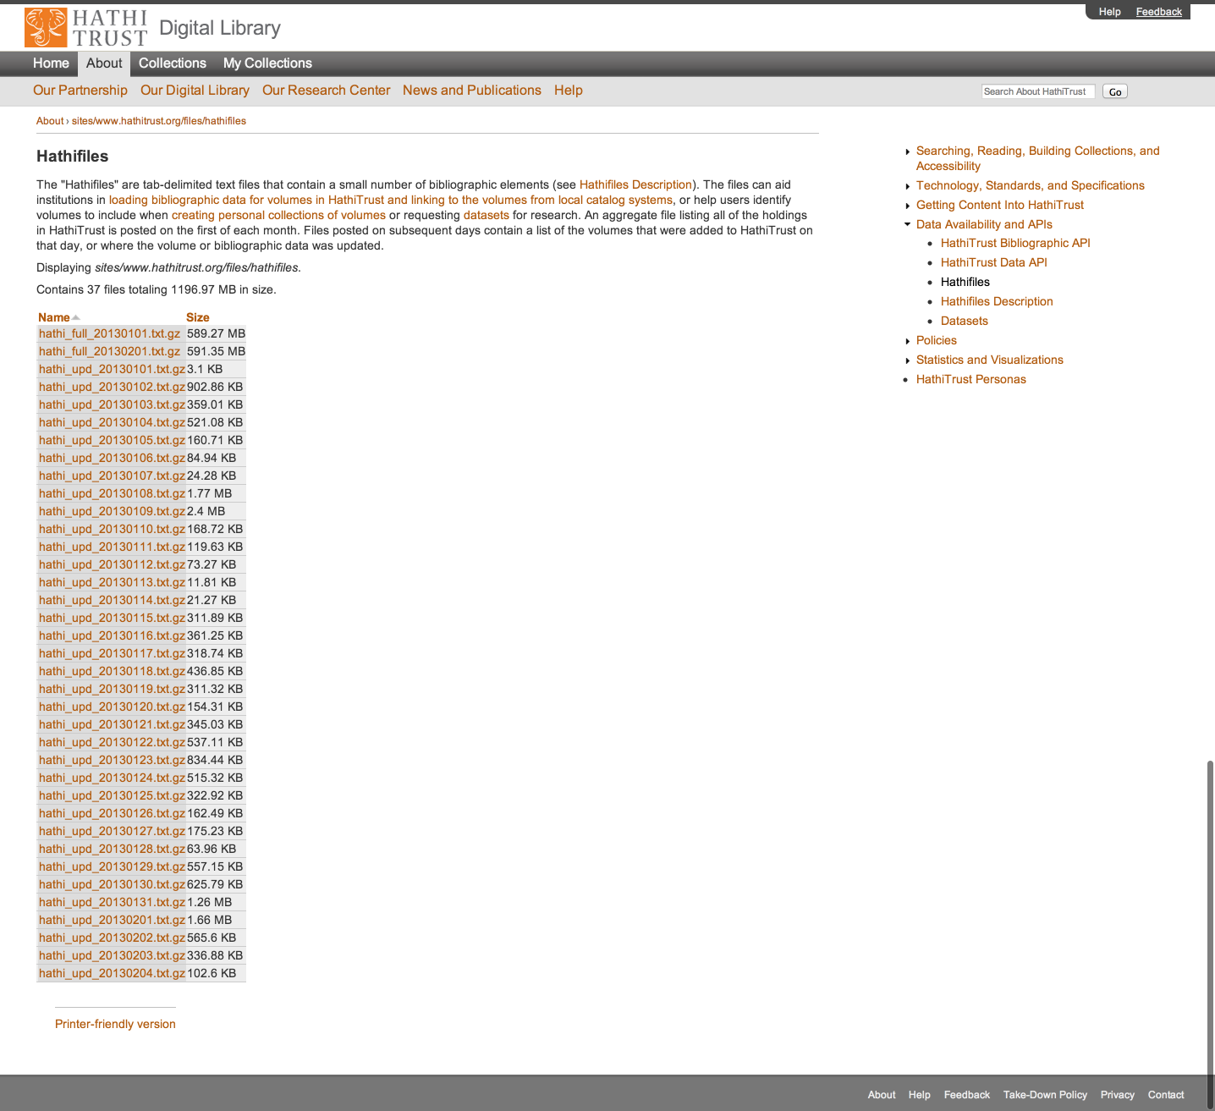

Slide 49
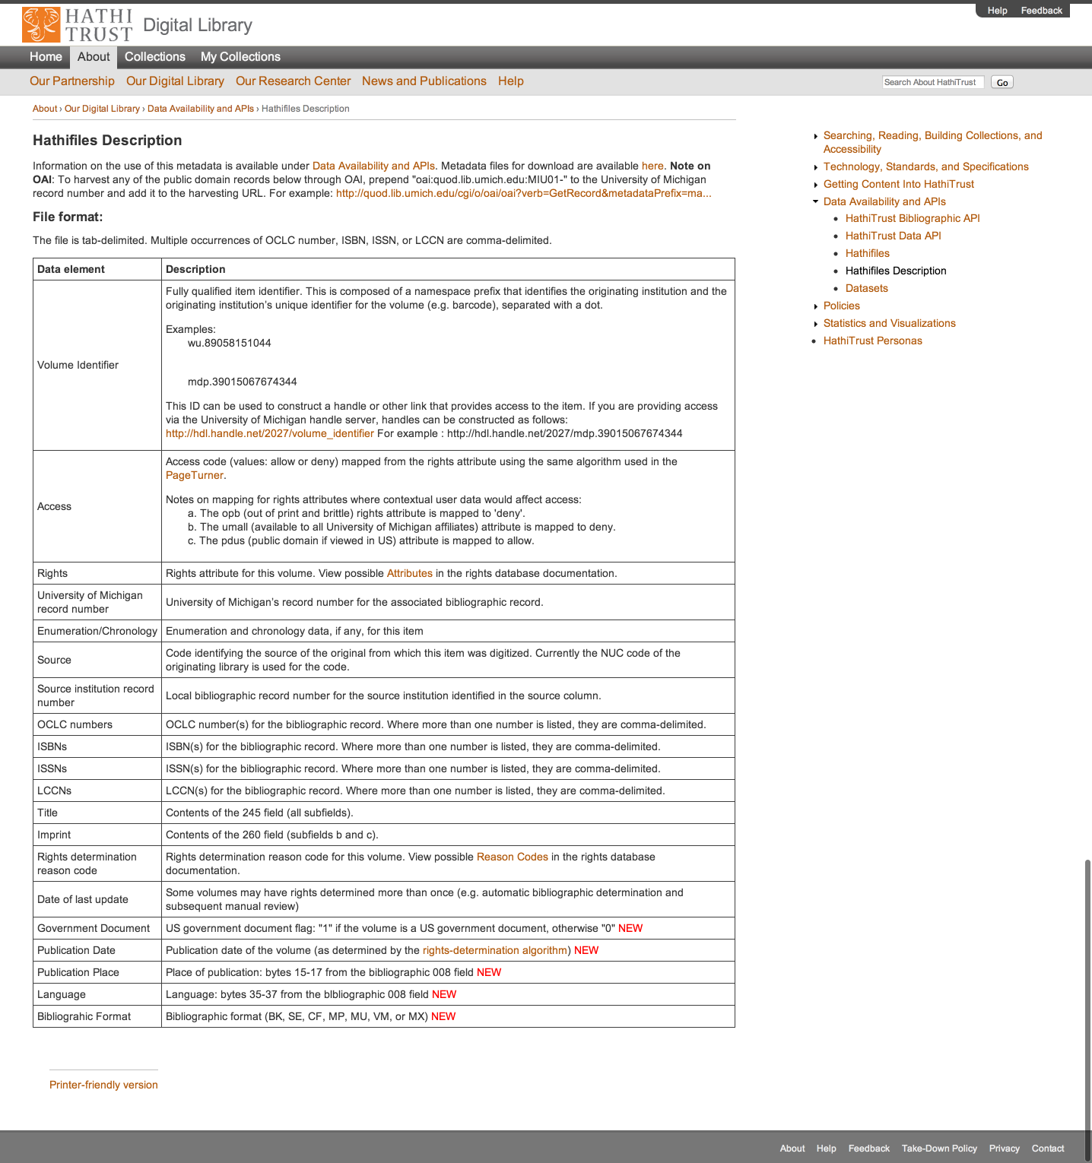

Slide 50
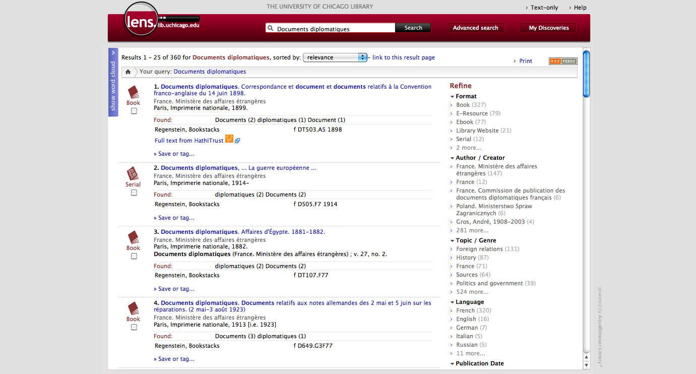

Slide 51
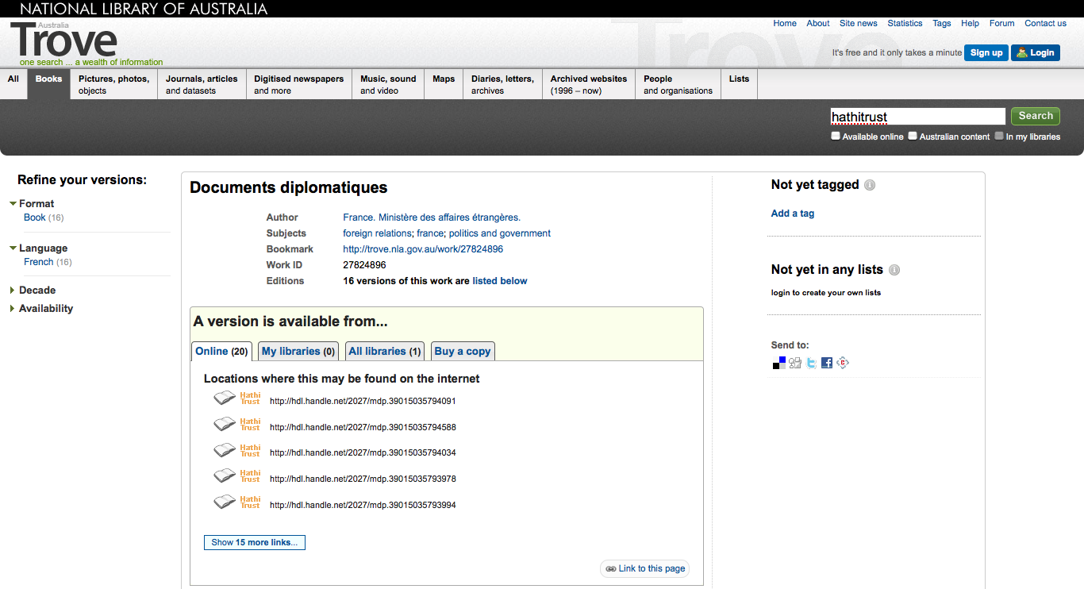

Slide 52
Datasets
Google-digitized
  ~2.8 million texts
  Requires proposal to HathiTrust
  Agreement with Google
  Statement on use/management
Non-Google-digitized
  ~370,000 texts
  Freely available
  Statement on management

Slide 53
Research Center
Environment to perform research on HathiTrust corpus
http://www.hathitrust.org/htrc

Slide 54

http://lib.umich.edu/mpach
Package of tools to enable publication of open access, born-digital journal content, directly into HathiTrust
  Including accompanying data and media files
Allows integration with popular journal publishing tools such as Open Journal Systems (OJS)

Slide 55
Higher Education
Source / Archive
Editorial
Market

Slide 56
Access Determinations
Automated
Manual

Slide 57
Automatic Rights Determination
Conducted on all works at time of ingest and when records are modified
  Public domain worldwide
    US works published before 1923, US federal government publications, non-US works published prior to 1873
  Public domain in the United States
    Non-US works published prior to 1923

Slide 58
Manual Rights Determination
IMLS-funded CRMS project
  CRMS-US
    2008: US-published works 1923-1963
    Staff at 4 partner institutions
  CRMS-World
    2011: Expanded to non-US works
    Staff at 16 partner institutions
  Double review with additional expert review for conflicts
  Compliance with copyright formalities
  As of January 2013 241,541 reviewed, more than 132,644 opened
Rights Holder Permissions

Slide 59
Rights Database
System of Precedence
Manual
Bibliographic (automatic)

Slide 60
Lawful uses
Users who have print disabilities
  All in-copyright works in HathiTrust currently owned (or owned previously) by the partner institution
  Must be authenticated
  Must be on U.S. soil
  One simultaneous access per copy owned
  http://www.hathitrust.org/accessibility

Slide 61
Lawful uses (2)
Out of print and brittle, missing
  Works must be currently owned (or owned previously) by the partner institution
  Must be authenticated or accessing work from library premises
  Must be on U.S. soil
  One simultaneous access per copy owned
  http://www.hathitrust.org/out-of-print-brittle
Access and use statements
  http://www.hathitrust.org/access_use

Slide 62
Outline
The Big Idea ✔
  Mission and Goals ✔
What we’re doing to get there ✔
  Repository and Content ✔
  Making content available ✔
  Organizational structure
How HathiTrust can change the way we work

Slide 63
Governance
Budget, Finances
Decision-making
Policy
Planning
Repository Administration
Web and application server configuration and maintenance
Security
Permissions
Logging
Repository Administration
Data management (content storage, backup, integrity checks, deletion)
Content and Metadata specifications
Disaster Recovery
Processes for ensuring content integrity
Rights Management
Copyright determination
Copyright review
Copyright information management (database)
Rightsholder permissions
Bibliographic Data Management
Entity description (record-level)
Object identification (item-level)
Collection Development
Digital
Expansion beyond books and journals (born-digital, images and maps, audio)
Selection of content (for non-Google volume ingest and pilots projects)
Print
Cloud Library (effect of digital on print)
Hardware selection and replacement
Enterprise Management
Communication and Coordination with partner institutions
Hardware configuration and maintenance
Project management
Data availability
e-Commerce
Content Access
PageTurner
Collection Builder
Large-scale Search
Bibliographic Catalog
Research Center
APIs
Quality Assurance
Quality Review
Content Certification
User Services
Usability
User support (helpdesk)
Outreach
Project website
Monthly newsletter
Papers and presentations
Communication with potential partners
Surveys, general inquiries
Repository evaluation and audit (e.g., DRAMBORA, TRAC)
Legal
Risk management (use of materials)
Partner agreements
Advocacy
Content Ingest
Transformation
Validation
Print on Demand
Financial contributions of partners
HathiTrust Functional Framework

Slide 64
Executive Committee
Strategic Advisory Board
Budget/Finances Decision-making
Guidance on Policy, Planning
Collective Work: Working Groups and Committees
Operational
  Communications
  User Support
  User Experience
  Strategic
  Collections
  Discovery Interface
  Full-text Search
Operational
Communications
User Support
User Experience
Distributed work
Driven by needs of institutions
Leverage across the partnership
Projects, Print on Demand, Grant Work, Ingest Specifications, PageTurner, Bibliographic Data Management
HathiTrust

Slide 65
Constitutional Convention
October 2011
52 partners
3-year review overseen by SAB
Ballot Proposals
  Print monograph storage
  Approval Process for development initiatives
  U.S. Government Documents
  Fee-for-service content deposit
  Governance

Slide 66
Strategic Advisory Board
Guidance on Policy, Planning
12-member Board of Governors
Chief Executive Officer
Executive Committee
Executive Committee
HathiTrust
Budget/Finances
Decision-making

Slide 67
Governance
Efficient, practical
Inclusive, collective

Slide 68
Outline
The Big Idea ✔
  Mission and Goals ✔
What we’re doing to get there ✔
  Repository and Content ✔
  Making content available ✔
  Organizational structure ✔
How HathiTrust can change the way we work

Slide 69
How HathiTrust Can Change the Way We Work

Slide 70
Seeing collective problems as collective

Slide 71
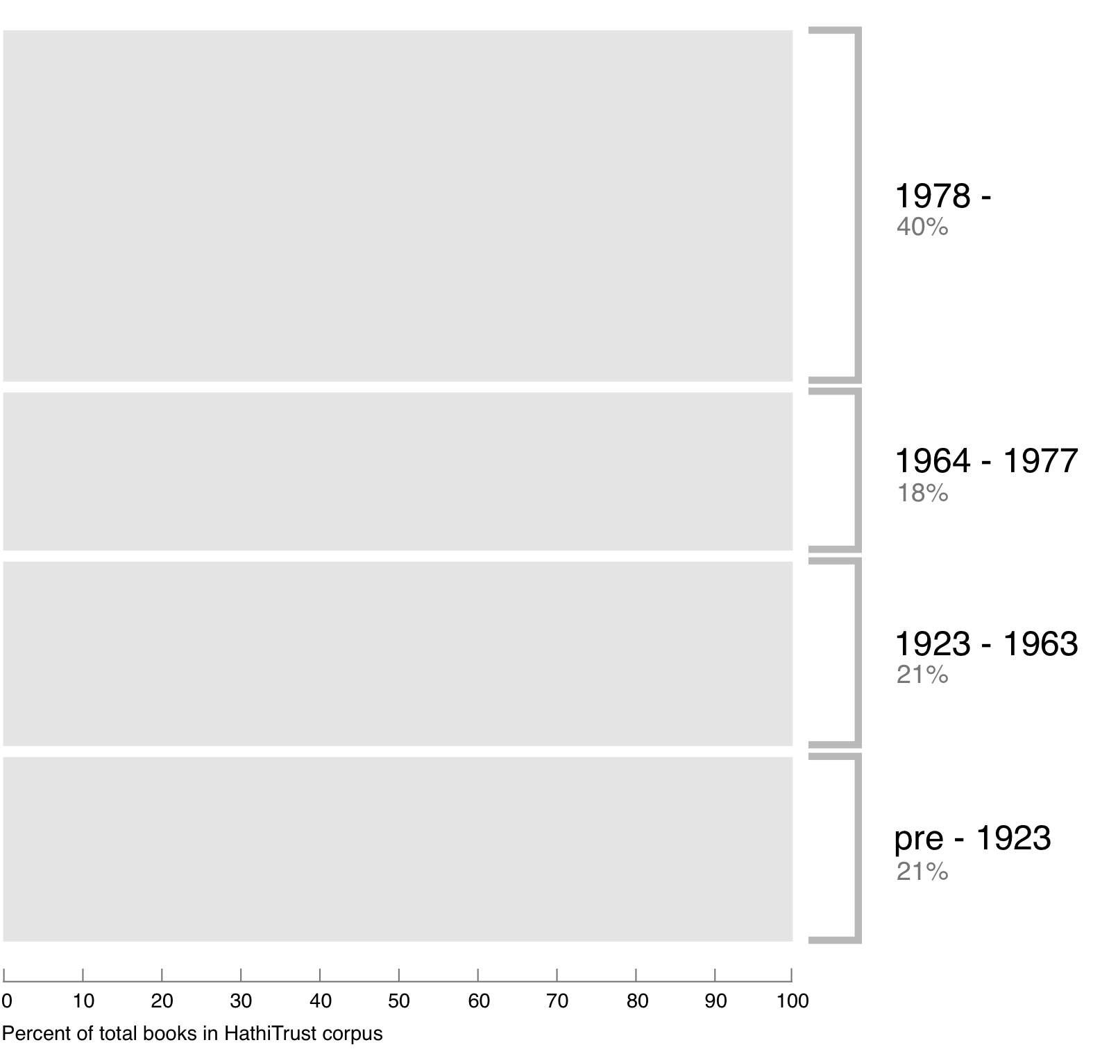
Breakdown of HathiTrust book corpus by publication date
42%
19%
20%
19%
Bibliographic Indeterminacy and the Scale of Problems and Opportunities of "Rights" in Digital Collection Building – 2/2011

Slide 72
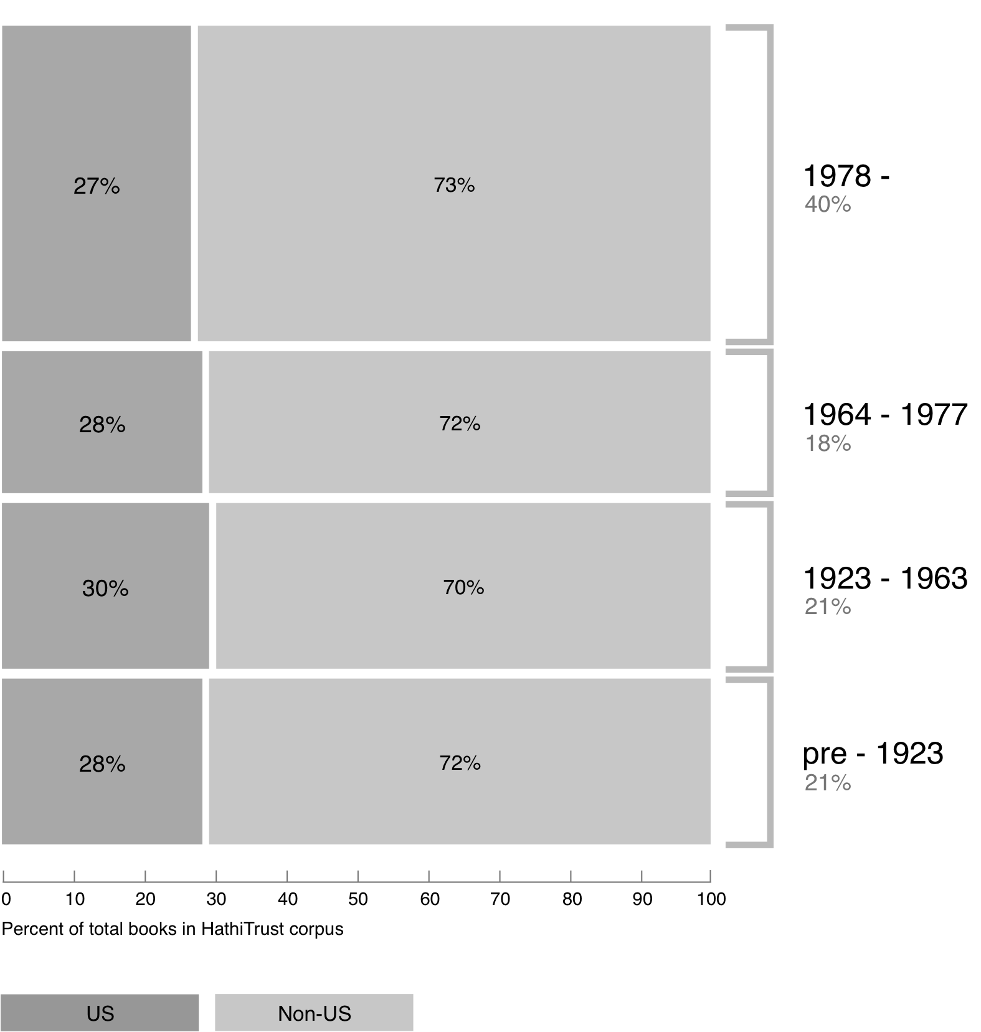
Breakdown of HathiTrust book corpus by publication date
42%
19%
20%
19%

Slide 73
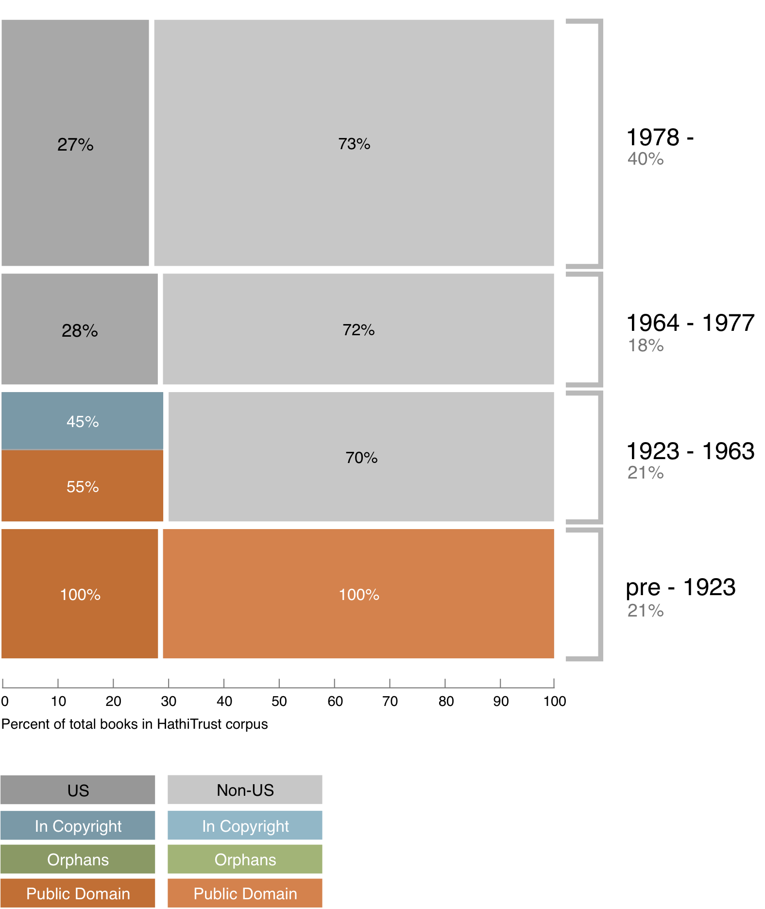
Copyright status of books published pre-1923 and US works published 1923-1963
42%
19%
20%

Slide 74
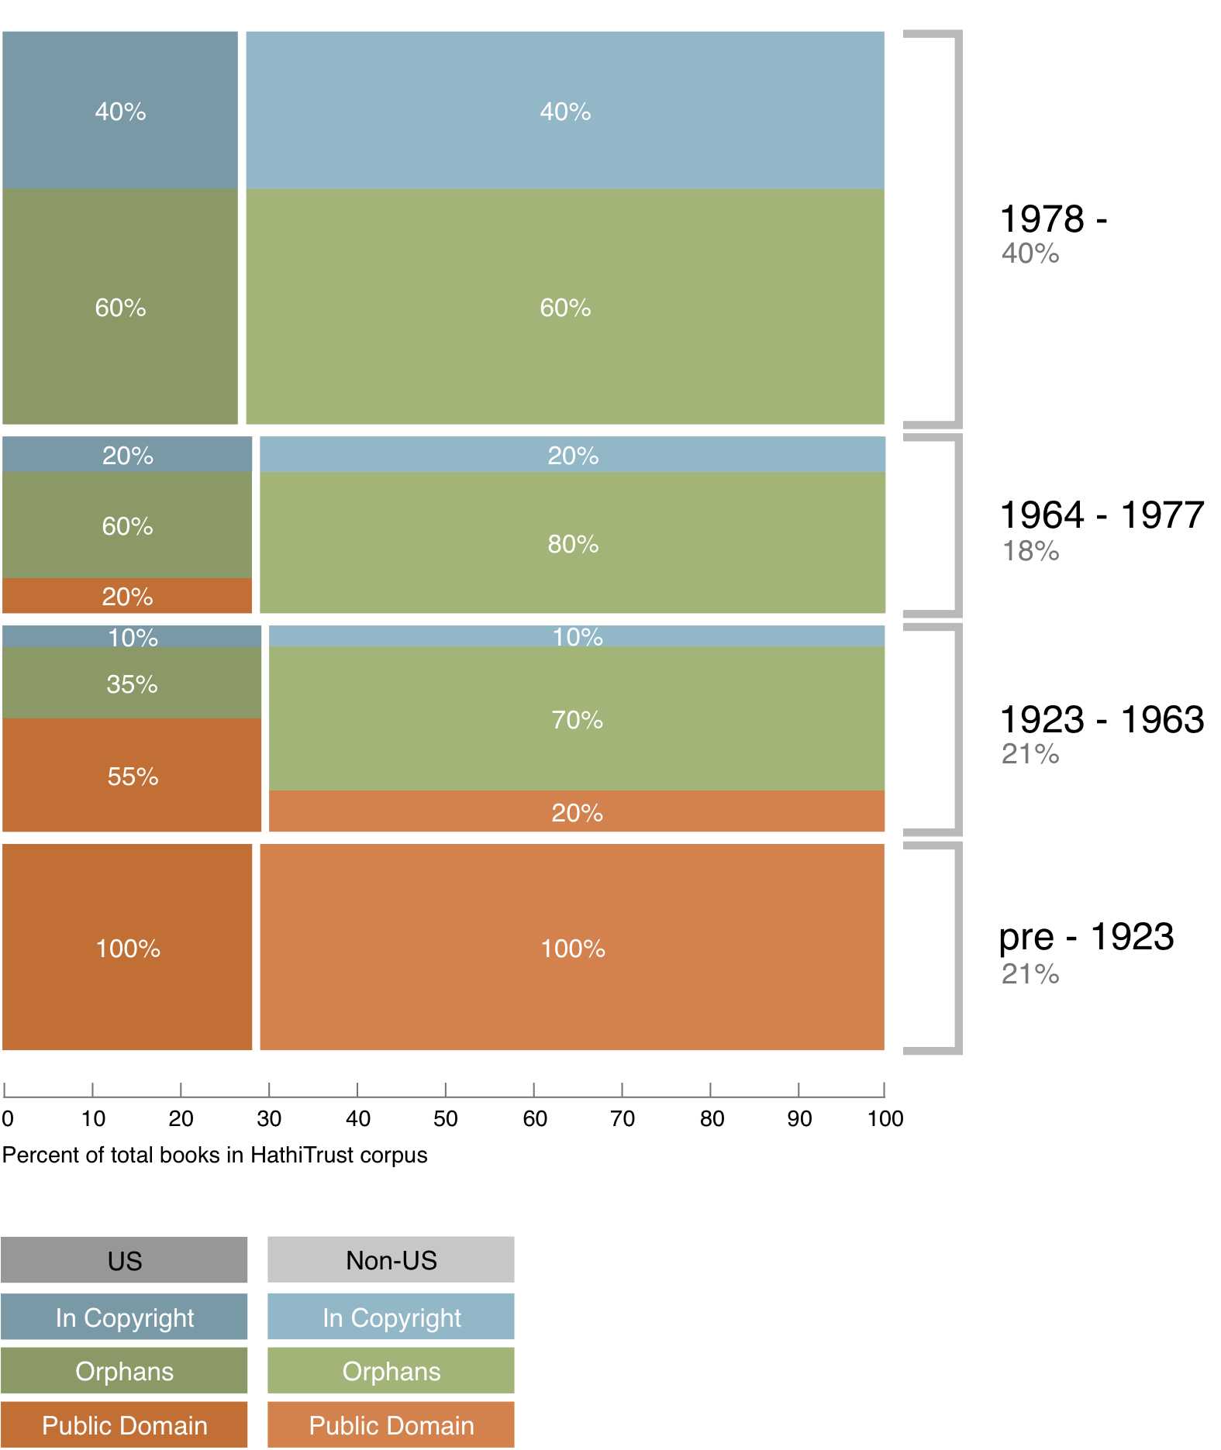
Copyright status of books published pre-1923 and US works published 1923-1963
42%
19%
20%
19%

Slide 75
Copyright status of books published pre-1923 and US works published 1923-1963
42%
In Print ?
19%
20%
19%

Slide 76
Relationships
Identification
Description
Rights

Slide 77
Relationships
Identification
Description
Rights
Relationships
  Bibliographic records

Slide 78
Relationships
Identification
Description
Rights
Relationships
  Bibliographic records
  Bib records and objects

Slide 79
Relationships
Identification
Description
Rights
Relationships
  Bibliographic records
  Bib records and objects
  Digital objects

Slide 80
Relationships
Identification
Description
Rights
Relationships
  Bibliographic records
  Bib records and objects
  Digital objects
  Digital and print

Slide 81
Understanding the relationship between the collective and local

Slide 82
1st model: Price per GB

Slide 83
 | 2008 | 2009 | 2010 | 2011 | 2012 (Oct)
Total Volumes | 2,477,871 | 5,221,092 | 7,836,698 | 9,966,572 | 10,531,566
Public Domain | 372,085 | 758,947 | 1,959,223 | 2,712,626 | 3,218,132

Slide 84
A global change in the library environment
Academic print book collection already substantially duplicated in mass digitized book corpus
June 2010
Median duplication: 31%
June 2009
Median duplication: 19%
Courtesy of Constance Malpas, OCLC Research
Notes:
84

Slide 85
Digitized Books in Shared Repositories
~3.5M titles
~75% of mass digitized corpus is ‘backed up’ in one or more shared print repositories
~2.5M
Courtesy of Constance Malpas, OCLC Research
Notes:
85

Slide 86
Collection Overlap
More than 50% median overlap with ARL institutions; higher for small liberal arts colleges
New Pricing model based on Print holdings
  http://www.hathitrust.org/cost
  Requires print holdings database
  Also support expansion of legal uses, efforts in de-duplication
  Facilitate individual and collaborative collection development and management operations
Print monographs archiving

Slide 87
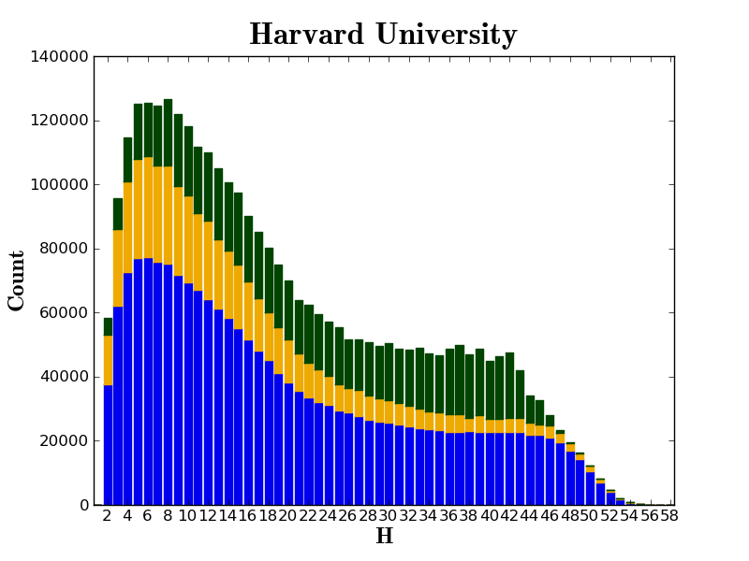

Slide 88
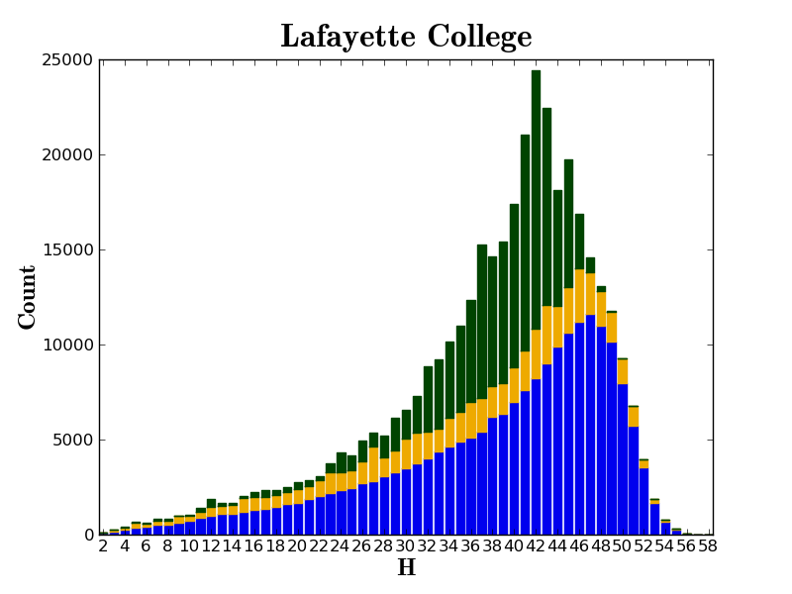

Slide 89
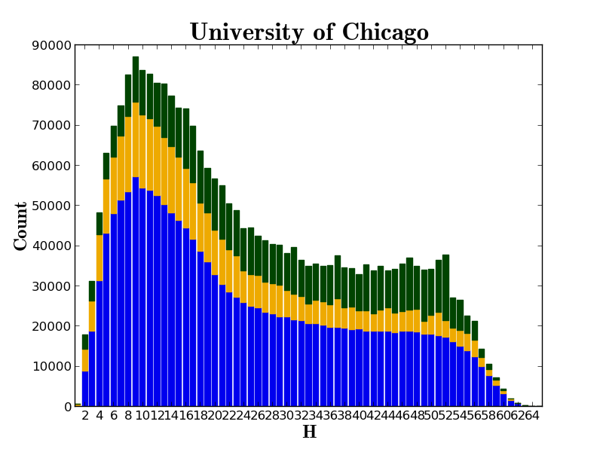

Slide 90
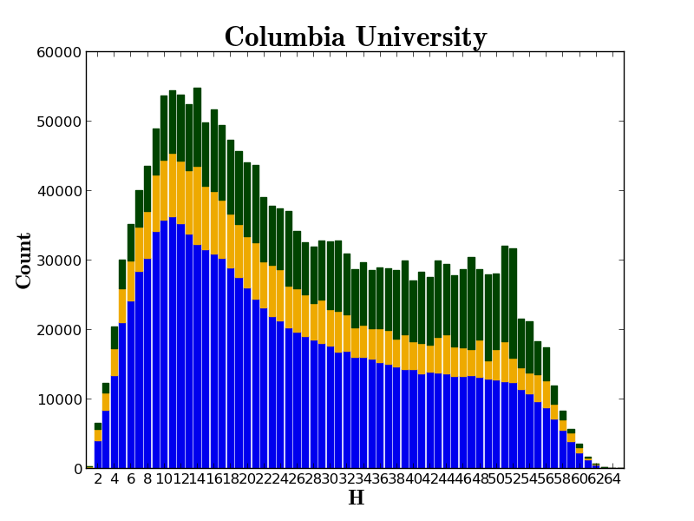

Slide 91
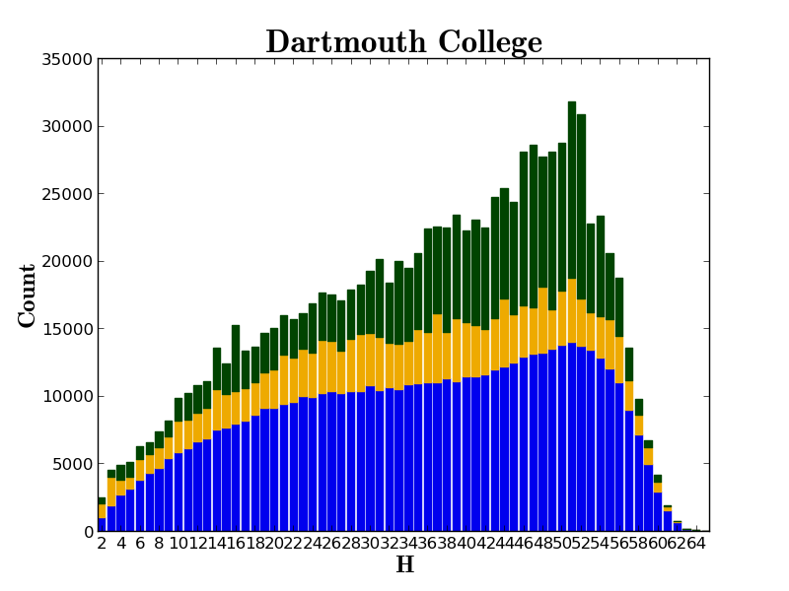

Slide 92
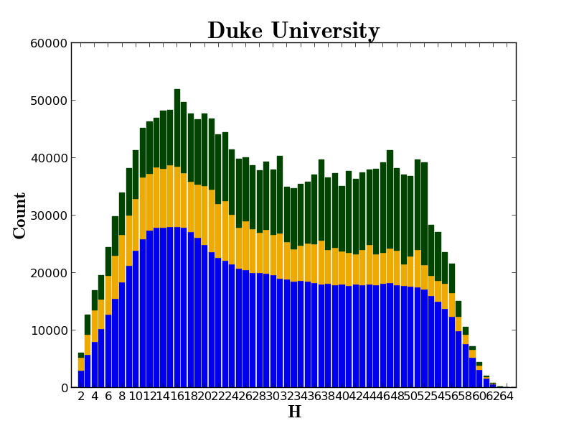

Slide 93
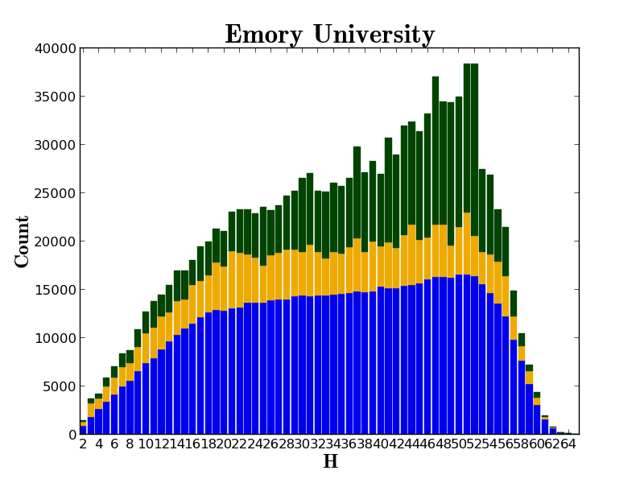

Slide 94
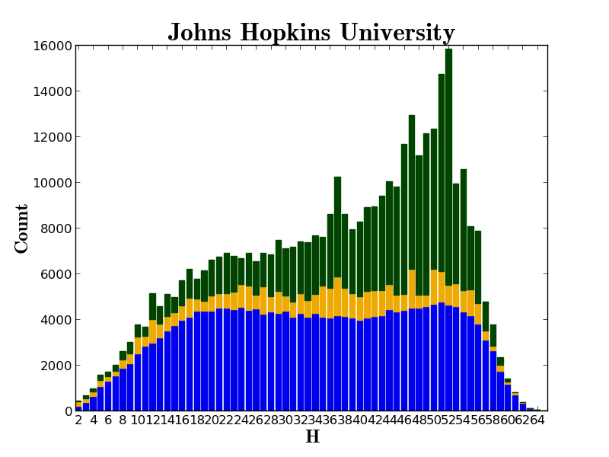

Slide 95
Sourcing and Scaling
http://orweblog.oclc.org/archives/002058.html

Slide 96
Scale
  Institution-scale
  Group-scale
  Web-scale

Slide 97
Sourcing
  Institutional
  Collaborative
  Third-party

Slide 98
A new kind of library

Slide 99
Thank you!

Slide 100
How to find out more
About: http://www.hathitrust.org/about
Twitter: http://twitter.com/hathitrust
Facebook: http://www.facebook.com/hathitrust
Monthly newsletter:
  http:www.hathitrust.org/updates
  RSS http://www.hathitrust.org/updates_rss
Contact us: feedback@issues.hathitrust.org
Blogs: http://www.hathitrust.org/blogs
  Large-scale Search
  Perspectives from HathiTrust

