Slide 1

Digital Preservation
A Matter of Trust

Slide 2
Context
* As of March 5, 2011

Slide 3
Three inter-related pieces
Fidelity or appropriateness of capture
Openness and flexibility of formats
Viability of the “medium” (construed broadly)

Slide 4
Fidelity or appropriateness of capture
Kenney and Chapman’s benchmarking studies to aid in determining appropriate resolution
The purpose to which something is put: the same work may be digitized several different ways, depending on purpose, including analysis of the artifact, reproduction, computation, different user communities (e.g., print-disabled)
Jeremy York, “Legibility and Large-Scale Digitization”

Slide 5
Openness and flexibility of formats
Standards (memorialized, shared)
Transformability: A rich and flexible master allows us to, on demand, create versions for many different purposes (no dead ends, lots of tools to take from X to Y)
Consider mobile interfaces (see example)

Slide 6
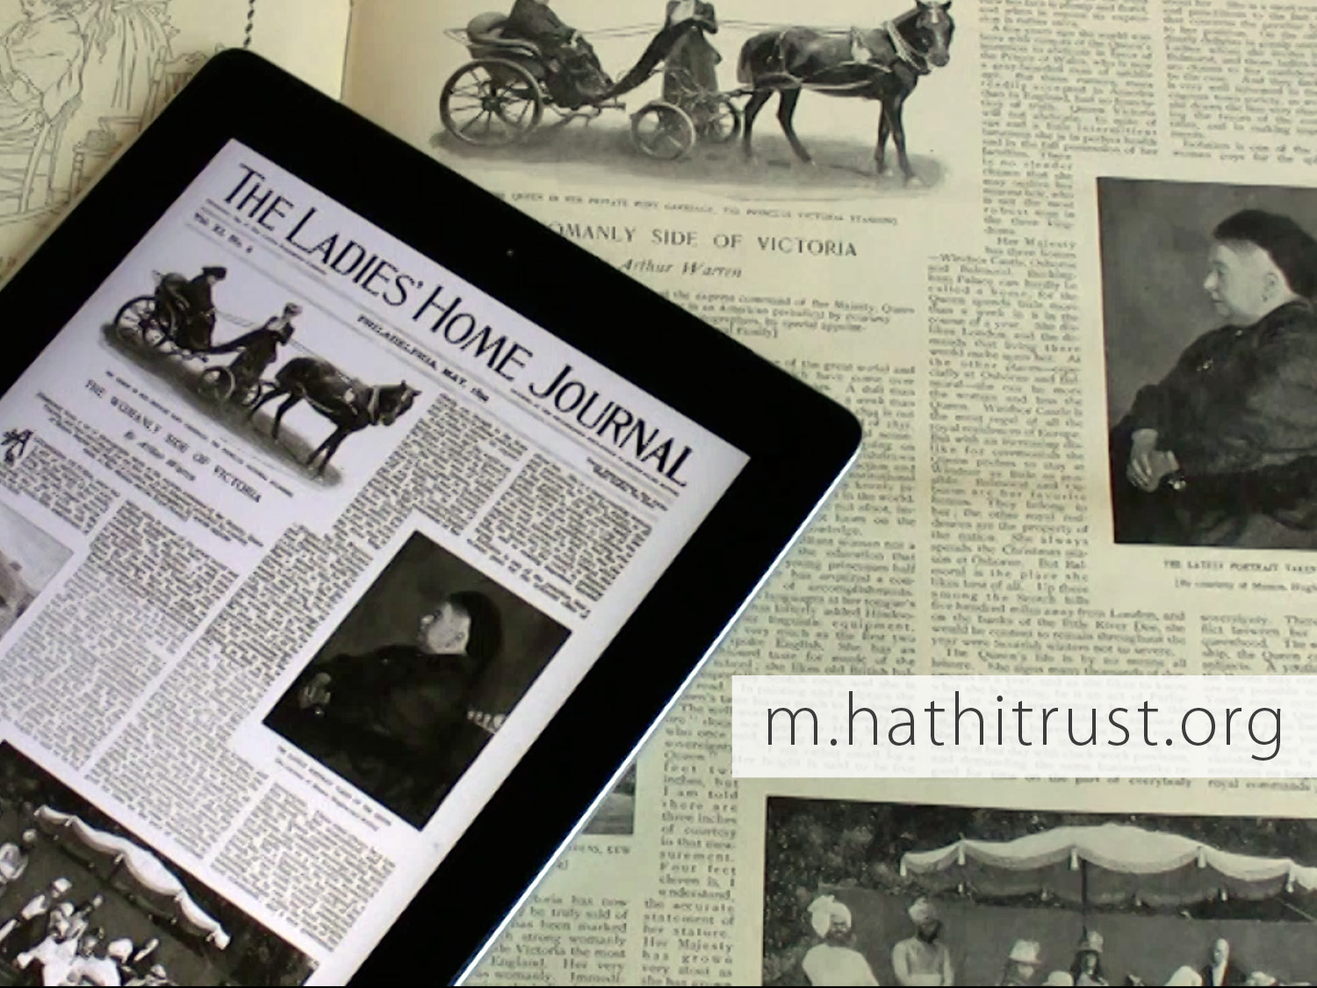
mobile

Slide 7
Viability of the “medium”
Formerly considered in terms of substrates (cf., NISO testing on durability of gold CD-ROM)
Now, redundancy within and replication among
And audit, self-audit and external (cf. TRAC)

Slide 8
Knowing what you have
Strong metadata
Registration (e.g., Keepers) and reporting (so that others understand what is preserved)
Overlap analysis (understanding how collections relate to the archive)

Slide 10
A global change in the library environment
Academic print book collection already substantially duplicated in mass digitized book corpus
June 2010
Median duplication: 31%
June 2009
Median duplication: 19%
Notes:
10

Slide 11
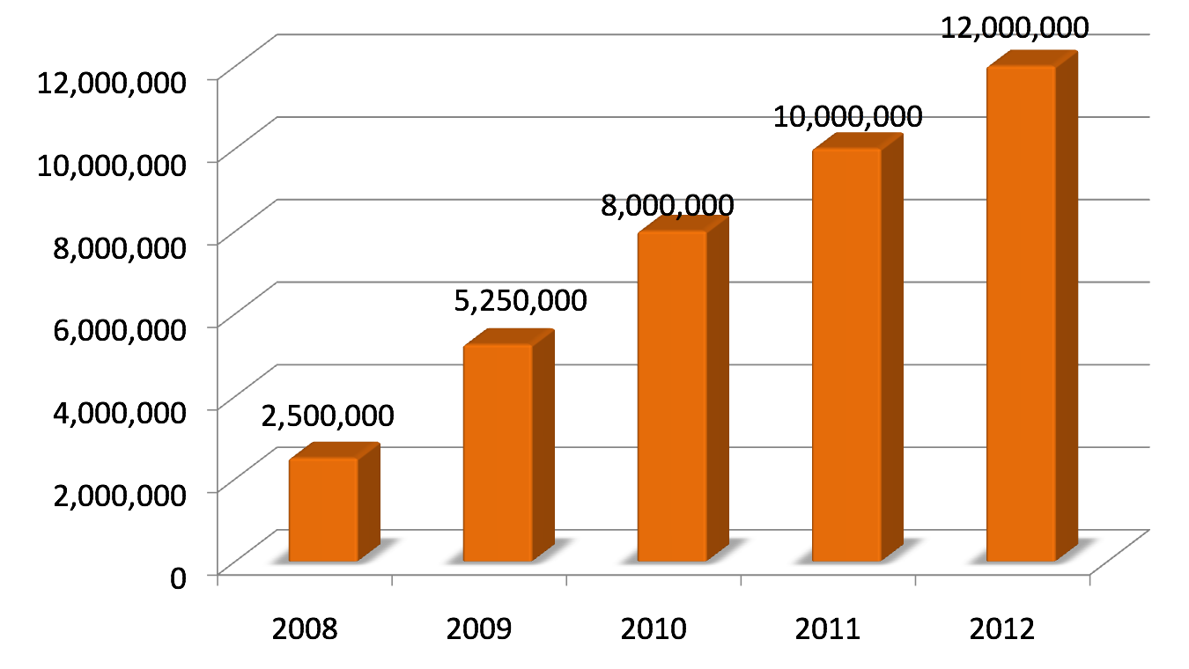
HathiTrust Content Growth
Notes:
11

Slide 12
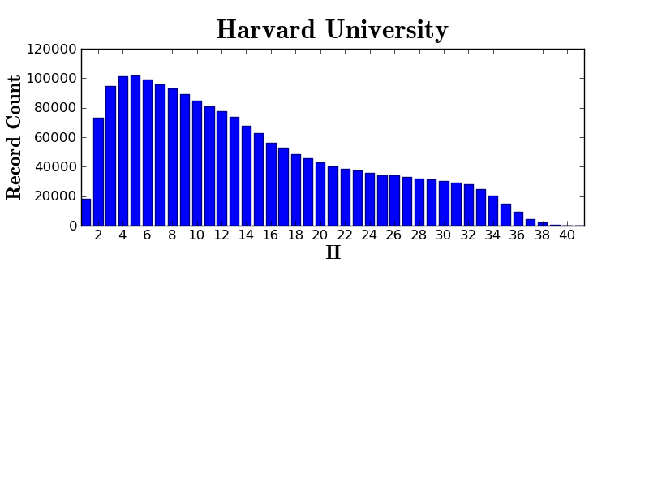
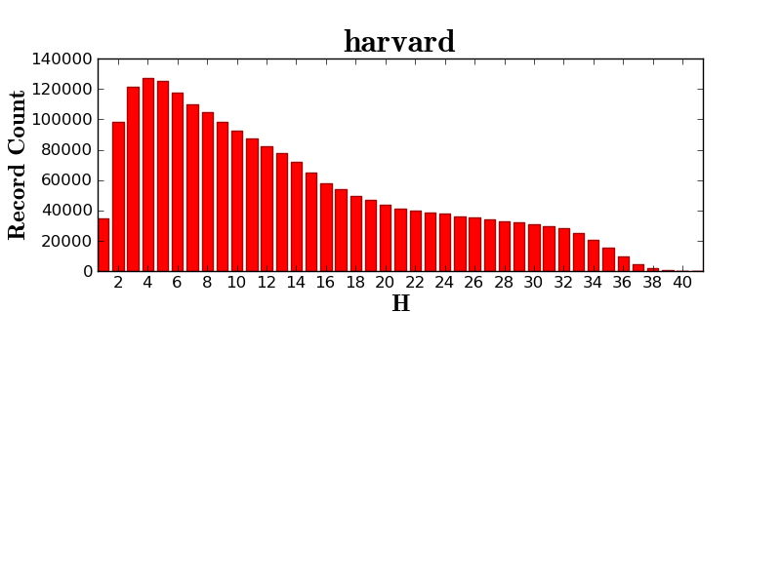

Slide 13
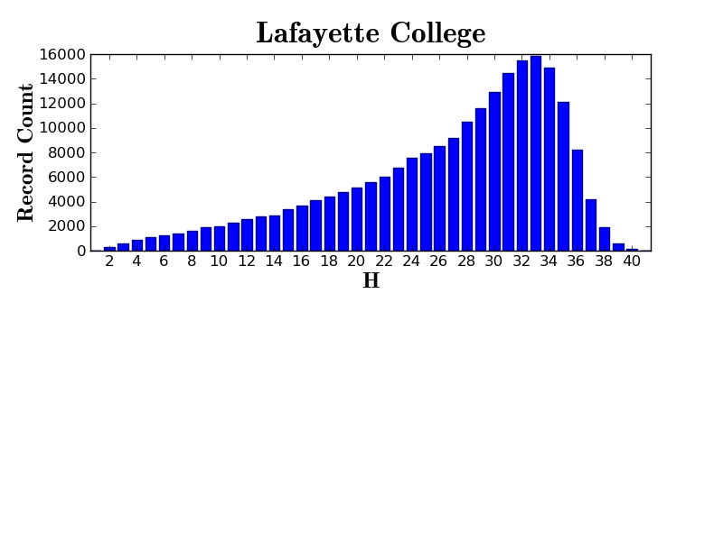

Slide 14
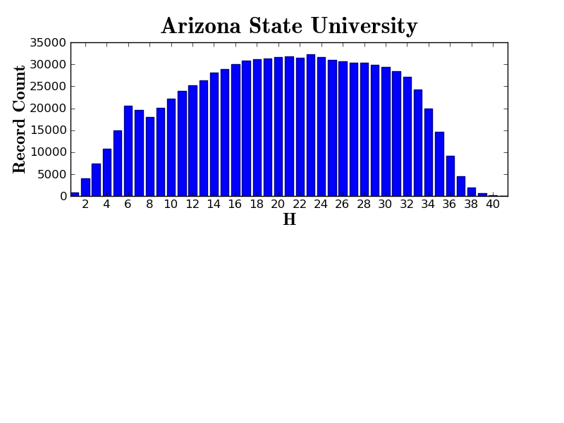

Slide 15
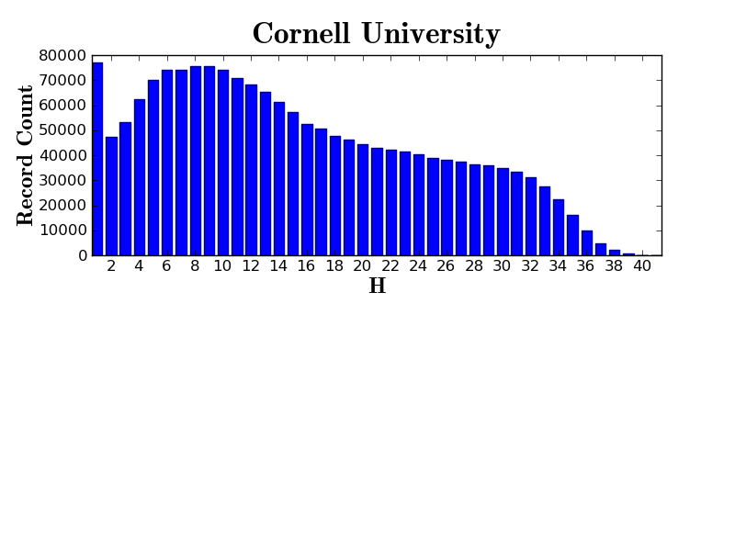

Slide 16
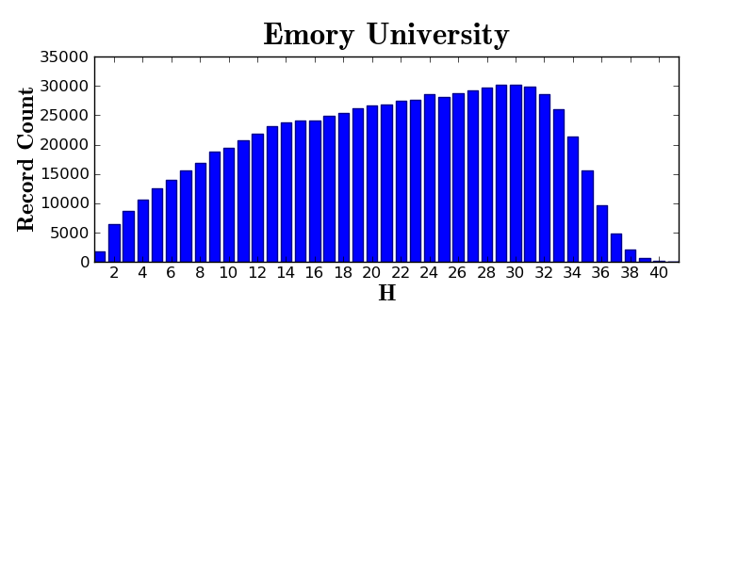

Slide 17
Governance
Budget, Finances
Decision-making
Policy
Planning
Repository Administration
Web and application server configuration and maintenance
Security
Permissions
Logging
Repository Administration
Data management (content storage, backup, integrity checks, deletion)
Content and Metadata specifications
Disaster Recovery
Processes for ensuring content integrity
Rights Management
Copyright determination
Copyright review
Copyright information management (database)
Rightsholder permissions
Bibliographic Data Management
Entity description (record-level)
Object identification (item-level)
Collection Development
Digital
Expansion beyond books and journals (born-digital, images and maps, audio)
Selection of content (for non-Google volume ingest and pilots projects)
Print
Cloud Library (effect of digital on print)
Hardware selection and replacement
Enterprise Management
Communication and Coordination with partner institutions
Hardware configuration and maintenance
Project management
Data availability
e-Commerce
Content Access
PageTurner
Collection Builder
Large-scale Search
Bibliographic Catalog
Research Center
APIs
Quality Assurance
Quality Review
Content Certification
User Services
Usability
User support (helpdesk)
Outreach
Project website
Monthly newsletter
Papers and presentations
Communication with potential partners
Surveys, general inquiries
Repository evaluation and audit (e.g., DRAMBORA, TRAC)
Legal
Risk management (use of materials)
Partner agreements
Advocacy
Content Ingest
Transformation
Validation
Print on Demand
Financial contributions of partners
HathiTrust Functional Framework

