Slide 1
Institution Uses of HathiTrust
Jeremy York
Maine Shared Collections Strategy
May 23, 2013

Slide 2
Partnership
Arizona State University
Baylor University
Boston College
Boston University
Brandeis University
Brown University
California Digital Library
Carnegie Mellon University
Columbia University
Cornell University
Dartmouth College
Duke University
Emory University
Florida State University
Getty Research Institute
Harvard University Library
Indiana University
Iowa State University
Johns Hopkins University
Kansas State University
Lafayette College
Library of Congress
Massachusetts Institute of Technology
McGill University`
Michigan State University
New York Public Library
New York University
North Carolina Central
University
North Carolina State
University
Northwestern University
The Ohio State University
The Pennsylvania State
University
Princeton University
Purdue University
Stanford University
Syracuse University
Texas A&M University
Tufts University
Universidad Complutense
de Madrid
University of Alberta
University of Arizona
University of Calgary
University of California
Berkeley
Davis
Irvine
Los Angeles
Merced
Riverside
San Diego
San Francisco
Santa Barbara
Santa Cruz
The University of Chicago
University of Connecticut
University of Delaware
University of Florida
University of Houston
University of Illinois
University of Illinois at Chicago
The University of Iowa
University of Kansas
University of Maryland
University of Miami
University of Michigan
University of Minnesota
University of Missouri
University of Nebraska-Lincoln
The University of North
Carolina at Chapel Hill
University of Notre Dame
University of Pennsylvania
University of Pittsburgh
University of Utah
University of Vermont
University of Virginia
University of Washington
University of Wisconsin- Madison
Utah State University
Vanderbilt University
Virginia Tech
Wake Forest University
Washington University
Yale University Library

Slide 3
Digital Repository
Launched 2008
Initial focus on digitized book and journal content
10.7 million total volumes
5.6 million book titles
278,000 serial titles
3.3 million public domain (~31%)

Slide 4
Mission
To contribute to the common good by collecting, organizing, preserving, communicating, and sharing the record of human knowledge

Slide 5
Collections and Collaboration
Comprehensive collection
Preservation…with Access
Repository centralized, yet open
Shared strategies
Copyright
Collection management, development
Preservation
Discovery / Use
Bibliographic Indeterminacy
Efficient user services
Public Good

Slide 6
Preservation...with Access
Long-term preservation
Bit-level and migration
Bibliographic search
Full-text search
Copyright review
Reading and download capabilities
Access for users who have print disabilities
Access to out of bring and brittle books
Subject to terms and conditions at http://www.hathitrust.org/access_use#ic-access
Support beyond books and journals

Slide 7
Getting Content into HathiTrust
Administrative forms
Digital Assets Submission Inventory
Administrative Coversheet
Content
Workflows for Google- and IA-digitized Institutions package to HathiTrust specifications
http://www.hathitrust.org/ingest_tools
Planning for next phase of tools
Metadata
Bibliographic data (MARC) to specifications

Slide 8
Copyright Distribution
Notes:
8

Slide 9
Content Sources

Slide 10
 | 2008 | 2009 | 2010 | 2011 | 2012 | 2013 (May)
Total Volumes | 2,477,871 | 5,221,092 | 7,836,698 | 9,966,572 | 10,622,285 | 10,724,270
Public Domain | 372,085 | 758,947 | 1,959,223 | 2,712,626 | 3,296,941 | 3,373,522

Slide 11
Centralized...yet open
Print on demand
ILL
Use in local catalogs
Collection Management/Developement

Slide 12
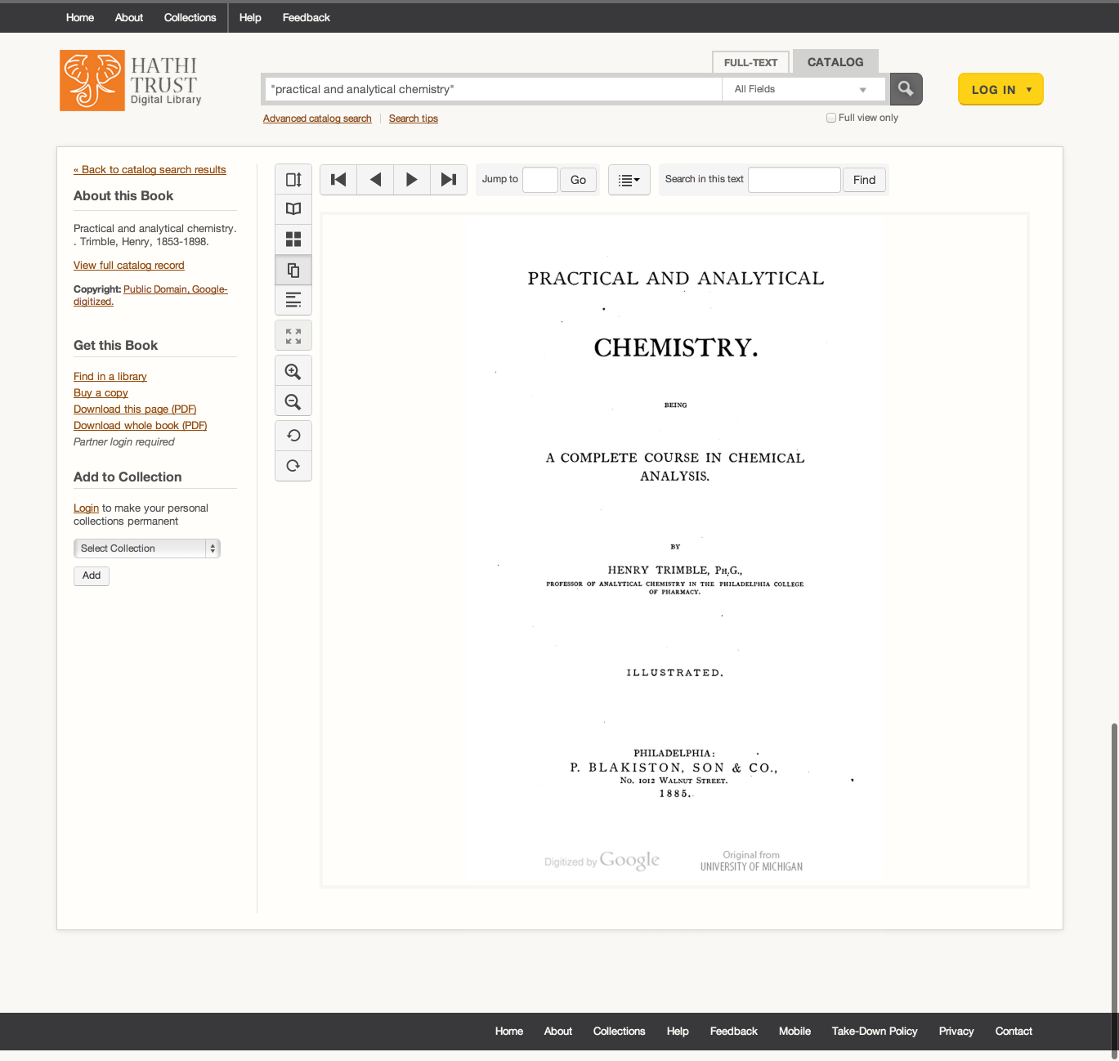

Slide 13
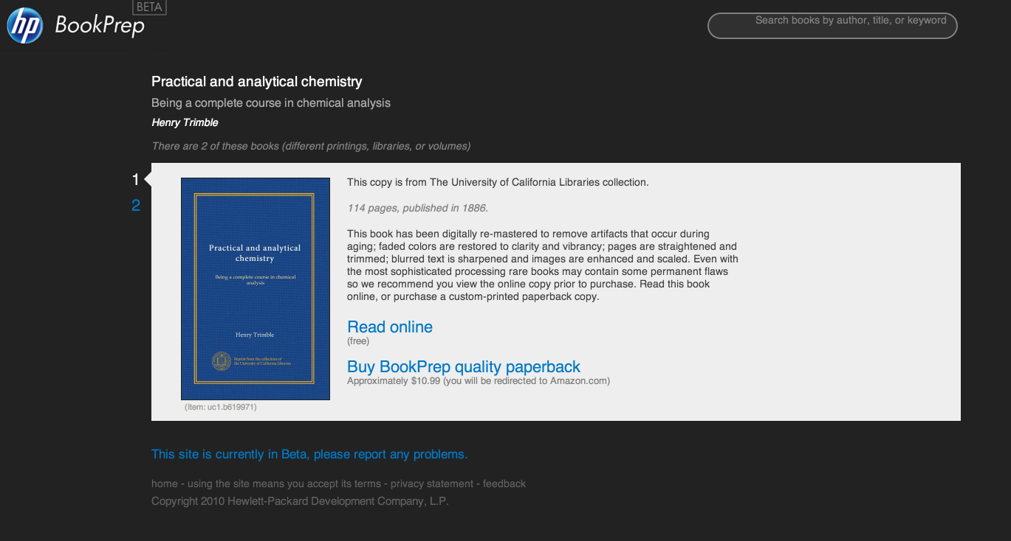

Slide 16
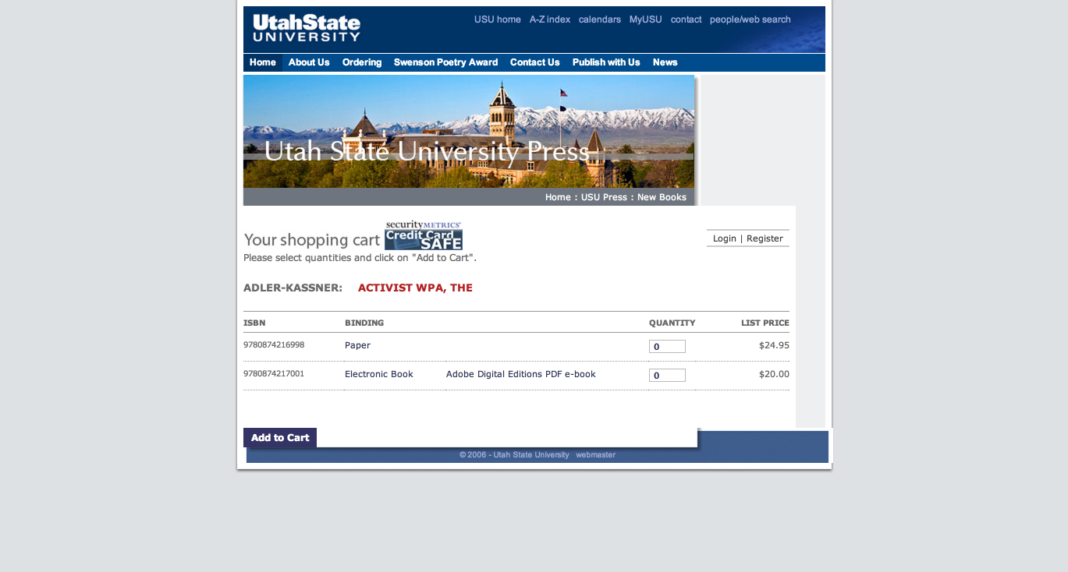

Slide 17
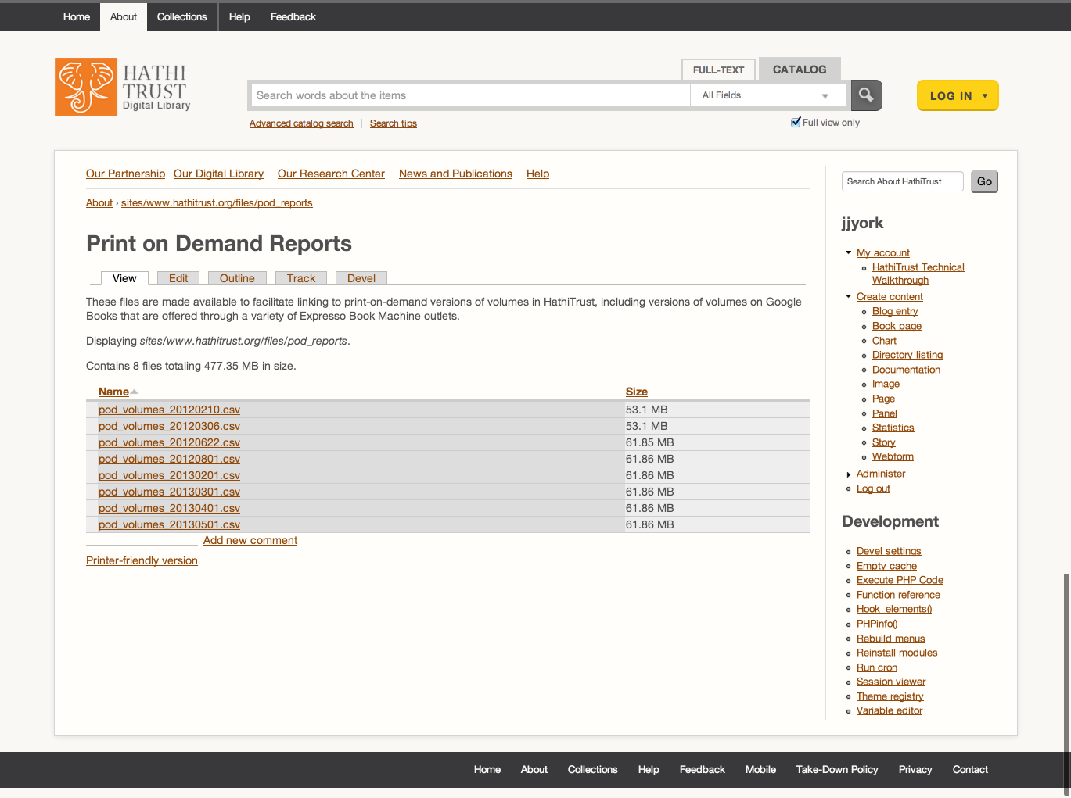

Slide 18
Inter-library Loan

Slide 19
Use in Local Catalogs

Slide 20
APIs
Bibliographic API
Volume and rights information
MARC records
http://www.hathitrust.org/bib_api
OAI
http://www.hathitrust.org/data
“Hathifiles”
http://www.hathitrust.org/hathifiles
Data API
Volume and rights information
Page images
OCR
http://www.hathitrust.org/data_api

Slide 21
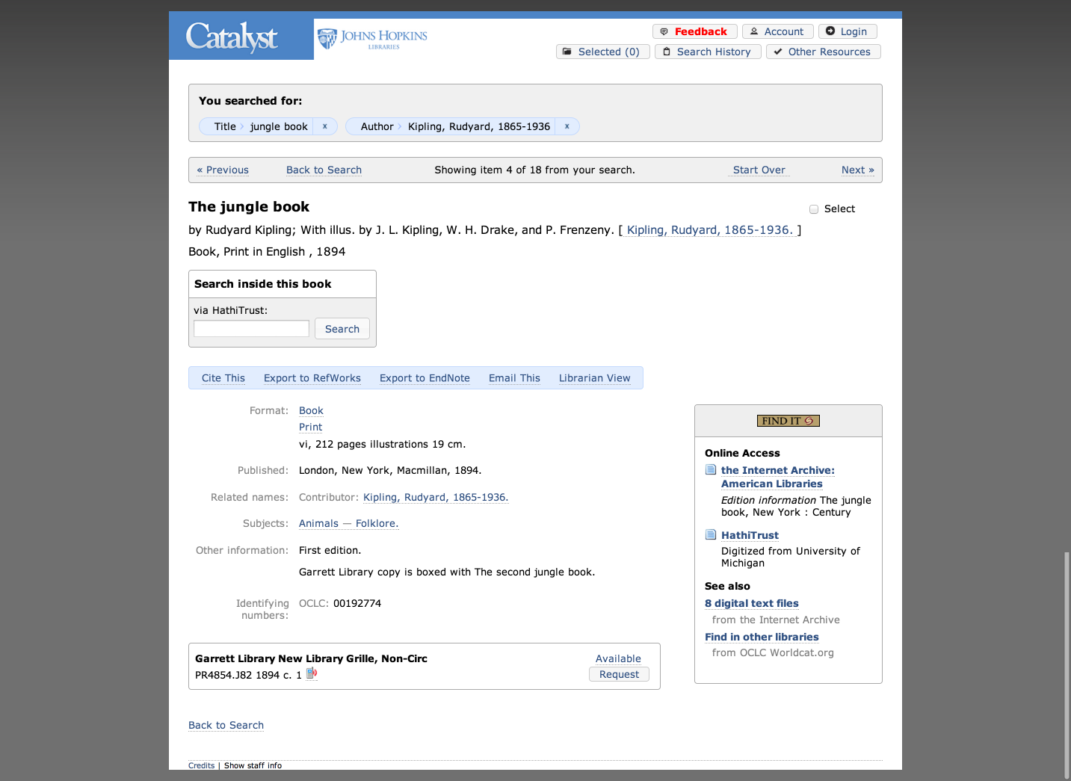

Slide 22
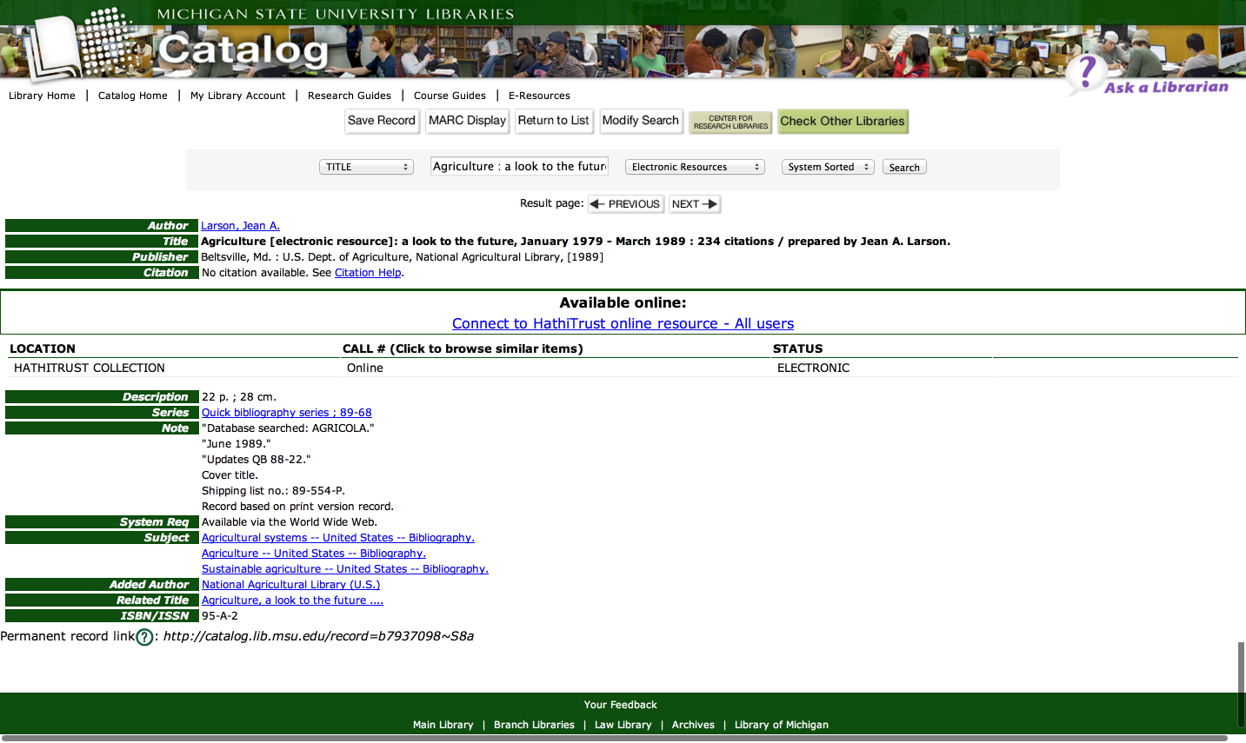

Slide 23
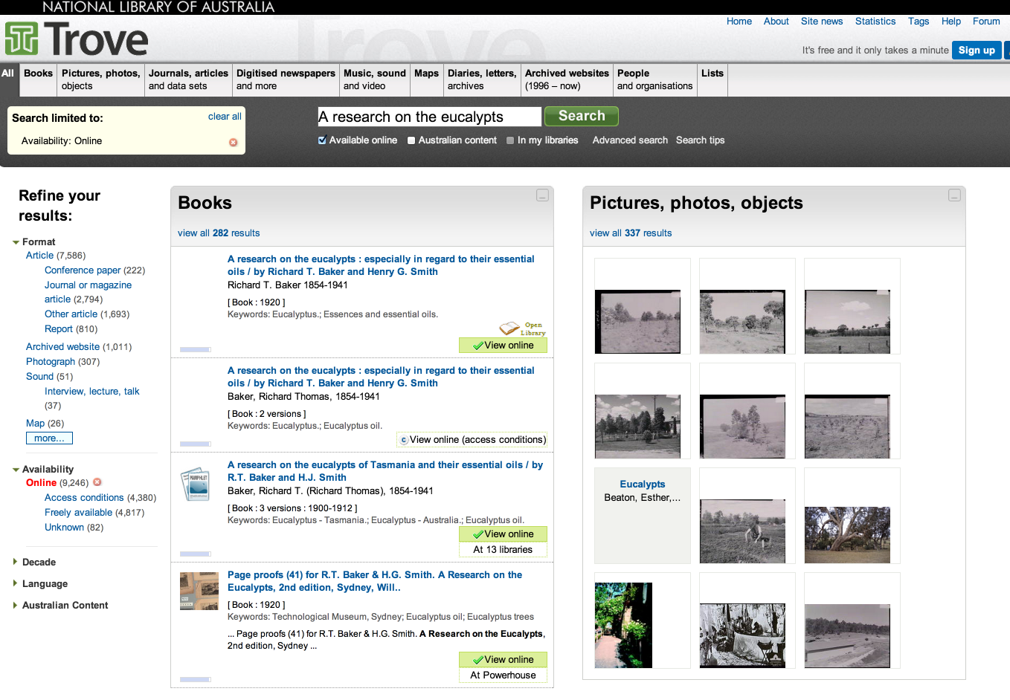

Slide 24
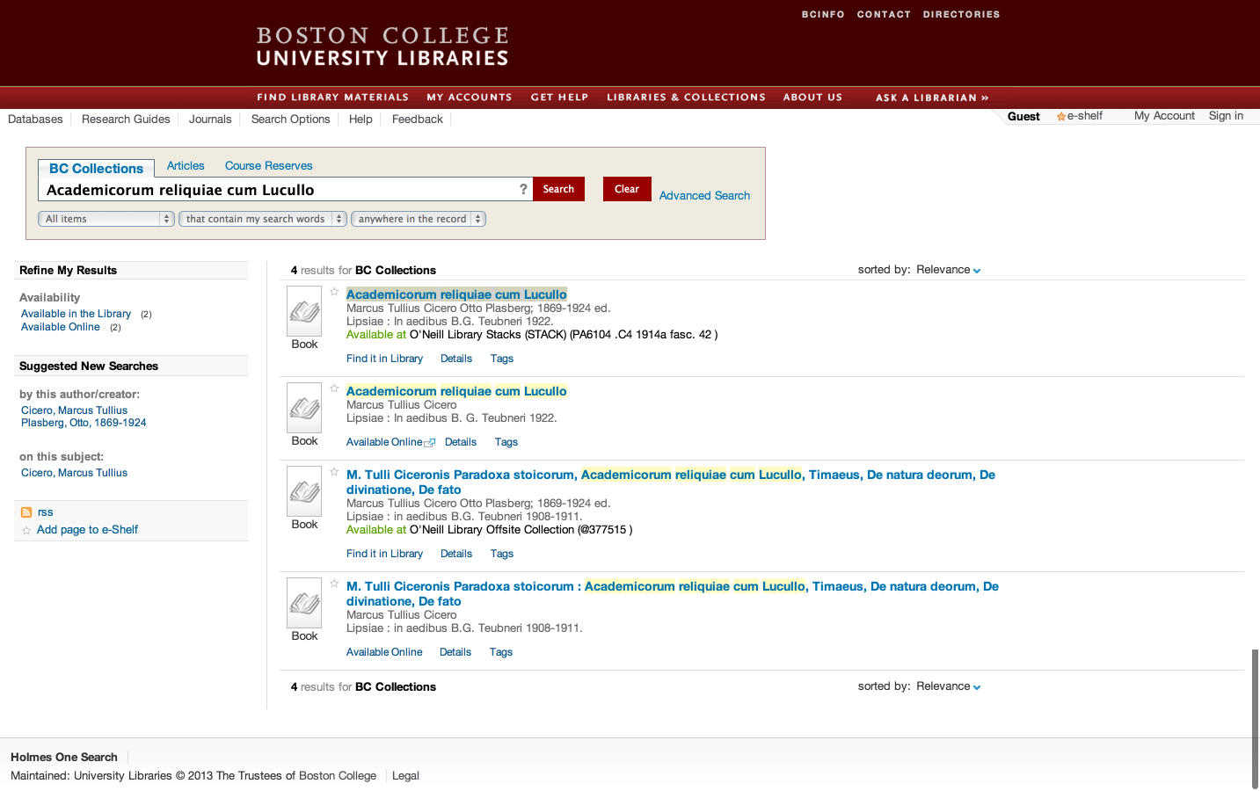

Slide 25
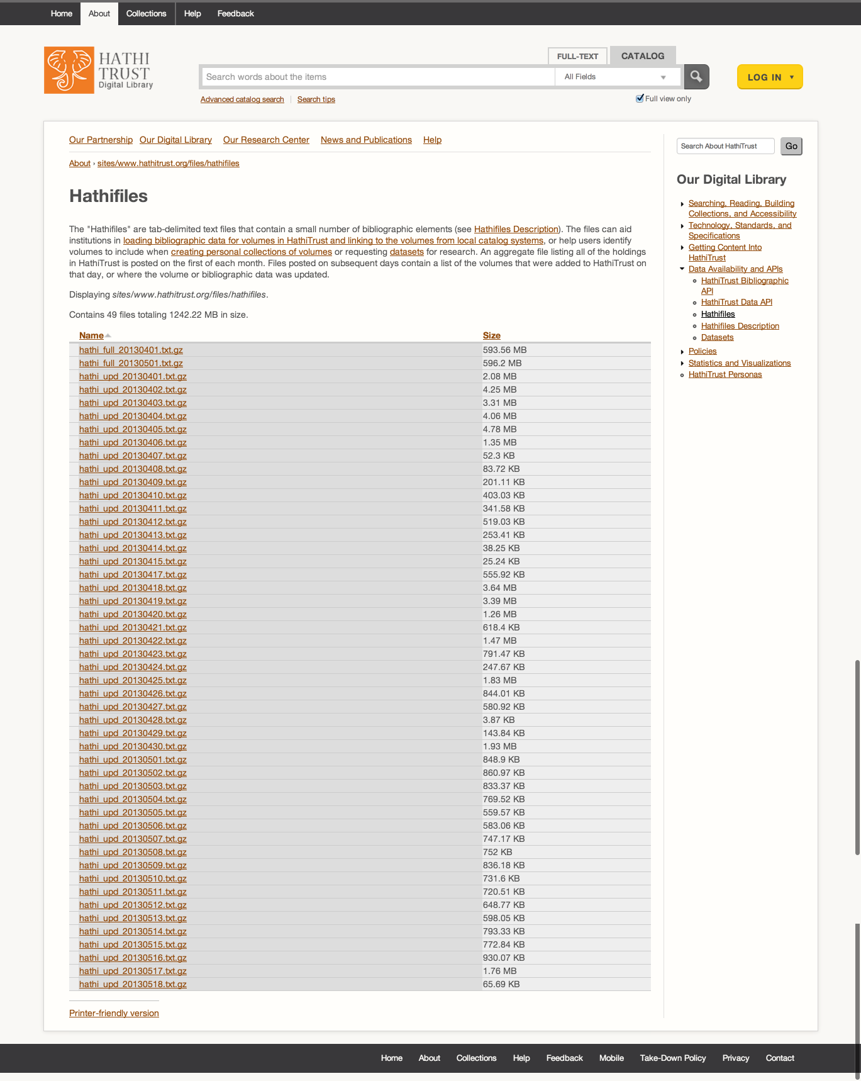

Slide 26
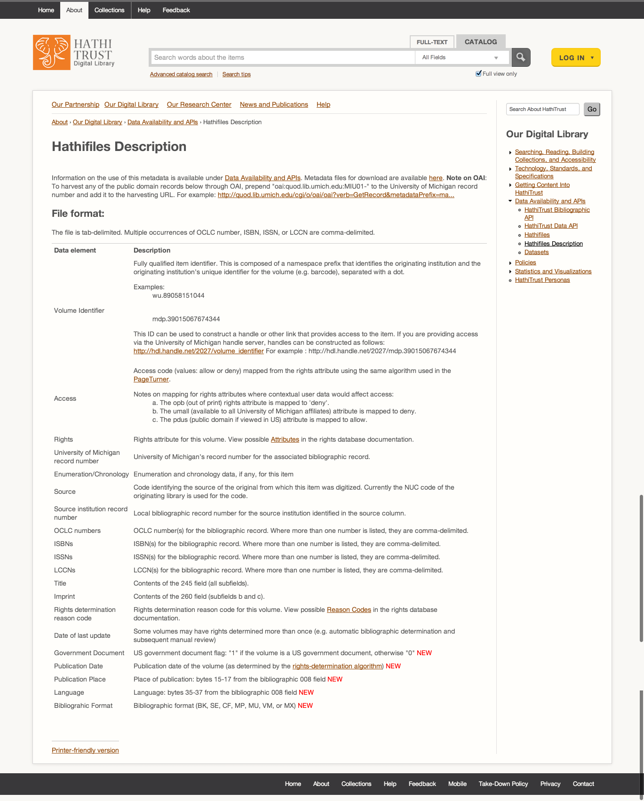

Slide 27
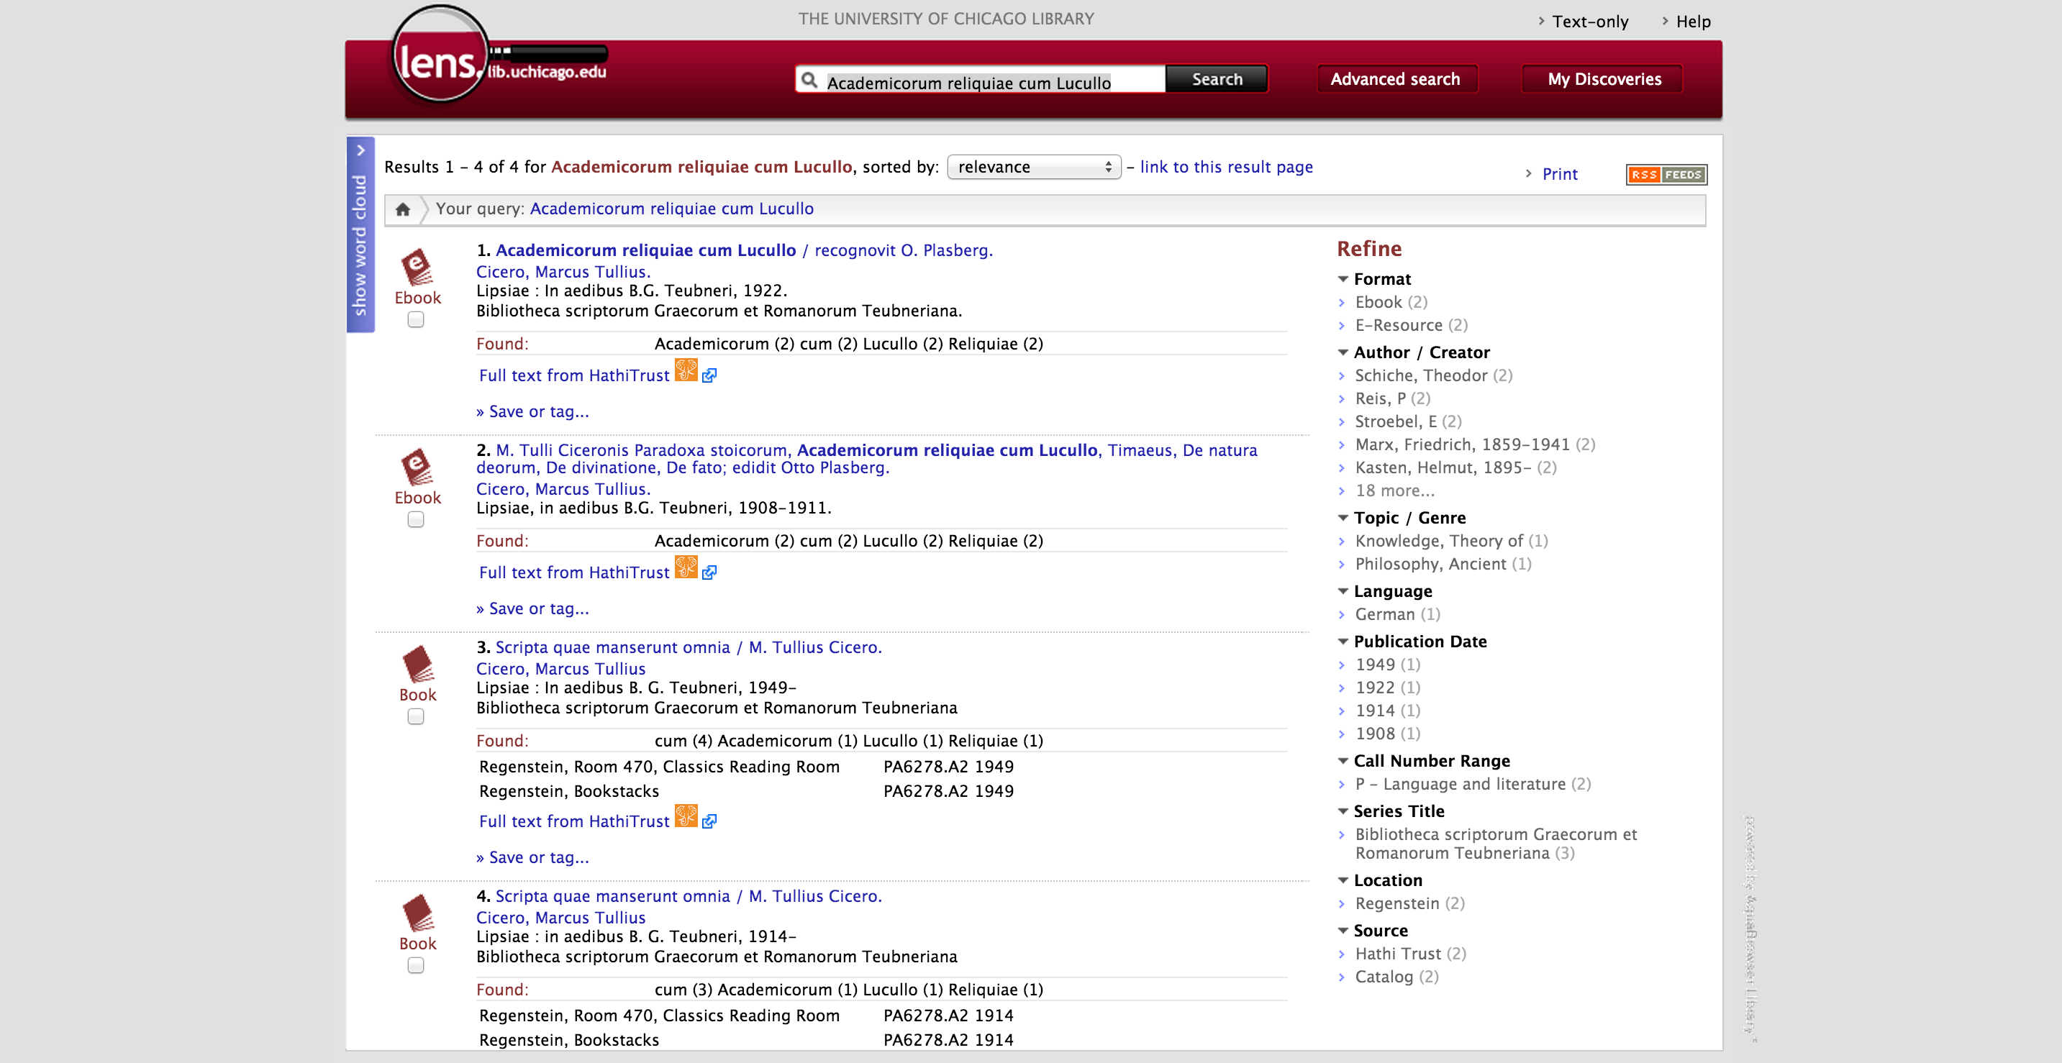

Slide 29
Use of Collections

Slide 30
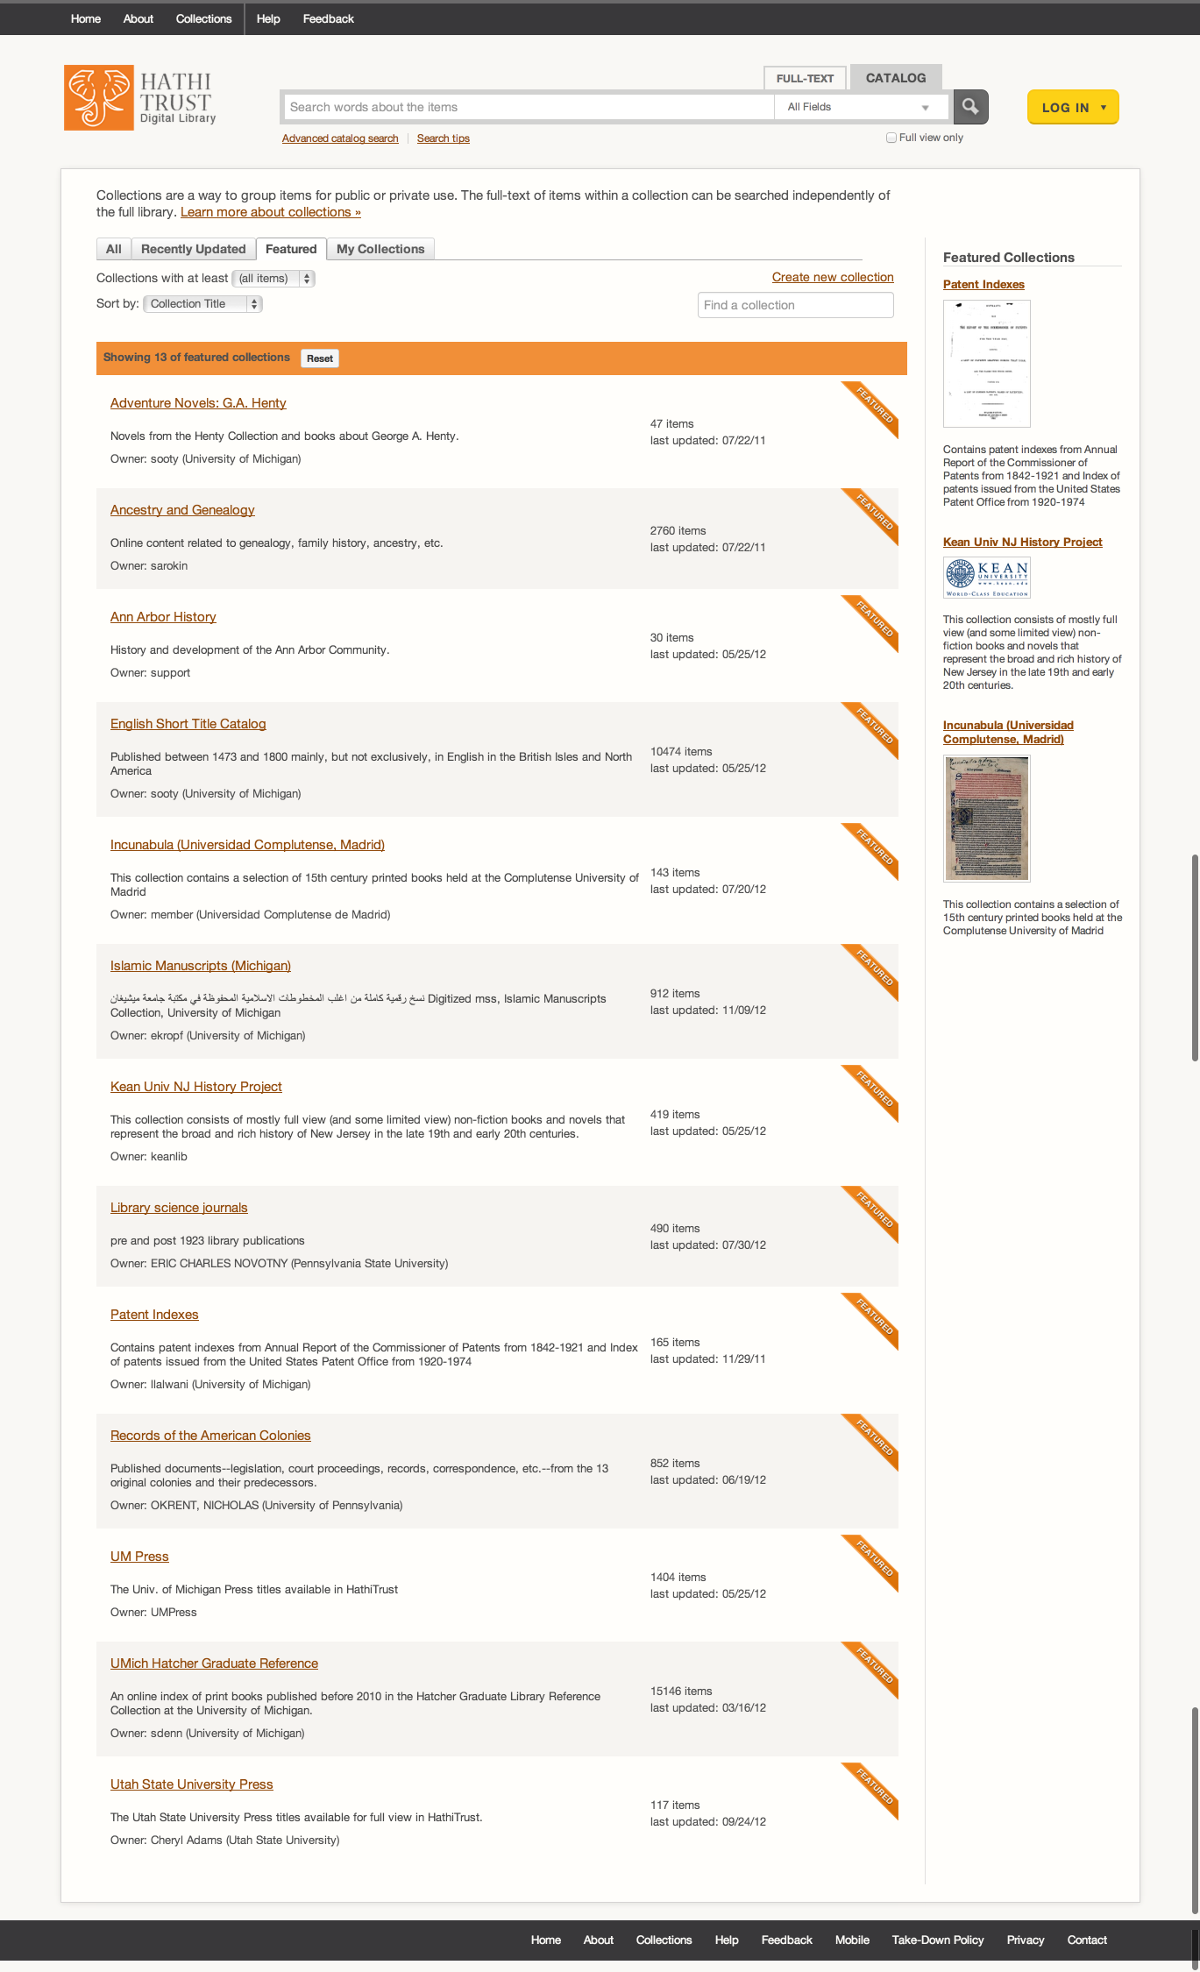

Slide 31
Collection Examples
Physical spaces
Collections within HathiTrust
English Short Title Catalog
USU Press, UM Press
Indiana University Folklore
Islamic Manuscripts
Incunabula (Universidad Complutense de Madrid)
Collections drawn from the collection
Patent Indexes
19th cen cookbooks
Dictionaries
Anarchism pamphlets
Historical and topical collections
Datasets

Slide 32
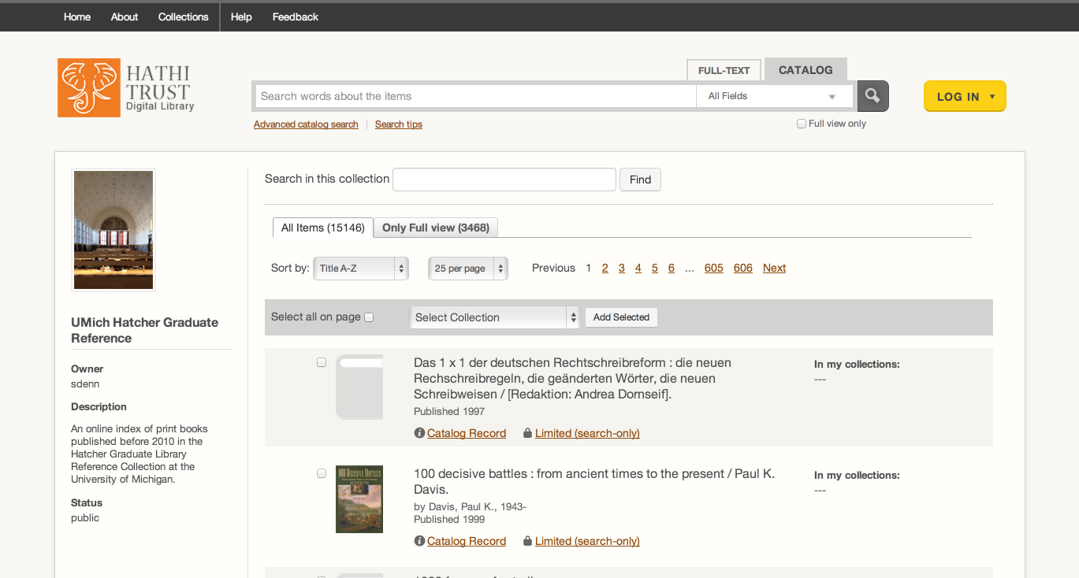

Slide 33
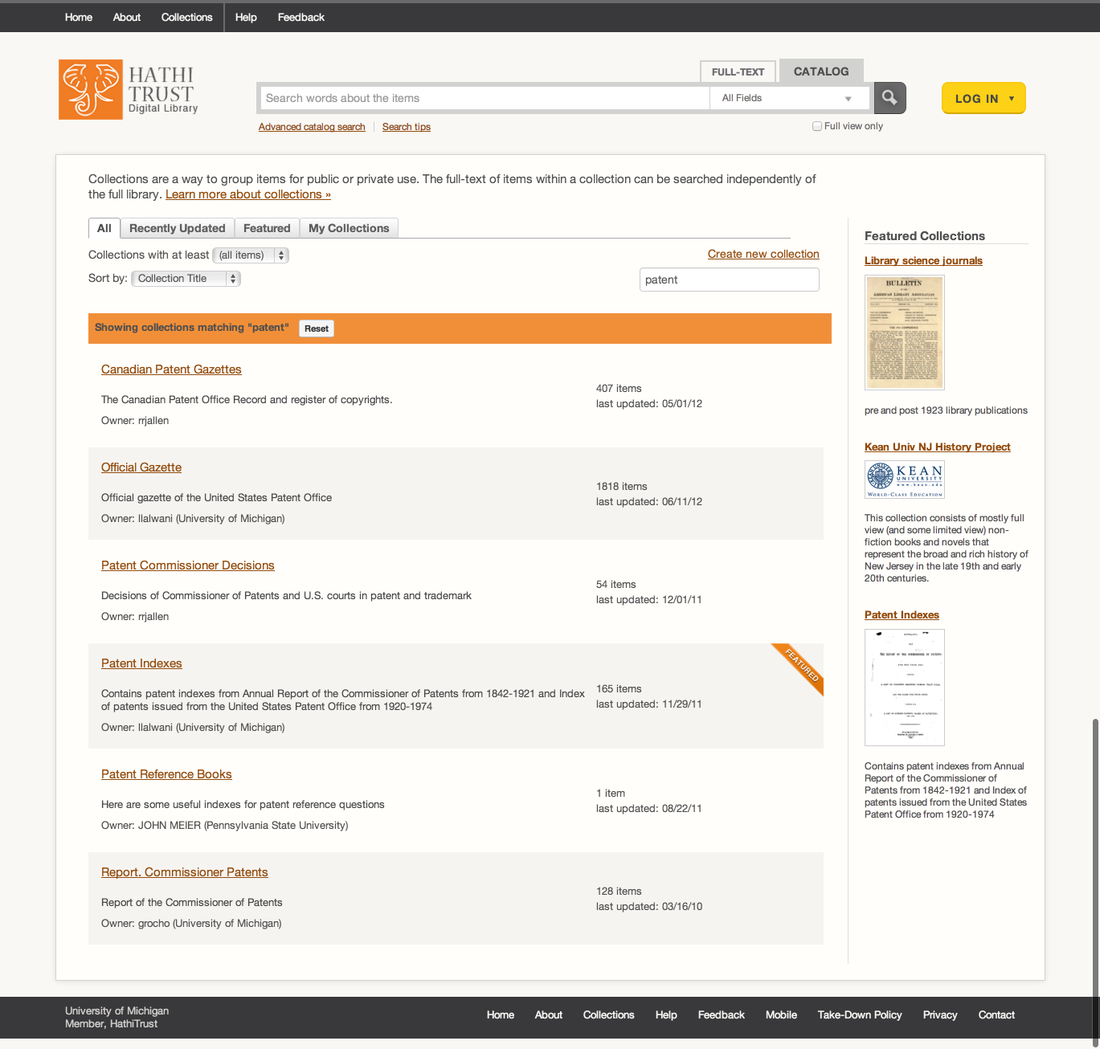

Slide 34
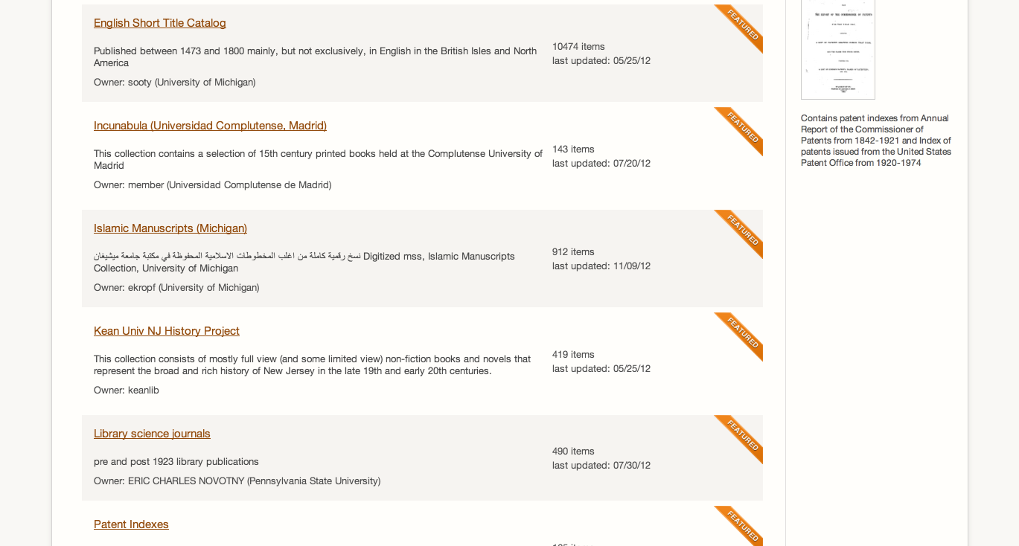

Slide 35
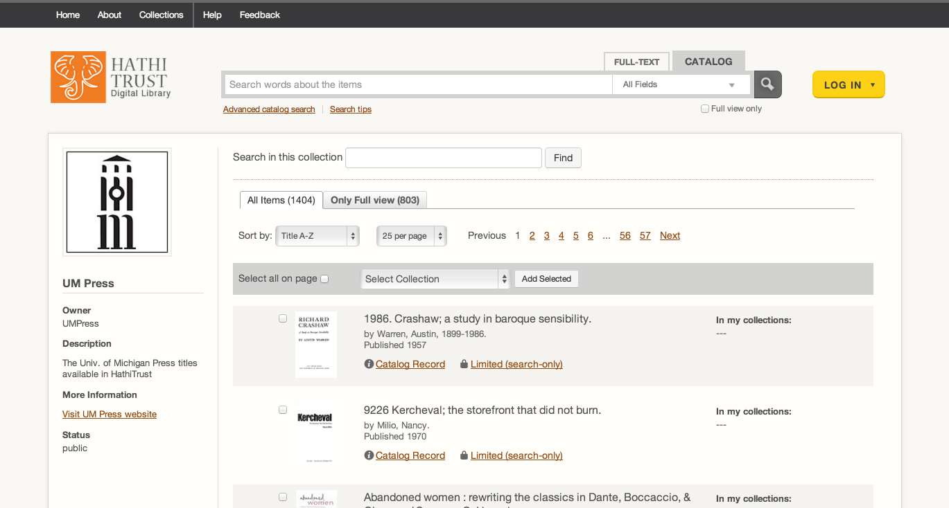

Slide 36
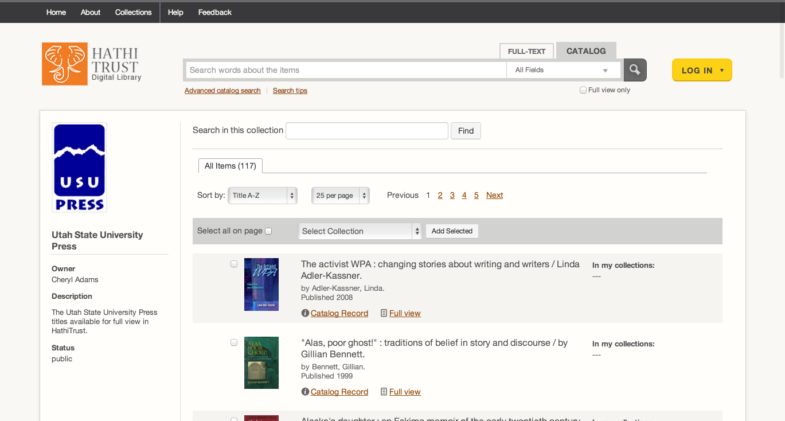

Slide 37
Library Collections
Use in digitization planning
Use in collection management, development, analysis
Requests for accession
Collection analysis
Holdings data
Print monographs archive

Slide 40
How to find out more
About: http://www.hathitrust.org/about
Twitter: http://twitter.com/hathitrust
Facebook: http://www.facebook.com/hathitrust
Monthly newsletter:
http:www.hathitrust.org/updates
RSS http://www.hathitrust.org/updates_rss
Contact us: feedback@issues.hathitrust.org
Blogs: http://www.hathitrust.org/blogs
Large-scale Search
Perspectives from HathiTrust

