Slide 1
More, Better, Together: HathiTrust Accomplishments and Aspirations
The Researcher of Tomorrow
Universidad Complutense de Madrid
December 4, 2012
Jeremy York, Project Librarian, HathiTrust
Unless otherwise noted, these slides and their contents are licensed under a Creative Commons Attribution Unported License.

Slide 2
Partnership
Arizona State University
Baylor University
Boston College
Boston University
Brandeis University
California Digital Library
Carnegie Mellon University
Columbia University
Cornell University
Dartmouth College
Duke University
Emory University
Florida State University
Getty Research Institute
Harvard University Library
Indiana University
Johns Hopkins University
Kansas State University
Lafayette College
Library of Congress
Massachusetts Institute of Technology
McGill University`
Michigan State University
New York Public Library
New York University
North Carolina Central
University
North Carolina State
University
Northwestern University
The Ohio State University
The Pennsylvania State
University
Princeton University
Purdue University
Stanford University
Syracuse University
Texas A&M University
Universidad Complutense
de Madrid
University of Arizona
University of Calgary
University of California
Berkeley
Davis
Irvine
Los Angeles
Merced
Riverside
San Diego
San Francisco
Santa Barbara
Santa Cruz
The University of Chicago
University of Connecticut
University of Delaware
University of Florida
University of Illinois
University of Illinois at Chicago
The University of Iowa
University of Maryland
University of Miami
University of Michigan
University of Minnesota
University of Missouri
University of Nebraska-Lincoln
The University of North
Carolina at Chapel Hill
University of Notre Dame
University of Pennsylvania
University of Pittsburgh
University of Utah
University of Vermont
University of Virginia
University of Washington
University of Wisconsin- Madison
Utah State University
Virginia Tech
Washington University
Yale University Library

Slide 3
Digital Repository
Launched 2008
Initial focus on digitized book and journal content
10.6 million total volumes
5.5 million book titles
275,000 serial titles
3.2 million public domain (~31%)

Slide 4
The Name
The meaning behind the name
Hathi (hah-tee)--Hindi for elephant
Big, strong
Never forgets, wise
Secure
Trustworthy

Slide 5
Mission
To contribute to the common good by collecting, organizing, preserving, communicating, and sharing the record of human knowledge

Slide 6
HathiTrust
Universal Library
Common Goal
Single Entity, Many Partners

Slide 7
Collections and Collaboration
Comprehensive collection
Preservation…with Access
Shared strategies
Copyright
Collection management, development
Preservation
Discovery / Use
Bibliographic Indeterminacy
Efficient user services
Public Good

Slide 8
More

Slide 9
Content Sources
Notes:
9

Slide 10
Language Distribution (1)
The top 10 languages make up ~86% of all content
Notes:
10

Slide 11
Language Distribution (2)
The next 40 languages make up ~13% of total
Notes:
11

Slide 12
Dates
Notes:
12

Slide 14
TDR
Preservation...
with Access

Slide 15
1. Rights Determination
Automated
Manual
Manual
Bibliographic

Slide 16
2. Sensitivity to diverse rights regimes
Public domain worldwide
Public domain in the United States
Public domain in ....
 | Opened | Reviewed | Percent
CRMS-US | 178,872 | 338,463 | 53%
CRMS-World | 15,181 | 30,965 | 49%
Total | 194,053 | 369,428 | 53%

Slide 17
3. Permissions
Open Access
Preservation
Born-digital

Slide 18
Copyright Distribution
Notes:
18

Slide 19
4. Lawful access
U.S.
Print disabilities
Damaged or lost
Extensible

Slide 20
Relation to print, pricing model
Pay by overlap
Full view = shared
Limited = if “held”
Pay per GB

Slide 21
Holdings Database
Single-part monographs
OCLC #; Local system ID; Holding Status; Condition
Multi-part monographs
Include enumeration and chronology
Serials
OCLC #; Local system ID; ISSN

Slide 22
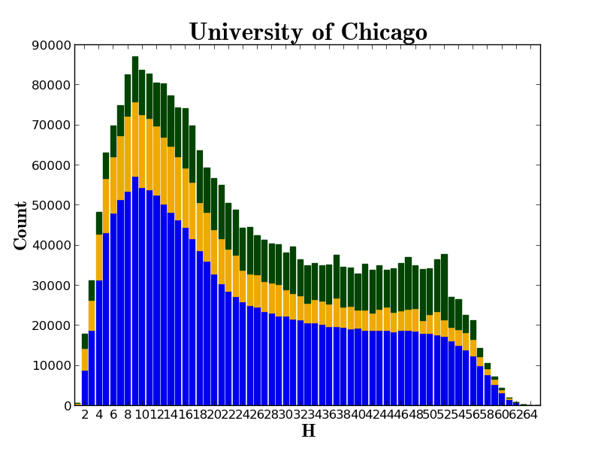

Slide 23
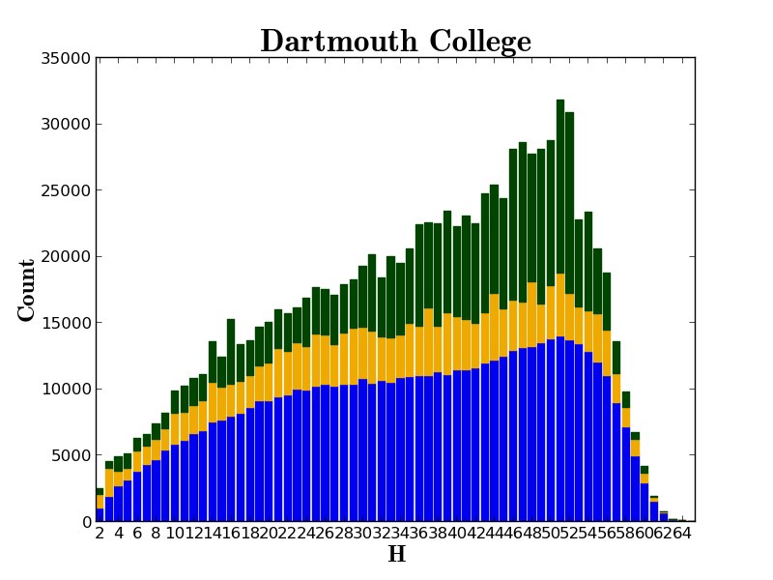

Slide 24
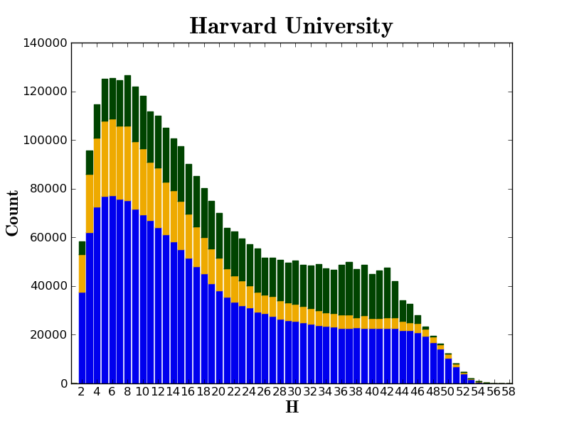

Slide 25
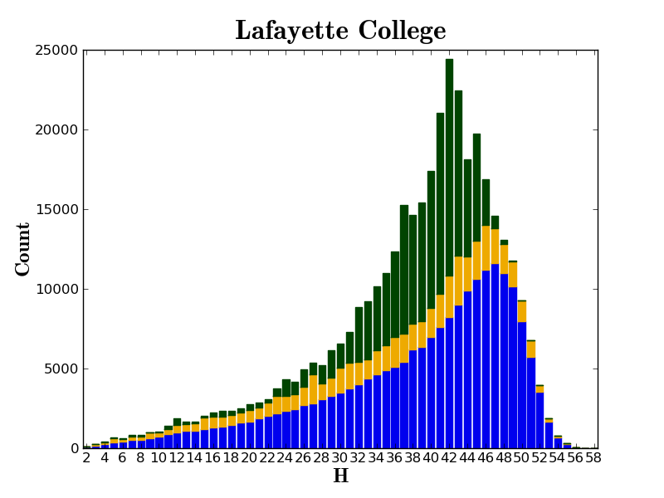

Slide 26
More
Growing the collection
Expanding rights review
Expanding access
Partner-wide and local strategies

Slide 27
Better

Slide 28
Leveraging expertise
Preservation
Access
Relationships

Slide 29
1. Preservation
Difficult questions
Collective experience
Shared resources

Slide 30
2. Access
Access
Full-text search
Collections
APIs
Datasets

Slide 31
3. Relationships
Relationships
Bibliographic records
Bib records and objects
Digital objects
Digital and print
Strategies
Metadata management
Targeted efforts

Slide 32
Better
Leveraging expertise and resources for
Preservation
Access
Relationships

Slide 33
Together

Slide 34
Governance
Budget, Finances
Decision-making
Policy
Planning
Repository Administration
Web and application server configuration and maintenance
Security
Permissions
Logging
Repository Administration
Data management (content storage, backup, integrity checks, deletion)
Content and Metadata specifications
Disaster Recovery
Processes for ensuring content integrity
Rights Management
Copyright determination
Copyright review
Copyright information management (database)
Rightsholder permissions
Bibliographic Data Management
Entity description (record-level)
Object identification (item-level)
Collection Development
Digital
Expansion beyond books and journals (born-digital, images and maps, audio)
Selection of content (for non-Google volume ingest and pilots projects)
Print
Cloud Library (effect of digital on print)
Hardware selection and replacement
Enterprise Management
Communication and Coordination with partner institutions
Hardware configuration and maintenance
Project management
Data availability
e-Commerce
Content Access
PageTurner
Collection Builder
Large-scale Search
Bibliographic Catalog
Research Center
APIs
Quality Assurance
Quality Review
Content Certification
User Services
Usability
User support (helpdesk)
Outreach
Project website
Monthly newsletter
Papers and presentations
Communication with potential partners
Surveys, general inquiries
Repository evaluation and audit (e.g., DRAMBORA, TRAC)
Legal
Risk management (use of materials)
Partner agreements
Advocacy
Content Ingest
Transformation
Validation
Print on Demand
Financial contributions of partners
HathiTrust Functional Framework

Slide 35
More
Better
Content
Rights
Determinations
Permissions
Lawful access
Collaborate globally, plan locally
Shared expertise /resources for:
Preservation
Access
Relationships
Together
?

Slide 36
Thank you!

