Slide 1
HathiTrust Infrastructure and
Information Organization
November 7, 2011
Jeremy York
Project Librarian, HathiTrust

Slide 2
Partnership
Arizona State University
Baylor University
Boston University
California Digital Library
Columbia University
Cornell University
Dartmouth College
Duke University
Emory University
Getty Research Institute
Harvard University Library
Indiana University
Johns Hopkins University
Lafayette College
Library of Congress
Massachusetts Institute of Technology
McGill University
Michigan State University
New York Public Library
New York University
North Carolina Central
University
North Carolina State
University
Northwestern University
The Ohio State University
The Pennsylvania State
University
Princeton University
Purdue University
Stanford University
Texas A&M University
Universidad Complutense
de Madrid
University of Arizona
University of Calgary
University of California
Berkeley
Davis
Irvine
Los Angeles
Merced
Riverside
San Diego
San Francisco
Santa Barbara
Santa Cruz
The University of Chicago
University of Connecticut
University of Florida
University of Illinois
University of Illinois at Chicago
The University of Iowa
University of Maryland
University of Miami
University of Michigan
University of Minnesota
University of Missouri
University of Nebraska-Lincoln
The University of North Carolina at Chapel Hill
University of Notre Dame
University of Pennsylvania
University of Pittsburgh
University of Utah
University of Virginia
University of Washington
University of Wisconsin- Madison
Utah State University
Yale University Library

Slide 3
Digital Repository
Launched 2008
Initial focus on digitized book and journal content
“Light” archive
  As accessible as possible within the bounds of law

Slide 4
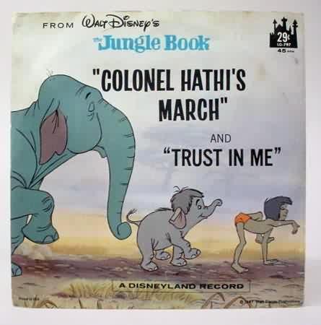
The Name
The meaning behind the name
  Hathi (hah-tee)--Hindi for elephant
  Big, strong
  Never forgets, wise
  Secure
  Trustworthy

Slide 5
Content
9,728,814 Total volumes
2,654,979 “Public domain”
5,164,532 Book titles
256,874 Serial titles
* As of November 5, 2011
Notes:
5

Slide 6
Mission
To contribute to the common good by collecting, organizing, preserving, communicating, and sharing the record of human knowledge

Slide 7
Collections and Collaboration
Comprehensive collection
  Preservation…with Access
Shared strategies
  Collection management, development
  Copyright
  Preservation (digital and print)
  Bibliographic Indeterminacy
  Discovery / Use
  Efficient user services
Public Good

Slide 8
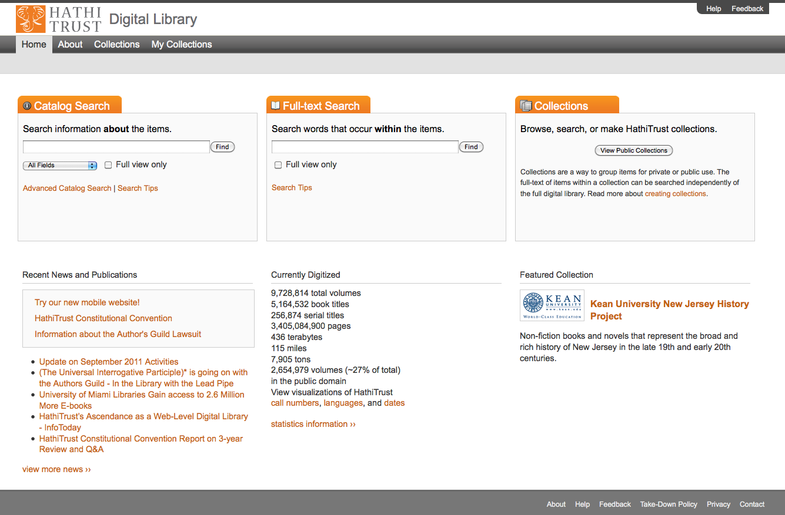

Slide 9
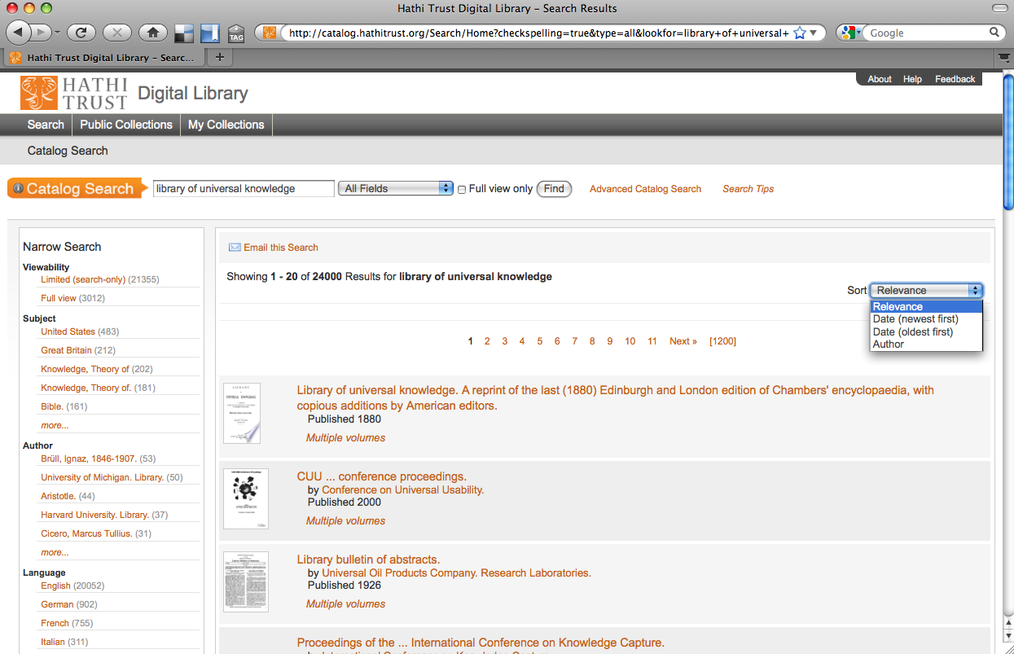

Slide 10
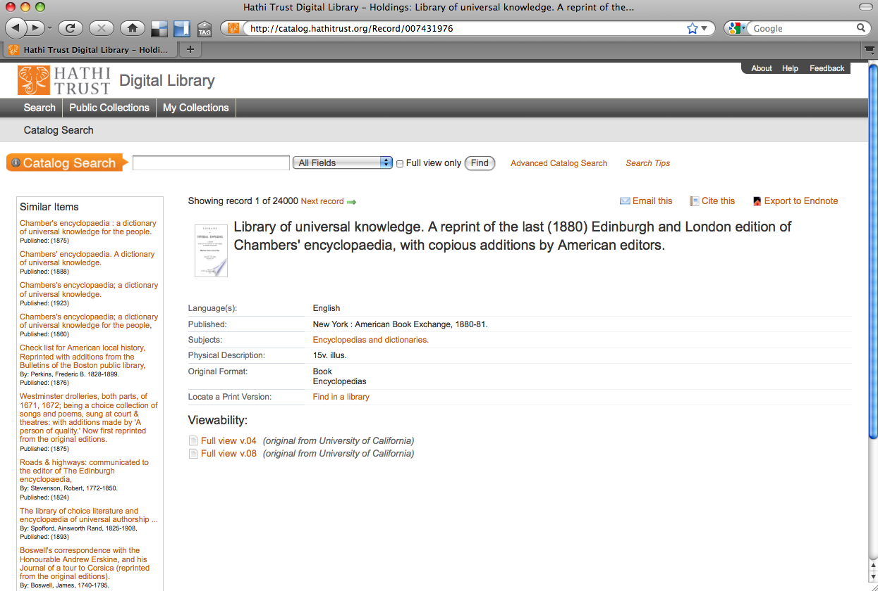

Slide 11
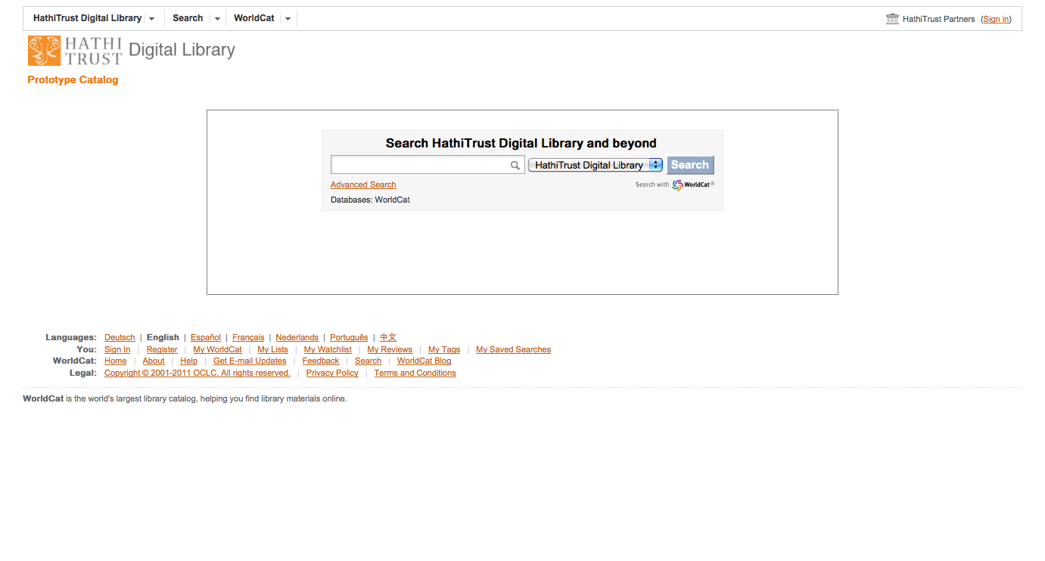

Slide 12
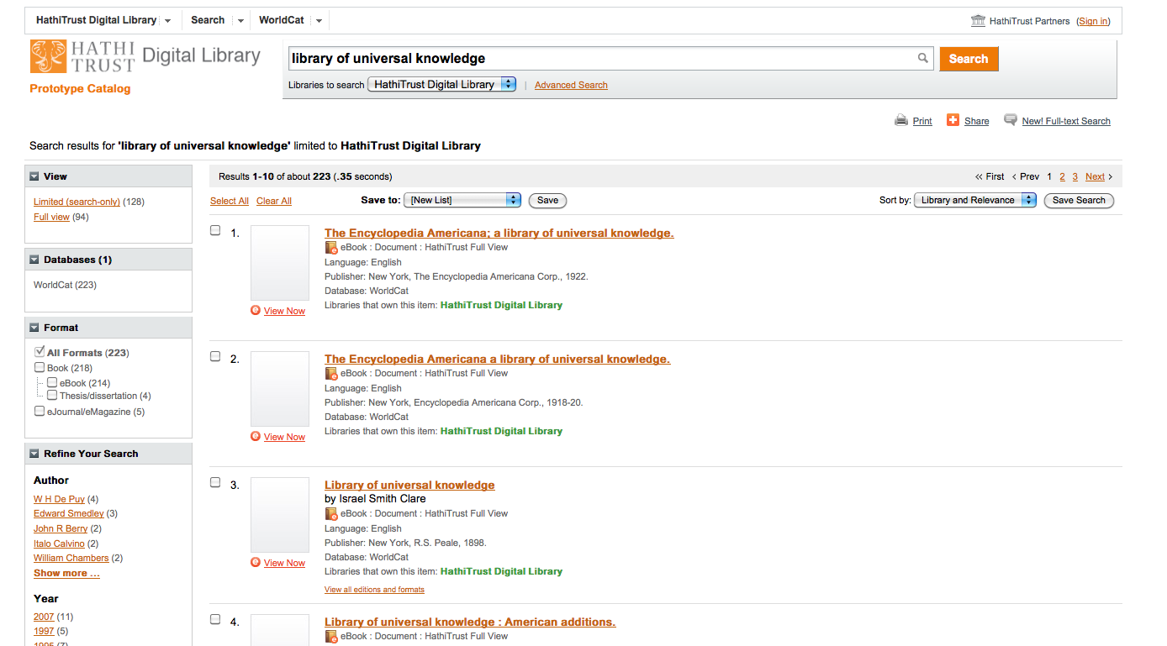

Slide 13
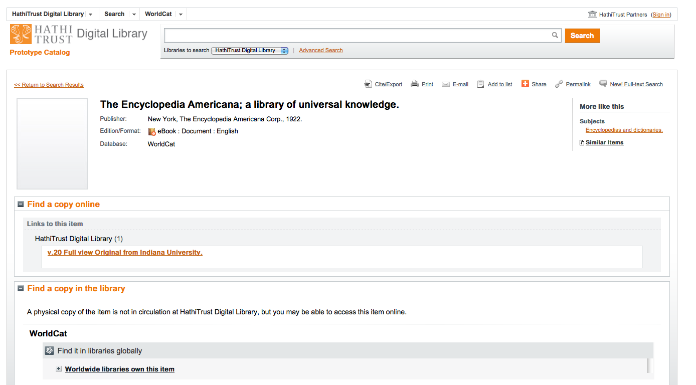

Slide 14
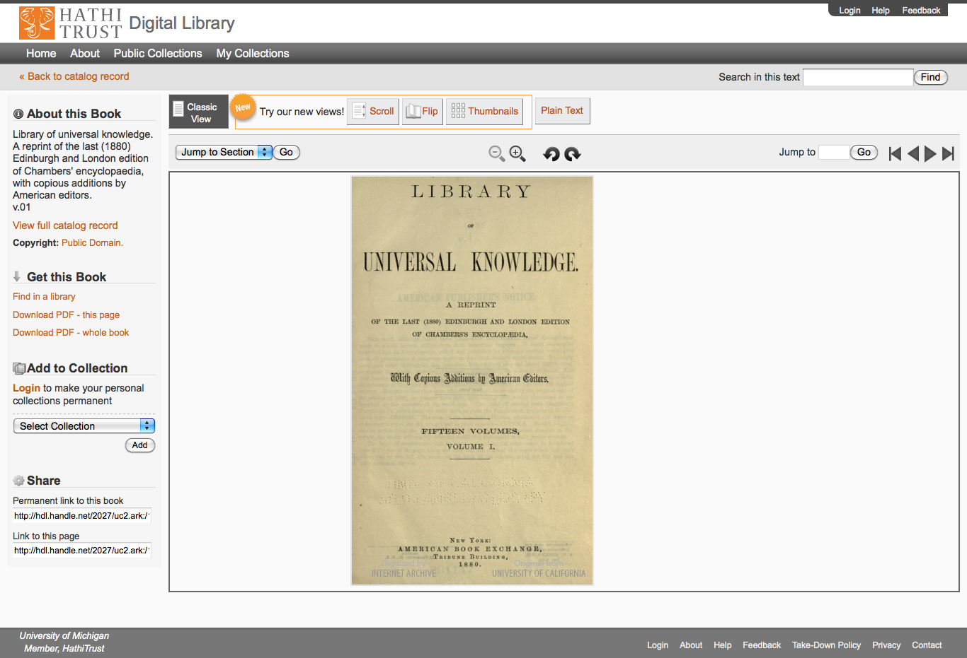

Slide 15
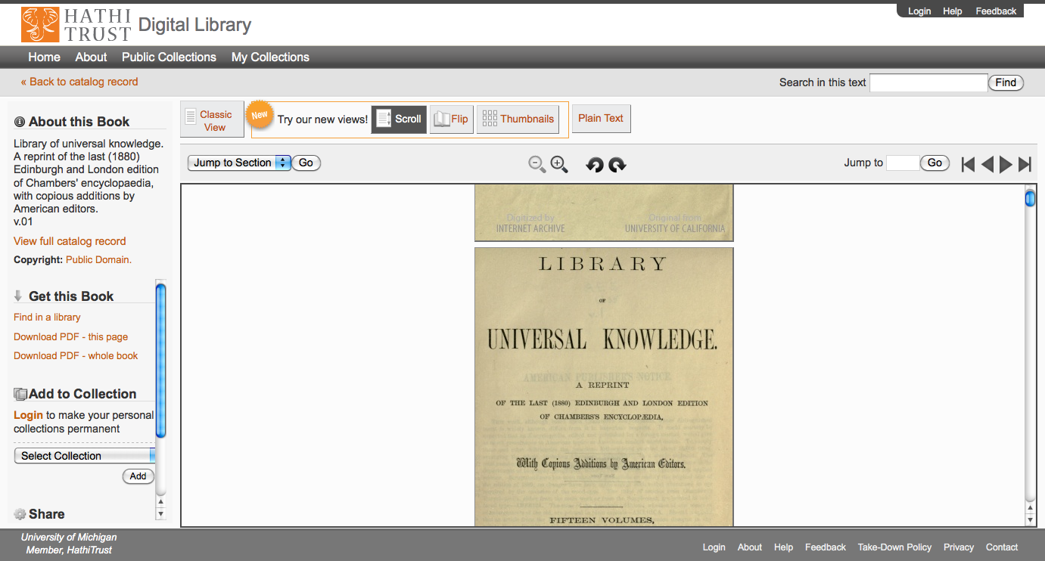

Slide 16
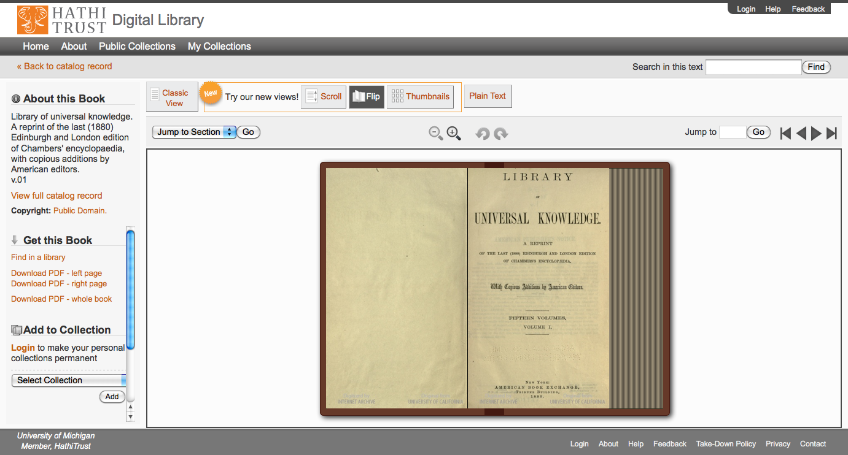

Slide 17
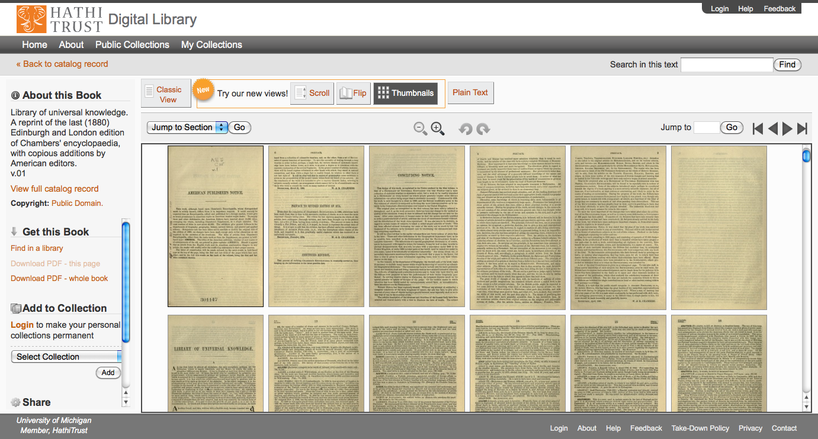

Slide 18
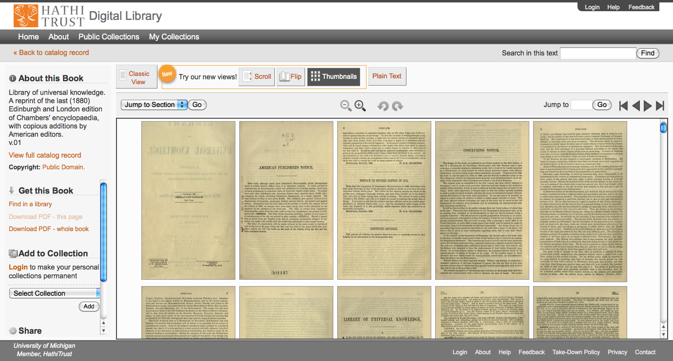

Slide 19
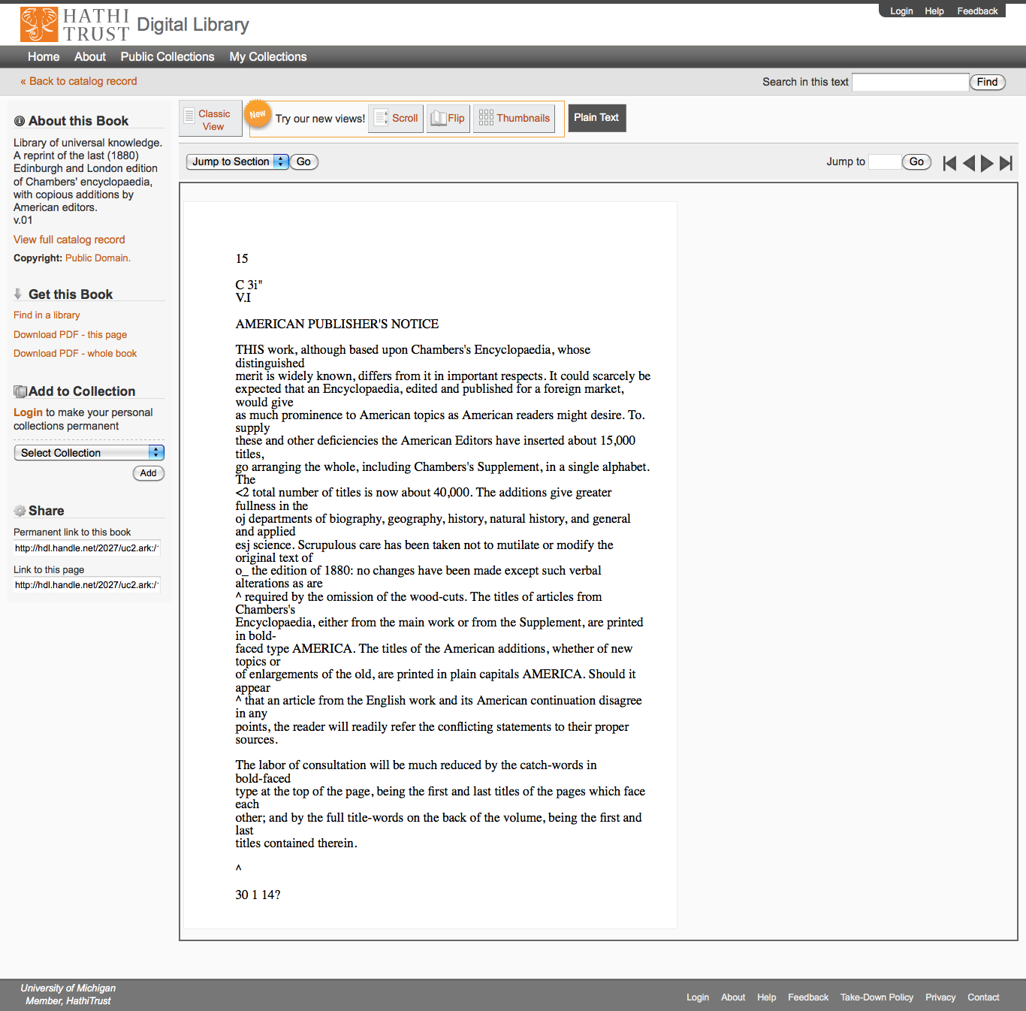

Slide 20
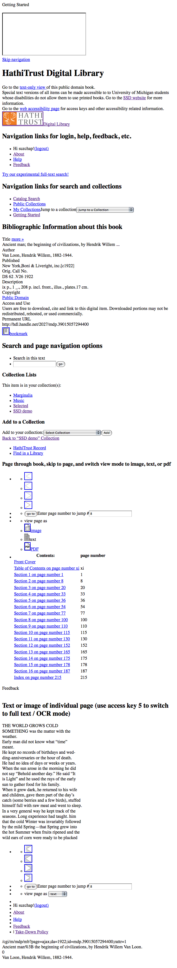
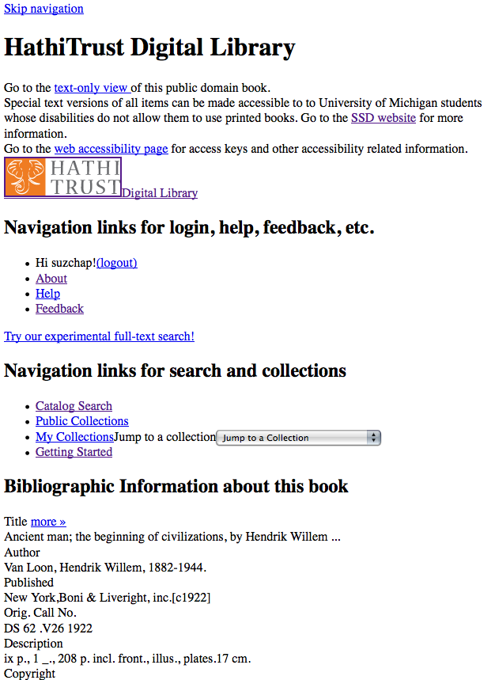
Skip navigation link
Info about SSD service & link to accessibility page
Descriptive headings added (hidden from GUI with CSS)
Added labels & descriptive titles to forms & ToC table
Access keys for navigating pages with keyboard
Images used for style are in css so no need to use alt tags

Slide 21
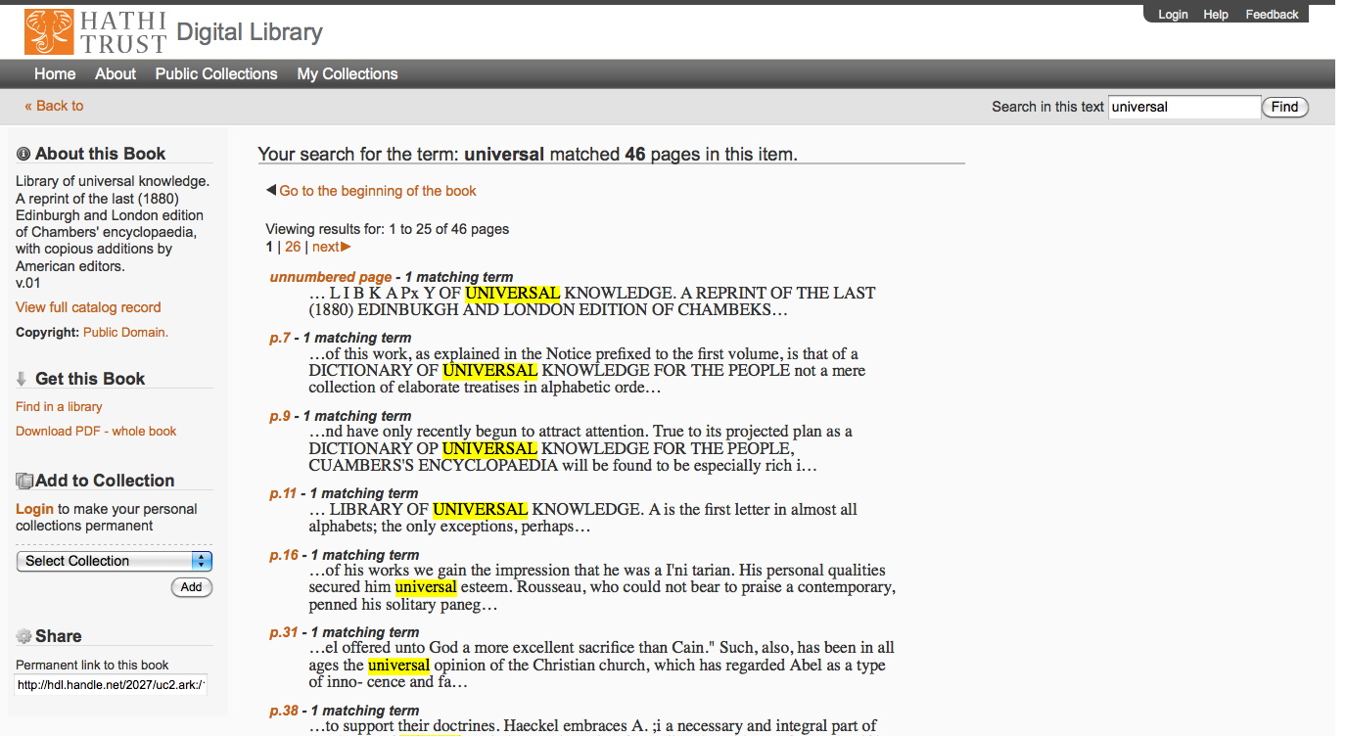

Slide 22
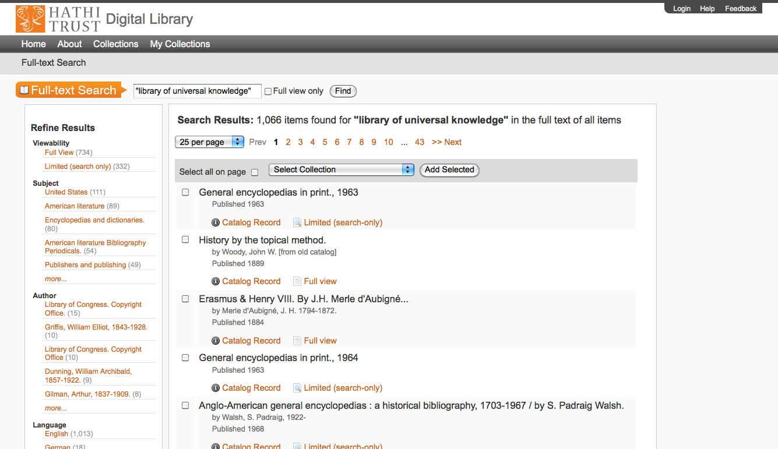

Slide 23
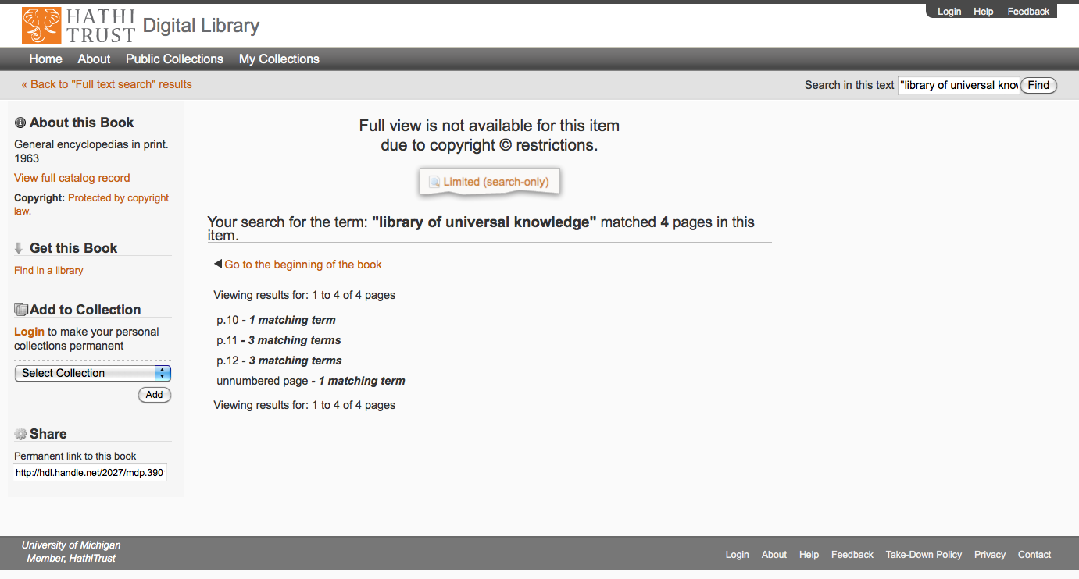

Slide 24
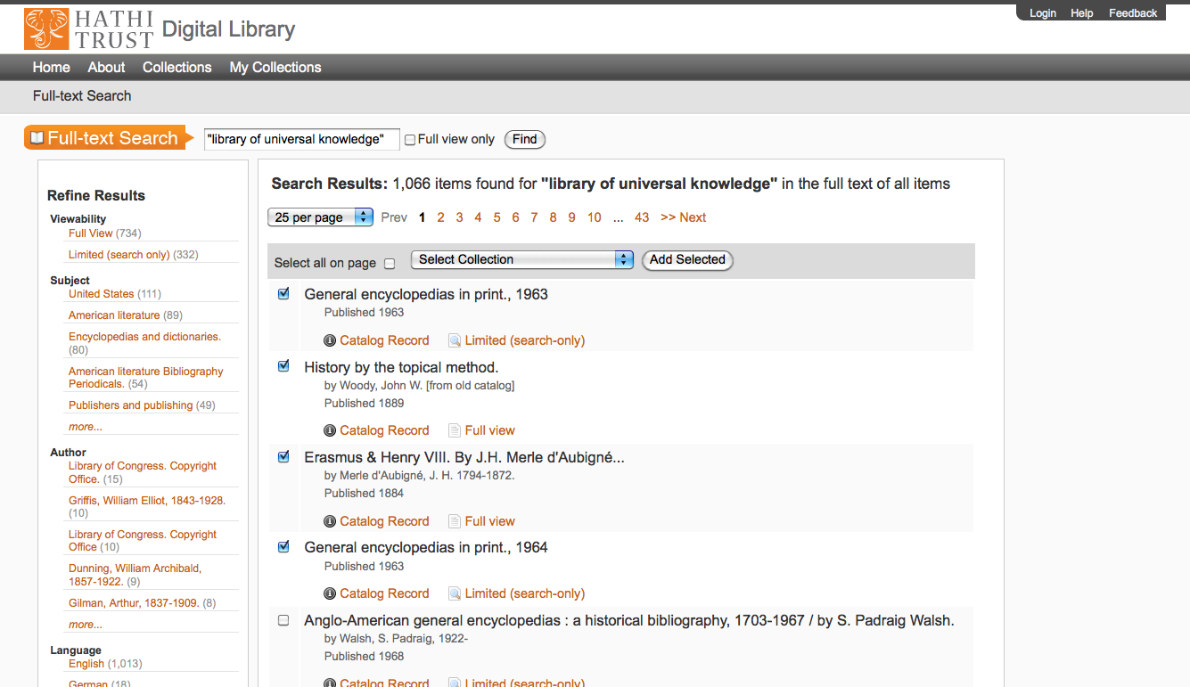

Slide 25
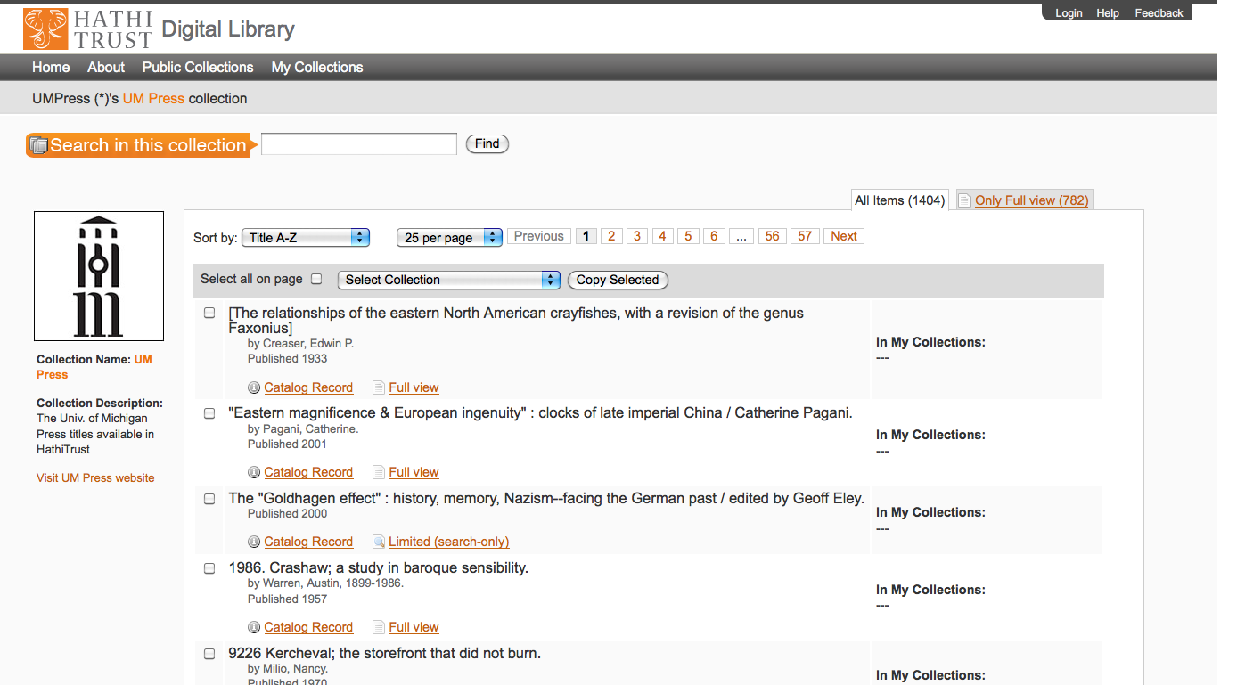

Slide 26
Access Matrix
Type of work | Search – Bib and Full text | View | Full-PDF download | Print on Demand | Print disabilities | Section 108 (preservation uses)
Public domain worldwide | World | World | World if no restrictions, Partners if restrictions | World | Partners worldwide | N/A
Public domain in the US | World | US | US if no restrictions, US partners if restrictions | US | US Partners | N/A
Open Access (+Creative Commons) | World | World | World if no restrictions | World with permission | Partners worldwide if no restrictions | N/A
In copyright (and undetermined) | World | Not available | Not available | Not available | Partners US and worldwide, where applicable | Partners US and worldwide, where applicable

Slide 27
Technical Infrastructure

Slide 28
Repository Philosophy/Design
OAIS/TRAC
Consistency
Standardization
Simplicity (in design, not function)
Practicality
Sustainability

Slide 29
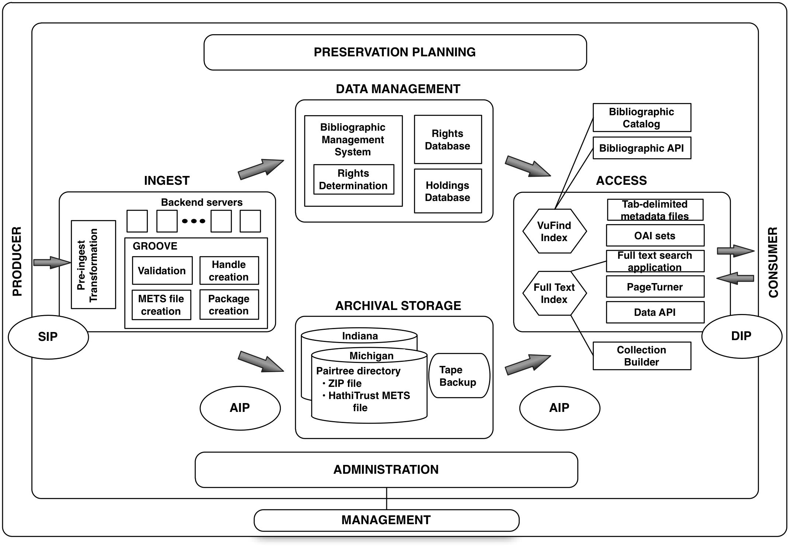

Slide 30
Content
Largely uniform in technical characteristics
4 formats
  ITU G4 TIFF
  JPEG2000
  JPEG
  Unicode (with and without coordinates)

Slide 31

Object Package
images
text
Source METS
Zip
HT
METS
bib
data
bib
data

Slide 32
Ingest
Bibliographic Data
  Must be present prior to content ingest
  MARCXML, as complete as possible
Content
  Pre-ingest
  Ingest

Slide 33
Ingest (2)
Bibliographic data
SIP
Content
Backend servers
Pre-ingest
GROOVE
Evaluation
Determination
of standards
- Modification /
Transformation
Validation
Handle
creation
METS creation
Package
creation
Ensure conformance
  Barcode
  Fixity
  Consistency
  Well-formedness
  Prepare archival package

Slide 34
Archival Storage
Reliability – ensure integrity
Redundancy – in single and multiple sites
Scalability – including ease of management
Accessibility – for repository processes and services
Platform-independence – for data/object management

Slide 35
Media & Architecture
Isilon Systems
Load balancing and failover
Ingest at Michigan, replicated to Indiana
Replacement on 3-4 year cycle
Archival Storage
Indiana
Tape Backup
Michigan

Slide 36
Architecture & Management
../uc1/pairtree_root/b3/54/34/86/b34543486
images
text
Source METS
b34543486.zip
HT
METS
b34543486.mets.xml
Example ids:
wu.89094366434
mdp.39015037375253
uc2.ark:/1390/t26973133
miua.aaj0523.1950.001
bib
data
bib
data

Slide 37
Data Management
- Inventory
Loading and updating
records
Duplicate detection and
collation
Solr indexes behind
VuFind catalog
Source of information
for Access services
- Rights determination
(automated and support
for manual review)
Bibliographic Management System
Rights Database
Rights Determination
Holdings Database
Copyright Review Management System

Slide 38
Rights Database
System of precedence
15 attributes
15 reason codes
Manual
Conformance with formalities
Contractual agreements
Access control overrides
Bibliographic (automatic)

Slide 39
Print Holdings Database
Volumes institutions own or have owned
  For monographic holdings
    Only print volumes (not microform, etc.)
    OCLC number [required]
    Bib record ID [required]
    Enumeration/chronology, if available
    Condition (e.g., brittle) [optional]
    Holding Status (e.g., current holding, withdrawn, missing, etc.) [optional]
  For serial holdings
    OCLC number [required]
    Bib record ID [required]
    ISSN, if available

Slide 40
Access
Data Management
Bibliographic Catalog
Rights Database
Bibliographic API
Bibliographic Management
Rights
Determination
Tab-delimited Metadata files
Holdings Database
VuFind
Index
OAI sets
Full text Search application
Archival Storage
Full text
Index
PageTurner
Indiana
Michigan
Data API
Collection Builder

Slide 41
Content Access
Data Management
Bibliographic Catalog
Rights Database
Bibliographic API
Bibliographic Management
Rights
Determination
Tab-delimited Metadata files
Holdings Database
VuFind
Index
OAI sets
Full text Search application
Archival Storage
Full text
Index
PageTurner
Indiana
Michigan
Data API
Collection Builder

Slide 42
Search and Aggregation Access
Data Management
Bibliographic Catalog
Rights Database
Bibliographic API
Bibliographic Management
Rights
Determination
Tab-delimited Metadata files
Holdings Database
VuFind
Index
OAI sets
Full text Search application
Archival Storage
Full text
Index
PageTurner
Indiana
Michigan
Data API
Collection Builder

Slide 43
Metadata Access
Data Management
Bibliographic Catalog
Rights Database
Bibliographic API
Bibliographic Management
Rights
Determination
Tab-delimited Metadata files
Holdings Database
VuFind
Index
OAI sets
Full text Search application
Archival Storage
Full text
Index
PageTurner
Indiana
Michigan
Data API
Collection Builder

Slide 44
Object Package
images
text
Source METS
Zip
HT
METS
bib
data
bib
data

Slide 45
METS Object
Why METS?
  Can serve as Archival Information Package and a Dissemination Information Package
  Designed to record the relationship between pieces of complex digital objects
  Can be created automatically as texts are loaded or reloaded
  Preservation actions (PREMIS)

Slide 46
Metadata
Details and specifications at repository level
  Object specifications / Validation criteria
  Page-tagging
Variations at object level
  Files missing
  Non-valid files
  Incorrect file checksums
http://www.hathitrust.org/digital_object_specifications

Slide 47
HathiTrust METS
Contains regularized information that is generally applicable to items across the repository, not specific to a particular source, that we can see a current or near-term use for.
This information is fundamentally valuable for understanding or using the preserved object in preservation activities after deposit, or in the access and display environments, including the APIs.

Slide 48
Source METS
Contains information that may be valuable for preservation or archaeology, but is subjective (descriptive, e.g., bibliographic data, page-tags), idiosyncratic, or we do not have a clear idea of its use and/or application. The information could be used to enhance knowledge of about the core files, but is not fundamentally valuable for understanding or using the preserved object in the repository.
Is a “parking lot” for information we are getting that may be useful in the future.
The desire not to touch things after they entire the repository might result in information that might be included in the Source METS being stored in other ways (e.g., in-repository fixity checks)

Slide 49
HathiTrust METS (2)
What’s there?
  2 dmdSecs: Marcxml and mdRef
  amdSec containing one techMD with PREMIS metadata
  fileSec with 4 fileGrps (zip, images, OCR, hOCR)
  Physical structMap tying together files with metadata (pg. numbers and features)
METS Creation (Google) | Example
METS Creation (IA) | Example
HathiTrust METS Profile

Slide 50
Source METS (2)
What’s there?
  dmdSecs
  amdSec
  fileSec (coordOCR, OCR, images…)
  Physical structMap tying together files with metadata (pg. numbers and features)
Source METS example (Google)
Source METS example (IA)
Source METS Creation

Slide 51
Vocabularies
PREMIS
Pagetag mapping

Slide 52
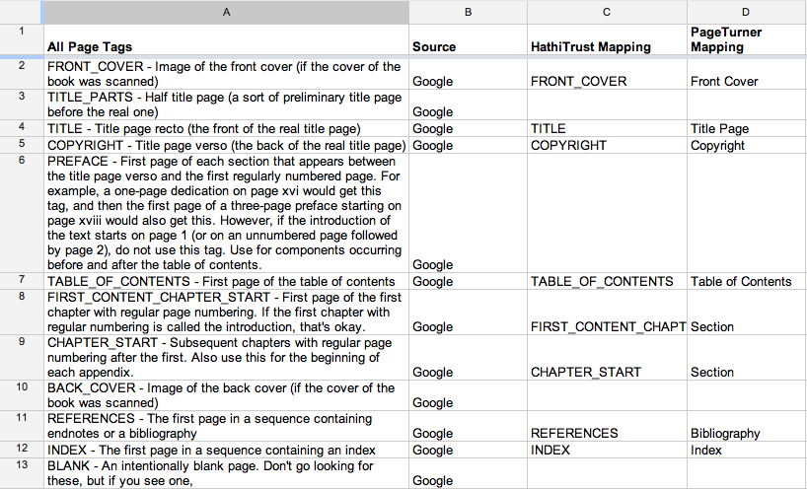
Pagetag Mapping (Google)

Slide 53
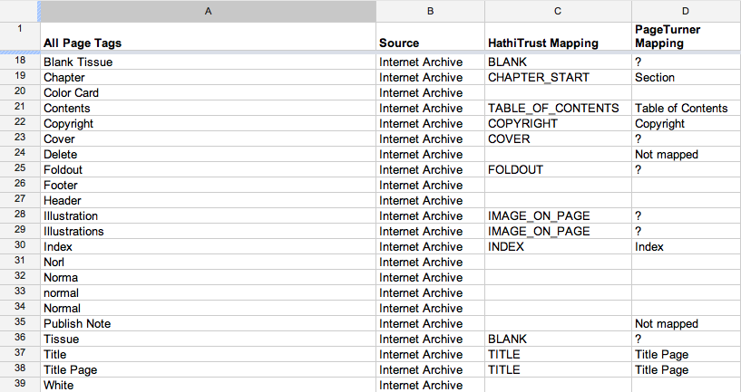
Pagetag Mapping (IA)

Slide 54
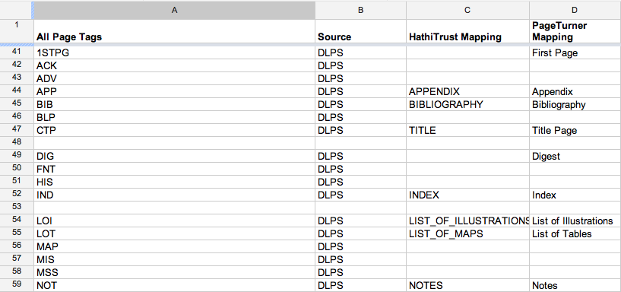
Pagetag Mapping (DLPS)

Slide 55
Change Management
PREMIS 2.1 “uplift”
Add
  Reading order
  Explicitly record page insertions
  Deletion PREMIS event
  PREMIS event to mark move to PREMIS 2.1
  Reference to Source METS
  Scheme to identify "version" of METS files
  Preservation levels (e.g., for PDF/A and PDF)
  New method of coding PDFs in the METS
Remove
  MARC metadata (pending approval of UC)
  References to pagedata and notes.txt
PREMIS 2.1 example

Slide 56
How to find out more
Website “About” section
  http:/www.hathitrust.org/about
Twitter
  http://twitter.com/hathitrust
Monthly newsletter
  http://www.hathitrust.org/updates
  http://www.hathitrust.org/updates_rss (RSS)
Contact us
  feedback@issues.hathitrust.org
  jjyork@umich.edu

Slide 57
Thank you!

