Slide 1
HathiTrust Overview
MichALL Spring Meeting
May 18, 2012
Jeremy York, Project Librarian, HathiTrust

Slide 2
Partnership
Arizona State University
Baylor University
Boston College
Boston University
California Digital Library
Columbia University
Cornell University
Dartmouth College
Duke University
Emory University
Florida State University
Getty Research Institute
Harvard University Library
Indiana University
Johns Hopkins University
Lafayette College
Library of Congress
Massachusetts Institute of Technology
McGill University`
Michigan State University
New York Public Library
New York University
North Carolina Central
University
North Carolina State
University
Northwestern University
The Ohio State University
The Pennsylvania State
University
Princeton University
Purdue University
Stanford University
Texas A&M University
Universidad Complutense
de Madrid
University of Arizona
University of Calgary
University of California
Berkeley
Davis
Irvine
Los Angeles
Merced
Riverside
San Diego
San Francisco
Santa Barbara
Santa Cruz
The University of Chicago
University of Connecticut
University of Florida
University of Illinois
University of Illinois at Chicago
The University of Iowa
University of Maryland
University of Miami
University of Michigan
University of Minnesota
University of Missouri
University of Nebraska-Lincoln
The University of North
Carolina at Chapel Hill
University of Notre Dame
University of Pennsylvania
University of Pittsburgh
University of Utah
University of Virginia
University of Washington
University of Wisconsin- Madison
Utah State University
Washington University
Yale University Library

Slide 3
Digital Repository
Launched 2008
Initial focus on digitized book and journal content
  10,302,450 total volumes
  5,462,709 book titles
  271,014 serial titles
  2,994,286 public domain (~29%)

Slide 4
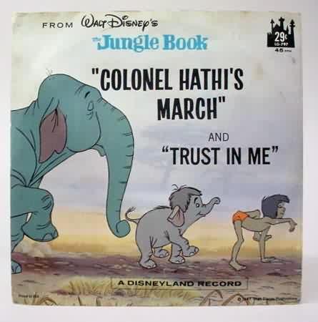
The Name
The meaning behind the name
  Hathi (hah-tee)--Hindi for elephant
  Big, strong
  Never forgets, wise
  Secure
  Trustworthy

Slide 5
Mission
To contribute to the common good by collecting, organizing, preserving, communicating, and sharing the record of human knowledge

Slide 6
Collections and Collaboration
Comprehensive collection
  Preservation…with Access
Shared strategies
  Copyright
  Collection management, development
  Preservation
  Discovery / Use
  Bibliographic Indeterminacy
  Efficient user services
Public Good

Slide 7
Content

Slide 8
Content Distribution
Notes:
8

Slide 9
Content Sources
Notes:
9

Slide 10
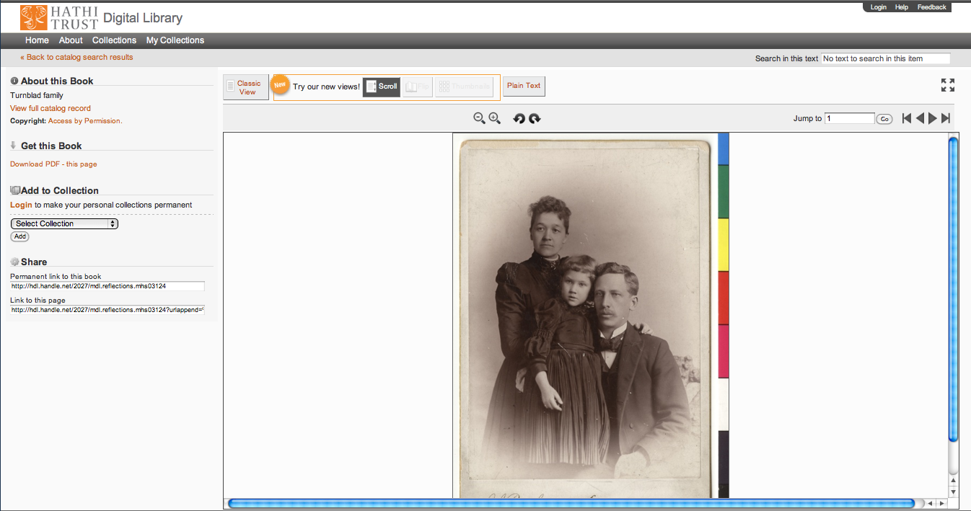

Slide 11

Dates
Notes:
11

Slide 12
Language Distribution (1)
The top 10 languages make up ~86% of all content
Notes:
12

Slide 13
Language Distribution (2)
The next 40 languages make up ~13% of total
Notes:
13

Slide 14
Preservation and Access

Slide 15
Preservation with Access
Cost effective preservation and access services
Preservation
  TRAC-certified
  Robust infrastructure
  Long-term commitments on digital content facilitate planning, decision-making

Slide 16
Preservation with Access (2)
Discovery
  Bibliographic and full-text search of all materials
  Extended discovery (ProQuest, EBSCO, OCLC, Ex Libris)
  Mechanisms for local loading of records

Slide 17
Preservation with Access (3)
Access and Use
  Public domain and open access works
  Full download of materials where possible*
  Print on demand
  Collections and APIs
  Research Center*
  Lawful uses of in-copyright works*

Slide 18
Lawful uses
Access to users who have print disabilities
Section 108 uses of materials
Access to orphan works

Slide 19
Terms of Access
Available to students, faculty, staff of partnering institutions
  On library premises or authenticated into HathiTrust
Partner libraries own a print copy
  One simultaneous user per print copy owned
Users must be on U.S. soil
One page at a time download

Slide 20
How do we facilitate uses?
Fundamental issues of
  Identification
  Description
  Rights

Slide 21
Copyright

Slide 22
Automatic Rights Determination
Conducted on all works at time of ingest and when records are modified
  Public domain worldwide
    US works published before 1923, US federal government publications, non-US works published prior to 1872
  Public domain in the United States
    Non-US works published prior to 1923

Slide 23
Manual Rights Determination
IMLS-funded CRMS project
  US-published works 1923-1963
  Conformance with formalities
  Expanding to non-US works
  Double-blind review with expert review for conflicts
  Staff at 4 HathiTrust partner institutions (15 will take part in non-US)
  As of February 2012 ~190,000 reviewed, more than 100,000 opened
Rights Holder Permissions

Slide 24
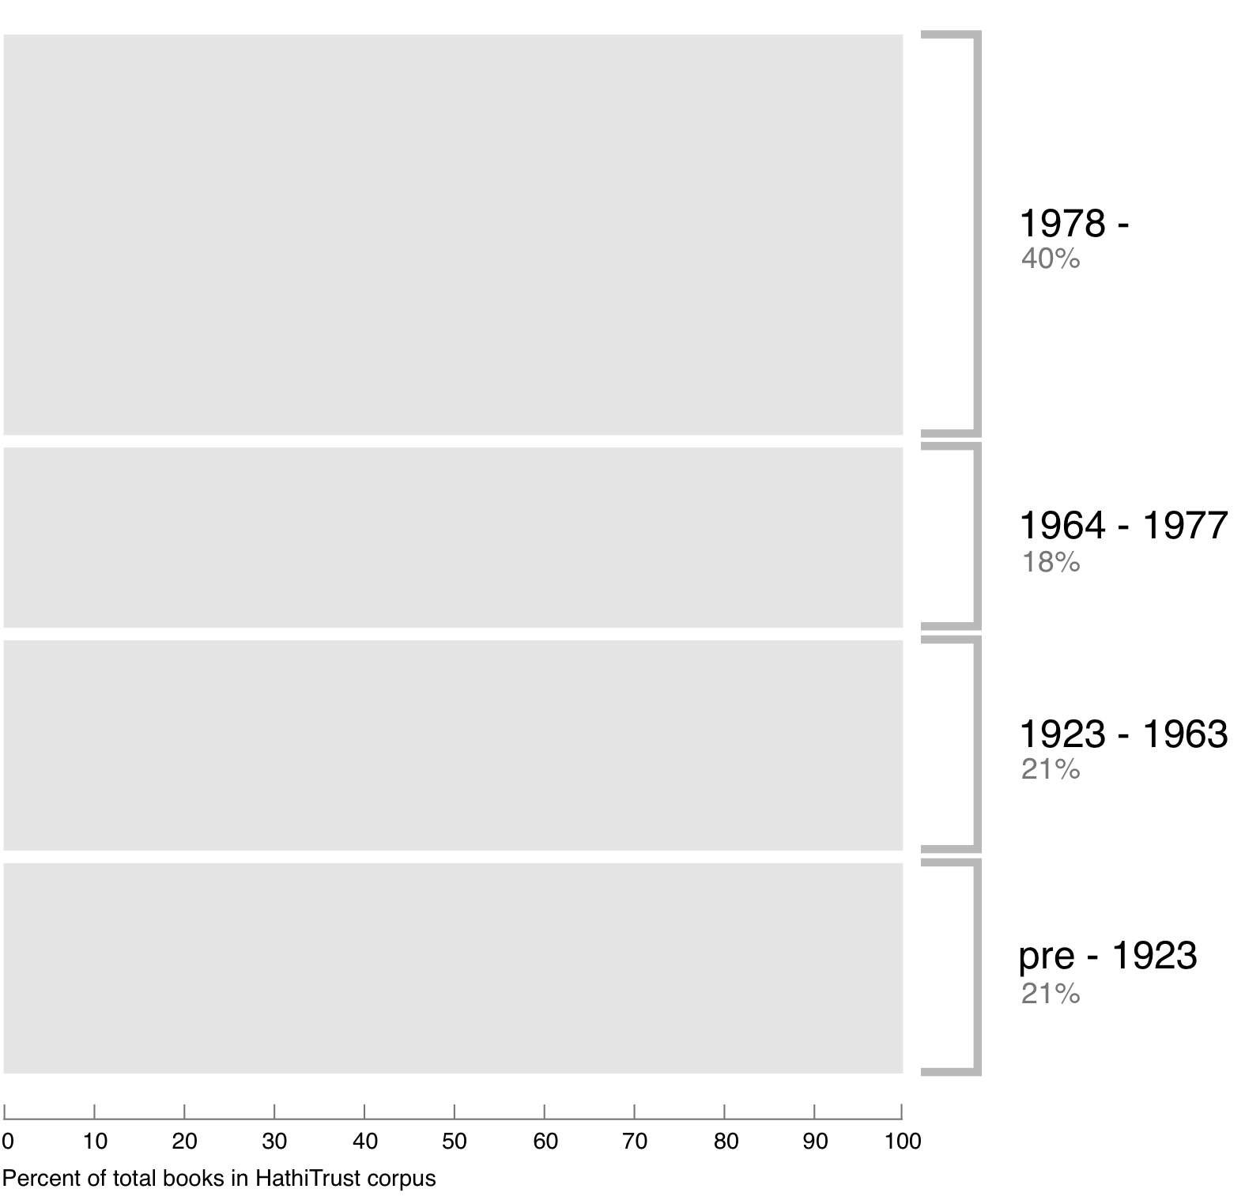
Breakdown of HathiTrust book corpus by publication date
Bibliographic Indeterminacy and the Scale of Problems and Opportunities of "Rights" in Digital Collection Building – 2/2011

Slide 25
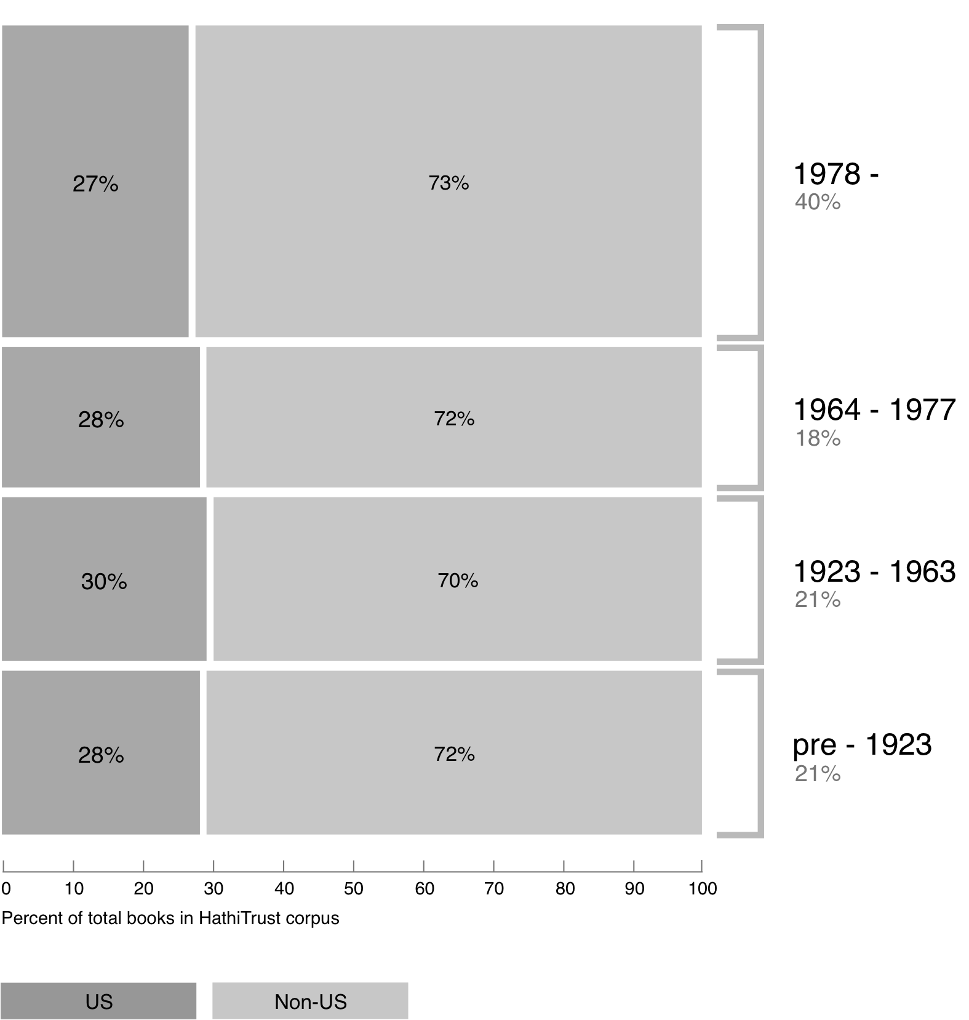
Breakdown of HathiTrust book corpus by publication date

Slide 26
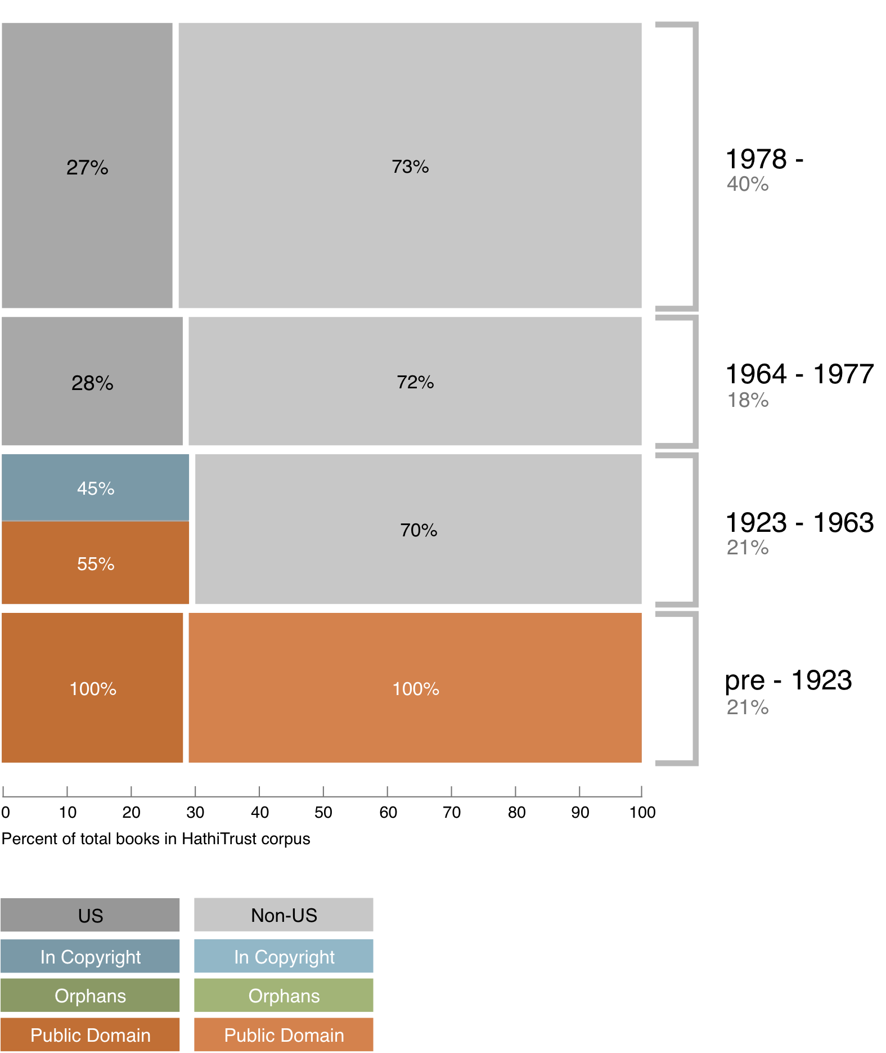
Copyright status of books published pre-1923 and US works published 1923-1963

Slide 27
Copyright status of books published pre-1923 and US works published 1923-1963
?

Slide 28
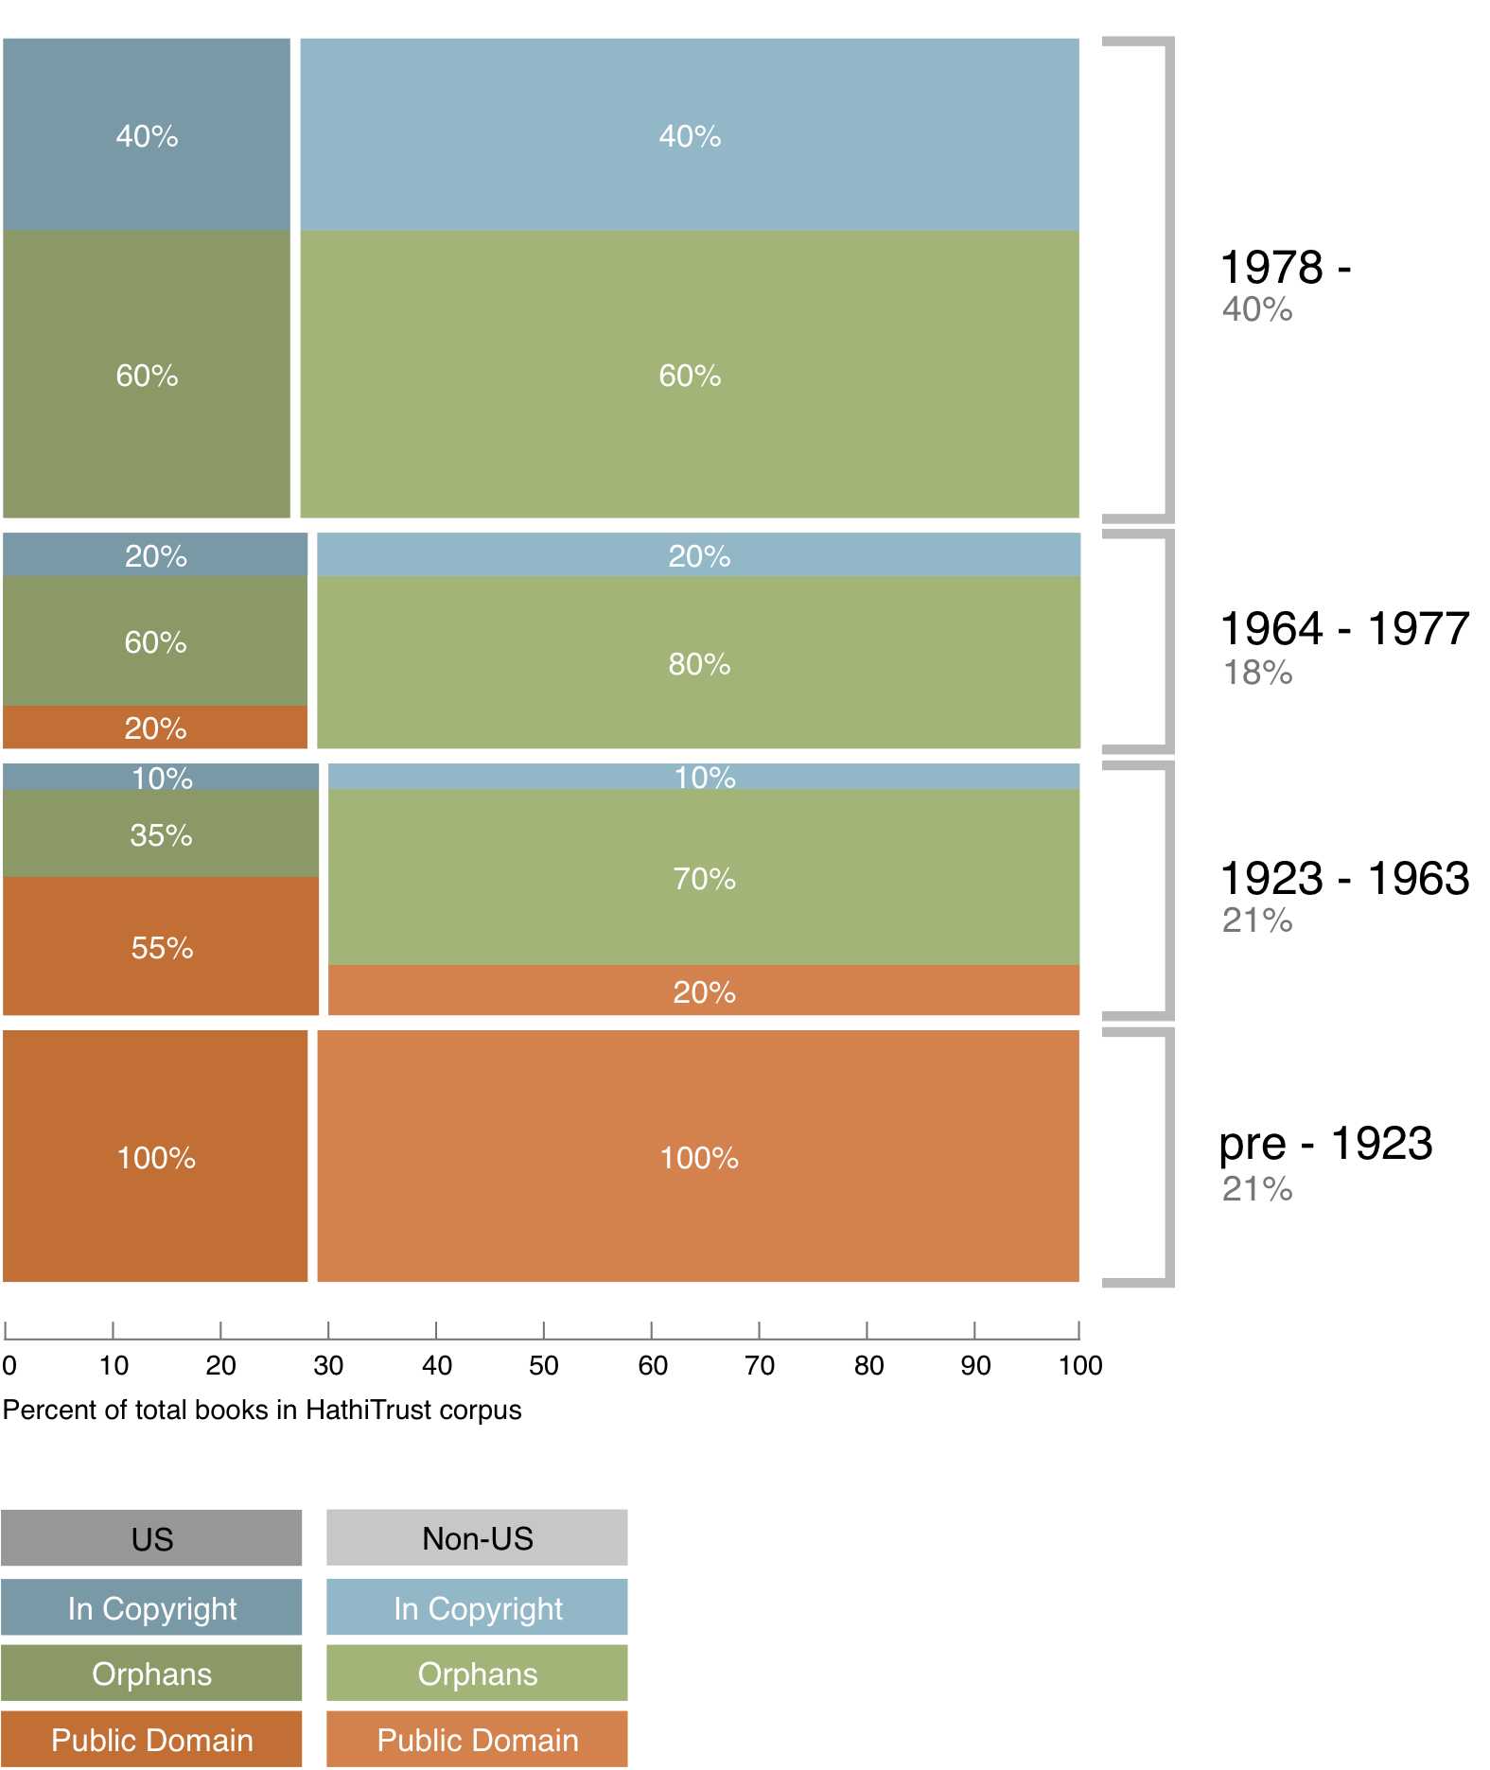
Copyright status of books published pre-1923 and US works published 1923-1963

Slide 29
Copyright status of books published pre-1923 and US works published 1923-1963
In Print ?

Slide 30
Collection Management

Slide 31
A global change in the library environment
Academic print book collection already substantially duplicated in mass digitized book corpus
June 2010
Median duplication: 31%
June 2009
Median duplication: 19%
Notes:
31

Slide 32
Digitized Books in Shared Repositories
~3.5M titles
~75% of mass digitized corpus is ‘backed up’ in one or more shared print repositories
~2.5M
Notes:
32

Slide 33
Collection Management, Development
Overlap
  More than 50% median overlap with ARL institutions; higher for small liberal arts colleges
Pricing model based on Print holdings
  Requires print holdings database
  Also support expansion of legal uses, efforts in de-duplication
  Facilitate individual and collaborative collection development and management operations

Slide 34
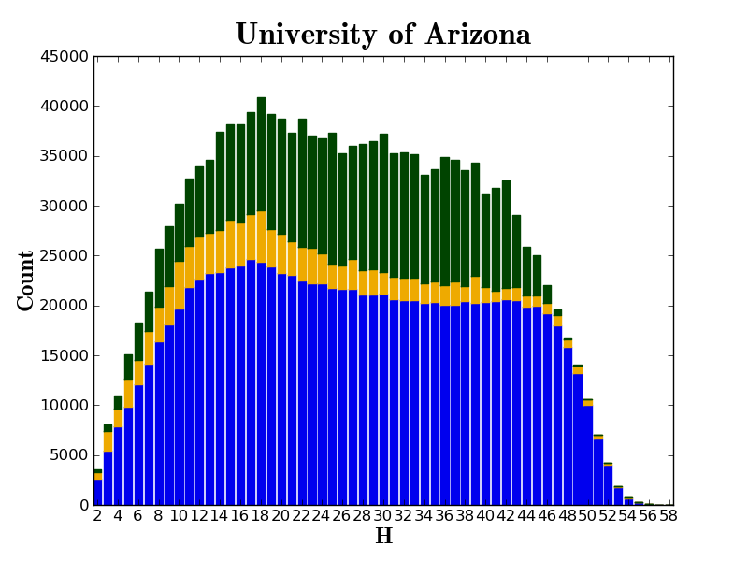

Slide 35
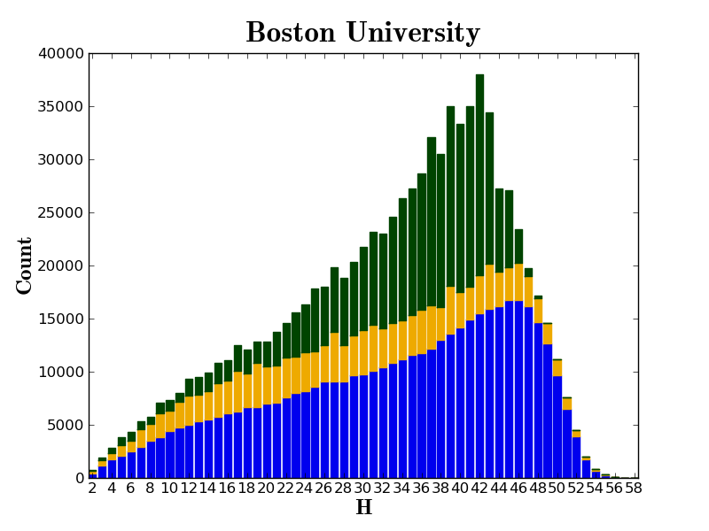

Slide 36
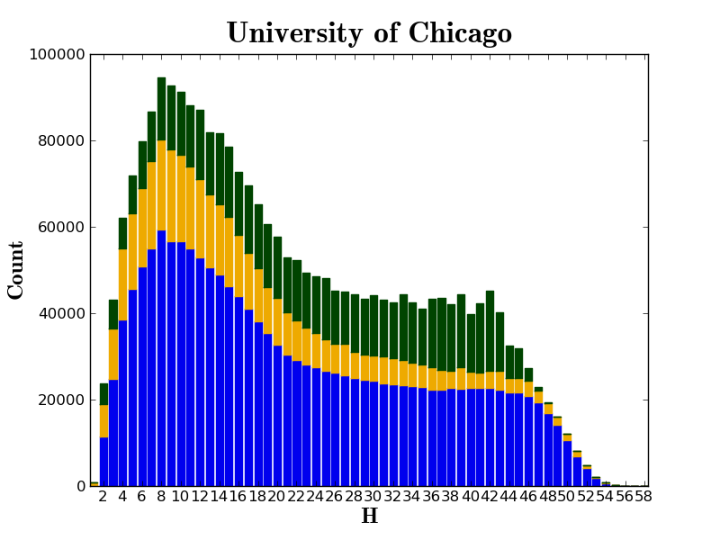

Slide 37
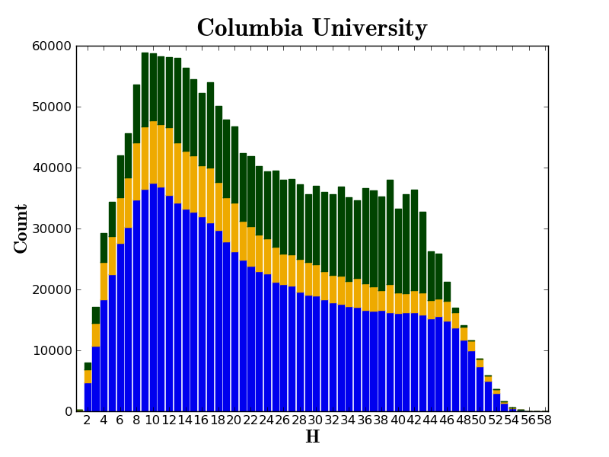

Slide 38
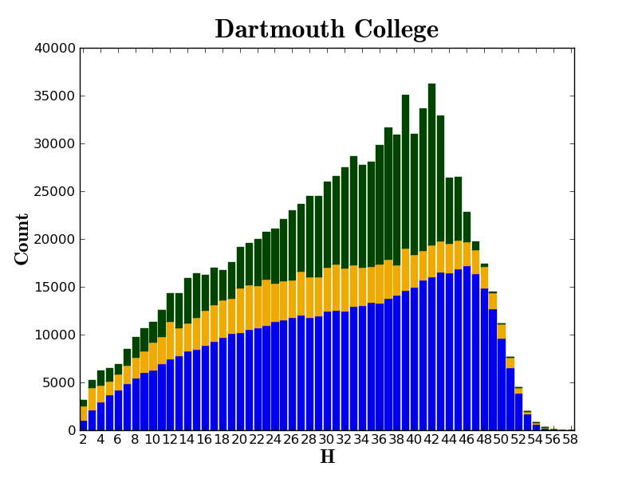

Slide 39
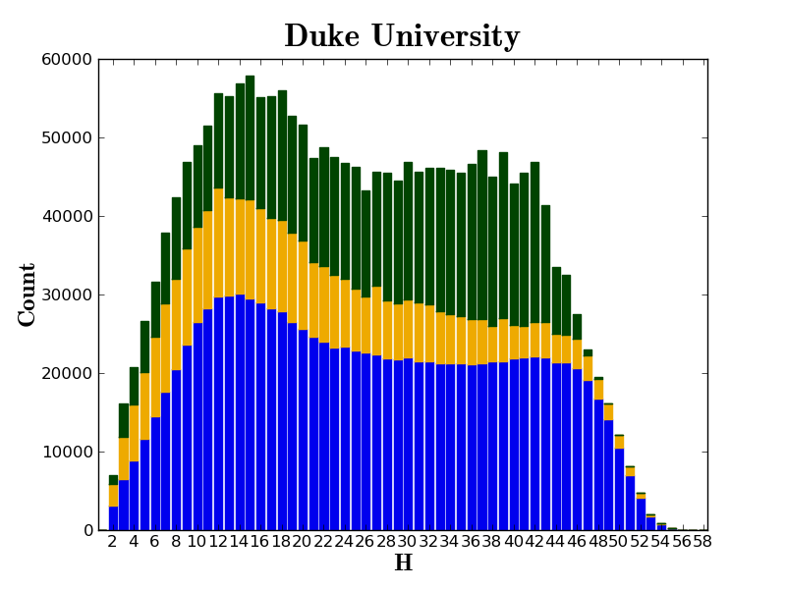

Slide 40
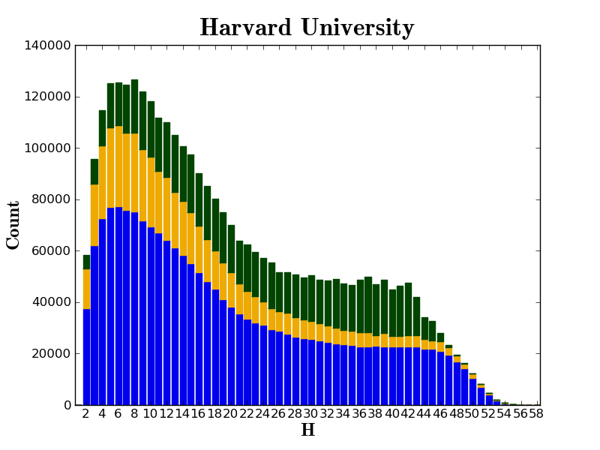

Slide 41
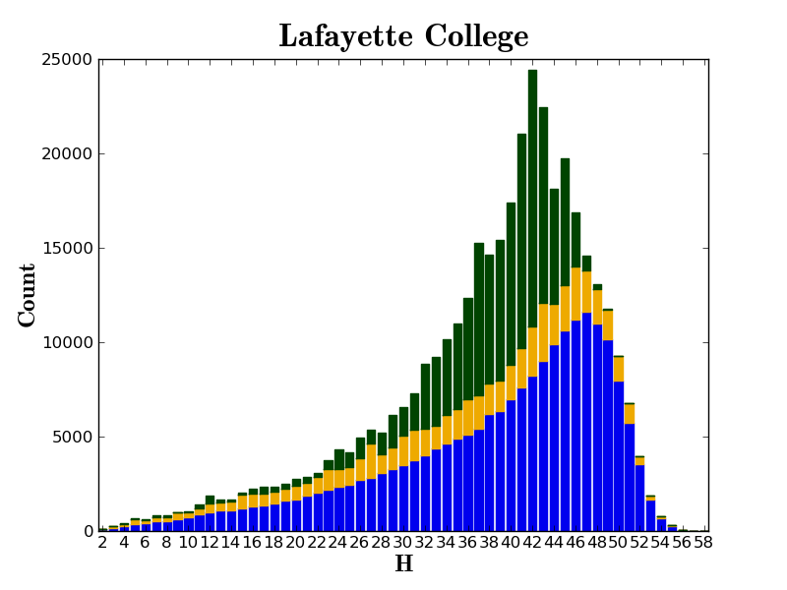

Slide 42
Holdings relevant to Law
Reports
Committee Hearings
Government Documents
Law Reviews
Information around court cases

Slide 43
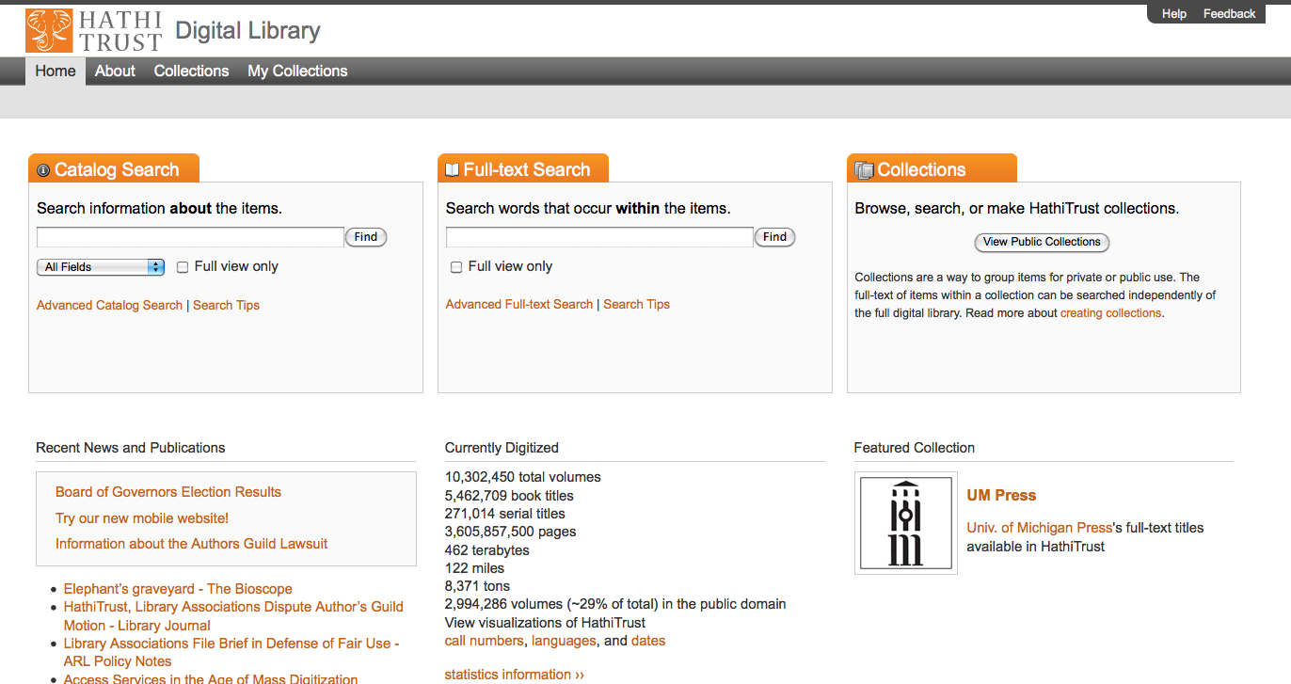

Slide 44
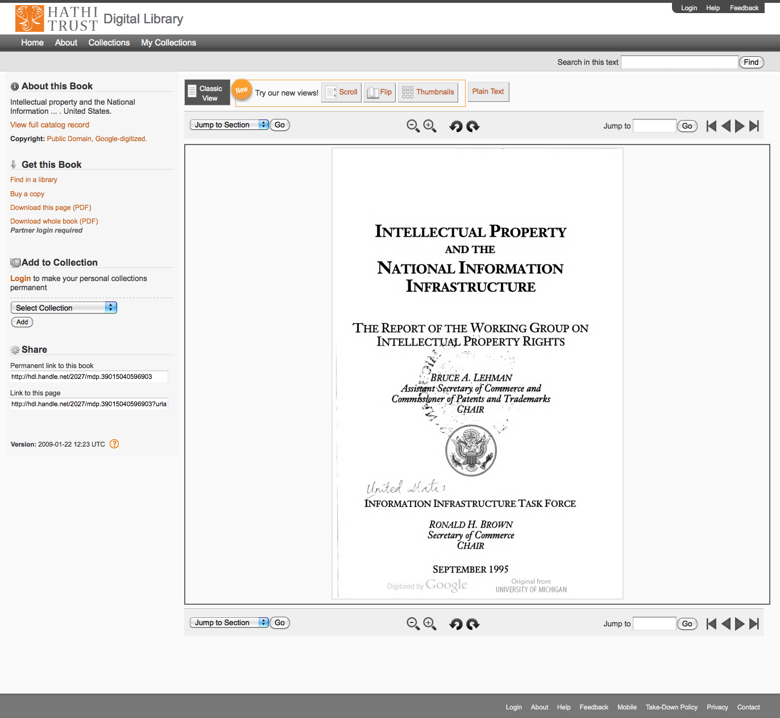

Slide 45
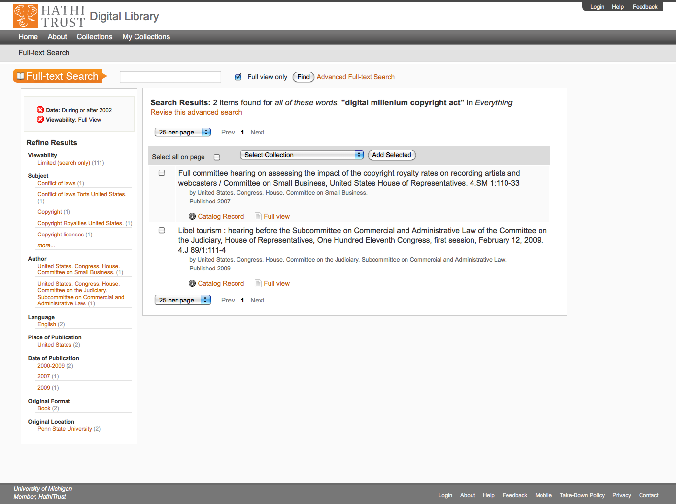

Slide 46
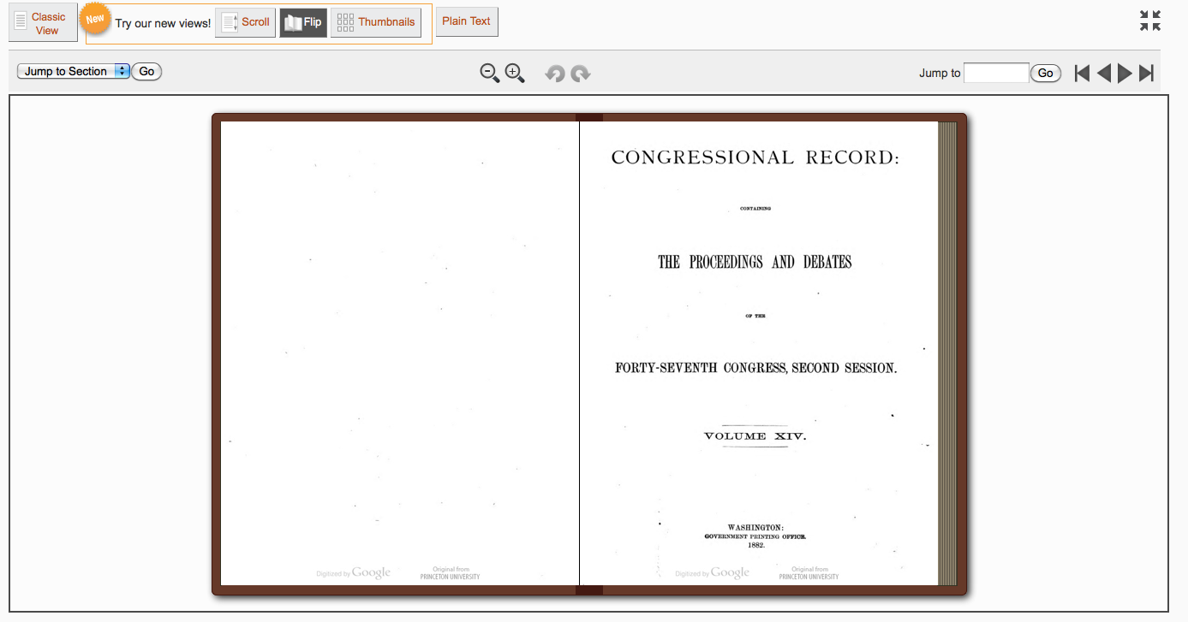

Slide 47
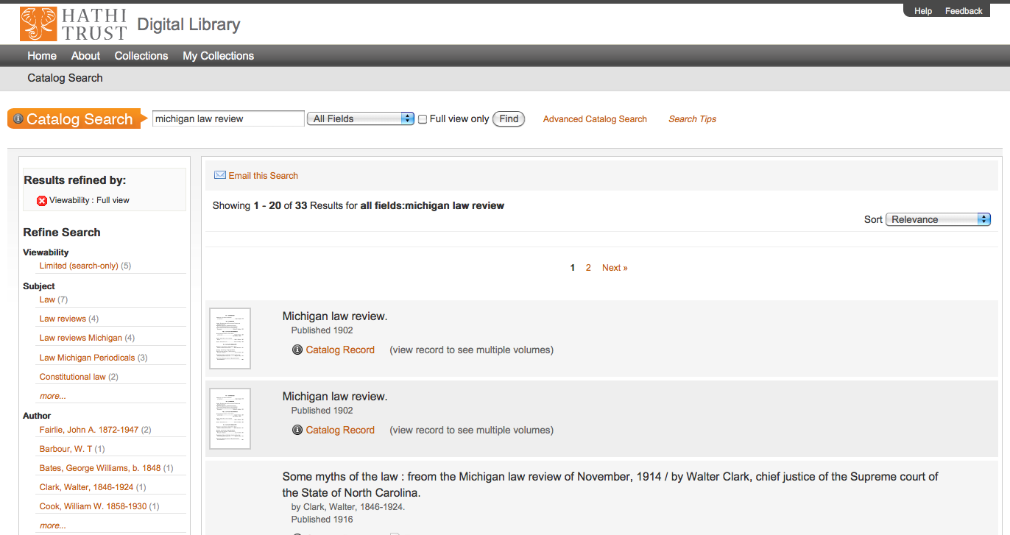

Slide 48
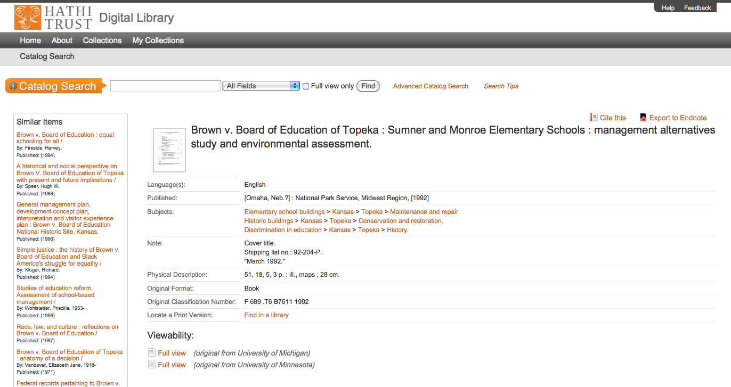

Slide 49
How to find out more
Web site “About” section
  http://www.hathitrust.org/about
HathiTrust Research Center
  http://www.hathitrust.org/htrc
Twitter
  http://twitter.com/hathitrust
Monthly newsletter
  http://www.hathitrust.org/updates
  RSS: http://www.hathitrust.org/updates_rss
Contact us: feedback@issues.hathitrust.org
Blogs: http://www.hathitrust.org/blogs
  Large-scale search
  Perspectives from HathiTrust

Slide 50
Thank you very much!

