Slide 1
HathiTrust: The Collection and Its Uses
NEFLIN Webinar - November 7, 2013
Jeremy York, Assistant Director, HathiTrust
Sigrid Cordell, Librarian for English Language and Literature, University of Michigan Library
Unless otherwise noted, these slides and their contents are licensed under a Creative Commons Attribution Unported License.

Slide 2
Partnership
Allegheny College
Arizona State University
Baylor University
Boston College
Boston University
Brandeis University
Brown University
California Digital Library
Carnegie Mellon University
Colby College
Columbia University
Cornell University
Dartmouth College
Duke University
Emory University
Florida State University
Getty Research Institute
Harvard University Library
Indiana University
Iowa State University
Johns Hopkins University
Kansas State University
Lafayette College
Library of Congress
Massachusetts Institute of Technology
McGill University`
Michigan State University
New York Public Library
New York University
North Carolina Central
University
North Carolina State
University
Northwestern University
The Ohio State University
The Pennsylvania State
University
Princeton University
Purdue University
Stanford University
Syracuse University
Temple University
Texas A&M University
Tufts University
Universidad Complutense
de Madrid
University of Alberta
University of Alabama
University of Arizona
University of British Columbia
University of Calgary
University of California
Berkeley
Davis
Irvine
Los Angeles
Merced
Riverside
San Diego
San Francisco
Santa Barbara
Santa Cruz
The University of Chicago
University of Connecticut
University of Delaware
University of Florida
University of Houston
University of Illinois
University of Illinois at Chicago
The University of Iowa
University of Kansas
University of Maryland
University of Massachusetts, Amherst
University of Miami
University of Michigan
University of Minnesota
University of Missouri
University of Nebraska-Lincoln
The University of North
Carolina at Chapel Hill
University of Notre Dame
University of Oklahoma
University of Pennsylvania
University of Pittsburgh
University of Utah
University of Vermont
University of Virginia
University of Washington
University of Wisconsin- Madison
Utah State University
Vanderbilt University
Virginia Tech
Wake Forest University
Washington University
Yale University Library

Slide 3
Digital Repository
Launched 2008
Initial focus on digitized book and journal content
10.8 million total volumes
5.6 million book titles
282,000 serial titles
3.4 million public domain (~32%)

Slide 4
The Name
The meaning behind the name
Hathi (hah-tee)--Hindi for elephant
Big, strong
Never forgets, wise
Secure
Trustworthy

Slide 5
Mission
To contribute to the common good by collecting, organizing, preserving, communicating, and sharing the record of human knowledge

Slide 6
HathiTrust
Universal Library
Common Goal
Single Entity, Many Partners

Slide 7
Collections and Collaboration
Comprehensive collection
Preservation…with Access
Shared strategies
Copyright
Collection management, development
Preservation
Discovery / Use
Bibliographic Indeterminacy
Efficient user services
Public Good

Slide 8
Copyright Distribution
Notes:
8

Slide 9
Language Distribution (1)
The top 10 languages make up ~86% of all content
Notes:
9

Slide 10
Services
Long-term preservation
Bit-level and migration
Bibliographic search
Full-text search
Reading and download capabilities
Print on demand
APIs and Data feeds
Data API
Bibliographic API
“Hathifiles” inventory files
OAI
Collections
Datasets, Research Center

Slide 11
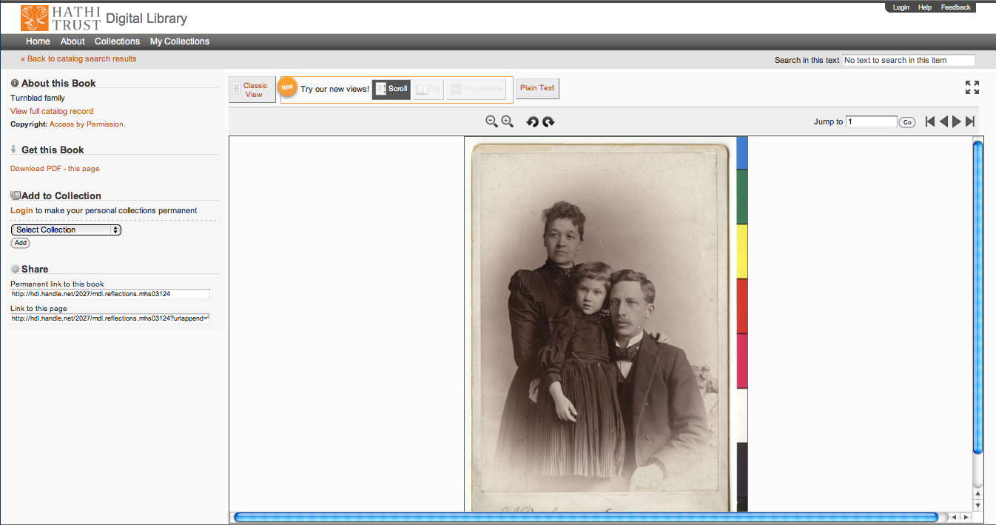
Support Beyond Books and Journals

Slide 12
Rights Determination
CRMS US (since 2008)
Published in US, 1923-1963
291,275 determinations
152,266 opened (~53%)
CRMS-World (since 2012)
Published non-US (UK, Canada, Australia, Spain)
75,544 determinations
39,889 opened (~54%)
Permissions
Open access – 6,688
Additional Creative Commons – 6,108

Slide 13
Collection Management, Development
Overlap
More than 50% median overlap with ARL institutions; higher for small liberal arts colleges
Pricing model based on Print holdings
Requires print holdings database
Also support expansion of legal uses, efforts in de-duplication
Facilitate individual and collaborative collection development and management operations
Print monographs archiving

Slide 14
How to find out more
About: http://www.hathitrust.org/about
Twitter: http://twitter.com/hathitrust
Facebook: http://www.facebook.com/hathitrust
Monthly newsletter:
http:www.hathitrust.org/updates
RSS http://www.hathitrust.org/updates_rss
Contact us: feedback@issues.hathitrust.org
Blogs: http://www.hathitrust.org/blogs
Large-scale Search
Perspectives from HathiTrust

Slide 15
Teaching with HathiTrust

Slide 16
For students, HathiTrust is a rich source of primary materials that cross disciplines, topics, and geography.
For instructors, HathiTrust offers a contained, but expansive, environment in which students can search for sources

Slide 17
HathiTrust contains materials in all disciplines…
and includes a wide range of primary source materials, such as:
Diaries
Correspondence
Reports
Newspapers
Memoirs

Slide 18
HathiTrust covers a wide range of formats, such as
Books
Encyclopedias
Archival materials
Directories
Periodicals
Maps
Musical scores
Statistics
Visual Materials

Slide 19
Research as Play
HathiTrust can be used pedagogically to encourage scholarly exploration.
Researchers can browse for items by category, date, geography, or subject.

Slide 22
Thank You.
Jeremy York (jjyork@umich.edu)
Sigrid Cordell (scordell@umich.edu)
Notes:
Required – End Slide

