Slide 1
We’re Preserving the Past, What About the Present?
NISO Webinar: Ensuring the Preservation of E-Books
May 23, 2012
Jeremy York, Project Librarian, HathiTrust

Slide 2
Outline
About HathiTrust
Preservation and Access Strategies
What about the present?

Slide 3
Partnership
Arizona State University
Baylor University
Boston College
Boston University
California Digital Library
Columbia University
Cornell University
Dartmouth College
Duke University
Emory University
Florida State University
Getty Research Institute
Harvard University Library
Indiana University
Johns Hopkins University
Lafayette College
Library of Congress
Massachusetts Institute of Technology
McGill University`
Michigan State University
New York Public Library
New York University
North Carolina Central
University
North Carolina State
University
Northwestern University
The Ohio State University
The Pennsylvania State
University
Princeton University
Purdue University
Stanford University
Texas A&M University
Universidad Complutense
de Madrid
University of Arizona
University of Calgary
University of California
Berkeley
Davis
Irvine
Los Angeles
Merced
Riverside
San Diego
San Francisco
Santa Barbara
Santa Cruz
The University of Chicago
University of Connecticut
University of Florida
University of Illinois
University of Illinois at Chicago
The University of Iowa
University of Maryland
University of Miami
University of Michigan
University of Minnesota
University of Missouri
University of Nebraska-Lincoln
The University of North
Carolina at Chapel Hill
University of Notre Dame
University of Pennsylvania
University of Pittsburgh
University of Utah
University of Virginia
University of Washington
University of Wisconsin- Madison
Utah State University
Washington University
Yale University Library

Slide 4
The Name
The meaning behind the name
Hathi (hah-tee)--Hindi for elephant
Big, strong
Never forgets, wise
Secure
Trustworthy

Slide 5
Strategic Advisory Board
Guidance on Policy, Planning
12-member Board of Governors
Executive Committee
Executive Director
Executive Committee
HathiTrust
Budget/Finances
Decision-making

Slide 6
Digital Repository
Launched 2008
Initial focus on digitized book and journal content
10,309,742 total volumes
5,464,306 book titles
271,119 serial titles
3,001,018 public domain (~29%)
“Light” archive

Slide 7
Collections and Collaboration
Comprehensive collection
Preservation…with Access
Shared strategies
Copyright
Collection management, development
Preservation
Discovery / Use
Bibliographic Indeterminacy
Efficient user services
Public Good

Slide 8
Preservation and Access

Slide 9
Repository Philosophy/Design
OAIS/TRAC
Consistency
Standardization
Simplicity (in design, not function)
Practicality
Sustainability

Slide 10
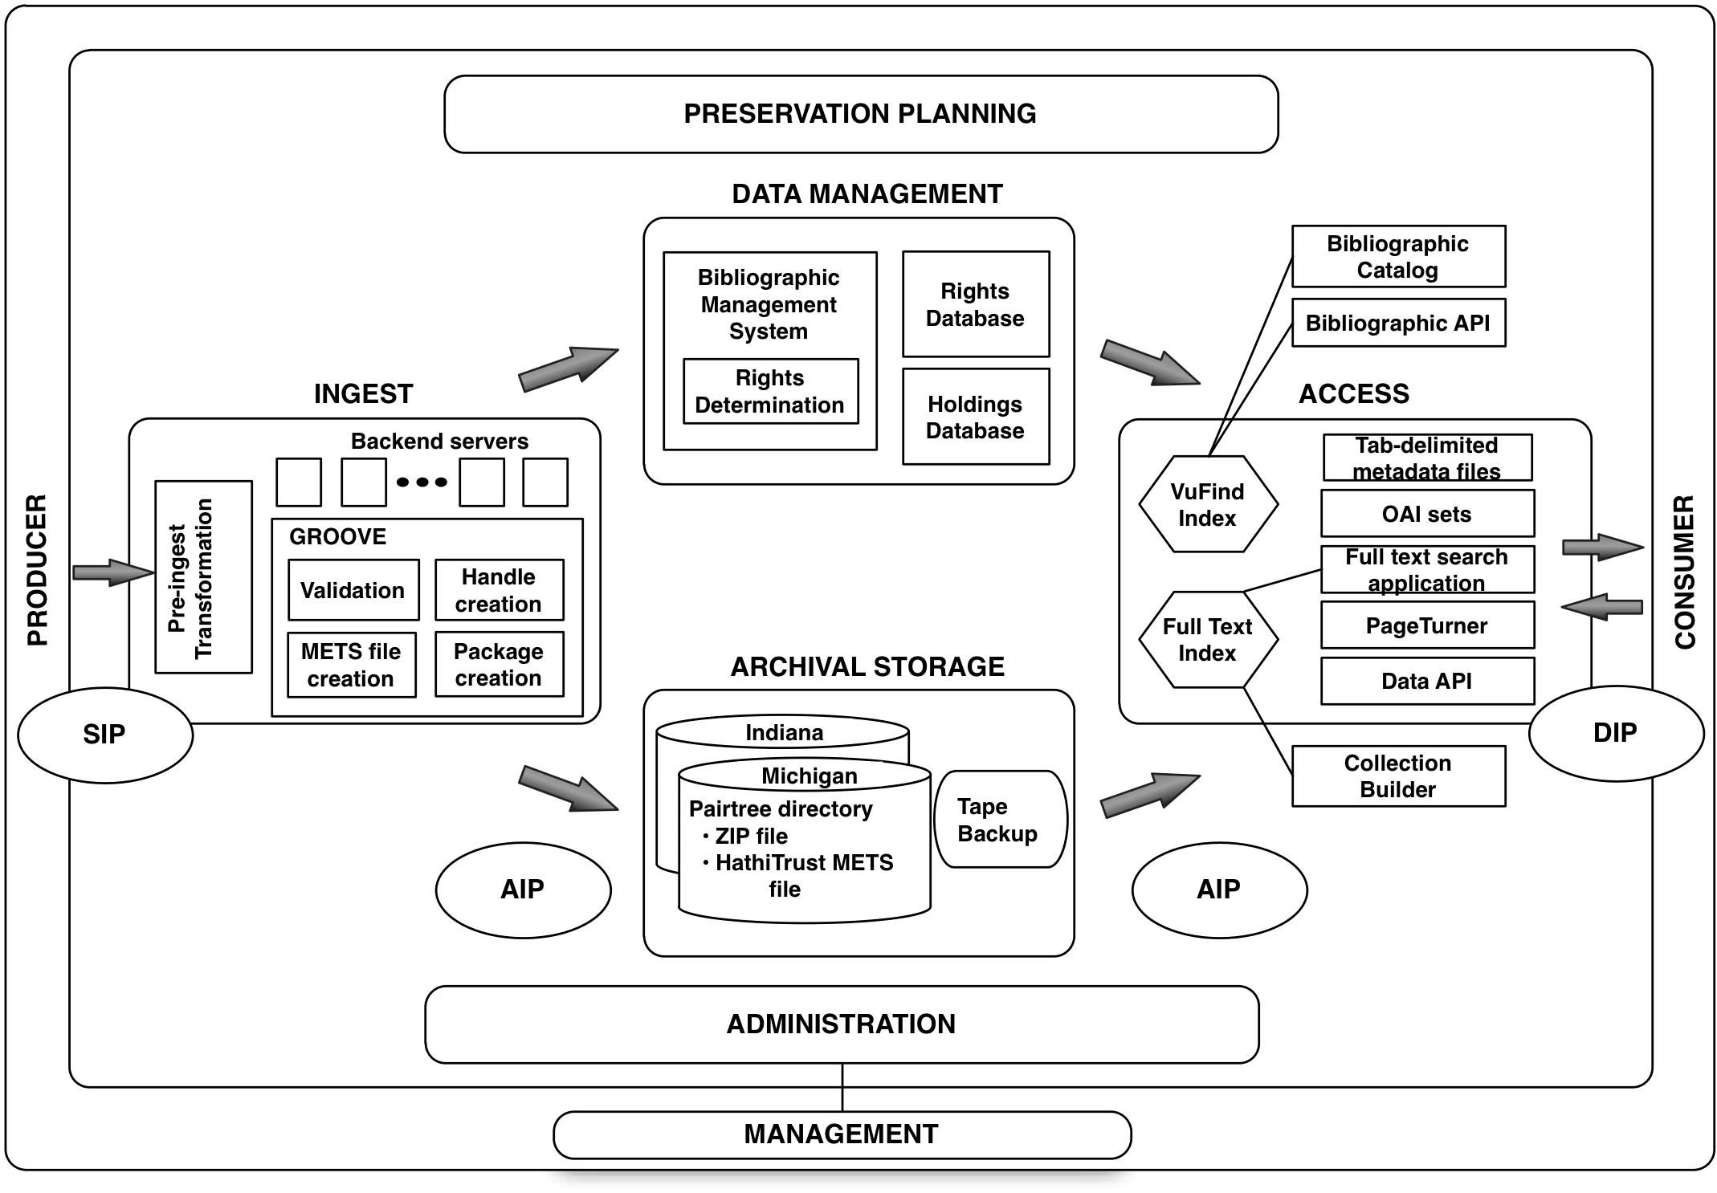

Slide 15
What about the Present?

Slide 16
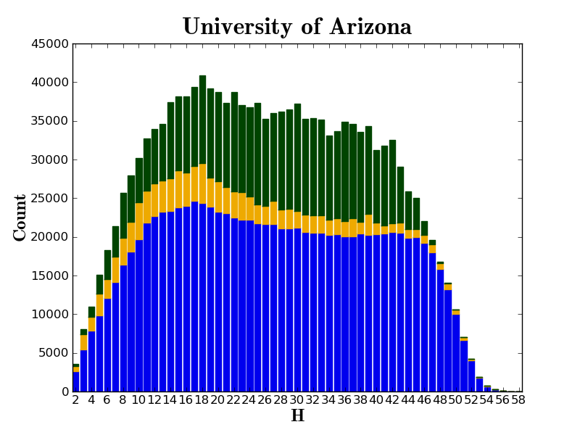
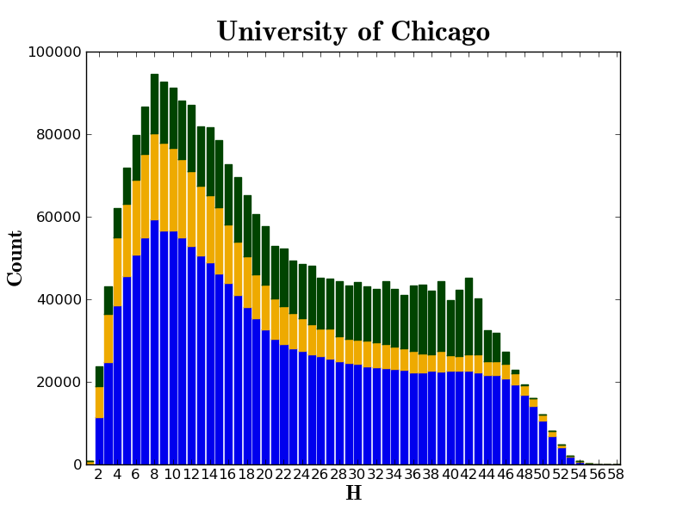
Dates
Collections
Languages

Slide 17
To contribute to the common good by collecting, organizing, preserving, communicating, and sharing the record of human knowledge

Slide 18
Rights holders open access
Publishers deposit master files
Publish directly into the repository

Slide 19
jPach: Journal Publishing in HathiTrust
http://lib.umich.edu/jpach
Package of tools to enable publication of open access journals
Includes modifications to existing code base; new components to facilitate ingest, display, and discoverability of born-digital open-access journal literature
Allow integration with popular journal publishing tools such as Open Journal Systems (OJS)

Slide 20
Key Elements
Openness
Content must be licensed for perpetual open access
Additional formats
Fixity of bitstream guaranteed where preservation specifications cannot be developed
Allow download of content not rendered in the interface
Support articles and contextual information (lists of editors, submission requirements)
Support for revisions to content

Slide 23
Publishing into the Repository

Slide 24
Higher Education
Source / Archive
Editorial
Market

Slide 25
Publishing into the Repository
Openness
Continual stewardship and access
Sustainability
Library as engine of communication

Slide 26
How to find out more
About: http://www.hathitrust.org/about
Twitter: http://twitter.com/hathitrust
Facebook: http://www.facebook.com/hathitrust
Monthly newsletter:
http:www.hathitrust.org/updates
RSS http://www.hathitrust.org/updates_rss
Contact us: feedback@issues.hathitrust.org
Blogs: http://www.hathitrust.org/blogs
Large-scale Search
Perspectives from HathiTrust

Slide 27
Thank you very much!

