Slide 1
Sharing Collections through Shared Stewardship
A HathiTrust Progress Report
Northwestern University
October 21, 2014
Mike Furlough
Executive Director, HathiTrust
Unless otherwise noted, these slides and their contents are licensed under a Creative Commons Attribution Unported License.

Slide 2
Today’s Conversation
Do you really know HathiTrust?
How things work
Collections and data
What are we working on now?
How has the world changed since we began?
And what does that mean for HathiTrust

Slide 3
The Partnership

Slide 4
Mission
To contribute to the common good by collecting, organizing, preserving, communicating, and sharing the record of human knowledge.
Efforts include, but are not limited to
…building comprehensive collections co-owned and managed by partners.
…enabling access by users with print disabilities.
…supporting computational research with the collections.
…stimulating shared collection storage strategies among libraries.

Slide 5
Timeline: Highlights
Google Library Project announced (2004)
Launch (2008)
TRAC certification (2011)
Constitutional convention (2011)
10 million volumes (2012)
New governance established (2012)
Current bylaws and fee structure (2013)
12 million volumes (2014)

Slide 6
HathiTrust Members
Allegheny College
Arizona State University
Baylor University
Boston College
Boston University
Brandeis University
Brown University
California Digital Library
Carnegie Mellon University
Colby College
Columbia University
Cornell University
Dartmouth College
Duke University
Emory University
Florida State University
Getty Research Institute
Harvard University Library
Indiana University
Iowa State University
Johns Hopkins University
Kansas State University
Lafayette College
Library of Congress
Massachusetts Institute of Technology
McGill University`
Michigan State University
Montana State University
Mount Holyoke College
New York Public Library
New York University
North Carolina Central
University
North Carolina State
University
Northwestern University
The Ohio State University
The Pennsylvania State
University
Princeton University
Purdue University
Rutgers University
Stanford University
Syracuse University
Temple University
Texas A&M University
Texas Tech
Tufts University
Universidad Complutense
de Madrid
University of Alabama
University of Alberta
University of Arizona
University of British Columbia
University of Calgary
University of California
Berkeley
Davis
Irvine
Los Angeles
Merced
Riverside
San Diego
San Francisco
Santa Barbara
Santa Cruz
The University of Chicago
University of Connecticut
University of Delaware
University of Florida
University of Houston
University of Illinois
University of Illinois at Chicago
The University of Iowa
University of Kansas
University of Maine
University of Maryland
University of Massachusetts, Amherst
University of Miami
University of Michigan
University of Minnesota
University of Missouri
University of Nebraska-Lincoln
University of New Mexico
The University of North
Carolina at Chapel Hill
University of Notre Dame
University of Oklahoma
University of Pennsylvania
University of Pittsburgh
University of Queensland
University of Tennessee, Knoxville
University of Texas
University of Utah
University of Vermont
University of Virginia
University of Washington
University of Wisconsin- Madison
Utah State University
Vanderbilt University
Virginia Tech
Wake Forest University
Washington University
Yale University Library

Slide 7
Growth in Membership

Slide 8
Shared Responsibilities
Leverage expertise across institutions
Collective work
Distributed Infrastructure
Preservation repository and access services
University of Michigan
Mirror site: Indiana University
Metadata management services (Zephir)
California Digital Library
HathiTrust Research Center
Indiana University and University of Illinois

Slide 9
Governance
HathiTrust
Members
Board of Governors
Program Steering Committee
Executive Director
Committees and Working Groups
Operations

Slide 10
Five-year terms (beginning Jan 2013)
Betsy Wilson (University of Washington)
Bob Wolven (University of Columbia)
Ex Officio (Board, PSC, Executive Committee):
Mike Furlough, Executive Director
Four year terms
Richard Clement (University of New Mexico)
Patricia Steele (University of Maryland)
Executive Committee
- Chair
- Past Chair
- Treasurer
- Chair of PSC
- Executive Director
Three year terms:
Carol Mandel (New York University)
Sarah Michalak (University of North Carolina-Chapel Hill)
Members appointed by the founding institutions:
James Hilton (University of Michigan)
Carol Diedrichs (Ohio State University)
Laine Farley (California Digital Library)
Wendy Lougee (University of Minnesota)
Brian Schottlaender (UC, San Diego)
Brenda Johnson (Indiana University)
HathiTrust Board of Governors

Slide 11
Program Steering Committee
Serves at the direction of the Board of Governors to…
Reviews HathiTrust’s development agenda, shaping initiatives and strategies for Board discussion and decision-making, and considering the implications of those initiatives for the future.
Recommends alterations in the development agenda based on such reviews. Based on its reviews, develops position papers for the member community to encourage debate or mobilize discussion with regard to particular issues.
Works with the Board of Governors to develop policies for HathiTrust and its members.

Slide 12
Program Steering Committee Membership
Ivy Anderson (CDL)
John Butler (Minnesota)
Chris Freeland (Washington University)
Todd Grappone (UCLA)
Martha Hruska (UC San Diego)
Martin Kurth (New York University)
Erika Linke (Carnegie Mellon University)
Robert McDonald (Indiana)
Matthew Sheehy (Harvard)
Elaine Westbrooks (Michigan)
Bob Wolven, Chair (Columbia)

Slide 13
PSC Actions 2013-2014
Initial focus on Constitutional Convention Ballot Initiatives
Re-established Collections Committee
Created Rights & Access Working Group
Charged Zephir Advisory Group

Slide 14
Standing Committees and Working Groups
Collections Committee
Rights and Access Working Group
User Support Working Group

Slide 15
Collections and Access

Slide 16
Growth of Collection

Slide 17
Preservation with Access
Preservation
TRAC-certified
Long-term commitments on digital content facilitate planning, decision-making
Discovery
Bibliographic and full-text search of all materials
Mechanisms for local loading of records
Access and Use
Full text search (all users)
Public domain and open access works (all users)
Collections and APIs (all users)
Lawful uses of in-copyright works (members)

Slide 18
Content Sources

Slide 19
Dates
* As of February 17, 2014
Notes:
19

Slide 20
Language Distribution (1)
The top 10 languages make up ~87% of all content
* As of February 17, 2014
Notes:
20

Slide 21
Language Distribution (2)
The next 40 languages make up ~12% of total
* As of February 17, 2014

Slide 22
Access: Lawful uses of in-copyright works
Sensitive to multiple legal regimes
Full-text search (everyone everywhere)
Access to users who have print disabilities (through member proxy in US, and where law permits)**
Access works that are damaged or missing and also out of print and unavailable (members in US only)
**Terms and conditions at http://www.hathitrust.org/access_use#ic-access

Slide 23
Collective Action: Copyright Review
Copyright Review Management System
CRMS US: Works published in US, 1923-1963
CRMS-World: Published non-US (UK, Canada, Australia, Spain)
Through both projects over 450,000 items reviewed
52% determined to have some public domain status

Slide 24
Copyright Distribution

Slide 25
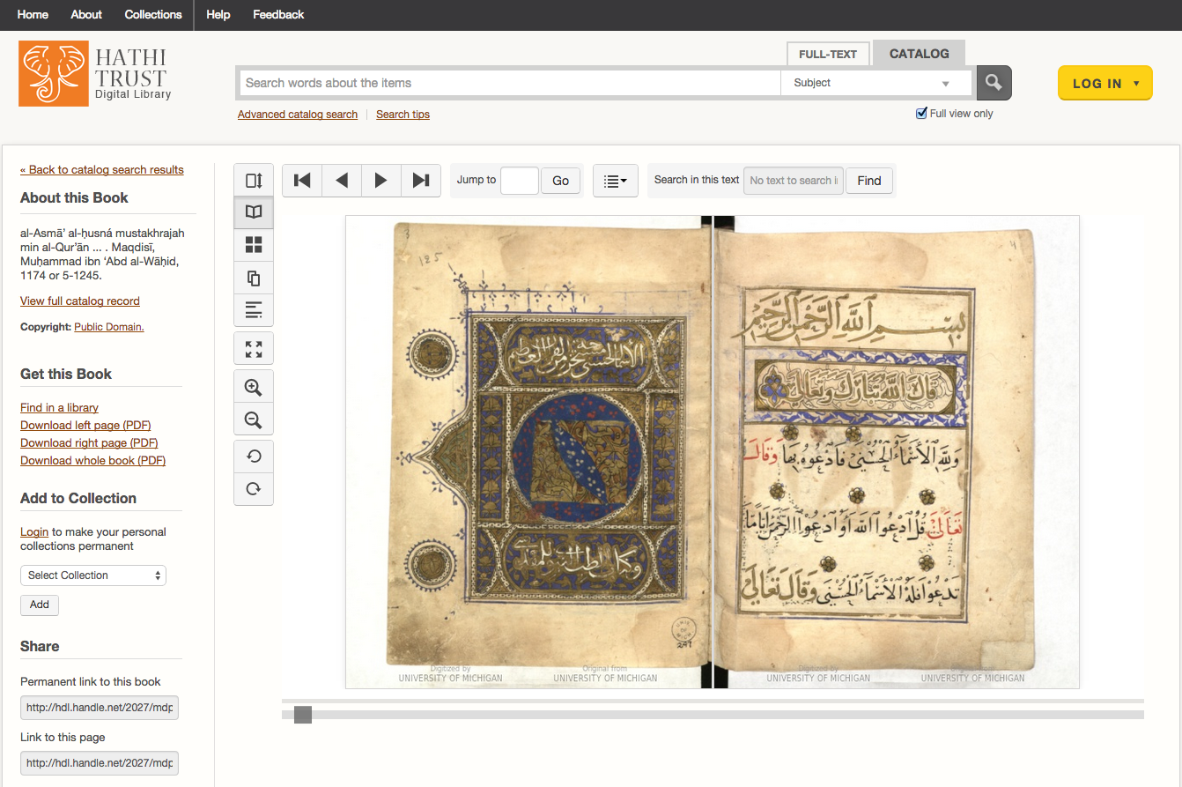
Special Collections: Islamic Manuscripts

Slide 26
Current Initiatives

Slide 27
Current Initiatives
Developing a shared print monographs archive
Expanding coverage and access to US government publications
Expanding support for computational (non-consumptive) research

Slide 28
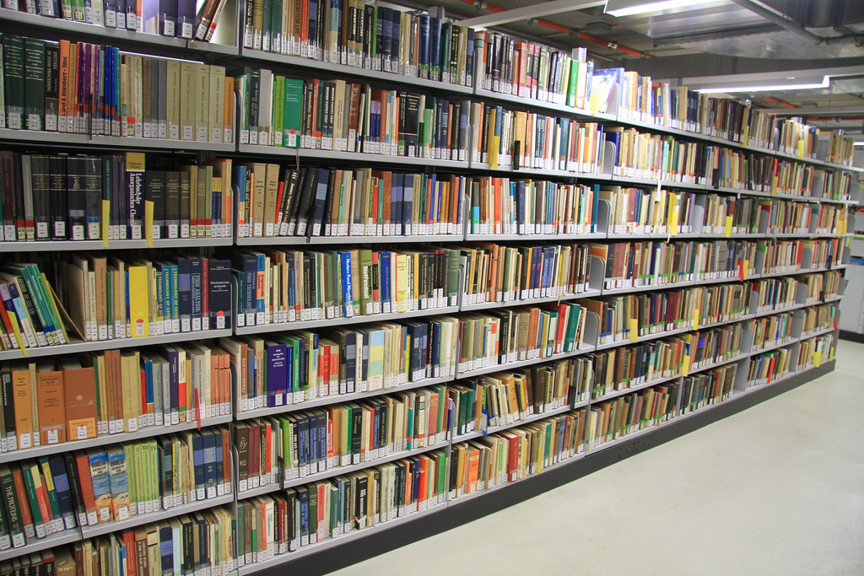
Shared Print Monographs Archive
Ballot Initiative passed at the 2011 HT Constitutional Convention (Con-Con)
“To develop a print monographs archive corresponding to volumes represented within the HathiTrust”
HathiTrust Board of Governors recently approved appointment of a PSC-designed task force to begin process
Photo by Mal BooTH CC-BY-NC-ND https://www.flickr.com/photos/malbooth/5100435988

Slide 29
Why A Shared Print Archive Program
Many regional efforts, but limited national/international coordination
Strengthens preservation commitments
Connects both print and digital preservation
Significant need and desire to reduce costs of collection management and associated footprint

Slide 30
Print Monographs Archive Task Force
Tom Teper, Chair (University of Illinois)
Clem Guthro (Colby College)
Robert Kieft (Occidental College)
Erik Mitchell (University of California, Berkeley)
Jake Nadal (ReCAP)
Jo Anne Newyear Ramirez (University of British Columbia)
Matthew Sheehey (Harvard University)
Emily Stambaugh (California Digital Library)
Karla Strieb (Ohio State University)

Slide 31
Questions: Monographs Archive
What incentives will encourage participation?
What services and access models are needed?
What structures are needed to establish commitments from multiple programs?
What costs will be associated with the program and how should they be allocated?
Which libraries are most likely to benefit?

Slide 32
Government Documents Initiative
Ballot Initiative: provide “expanded coverage & enhanced access to U.S. Government Documents.”
Activities:
Developing a registry of US Federal Government Documents
HathiTrust Board of Governors recently approved appointment of a PSC-designed Advisory Group to begin process
Photo detail from http://babel.hathitrust.org/cgi/pt?id=mdp.39015087610286;view=1up;seq=14

Slide 33
Existing Government Documents
568,219 documents as of September 2014
441,096 from the CIC, working in conjunction with Google
CIC libraries and the University of California will continue to supply

Slide 34
Working Group Membership
Mark Sandler (CIC)
Prue Adler (Association of Research Libraries)
Ivy Anderson (California Digital Library)
Joni Blake (Greater Western Library Alliance)
Kirsten Clark (Minnesota)
Rick Clement (New Mexico)
Elizabeth Cowell (Santa Cruz)
Mark Phillips (North Texas)
Jon Rothman (Michigan)
Judy Russell (Florida)
Barbie Selby (Virginia)
Jeremy York (HathiTrust)

Slide 35
Working Group Tasks
Develop an overall strategy for building a comprehensive public domain corpus of U.S. federal documents in HathiTrust
Recommend investments as needed to pursue the initiative
Advise the Board on relevant policy issues
Provide oversight and guidance as the project develops

Slide 36
The Registry
Goal: “….include metadata for the comprehensive corpus of U.S. federal documents. This will include materials produced at U.S. government expense, in all formats, at the item level, from 1789 to the present.

Slide 37
Computational Access
HathiTrust distributes public domain datasets
HathiTrust Research Center
Developed collaboratively by Indiana University and University of Illinois; launched July 2011
Funding from the Sloan Foundation, Andrew W. Mellon Foundation, and NEH Office of Digital Humanities.
Partially Funded by HathiTrust (2014-2018)
Photo by Nocolas Nova CC-BY-NC https://www.flickr.com/photos/nnova/3455992927

Slide 38
Mission of the HT Research Center
Mission: Enable researchers world-wide to accomplish tera-scale text data-mining and analysis
Develop cyberinfrastructure to enable HPC access to the HathiTrust Digital Library
Develop cutting-edge software tools for processing, analyzing text
Develop translational tools and data that can be used to enhance HathiTrust Digital Library services to users

Slide 39
HTRC Governance
Reports to the HathiTrust Board of Governors
Advisory Group in formation
HTRC Executive Committee
J. Stephen Downie (Co-director), Professor and Associate Dean for Research, University of Illinois GSLIS
Beth Plale (Co-director and Chair), Director Data To Insight Center and professor in the School of Informatics and Computing at Indiana University
Robert H. McDonald, Associate Dean of Libraries/Deputy Director Data to Insight Center at Indiana University
Beth Sandore Namachchivaya, Associate University Librarian for Information Technology Planning & Policy at the University of Illinois
John Unsworth, Vice Provost for Library & Technology Services and Chief Information Officer at Brandeis University

Slide 40
Goals for HTRC
Provide a persistent and sustainable structure to enable original and cutting edge research.
Leverage data storage and computational infrastructure at Indiana & Illinois
Stimulate community development of new functionality and tools
Use tools to enable discoveries that would not be possible without the HTRC
Enable scholars to fully utilize content of HathiTrust Library while preventing intellectual property misuse within U.S. copyright law.
Provision secure computational and data environment for scholars to perform research using HathiTrust Digital Library.

Slide 41
HathiTrust Research Center UnCamp #3
March 30-31, 2015
University of Michigan
Ann Arbor, MI

Slide 42
Some Thoughts on the Present and Future

Slide 43
How are we positioned?
Our mission, collection, and the repository operations are all strong.
Our brand reputation is outstanding.
Our work is solidly supported by the law.
We have expanded access in unprecedented ways.
The partnership provides a solid base for action.
We have very important programs underway.

Slide 44
What needs thought?
Strategy, mission, and role in the future
Membership growth
Collections program
Public policy
(Inter)National digital infrastructure
Services for members and the public
Organizational
Engagement with researchers and libraries
Enabling more participation in plans and action
Standing on our own

Slide 45
Assumptions
Our actions must align with the mission, goals, and purpose across our partnership.
A few additional assumptions
We should pursue complementarity and cooperation, not competition and duplication.
Scale will continue to drive our strategies
Potential partners are not just other libraries and library organizations, but also readers, authors, publishers.

Slide 46
How to find out more
About: http://www.hathitrust.org/about
Resources: http://www.hathitrust.org/resources
Twitter: http://twitter.com/hathitrust
Facebook: http://www.facebook.com/hathitrust
Monthly newsletter:
http:www.hathitrust.org/updates
RSS http://www.hathitrust.org/updates_rss
Contact us: feedback@issues.hathitrust.org
Blogs: http://www.hathitrust.org/blogs
Large-scale Search
Perspectives from HathiTrust

Slide 47
Thank you! furlough@hathitrust.org @MikeFurlough

