Slide 1
Getting the Most Out of HathiTrust: An Overview of Resources, Tools, and Services
Jeremy York
Oakland University
April 10, 2014

Slide 2
Partnership
Allegheny College
Arizona State University
Baylor University
Boston College
Boston University
Brandeis University
Brown University
California Digital Library
Carnegie Mellon University
Colby College
Columbia University
Cornell University
Dartmouth College
Duke University
Emory University
Florida State University
Getty Research Institute
Harvard University Library
Indiana University
Iowa State University
Johns Hopkins University
Kansas State University
Lafayette College
Library of Congress
Massachusetts Institute of Technology
McGill University`
Michigan State University
New York Public Library
New York University
North Carolina Central
University
North Carolina State
University
Northwestern University
The Ohio State University
The Pennsylvania State
University
Princeton University
Purdue University
Stanford University
Syracuse University
Temple University
Texas A&M University
Tufts University
Universidad Complutense
de Madrid
University of Alabama
University of Alberta
University of Arizona
University of British Columbia
University of Calgary
University of California
Berkeley
Davis
Irvine
Los Angeles
Merced
Riverside
San Diego
San Francisco
Santa Barbara
Santa Cruz
The University of Chicago
University of Connecticut
University of Delaware
University of Florida
University of Houston
University of Illinois
University of Illinois at Chicago
The University of Iowa
University of Kansas
University of Maryland
University of Massachusetts, Amherst
University of Miami
University of Michigan
University of Minnesota
University of Missouri
University of Nebraska- Lincoln
The University of North
Carolina at Chapel Hill
University of Notre Dame
University of Oklahoma
University of Pennsylvania
University of Pittsburgh
University of Queensland
University of Tennessee, Knoxville
University of Texas
University of Utah
University of Vermont
University of Virginia
University of Washington
University of Wisconsin- Madison
Utah State University
Vanderbilt University
Virginia Tech
Wake Forest University
Washington University
Yale University Library

Slide 3
Digital Repository
Launched 2008
Initial focus on digitized book and journal content
  11 million total volumes
  5.8 million book titles
  288,000 serial titles
  3.7 million volumes in the public domain (~34%)

Slide 4
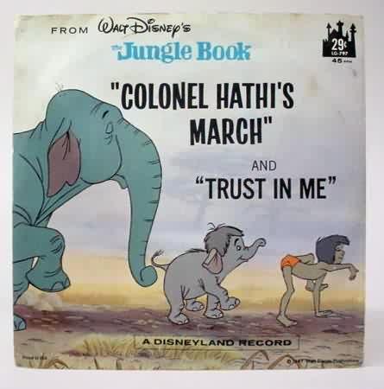
The Name
The meaning behind the name
  Hathi (hah-tee)--Hindi for elephant
  Big, strong
  Never forgets, wise
  Secure
  Trustworthy

Slide 5
Mission
To contribute to the common good by collecting, organizing, preserving, communicating, and sharing the record of human knowledge

Slide 6
HathiTrust
Universal Library
Common Goal
Single Entity, Many Partners

Slide 7
Collections and Collaboration
Comprehensive collection
  Preservation…with Access
Shared strategies
  Copyright
  Collection management, development
  Preservation
  Discovery / Use
  Bibliographic Indeterminacy
  Efficient user services
Public Good

Slide 8
Collections

Slide 9
Content Sources

Slide 10

Dates
* As of February 17, 2014
Notes:
10

Slide 11
Language Distribution (1)
The top 10 languages make up ~87% of all content
* As of February 17, 2014
Notes:
11

Slide 12
Language Distribution (2)
The next 40 languages make up ~12% of total
* As of February 17, 2014

Slide 13
Content Distribution
* As of February 17, 2014
Notes:
13

Slide 14
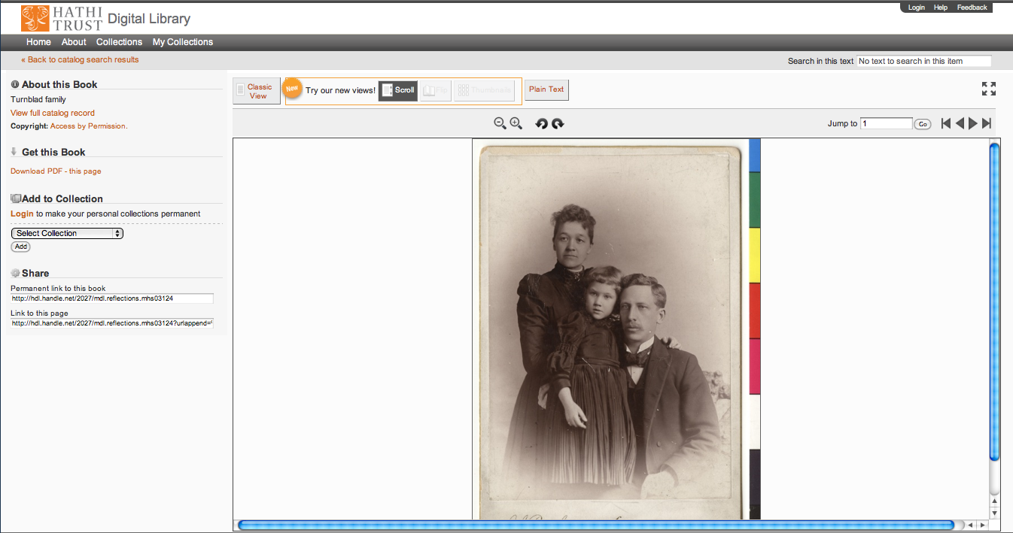
Support Beyond Books and Journals

Slide 15

http://lib.umich.edu/mpach
Package of tools to enable publication of open access, born-digital journal content, directly into HathiTrust
  Including accompanying data and media files
Allows integration with popular journal publishing tools such as Open Journal Systems (OJS)

Slide 16
But what is IN HathiTrust?

Slide 17
HathiTrust contains materials in all disciplines…
HathiTrust by call number
and includes a wide range of primary source materials, such as:
Diaries
Correspondence
Reports
Newspapers
Memoirs

Slide 18
HathiTrust covers a wide range of formats, such as
Books
Encyclopedias
Archival materials
Directories
Periodicals
Maps
Musical scores
Statistics
Visual Materials

Slide 19
User Collections
Featured Collections:
  https://babel.hathitrust.org/cgi/mb?colltype=featured
All Collections with at least 250 items
  https://babel.hathitrust.org/cgi/mb?colltype=all

Slide 20
For students, HathiTrust is a rich source of primary materials that cross disciplines, topics, and geography.
For instructors, HathiTrust offers a contained, but expansive, environment in which students can search for sources

Slide 21
Services

Slide 22
Preservation with Access
Cost effective preservation and access services
Preservation
  TRAC-certified
  Robust infrastructure
  Long-term commitments on digital content facilitate planning, decision-making
  Facilitate activities such as discovery, copyright review, use of materials

Slide 23
Planning/Decision-making
Overlap
  More than 50% median overlap with ARL institutions; higher for small liberal arts colleges
Pricing model based on Print holdings
  Also support expansion of legal uses, efforts in de-duplication
Print monographs archiving
Collections Committee

Slide 24
Preservation with Access (2)
Discovery
  Bibliographic and full-text search of all materials
  Extended discovery (ProQuest, EBSCO, OCLC, Ex Libris)
  Mechanisms for local loading of records

Slide 25
Preservation with Access (3)
Access and Use
  Public domain and open access works
  Full download of materials where possible*
  Print on demand
  Collections and APIs
  Research Center*
  Lawful uses of in-copyright works*
  Copyright review
  Rights holder permissions

Slide 26
Lawful uses
Access to users who have print disabilities
Access works that are damaged or missing and also out of print
  Subject to terms and conditions at http://www.hathitrust.org/access_use#ic-access

Slide 27
Copyright Review / Permissions
CRMS US (since 2008)
  Published in US, 1923-1963
  312,667 determinations
  163,968 opened (~52%)
CRMS-World (since 2012)
  Published non-US (UK, Canada, Australia, Spain)
  102,366 determinations
  52,164 opened (~51%)
Permissions
  Open access – 6,982
  Additional Creative Commons – 6,835

Slide 28
Demo
Bibliographic and Full-text search
Public domain and open access works
Full download of materials where possible*

Slide 29
Type of work | Searchable (bibliographic and full-text) | Viewable* | Full-PDF download | Print on Demand | Print disabilities* | Preservation uses (Section 108)*
Public domain worldwide | Worldwide | Worldwide | Partners only if 3rd-party restrictions, if not, worldwide. | Worldwide | Worldwide | N/A
Public domain (US) – Non-US works published between 1873 and 1923. | Worldwide | When accessed from with the United States | Partners in the US if 3rd party restrictions, if not, anyone in the US | Available within the United States | Partners in the US; partners worldwide where laws permit | N/A
Works that rights holders have opened access to in HathiTrust | Worldwide | Worldwide | Worldwide (if digitized by Google, full-PDF only available if opened with CC license) | Worldwide with permission | Worldwide | N/A
Works that are in-copyright or of undetermined status | Worldwide | Not available | Not available | Not available | Partners in the US; partners worldwide where laws permit | Partners in the US; partner worldwide where laws permit
* Note: Access to in-copyright works is subject to conditions listed in HathiTrust’s policies on Access and Use.

Slide 30
Research as Play
HathiTrust can be used pedagogically to encourage scholarly exploration.
Researchers can browse for items by category, date, geography, or subject.

Slide 31
Examples of uses
Oxford English Dictionary research
    @bgzimmer Ben Zimmer 7/4/11
    @armavirumque Problem is "cut the mustard" (OED 1891) predates "muster." Earliest I've seen for "muster" is 1912.http://bit.ly/kOy3aD
Thesis research
Islamic Manuscripts
  http://www.mirasmaktoob.ir/d.asp?id=11018
  http://hdl.handle.net/2027/mdp.39015079126689
Local/Family History

Slide 32
Demo
Print on demand
Collections and APIs
Computational Research
  Datasets
  Research Center

Slide 33
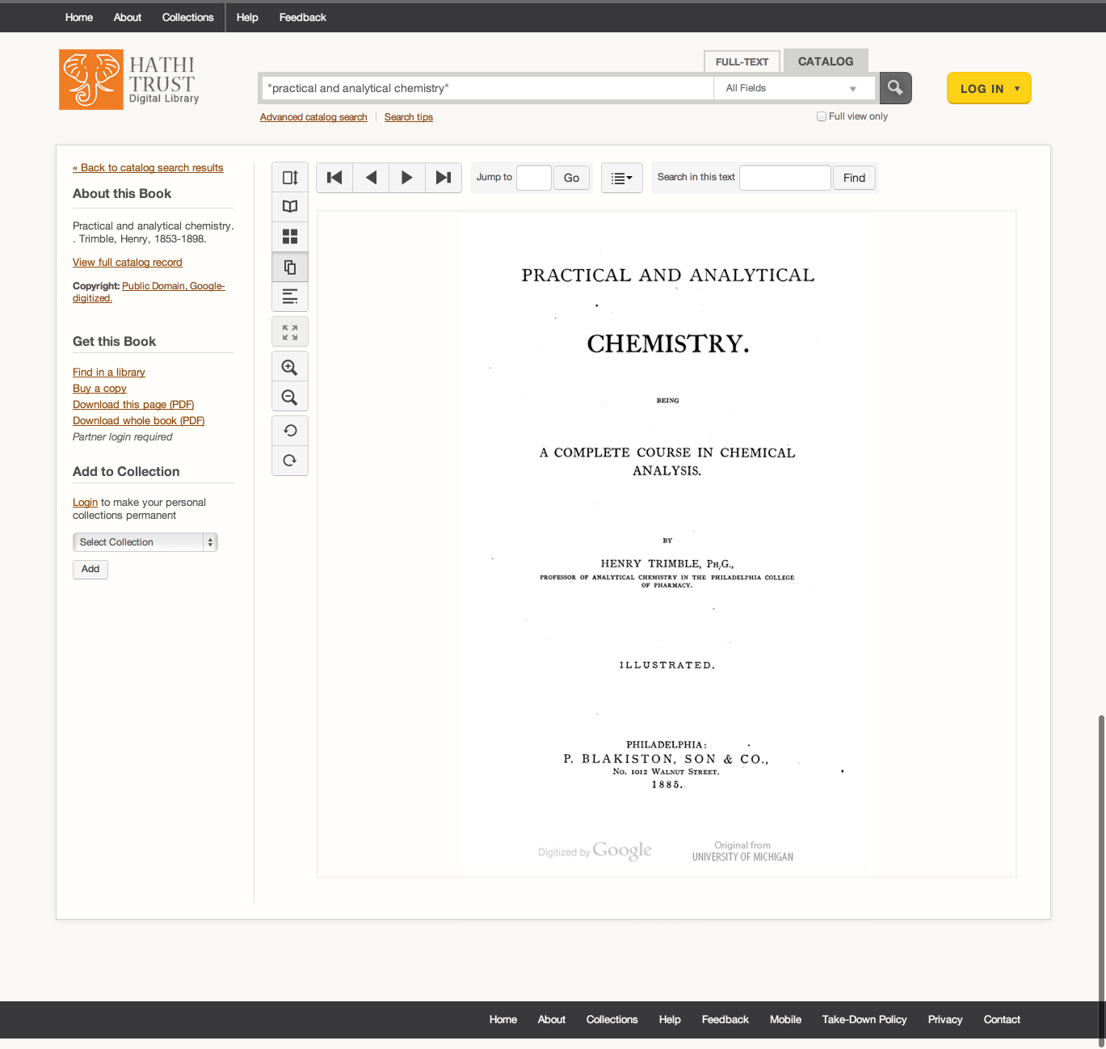

Slide 34
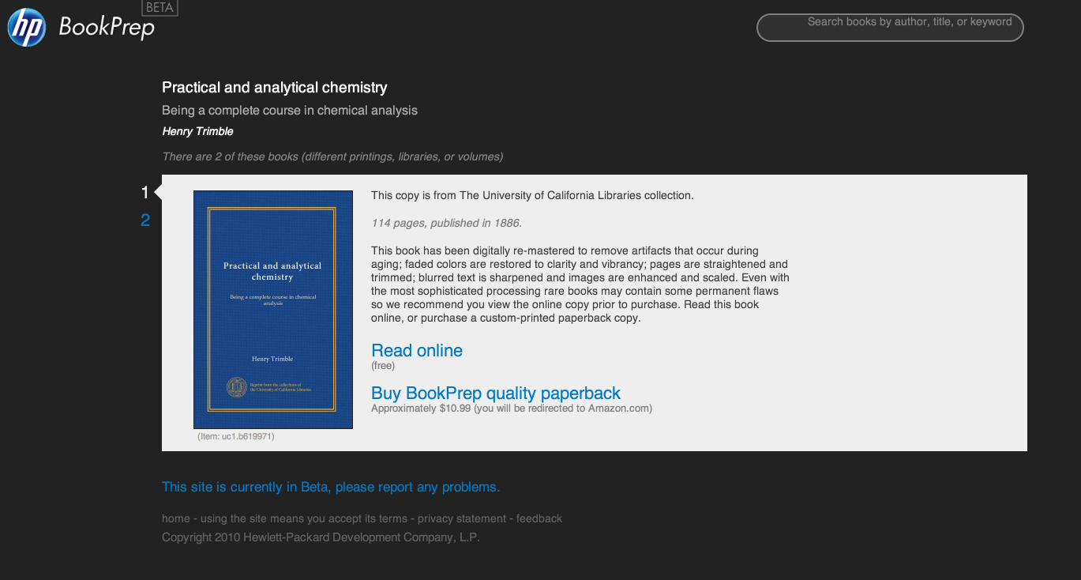

Slide 35
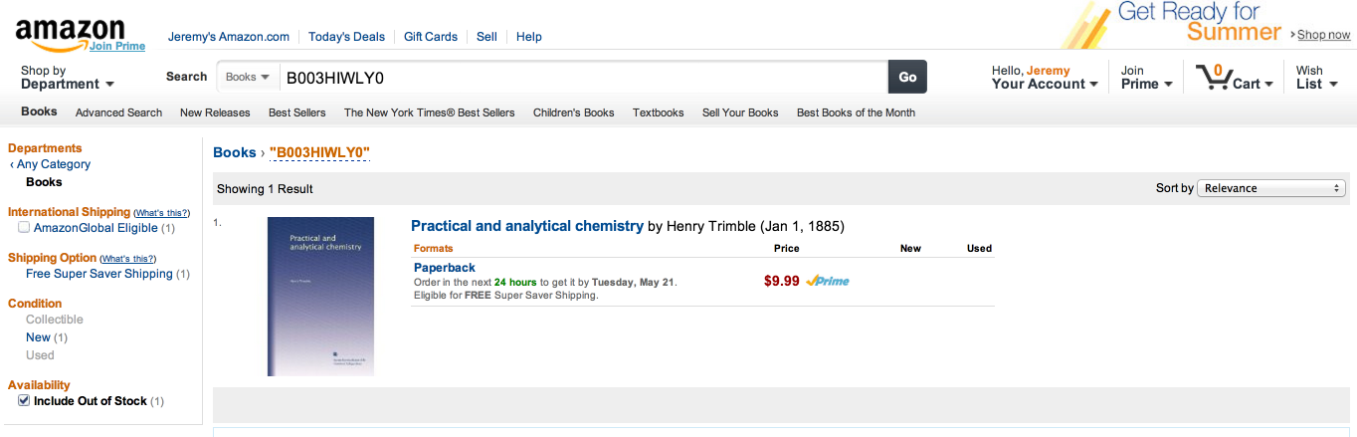

Slide 36
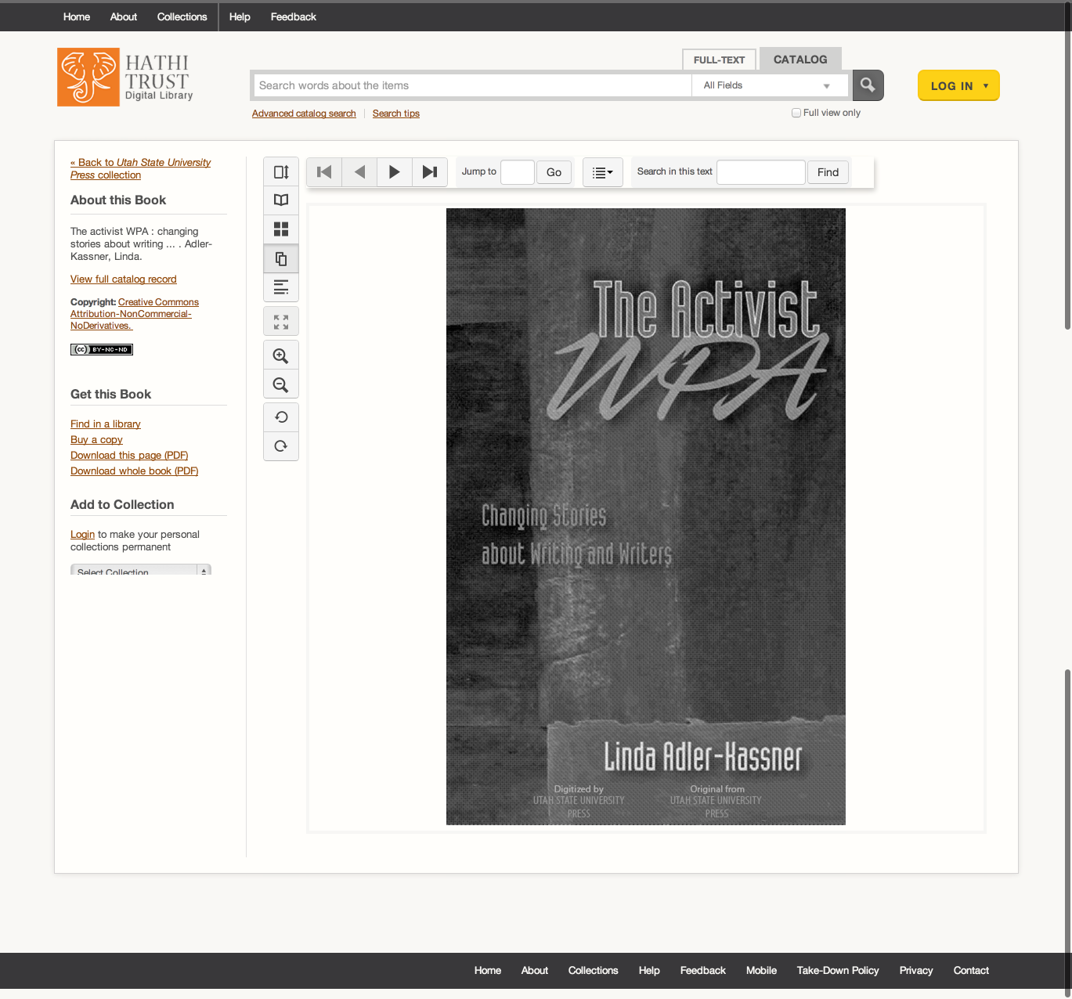

Slide 37
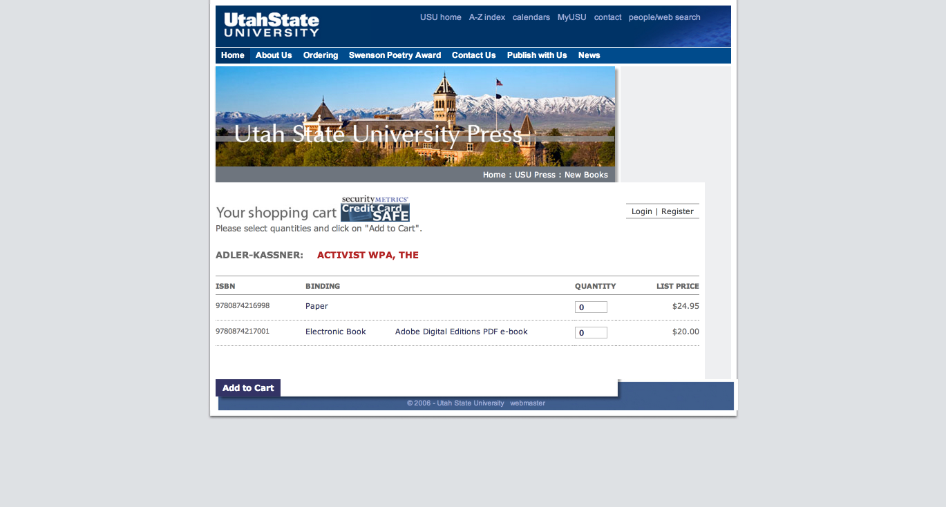

Slide 38
Collections

Slide 39
APIs
Bibliographic API
  Volume and rights information
  MARC records
  http://www.hathitrust.org/bib_api
OAI
  http://www.hathitrust.org/data
“Hathifiles”
  http://www.hathitrust.org/hathifiles
Data API
  Volume and rights information
  Page images
  OCR
  http://www.hathitrust.org/data_api

Slide 40
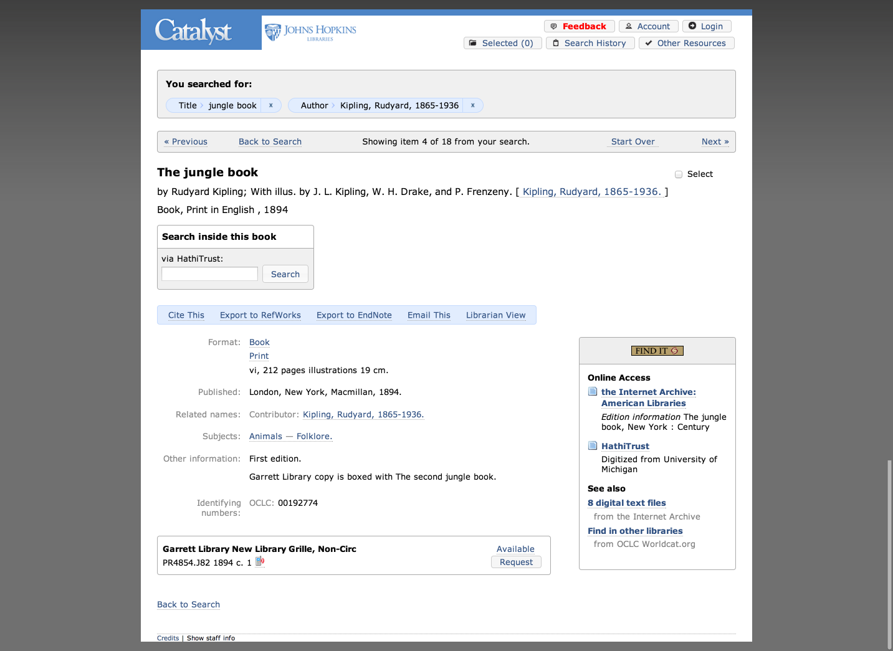

Slide 41
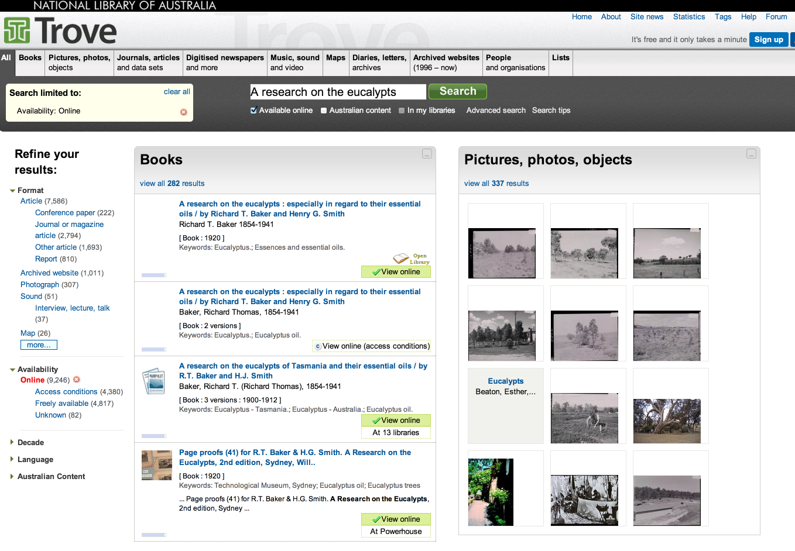

Slide 42
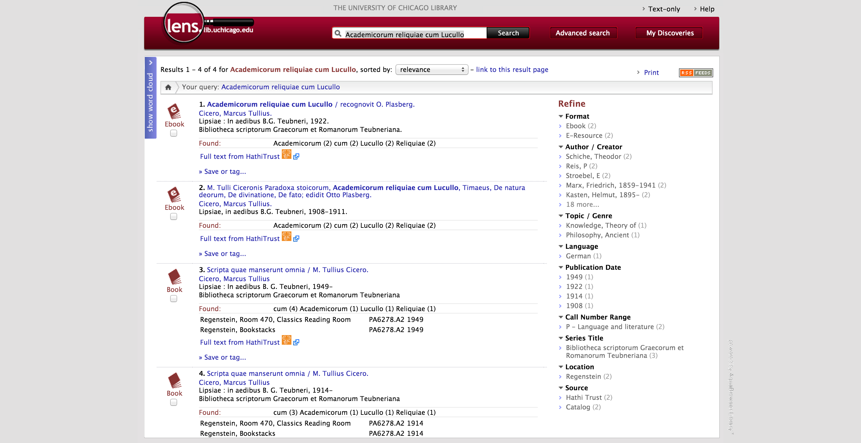

Slide 43
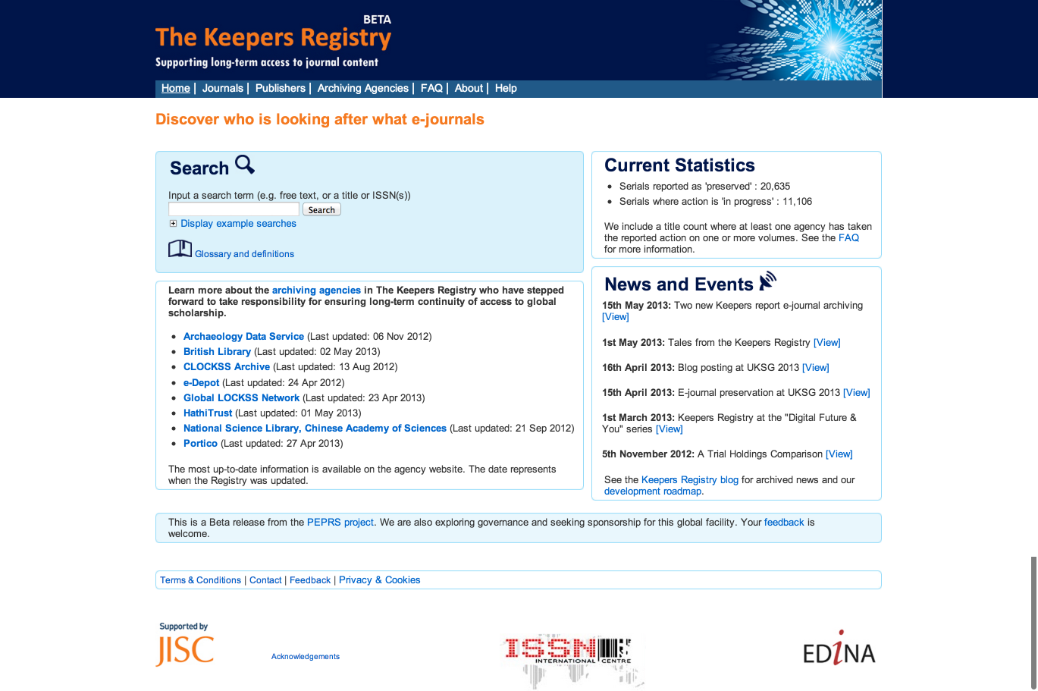

Slide 44
Data API Demonstration
http://www.hathitrust.org/data_api
Examples
  mdp.39015071393550 (seq 7)
  loc.ark:/13960/t0000h93g (seq 7)
Page Image
Page OCR
Page Coordinate OCR
METS
Object Metadata
  Rights, page numbers and features
Page Metadata
  Rights, page sequence and number, format

Slide 45
Bib API
http://www.hathitrust.org/bib_api
Gives bibliographic, volume, rights information
When supplied with
  OCLC, LCCN, LSSN, ISBM, HTID, Record ID
Returns “brief” and “full” results
  Full includes MARCXML in JSON wrapper
http://catalog.hathitrust.org/api/volumes/brief/<id type>/<id value>.json
http://catalog.hathitrust.org/api/volumes/full/<id type>/<id value>.json
Examples: mdp.39015071393550; loc.ark:/13960/t0000h93g

Slide 46
OAI
OAI sets (MARC21 or Dublic Core)
  Public domain and open access (set=hathitrust:pd)
  Public domain in the United States (set=hathitrust:pdus)
  All (PD, OA, PDUS) (set=hathitrust)
http://quod.lib.umich.edu/cgi/o/oai/oai?verb=ListRecords&metadataPrefix=marc21&set=hathitrust

Slide 47
Hathifiles
Tab-delimited inventory files
Aggregated monthly
Daily incremental files
Contain
  Identifiers
  Limited bibliographic information
  Rights, language, gov docs status information

Slide 48
Data Element | Example
Volume identifier | coo.31924003924275
Access | deny
Rights | ic
University of Michigan Record # | 002052896
Enumeration/Chronology | Band I
Source | COO
Source Institution Record # | 17132
OCLC numbers | 62370740
ISBNs
ISSNs | gs 12000204
LCCNs

Slide 49
Data Element | Example
Title | Anleitung zur bestimmung der karbonpflanzen…
Imprint | Kommissionsverlag von Craz & Gerlach (J. Stettner) 1911-
Rights determination reason code | bib
Date of last update | 2011-04-11 20:32:41
Government document | 0
Publication date | 1911
Publication place | gw
Language | ger
Bibliographic format | BK

Slide 50
Computational Access
Distribution of datasets
  http://www.hathitrust.org/datasets
HathiTrust Research Center
  Developed collaboratively by Indiana University and University of Illinois; launched July 2011
  Enables computational access to public domain and open access materials; working to support in-copyright materials as well

Slide 51
Datasets
Non-Google-digitized Dataset (400,000+)
  PD, PDUS, Open Access
  Signed researcher statement
Google-digitized (3.2 million+)
  PD, PDUS, Open Access
  Agreement between institution and Google
  Brief proposal
    Characterize texts
    Provide ids (custom sets possible)
    Research, results, use of results
  Signed researcher statement

Slide 52

File System
../uc1/pairtree_root/b3/54/34/86/b34543486
images
text
Source METS
b34543486.zip
HT
METS
b34543486.mets.xml
bib
data
bib
data

Slide 53
Dataset structure
id (list of ids in dataset)
meta.tar.gz (bibliographic data)
loc
mdp
uc1
text
b34543486.zip
HT
METS
b34543486.mets.xml

Slide 54
HTRC
http://www.hathitrust.org/htrc
Bring researchers to the data
Build services to meet demand
Develop
  Tools that facilitate research by digital humanities and informatics communities
  Secure cyber-infrastructure

Slide 55
Using the HTRC
Portal: sign up, browse volume lists and algorithms, execute algorithms, view results
  https://htrc2.pti.indiana.edu/HTRC-UI-Portal2/
Workset Builder
  https://htrc2.pti.indiana.edu/blacklight
Sandbox: run own algorithms
Getting Started with the HTRC [Google doc]
  http://bit.ly/1hCnyzX

Slide 56
HTRC Programming
HTRC Community Pages
  http://wiki.htrc.illinois.edu/display/COM/HathiTrust+Research+Community+Pages
Client code for accessing open-open content
  http://wiki.htrc.illinois.edu/pages/viewpage.action?pageId=15040514
Programming client access to data in HTRC Sandbox
  http://wiki.htrc.illinois.edu/display/COM/Programming+client+access+to+data+in+HTRC+Sandbox

Slide 57
HTRC Lists
htrc-announce
  https://list.indiana.edu/sympa/subscribe/htrc-announce-l
  General announcements about HTRC workshops, updates, new tools, and larger community issues.
htrc-usergroup
  https://list.indiana.edu/sympa/subscribe/htrc-usergroup-l
  Submit recommendations, development issues, technical discussion about HTRC.
htrc-uncamp
  https://list.indiana.edu/sympa/subscribe/htrc-uncamp-l
  Logistics and Announcements specific to HTRC UnCamp.

Slide 58
Projects
Burton, Vernon. “The South as ‘Other,’ the Southerner as ‘Stranger.’”
  Explore how attitudes expressed in print about slavery, southerners, and non-southerners have changed over both time and space.
Ted Underwood, Associate Professor of English at the University of Illinois, Urbana-Champaign.
  Using public domain texts received from HathiTrust to explore changing relationships in literary genres from 1700-1899.
Andrew Piper, Associate professor of German literature at McGill University.
  Analyzing linguistic patters in German texts from 1700-1900
Amanda Watson, librarian at New York University.
  Studying How poetry anthologies in selected texts reflect the rise and fall of poets’ reputations over the course of the 19th century.
Glenn Worthey, Digital Humanities Librarian at Stanford University Libraries.
  Performing spatio-temporal investigation into the history of Brazilian Portuguese, to be accomplished by text-mining methods (n-gram analysis, etc.).
Matthew Wilkens, Assistant professor of English, University of Notre Dame.
  American Council of Learned Societies (ACLS) fellowship for project “Literary Geography at Scale.”

Slide 59
Partnership

Slide 60
Requirements
Non-profit libraries or non-profit institutions with libraries
Partnership agreement
Print holdings information
Shibboleth
  http://www.hathitrust.org/eligibility_agreements
  http://www.hathitrust.org/partnership_checklist

Slide 61
Fees
All partners share in infrastructure costs for public domain volumes:
  (PD*C*X)/N
Share in infrastructure costs for in copyright volumes based on holdings
    For a given in­copyright volume:
    IC=(C*X)/H
C = ~$0.155 per vol per year
X = 1.5

Slide 62
Print Holdings Database
  Volumes institutions own or have owned
Supports fee model
Supports lawful uses
Supports collection analysis
Monographs | Serials
OCLC number Bib record ID Enum/chron for multi-part monographs, if available Condition (e.g., brittle) Holding Status (current holding, withdrawn, missing, etc.) | OCLC number [required] Bib record ID [required] ISSN, if available

Slide 63
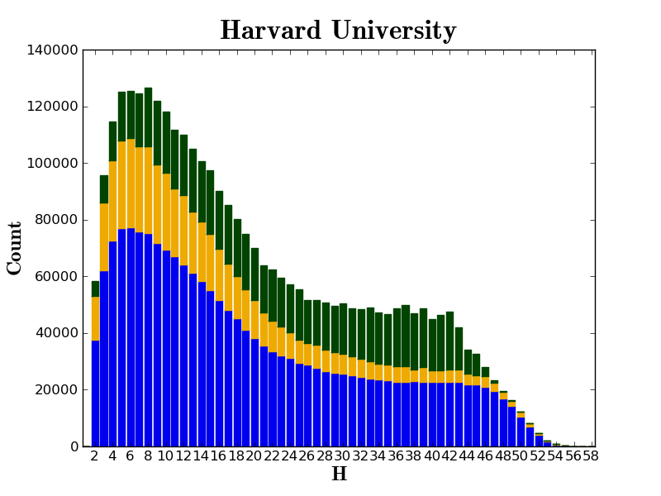

Slide 64
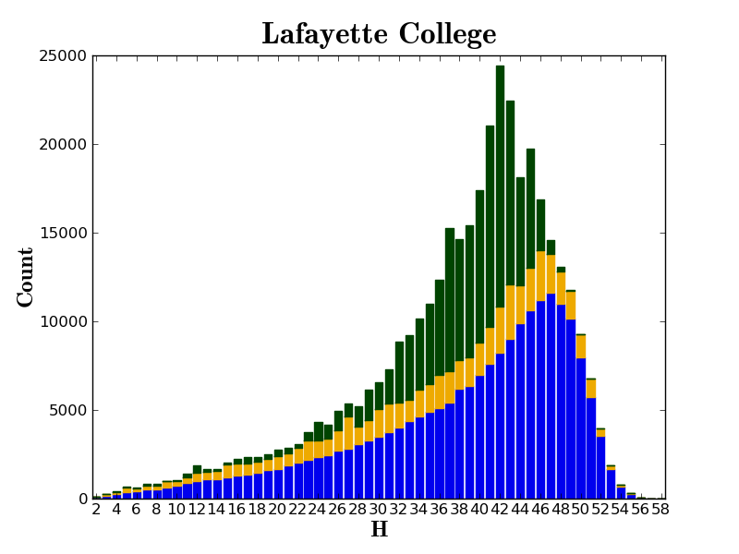

Slide 65
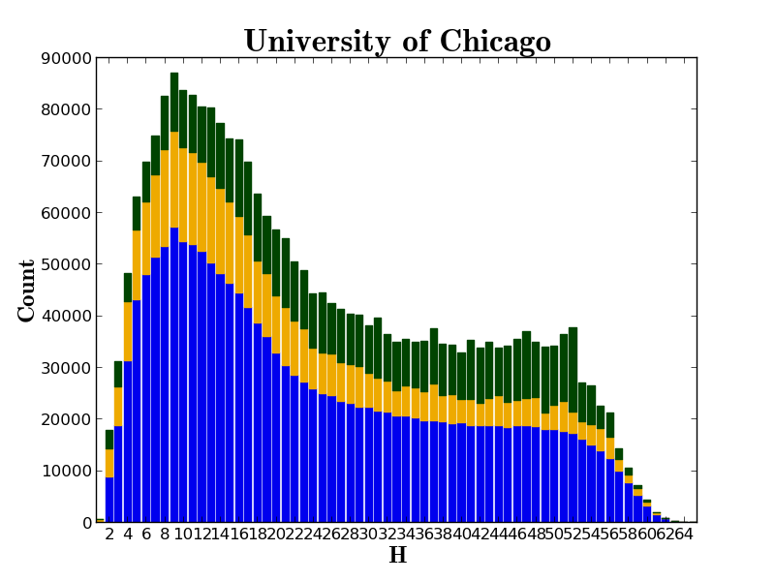

Slide 66
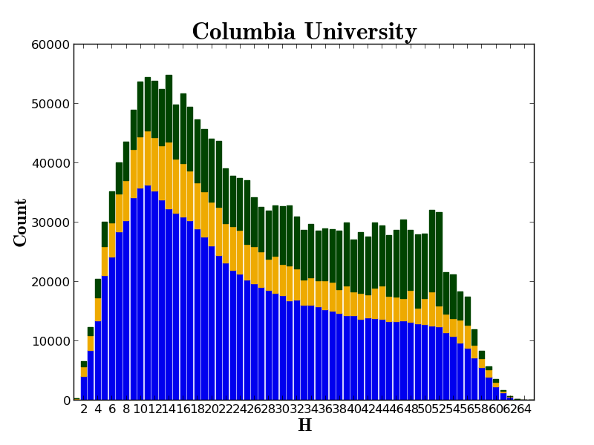

Slide 67
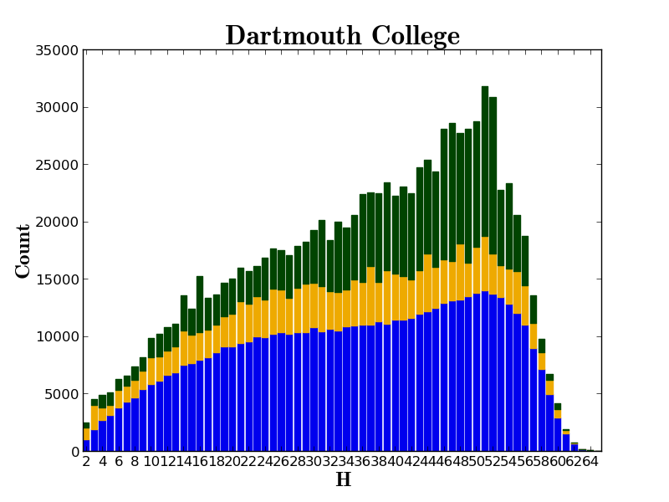

Slide 68
HathiTrust overall benefits to libraries
Digital Curation
  Drive costs down
  Reduce “bibliographic indeterminacy”
  Make meaningful decisions about formats and quality
  Increase discoverability, use
  Consolidate development talent
  Improve strength of archiving
Print Curation
  Means to associate our print holdings
  Coordinated record-keeping
Subsidiary benefits
  Quantify problems
  Collective attention to solving shared problems
  Understanding relationship between collective and local

Slide 69
How to find out more
About: http://www.hathitrust.org/about
Resources: http://www.hathitrust.org/resources
Twitter: http://twitter.com/hathitrust
Facebook: http://www.facebook.com/hathitrust
Monthly newsletter:
  http:www.hathitrust.org/updates
  RSS http://www.hathitrust.org/updates_rss
Contact us: feedback@issues.hathitrust.org
Blogs: http://www.hathitrust.org/blogs
  Large-scale Search
  Perspectives from HathiTrust

