Slide 1
Using HathiTrust in Research and Education
Open Access Week
University of Michigan
Angelina Zaytsev, Project Librarian, HathiTrust

Slide 2
Outline
Introduction to HathiTrust:
What is HathiTrust?
What is in HathiTrust?
Access & Use
Who can access?
What is open?
Using HathiTrust
Searching & using the interface
Other tools: Collection Builder, embedding content
Access to data

Slide 3
What is HathiTrust?

Slide 4
What is HathiTrust?
Founded in 2008
A partnership community
A digital library, a digital repository

Slide 5
What is HathiTrust?
Mission: To contribute to the common good by collecting, organizing, preserving, communicating, and sharing the record of human knowledge
The metaphor of the elephant

Slide 6
What is in HathiTrust?

Slide 7
The Collection: Books and Journals
Initial focus on digitized book and journal content
10,547,953 total volumes
5,556,329 book titles
274,609 serial titles

Slide 8
The Collection: Dates
Notes:
8

Slide 9
The Collection: Language Distribution
The top 10 languages make up ~86% of all content
Notes:
9

Slide 10
The Collection: Language Distribution
The next 40 languages make up ~13% of total
Notes:
10

Slide 11
The Collection: Public Domain

Slide 12
Access & Use

Slide 13
Who can access HathiTrust?
Anyone:
Can view public domain content
Can view open access content or content opened with a CC license
Can search within in-copyright and open content
Can download full PDF versions of open access books & public domain items with no third-party restrictions
Can download public domain/open access books with third-party restrictions one page at a time
TIP:
Not a UM member but want to download a Google-digitized book? SEARCH IN GOOGLE BOOKS!

Slide 14
Who can access HathiTrust
Members:
Can view public domain content
Can view open access content or content opened with a CC license
Can search within in-copyright and open content
Can download full PDF versions of public domain/open access books with no third-party restrictions
Can download full PDF versions of public domain books/open access books within limits of third-party restrictions

Slide 15
What is open?
Notes:
15

Slide 16
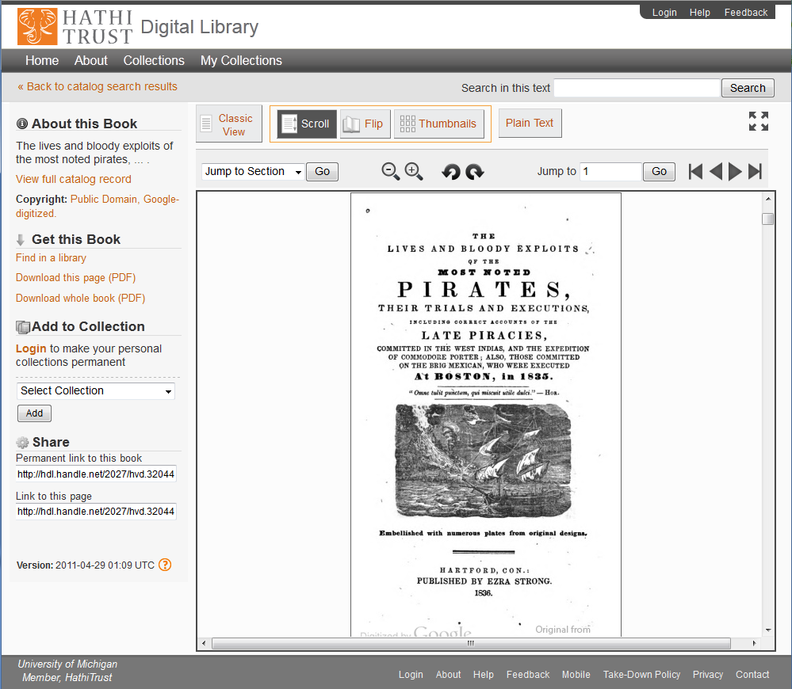
TIP:
Suspect that something should be opened? CONTACT US!

Slide 17
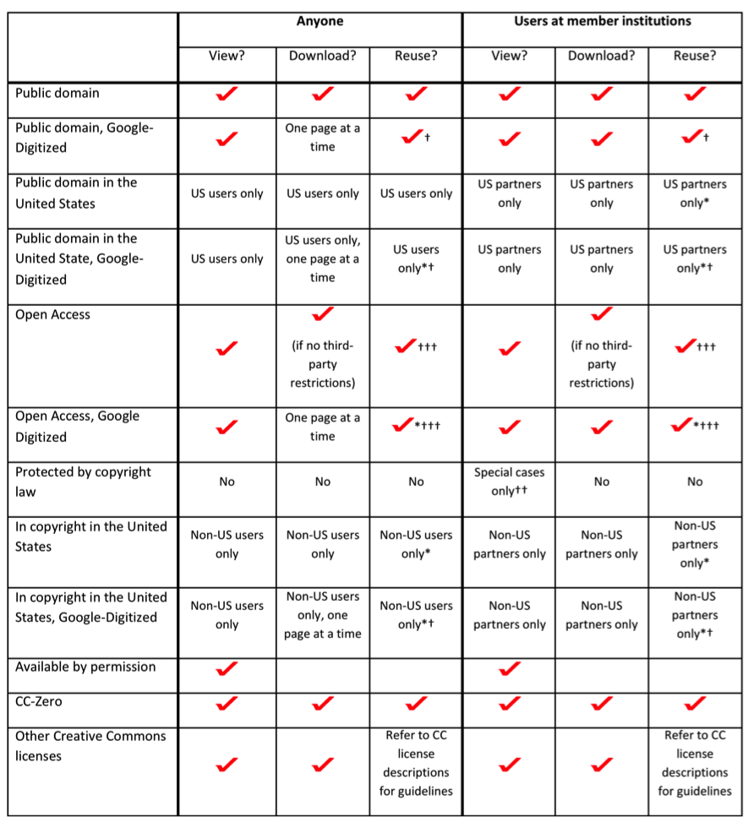
* If reusing content, users should make appropriate efforts to determine the copyright status of the work in other countries and use the work accordingly.
†Content digitized by Google and other kinds of content with third-party restrictions may have limitations on the kinds of reuse is allowed. For example, Google requests that content that they have digitized not be re-hosted, redistributed or used commercially.
†Content digitized by Google and other kinds of content with third-party restrictions may have limitations on the kinds of reuse is allowed. For example, Google requests that content that they have digitized not be re-hosted, redistributed or used commercially.
††General access is not available. However, works may be made available to affiliates of HathiTrust member institutions under strictly limited conditions in accordance with the statutory limitations to the rights provided by copyright law, including, but not limited to Section 107 provisions for fair use, Section 108 provisions for libraries and archives, and the rights provided to registered users with disabilities.
†††Permission for subsequent use may be required from the rights holder. Uses may also be made in accordance with statutory limitations to the rights provided by copyright law, including, but not limited to Section 107 provisions for fair use, Section 108 provisions for libraries and archives, and the rights provided to registered users with disabilities.

Slide 18
What is open?
TIP:
Travelling oversees but need access to HathiTrust? LOGIN FIRST!
Notes:
18

Slide 19
Mobile version
m.hathitrust.org
Read on the go
Download epubs

Slide 20
Lawful uses
Access to users who have print disabilities
Section 108 uses of materials

Slide 21
Lawful uses of in-copyright works
At University of Michigan
Users registered with OSSD
All in-copyright works in HathiTrust owned by Michigan
Must be authenticated
Must be on U.S. soil
One simultaneous access per copy owned
Uses under Section 108
Must be out of print and brittle
Must be authenticated or accessing work from library premises
Must be on U.S. soil
One simultaneous access per copy owned
Access and Use Statements
http://www.hathitrust.org/access_use

Slide 22
Are you a rights holder?
Make your work available to the public by completing our permission agreement at http://www.hathitrust.org/permissions_agreement
Option to apply a Creative Commons license

Slide 23
For more information
Access & use policies http://www.hathitrust.org/access_use
Help section on searching & viewing books http://www.hathitrust.org/help_digital_library

Slide 24
Using HathiTrust

Slide 25
Searching
Catalog Search
Full text Search
Search within a book
Search within a collection

Slide 26
Catalog Search
Search within records
Phrase searching (use “”), wildcards (use *, ?), Boolean searching (use AND, OR)
Advanced search: combine multiple fields
TIP:
Are your search results not specific enough? USE FILTERS!

Slide 27
Full text search
Search within books across the HathiTrust collection
Phrase searching (use “”), multiple term searching, Boolean searching (use AND, OR, -)
http://www.hathitrust.org/help_digital_library#SearchTips
Advanced search
TIP:
Want to search within your search results? CREATE A COLLECTION!
Use Case
Search for an article title or author.

Slide 28
Search within a book
“Search in this text”
Previous search terms are pre-populated
Use Case
When you have the print version, search within a limited view book for specific terms – a better index.
Use Case
Determine how appropriate to your research a limited view book is prior to getting the print version.

Slide 29
PageTurner
Different views: scroll view, classic view, flip view, thumbnails, & plain text; expand to full screen
“Jump to section”
“Search in this text”
“About this book”
“Get this book”
“Add to collection”
Permanent urls

Slide 30
3
1
4
2
5
6
7

Slide 31
Citations
In record view: see the MLA or APA citation, export the citation to Endnote (or other citation managers)
Citation manager export (e.g., Zotero): export single record when in catalog or PageTurner view, export catalog search results

Slide 32
Collection Builder
Create a collection from the PageTurner, from full text search results, from another user’s collection
Search within a collection
Public or private
Bulk editing
Use Case
Create a collection from full text search results to do a more refined search within your results.

Slide 33
Embedding HathiTrust content
Books can be embedded in your website by using an iframe
Similar to the mobile format
Use this code & modify it
See http://www.hathitrust.org/embed for more information.
TIP:
IT’S EASY!
<iframe width="450" height="700“ src="http://hdl.handle.net/2027/wu.89004292751?urlappend=%3Bui=embed"> </iframe>

Slide 34
Data API
Request access key for programmatic use
Web client interface for non-programmatic use
Retrieve METS file, object or page metadata, page image in different formats, page OCR or coordinate OCR
Same restrictions as covered in access & use statements
See http://www.hathitrust.org/data_api for more information.

Slide 35
Datasets
Text & METS metadata of public domain & open access volumes
Bibliographic data is included
Non-Google-digitized dataset: ≈300,000 vols (200 GB), mostly English and prior to 1923
No restrictions, available upon request
User needs to sign statement

Slide 36
Datasets
Google-digitized dataset: ≈ 2.5 million public domain & open access vols, 2 TBs, includes variety of languages, subjects and dates
For scholarly research purposes only, restrictions on reuse
User’s institution must sign agreement with Google
Must submit brief proposal to HathiTrust & sign statement
Can help create customized subset
Contact hathitrust-datasets@umich.edu or visit http://www.hathitrust.org/datasets for more information

Slide 37
HathiTrust Research Center
Working to create an environment that will allow scholars to perform research against HathiTrust data
Currently working with public domain data

Slide 38
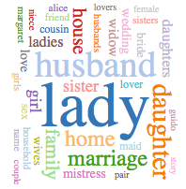
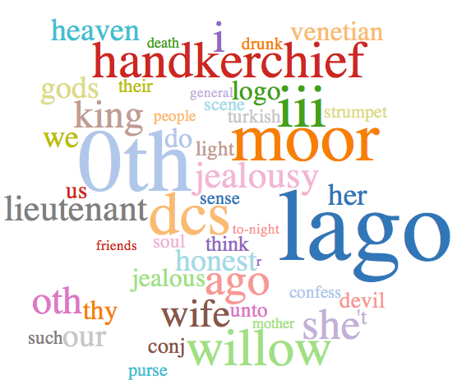
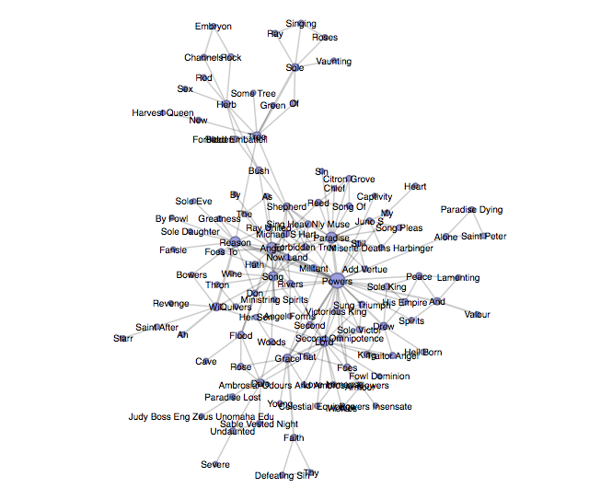
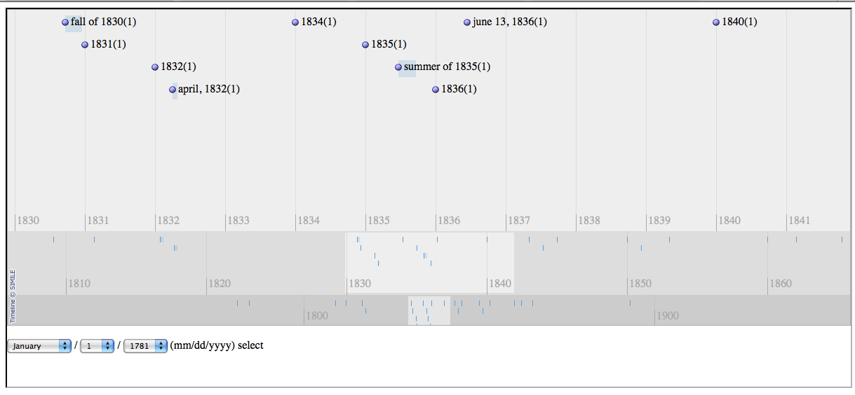
HTRC demonstration of capabilities HTRC unCamp, Sept 10 & 11, 2012
Dunning Loglikelihood
Tag Cloud Analysis
Data extraction to simile timeline
To view more examples of capabilities, see http://wiki.htrc.illinois.edu/display/OUT/HTRC+UnCamp2012+Agenda
Entity extraction for network analysis

Slide 39
For more information…
Website: www.hathitrust.org
Twitter: @hathitrust
Facebook: www.facebook.com/hathitrust
Monthly news & updates
http://www.hathitrust.org/updates_rss
https://groups.google.com/forum/?fromgroups#!forum/hathitrust-updates
Pinterest: pinterest.com/hathitrust
Email us: feedback@issues.hathitrust.org

