Slide 1
HathiTrust: Aspiring to Build the Universal Library
Purdue University
April 19, 2012
Jeremy York, Project Librarian, HathiTrust

Slide 2
Partnership
Arizona State University
Baylor University
Boston College
Boston University
California Digital Library
Columbia University
Cornell University
Dartmouth College
Duke University
Emory University
Florida State University
Getty Research Institute
Harvard University Library
Indiana University
Johns Hopkins University
Lafayette College
Library of Congress
Massachusetts Institute of Technology
McGill University`
Michigan State University
New York Public Library
New York University
North Carolina Central
University
North Carolina State
University
Northwestern University
The Ohio State University
The Pennsylvania State
University
Princeton University
Purdue University
Stanford University
Texas A&M University
Universidad Complutense
de Madrid
University of Arizona
University of Calgary
University of California
Berkeley
Davis
Irvine
Los Angeles
Merced
Riverside
San Diego
San Francisco
Santa Barbara
Santa Cruz
The University of Chicago
University of Connecticut
University of Florida
University of Illinois
University of Illinois at Chicago
The University of Iowa
University of Maryland
University of Miami
University of Michigan
University of Minnesota
University of Missouri
University of Nebraska-Lincoln
The University of North
Carolina at Chapel Hill
University of Notre Dame
University of Pennsylvania
University of Pittsburgh
University of Utah
University of Virginia
University of Washington
University of Wisconsin- Madison
Utah State University
Washington University
Yale University Library

Slide 3
Digital Repository
Launched 2008
Initial focus on digitized book and journal content
  10,109,919 total volumes
  5,372,755 book titles
  266,540 serial titles
  2,802,347 public domain (~28%)

Slide 4
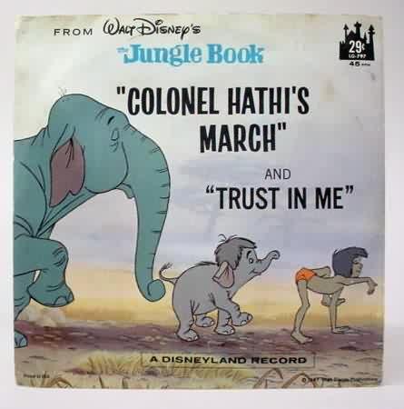
The Name
The meaning behind the name
  Hathi (hah-tee)--Hindi for elephant
  Big, strong
  Never forgets, wise
  Secure
  Trustworthy

Slide 5
Mission
To contribute to the common good by collecting, organizing, preserving, communicating, and sharing the record of human knowledge

Slide 6
HathiTrust
Universal Library
Common Goal
Single Entity, Many Partners

Slide 7
Collections and Collaboration
Comprehensive collection
  Preservation…with Access
Shared strategies
  Copyright
  Collection management, development
  Preservation
  Discovery / Use
  Bibliographic Indeterminacy
  Efficient user services
Public Good

Slide 8
Content Distribution
Notes:
8

Slide 9
Content Sources
Notes:
9

Slide 10
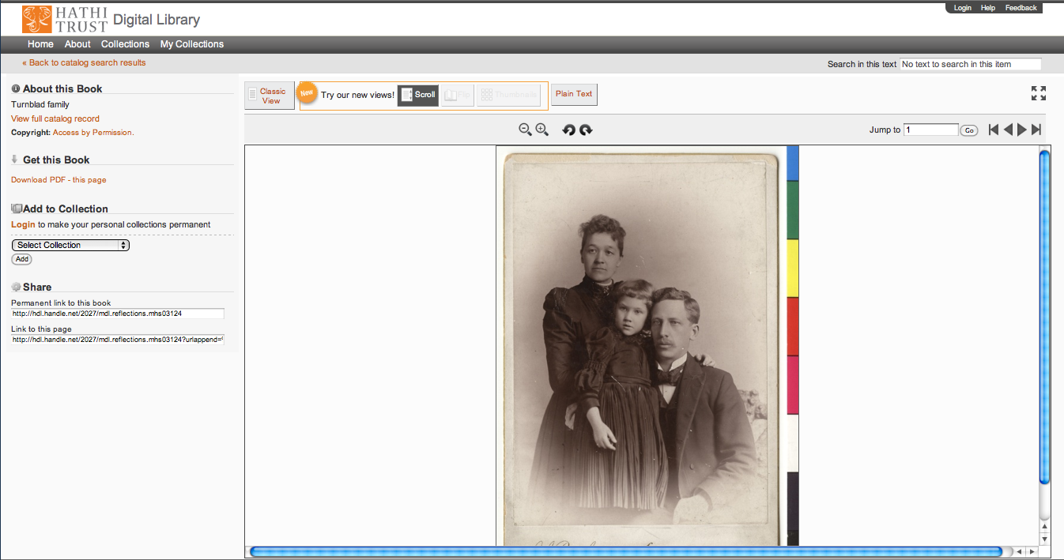

Slide 11

Dates
Notes:
11

Slide 12
Language Distribution (1)
The top 10 languages make up ~86% of all content
Notes:
12

Slide 13
Language Distribution (2)
The next 40 languages make up ~13% of total
Notes:
13

Slide 14
Preservation with Access
Cost effective preservation and access services
Preservation
  TRAC-certified
  Robust infrastructure
  Long-term commitments on digital content facilitate planning, decision-making

Slide 15
Executive Committee
Strategic Advisory Board
Budget/Finances Decision-making
Guidance on Policy, Planning
Collective Work: Working Groups and Committees
Operational
  Communications
  User Support
  User Experience
  Strategic
  Collections
  Discovery Interface
  Full-text Search
Operational
Communications
User Support
User Experience
Distributed work
Driven by needs of institutions
Leverage across the partnership
Projects, Grant Work, Ingest Specifications, PageTurner, Bibliographic Data Management
HathiTrust

Slide 16
Governance
Budget, Finances
Decision-making
Policy
Planning
Repository Administration
Web and application server configuration and maintenance
Security
Permissions
Logging
Repository Administration
Data management (content storage, backup, integrity checks, deletion)
Content and Metadata specifications
Disaster Recovery
Processes for ensuring content integrity
Rights Management
Copyright determination
Copyright review
Copyright information management (database)
Rightsholder permissions
Bibliographic Data Management
Entity description (record-level)
Object identification (item-level)
Collection Development
Digital
Expansion beyond books and journals (born-digital, images and maps, audio)
Selection of content (for non-Google volume ingest and pilots projects)
Print
Cloud Library (effect of digital on print)
Hardware selection and replacement
Enterprise Management
Communication and Coordination with partner institutions
Hardware configuration and maintenance
Project management
Data availability
e-Commerce
Content Access
PageTurner
Collection Builder
Large-scale Search
Bibliographic Catalog
Research Center
APIs
Quality Assurance
Quality Review
Content Certification
User Services
Usability
User support (helpdesk)
Outreach
Project website
Monthly newsletter
Papers and presentations
Communication with potential partners
Surveys, general inquiries
Repository evaluation and audit (e.g., DRAMBORA, TRAC)
Legal
Risk management (use of materials)
Partner agreements
Advocacy
Content Ingest
Transformation
Validation
Print on Demand
Financial contributions of partners
HathiTrust Functional Framework

Slide 17
Constitutional Convention
October 2011
52 partners
3-year review overseen by SAB
Ballot Proposals
  Print monograph storage
  Approval Process for development initiatives
  U.S. Government Documents
  Fee-for-service content deposit
  Governance

Slide 18
Emerging Governance
12-member Board of Governors
  3-member Executive Committee
  Executive Director
6 seats to founding institutions
  2 California, 2 CIC (minus Indiana and Michigan)
  1 Indiana, 1 Michigan
Voting (March 1 – March 15)
Announcement of Results March 30
Begin work April 16, 2012

Slide 19
Board of Governors (1)
Elected at-large:
Five year terms:
  Betsy Wilson (University of Washington)
  Robert Wolven (Columbia University)
Four year terms:
  Richard Clement (Utah State University)
  Patricia Steele (University of Maryland)
Three year terms:
  Carol Mandel (New York University)
  Sarah Michalak (University of North Carolina-Chapel Hill)

Slide 20
Board of Governors (2)
Appointed by the founding institutions:
Paul Courant (University of Michigan)
Carol Diedrichs (Ohio State University)
Laine Farley (California Digital Library)
Wendy Lougee (University of Minnesota)
Brian Schottlaender (University of California, San Diego)
Bradley Wheeler (Indiana University)

Slide 21
Preservation with Access
Cost effective preservation and access services
Preservation
  TRAC-certified
  Robust infrastructure
  Long-term commitments on digital content facilitate planning, decision-making

Slide 22
Preservation with Access (2)
Discovery
  Bibliographic and full-text search of all materials
  Extended discovery (ProQuest, EBSCO, OCLC, Ex Libris)
  Mechanisms for local loading of records

Slide 23
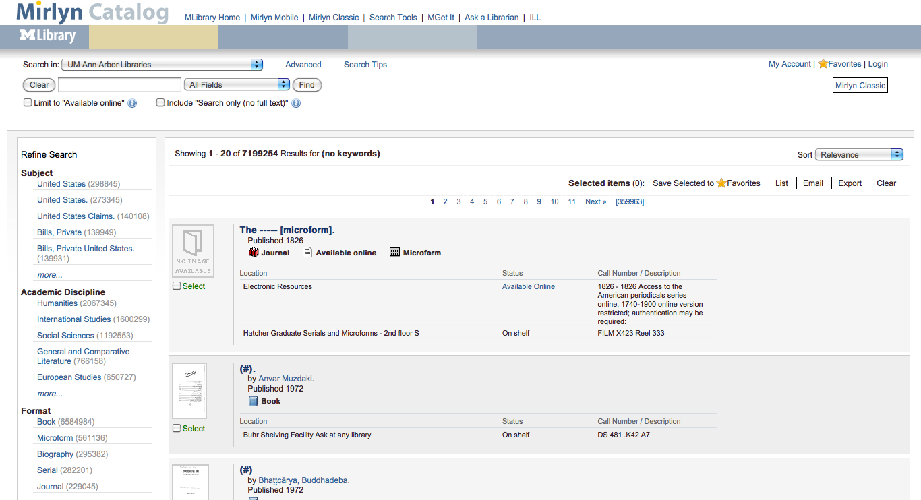

Slide 24
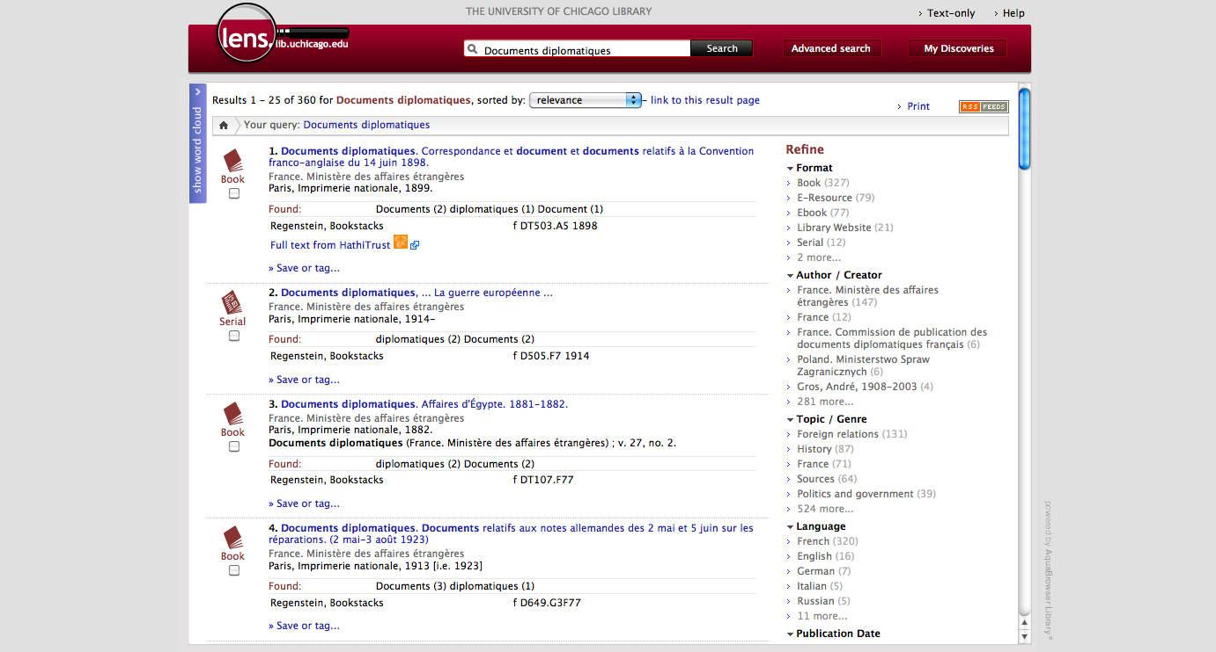

Slide 25
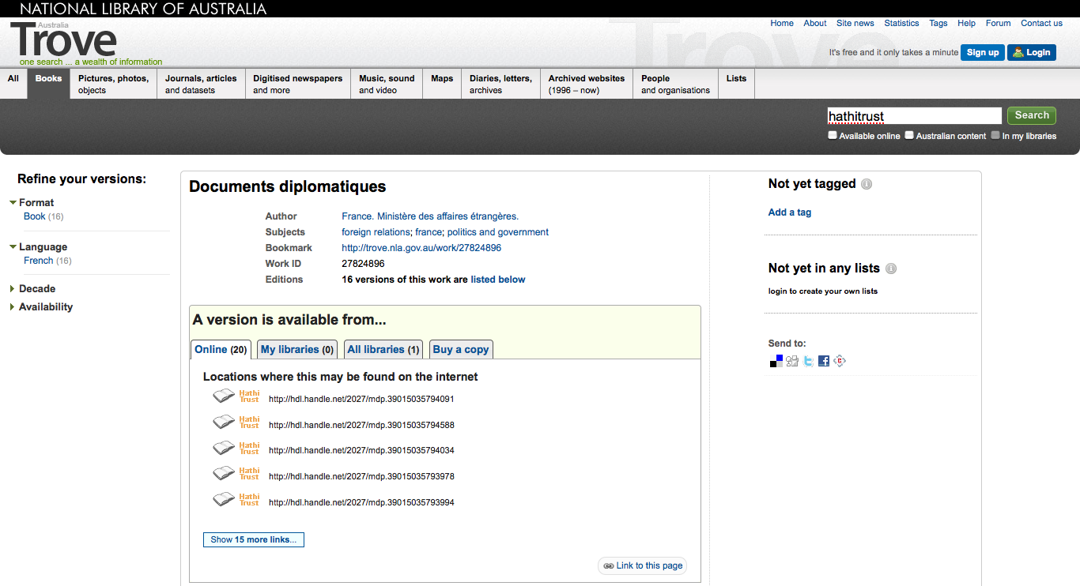

Slide 26
Preservation with Access (3)
Access and Use
  Public domain and open access works
  Full download of materials where possible*
  Print on demand
  Collections and APIs
  Research Center*
  Lawful uses of in-copyright works*

Slide 27
Lawful uses
Access to users who have print disabilities
Section 108 uses of materials
Access to orphan works

Slide 28
Terms of Access
Available to students, faculty, staff of partnering institutions
  On library premises or authenticated into HathiTrust
Partner libraries own a print copy
  One simultaneous user per print copy owned
Users must be on U.S. soil
One page at a time download

Slide 29
Type of work | Searchable (bibliographic and full-text) | Viewable* | Full-PDF download | Print on Demand | Print disabilities* | Preservation uses (Section 108)*
Public domain worldwide | Worldwide | Worldwide | Partners only if scanned by Google, if not, worldwide. | Worldwide | Partners worldwide | N/A
Public domain (US) – Non-US works published between 1872 and 1923. | Worldwide | When accessed from with the United States | Partners in the US if scanned by Google, if not, anyone US | Available within the United States | Partners in the US; partners worldwide where similar laws in effect | N/A
Works that rights holders have opened access to in HathiTrust | Worldwide | Worldwide | Worldwide (if digitized by Google, full-PDF only available if opened with CC license) | Worldwide with permission | Partners worldwide | N/A
Works that are in-copyright or of undetermined status | Worldwide | Not available | Not available | Not available | Partners in the US; partners worldwide where similar laws in effect | Partners in the US; partner worldwide where similar laws in effect
Orphan works | Worldwide | To participating partners | Not available | Not available | Partners in the US | Partners in the US; partners worldwide where similar laws in effect
* Note: Access to in-copyright works is subject to conditions on Terms of Access slide. See here also.

Slide 30
How do we facilitate uses?
Fundamental issues of
  Identification
  Description
  Rights

Slide 31
Approach
Collective problems as collective
Web of relationships
Rights
Records
Digital Volumes
Libraries
Print Volumes

Slide 32
Bibliographic Data
Normalization of bibliographic data
  University of Michigan
    Efficiency
  California Digital Library

Slide 33
Copyright
Bibliographic metadata
Automatic and manual rights determination

Slide 34
Automatic Rights Determination
Conducted on all works at time of ingest and when records are modified
  Public domain worldwide
    US works published before 1923, US federal government publications, non-US works published prior to 1872
  Public domain in the United States
    Non-US works published prior to 1923

Slide 35
Manual Rights Determination
IMLS-funded CRMS project
  US-published works 1923-1963
  Conformance with formalities
  Expanding to non-US works
  Double-blind review with expert review for conflicts
  Staff at 4 HathiTrust partner institutions (15 will take part in non-US)
  As of February 2012 ~190,000 reviewed, more than 100,000 opened
Rights Holder Permissions

Slide 36
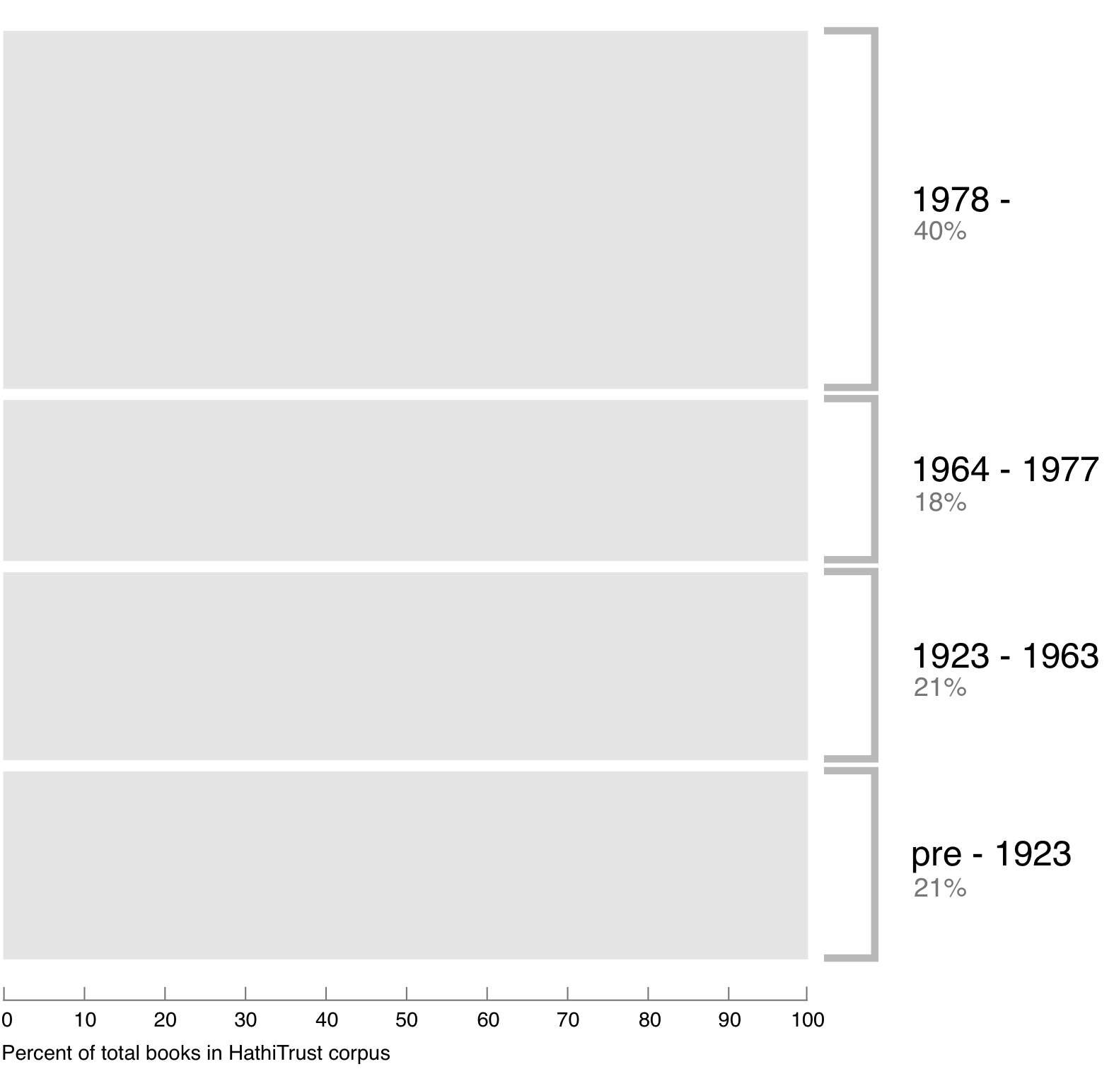
Breakdown of HathiTrust book corpus by publication date
Bibliographic Indeterminacy and the Scale of Problems and Opportunities of "Rights" in Digital Collection Building – 2/2011

Slide 37
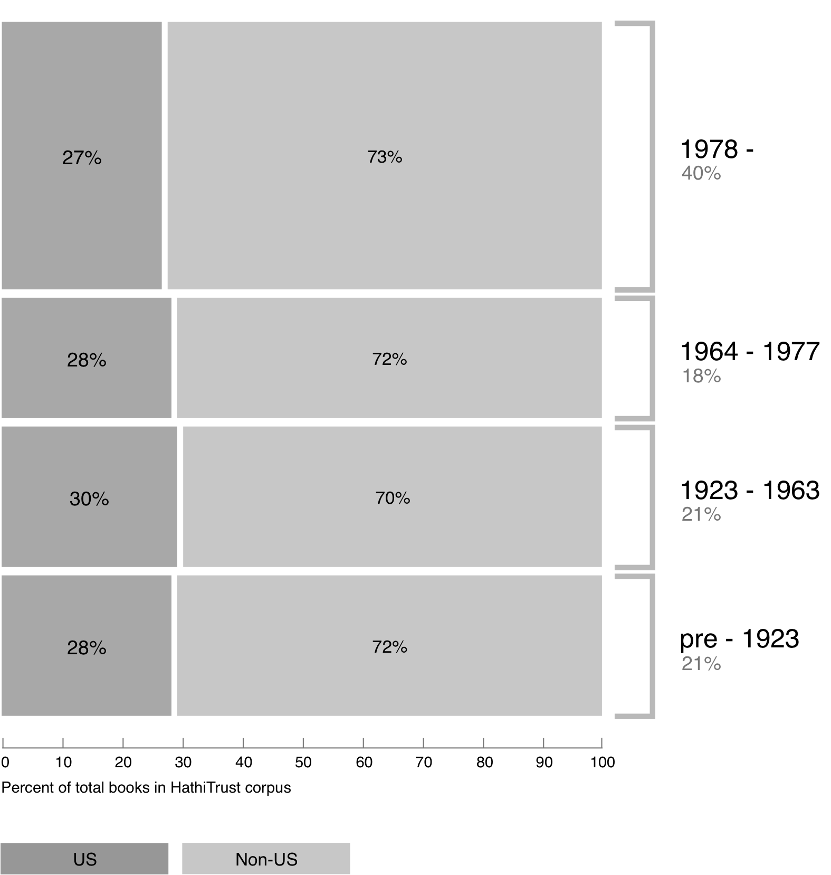
Breakdown of HathiTrust book corpus by publication date

Slide 38
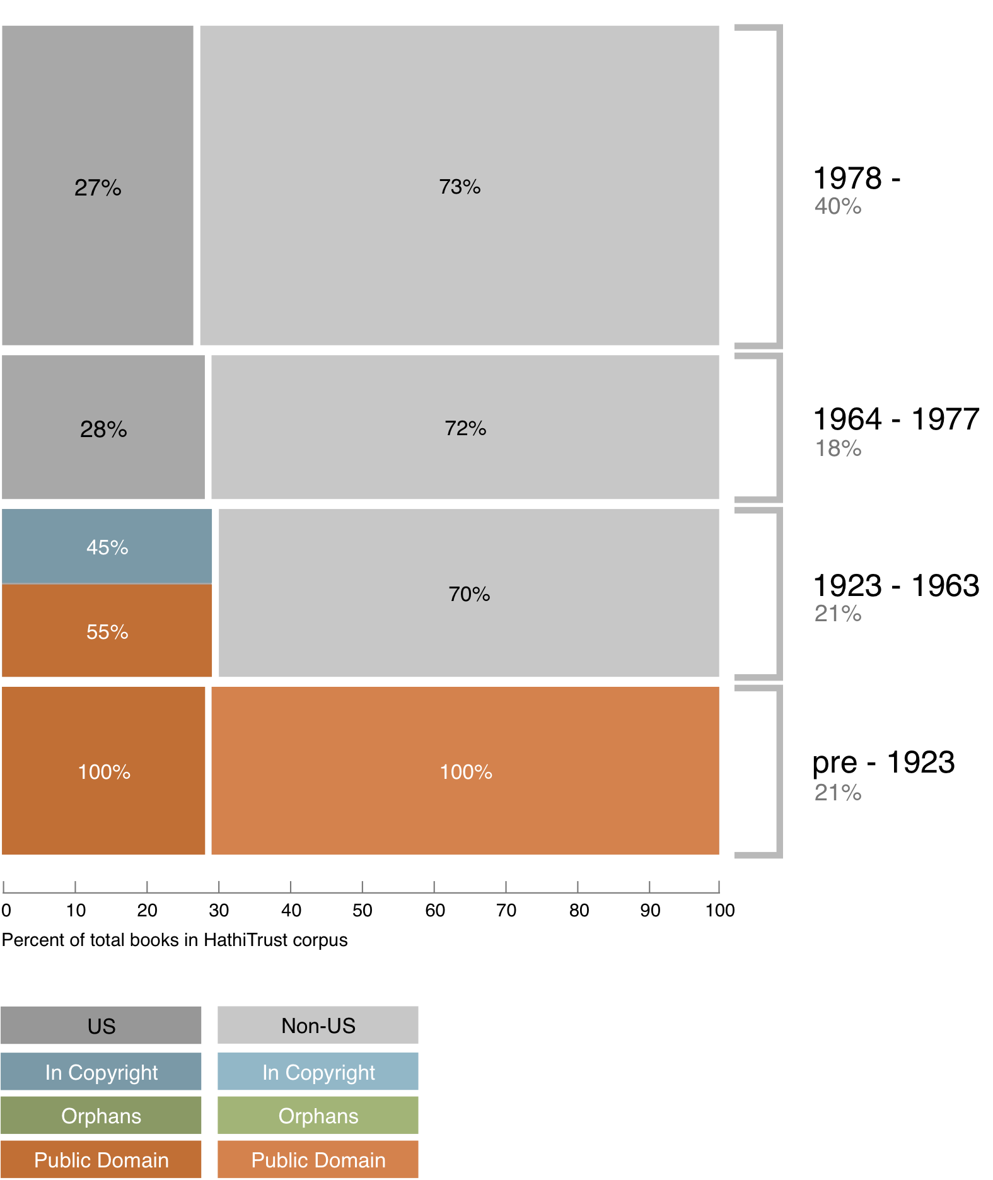
Copyright status of books published pre-1923 and US works published 1923-1963

Slide 39
Copyright status of books published pre-1923 and US works published 1923-1963
Pre-1872 ~ 5%

Slide 40
Copyright status of books published pre-1923 and US works published 1923-1963
Pre-1872 ~ 5%
Public Domain worldwide

Slide 41
Copyright status of books published pre-1923 and US works published 1923-1963
?
Pre-1872 ~ 5%
Public Domain worldwide

Slide 42
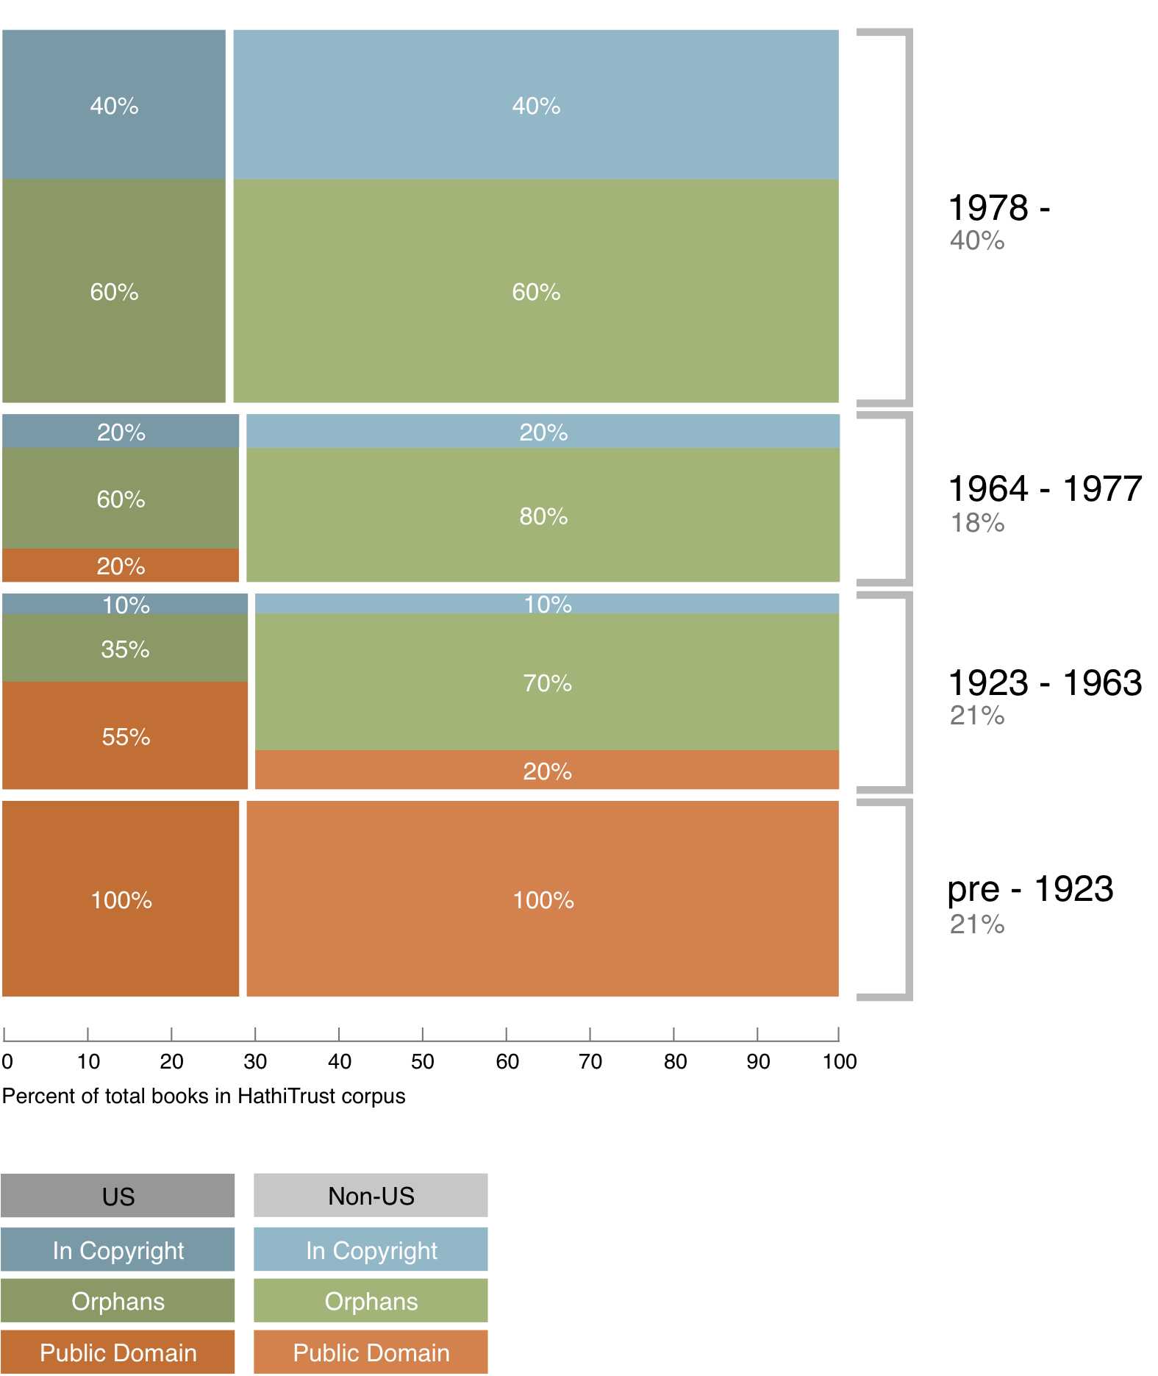
Copyright status of books published pre-1923 and US works published 1923-1963

Slide 43
Copyright status of books published pre-1923 and US works published 1923-1963
In Print ?

Slide 44
Collection Management, Development
Overlap

Slide 45
A global change in the library environment
Academic print book collection already substantially duplicated in mass digitized book corpus
June 2010
Median duplication: 31%
June 2009
Median duplication: 19%
Notes:
45

Slide 46
Digitized Books in Shared Repositories
~3.5M titles
~75% of mass digitized corpus is ‘backed up’ in one or more shared print repositories
~2.5M
Notes:
46

Slide 47
Collection Management, Development
Overlap
  More than 50% median overlap with ARL institutions; higher for small liberal arts colleges
Pricing model based on Print holdings
  Requires print holdings database
  Also support expansion of legal uses, efforts in de-duplication
  Facilitate individual and collaborative collection development and management operations
Print monographs archiving

Slide 48
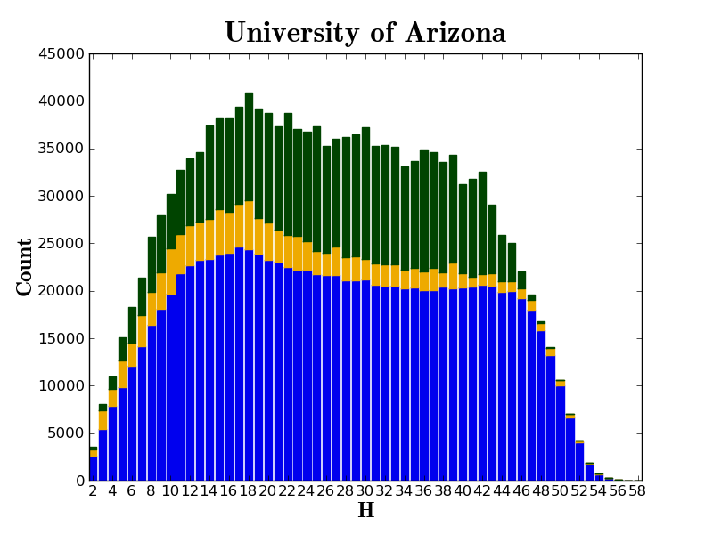

Slide 49
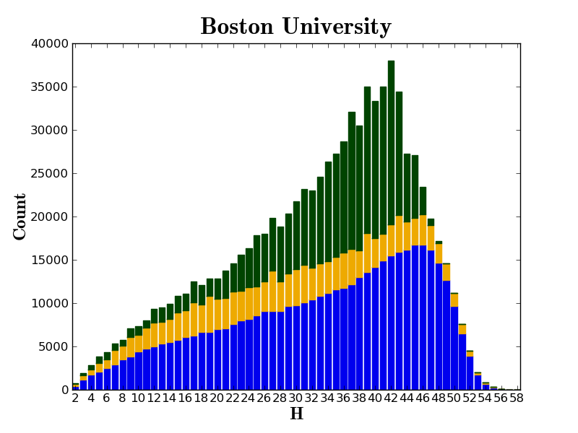

Slide 50
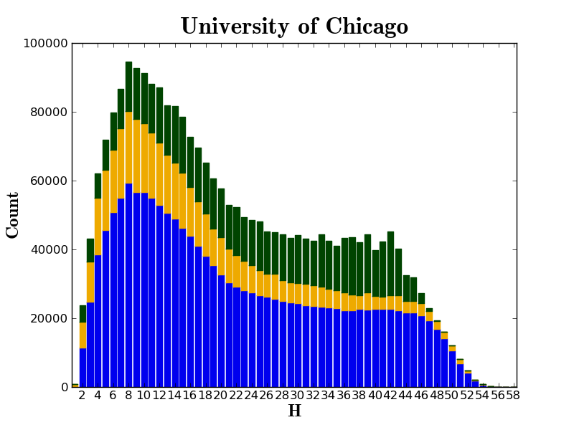

Slide 51
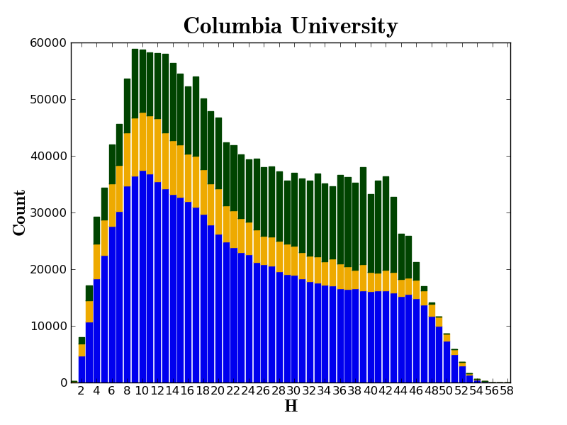

Slide 52
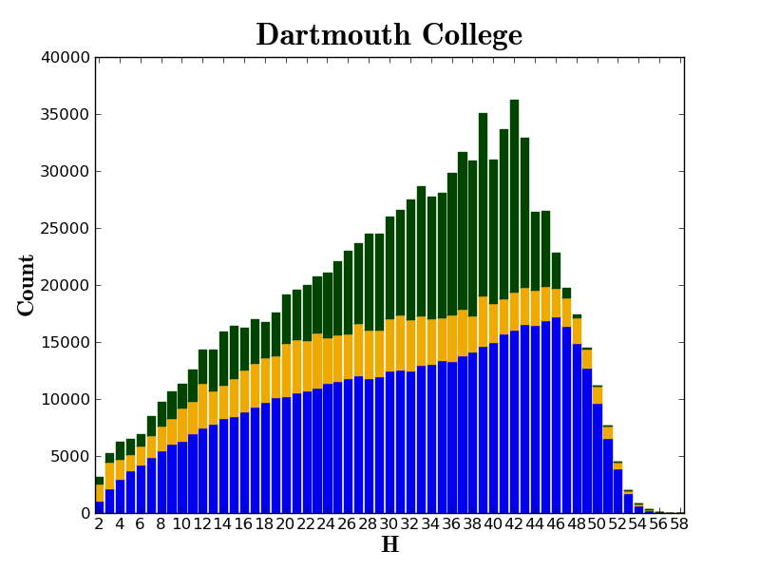

Slide 53
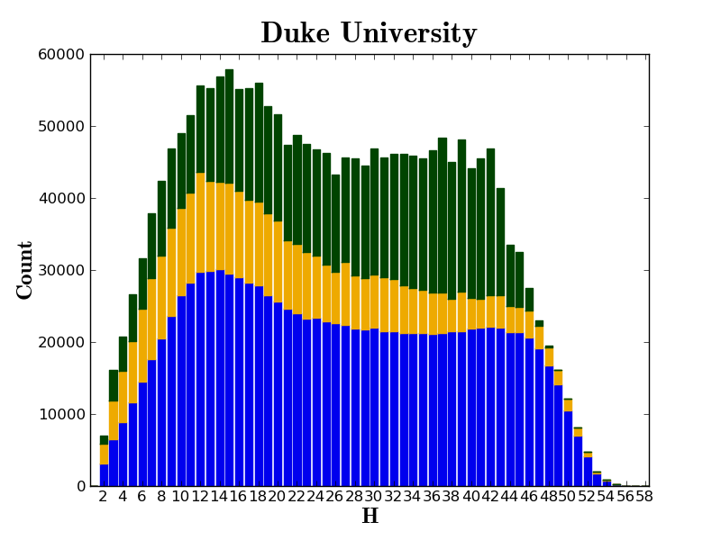

Slide 54
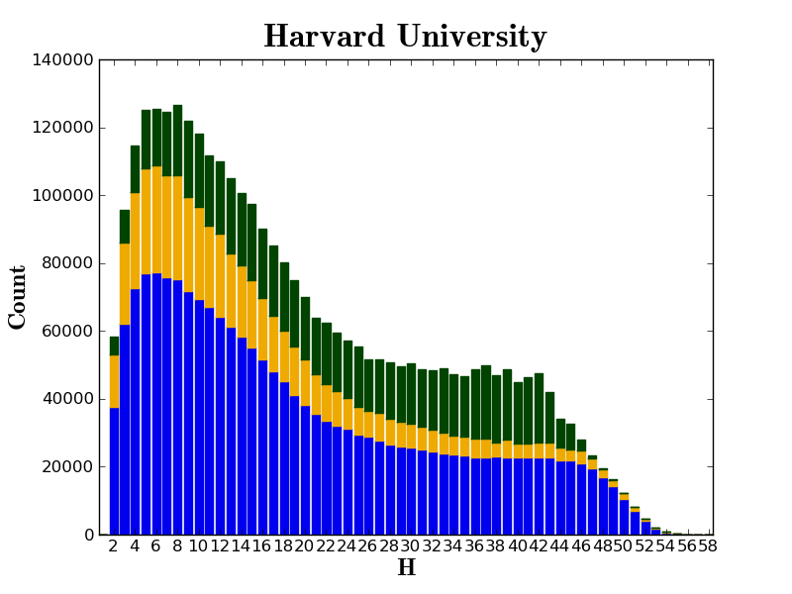

Slide 55
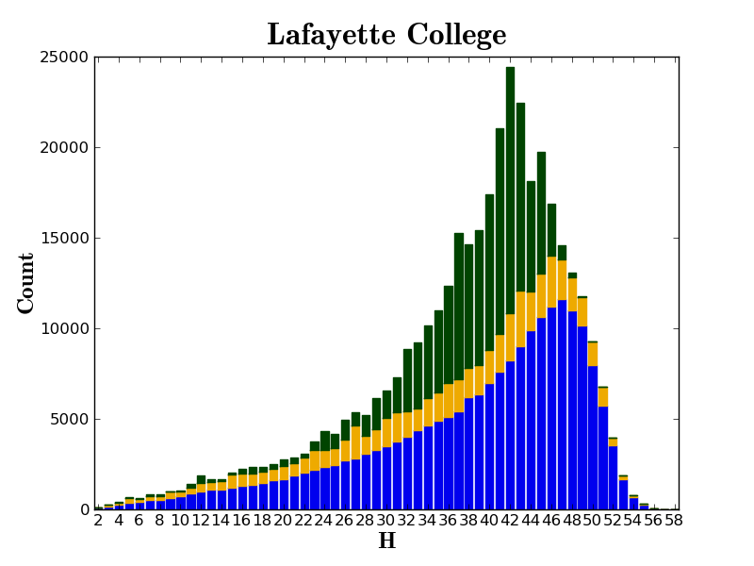

Slide 56
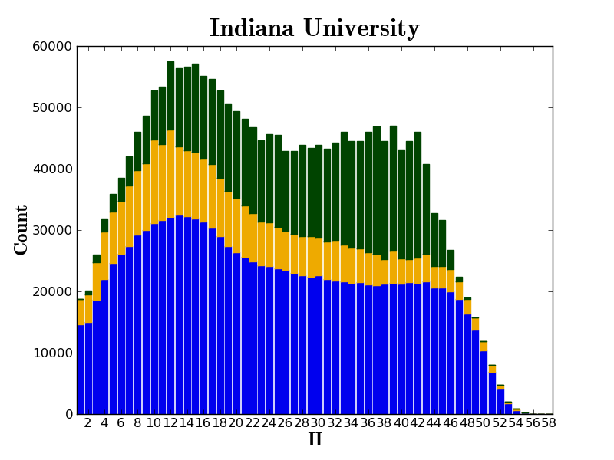

Slide 57
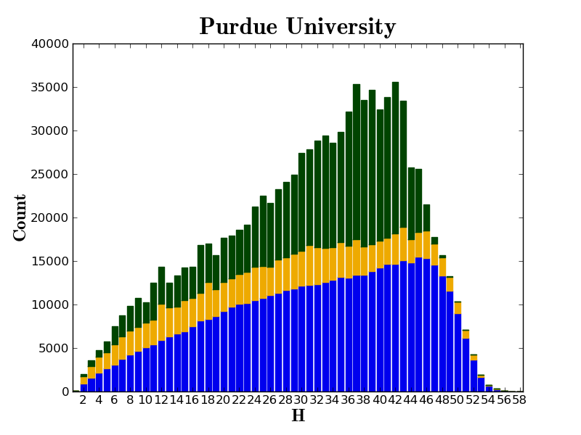

Slide 58
Collection Management, Development
Discovery (OCLC)
Collections Committee

Slide 59
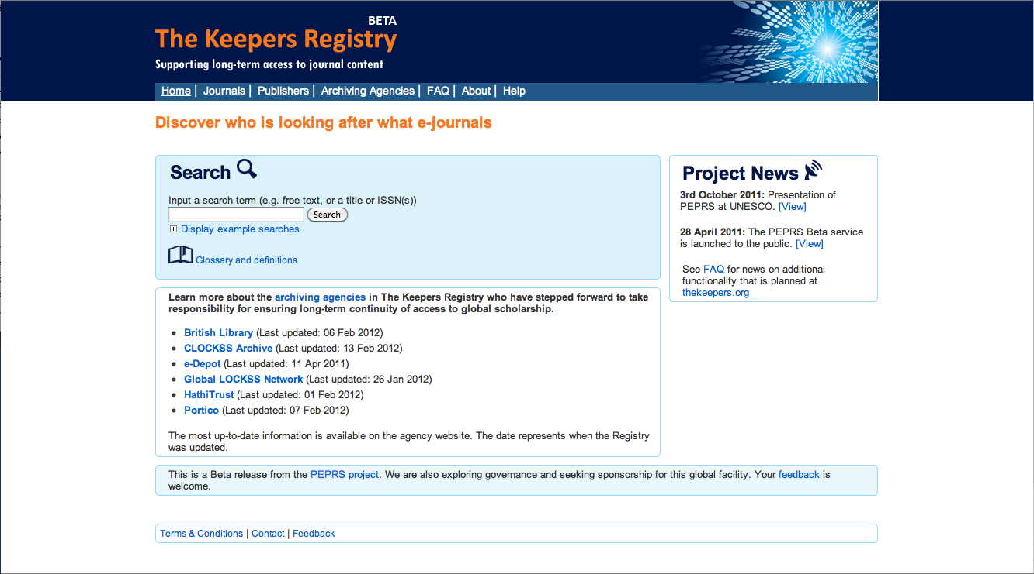

Slide 60
Comprehensive Picture
“Definitional Issues”
  Identification, Description, Rights
Discovery and Use
  Finding
  Relating (APIs and integration)
  Using (Reading, Computational activities)
Collection management, development
Preservation infrastructure
  Digital and Print
  Relationships

Slide 61
Work going forward
Definitional elements
Print archiving, management
Discovery and use
  Lawful uses
Research Center
Quality
Government documents
Beyond books and journals
Publishing
Transitioning to next phase of partnership

Slide 62
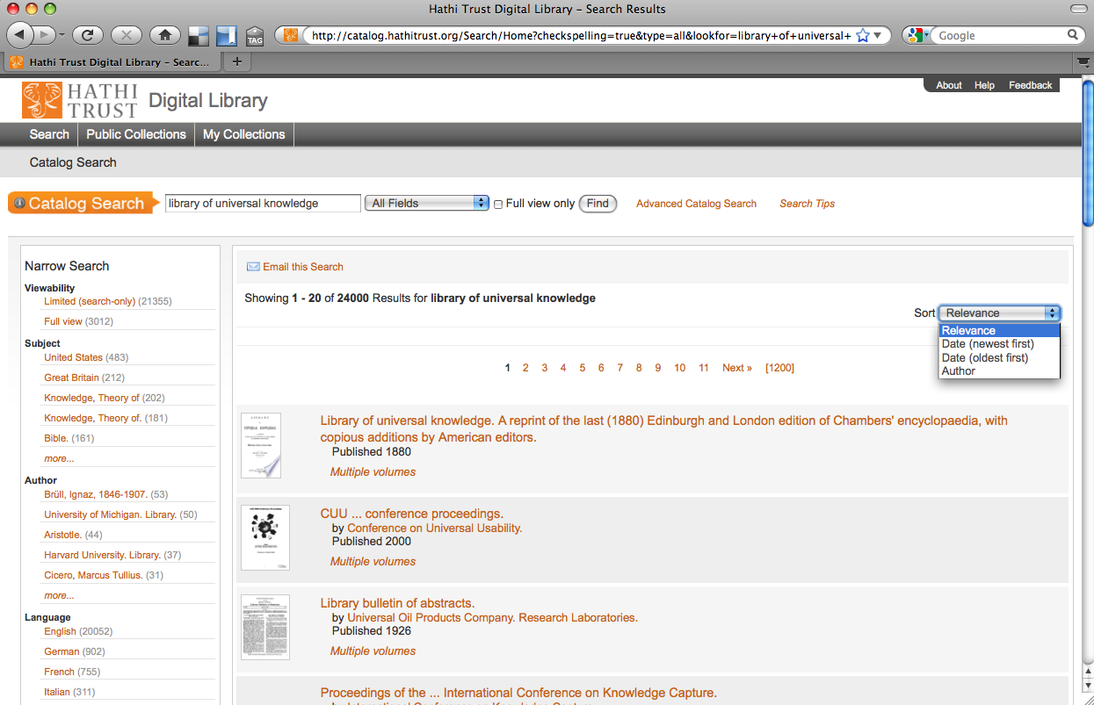

Slide 63
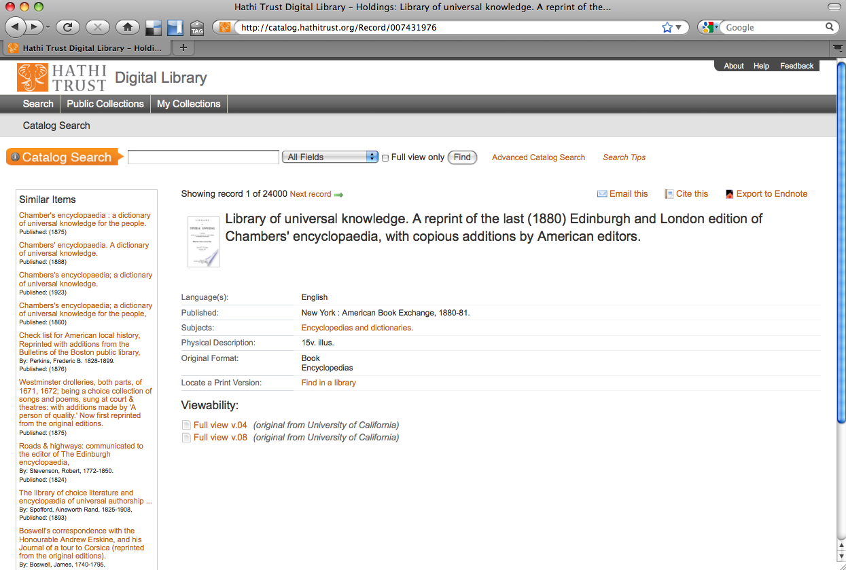

Slide 64
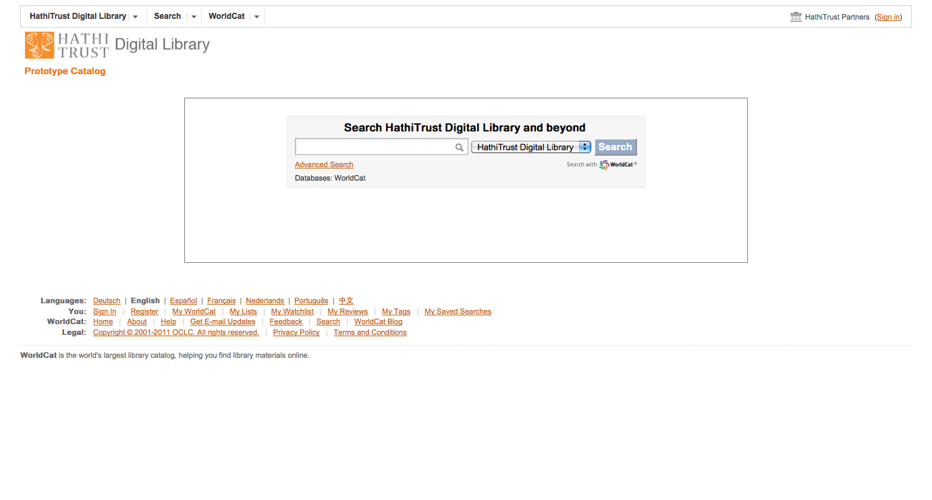

Slide 65
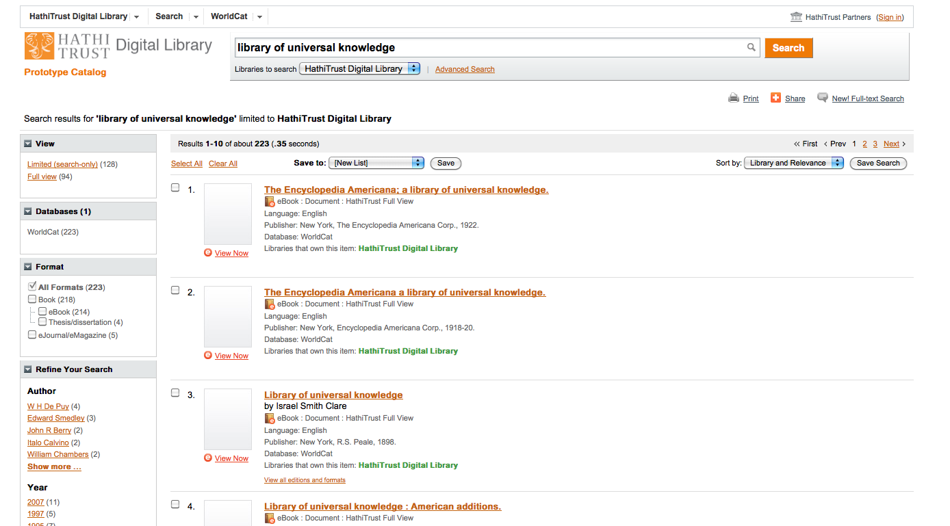

Slide 66
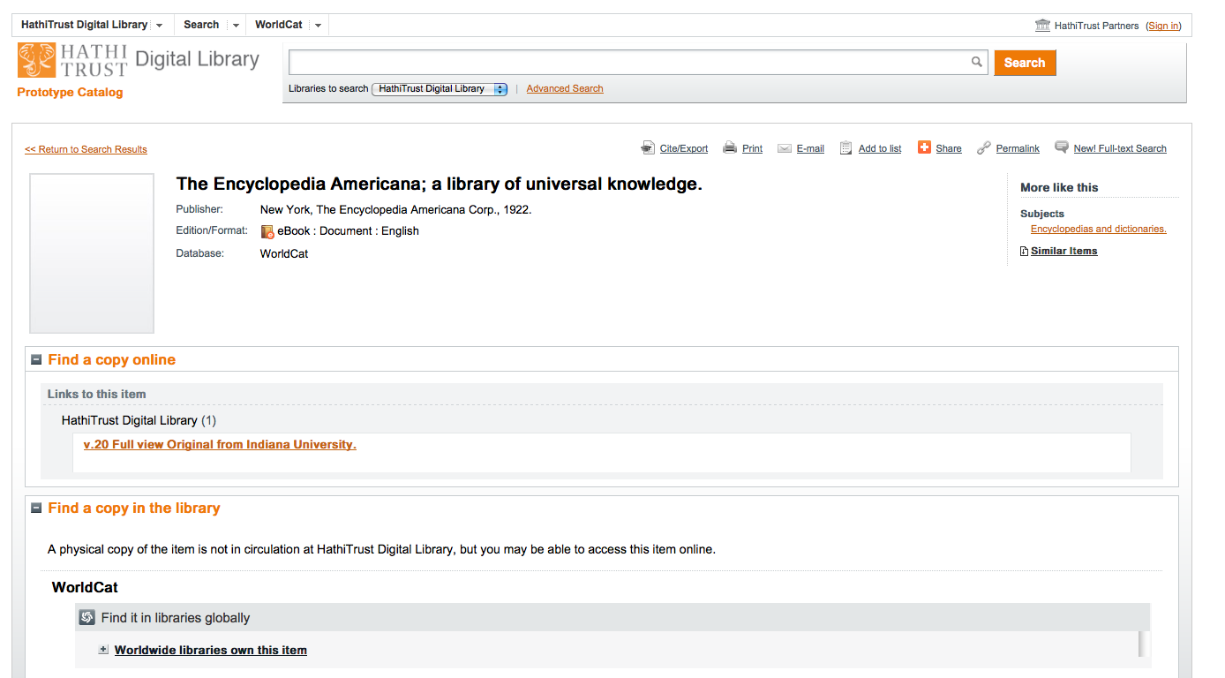

Slide 67
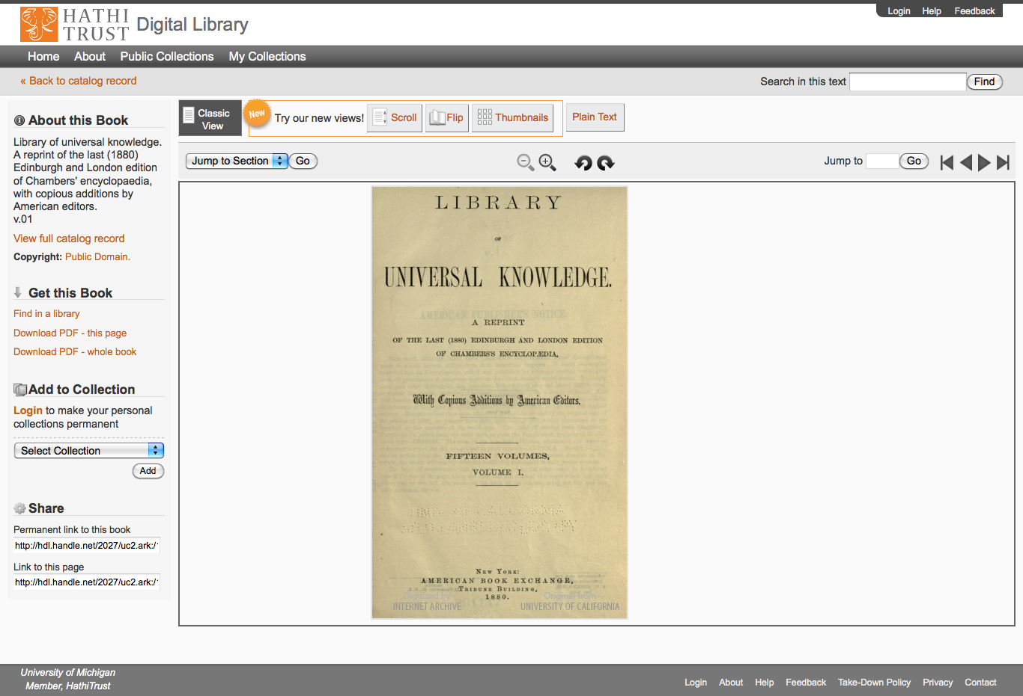

Slide 68
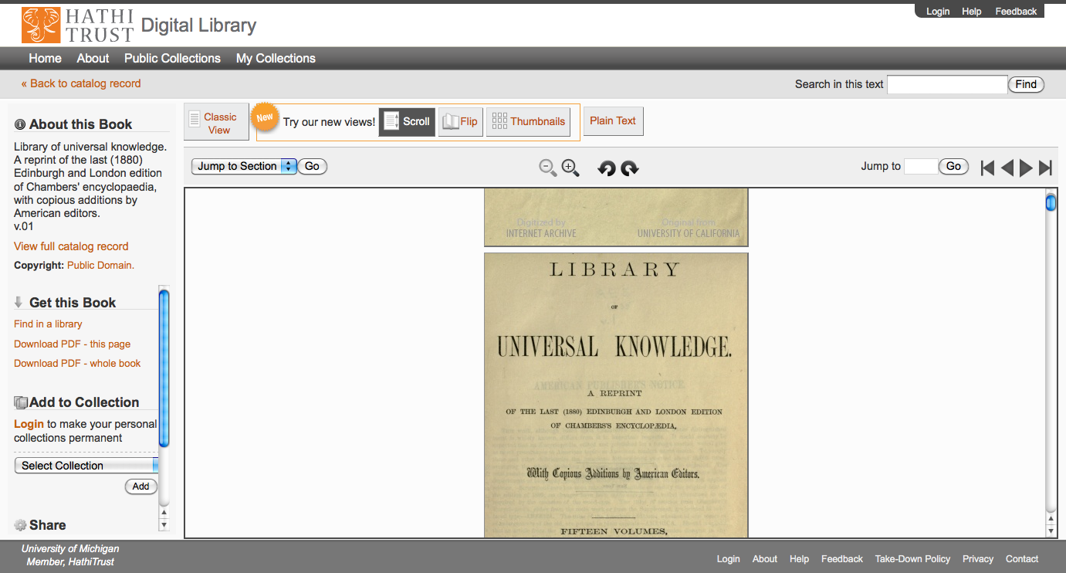

Slide 69
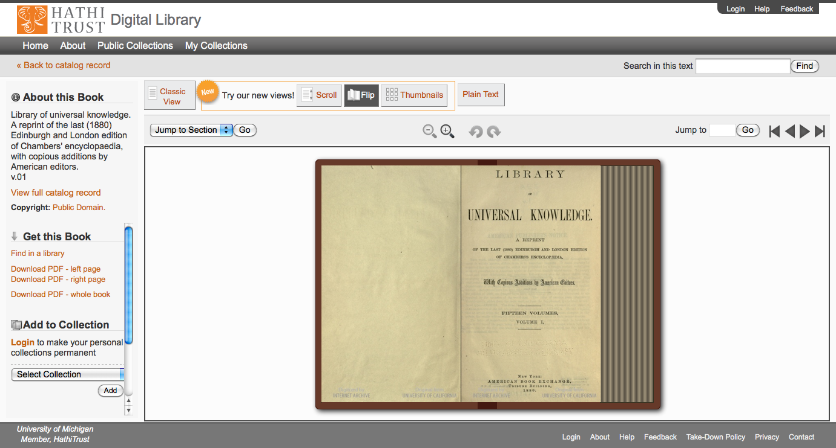

Slide 70
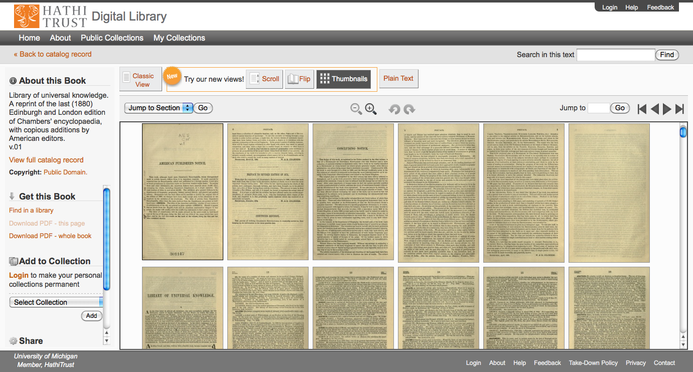

Slide 71
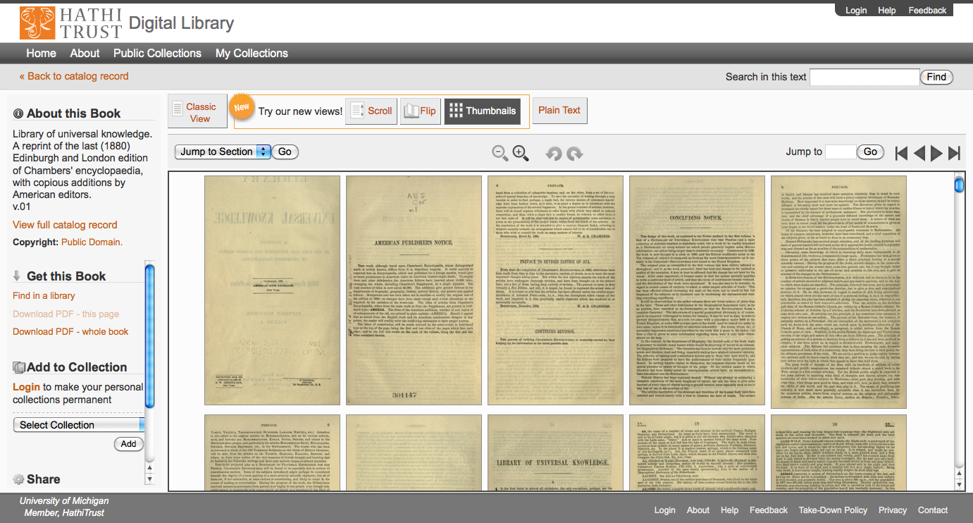

Slide 72
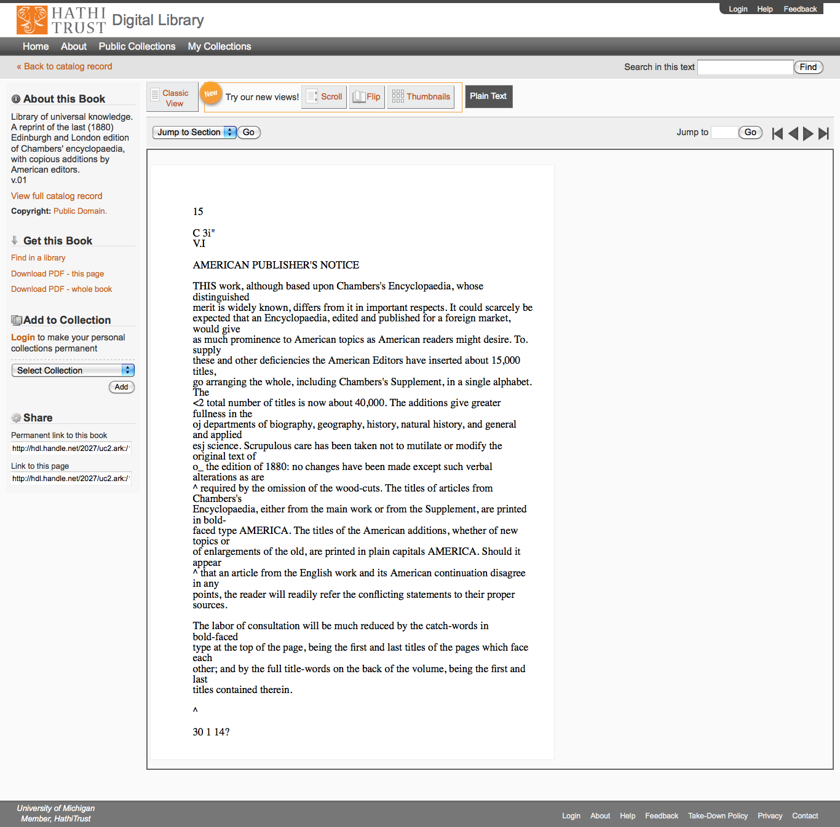

Slide 73
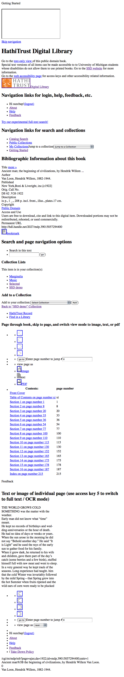
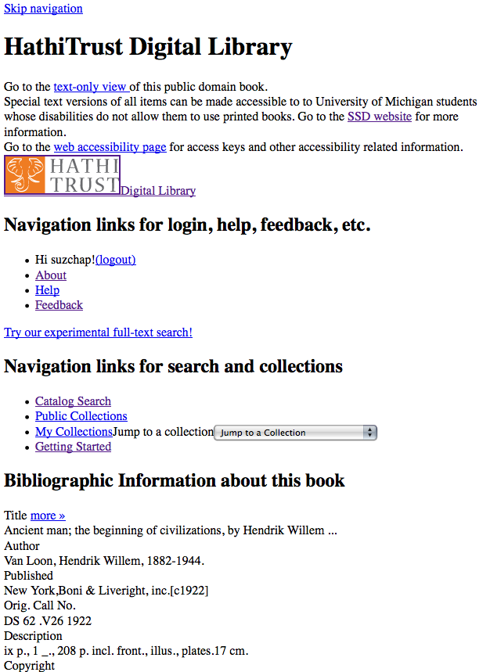
Skip navigation link
Info about SSD service & link to accessibility page
Descriptive headings added (hidden from GUI with CSS)
Added labels & descriptive titles to forms & ToC table
Access keys for navigating pages with keyboard
Images used for style are in css so no need to use alt tags

Slide 74
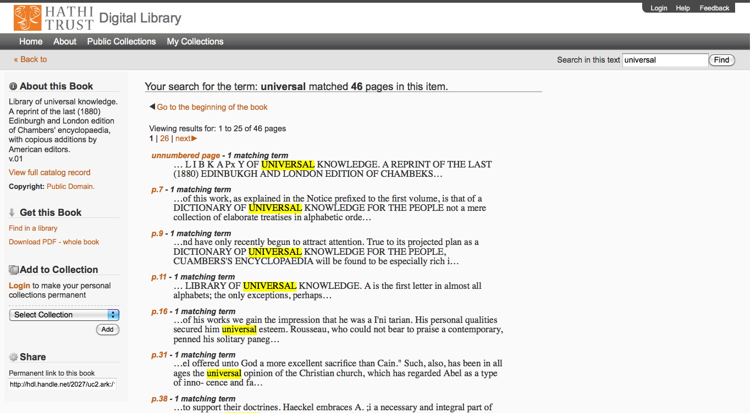

Slide 75
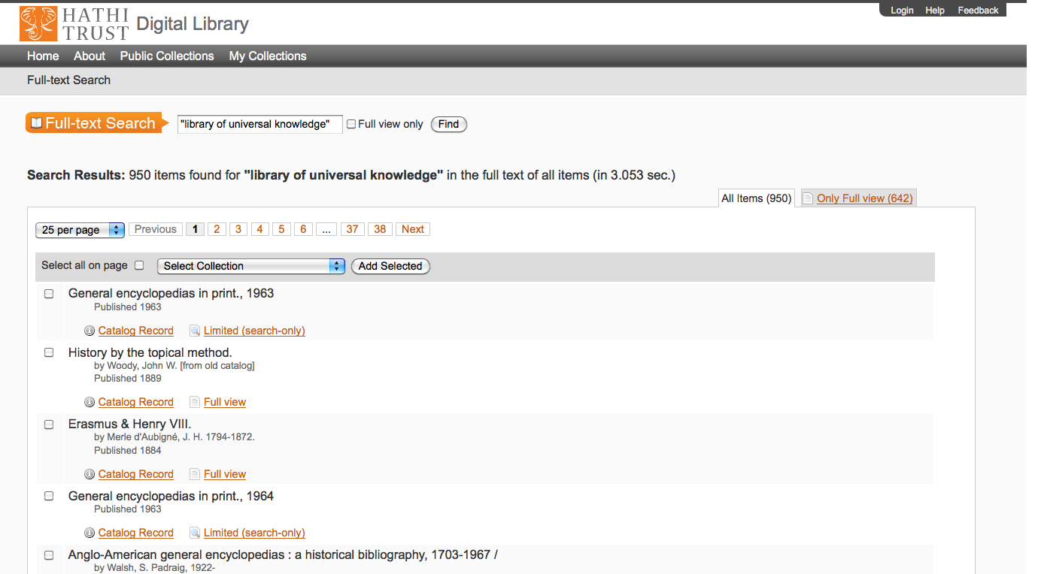

Slide 76
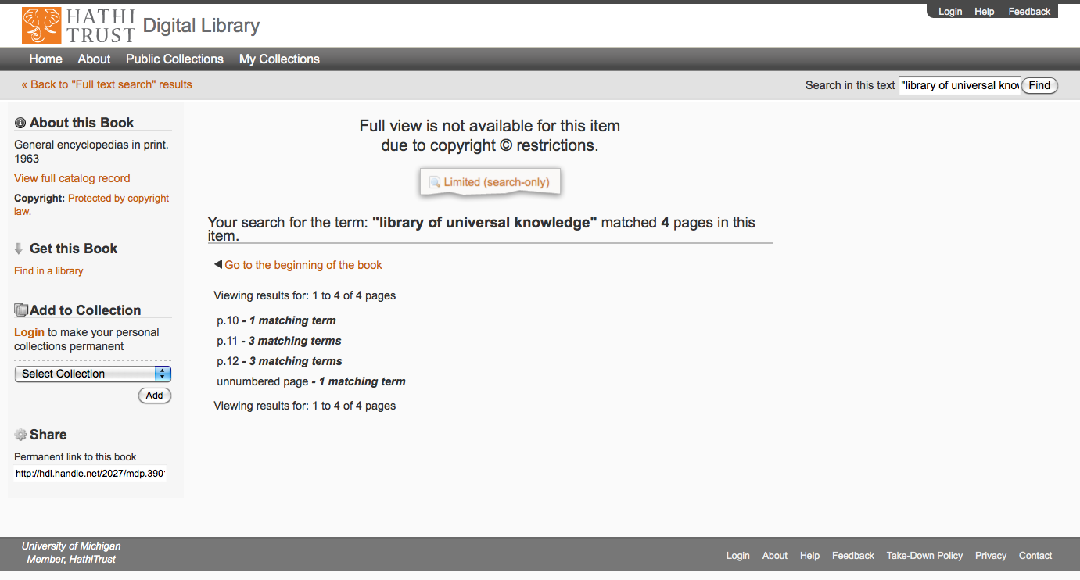

Slide 77
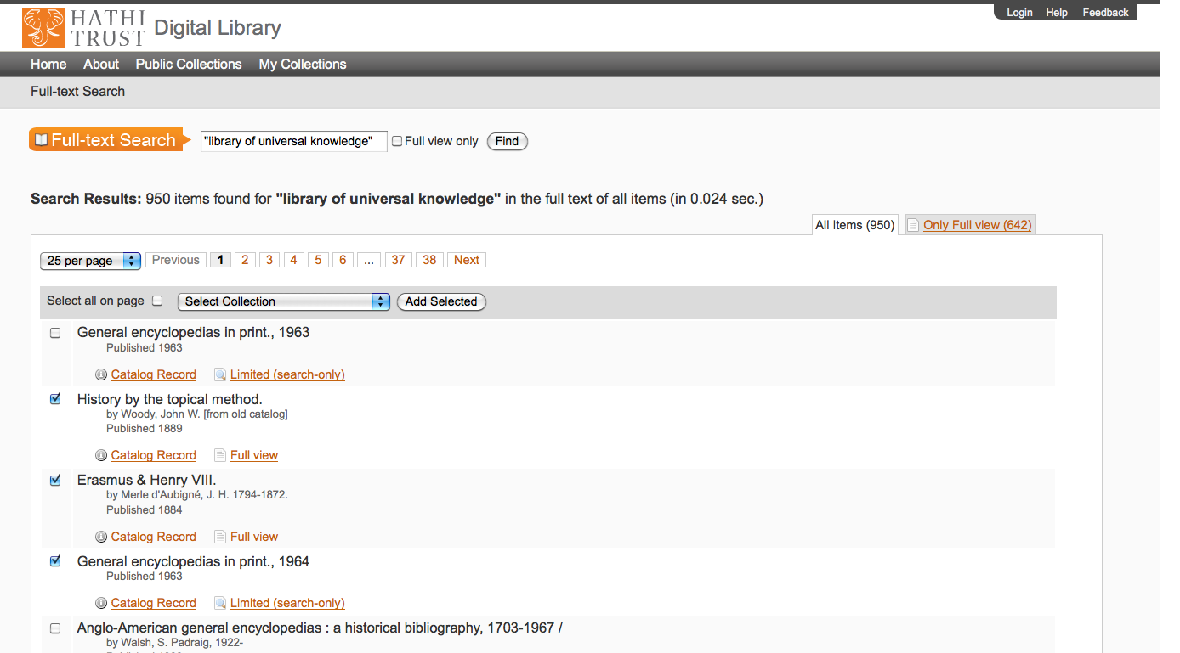

Slide 78
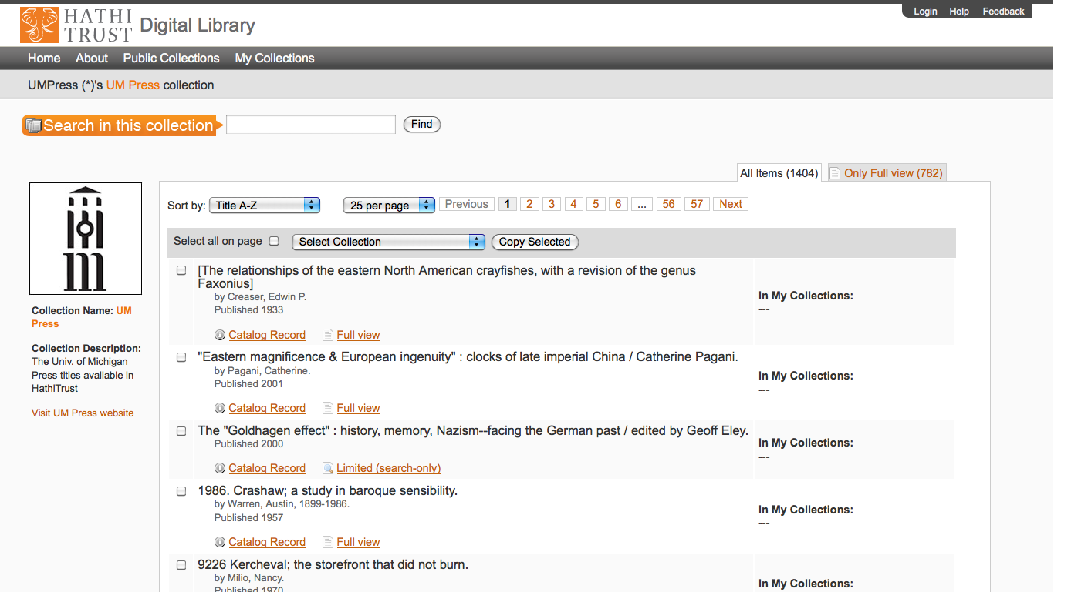

Slide 79
Search Examples

Slide 80
How to find out more
Web site “About” section
  http://www.hathitrust.org/about
HathiTrust Research Center
  http://www.hathitrust.org/htrc
Twitter
  http://twitter.com/hathitrust
Monthly newsletter
  http://www.hathitrust.org/updates
  RSS: http://www.hathitrust.org/updates_rss
Contact us: feedback@issues.hathitrust.org
Blogs: http://www.hathitrust.org/blogs
  Large-scale search
  Perspectives from HathiTrust

Slide 81
Thank you very much!

