Slide 1
HathiTrust: An Above Campus Solution
Sarah Michalak
RLUK Birmingham
November 14, 2014

Slide 2
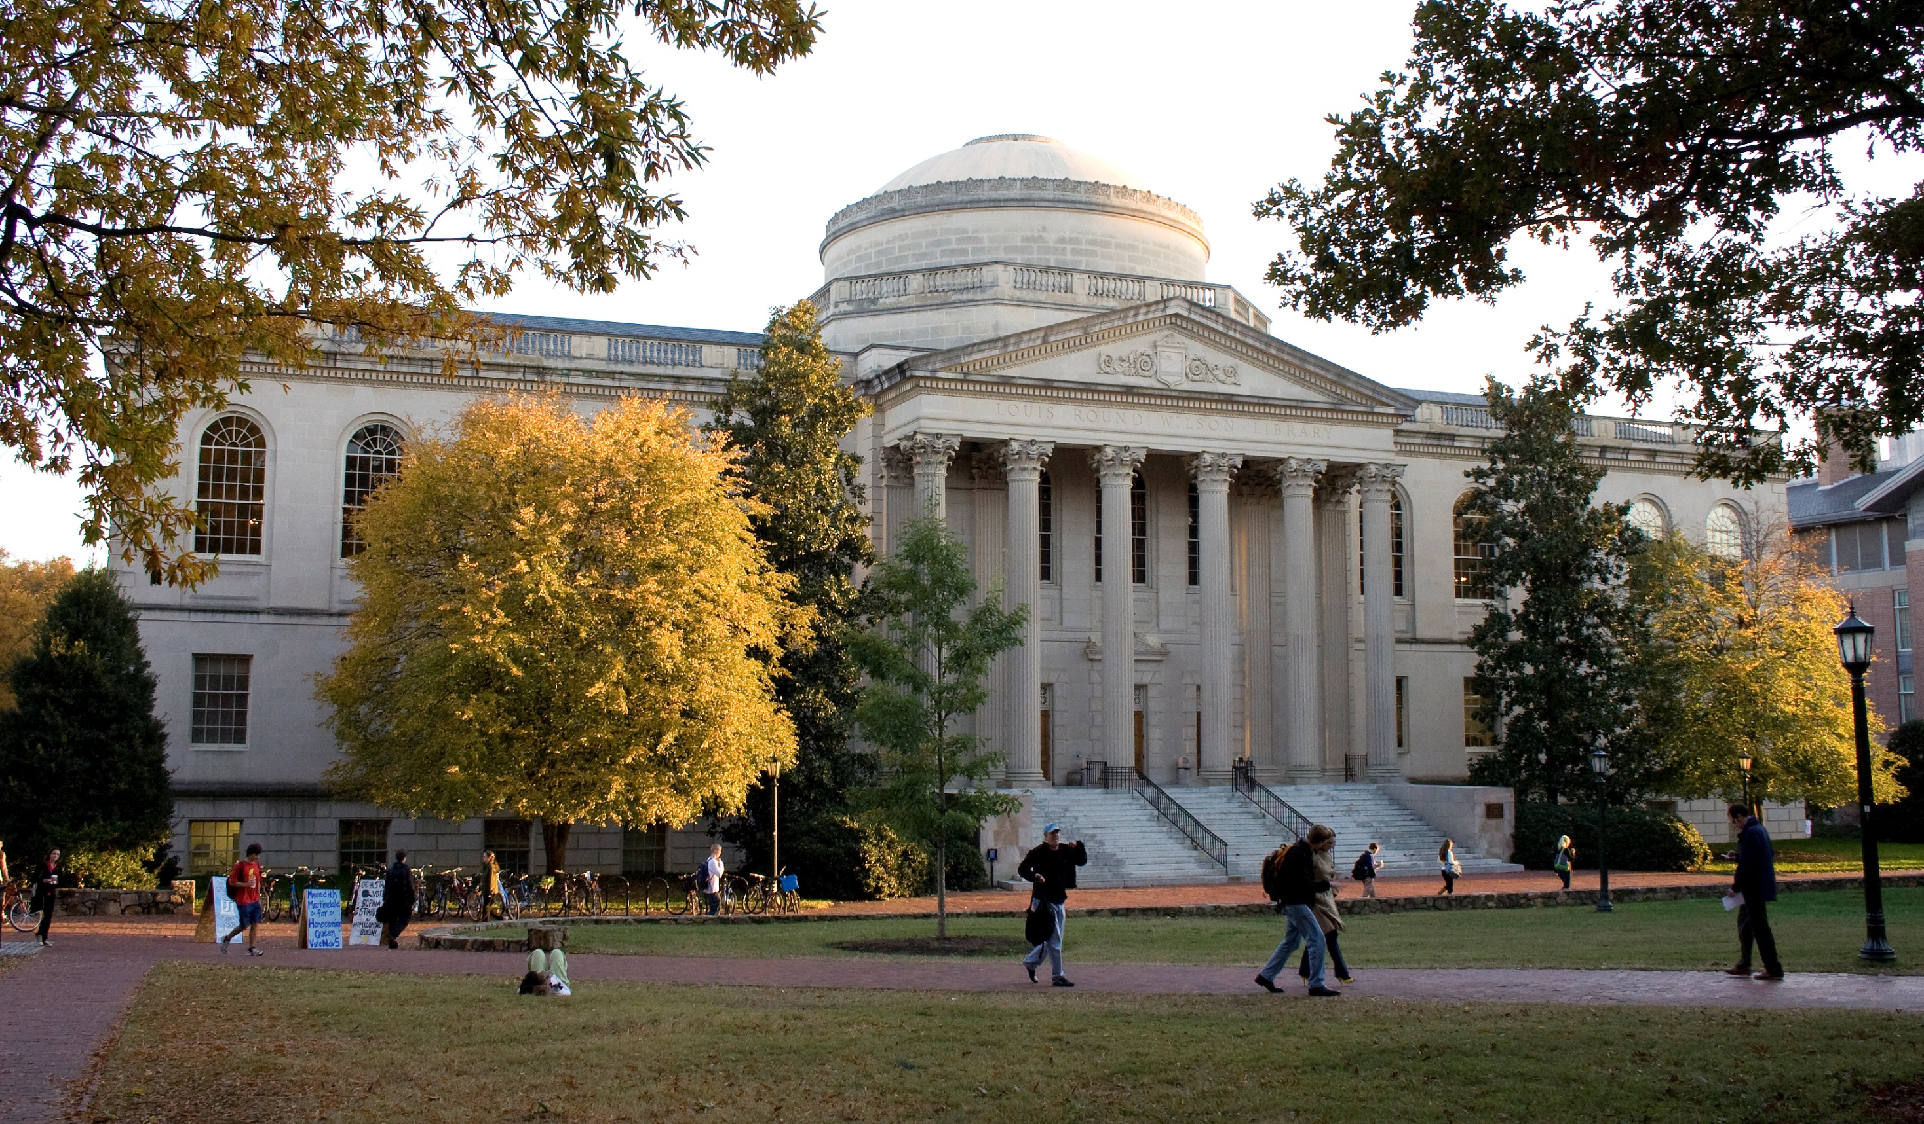

Slide 3
Today’s Discussion - HathiTrust
Mission and partnership
Collections
Services
HathiTrust Research Center
Benefits for Libraries

Slide 4
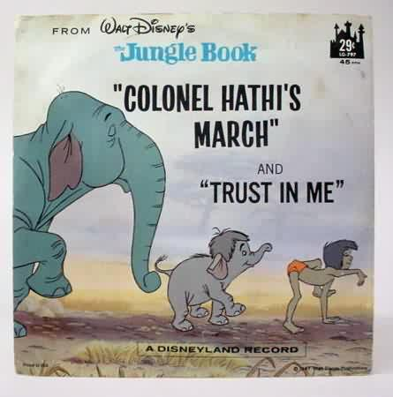
The Name
The meaning behind the name
Hathi (hah-tee)--Hindi for elephant
Never forgets
Full of wisdom
Secure
Trustworthy
Big, strong

Slide 5
The Mission and Partnership

Slide 6
Mission
To contribute to the common good by collecting, organizing, preserving, communicating, and sharing the record of human knowledge.
Efforts include, but are not limited to
…building comprehensive collections co-owned and managed by partners.
…enabling access by users with print disabilities.
…supporting computational research with the collections.
…stimulating shared collection storage strategies among libraries.

Slide 7
HathiTrust Members
Allegheny College
Arizona State University
Baylor University
Boston College
Boston University
Brandeis University
Brown University
California Digital Library
Carnegie Mellon University
Colby College
Columbia University
Cornell University
Dartmouth College
Duke University
Emory University
Florida State University**
Getty Research Institute
Harvard University Library
Indiana University
Iowa State University
Johns Hopkins University
Kansas State University
Lafayette College
Library of Congress
Massachusetts Institute of Technology
McGill University`
Michigan State University
Montana State University
Mount Holyoke College
New York Public Library
New York University
North Carolina Central
University
North Carolina State
University
Northwestern University
The Ohio State University
The Pennsylvania State
University
Princeton University
Purdue University
Rutgers University
Stanford University
Syracuse University
Temple University
Texas A&M University
Texas Tech
Tufts University
Universidad Complutense
de Madrid
University of Alabama
University of Alberta
University of Arizona
University of British Columbia
University of Calgary
University of California
Berkeley
Davis
Irvine
Los Angeles
Merced
Riverside
San Diego
San Francisco
Santa Barbara
Santa Cruz
The University of Chicago
University of Connecticut
University of Delaware
University of Florida
University of Houston
University of Illinois
University of Illinois at Chicago
The University of Iowa**
University of Kansas**
University of Maine
University of Maryland**
University of Massachusetts, Amherst
University of Miami
University of Michigan
University of Minnesota**
University of Missouri**
University of Nebraska- Lincoln**
University of New Mexico
The University of North
Carolina at Chapel Hill**
University of Notre Dame
University of Oklahoma
University of Pennsylvania
University of Pittsburgh
University of Queensland
University of Tennessee, Knoxville**
University of Texas
University of Utah
University of Vermont
University of Virginia**
University of Washington**
University of Wisconsin- Madison**
Utah State University**
Vanderbilt University
Virginia Tech
Wake Forest University
Washington University
Yale University Library

Slide 8
How Are Costs Shared?
Public domain volumes: All partners share in infrastructure costs for each item.
In copyright volumes: Partners share costs based on their holdings.
Infrastructure cost per volume: ~$0.168 per volume per year.
All partners pay an additional amount above costs to fund new programs and investigations.

Slide 9
Collections and Access

Slide 10
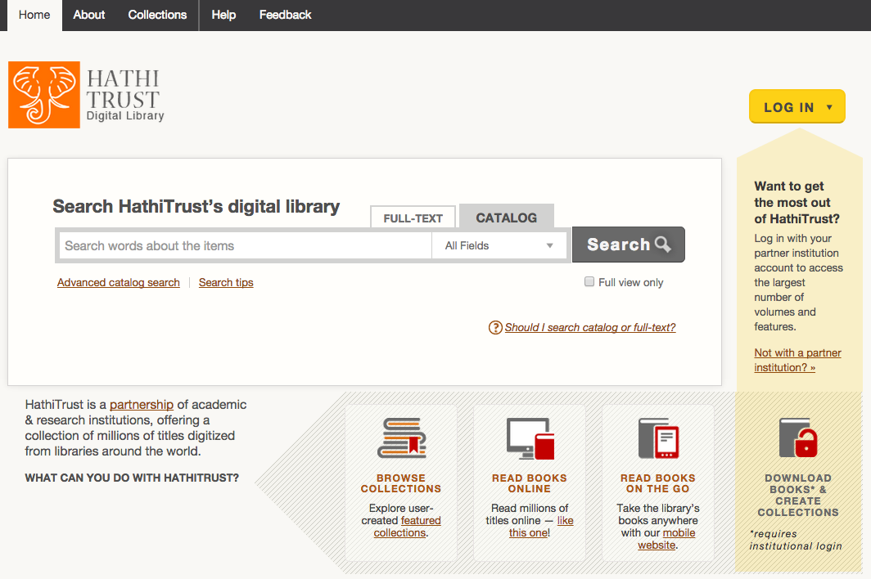
HATHITRUST.ORG

Slide 11
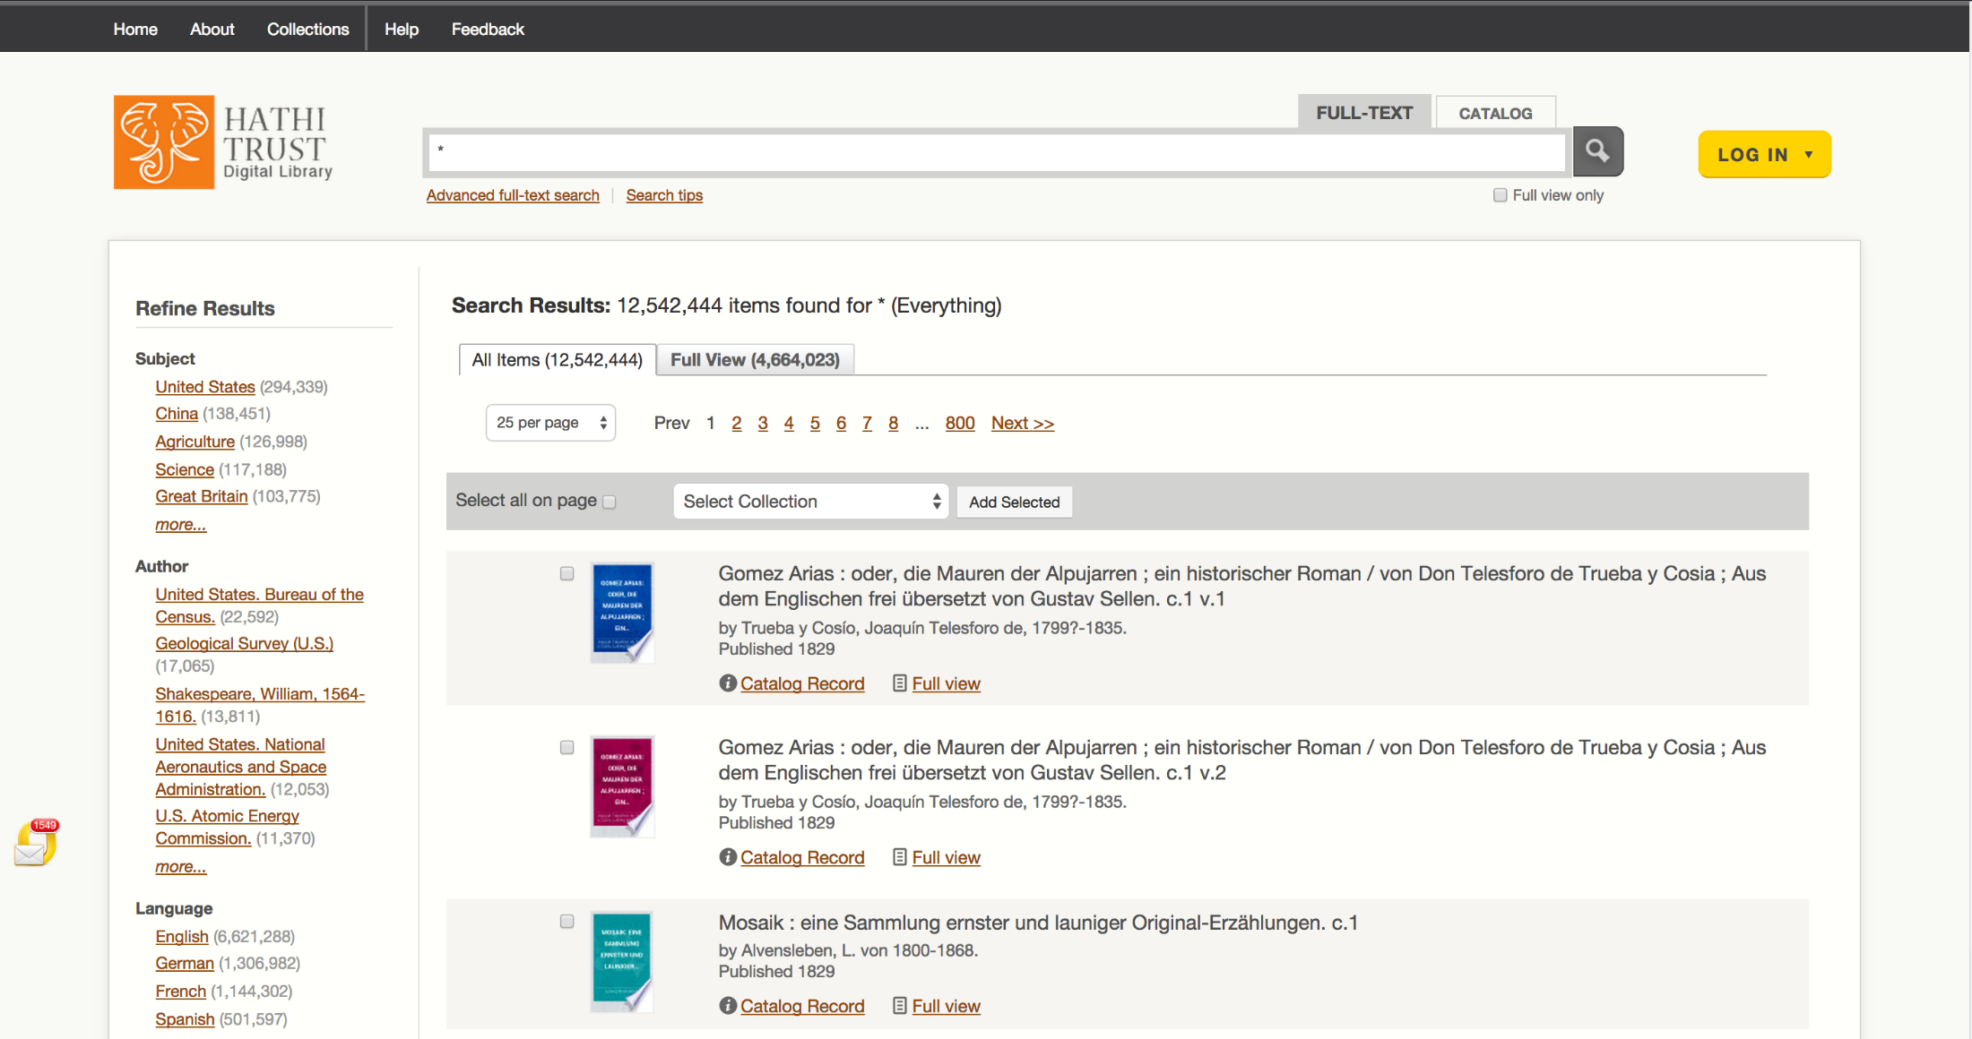
12.5 million total volumes
6.4 million book titles
327,000 serial titles
575,889 government publications
4.6 million volumes in the public domain (~37%)

Slide 12
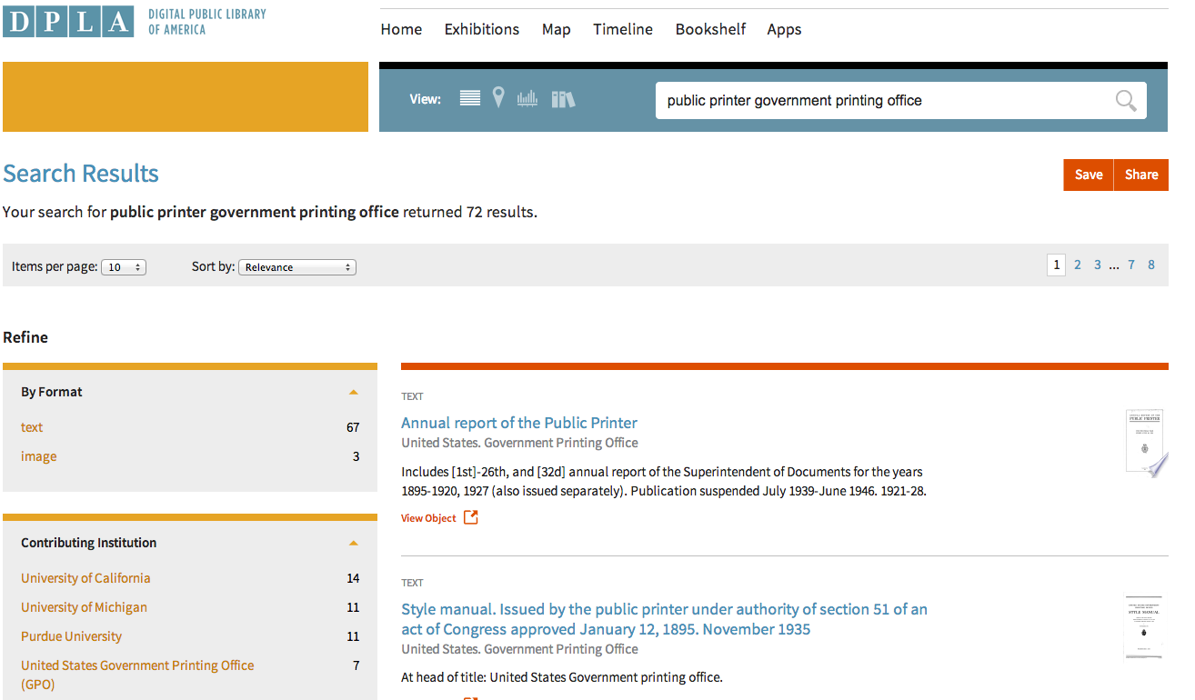
Link takes you to HathiTrust
Records loaded into DPLA, local library catalogs, and commercial databases

Slide 13
Collective Stewardship
Leverage expertise across institutions
Distributed Functions and Services
Preservation repository and access services
University of Michigan
Mirror site: Indiana University
Metadata management services
California Digital Library
HathiTrust Research Center
Indiana University and University of Illinois

Slide 14
Collection Sources

Slide 15
Dates
Notes:
15

Slide 16
Language Distribution (1)
The top 10 languages make up ~87% of all content
Notes:
16

Slide 17
Language Distribution (2)
The next 40 languages make up ~12% of total

Slide 18
Copyright Distribution

Slide 19
Services

Slide 20
Preservation with Access
Preservation
TRAC-certified
Long-term commitments to preserve digital content facilitate planning, decision-making
Discovery
Bibliographic and full-text search of all materials
Mechanisms for local loading of records
Access and Use
Full text search (all users)
Public domain and open access works (all users)
Collections and APIs (all users)
Lawful uses of in-copyright works (members)

Slide 21
Access: Lawful uses of in-copyright works
Sensitive to multiple legal regimes
Full-text search (everyone everywhere)
Access to users who have print disabilities (through member proxy in US, and where law permits)**
Access works that are damaged or missing and also out of print and unavailable (members in US only)
**Terms and conditions at http://www.hathitrust.org/access_use#ic-access

Slide 22
Collective Action: Copyright Review
Copyright Review Management System
Systematic manual review of copyright registrations to determine status of portions of the HathiTrust Collection
CRMS US: Published in US, 1923-1963
316,396 reviewed / 166,753 PD (~53%)
CRMS-World: Published in UK (1874-1944), Canada, Australia (1894-1964)
145,804 reviewed / 75,775 PD-world 9 (~52%)

Slide 23
HathiTrust Research Center
http://www.hathitrust.org/htrc
Operated by the University of Illinois, Urbana-Champaign and Indiana University, with additional financial support from HathiTrust.
Co-led by Beth Plale (Indiana) and Stephen Downie (Illinois).
Goal: enable researchers world-wide to carry out computational investigation of HT repository.

Slide 24
Aims of the HTRC
Focus on developing services to researchers
Develop model for access: the ‘workset’
Develop tools that facilitate research by digital humanities and informatics communities
Develop secure cyberinfrastructure that allows computational investigation of entire copyrighted and public domain HathiTrust repository

Slide 25
Example Projects Supported by HTRC
Muñoz, Trevor, University of Maryland. “Distributed Metadata Correction and Annotation.”
Correction, annotation and enhancement of HT records and export as linked data
Page, Kevin, Oxford University. “ElEPHãT: Early English Print in HathiTrust, a Linked Semantic Workset Prototype”
Development of secondary worksets based on both HT and the Early English Books Online Text Creation Partnership (EEBO-TCP).
Burton, Vernon. “The South as ‘Other,’ the Southerner as ‘Stranger.’”
Explore how attitudes expressed in print about slavery, southerners, and non-southerners have changed over both time and space.
Ted Underwood, Associate Professor of English at the University of Illinois, Urbana-Champaign.
Using public domain texts received from HathiTrust to explore changing relationships in literary genres from 1700-1899.

Slide 26
HathiTrust overall benefits to libraries
Digital Curation
Drive costs down
Reduce “bibliographic indeterminacy”
Make meaningful decisions about formats and quality
Increase discoverability, use
Consolidate development talent
Improve strength of archiving
Print Curation
Means to associate our print holdings
Coordinated record-keeping
Subsidiary benefits
Quantify problems
Collective attention to solving shared problems
Understanding relationship between collective and local

Slide 27
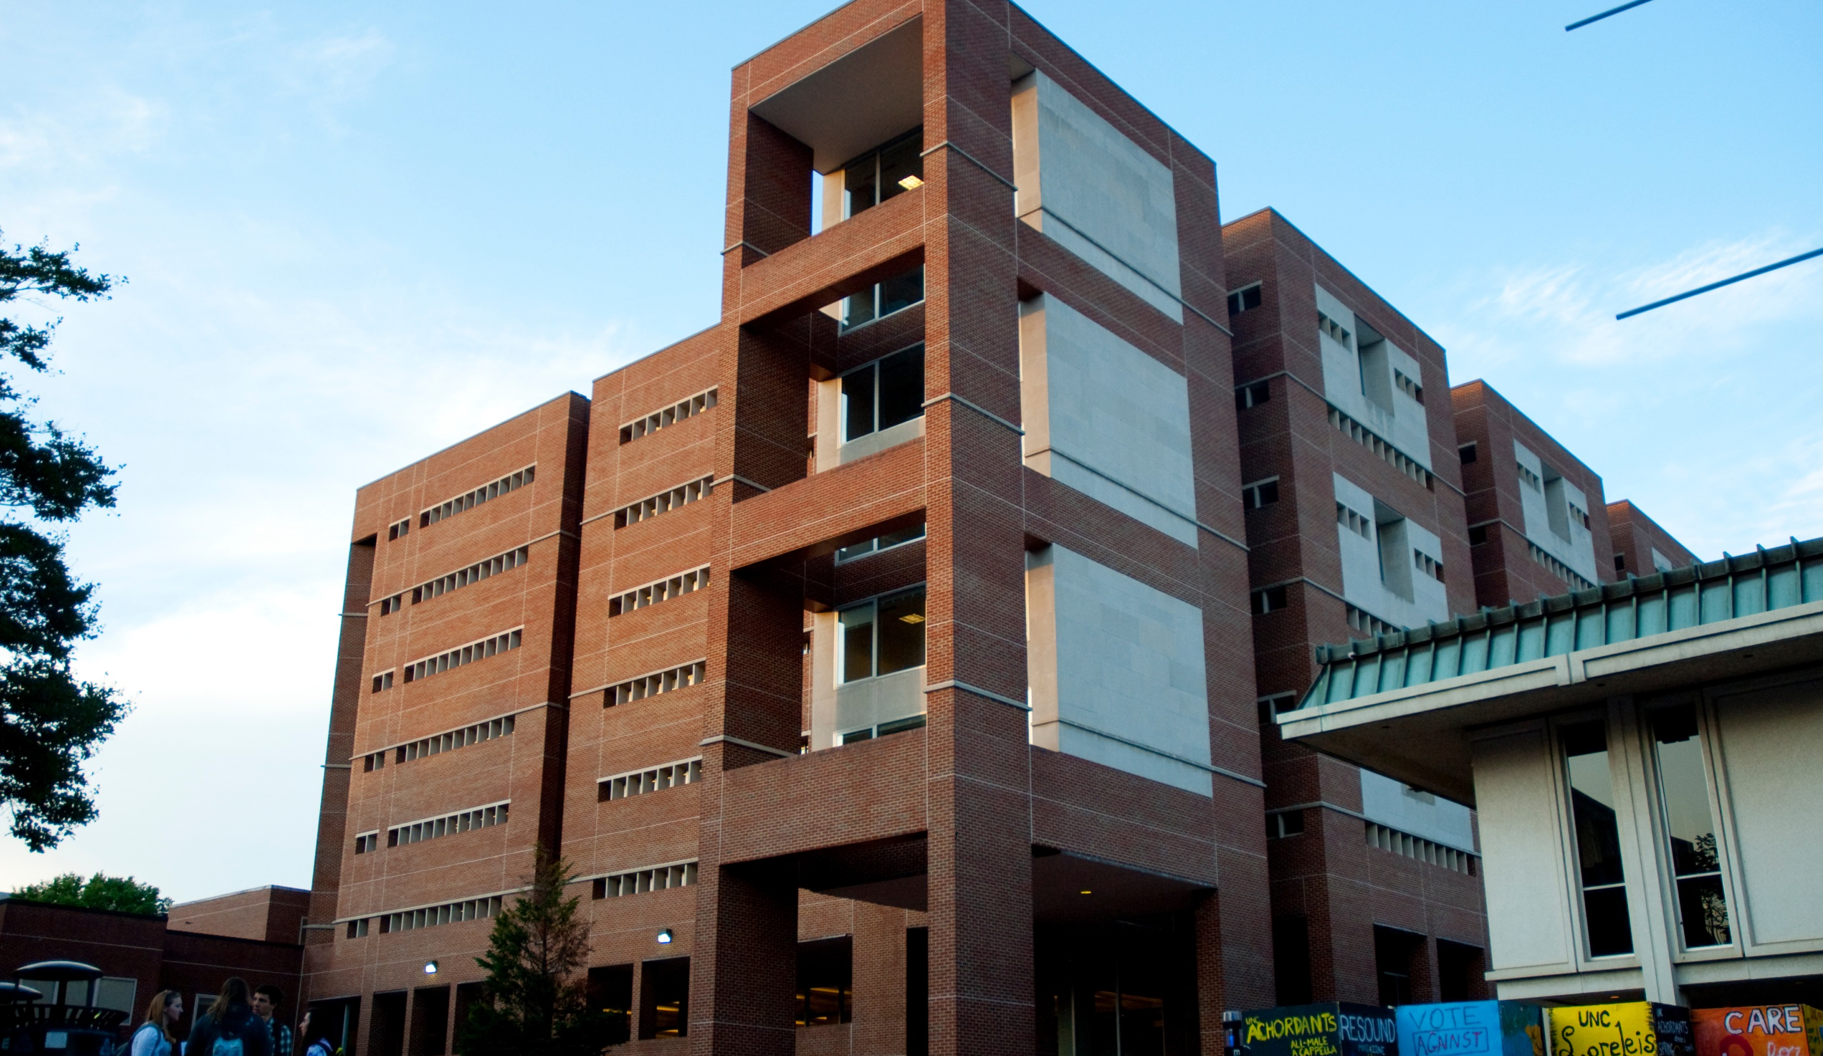

Slide 28
Benefits for UNC-Chapel Hill
Preservation solution for UNC digitized books and journals.
Online access to hundred’s of thousands of titles we do not have in our collection.
Live links to Hathi materials in our catalog is a convenience for users and enriches our collections.
Hathi-led “community developments” provide tools and expertise we might not have otherwise.
Digital humanities scholars and other researchers have the benefit of computational research over the large-scale corpus.

Slide 29
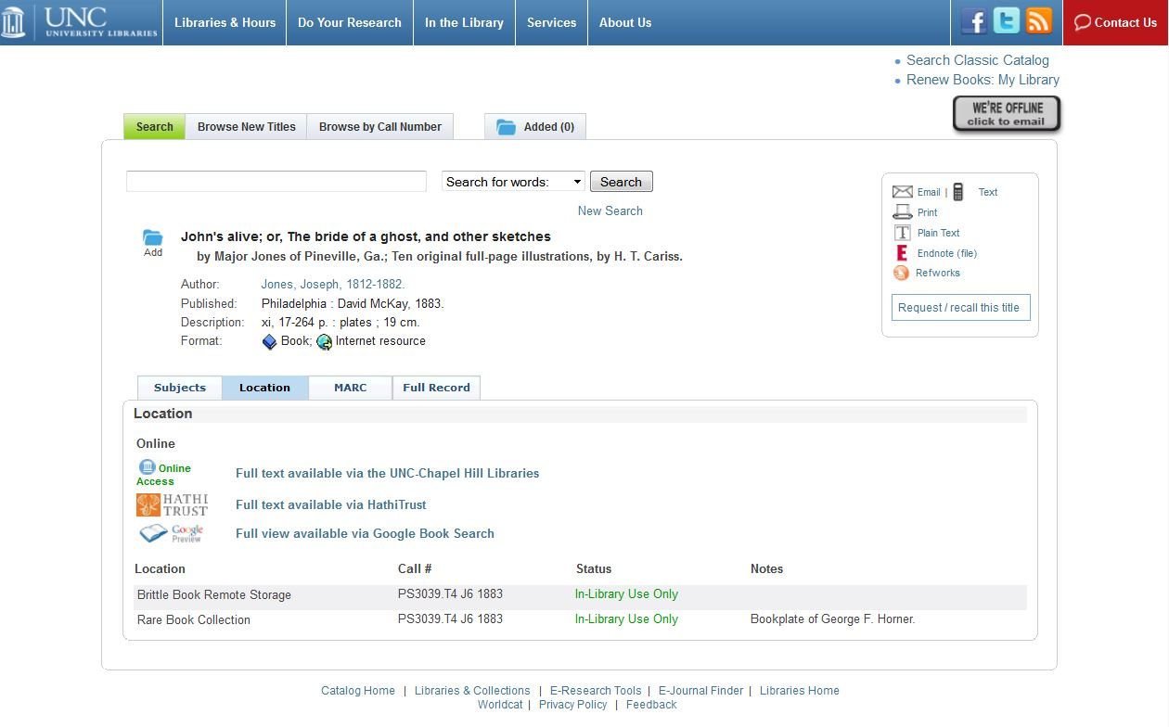

Slide 30
The HathiTrust Digital Library
Large Scale Digital Preservation and Access
For the Public Good

