Slide 1
Preservation with a Purpose: End User Access Services in HathiTrust
Jeremy York
Rutgers University
February 24, 2015

Slide 2
About

Slide 3
HathiTrust Members
Allegheny College
American University of Beirut
Arizona State University
Baylor University
Boston College
Boston University
Brandeis University
Brown University
California Digital Library
Carnegie Mellon University
Case Western Reserve
Colby College
Columbia University
Cornell University
Dartmouth College
Duke University
Emory University
Getty Research Institute
Georgetown University
Georgia Tech
Harvard University Library
Indiana University
Iowa State University
Johns Hopkins University
Kansas State University
Lafayette College
Library of Congress
Massachusetts Institute of Technology
McGill University`
Michigan State University
Montana State University
Mount Holyoke College
New York Public Library
New York University
North Carolina Central
University
North Carolina State
University
Northeastern University
Northwestern University
The Ohio State University
Oklahoma State University
Penn State
Princeton University
Purdue University
Rutgers University
Stanford University
State University System of Florida
Syracuse University
Temple University
Texas A&M University
Texas Tech
Tufts University
Universidad Complutense
de Madrid
University of Alabama
University of Alberta
University of Arizona
University of British Columbia
University of Calgary
University of California
Berkeley
Davis
Irvine
Los Angeles
Merced
Riverside
San Diego
San Francisco
Santa Barbara
Santa Cruz
The University of Chicago
University of Connecticut
University of Delaware
University of Houston
University of Illinois
University of Illinois at Chicago
The University of Iowa
University of Kansas
University of Maine
University of Maryland
University of Massachusetts, Amherst
University of Miami
University of Michigan
University of Minnesota
University of Missouri
University of Nebraska-Lincoln
University of New Mexico
The University of North
Carolina at Chapel Hill
University of Notre Dame
University of Oklahoma
University of Pennsylvania
University of Pittsburgh
University of Queensland
University of Tennessee, Knoxville
University of Texas
University of Utah
University of Vermont
University of Virginia
University of Washington
University of Wisconsin- Madison
Utah State University
Vanderbilt University
Virginia Tech
Wake Forest University
Washington University
Yale University Library

Slide 4
Partnership
Preserve and expand access to library collections
Leverage collection action
Shared Print Monographs Archive
US Federal Government Documents
Rights and Access
Discovery and Use

Slide 5
Digital Repository
Launched 2008
Initial focus on digitized book and journal content
13.2 million total volumes
6.7 million book titles
350,000 serial titles
4.9 million volumes in the public domain (~37%)

Slide 6
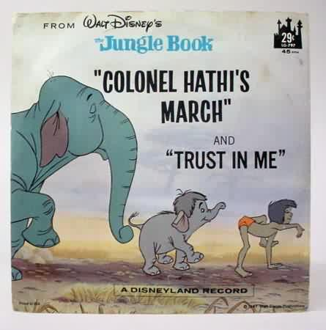
The Name
The meaning behind the name
Hathi (hah-tee)--Hindi for elephant
Big, strong
Never forgets, wise
Secure
Trustworthy

Slide 7
What is in HathiTrust?

Slide 8
Libraries in US by # Volumes
ALA - Nation’s Largest Libraries: http://www.ala.org/tools/libfactsheets/alalibraryfactsheet22; Data from 2010-2011.

Slide 9
1. Michigan | 4,712,752
2. California | 3,612,596
3. Harvard | 838,115
4. Wisconsin | 561,094
5. Indiana | 529,601
6. Cornell | 510,286
7. Penn State | 388,713
8. Illinois | 329,136
9. NYPL | 294,883
10. Princeton | 252,837
11. Minnesota | 193,124
12. Madrid | 117,291
13. Library of Congress | 108,892
14. Keio University | 90,112

Slide 10
Collection Overlap
19% overlap in 2009 (2.93 million volumes)
31% overlap in 2010 (6.15 million volumes)
More than 50% median overlap with ARL institutions
higher for small liberal arts colleges

Slide 11
HathiTrust contains materials in all disciplines…
HathiTrust by call number
http://www.hathitrust.org/visualizations_callnumbers
and includes a wide range of primary source materials, such as:
Diaries
Correspondence
Reports
Newspapers
Memoirs

Slide 12
HathiTrust covers a wide range of formats, such as
Books
Encyclopedias
Archival materials
Directories
Periodicals
Maps
Musical scores
Statistics
Visual Materials

Slide 13
Dates
Notes:
13

Slide 14
Language Distribution (1)
The top 10 languages make up ~87% of all content

Slide 15
Language Distribution (2)
The next 40 languages make up ~12% of total

Slide 16
HathiTrust and other e-databases

Slide 17
Access and Services

Slide 18
Determinants of Access
Copyright determination / Permissions
Third-party agreements
Overlap with print collection

Slide 19
Full View
Limited View
PD U.S.
PD Worldwide
Open Access
In Copyright / Undetermined
IC U.S.
No
Restrictions
Restrictions
Special Access Only
Full Download
Page-at-a-time Download
No Download

Slide 20
Content Distribution
Notes:
20

Slide 21
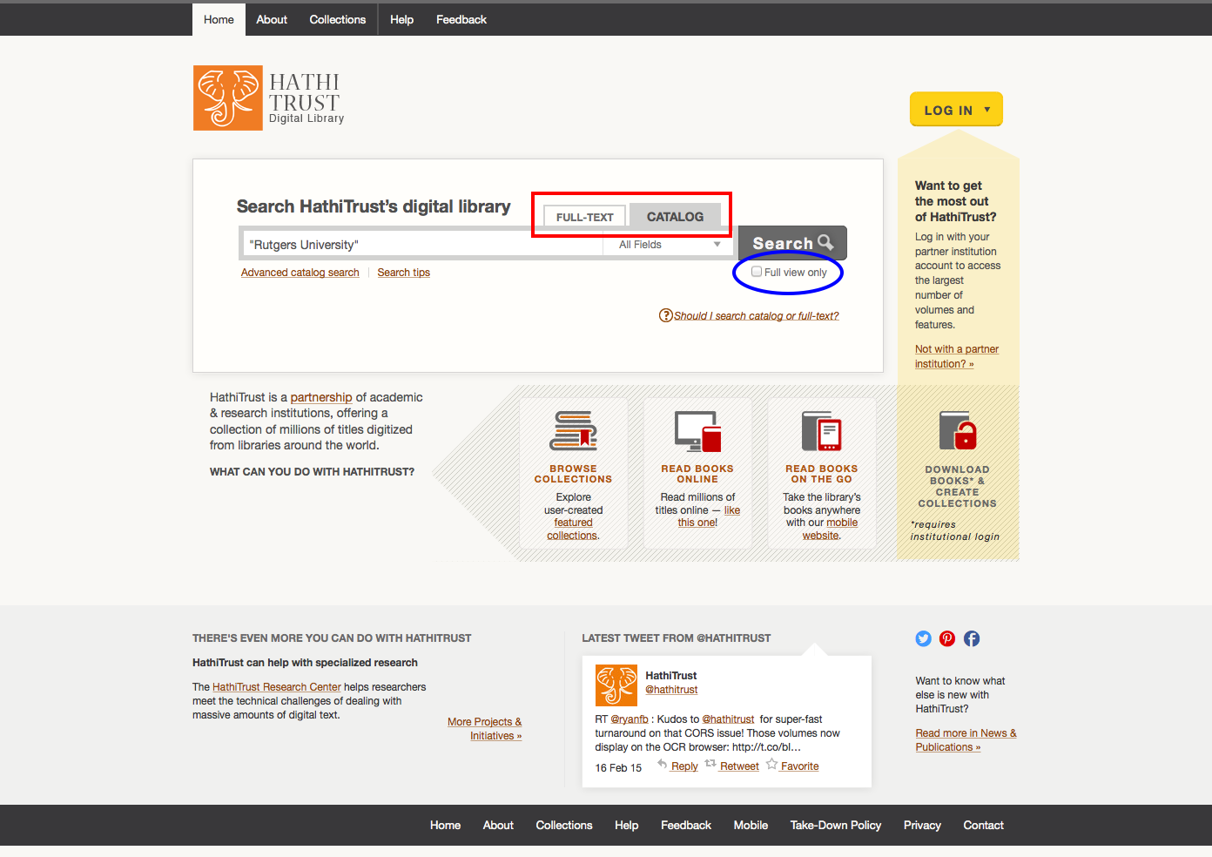

Slide 22
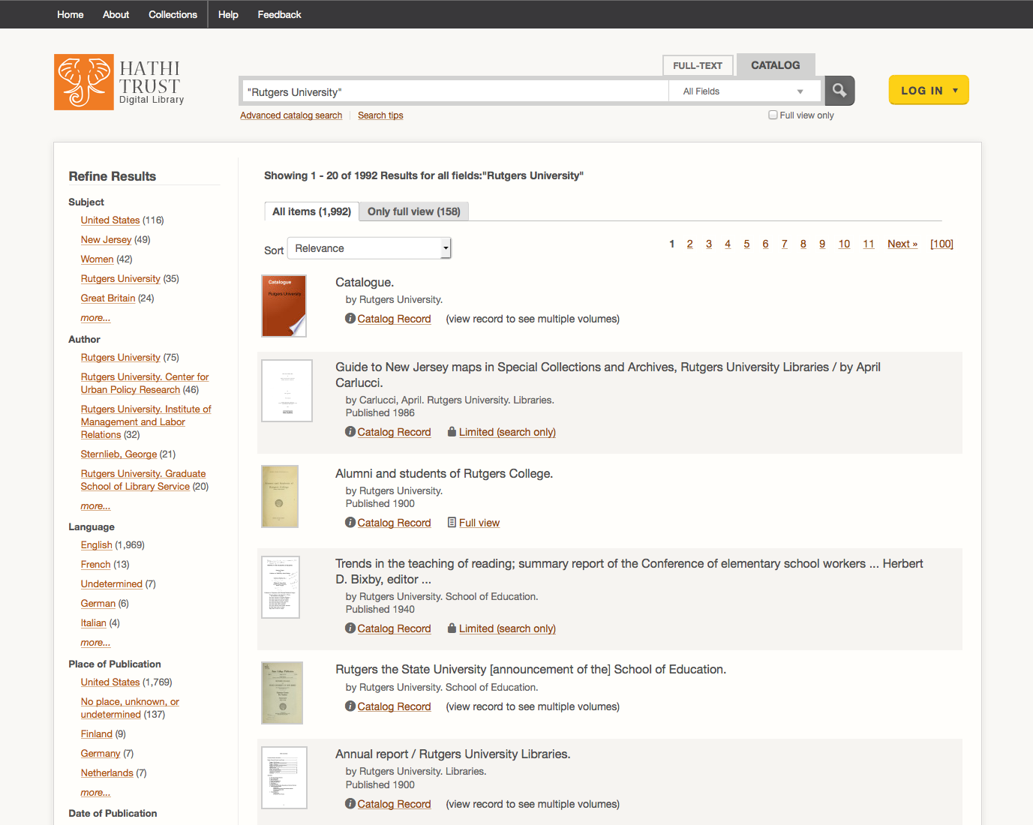

Slide 23
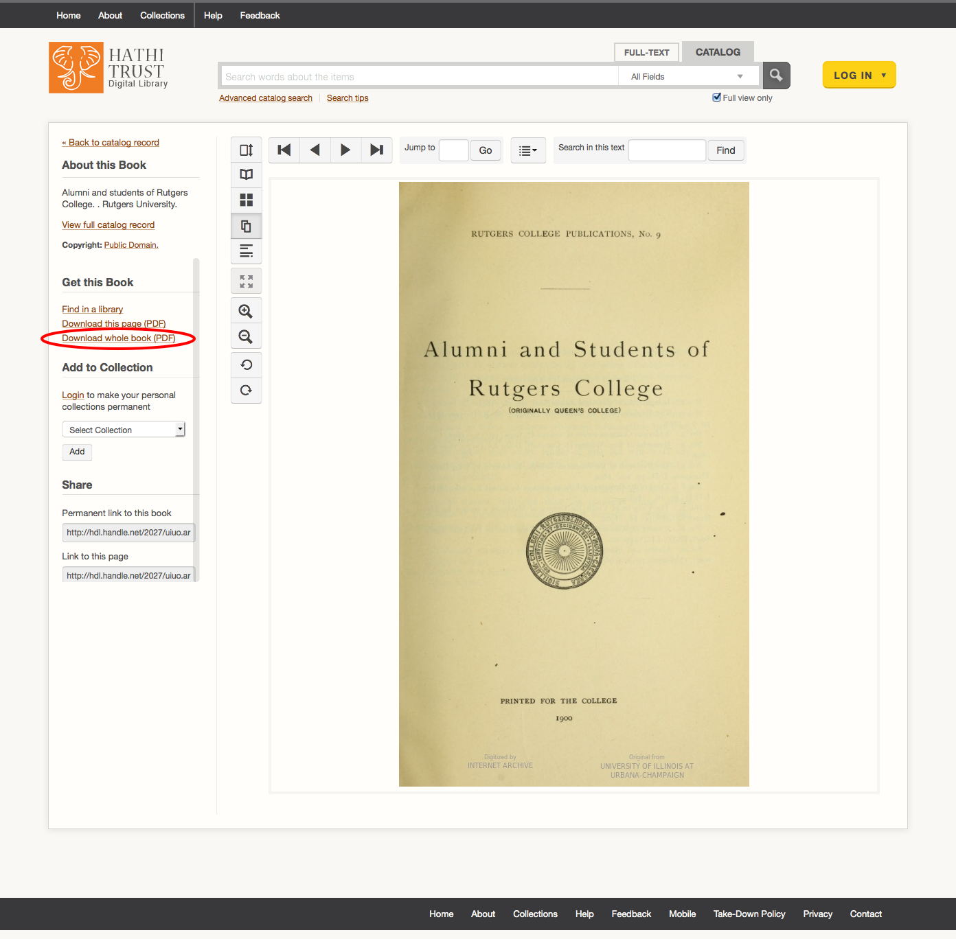
✔
Full View (PD/PDUS, OA)
No Restrictions
Full View (PD/PDUS, OA)
Restrictions
Limited View

Slide 24
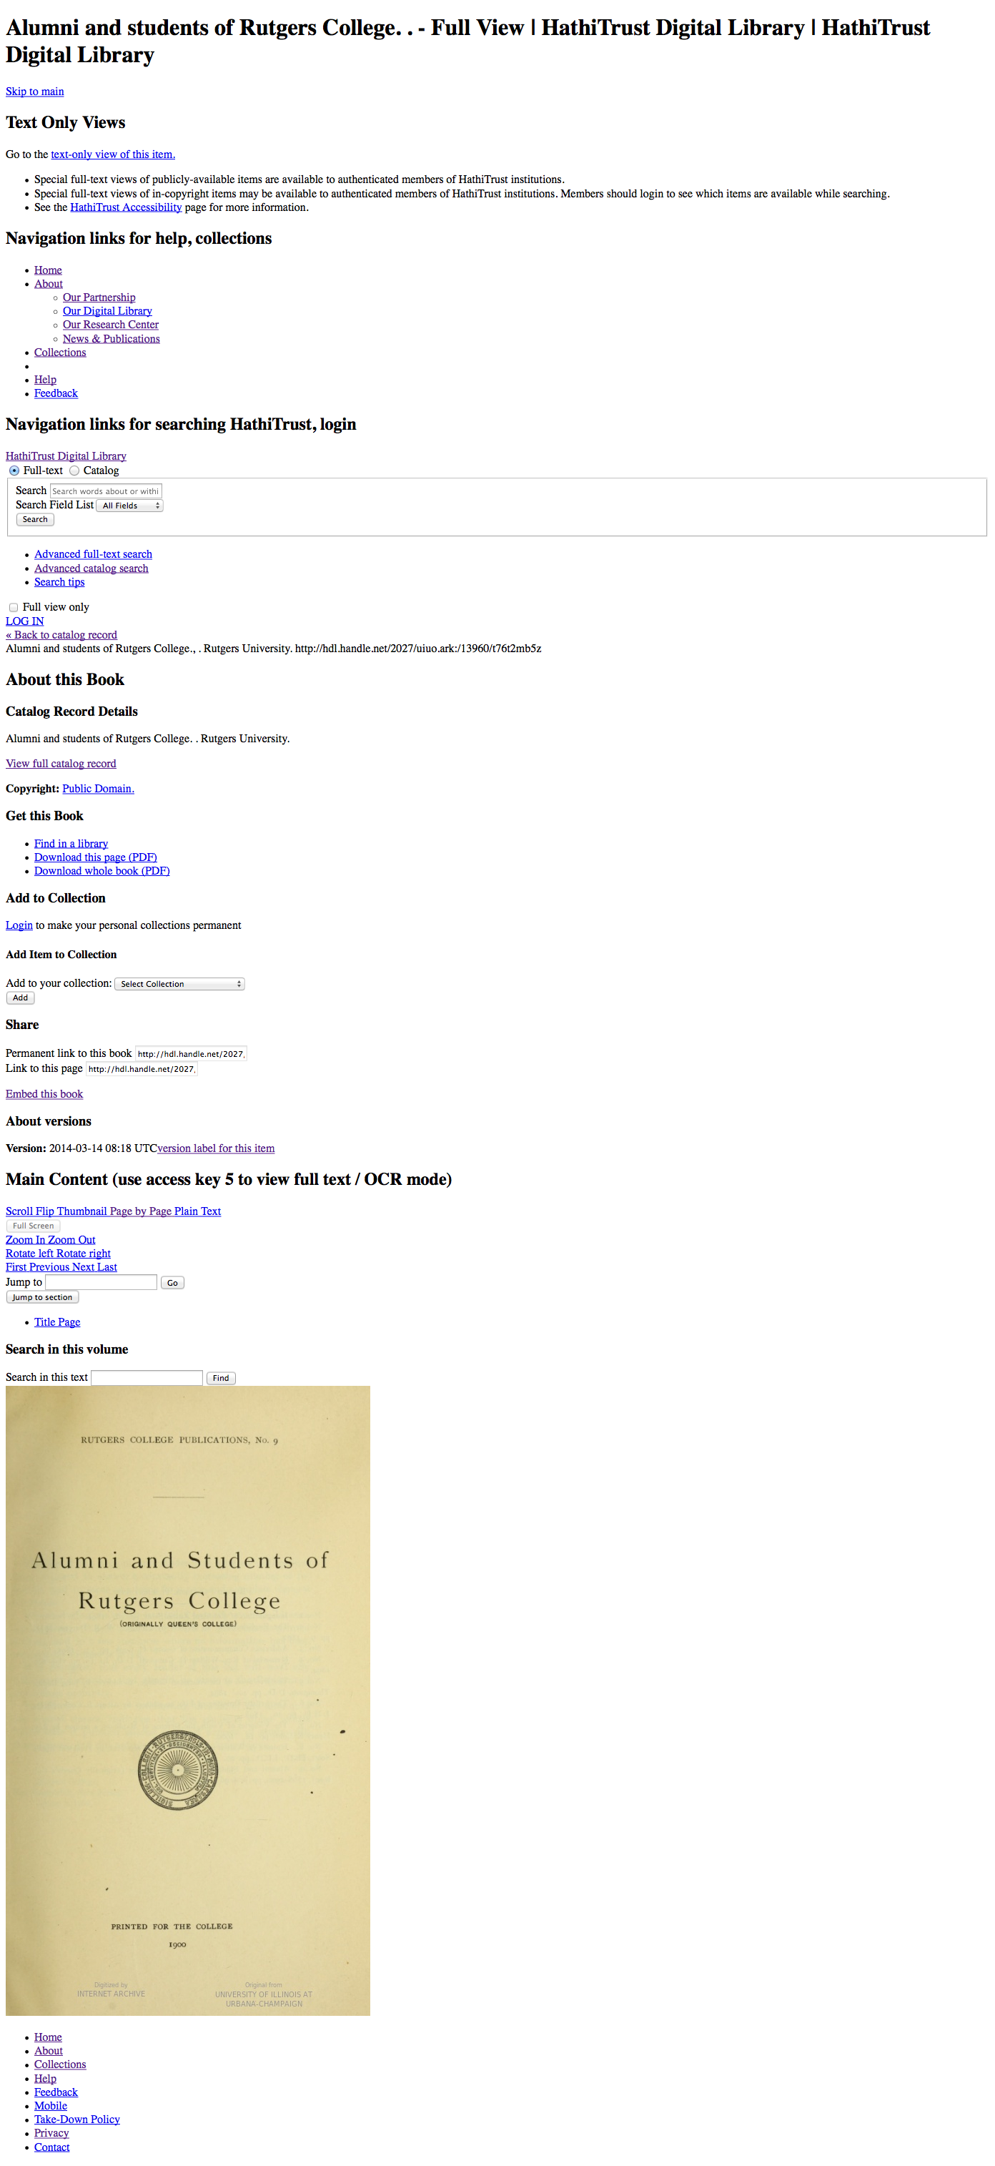

Slide 25
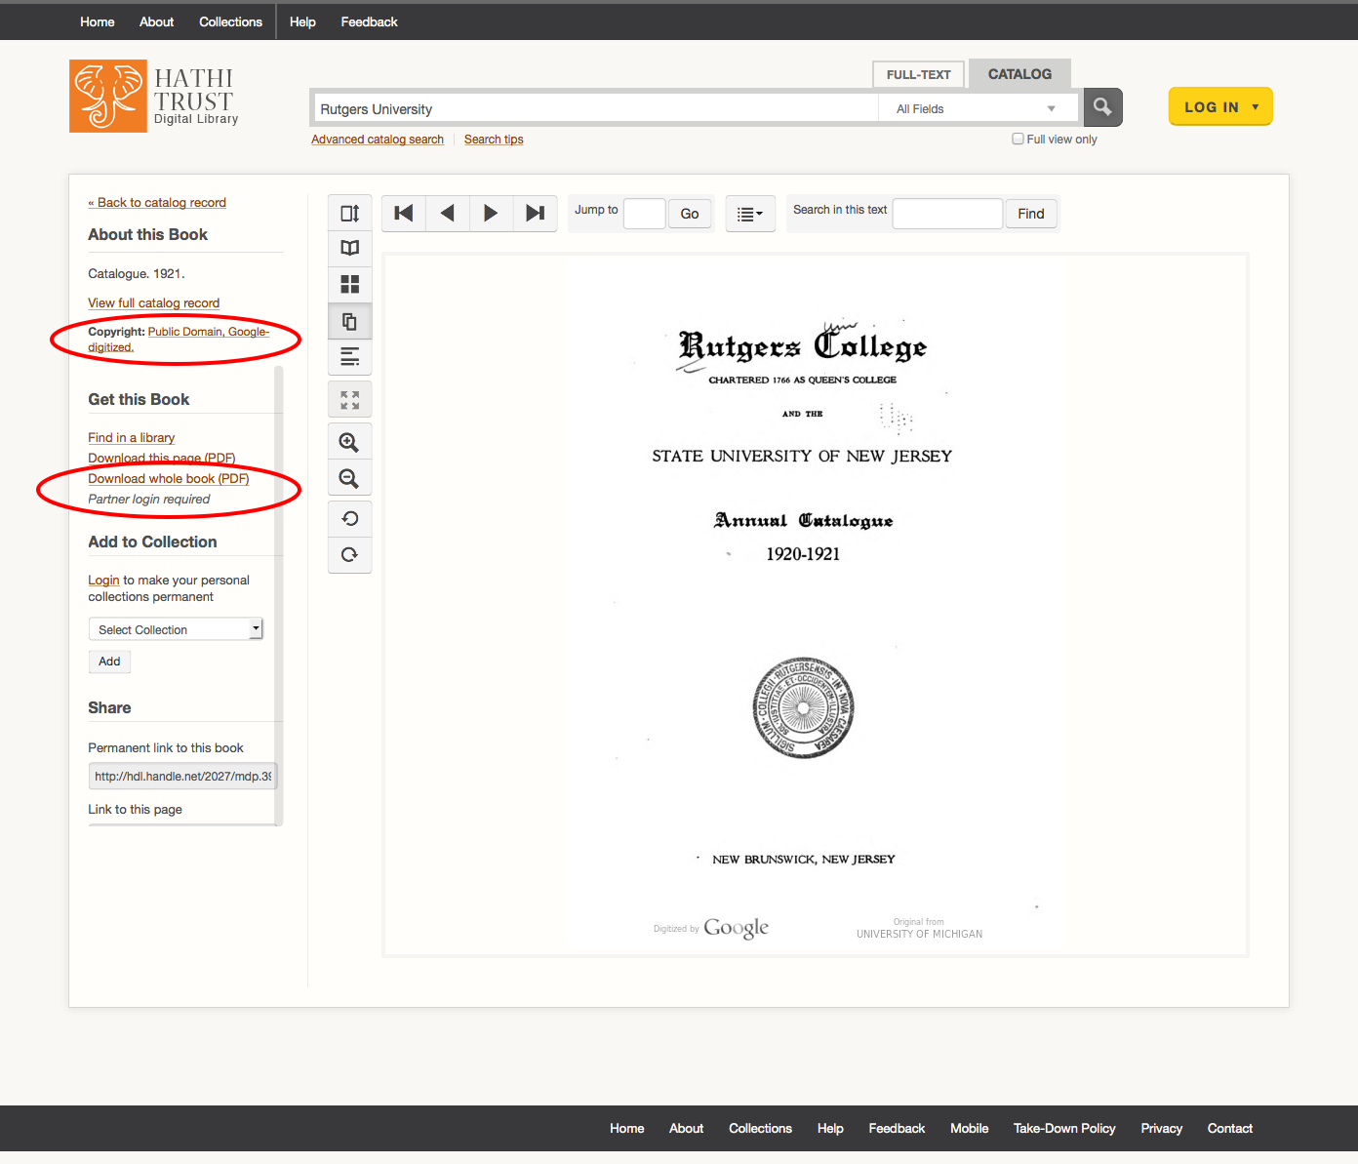
Full View (PD/PDUS, OA)
No Restrictions
✔
Full View (PD/PDUS, OA)
Restrictions
Limited View

Slide 26
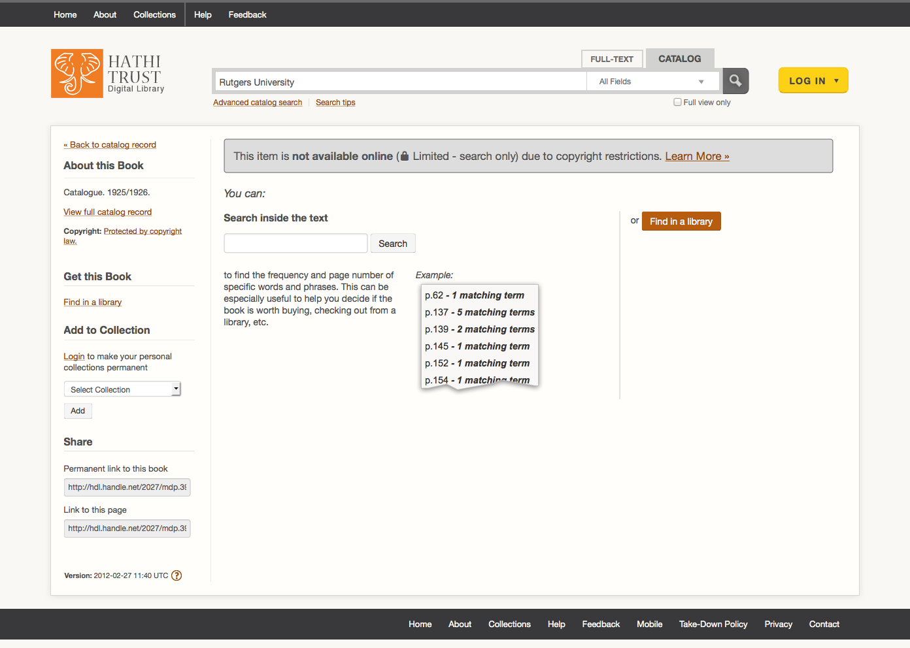
Full View (PD/PDUS, OA)
No Restrictions
Full View (PD/PDUS, OA)
Restrictions
✔
Limited View

Slide 27
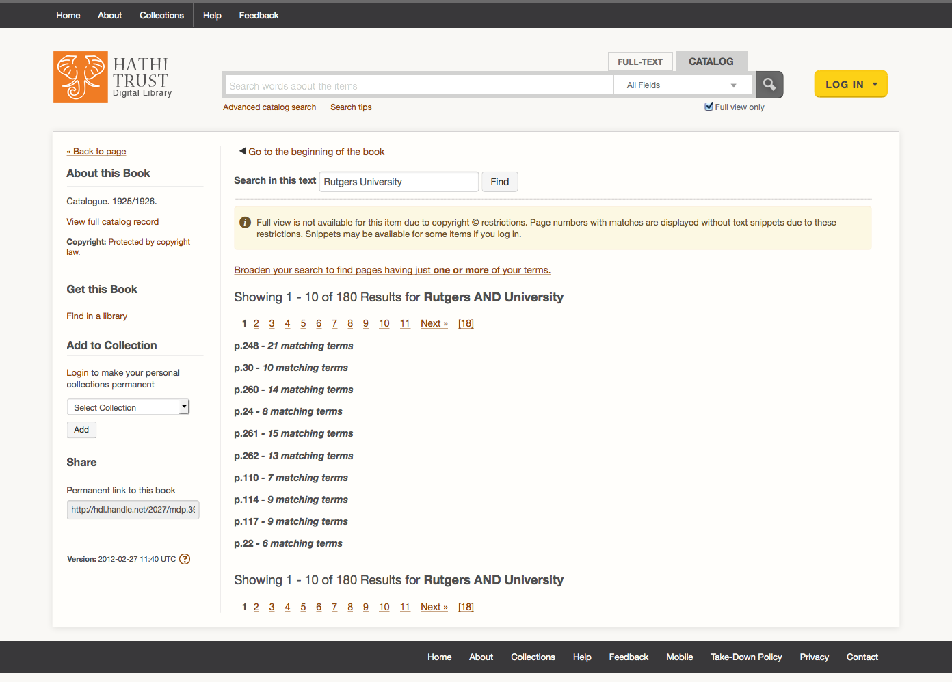

Slide 28
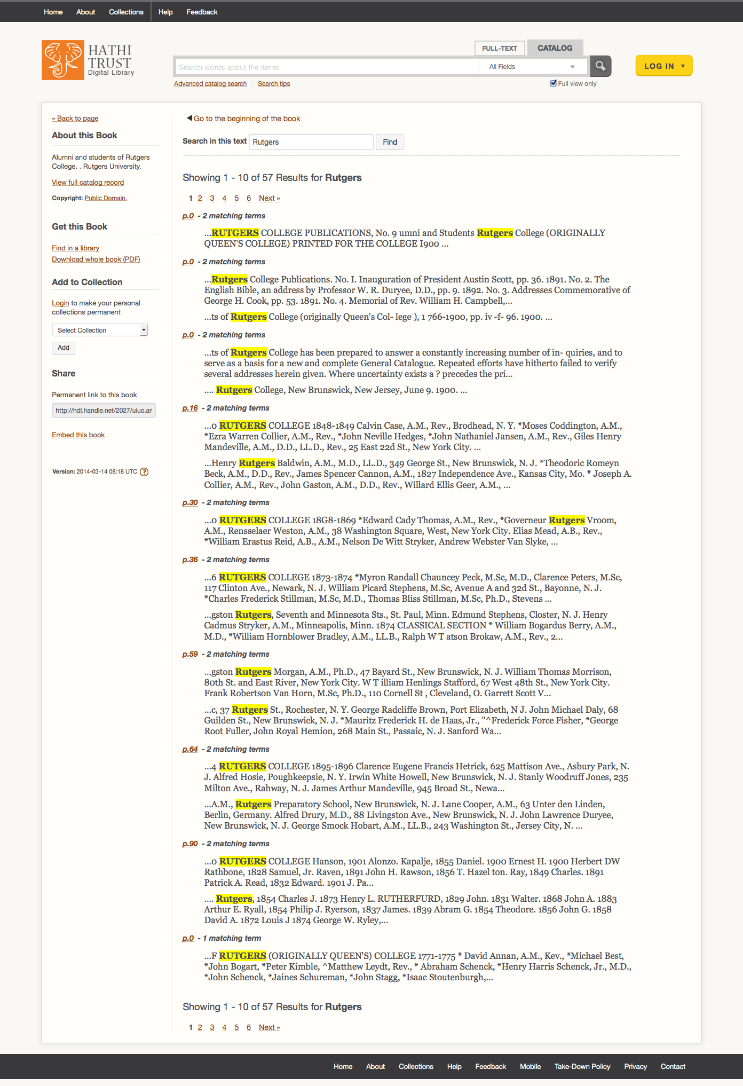

Slide 29
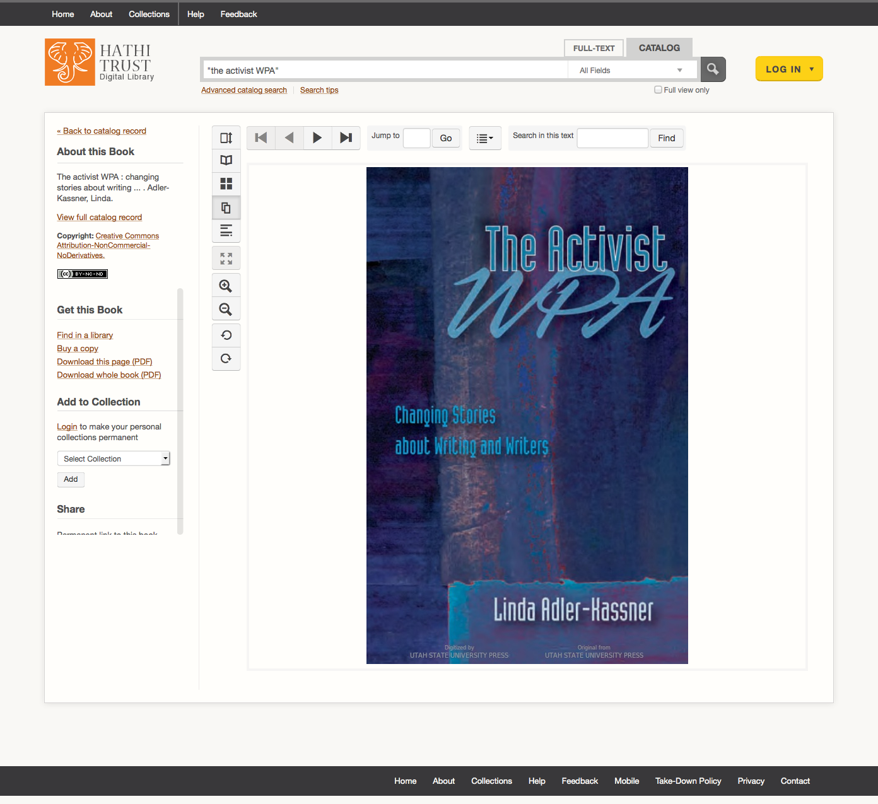
✔
Full View (PD/PDUS, OA)
No Restrictions
Full View (PD/PDUS, OA)
Restrictions
Limited View

Slide 31
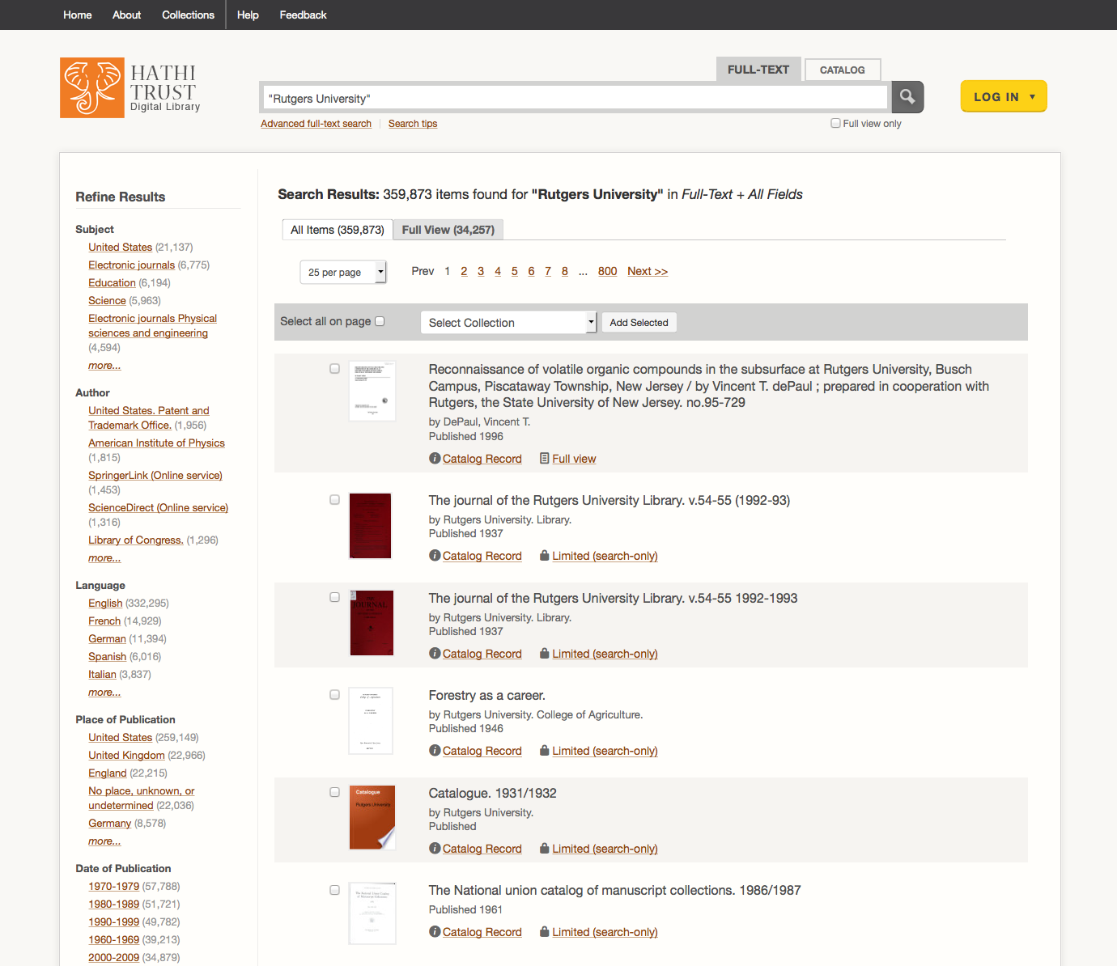

Slide 32
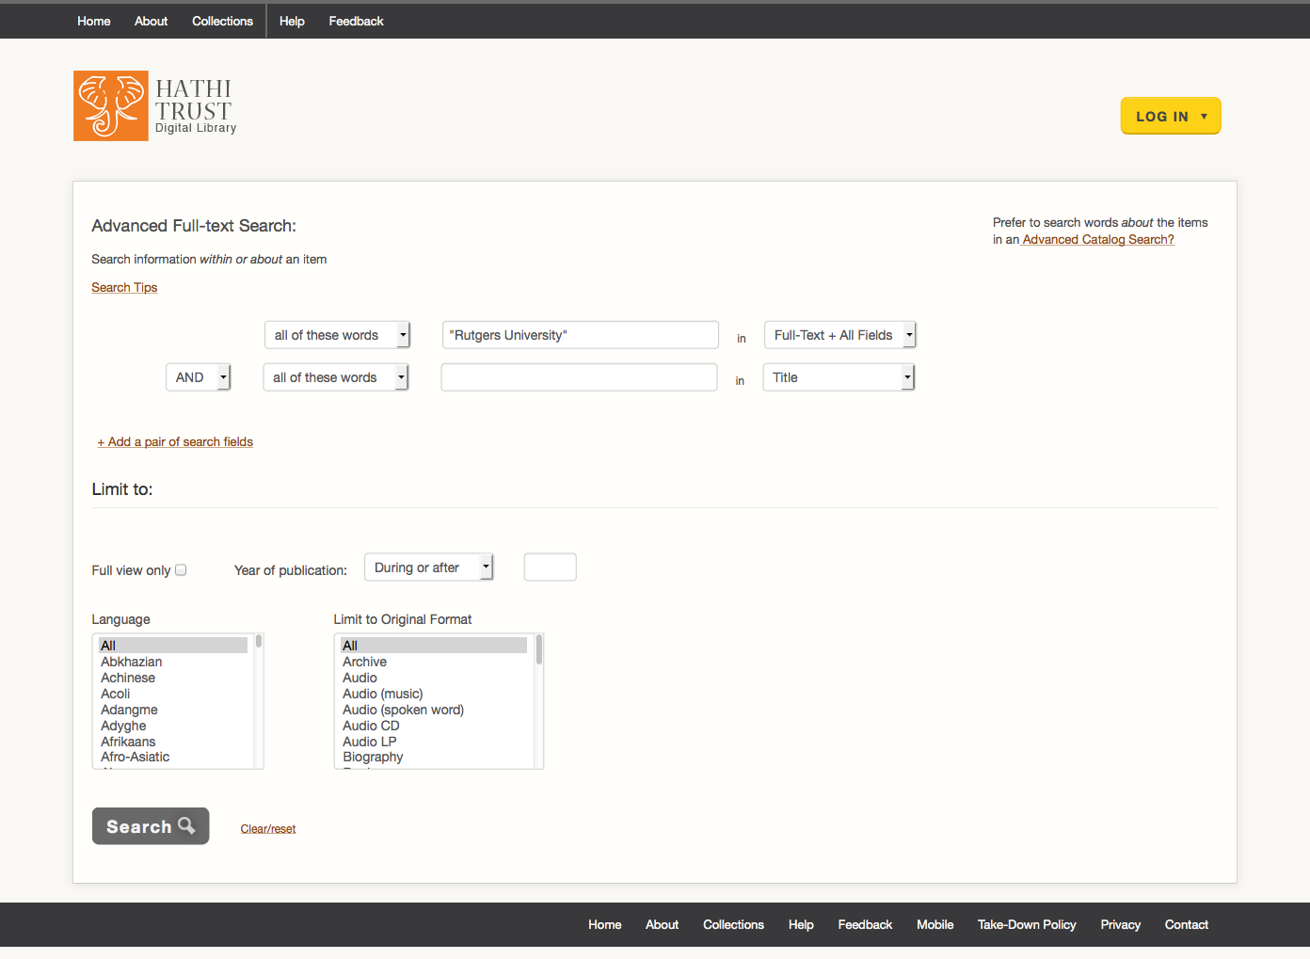

Slide 33
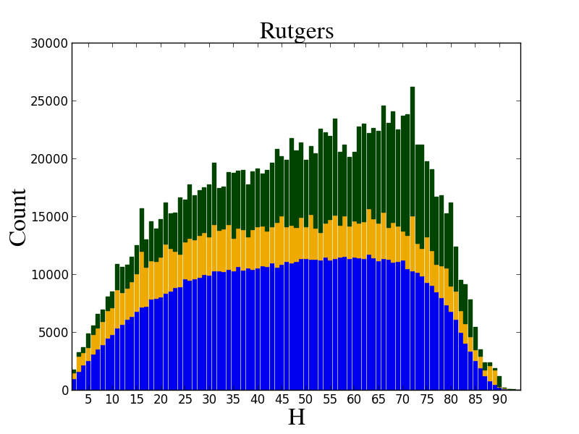

Slide 34
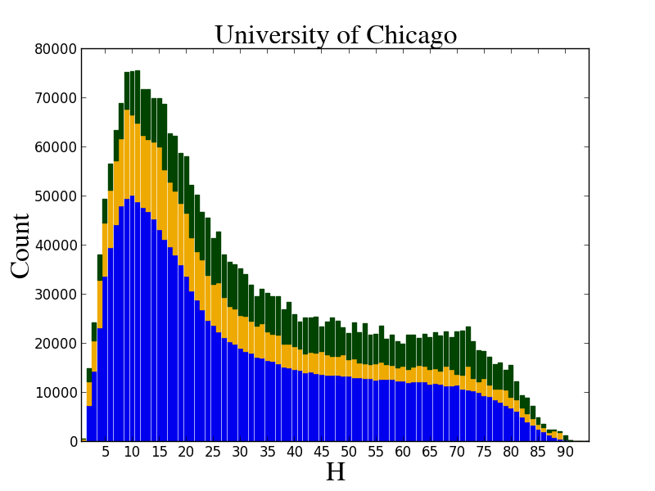

Slide 35
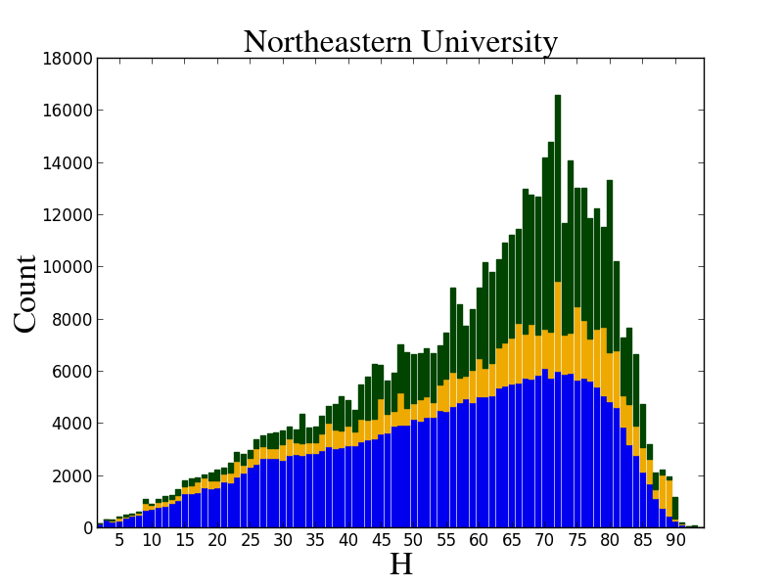

Slide 36
Lawful uses
Access to users who have print disabilities
Access works that are damaged or missing and also out of print
Subject to terms and conditions at http://www.hathitrust.org/access_use#ic-access

Slide 37
Type of work | Searchable (bibliographic and full-text) | Viewable* | Full-PDF download | Print on Demand | Print disabilities* | Preservation uses (Section 108)*
Public domain worldwide | Worldwide | Worldwide | Partners-only if 3rd-party restrictions, if not, worldwide. | Worldwide | Worldwide | N/A
Public domain (US) – Non-US works published between 1873 and 1923. | Worldwide | When accessed from with the United States | Partners in the US if 3rd party restrictions, if not, anyone in the US | Available within the United States | Partners in the US; partners worldwide where laws permit | N/A
Works that rights holders have opened access to in HathiTrust | Worldwide | Worldwide | If third-party restrictions, full-PDF only available if opened with CC license) | Worldwide with permission | Worldwide | N/A
Works that are in-copyright or of undetermined status | Worldwide | Not available | Not available | Not available | Partners in the US; partners worldwide where laws permit | Partners in the US; partner worldwide where laws permit
* Note: Access to in-copyright works is subject to conditions listed in HathiTrust’s policies on Access and Use.

Slide 38
Best way to ensure you are getting full access: LOGIN

Slide 39
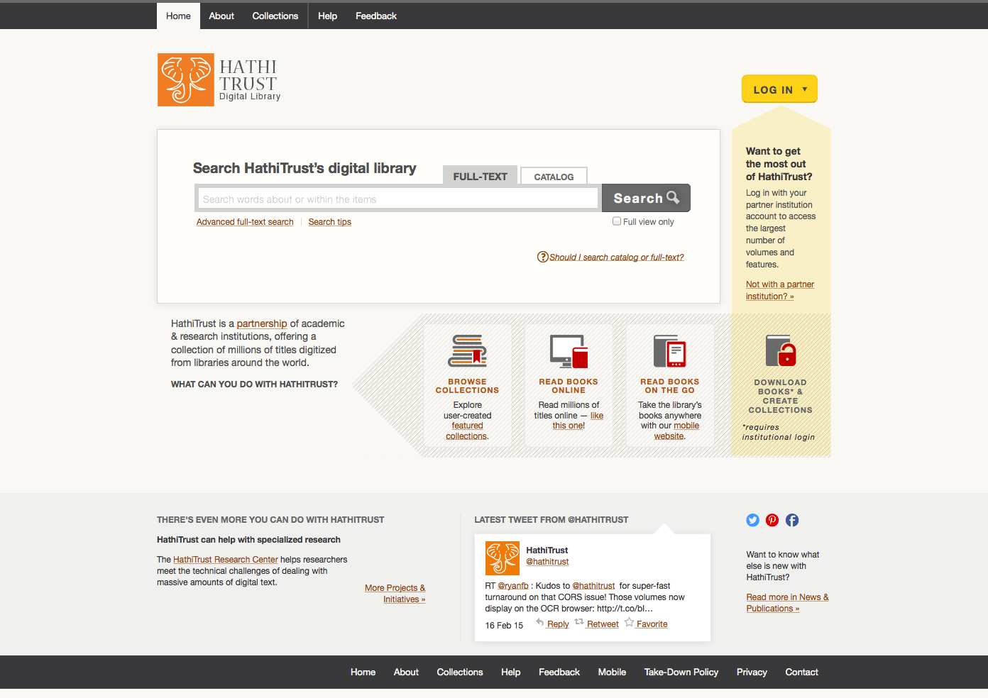

Slide 40
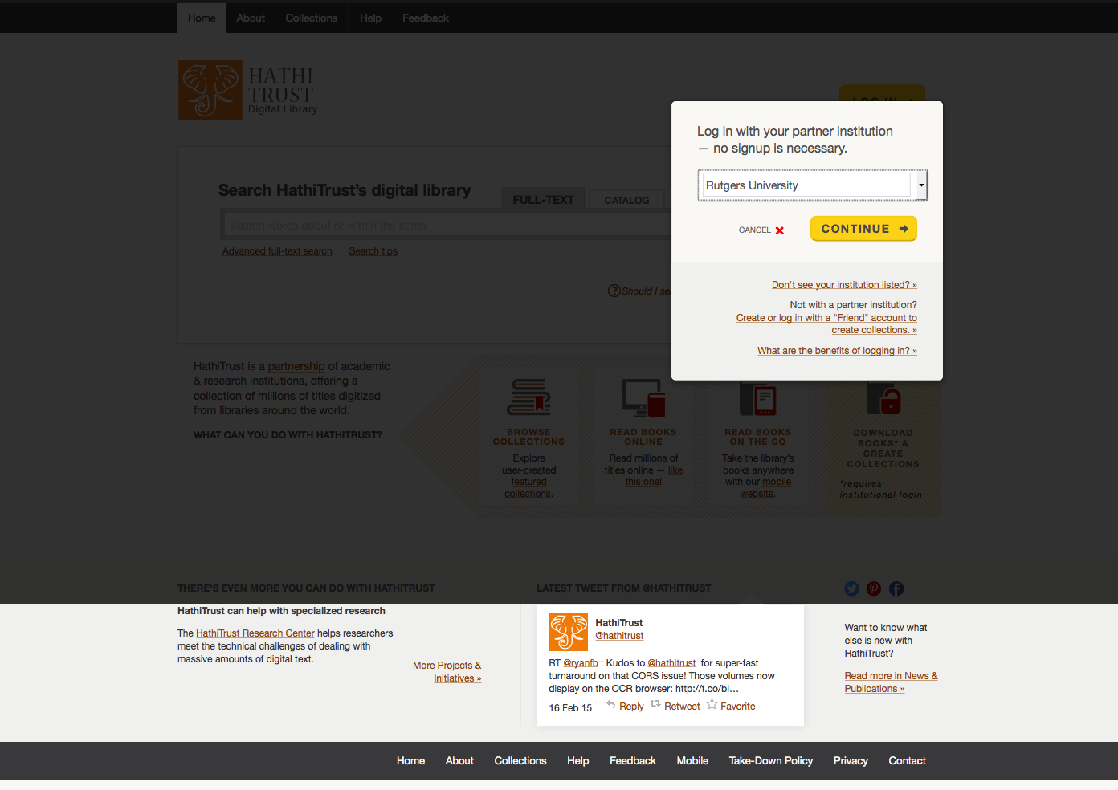

Slide 41
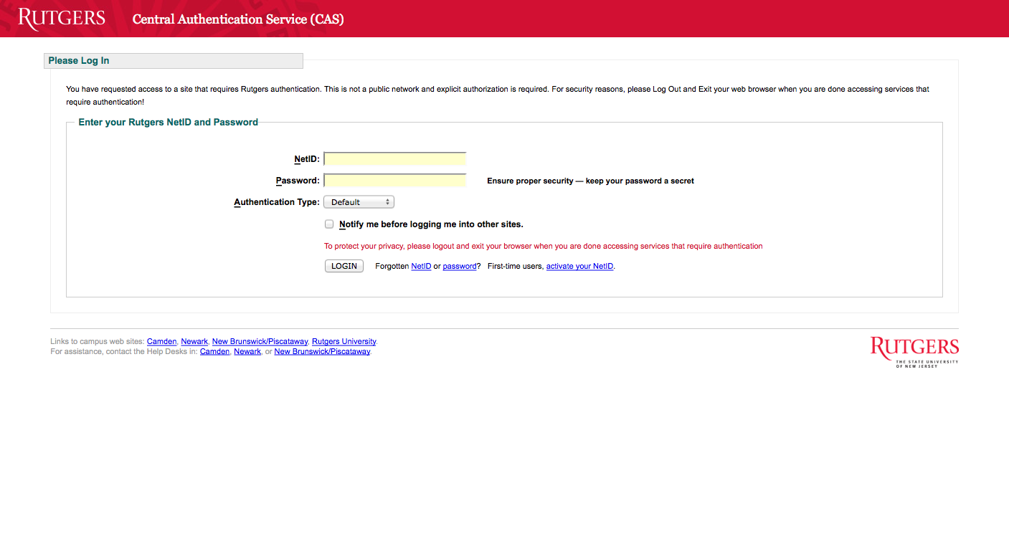

Slide 42
User Collections
Featured Collections:
https://babel.hathitrust.org/cgi/mb?colltype=featured
All Collections with at least 250 items
https://babel.hathitrust.org/cgi/mb?colltype=all

Slide 43
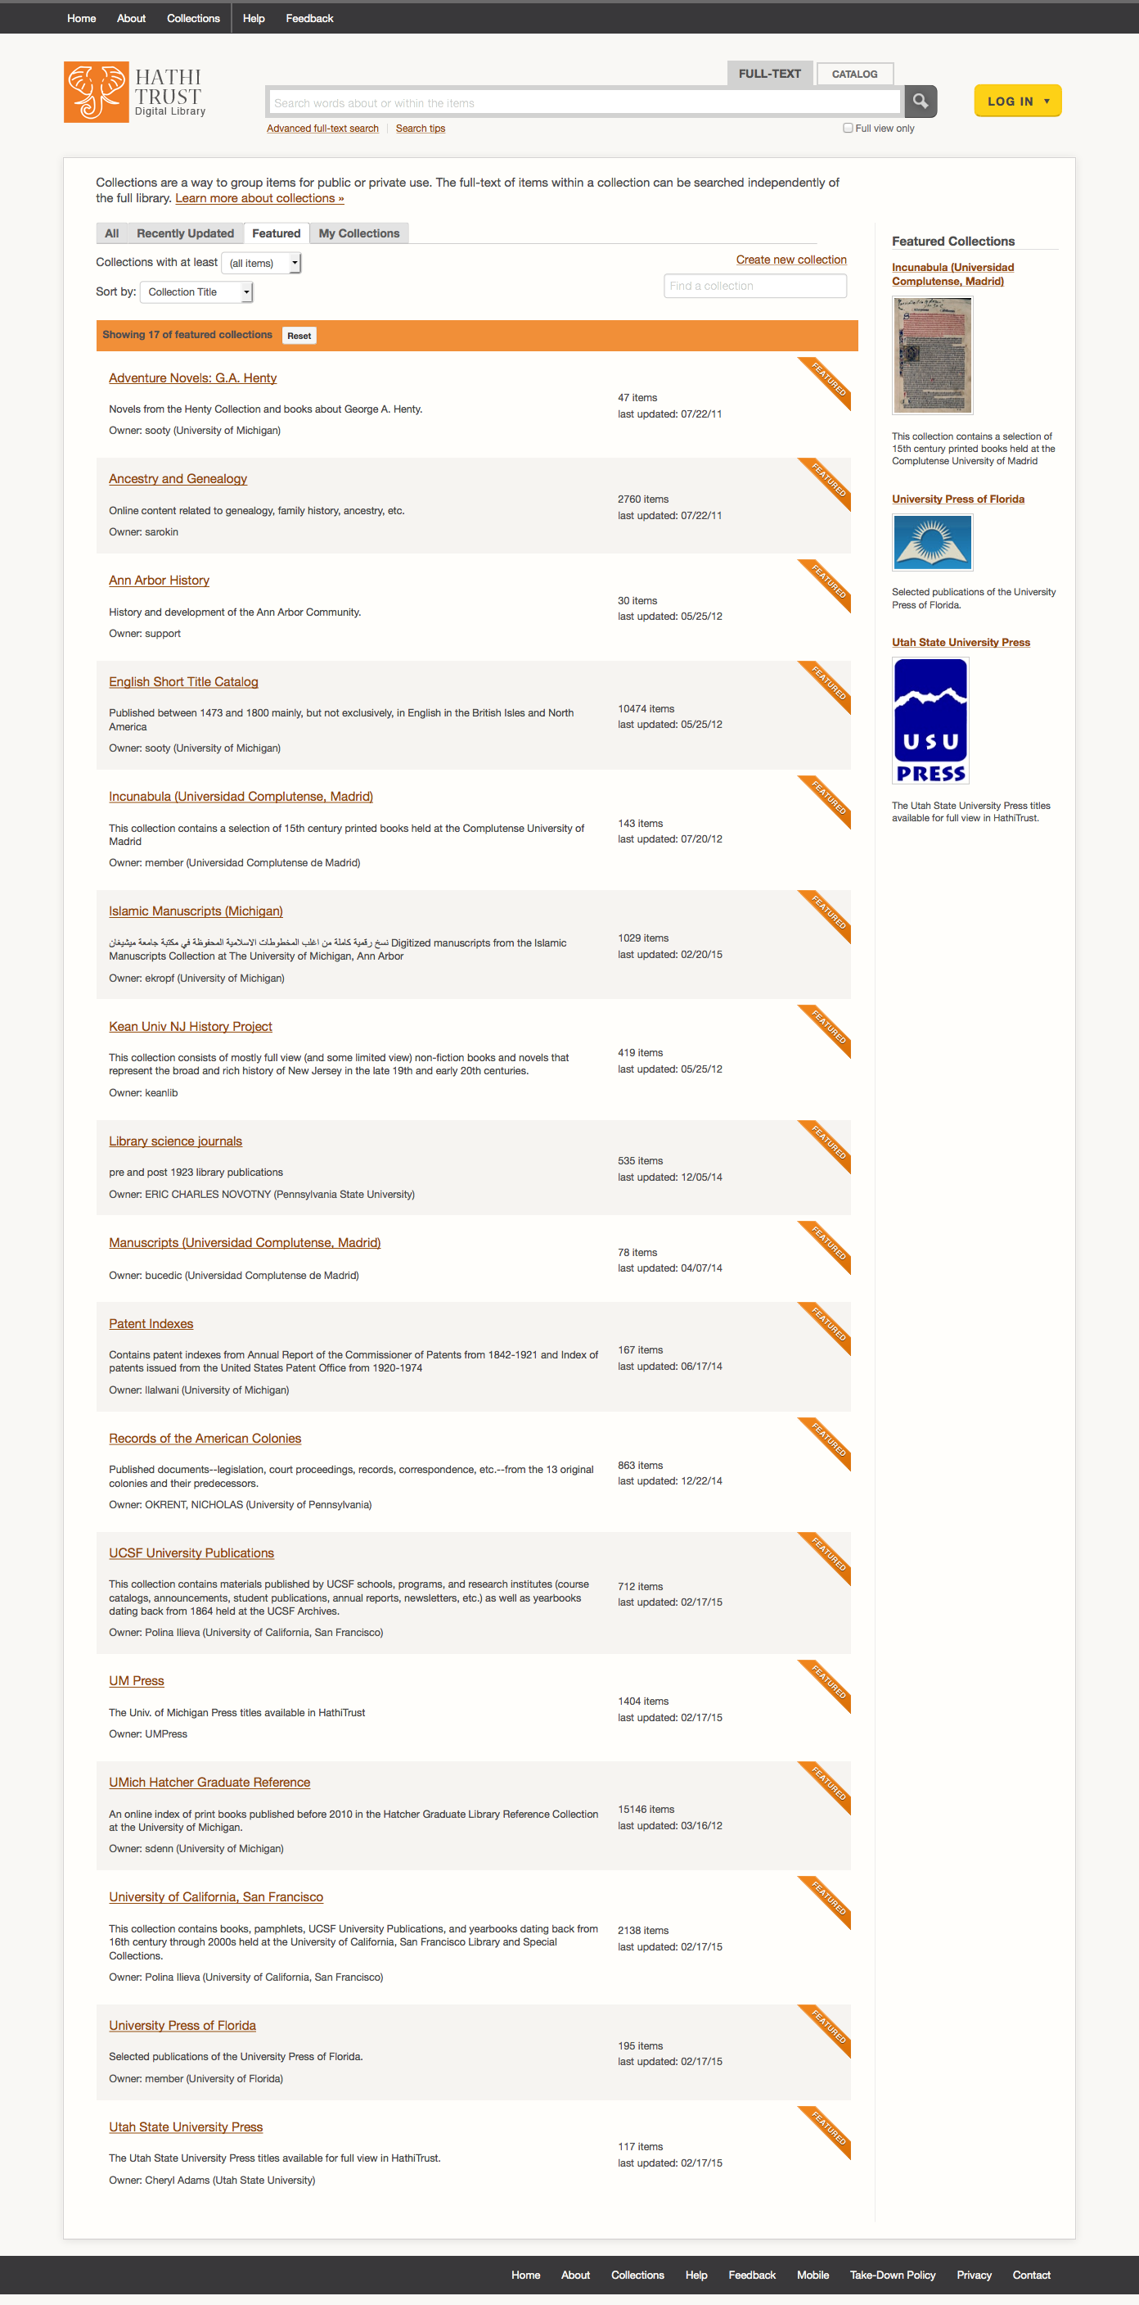
Adventure Novels: G. A. Henty
Ancestry and Genealogy
Ann Arbor History
English Short Title Catalog
Incunabula (Universidad Complutense de Madrid)
Islamic Manuscripts
Kean University NJ History Project
Library Science Journals
Manuscripts (Universidad Complutense de Madrid)
Patent Indexes
Records of the American Colonies
UCSF University Publications
UM Press
UMich Hatcher Reference
University of California, San Francisco
University Press of Florida
Utah State University Press

Slide 44
Examples of uses
Oxford English Dictionary research
@bgzimmer Ben Zimmer 7/4/11
@armavirumque Problem is "cut the mustard" (OED 1891) predates "muster." Earliest I've seen for "muster" is 1912.http://bit.ly/kOy3aD
Thesis research
Islamic Manuscripts
Local/Family History

Slide 45
APIs
Bibliographic API
Volume and rights information
MARC records
http://www.hathitrust.org/bib_api
OAI
http://www.hathitrust.org/data
“Hathifiles”
http://www.hathitrust.org/hathifiles
Data API
Volume and rights information
Page images
OCR
http://www.hathitrust.org/data_api

Slide 46
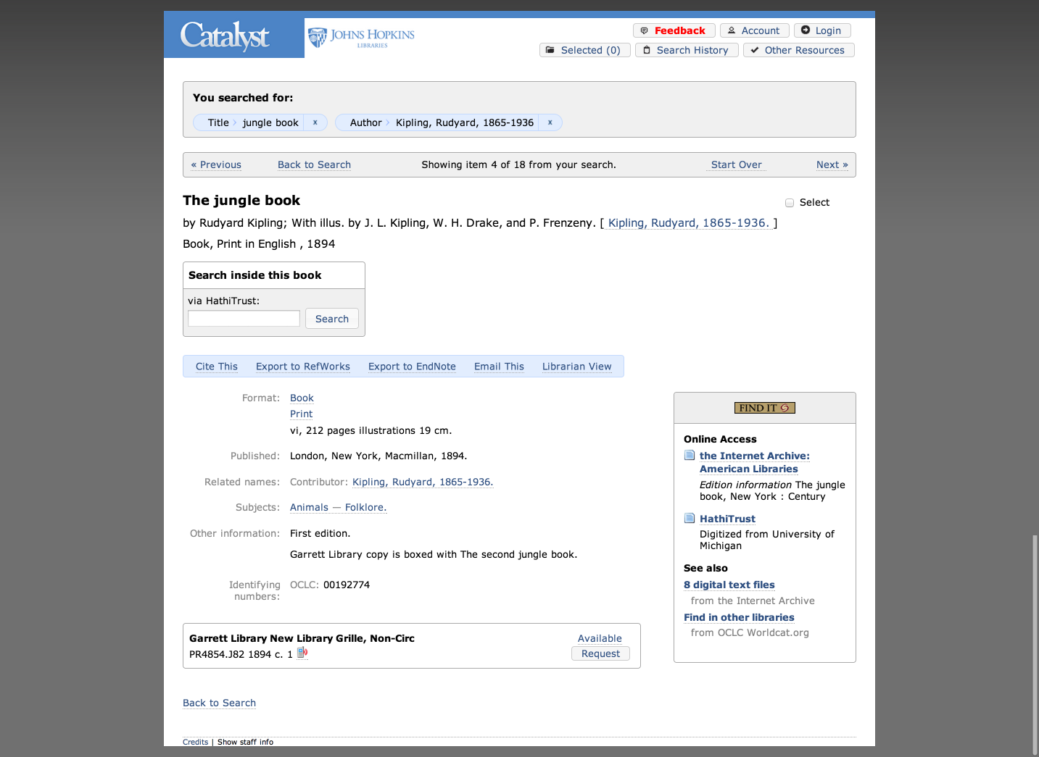

Slide 47
Services
Public domain and open access works ✔
Full download of materials where possible* ✔
Print on demand ✔
Lawful uses of in-copyright works* ✔
Collections and APIs ✔
Computational Access

Slide 48
Computational Access
Distribution of datasets
http://www.hathitrust.org/datasets
Non-Google-digitized Dataset (540,000+)
PD, PDUS, Open Access
Signed researcher statement
Google-digitized (4.4 million+)
PD, PDUS, Open Access
Agreement between institution and Google
Brief proposal
Characterize texts
Provide ids (custom sets possible)
Research, results, use of results
Signed researcher statement

Slide 49
HTRC
http://www.hathitrust.org/htrc
HathiTrust Research Center
Developed collaboratively by Indiana University and University of Illinois; launched July 2011
Enables computational access to public domain and open access materials; working to support in-copyright materials as well
Secure Environment – bring researchers to the data
Build services and tools that facilitate research by digital humanities and informatics communities
Advanced Collaborative Support
RFP: http://www.hathitrust.org/htrc/acs-rfp
Awards: http://www.hathitrust.org/htrc_acs_awards_spring2015

Slide 50
Using the HTRC
Portal: sign up, browse volume lists and algorithms, execute algorithms, view results
https://htrc2.pti.indiana.edu/HTRC-UI-Portal2/
Workset Builder
https://htrc2.pti.indiana.edu/blacklight
Sandbox: run own algorithms
Getting Started with the HTRC [Google doc]
http://bit.ly/1hCnyzX

Slide 51
HTRC UnCamp
Ann Arbor, Michigan
March 30-31, 2015
Keynotes, demos, “unconference” sessions
Registration, Agenda, Logistics:
http://www.hathitrust.org/htrc_uncamp2015
Email lists
http://www.hathitrust.org/htrc

Slide 52
Projects (1)
Detecting Literary Plagiarisms: The Case of Oliver Goldsmith.
Douglas Duhaime. University of Notre Dame.
Taxonomizing the Texts: Towards Cultural-Scale Models of Full Text. Colin Allen, Jaimie Murdock. Indiana University Bloomington.
Allen and Murdock will carry out a cultural-scale investigation and topic modeling on HT public-domain full text through random sampling to select collections
Topic modeling to select collections according to the Library of Congress Subject Headings (LCSH).
The Trace of Theory.
Geoffrey Rockwell, Laura Mandell, Stefan Sinclair, Matthew Wilkens, Susan Brown. University of Alberta, Texas A&M University, University of Notre Dame.
Topic modeling; tools and methods to track the concept of “theory”.
Dr. Michelle Alexopolous, University of Toronto
Tracking technology diffusion through time using the HT corpus.

Slide 53
Projects (2)
Burton, Vernon. “The South as ‘Other,’ the Southerner as ‘Stranger.’”
Explore how attitudes expressed in print about slavery, southerners, and non-southerners have changed over both time and space.
Ted Underwood, Associate Professor of English at the University of Illinois, Urbana-Champaign.
Using public domain texts received from HathiTrust to explore changing relationships in literary genres from 1700-1899.
Andrew Piper, Associate professor of German literature at McGill University.
Analyzing linguistic patters in German texts from 1700-1900
Amanda Watson, librarian at New York University.
Studying How poetry anthologies in selected texts reflect the rise and fall of poets’ reputations over the course of the 19th century.
Glenn Worthey, Digital Humanities Librarian at Stanford University Libraries.
Performing spatio-temporal investigation into the history of Brazilian Portuguese, to be accomplished by text-mining methods (n-gram analysis, etc.).
Matthew Wilkens, Assistant professor of English, University of Notre Dame.
American Council of Learned Societies (ACLS) fellowship for project “Literary Geography at Scale.”

Slide 54
How to find out more
About: http://www.hathitrust.org/about
Resources: http://www.hathitrust.org/resources
Twitter: http://twitter.com/hathitrust
Facebook: http://www.facebook.com/hathitrust
Monthly newsletter:
http:www.hathitrust.org/updates
RSS http://www.hathitrust.org/updates_rss
Contact us: feedback@issues.hathitrust.org
Blogs: http://www.hathitrust.org/blogs
Large-scale Search
Perspectives from HathiTrust

