Slide 1
Putting it All Together: HathiTrust Vision, Practice, and Implementation
SENYLRC: Technologies and Trends Series
February 20, 2013
Jeremy York
Project Librarian, HathiTrust
Unless otherwise noted, these slides and their contents are licensed under a Creative Commons Attribution Unported License.

Slide 2
Poll
I work in
A public library
An academic library
A special or corporate library
A school library
Other

Slide 3
Poll
I work primarily in
Public services
Technical services
Collections
Administration
Information Technology
Other

Slide 4
Outline
Introduction
Vision
Practice
Implementation
How HathiTrust Can Change the Way We Work

Slide 5
Introduction

Slide 6
Partnership
Arizona State University
Baylor University
Boston College
Boston University
Brandeis University
California Digital Library
Carnegie Mellon University
Columbia University
Cornell University
Dartmouth College
Duke University
Emory University
Florida State University
Getty Research Institute
Harvard University Library
Indiana University
Iowa State University
Johns Hopkins University
Kansas State University
Lafayette College
Library of Congress
Massachusetts Institute of Technology
McGill University`
Michigan State University
New York Public Library
New York University
North Carolina Central
University
North Carolina State
University
Northwestern University
The Ohio State University
The Pennsylvania State
University
Princeton University
Purdue University
Stanford University
Syracuse University
Texas A&M University
Universidad Complutense
de Madrid
University of Arizona
University of Calgary
University of California
Berkeley
Davis
Irvine
Los Angeles
Merced
Riverside
San Diego
San Francisco
Santa Barbara
Santa Cruz
The University of Chicago
University of Connecticut
University of Delaware
University of Florida
University of Illinois
University of Illinois at Chicago
The University of Iowa
University of Kansas
University of Maryland
University of Miami
University of Michigan
University of Minnesota
University of Missouri
University of Nebraska-Lincoln
The University of North
Carolina at Chapel Hill
University of Notre Dame
University of Pennsylvania
University of Pittsburgh
University of Utah
University of Vermont
University of Virginia
University of Washington
University of Wisconsin- Madison
Utah State University
Vanderbilt University
Virginia Tech
Wake Forest University
Washington University
Yale University Library

Slide 7
Partnership
Requirements
  Member agreement
  Information about print holdings
  http://www.hathitrust.org/eligibility_agreements
Authentication via Shibboleth
Checklist
  http://www.hathitrust.org/partnership_checklist

Slide 8
Digital Repository
Launched 2008
Initial focus on digitized book and journal content
  10.6 million total volumes
  5.58 million book titles
  276,000 serial titles
  3.2 million public domain (~31%)

Slide 9
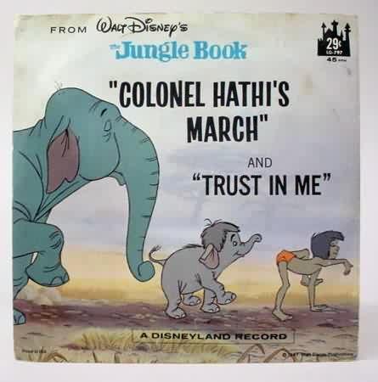
The Name
The meaning behind the name
  Hathi (hah-tee)--Hindi for elephant
  Big, strong
  Never forgets, wise
  Secure
  Trustworthy

Slide 10
Vision

Slide 11
Mission
To contribute to the common good by collecting, organizing, preserving, communicating, and sharing the record of human knowledge

Slide 12
HathiTrust
Universal Library
Common Goal
Single Entity, Many Partners

Slide 13
Collections and Collaboration
Comprehensive collection
  Preservation…with Access
  Repository centralized, yet open
Shared strategies
  Copyright
  Collection management, development
  Preservation
  Discovery / Use
  Bibliographic Indeterminacy
  Efficient user services
Public Good

Slide 14
Scope and Nature of the Work

Slide 15
1. Comprehensive Collection

Slide 16
Selection

Slide 17
Selection
Scope

Slide 18
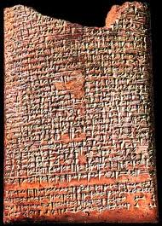
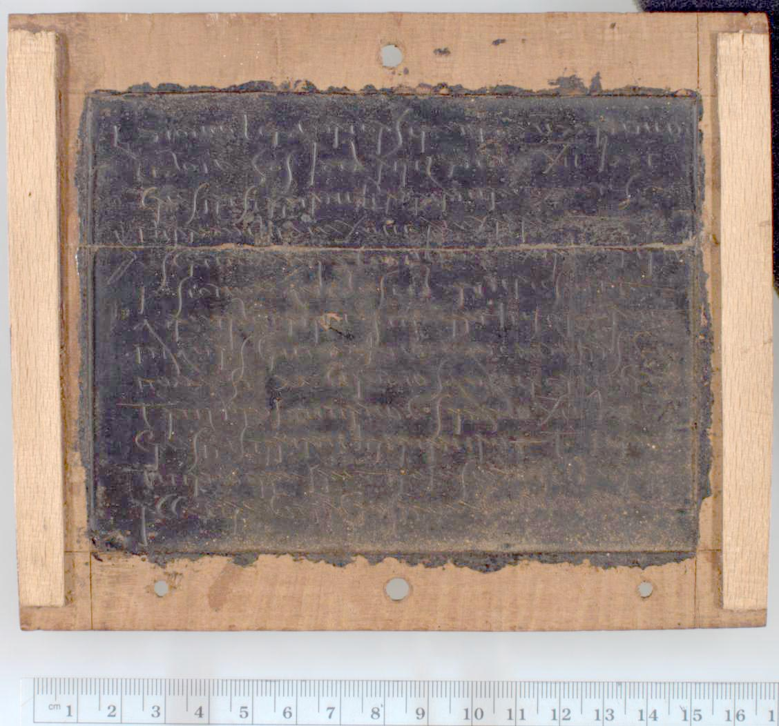
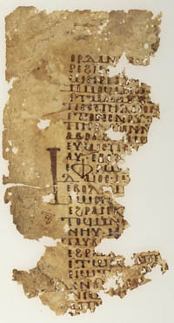
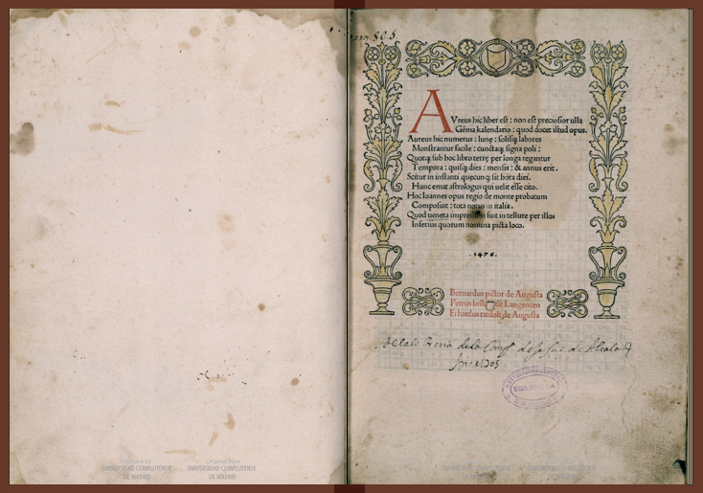
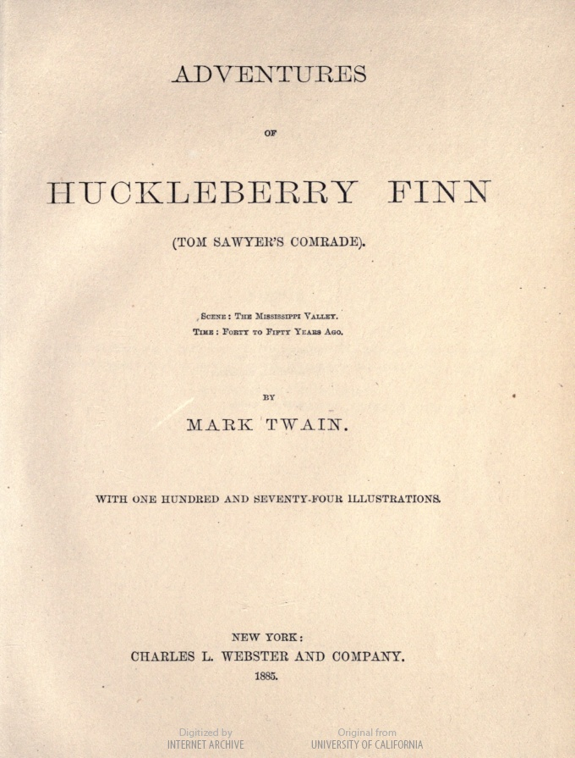
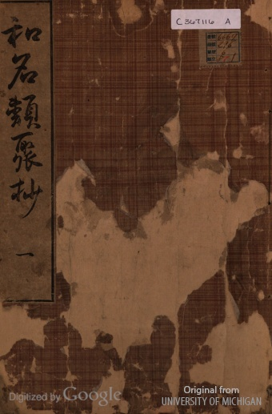
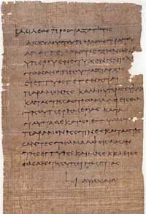
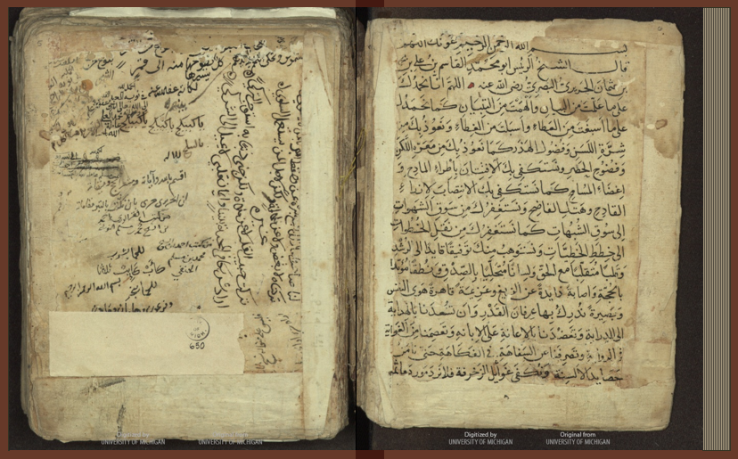
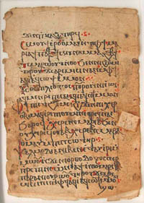
What is the published record?

Slide 19
The Collective Collection
Currently published literature
  print and digital
Published literature already owned by libraries
  print
Special Collections
  rare, unique, often unpublished, various types
New genres of scholarly communication
  databases, data, collaborative authorship

Slide 20
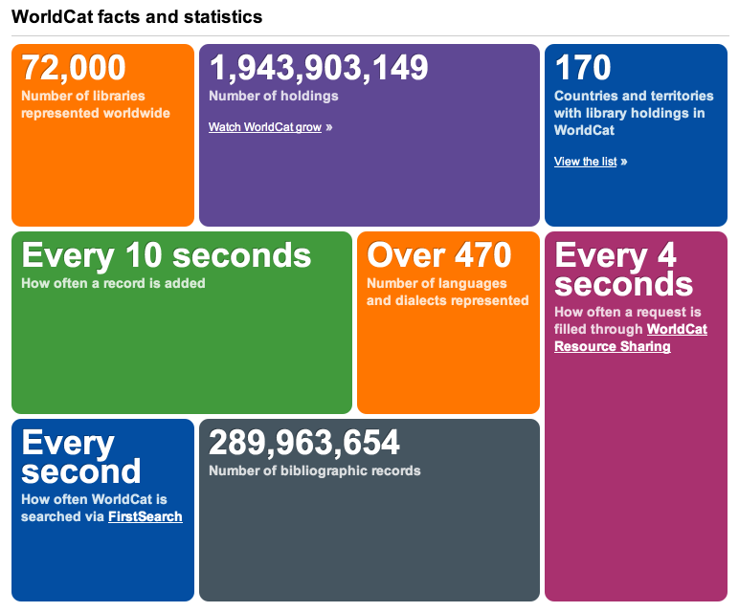
* As of February 2013

Slide 21
United States
 | Libraries | Volumes
Academic Libraries | 3,689 | 1,076,027,407
National Libraries | 4 | 75,150,000
Public Libraries | 9,225 | 815,909,000
School Libraries | 81,920 | 399,918,034
Special Libraries | 8,819 | 229,161,950
Total | 103,657 | 2,596,166,391
http://www.oclc.org/globallibrarystats/default.htm

Slide 22
2. Building the digital archive

Slide 23
Shared infrastructure
  Centralized
    Administration: Ingest, validation, content integrity
    Functionality: full-text search, viewing print on demand
  Geographically distributed
    In terms of backup, disaster recovery, digitization, content preparation

Slide 24
Outline
Introduction ✔
Vision ✔
  Mission and Goals ✔
  Comprehensive ✔
  Building the digital archive ✔
Practice
Implementation
How HathiTrust Can Change the Way We Work

Slide 25
Questions

Slide 26
Practice:
Repository and Content

Slide 27
Repository and Content
Objectives
  Direct ingest of non-Google-digitized content
  Support beyond books and journals
  Compliance with TRAC
    Organizational model

Slide 28
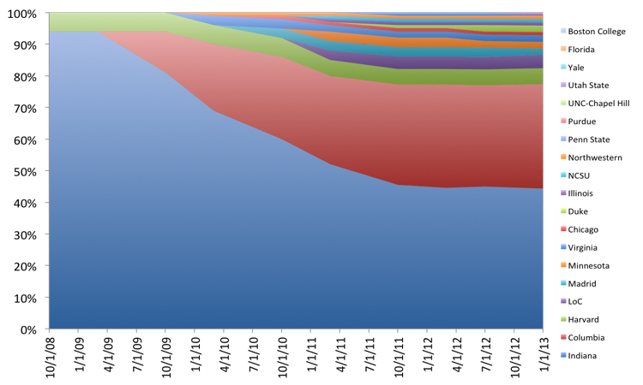

Slide 29
Direct Ingest of non-Google-digitized content

Slide 30
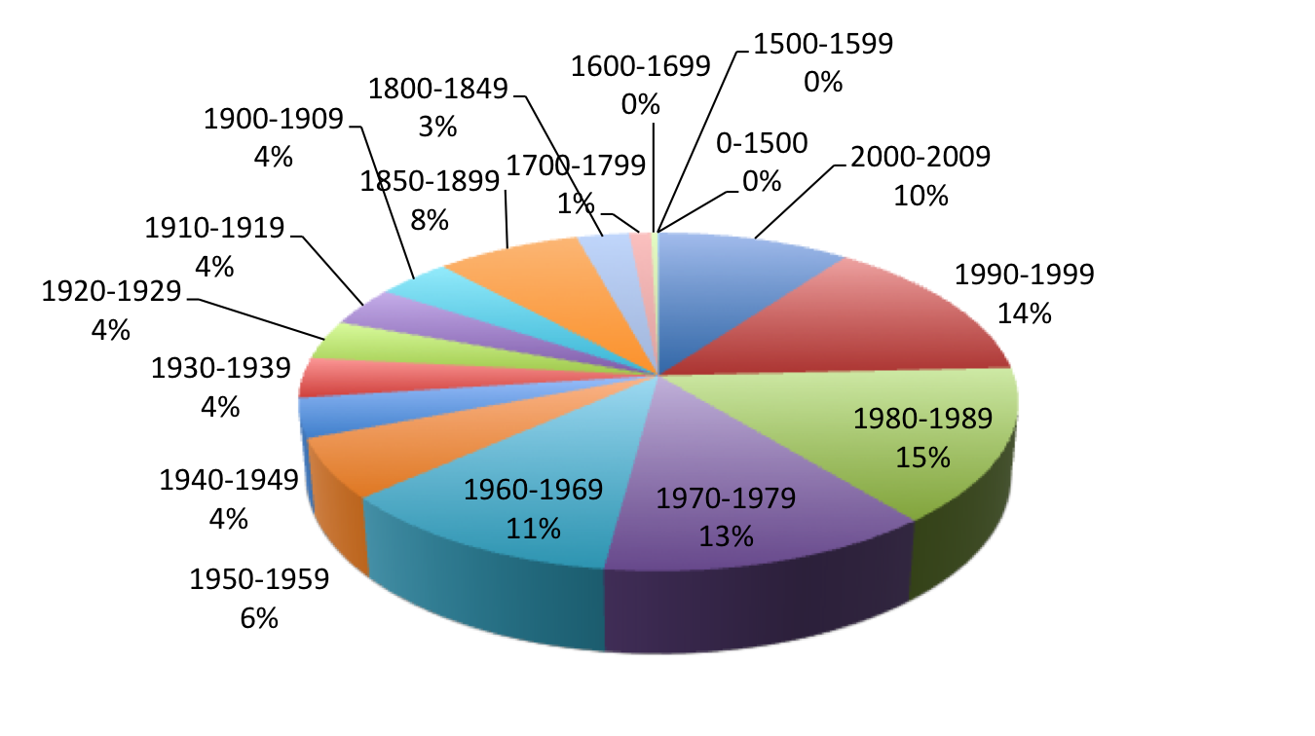
Dates
Notes:
30

Slide 31
Language Distribution (1)
The top 10 languages make up ~86% of all content
Notes:
31

Slide 32
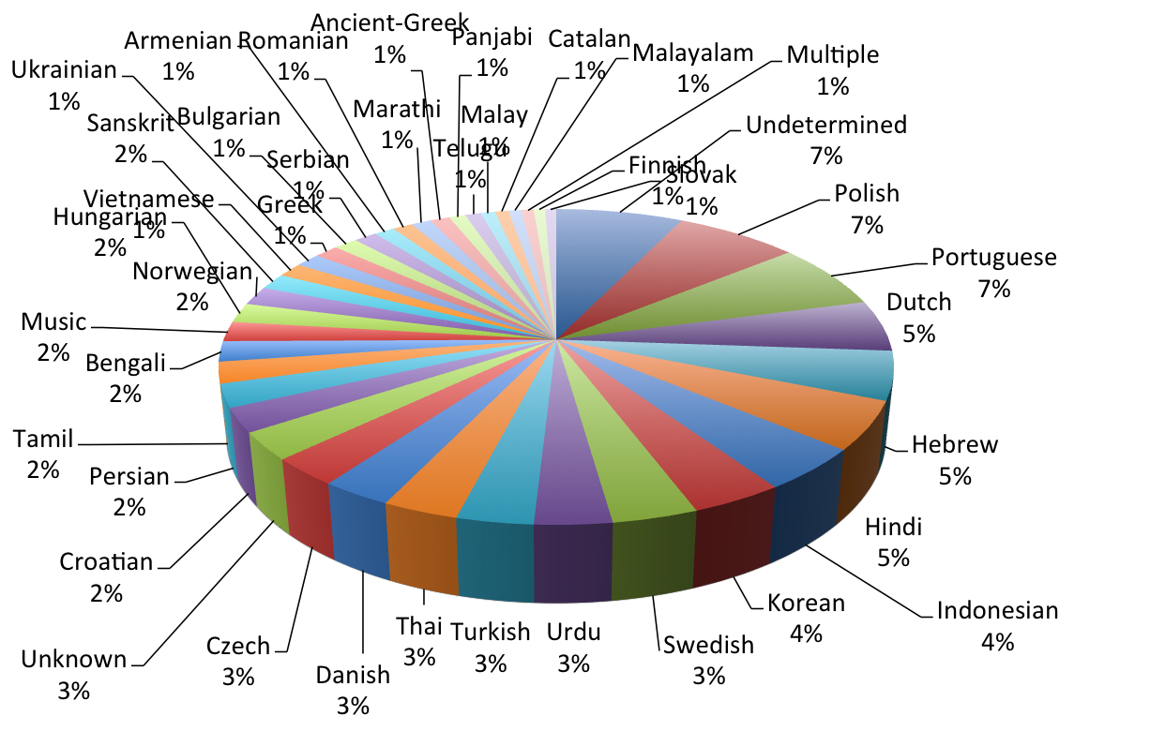
Language Distribution (2)
The next 40 languages make up ~13% of total
Notes:
32

Slide 33
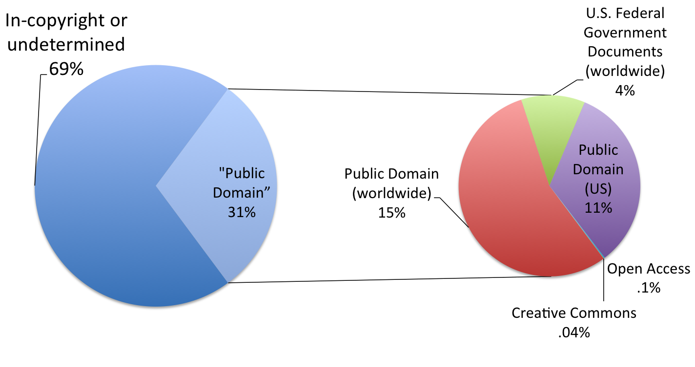
Copyright Distribution
Notes:
33

Slide 34
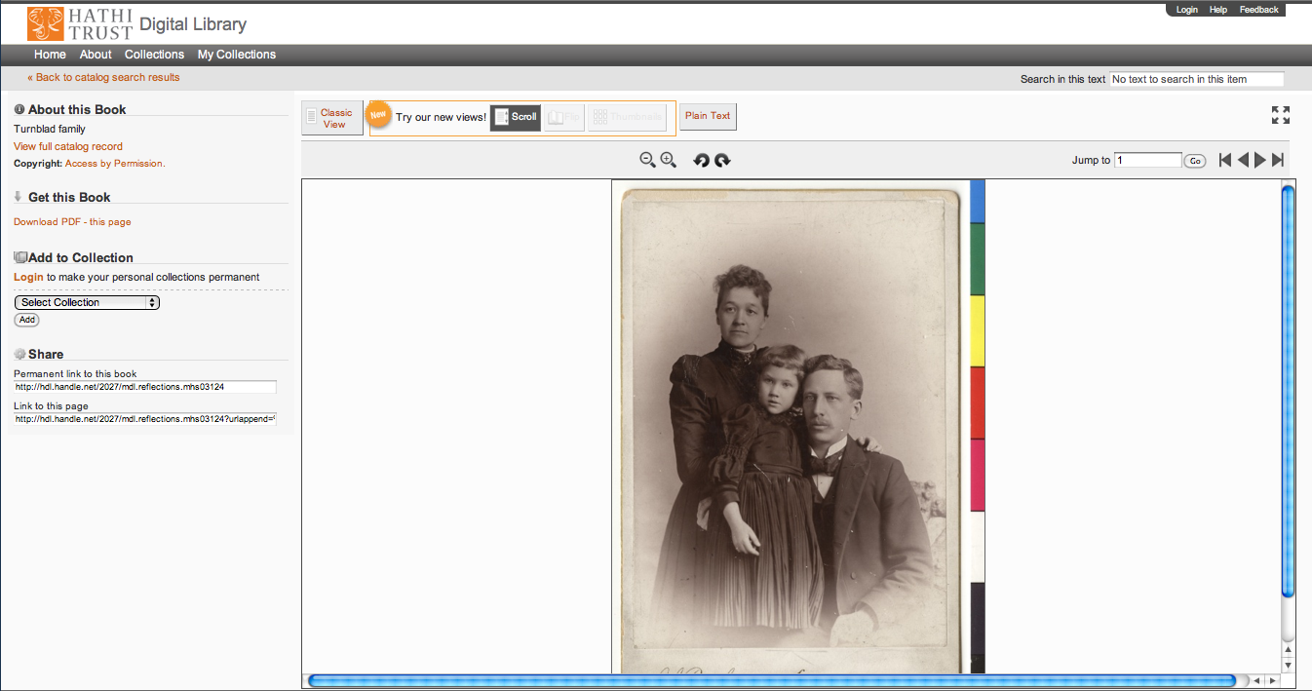
Support Beyond Books and Journals

Slide 35

http://lib.umich.edu/mpach
Package of tools to enable publication of open access, born-digital journal content, directly into HathiTrust
  Including accompanying data and media files
Allows integration with popular journal publishing tools such as Open Journal Systems (OJS)

Slide 36
Higher Education
Source / Archive
Editorial
Market

Slide 37
Repository and Content
Objectives
  Direct ingest of non-Google-digitized content ✔
  Support beyond books and journals ✔
  Compliance with TRAC
    Organizational model

Slide 38
Compliance with TRAC

Slide 39
Executive Committee
Strategic Advisory Board
Budget/Finances Decision-making
Guidance on Policy, Planning
Collective Work: Working Groups and Committees
Operational
  Communications
  User Support
  User Experience
  Strategic
  Collections
  Discovery Interface
  Full-text Search
Operational
Communications
User Support
User Experience
Distributed work
Driven by needs of institutions
Leverage across the partnership
Projects, Grant Work, Ingest Specifications, PageTurner, Bibliographic Data Management
HathiTrust

Slide 40
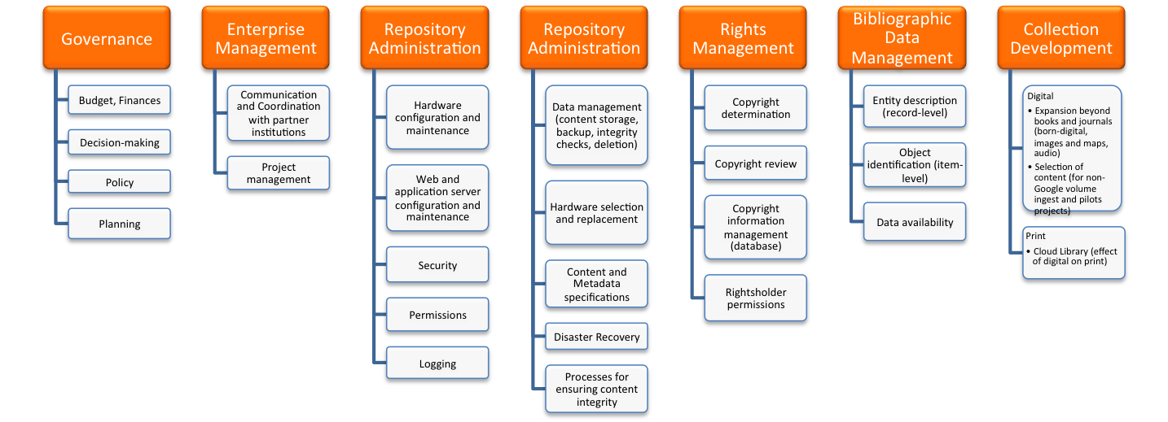
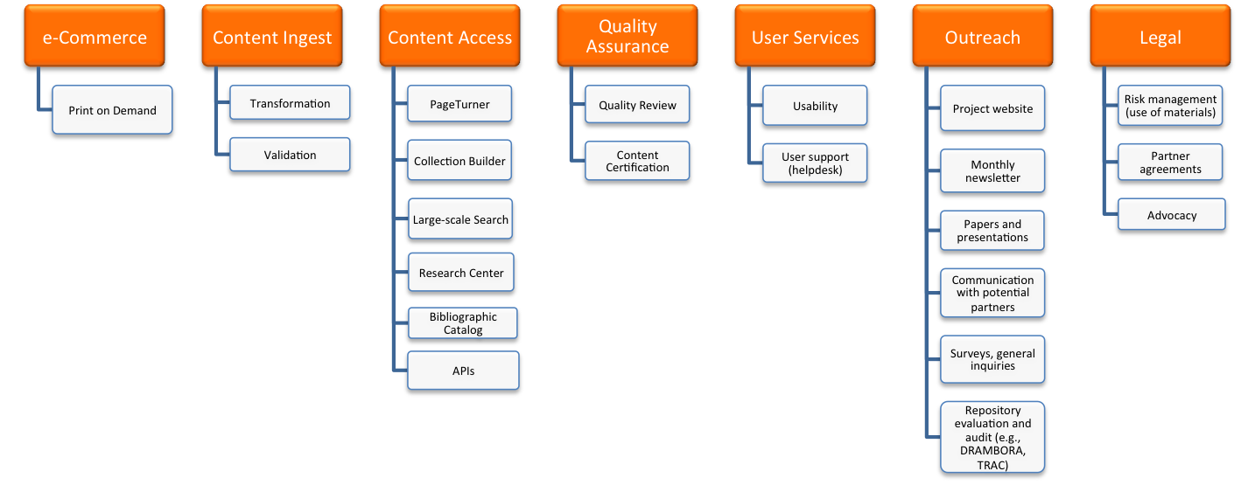
Financial contributions of partners
HathiTrust Functional Framework

Slide 41
Constitutional Convention
October 2011
52 partners
3-year review overseen by SAB
Ballot Proposals
  Print monograph storage
  Approval Process for development initiatives
  U.S. Government Documents
  Fee-for-service content deposit
  Governance

Slide 42
Strategic Advisory Board
Guidance on Policy, Planning
12-member Board of Governors
Executive Committee
Chief Executive Officer
Executive Committee
HathiTrust
Budget/Finances
Decision-making

Slide 43
Practice: Repository and Content
Objectives
  Direct ingest of non-Google-digitized content ✔
  Support beyond books and journals ✔
  Compliance with TRAC ✔
    Organizational model ✔

Slide 44
Questions

Slide 45
Practice:
Preservation for Access

Slide 46
Poll
How often do you use HathiTrust?
Have never used it
Have used in the past; infrequent
Monthly
Weekly
Daily

Slide 47
Poll
What do you use HathiTrust for?
Personal research
Assisting users (e.g., reference)
Collection management-related activities
Link to materials in HathiTrust from local catalog
Other

Slide 48
Poll
Is HathiTrust one of the resources you direct your users to?
Yes, have in the past
Yes, all the time
No

Slide 49
We engage in preservation
for purposes of access

Slide 50
Objectives
PageTurner mechanism; access mechanisms for users who have disabilities
Public discovery interface
  Full-text search
Virtual collections
Branding
APIs
  To allow integration with local systems
  To make it possible to develop other access mechanisms and discovery tools
Data Mining

Slide 51
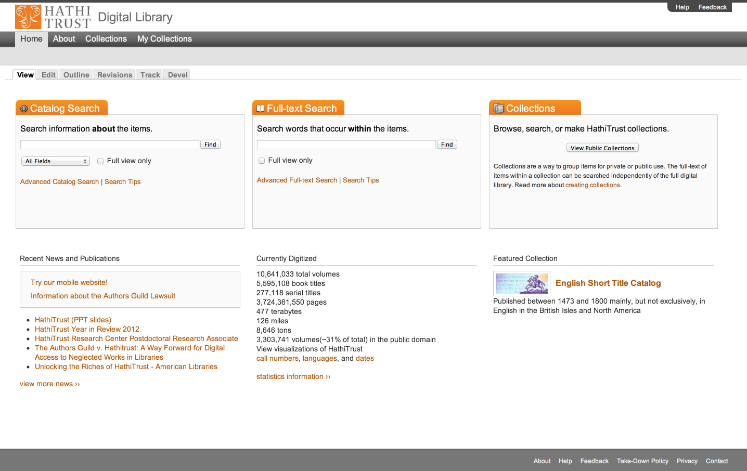
Access
Catalog
Full-text Search
PageTurner
Collections
APIs
Datasets

Slide 52
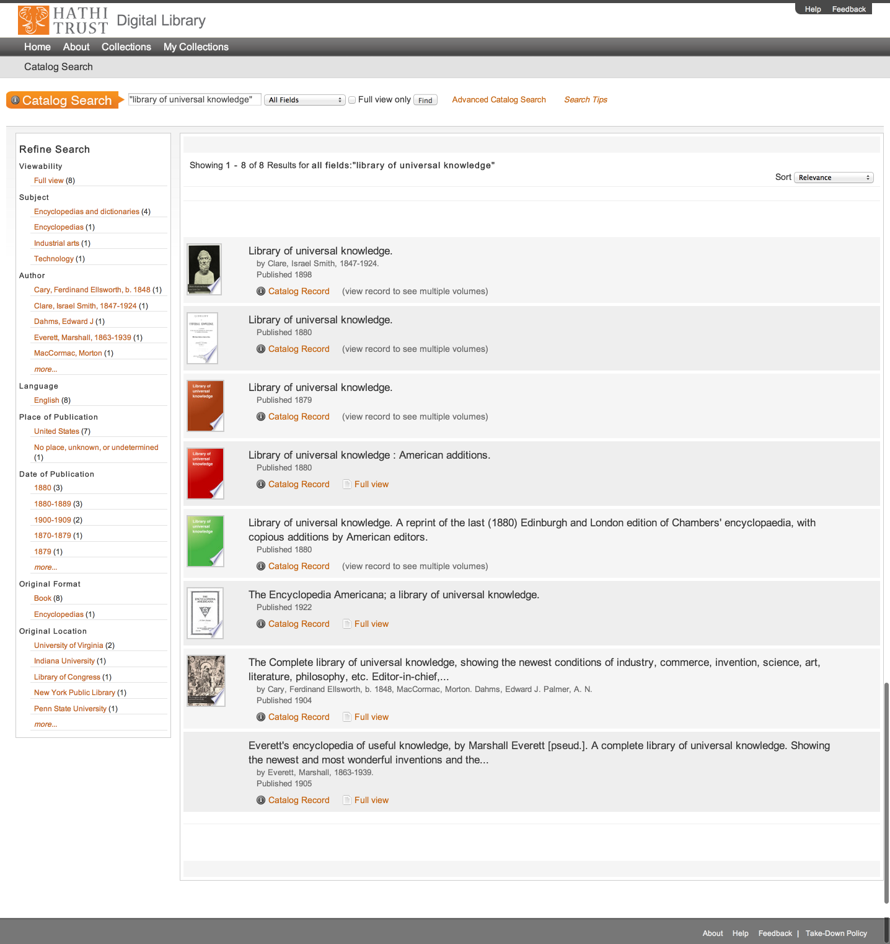
Access
Catalog
Full-text Search
PageTurner
Collections
APIs
Datasets

Slide 53
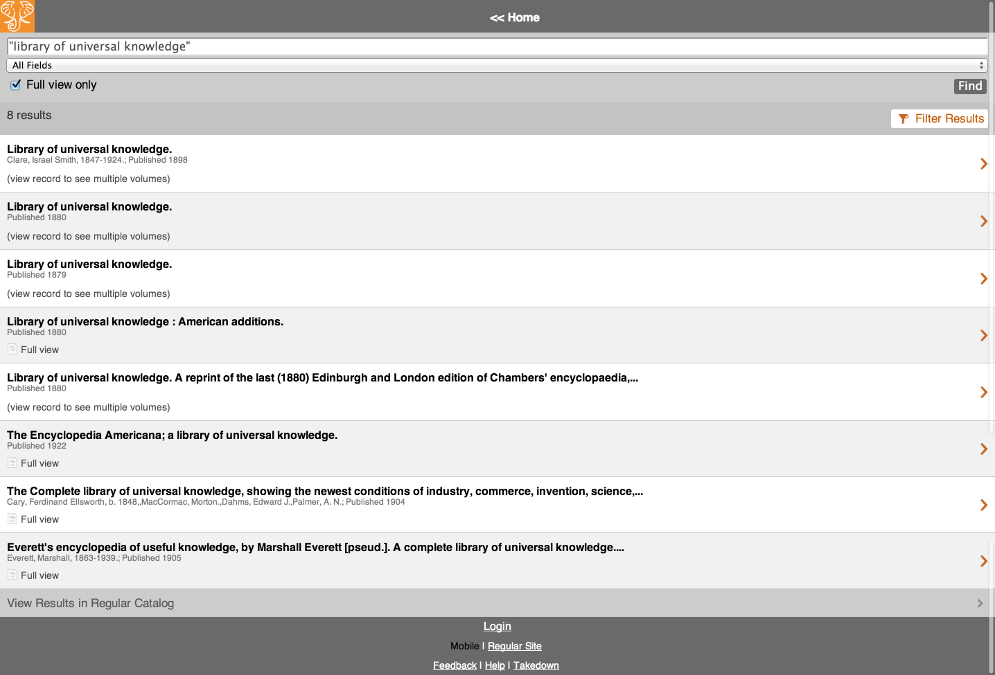
Access
Catalog
Full-text Search
PageTurner
Collections
APIs
Datasets

Slide 54
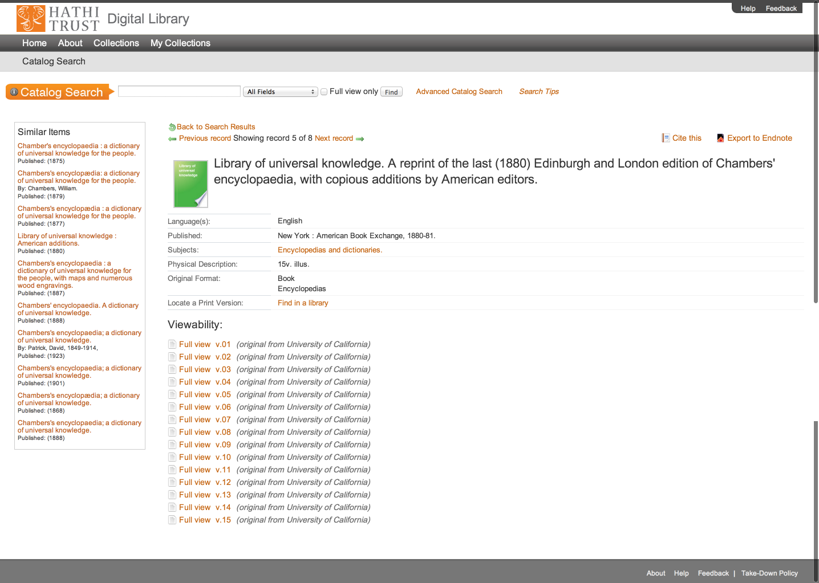
Access
Catalog
Full-text Search
PageTurner
Collections
APIs
Datasets

Slide 55
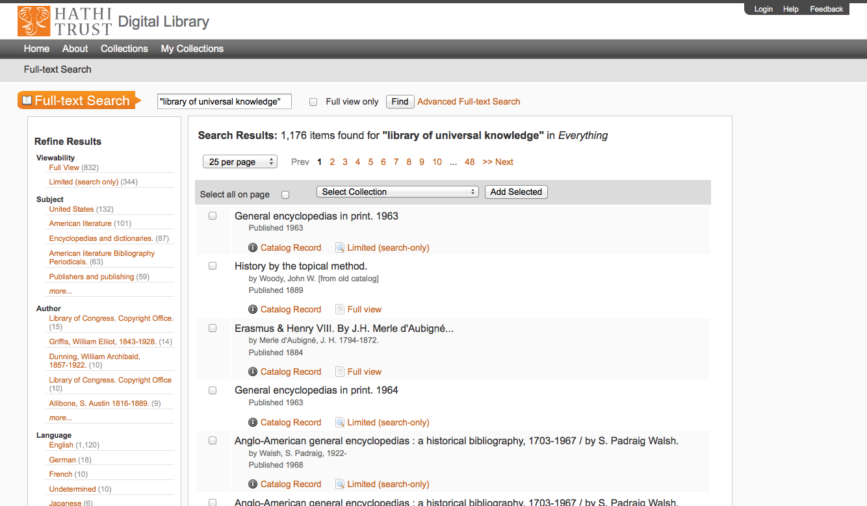
Access
Catalog
Full-text Search
PageTurner
Collections
APIs
Datasets

Slide 56
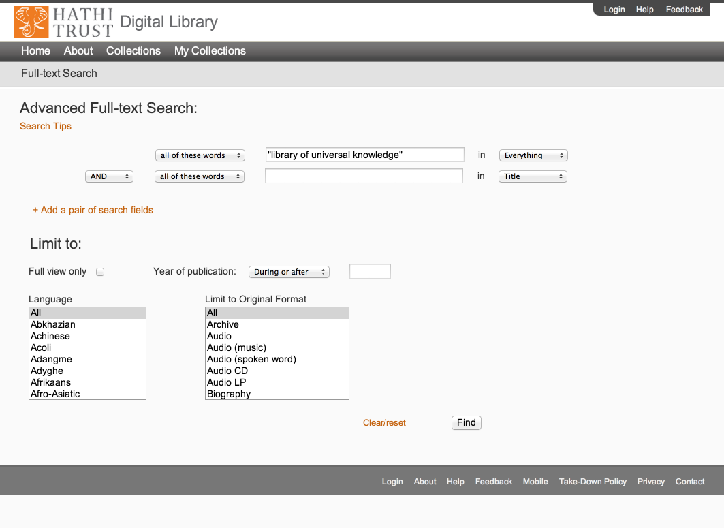
Access
Catalog
Full-text Search
PageTurner
Collections
APIs
Datasets

Slide 57
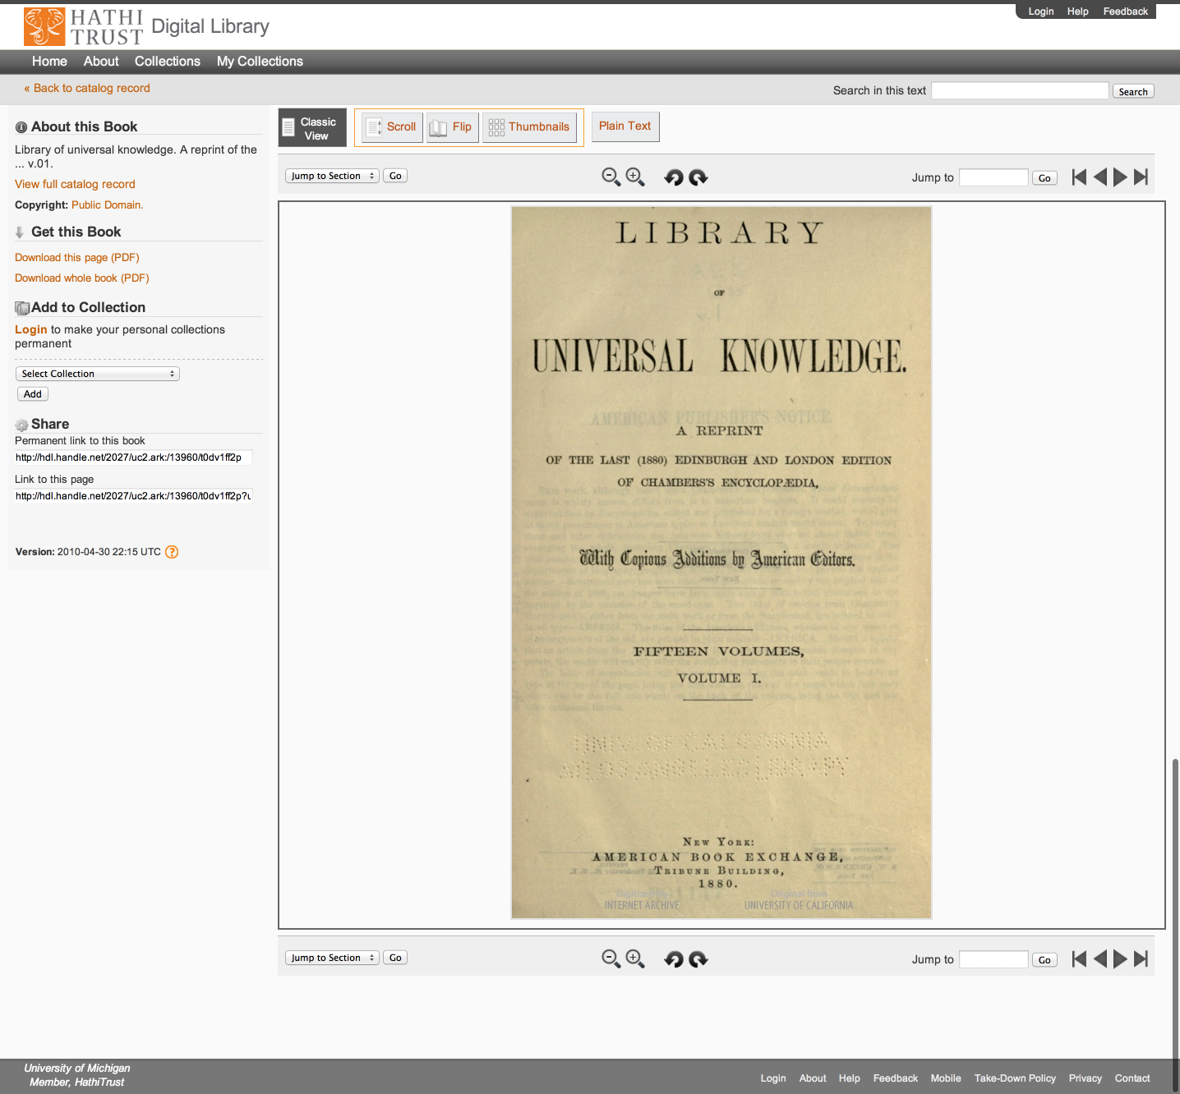
Access
Catalog
Full-text Search
PageTurner
Collections
APIs
Datasets

Slide 58
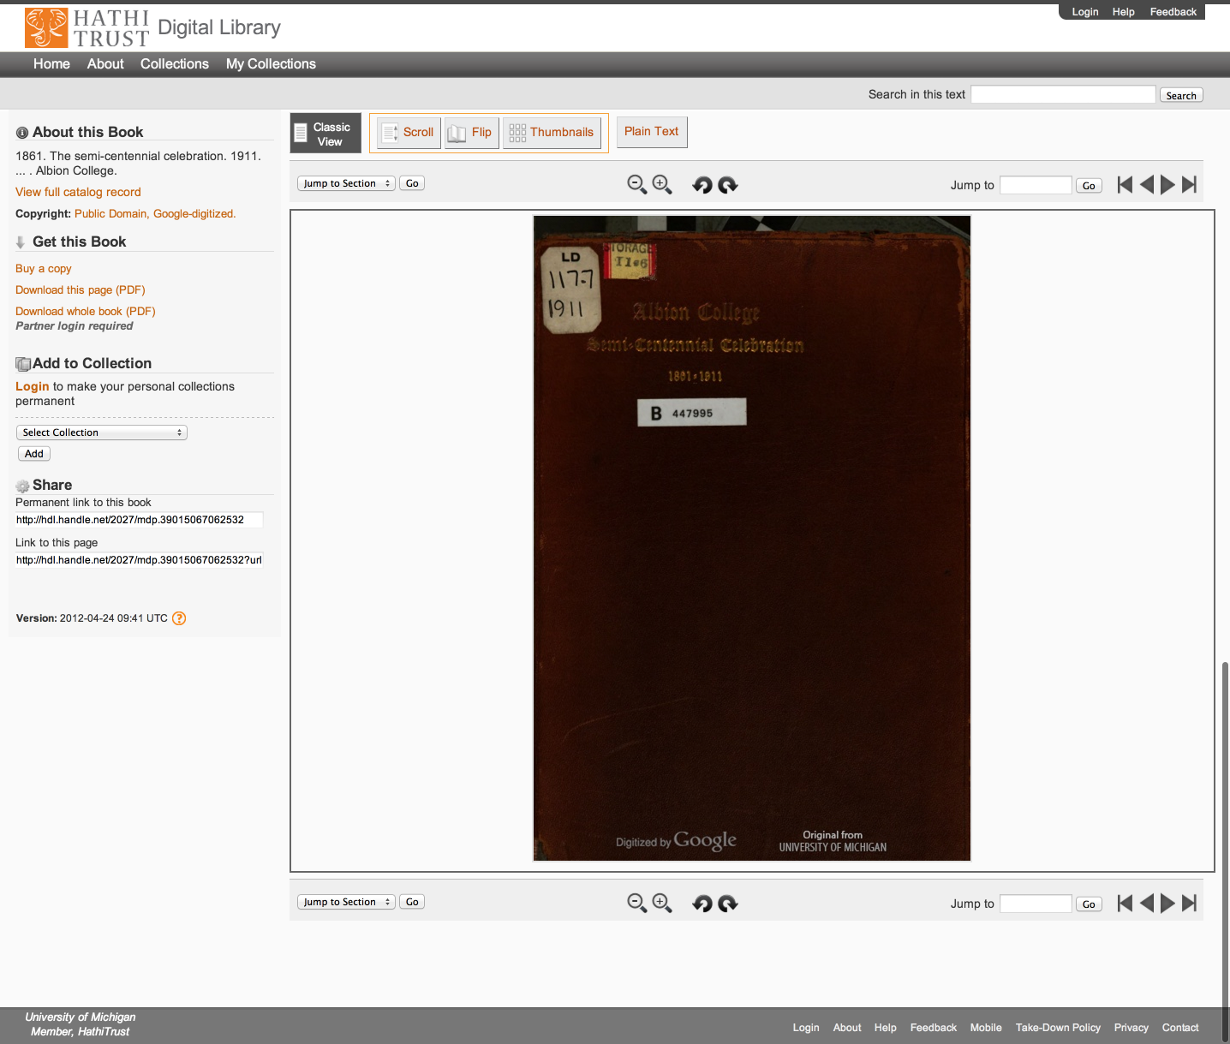
Access
Catalog
Full-text Search
PageTurner
Collections
APIs
Datasets

Slide 59
Access
Catalog
Full-text Search
PageTurner
Collections
APIs
Datasets

Slide 60
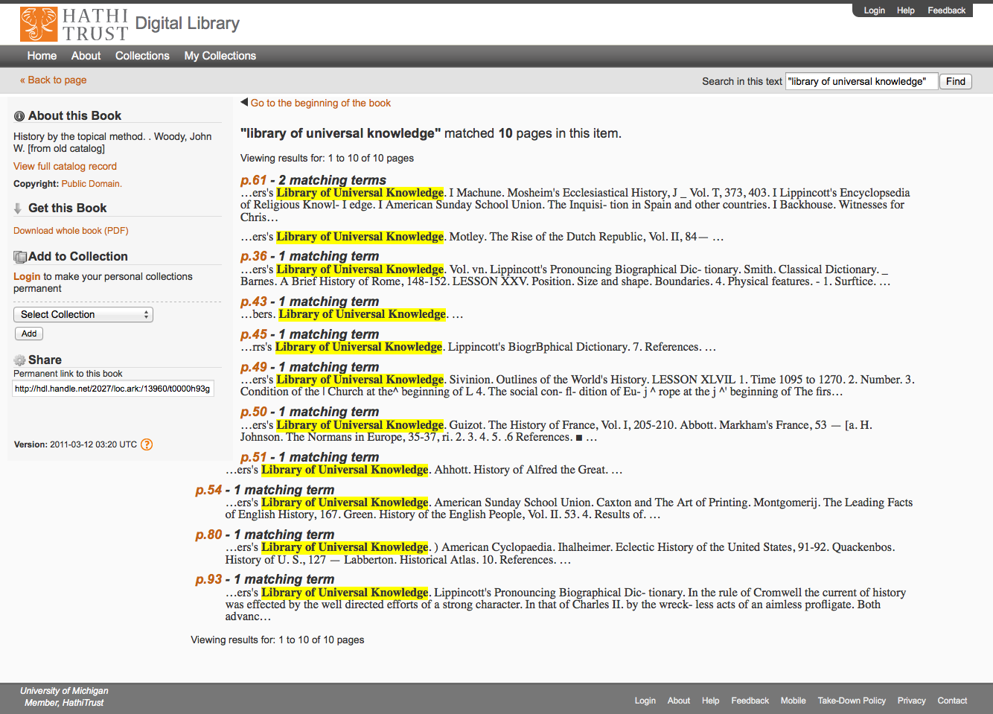
Access
Catalog
Full-text Search
PageTurner
Collections
APIs
Datasets

Slide 61
Access
Catalog
Full-text Search
PageTurner
Collections
APIs
Datasets

Slide 62
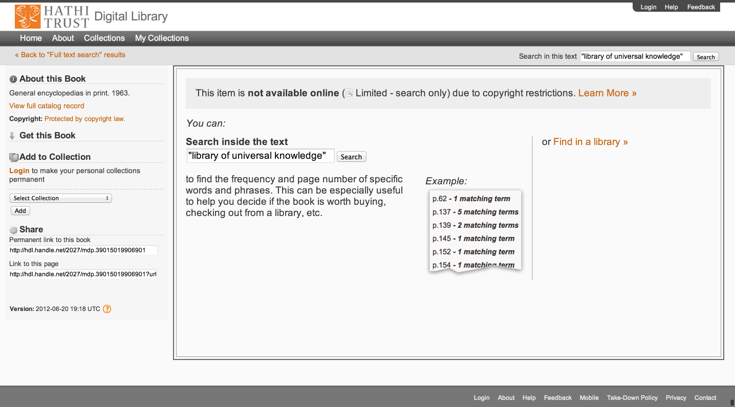
Access
Catalog
Full-text Search
PageTurner
Collections
APIs
Datasets

Slide 63
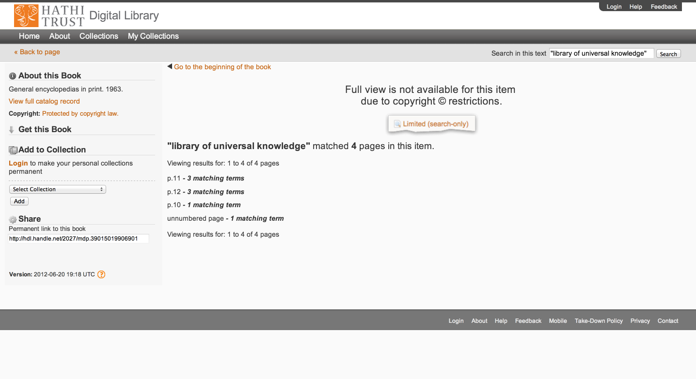
Access
Catalog
Full-text Search
PageTurner
Collections
APIs
Datasets

Slide 64
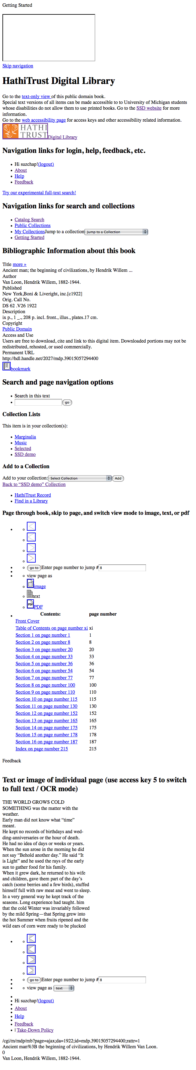
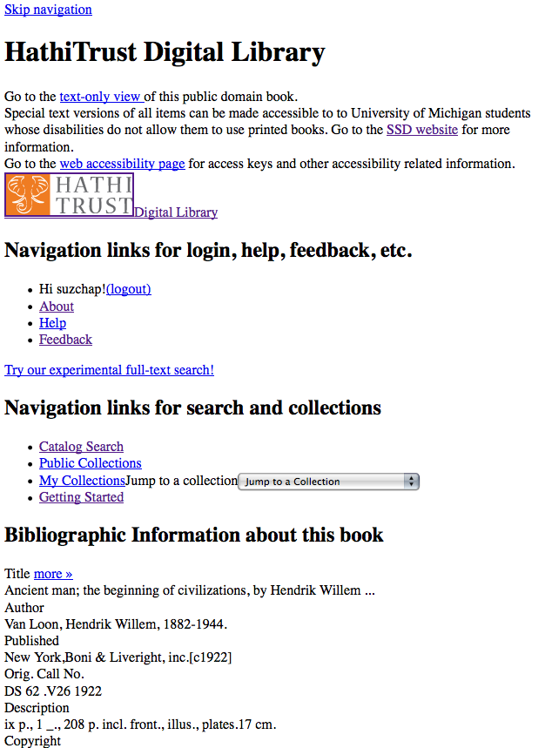
Skip navigation link
Info about SSD service & link to accessibility page
Descriptive headings added (hidden from GUI with CSS)
Added labels & descriptive titles to forms & ToC table
Access keys for navigating pages with keyboard
Images used for style are in css so no need to use alt tags

Slide 65
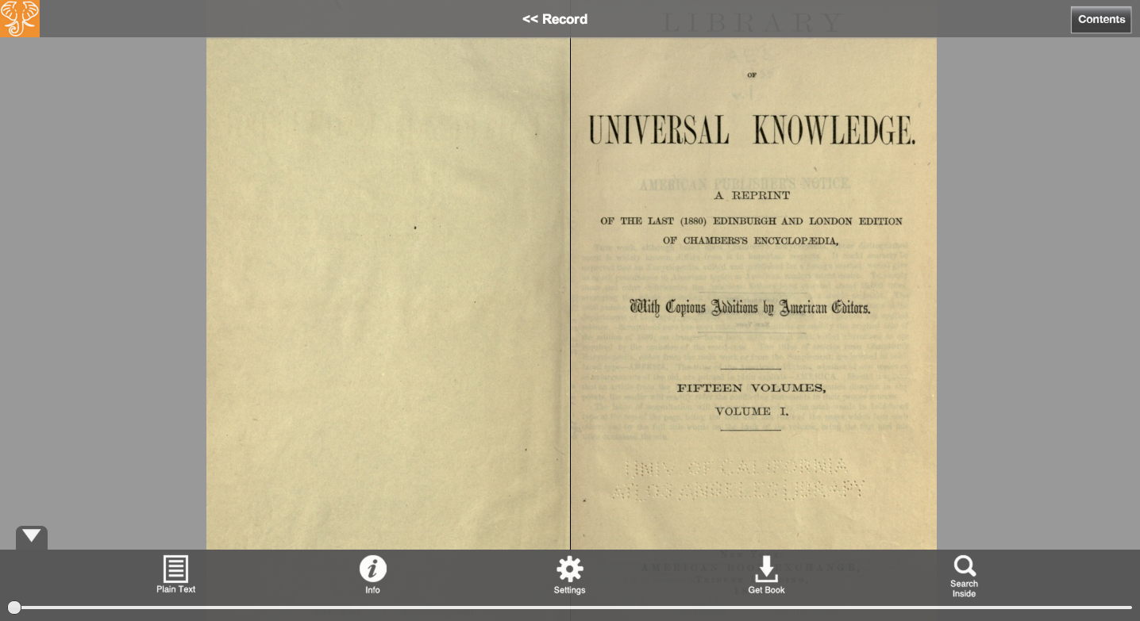
Access
Catalog
Full-text Search
PageTurner
Collections
APIs
Datasets

Slide 66
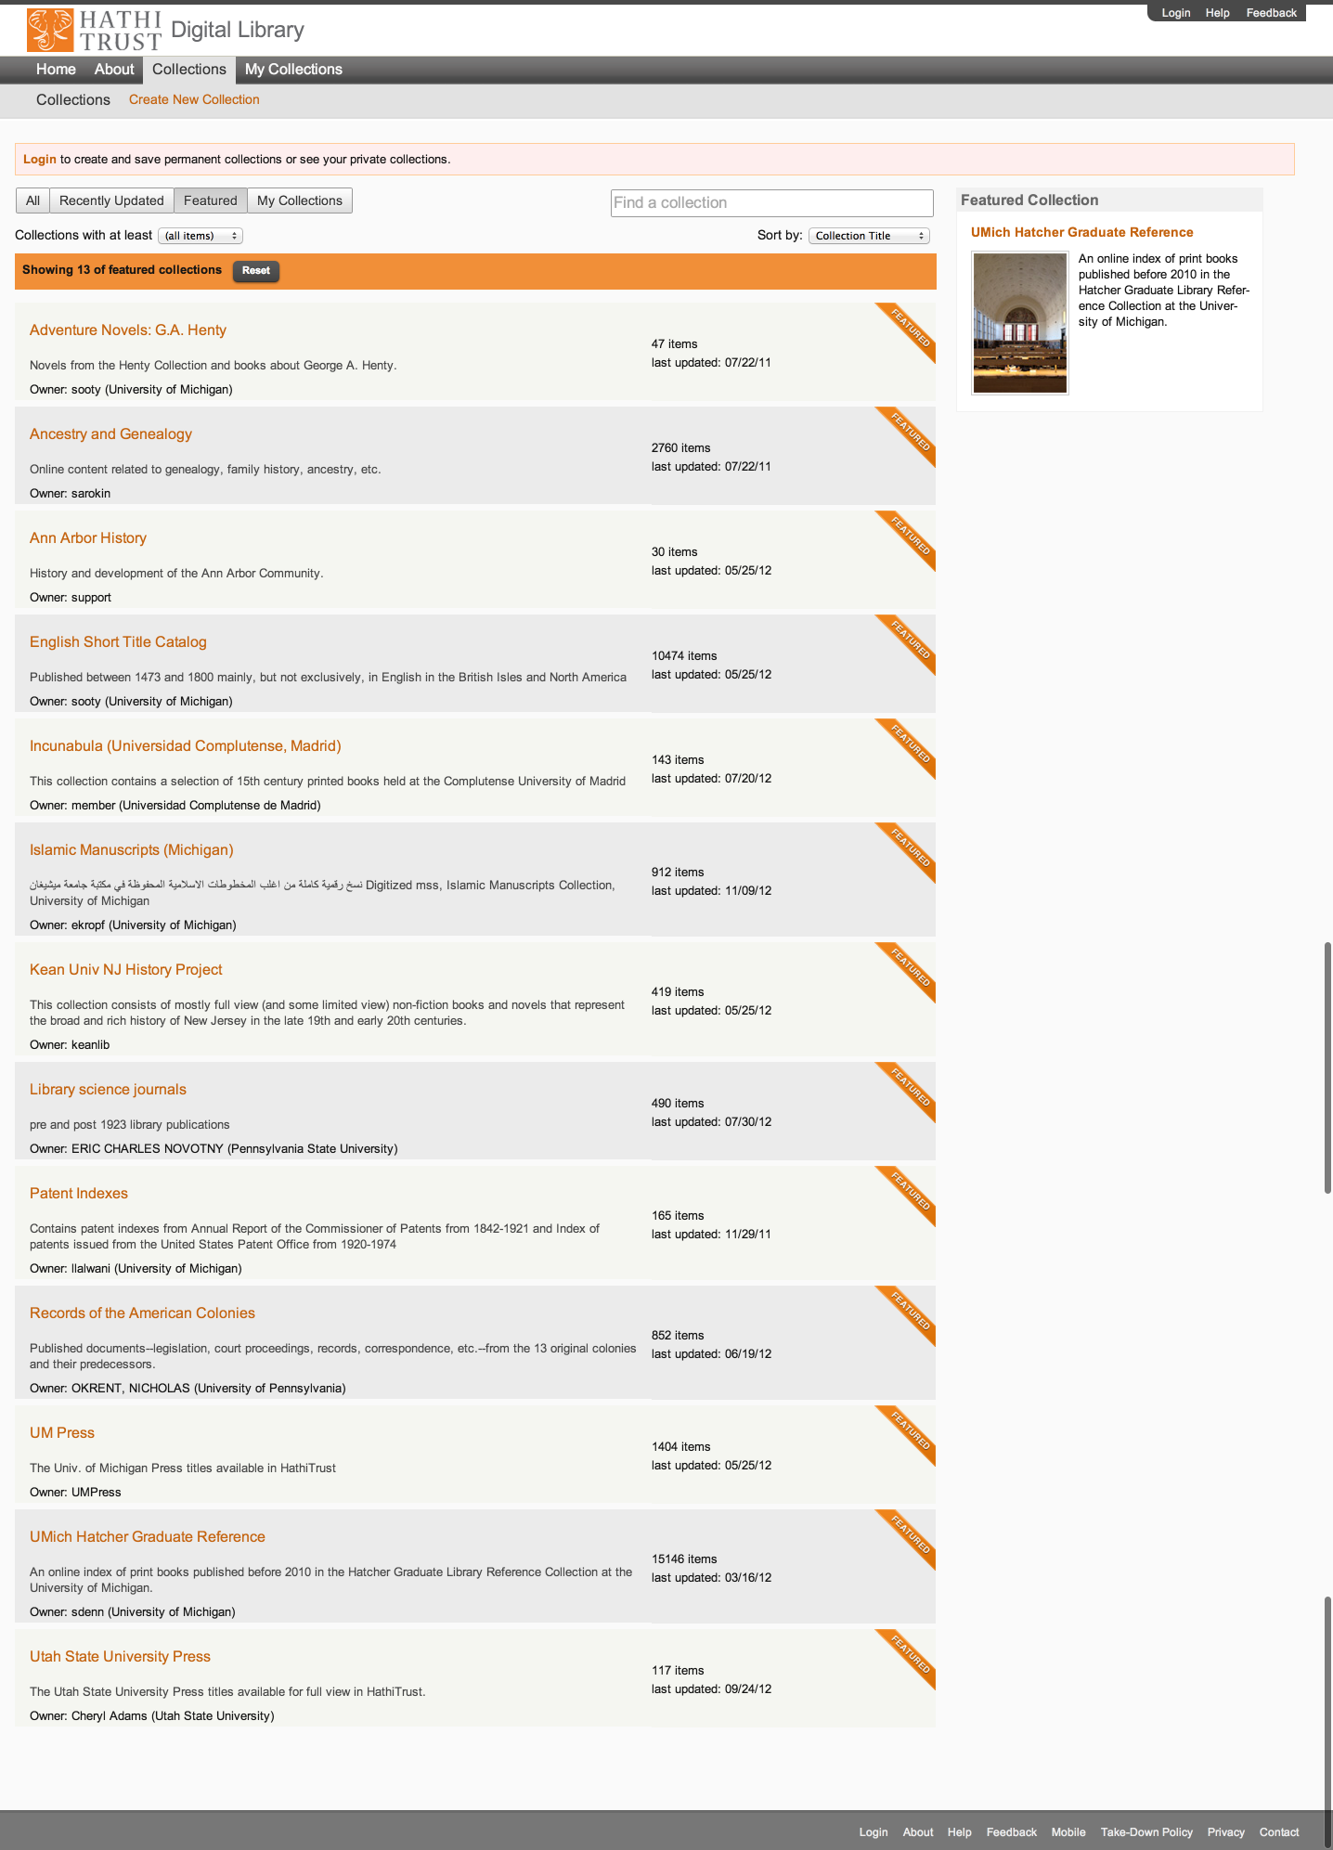
Access
Catalog
Full-text Search
PageTurner
Collections
APIs
Datasets

Slide 67
Access
Catalog
Full-text Search
PageTurner
Collections
APIs
Datasets

Slide 68
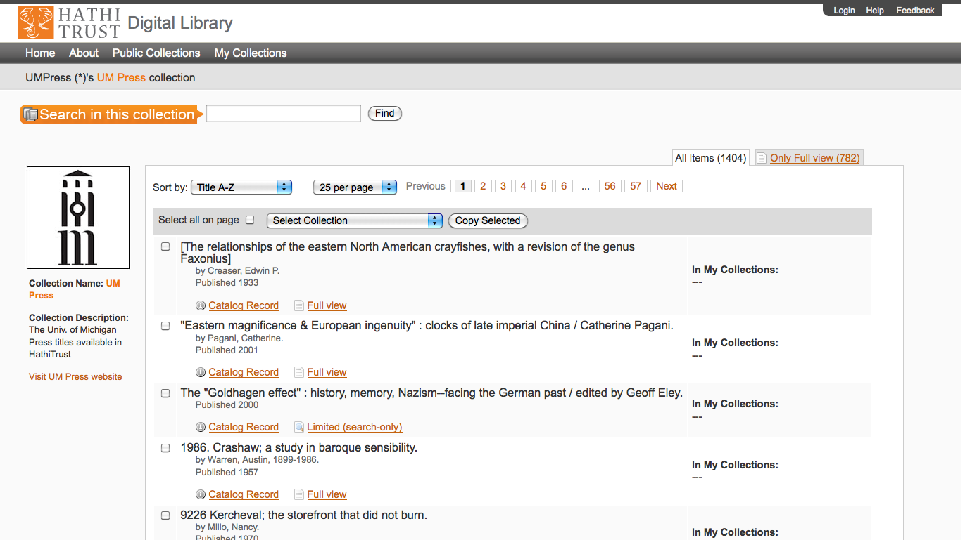
Access
Catalog
Full-text Search
PageTurner
Collections
APIs
Datasets

Slide 69
APIs
Data API
  Volume and rights information
  Page images
  OCR
  http://www.hathitrust.org/data_api
Bibliographic API
  Volume and rights information
  MARC records
  http://www.hathitrust.org/bib_api
OAI
  http://www.hathitrust.org/data
“Hathifiles”
  http://www.hathitrust.org/hathifiles

Slide 70
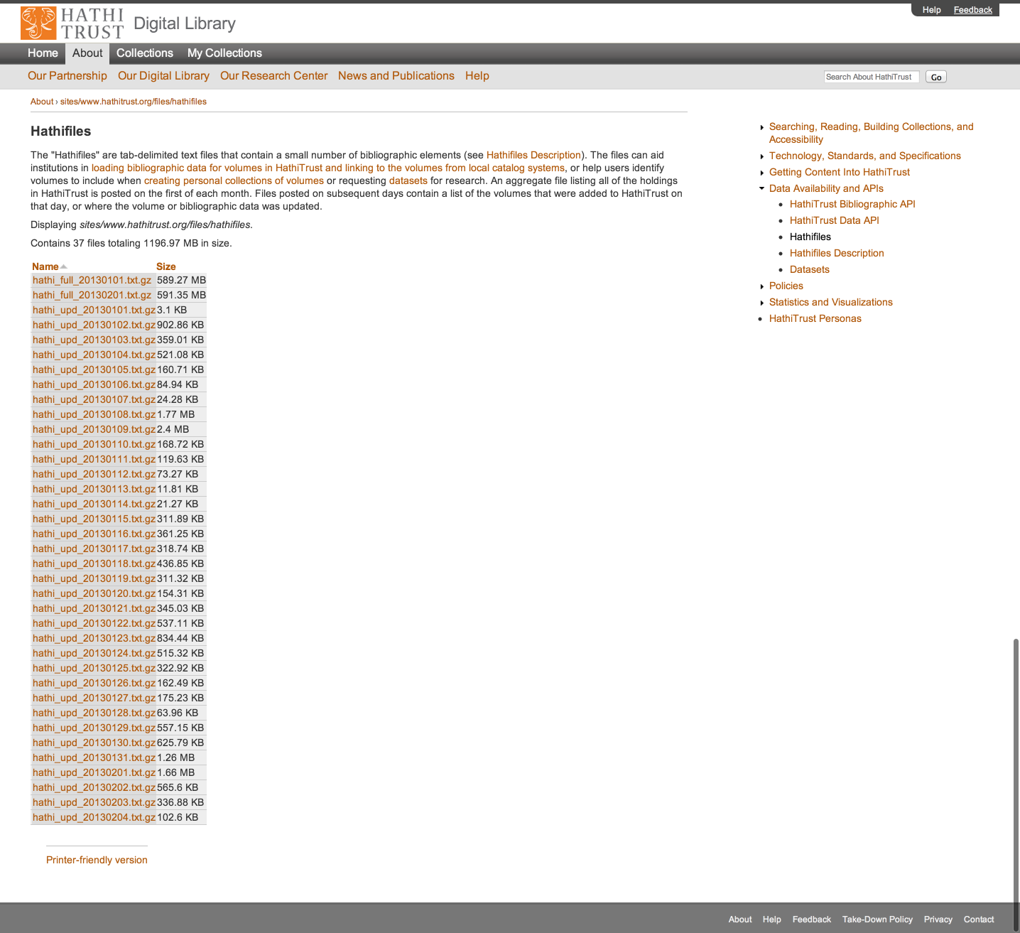

Slide 71
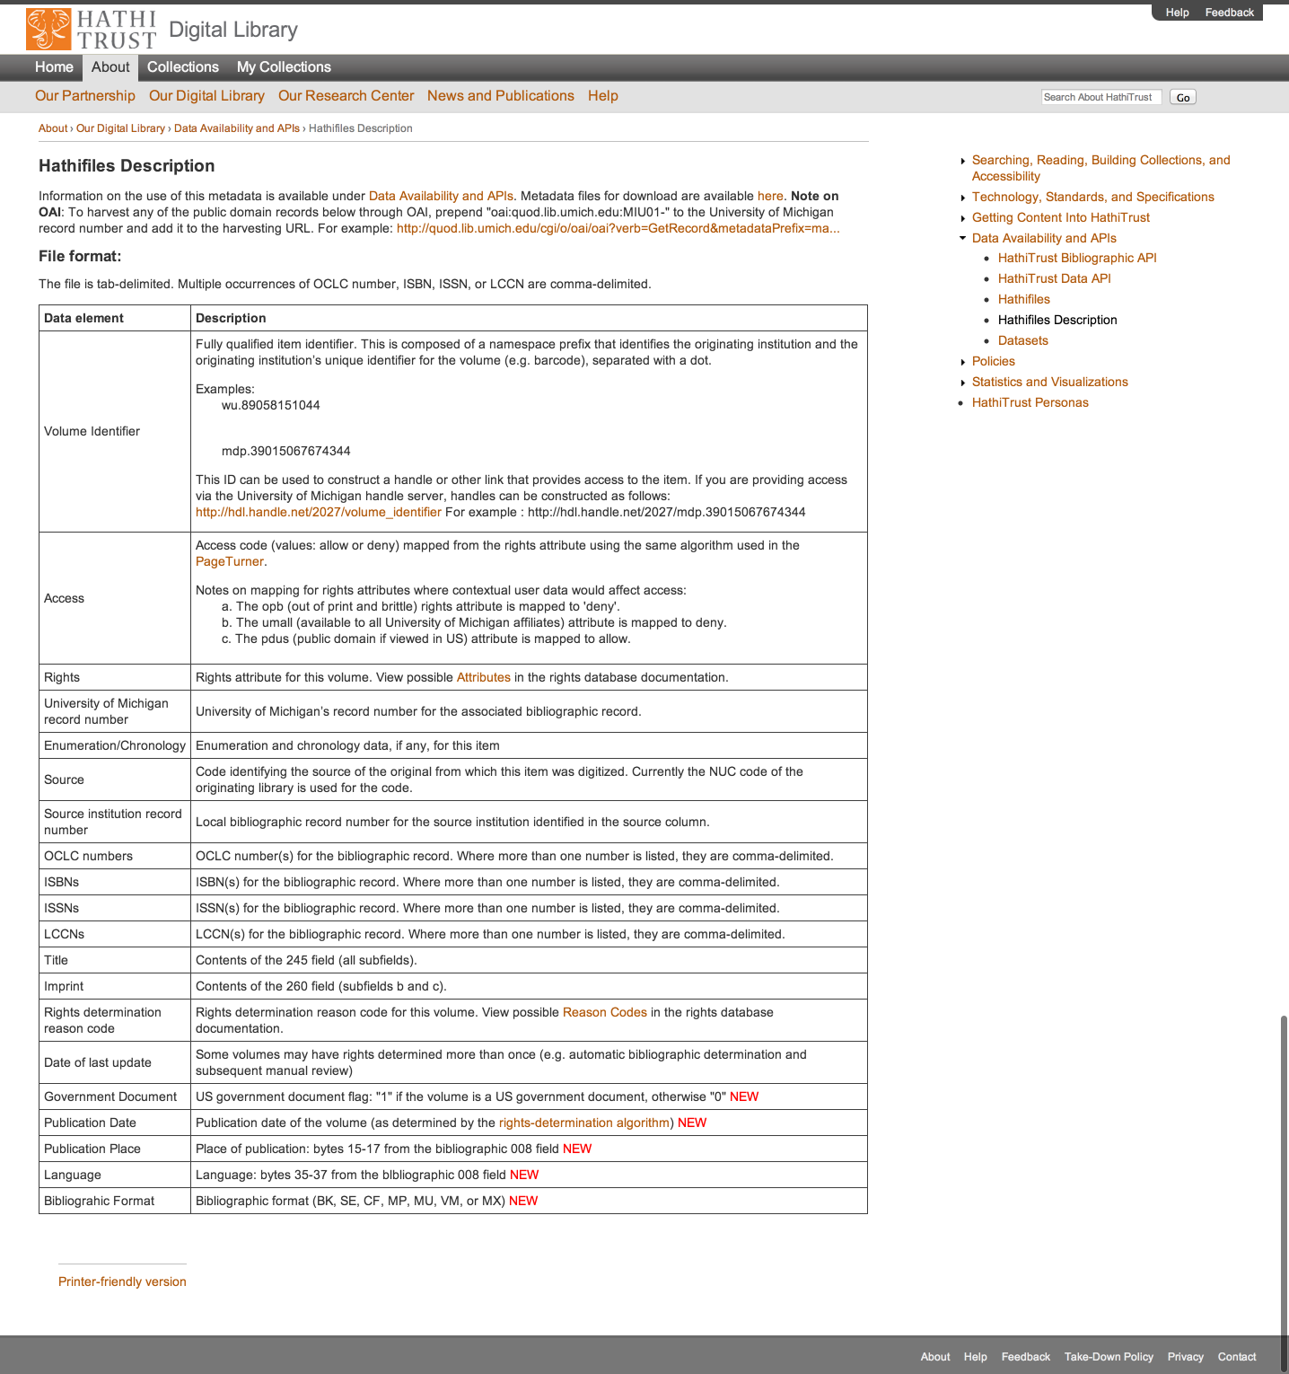

Slide 72
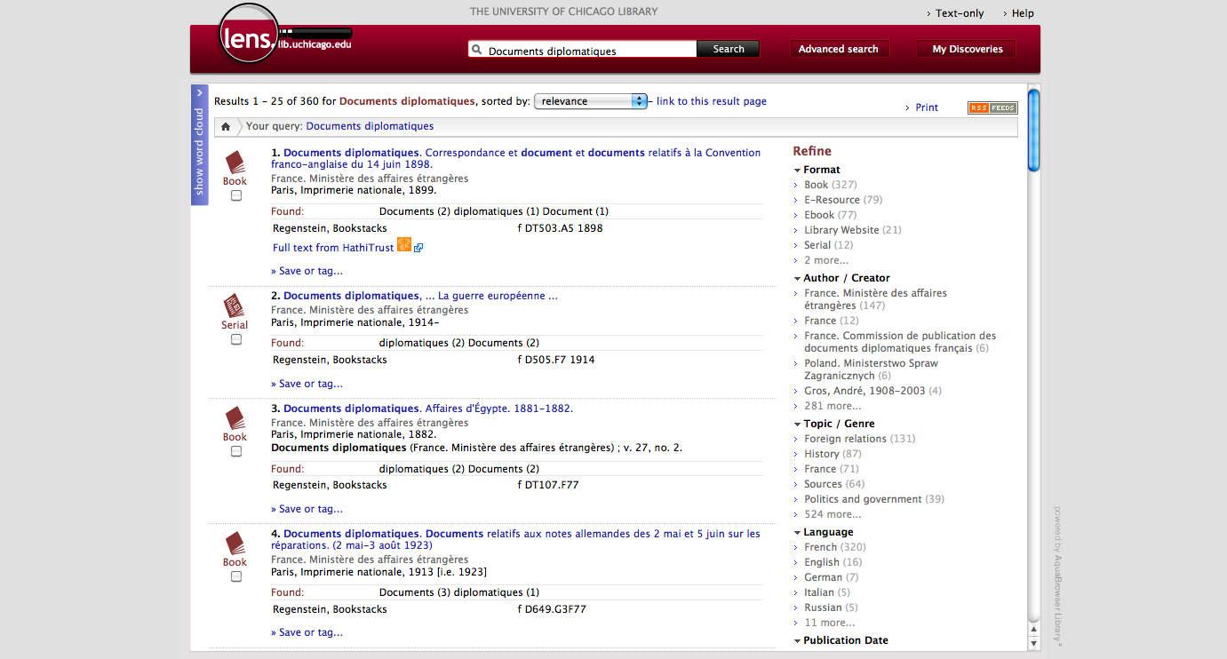

Slide 73
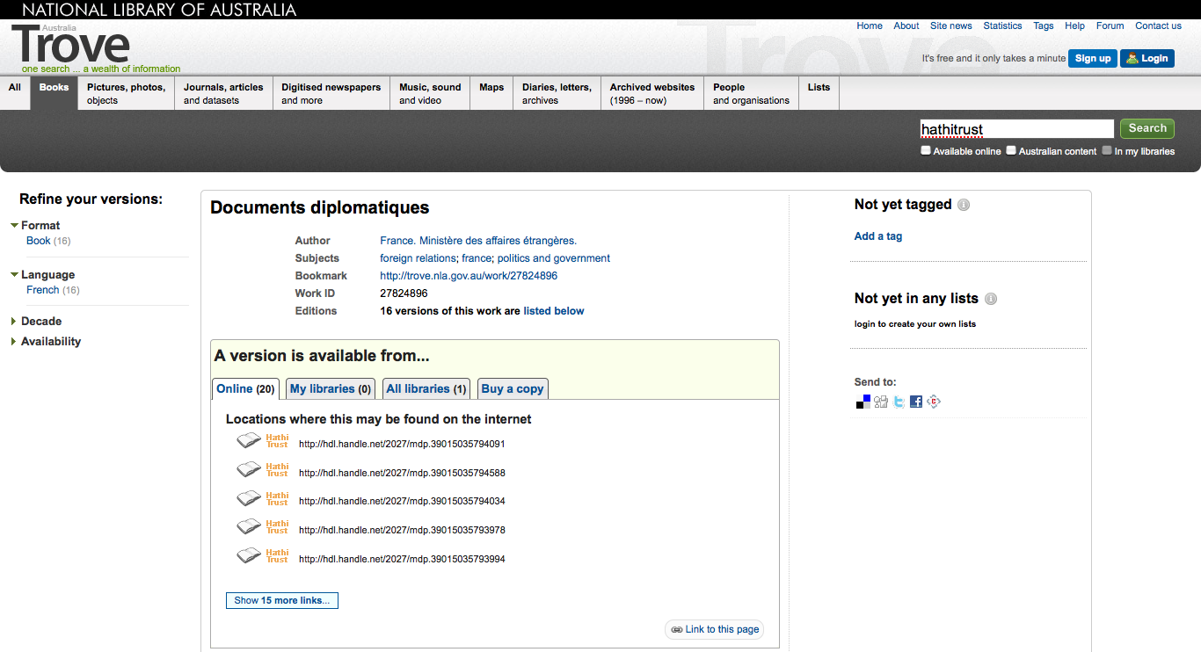

Slide 74
Datasets
Google-digitized
  ~2.8 million texts
  Requires proposal to HathiTrust
  Agreement with Google
  Statement on use/management
Non-Google-digitized
  > 350,000 texts
  Freely available
  Statement on management

Slide 75
Research Center
Environment to perform research on HathiTrust corpus
  http://www.hathitrust.org/htrc

Slide 76
Access Determinations
Automated
Manual

Slide 77
Automatic Rights Determination
Conducted on all works at time of ingest and when records are modified
  Public domain worldwide
    US works published before 1923, US federal government publications, non-US works published prior to 1873
  Public domain in the United States
    Non-US works published prior to 1923

Slide 78
Manual Rights Determination
IMLS-funded CRMS project
  CRMS-US
    2008: US-published works 1923-1963
    Staff at 4 partner institutions
  CRMS-World
    2011: Expanded to non-US works
    Staff at 16 partner institutions
  Double review with additional expert review for conflicts
  Compliance with copyright formalities
  As of February 2013 248,669 reviewed, 135,777 opened
Rights Holder Permissions

Slide 79
Rights Database
System of Precedence
Manual
Bibliographic (automatic)

Slide 80
Lawful uses
Users who have print disabilities
  All in-copyright works in HathiTrust currently owned (or owned previously) by the partner institution
  Must be authenticated
  Must be on U.S. soil
  One simultaneous access per copy owned
  http://www.hathitrust.org/accessibility

Slide 81
Lawful uses (2)
Out of print and brittle, missing
  Works must be currently owned (or owned previously) by the partner institution
  Must be authenticated or accessing work from library premises
  Must be on U.S. soil
  One simultaneous access per copy owned
  http://www.hathitrust.org/out-of-print-brittle
Access and use statements
  http://www.hathitrust.org/access_use

Slide 82
Vendor Agreements
Largest impact for HathiTrust is agreement with Google
  Receive digital copy from Google
  Share digital copy with partner libraries
  Prevent download for commercial purposes, redistribution of files, automated or systematic download

Slide 83
Type of work | Searchable (bibliographic and full-text) | Viewable* | Full-PDF download | Print on Demand | Print disabilities* | Preservation uses (Section 108)*
Public domain worldwide | Worldwide | Worldwide | Partners only if scanned by Google, if not, worldwide. | Worldwide | Partners worldwide | N/A
Public domain (US) – Non-US works published between 1872 and 1923. | Worldwide | When accessed from with the United States | Partners in the US if scanned by Google, if not, anyone US | Available within the United States | Partners in the US; partners worldwide where similar laws in effect | N/A
Works that rights holders have opened access to in HathiTrust | Worldwide | Worldwide | Worldwide (if digitized by Google, full-PDF only available if opened with CC license) | Worldwide with permission | Partners worldwide | N/A
Works that are in-copyright or of undetermined status | Worldwide | Not available | Not available | Not available | Partners in the US; partners worldwide where similar laws in effect | Partners in the US; partner worldwide where similar laws in effect
* Note: Access to in-copyright works is subject to conditions on Lawful uses slides. See also HathiTrust’s policies on Access and Use.

Slide 84
Authentication
Shibboleth
  Login with organization
  Attributes released to Service Provider
  Authorize access
  http://www.hathitrust.org/shibboleth

Slide 85
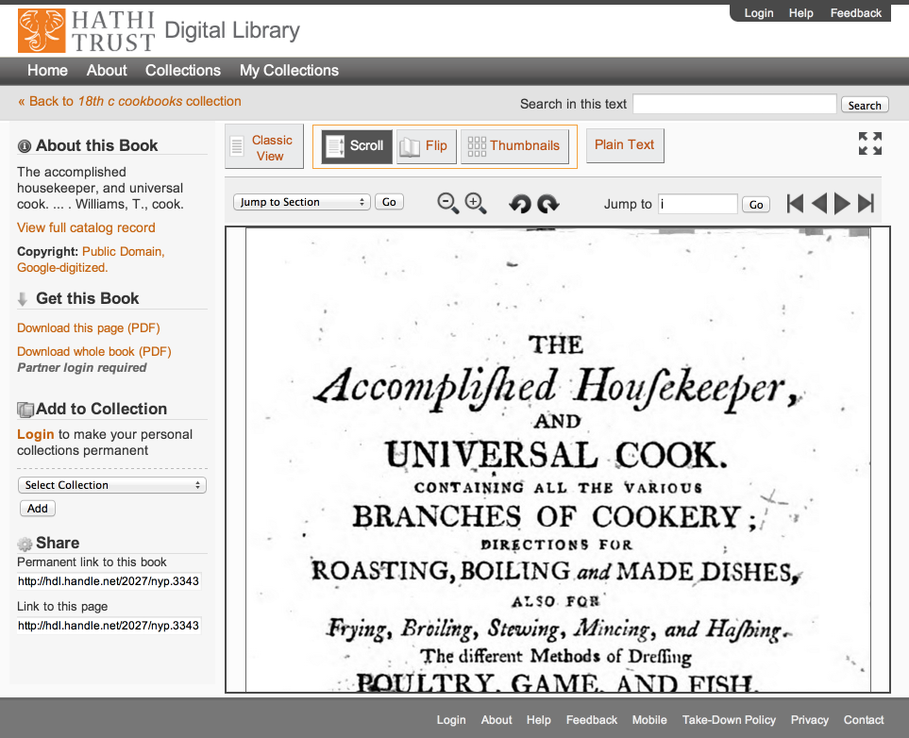

Slide 86
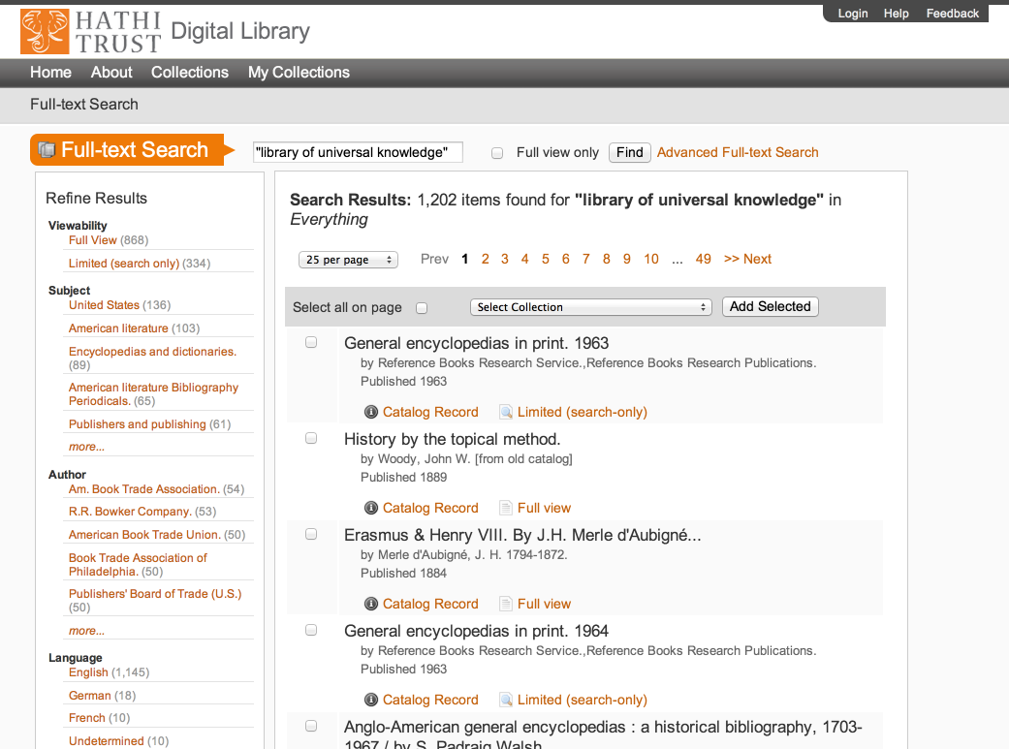

Slide 87
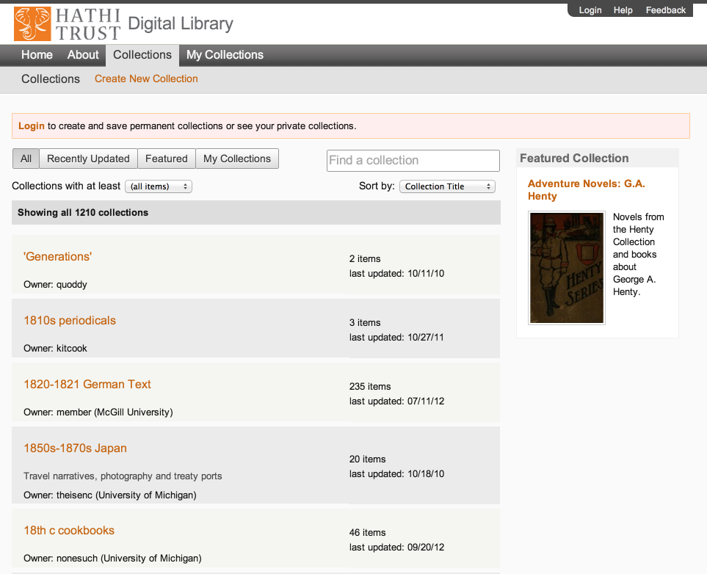

Slide 88
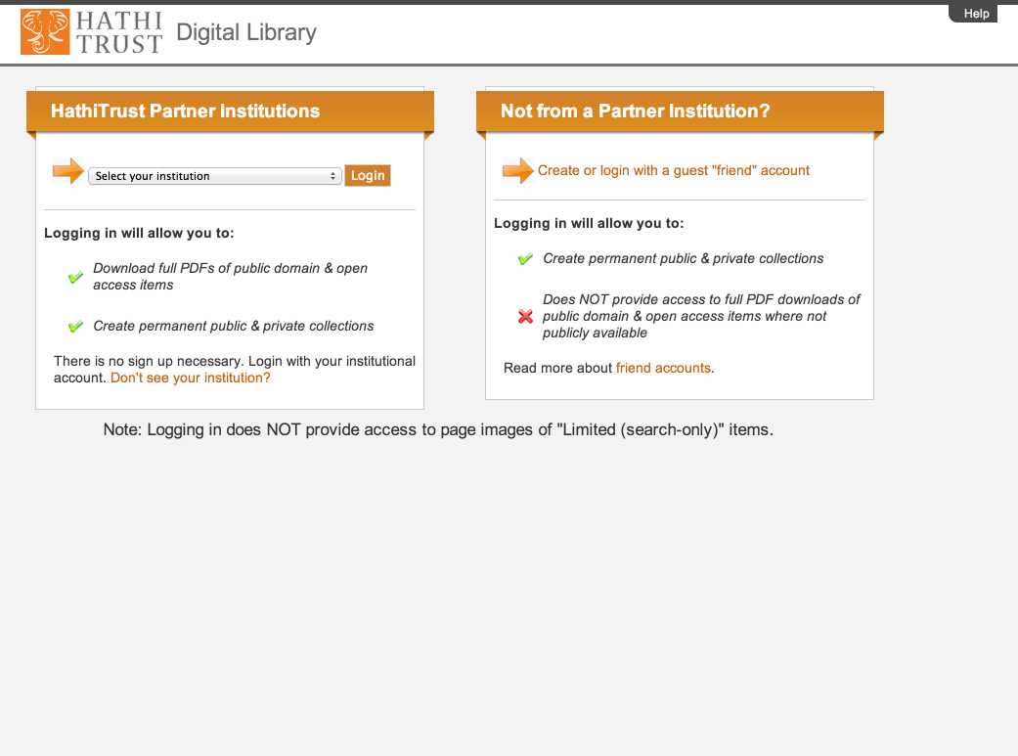

Slide 90
Outline
Introduction ✔
Vision ✔
  Mission and Goals ✔
  Comprehensive ✔
  Building the digital archive ✔
Practice
  Repository and Content ✔
  Preservation for Access ✔
Implementation
How HathiTrust Can Change the Way We Work

Slide 91
Questions

Slide 92
Implementation

Slide 93
Poll
Does your institution or organization host its own repository?
Host website and associated resources
Host digitized content (images, maps, etc.)
Host digitized or born-digital published works
Other

Slide 94
Poll
How many of these activities does your repository engage in?
Redundancy (e.g., backup)
Fixity and error-checking
Format validation
Format migration
Tracking provenance and actions performed on digital items
Less than 3
More than 3

Slide 95
Overarching ideas
Community
Scale
Access and Preservation
Openness

Slide 96
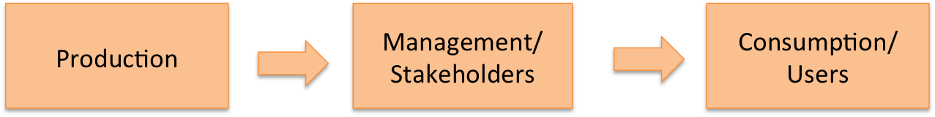
Community

Slide 97

Community

Slide 98
Scale
Mission
  To contribute to the common good by collecting, organizing, preserving, communicating, and sharing the record of human knowledge
Strategy
  “Co-owned and managed”

Slide 99
Preservation and Access
“Light” archive benefits
  Access to materials
  Checks on integrity
  Best chance for content to be used and valued, preserved

Slide 100
Openness
Repository centralized...open
Formats
Software
Organizational structure

Slide 101
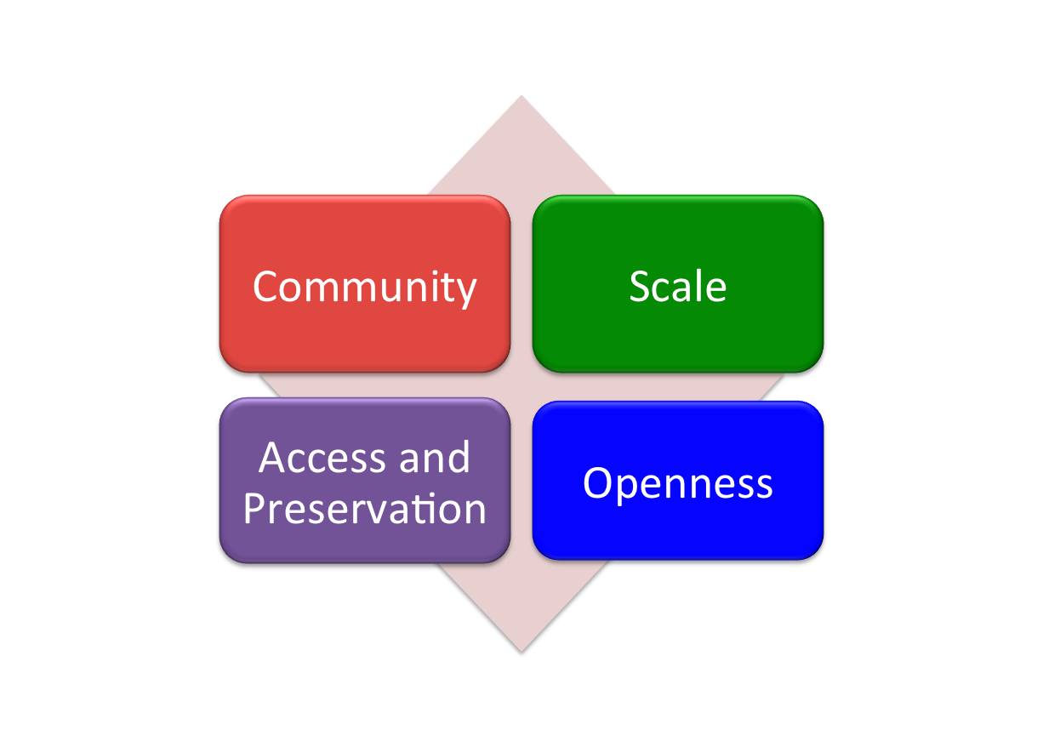
Overarching ideas

Slide 102

Repository Philosophy/Design
OAIS/TRAC
Consistency
Standardization
Simplicity (in design, not function)
Practicality
Sustainability

Slide 103

Source
Data Management
Access
Bib Data
Rights Data
Catalog
Ingest
Full-text Search
Holdings Data
Bibliographic Data
PageTurner
Content Package
Collections
Storage
Michigan
APIs
Indiana
Datasets
TDR

Slide 104
Source
Data Management
Access
Bib Data
Rights Data
Catalog
Ingest
Full-text Search
Holdings Data
Bibliographic Data
PageTurner
Content Package
Collections
Storage
Michigan
APIs
Indiana
Datasets

Slide 105
Source
Data Management
Access
Bib Data
Rights Data
Catalog
Ingest
Full-text Search
Holdings Data
Bibliographic Data
PageTurner
Content Package
Collections
Storage
Michigan
APIs
Indiana
Datasets

Slide 106
Content
Selection of content for digitization and preservation
Types of materials
Technology
  Largely uniform in technical characteristics
  3 formats
    ITU G4 TIFF
    JPEG2000
    Unicode (with and without coordinates)

Slide 107
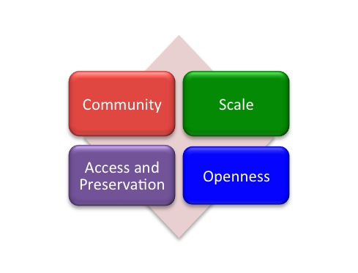
Content
Types and numbers of formats important to degree that satisfy community concerns
  Open formats, meet community standards
  Widely supported on a number of platforms
  Confidence in preservation and migration

Slide 108

Content Package
images
text
Source METS
Zip
HT
METS

Slide 109
Source
Data Management
Access
Bib Data
Rights Data
Catalog
Ingest
Full-text Search
Holdings Data
Bibliographic Data
PageTurner
Content Package
Collections
Storage
Michigan
APIs
Indiana
Datasets

Slide 110
Source
Rigorous validation to ensure conformance with specifications:
Resolution, image metadata
Barcode
Fixity
Consistency
Well-formedness
Prepare archival package
Ingest
Bibliographic Data
Content Package

Slide 111
Source
More about ingest
New Digitization
Existing Digitization
http://www.hathitrust.org/ingest
Ingest checklist:
Deposit Forms
Bibliographic metadata specifications
http://www.hathitrust.org/ingest_checklist
Ingest tools
Tools for validating, remediating, packaging
Detailed content specifications
http://www.hathitrust.org/ingest_tools
Deposit Guidelines
Policies
http://www.hathitrust.org/deposit_guidelines
Example METS files and METS profile
http://www.hathitrust.org/digital_object_specifications
Ingest
Bibliographic Data
Content Package

Slide 112
Source
Data Management
Access
Bib Data
Rights Data
Catalog
Ingest
Full-text Search
Holdings Data
Bibliographic Data
PageTurner
Content Package
Collections
Storage
Michigan
APIs
Indiana
Datasets

Slide 113
Data Management
Bib Data
Rights Data
Holdings Data
Bibliographic Data
Inventory
Loading and updating records
Duplicate detection and collation
Source of information for VuFind catalog, APIs
Rights determination (automated and support
for manual review)

Slide 114
Data Management
Bib Data
Rights Data
Holdings Data
namespace | id | attr | reason | source | user | time | note
Inu | 30000000078026 | 2 | 1 | 1 | Jhovater | 2009-10-15 23:30:23 | NULL

Slide 115
Rights Attributes
id | name | type | dscr
1 | pd | copyright | public domain
2 | ic | copyright | in-copyright
3 | opb | copyright | out-of-print and brittle (implies in-copyright)
4 | orph | copyright | copyright-orphaned (implies in-copyright)
5 | und | copyright | undetermined copyright status
6 | umall | access | available to UM affiliates and walk-in patrons (all campuses)
7 | world | access | available to everyone in the world
8 | nobody | access | available to nobody; blocked for all users
9 | pdus | copyright | public domain only when viewed in the US
10 | cc-by | copyright | Creative Commons Attribution
11 | cc-by-nd | copyright | Creative Commons Attribution-NoDerivatives
12 | cc-by-nc-nd | copyright | Creative Commons Attribution-NonCommercial-NoDerivatives
13 | cc-by-nc | copyright | Creative Commons Attribution-NonCommercial
14 | cc-by-nc-sa | copyright | Creative Commons Attribution-NonCommercial-ShareAlike
15 | cc-by-sa | copyright | Creative Commons Attribution-ShareAlike
16 | orphcand | copyright | orphan candidate - in 90-day holding period (implies in-copyright)
17 | cc-zero | copyright | Creative Commons Zero license (implies pd)
18 | und-world | copyright | Undetermined copyright status and permitted as world-viewable by the depositor
19 | Ic-us | copyright | In copyright in the US

Slide 116
Rights Determination Reason Codes
id | name | dscr
1 | bib | bibliographically-derived by automatic processes
2 | ncn | no printed copyright notice
3 | con | contractual agreement with copyright holder on file
4 | ddd | due diligence documentation on file
5 | man | manual access control override; see note for details
6 | pvt | private personal information visible
7 | ren | copyright renewal research was conducted
8 | nfi | needs further investigation (copyright research partially complete; an ambiguous, unclear, or other time-consuming situation was encountered)
9 | cdpp | title page or verso contain copyright date and/or place of publication information not in bib record
10 | cip | condition review and in-print status research was conducted
11 | unp | unpublished work
12 | gfv | Google viewability set at VIEW_FULL
13 | crms | derived from multiple reviews in the Copyright Review Management System (CRMS) via an internal resolution policy; consult CRMS records for details
14 | add | author death date research was conducted or notification was received from authoritative source
15 | exp | expiration of copyright term for non-US work with corporate author
16 | Del | Deleted from repository; see note for details
17 | Gatt | Non-US public domain work restored to in-copyright in the US by GATT

Slide 117
Data Management
Bib Data
Rights Data
Holdings Data
Single-part monographs
  OCLC #; Local system ID; Timestamp; Holding Status; Condition
Multi-part monographs
  Include enumeration and chronology
Serials
  OCLC #; Local system ID; Timestamp; ISSN

Slide 118
Source
Data Management
Access
Bib Data
Rights Data
Catalog
Ingest
Full-text Search
Holdings Data
Bibliographic Data
PageTurner
Content Package
Collections
Storage
Michigan
APIs
Indiana
Datasets

Slide 119
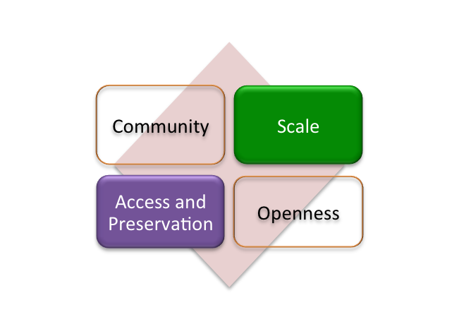
Reliability – ensure integrity
Redundancy – in single and multiple sites
Scalability – including ease of management
Accessibility – for repository processes and services
Platform-independence – for data/object management
Storage
Michigan
Indiana

Slide 120
Isilon storage
Disk-based
Load-balancing and fail-over
Internal redundancy (N+3)
Efficient, reliable replication (daily)
Continual checks on data integrity
Detection and repair of corrupt disk sectors
Scalable (single file system up to 5 petabytes)
Storage
Michigan
Indiana

Slide 121
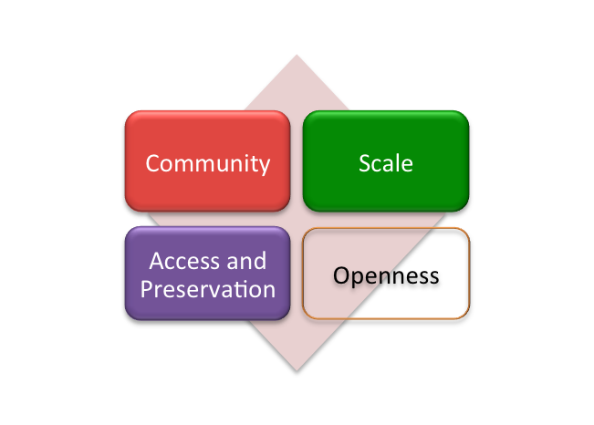
Object integrity
Continual checks on data integrity
Detection and repair of corrupt disk sectors
Fixity checks on ingest
Periodic checks on fixity of all objects
Storage
Michigan
Indiana

Slide 122
Architecture & Management
../uc1/pairtree_root/b3/54/34/86/b34543486
images
text
Source METS
b34543486.zip
HT
METS
b34543486.mets.xml
bib
data
bib
data

Slide 123
Architecture & Management
../uc1/pairtree_root/b3/54/34/86/b34543486
images
text
Source METS
b34543486.zip
HT
METS
b34543486.mets.xml
bib
data
bib
data

Slide 124
Architecture & Management
../uc1/pairtree_root/b3/54/34/86/b34543486
images
text
Source METS
b34543486.zip
HT
METS
b34543486.mets.xml
bib
data
bib
data

Slide 125
Architecture & Management
../uc1/pairtree_root/b3/54/34/86/b34543486
images
text
Source METS
b34543486.zip
HT
METS
b34543486.mets.xml
Example ids:
wu.89094366434
mdp.39015037375253
uc2.ark:/1390/t26973133
miua.aaj0523.1950.001
bib
data
bib
data

Slide 126
Architecture & Management
Reference
  Ability to locate objects definitively and reliably over time among other objects (Task Force on Archiving of Digital Information, 1996)
  Identification of objects
  Structure of the repository
  Embedding of identifiers
  Permanent URLs
  Version dates

Slide 127
Source
Data Management
Access
Bib Data
Rights Data
Catalog
Ingest
Full-text Search
Holdings Data
Bibliographic Data
PageTurner
Content Package
Collections
Storage
Michigan
APIs
Indiana
Datasets

Slide 128
Architecture & Management
../uc1/pairtree_root/b3/54/34/86/b34543486
images
text
Source METS
b34543486.zip
HT
METS
b34543486.mets.xml
bib
data
bib
data

Slide 129
What is METS?
Metadata Encoding and Transmission Standard
Administrative (including preservation), Technical, and Structural metadata

Slide 130
Why METS
Can serve as Archival Information Package and a Dissemination Information Package
Designed to record the relationship between pieces of complex digital objects
Can be created automatically as texts are loaded or reloaded
Preservation actions (PREMIS)

Slide 131
Metadata Framework
Details and specifications at repository level
  Object specifications / Validation criteria
  Page-tagging
Variations at object level
  Files missing
  Non-valid files
  Incorrect file checksums
http://www.hathitrust.org/digital_object_specifications

Slide 132
Source METS (1)
Record of objects prior to ingest into HathiTrust
Information valuable for preservation or archaeology, but subjective (descriptive, e.g., bibliographic data, page-tags), idiosyncratic, or use not clear.
“Parking lot” for information we are getting that may be useful in the future.

Slide 133
Source METS (2)
What’s there?
  dmdSec(s)
  amdSec
    Technical and preservation metadata
  fileSec (images, coordOCR, OCR, …)
    Mime Type, checksums, file size
  Physical structMap tying together files with metadata (pg. numbers and features)

Slide 134
HathiTrust METS (1)
Active record Regularized information generally applicable across the repository
  Not specific to a particular source
  Current or near-term use
Information fundamentally valuable for understanding or using the preserved object in preservation activities after deposit, or in the access and display environments, including the APIs.

Slide 135
HathiTrust METS (2)
What’s there?
  mdRef
  amdSec
    Technical and preservation metadata
  fileSec with 4 fileGrps (zip, images, OCR, coordOCR)
    Mime Type, checksums, file size
  Physical structMap tying together files with metadata (pg. numbers and features)

Slide 136
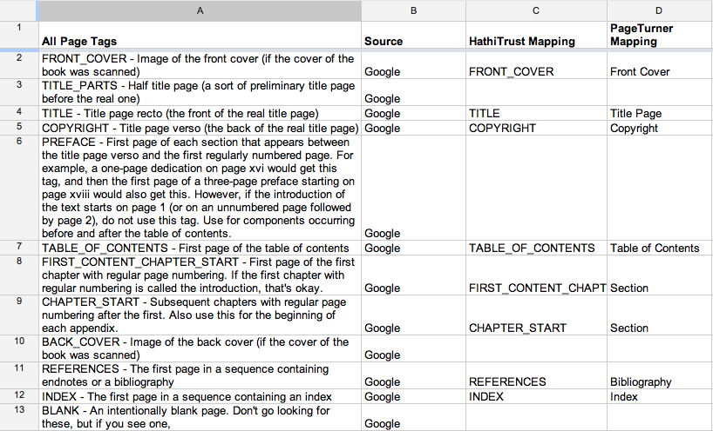
Page Feature Mapping (Google)

Slide 137
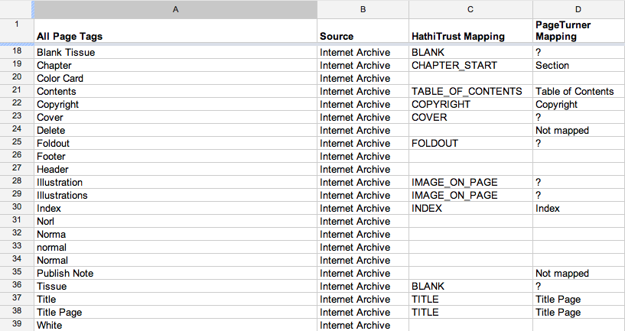
Pagetag Mapping (IA)

Slide 138
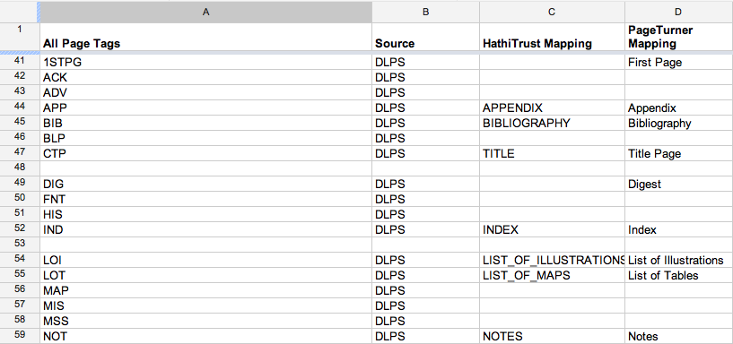
Pagetag Mapping (DLPS)

Slide 139
Object Entity
<PREMIS:object xsi:type="PREMIS:representation”>
<PREMIS:objectIdentifier>
  <PREMIS:objectIdentifierType>identifier</PREMIS:objectIdentifierType>
  <PREMIS:objectIdentifierValue>dul1.ark:/13960/t13n2vj0t</PREMIS:objectIdentifierValue>
  </PREMIS:objectIdentifier>
<PREMIS:significantProperties>
<PREMIS:significantPropertiesType>file count</PREMIS:significantPropertiesType>
    <PREMIS:significantPropertiesValue>960</PREMIS:significantPropertiesValue>
    </PREMIS:significantProperties>
  <PREMIS:significantProperties>
  <PREMIS:significantPropertiesType>page count</PREMIS:significantPropertiesType>
  <PREMIS:significantPropertiesValue>320</PREMIS:significantPropertiesValue>
  </PREMIS:significantProperties>
</PREMIS:object>
Event Entity
<PREMIS:event>
<PREMIS:eventIdentifier>
  <PREMIS:eventIdentifierType>UUID</PREMIS:eventIdentifierType>
  <PREMIS:eventIdentifierValue>9af6a994-f6fe-3a61-ac0e-be793d347edb</PREMIS:eventIdentifierValue>
  </PREMIS:eventIdentifier>
  <PREMIS:eventType>package inspection</PREMIS:eventType>
  <PREMIS:eventDateTime>2011-10-25T20:37:51Z</PREMIS:eventDateTime>
  <PREMIS:eventDetail>Inspection of download package for missing files</PREMIS:eventDetail>
  <PREMIS:eventOutcomeInformation>
  <PREMIS:eventOutcome>warning</PREMIS:eventOutcome>
  <PREMIS:eventOutcomeDetail>
  <PREMIS:eventOutcomeDetailNote>files missing</PREMIS:eventOutcomeDetailNote>
    <PREMIS:eventOutcomeDetailExtension>
    <HT:fileList status="missing">
          <HT:file>islandoradventur00whit_scanfactors.xml</HT:file> </HT:fileList>
    </PREMIS:eventOutcomeDetailExtension>
  </PREMIS:eventOutcomeDetail>
  </PREMIS:eventOutcomeInformation>
  <PREMIS:linkingAgentIdentifier>
  <PREMIS:linkingAgentIdentifierType>MARC21 Code</PREMIS:linkingAgentIdentifierType>
  <PREMIS:linkingAgentIdentifierValue>MiU</PREMIS:linkingAgentIdentifierValue>
  <PREMIS:linkingAgentRole>Executor</PREMIS:linkingAgentRole>
  </PREMIS:linkingAgentIdentifier>
  <PREMIS:linkingAgentIdentifier>
  <PREMIS:linkingAgentIdentifierType>tool</PREMIS:linkingAgentIdentifierType>
  <PREMIS:linkingAgentIdentifierValue>feedd.pl 0.9.17</PREMIS:linkingAgentIdentifierValue>
  <PREMIS:linkingAgentRole>software</PREMIS:linkingAgentRole>
  </PREMIS:linkingAgentIdentifier>
</PREMIS:event>
PREMIS Metadata

Slide 140
capture | Initial capture (digitization) of item
file rename | File renaming to HathiTrust conventions
image modification | Replace boilerplate images with blank images
image compression | Conversion of raw scans to compressed TIFF and JPEG2000
image header modification | Modification of image headers to meet HathiTrust conventions
ingestion | Ingestion of object package into the repository
message digest calculation | Calculation of page-level MD5 checksums (refers to checksum calculations performed prior to content submission to HathiTrust when these checksums are available)
validation | Validation of technical characteristics of image and OCR files
ocr split | Detail is package type specific, e.g.: a) Extraction of plain-text OCR from ALTO XML b) Split OCR into one plain text OCR file per page c) Splitting of IA XML OCR into one plain text OCR file and one XML file (with coordinates) per page
package inspection | Inspection of download package for missing files
page feature mapping | Mapping of original page feature tags to HathiTrust tags
fixity check | Validation of MD5 checksums of content files
zip archive creation | Compression of content files and source METS into zip archive
zip file message digest calculation | Calculation of md5 checksum for zip archive
source mets creation | Creation of source METS file

Slide 141
Object Entity
<PREMIS:object xsi:type="PREMIS:representation”>
<PREMIS:objectIdentifier>
  <PREMIS:objectIdentifierType>identifier</PREMIS:objectIdentifierType>
  <PREMIS:objectIdentifierValue>dul1.ark:/13960/t13n2vj0t</PREMIS:objectIdentifierValue>
  </PREMIS:objectIdentifier>
<PREMIS:significantProperties>
<PREMIS:significantPropertiesType>file count</PREMIS:significantPropertiesType>
    <PREMIS:significantPropertiesValue>960</PREMIS:significantPropertiesValue>
    </PREMIS:significantProperties>
  <PREMIS:significantProperties>
  <PREMIS:significantPropertiesType>page count</PREMIS:significantPropertiesType>
  <PREMIS:significantPropertiesValue>320</PREMIS:significantPropertiesValue>
  </PREMIS:significantProperties>
</PREMIS:object>
Event Entity
<PREMIS:event>
<PREMIS:eventIdentifier>
  <PREMIS:eventIdentifierType>UUID</PREMIS:eventIdentifierType>
  <PREMIS:eventIdentifierValue>9af6a994-f6fe-3a61-ac0e-be793d347edb</PREMIS:eventIdentifierValue>
  </PREMIS:eventIdentifier>
  <PREMIS:eventType>package inspection</PREMIS:eventType>
  <PREMIS:eventDateTime>2011-10-25T20:37:51Z</PREMIS:eventDateTime>
  <PREMIS:eventDetail>Inspection of download package for missing files</PREMIS:eventDetail>
  <PREMIS:eventOutcomeInformation>
  <PREMIS:eventOutcome>warning</PREMIS:eventOutcome>
  <PREMIS:eventOutcomeDetail>
  <PREMIS:eventOutcomeDetailNote>files missing</PREMIS:eventOutcomeDetailNote>
    <PREMIS:eventOutcomeDetailExtension>
    <HT:fileList status="missing">
          <HT:file>islandoradventur00whit_scanfactors.xml</HT:file> </HT:fileList>
    </PREMIS:eventOutcomeDetailExtension>
  </PREMIS:eventOutcomeDetail>
  </PREMIS:eventOutcomeInformation>
  <PREMIS:linkingAgentIdentifier>
  <PREMIS:linkingAgentIdentifierType>MARC21 Code</PREMIS:linkingAgentIdentifierType>
  <PREMIS:linkingAgentIdentifierValue>MiU</PREMIS:linkingAgentIdentifierValue>
  <PREMIS:linkingAgentRole>Executor</PREMIS:linkingAgentRole>
  </PREMIS:linkingAgentIdentifier>
  <PREMIS:linkingAgentIdentifier>
  <PREMIS:linkingAgentIdentifierType>tool</PREMIS:linkingAgentIdentifierType>
  <PREMIS:linkingAgentIdentifierValue>feedd.pl 0.9.17</PREMIS:linkingAgentIdentifierValue>
  <PREMIS:linkingAgentRole>software</PREMIS:linkingAgentRole>
  </PREMIS:linkingAgentIdentifier>
</PREMIS:event>
PREMIS Metadata

Slide 142
Provenance
Strategies
  Original source
  Agent of digitization
  Administrative metadata (provenance and preservation)

Slide 143
Provenance
Chain of custody
  Authenticity
  Document use by custodians

Slide 144
Provenance
Chain of custody
  Authenticity
  Document use by custodians
Reliability

Slide 145
Preservation Strategies
Information integrity
  Content
  Fixity
  Reference
  Provenance
  Context

Slide 146
Outline
Introduction ✔
Vision ✔
  Mission and Goals ✔
  Comprehensive ✔
  Building the digital archive ✔
Practice
  Repository and Content ✔
  Preservation for Access ✔
Implementation ✔
  Community ✔
  Scale ✔
  Access and Preservation ✔
  Openness ✔
How HathiTrust Can Change the Way We Work

Slide 147
Questions

Slide 148
How HathiTrust Can Change the Way We Work

Slide 149
Poll
Which of these do you see as the greatest challenge for your library?
Providing access to materials that are not currently accessible (increasing knowledge about collections that are held)
Increasing discovery and use of materials that are already accessible
Reconfiguring library space to better meet user needs
Offering existing services with fewer resources
Expanding services to better meet user needs
Other

Slide 150
Seeing collective problems as collective

Slide 151

Breakdown of HathiTrust book corpus by publication date
42%
19%
20%
19%
Bibliographic Indeterminacy and the Scale of Problems and Opportunities of "Rights" in Digital Collection Building – 2/2011

Slide 152

Breakdown of HathiTrust book corpus by publication date
42%
19%
20%
19%

Slide 153

Copyright status of books published pre-1923 and US works published 1923-1963
42%
19%
20%

Slide 154

Copyright status of books published pre-1923 and US works published 1923-1963
42%
19%
20%
19%

Slide 155
Copyright status of books published pre-1923 and US works published 1923-1963
42%
In Print ?
19%
20%
19%

Slide 156
Relationships
Identification
Description
Rights

Slide 157
Relationships
Identification
Description
Rights
Relationships
  Bibliographic records

Slide 158
Relationships
Identification
Description
Rights
Relationships
  Bibliographic records
  Bib records and objects

Slide 159
Relationships
Identification
Description
Rights
Relationships
  Bibliographic records
  Bib records and objects
  Digital objects

Slide 160
Relationships
Identification
Description
Rights
Relationships
  Bibliographic records
  Bib records and objects
  Digital objects
  Digital and print

Slide 161
Understanding the relationship between the collective and local

Slide 162
1st model: Price per GB

Slide 163

 | 2008 | 2009 | 2010 | 2011 | 2012 (Oct)
Total Volumes | 2,477,871 | 5,221,092 | 7,836,698 | 9,966,572 | 10,531,566
Public Domain | 372,085 | 758,947 | 1,959,223 | 2,712,626 | 3,218,132

Slide 164

A global change in the library environment
Academic print book collection already substantially duplicated in mass digitized book corpus
June 2010
Median duplication: 31%
June 2009
Median duplication: 19%
Courtesy of Constance Malpas, OCLC Research
Notes:
164

Slide 165

Digitized Books in Shared Repositories
~75% of mass digitized corpus is ‘backed up’ in one or more shared print repositories
~3.5M titles
~2.5M
Courtesy of Constance Malpas, OCLC Research
Notes:
165

Slide 166
Collection Overlap
More than 50% median overlap with ARL institutions; higher for small liberal arts colleges
New Pricing model based on Print holdings
  http://www.hathitrust.org/cost
  Requires print holdings database
  Also support expansion of legal uses, efforts in de-duplication
  Facilitate individual and collaborative collection development and management operations
Print monographs archiving

Slide 167


Slide 168


Slide 169


Slide 170


Slide 171


Slide 172


Slide 173


Slide 174


Slide 175
Sourcing and Scaling
http://orweblog.oclc.org/archives/002058.html

Slide 176
Scale
  Institution-scale
  Group-scale
  Web-scale

Slide 177
Sourcing
  Institutional
  Collaborative
  Third-party

Slide 178
A new kind of library

Slide 179
Thank you!

Slide 180
How to find out more
About: http://www.hathitrust.org/about
Twitter: http://twitter.com/hathitrust
Facebook: http://www.facebook.com/hathitrust
Monthly newsletter:
  http:www.hathitrust.org/updates
  RSS http://www.hathitrust.org/updates_rss
Contact us: feedback@issues.hathitrust.org
Blogs: http://www.hathitrust.org/blogs
  Large-scale Search
  Perspectives from HathiTrust

