Slide 1
HathiTrust Organization, Governance, and Costs
University of Michigan School of Information
October 9, 2012
Jeremy York, Project Librarian, HathiTrust

Slide 2
Partnership
Arizona State University
Baylor University
Boston College
Boston University
California Digital Library
Columbia University
Cornell University
Dartmouth College
Duke University
Emory University
Florida State University
Getty Research Institute
Harvard University Library
Indiana University
Johns Hopkins University
Kansas State University
Lafayette College
Library of Congress
Massachusetts Institute of Technology
McGill University`
Michigan State University
New York Public Library
New York University
North Carolina Central
University
North Carolina State
University
Northwestern University
The Ohio State University
The Pennsylvania State
University
Princeton University
Purdue University
Stanford University
Texas A&M University
Universidad Complutense
de Madrid
University of Arizona
University of Calgary
University of California
Berkeley
Davis
Irvine
Los Angeles
Merced
Riverside
San Diego
San Francisco
Santa Barbara
Santa Cruz
The University of Chicago
University of Connecticut
University of Delaware
University of Florida
University of Illinois
University of Illinois at Chicago
The University of Iowa
University of Maryland
University of Miami
University of Michigan
University of Minnesota
University of Missouri
University of Nebraska-Lincoln
The University of North
Carolina at Chapel Hill
University of Notre Dame
University of Pennsylvania
University of Pittsburgh
University of Utah
University of Vermont
University of Virginia
University of Washington
University of Wisconsin- Madison
Utah State University
Virginia Polytechnic University
Washington University
Yale University Library

Slide 3
Digital Repository
Launched 2008
Initial focus on digitized book and journal content
  10.5 million total volumes
  5.5 million book titles
  270,000 serial titles
  3.2 million public domain (~31%)

Slide 4

The Name
The meaning behind the name
  Hathi (hah-tee)--Hindi for elephant
  Big, strong
  Never forgets, wise
  Secure
  Trustworthy

Slide 5
Mission
To contribute to the common good by collecting, organizing, preserving, communicating, and sharing the record of human knowledge

Slide 6
HathiTrust
Universal Library
Common Goal
Single Entity, Many Partners

Slide 7
Collections and Collaboration
Comprehensive collection
  Preservation…with Access
Shared strategies
  Copyright
  Collection management, development
  Preservation
  Discovery / Use
  Bibliographic Indeterminacy
  Efficient user services
Public Good

Slide 8
Content Distribution
Notes:
8

Slide 9
Content Sources
Notes:
9

Slide 10

Dates
Notes:
10

Slide 11
Language Distribution (1)
The top 10 languages make up ~86% of all content
Notes:
11

Slide 12
Language Distribution (2)
The next 40 languages make up ~13% of total
Notes:
12

Slide 14
Preservation with Access
Cost effective preservation and access services
Preservation
  TRAC-certified
  Robust infrastructure
  Bit-level and migration
  Long-term commitments on digital content facilitate planning, decision-making

Slide 15
Access
Bibliographic search
Full-text search
Reading and download capabilities
Citation
Print on demand
Collections and APIs
Datasets, Research Center

Slide 16
Organizational Structure

Slide 17
Executive Committee
Strategic Advisory Board
Budget/Finances Decision-making
Guidance on Policy, Planning
Collective Work: Working Groups and Committees
Operational
  Communications
  User Support
  User Experience
  Strategic
  Collections
  Discovery Interface
  Full-text Search
Operational
Communications
User Support
User Experience
Distributed work
Driven by needs of institutions
Leverage across the partnership
Projects, Grant Work, Ingest Specifications, PageTurner, Bibliographic Data Management
HathiTrust

Slide 18
Governance
Budget, Finances
Decision-making
Policy
Planning
Repository Administration
Web and application server configuration and maintenance
Security
Permissions
Logging
Repository Administration
Data management (content storage, backup, integrity checks, deletion)
Content and Metadata specifications
Disaster Recovery
Processes for ensuring content integrity
Rights Management
Copyright determination
Copyright review
Copyright information management (database)
Rightsholder permissions
Bibliographic Data Management
Entity description (record-level)
Object identification (item-level)
Collection Development
Digital
Expansion beyond books and journals (born-digital, images and maps, audio)
Selection of content (for non-Google volume ingest and pilots projects)
Print
Cloud Library (effect of digital on print)
Hardware selection and replacement
Enterprise Management
Communication and Coordination with partner institutions
Hardware configuration and maintenance
Project management
Data availability
e-Commerce
Content Access
PageTurner
Collection Builder
Large-scale Search
Bibliographic Catalog
Research Center
APIs
Quality Assurance
Quality Review
Content Certification
User Services
Usability
User support (helpdesk)
Outreach
Project website
Monthly newsletter
Papers and presentations
Communication with potential partners
Surveys, general inquiries
Repository evaluation and audit (e.g., DRAMBORA, TRAC)
Legal
Risk management (use of materials)
Partner agreements
Advocacy
Content Ingest
Transformation
Validation
Print on Demand
Financial contributions of partners
HathiTrust Functional Framework

Slide 19
Strategic Advisory Board
Guidance on Policy, Planning
12-member Board of Governors
Executive Committee
Executive Director
Executive Committee
HathiTrust
Budget/Finances
Decision-making

Slide 20
Constitutional Convention
October 2011
52 partners
3-year review overseen by SAB
Ballot Proposals
  Print monograph storage
  Approval Process for development initiatives
  U.S. Government Documents
  Fee-for-service content deposit
  Governance

Slide 21
Emerging Governance
12-member Board of Governors
  5-member Executive Committee
  Executive Director
6 seats to founding institutions
  2 California, 2 CIC (minus Indiana and Michigan)
  1 Indiana, 1 Michigan
6 elected at-large
Voting (March 1 – March 15)
Announcement of Results March 30
Began work April 16, 2012

Slide 22
HathiTrust Board of Governors
Five year terms:
  Betsy Wilson (University of Washington)
  Robert Wolven (Columbia University)
Four year terms:
  Richard Clement (Utah State University)
  Patricia Steele (University of Maryland)
Three year terms:
  Carol Mandel (New York University)
  Sarah Michalak (University of North Carolina-Chapel Hill)
Members appointed by the founding institutions:
  Paul Courant (University of Michigan)
  Carol Diedrichs (Ohio State University)
  Laine Farley (California Digital Library)
  Wendy Lougee (University of Minnesota)
  Brian Schottlaender (University of California, San Diego)
  Bradley Wheeler (Indiana University)

Slide 23
Themes from Convention
One of the most important things we have ever done
Representative
Light-weight, nimble
Trust
Core values, core mission

Slide 24
Cost Model

Slide 25
Costs
Base funding from partner institutions
Basic infrastructure costs
Separately-maintained budget within University of Michigan
Commitments in 5-year periods

Slide 26
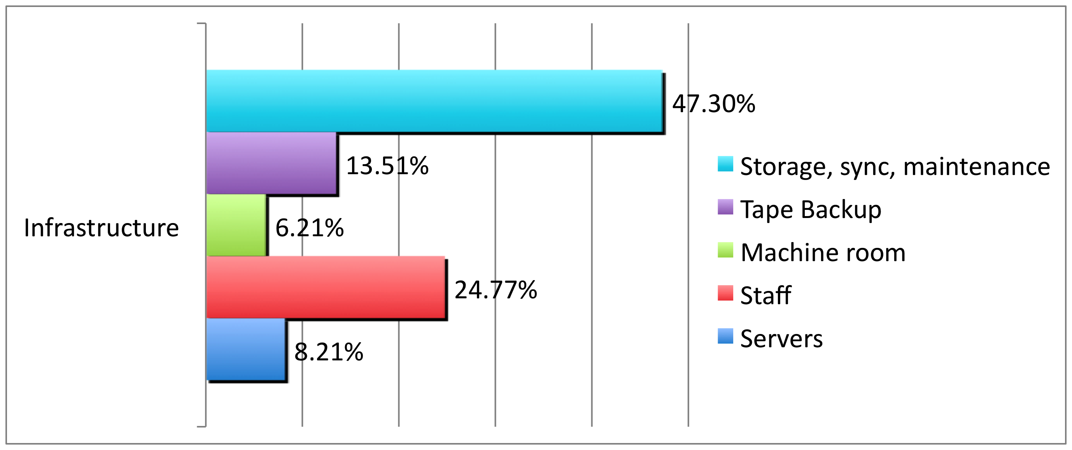
How much does it cost? (1)
Notes:
26

Slide 27
How much does it cost? (2)
$0.149/volume/year for Google-digitized
$0.489/volume/year for IA-digitized
$0.154/volume/year for all content
$3.40 per GB

Slide 28
The Cloud Library
Toward a Cloud Library
  CLIR, Mellon Foundation
  OCLC Research, NYU, HathiTrust, Recap Libraries
    Objective: Characterize the near-term opportunity for externalizing management of academic research collections leveraging capacity of large-scale shared print and digital repositories* (Malpas, RLG Partner Update, January 2010)
    Outcomes: opportunity and risk assessment based on aggregate collection analysis; draft service agreement enabling generic consumer library to selectively outsource preservation and access of low-use research collections to large-scale print and digital repositories

Slide 29
A global change in the library environment
Academic print book collection already substantially duplicated in mass digitized book corpus
June 2010
Median duplication: 31%
June 2009
Median duplication: 19%
Notes:
29

Slide 30
Digitized Books in Shared Repositories
~3.5M titles
~75% of mass digitized corpus is ‘backed up’ in one or more shared print repositories
~2.5M
Notes:
30

Slide 31
Collection Management, Development
Overlap
  More than 50% median overlap with ARL institutions; higher for small liberal arts colleges
Pricing model based on Print holdings
  Requires print holdings database
  Also support expansion of legal uses, efforts in de-duplication
  Facilitate individual and collaborative collection development and management operations
Print monographs archiving

Slide 32
New Cost Model
Original model based on GB contributed
New model based on overlap of print collections with HathiTrust digital collections
  Share in infrastructure costs for public domain volumes:
  (PD*C*X)/N
  Share in infrastructure costs for in copyright volumes based on holdings
    For a given in­copyright volume:
    IC=(C*X)/H

Slide 33
How does it work? (2)
Main factors in costs are
  Amount of content
  Number of partners
  Also a flexible multiplier designed to pay for programmatic activities
Tend to result in lower costs and more benefits over time

Slide 34
Print Holdings Database
Volumes institutions own or have owned
  For monographic holdings
    Only print volumes (not microform, etc.)
    OCLC number [required]
    Bib record ID [required]
    Enumeration/chronology for multi-part monographs, if available
    Condition (e.g., brittle) [optional]
    Holding Status (e.g., current holding, withdrawn, missing, etc.) [optional]
  For serial holdings
    OCLC number [required]
    Bib record ID [required]
    ISSN, if available

Slide 35
Every library is different
Our median rate of overlap may be the same
But our overlap profiles will differ by library

Slide 36
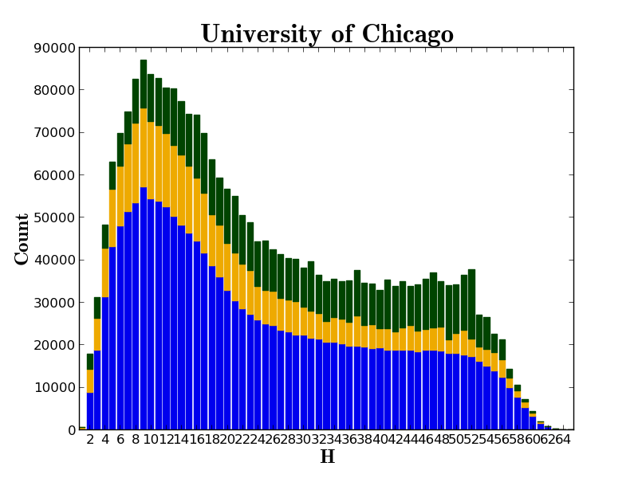

Slide 37
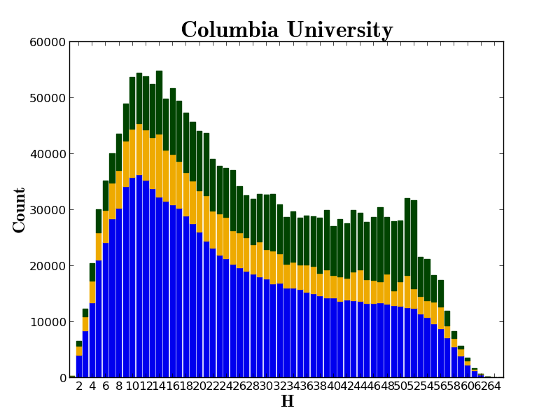

Slide 38
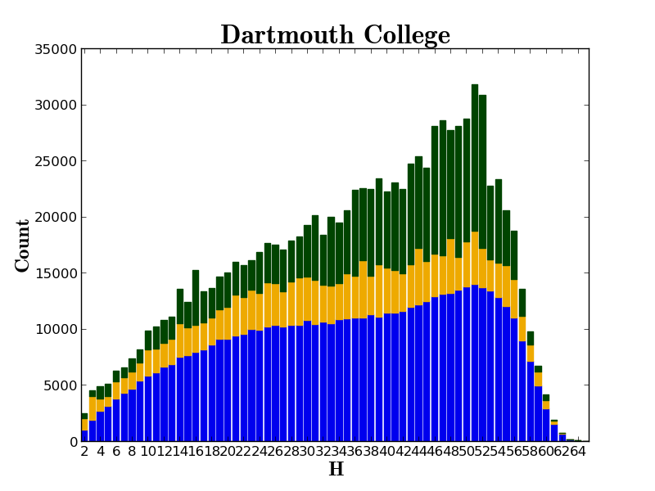

Slide 39
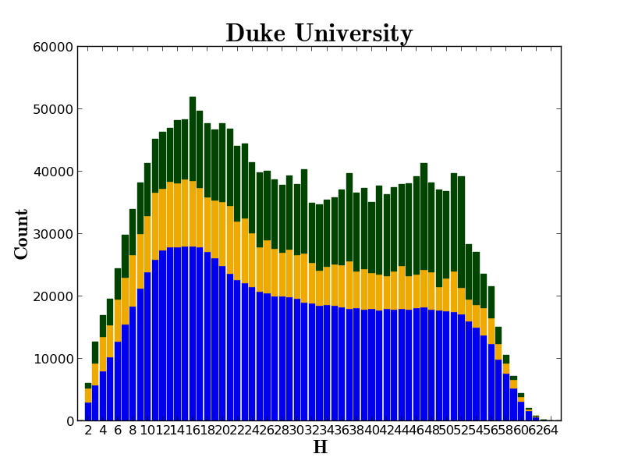

Slide 40
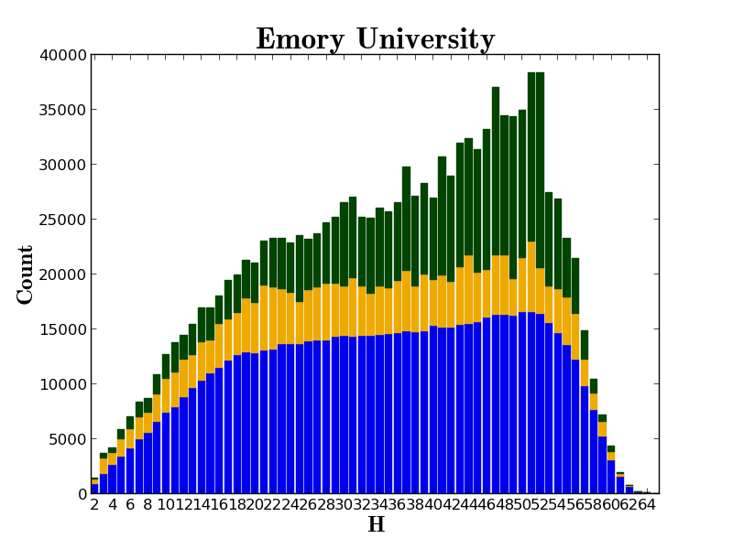

Slide 41
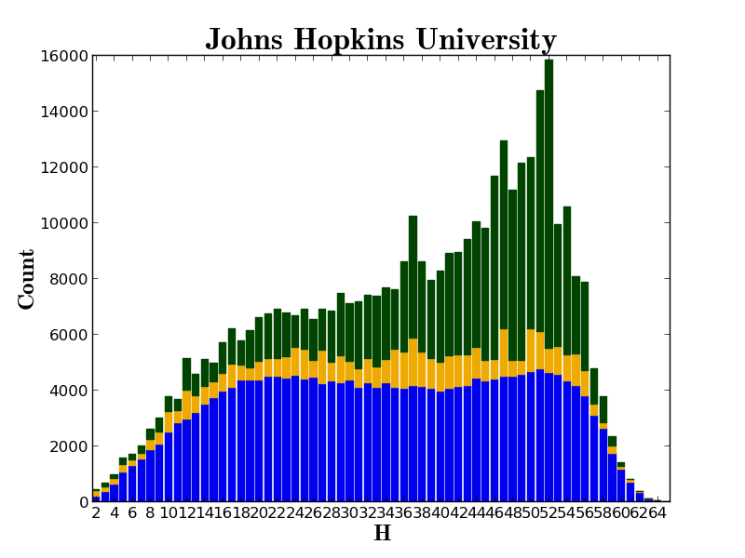

Slide 42
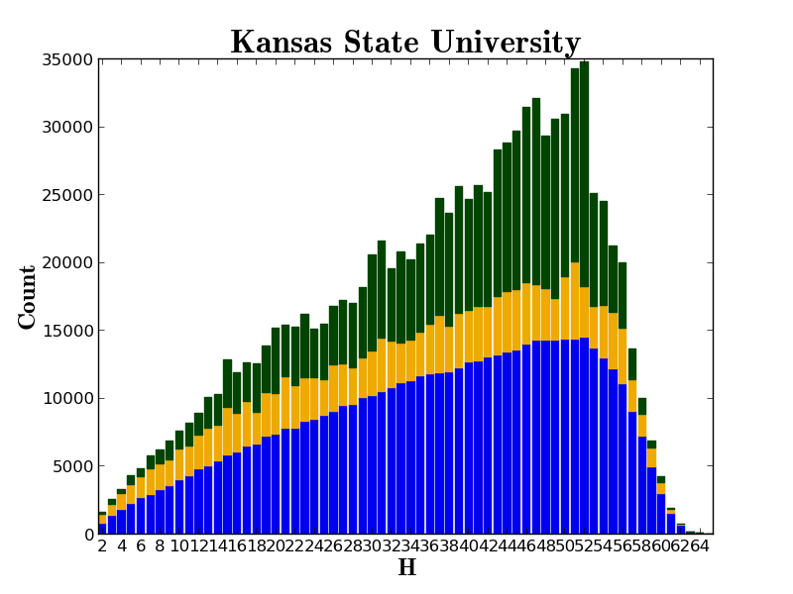

Slide 43
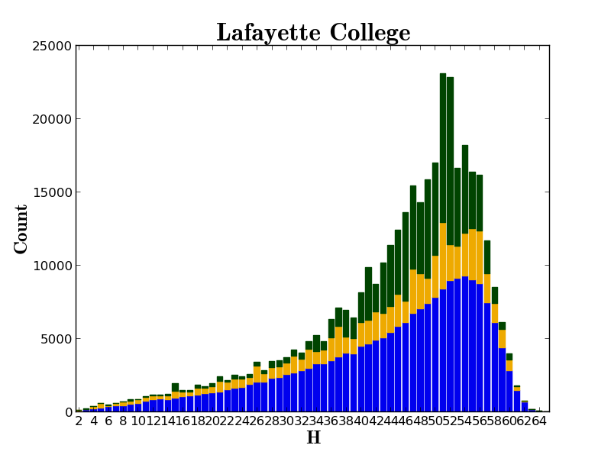

Slide 44
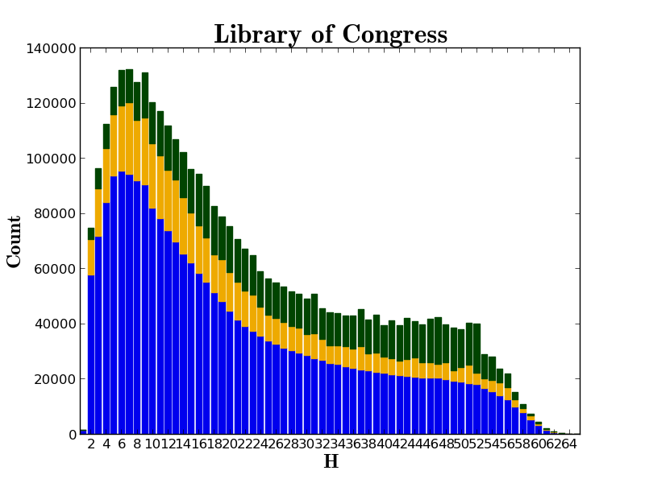

Slide 45
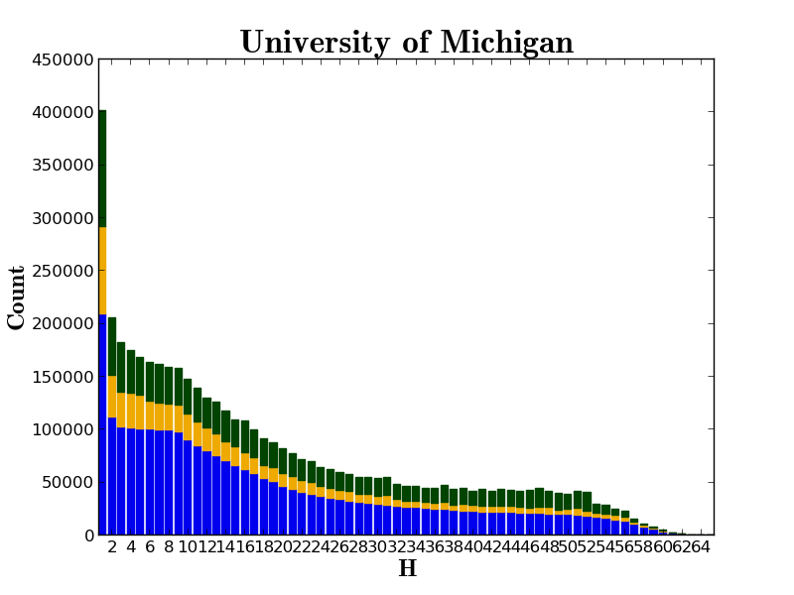

Slide 46
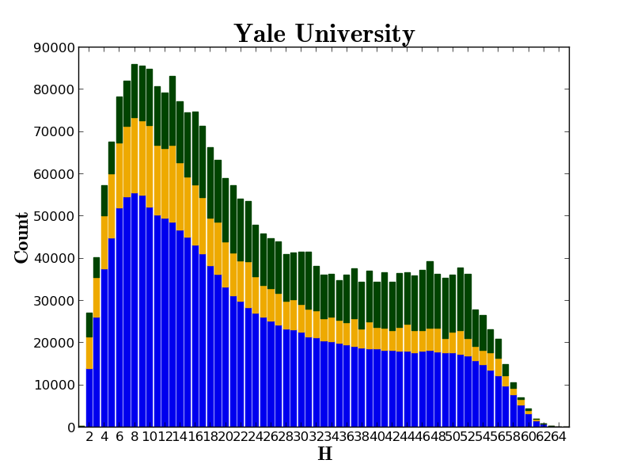

Slide 47
HathiTrust overall benefits to libraries
Digital Curation
  Drive costs down
  Reduce “bibliographic indeterminacy”
  Make meaningful decisions about formats and quality
  Increase discoverability, use
  Consolidate development talent
  Improve strength of archiving
Print Curation
  Means to associate our print holdings
  Coordinated record-keeping
Subsidiary benefits
  Quantify problems
  Collective attention to solving shared problems

Slide 48
Work going forward
Print Holdings
Print archiving, management
Government documents
Lawful uses
Quality
Research Center
Beyond books and journals
Publishing
Transitioning to next phase of partnership

Slide 49
How to find out more
About: http://www.hathitrust.org/about
Twitter: http://twitter.com/hathitrust
Facebook: http://www.facebook.com/hathitrust
Monthly newsletter:
  http:www.hathitrust.org/updates
  RSS http://www.hathitrust.org/updates_rss
Contact us: feedback@issues.hathitrust.org
Blogs: http://www.hathitrust.org/blogs
  Large-scale Search
  Perspectives from HathiTrust

