Slide 1
HathiTrust METS and PREMIS
October 25, 2011
Jeremy York
Project Librarian, HathiTrust

Slide 2
Partnership
Arizona State University
Baylor University
Boston University
California Digital Library
Columbia University
Cornell University
Dartmouth College
Duke University
Emory University
Getty Research Institute
Harvard University Library
Indiana University
Johns Hopkins University
Lafayette College
Library of Congress
Massachusetts Institute of Technology
McGill University
Michigan State University
New York Public Library
New York University
North Carolina Central
University
North Carolina State
University
Northwestern University
The Ohio State University
The Pennsylvania State
University
Princeton University
Purdue University
Stanford University
Texas A&M University
Universidad Complutense
de Madrid
University of Arizona
University of Calgary
University of California
Berkeley
Davis
Irvine
Los Angeles
Merced
Riverside
San Diego
San Francisco
Santa Barbara
Santa Cruz
The University of Chicago
University of Connecticut
University of Florida
University of Illinois
University of Illinois at Chicago
The University of Iowa
University of Maryland
University of Miami
University of Michigan
University of Minnesota
University of Missouri
University of Nebraska-Lincoln
The University of North Carolina at Chapel Hill
University of Notre Dame
University of Pennsylvania
University of Pittsburgh
University of Utah
University of Virginia
University of Washington
University of Wisconsin- Madison
Utah State University
Yale University Library
Notes:
63 partners, more in works

Slide 3
Content
9,710,978 Total volumes
2,641,310 “Public domain”
5,154,682 Book titles
256,196 Serial titles
* As of October 25, 2011
Notes:
3
Google
Book and Journal content
Google
Internet Archive
In-house, other vendor digitization
Images, Audio, Born Digital (coming soon…)
Talk about distribution of in copyright and public domain volumes, CC and open access. Encourage open access. Notable organizations recently to open with CC include Brooklyn Museum, SAA publications. Working currently with several university presses to ingest material – perpetual archiving in exchange for open access. Talk about CRMS later. All of these materials available through a single interface, with ability to divide and slice in different ways through collection features (will talk about – someone just created collection for SAA materials)

Slide 4
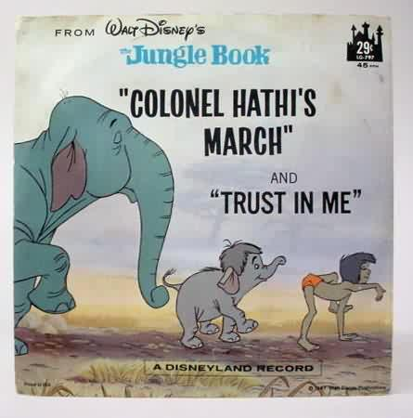
The Name
The meaning behind the name
Hathi (hah-tee)--Hindi for elephant
Big, strong
Never forgets, wise
Secure
Trustworthy

Slide 5
Mission
To contribute to the common good by collecting, organizing, preserving, communicating, and sharing the record of human knowledge

Slide 6
Collections and Collaboration
Comprehensive collection
Preservation…with Access
Shared strategies
Collection management, development
Copyright
Preservation (digital and print)
Bibliographic Indeterminacy
Discovery / Use
Efficient user services
Public Good
Notes:
Specific aims of Collections and Collaboration
Shared Strategies = Collective Attention to solving shared problems
HathiTrust is essentially about collections and collaboration – we are aiming a collectivity of content, as comprehensive as possible, beginning first with the published record; preserving and providing access to this to content, and using use it in ways that benefit us a libraries, and our ability to serve the needs of our primary communities of use. This includes engaging in shared strategies around
Collaborative collection management and collection development
Preservation – [acting together to improve the strength of our archiving capabilities and driving down costs by working at scale]
Copyright
User services - Lowering the costs associated with maintaining our collections and redirecting them toward improving interaction with users.
Underlying these efforts is a deep commitment inHathiTrust to public goods and openness – in our infrastructure, services, our use and creation of open source software, and our goal to serve the needs the partner community, but at the same time to provide public goods that are available to all.

Slide 7
Preservation
Bit-level, migration
Standard and open formats (ITU G4 TIFF, JPEG2000, JPG, Unicode)
Validation, integrity, redundancy
Philosophy: Designed for large-scale
OAIS/TRAC
Consistency
Standardization
Simplicity (in design, not function)
Practicality
Sustainability
Notes:
First and foremost, do preservation

Slide 8
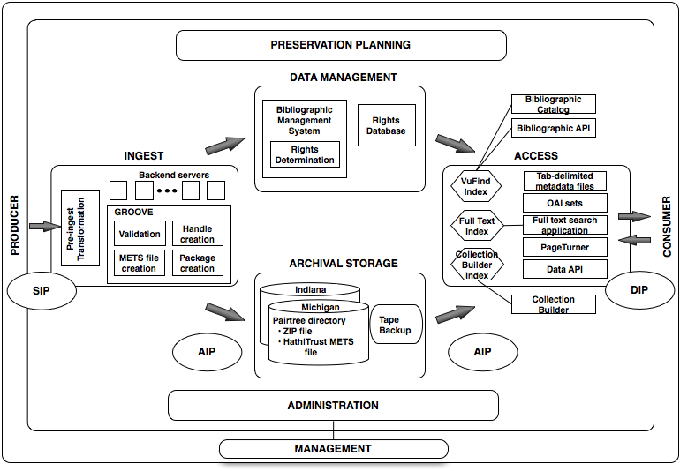
Holdings Database
Notes:
Inbound validation, standards-based
object storage and related metadata
Storage in Ann Arbor and Indianapolis
Encrypted backup to 3rd location
Rights database for rights metadata
Online catalog as source and storage for descriptive metadata
Objectives:
A guiding principle: preserve archival package
create deliverables on demand
Incorporate TDR-specific practices
Automatic validation in GROOVE
Check barcode check digit using Luhn algorithm
Fixity check on JPG2000, TIFF, UTF8 using MD5
Well-formedness and embedded metadata check on JPG2000, TIFF, UTF8 using JHOVE
Simple filesystem layout
One directory per volume, zip file and METS file
Use of a namespace allows for conflicting identifiers
Namespaces for institutions and, if needed, types of identifiers within the institution
Why METS?
Can serve as Archival Information Package and a Dissemination Information Package
Designed to record the relationship between pieces of complex digital objects
Can be created automatically as texts are loaded or reloaded
Preservation actions (PREMIS)
What’s there?metsHdr with an ID and CREATEDATE
2 dmdSecs: Marcxml and mdRef
amdSec containing one techMD with PREMIS metadata
fileSec with 4 fileGrps (zip, images, OCR, hOCR)
Physical structMap tying together files with metadata (pg. numbers and features)

Slide 9
Object Package
images
text
Source METS
Zip
HT
METS
bib
data
bib
data

Slide 10
Architecture & Management
../uc1/pairtree_root/b3/54/34/86/b34543486
images
text
Source METS
b34543486.zip
HT
METS
b34543486.mets.xml
Example ids:
wu.89094366434
mdp.39015037375253
uc2.ark:/1390/t26973133
miua.aaj0523.1950.001
bib
data
bib
data
Notes:
Pairtree – maps identifier strings to paths of objects
Easy for content to be imported, understood, used in new storage system without system knowing anything about nature or contents of stored objects
Allows object operations like backup, restore, to be performed using native OS tools
Facilitates disaster recovery
Ensures objects uniformly accessible to repository systems and access services

Slide 11
Holdings Database
Notes:
Inbound validation, standards-based
object storage and related metadata
Storage in Ann Arbor and Indianapolis
Encrypted backup to 3rd location
Rights database for rights metadata
Online catalog as source and storage for descriptive metadata
Automatic validation in GROOVE
Check barcode check digit using Luhn algorithm
Fixity check on JPG2000, TIFF, UTF8 using MD5
Well-formedness and embedded metadata check on JPG2000, TIFF, UTF8 using JHOVE
Simple filesystem layout
One directory per volume, zip file and METS file
Use of a namespace allows for conflicting identifiers
Namespaces for institutions and, if needed, types of identifiers within the institution
Why METS?
Can serve as Archival Information Package and a Dissemination Information Package
Designed to record the relationship between pieces of complex digital objects
Can be created automatically as texts are loaded or reloaded
Preservation actions (PREMIS)
What’s there?metsHdr with an ID and CREATEDATE
2 dmdSecs: Marcxml and mdRef
amdSec containing one techMD with PREMIS metadata
fileSec with 4 fileGrps (zip, images, OCR, hOCR)
Physical structMap tying together files with metadata (pg. numbers and features)

Slide 12
METS Object
Why METS?
Can serve as Archival Information Package and a Dissemination Information Package
Designed to record the relationship between pieces of complex digital objects
Can be created automatically as texts are loaded or reloaded
Preservation actions (PREMIS)

Slide 13
Metadata
Details and specifications at repository level
Object specifications / Validation criteria
Page-tagging
Variations at object level
Files missing
Non-valid files
Incorrect file checksums
http://www.hathitrust.org/digital_object_specifications

Slide 14
HathiTrust METS
Contains regularized information that is generally applicable to items across the repository, not specific to a particular source, that we can see a current or near-term use for.
This information is fundamentally valuable for understanding or using the preserved object in preservation activities after deposit, or in the access and display environments, including the APIs.

Slide 15
Source METS
Contains information that may be valuable for preservation or archaeology, but is subjective (descriptive, e.g., bibliographic data, page-tags), idiosyncratic, or we do not have a clear idea of its use and/or application. The information could be used to enhance knowledge of about the core files, but is not fundamentally valuable for understanding or using the preserved object in the repository.
Is a “parking lot” for information we are getting that may be useful in the future.
The desire not to touch things after they entire the repository might result in information that might be included in the Source METS being stored in other ways (e.g., in-repository fixity checks)

Slide 16
HathiTrust METS (2)
What’s there?
2 dmdSecs: Marcxml and mdRef
amdSec containing one techMD with PREMIS metadata
fileSec with 4 fileGrps (zip, images, OCR, hOCR)
Physical structMap tying together files with metadata (pg. numbers and features)
METS Creation (Google) | Example
METS Creation (IA) | Example
HathiTrust METS Profile
Notes:
Doctype declarations
Namespace declarations
URI that may or may not define schema
Schema locations

Slide 17
Source METS (2)
What’s there?
dmdSecs
amdSec
fileSec (coordOCR, OCR, images…)
Physical structMap tying together files with metadata (pg. numbers and features)
Source METS example (Google)
Source METS example (IA)
Source METS Creation

Slide 18
Vocabularies
PREMIS
Pagetag mapping

Slide 19
Change Management
PREMIS 2.1 “uplift”
Add
Reading order
Explicitly record page insertions
Deletion PREMIS event
PREMIS event to mark move to PREMIS 2.1
Reference to Source METS
Scheme to identify "version" of METS files
Preservation levels (e.g., for PDF/A and PDF)
New method of coding PDFs in the METS
Remove
MARC metadata (pending approval of UC)
References to pagedata and notes.txt
PREMIS 2.1 example

Slide 20
Print Holdings Database
Volumes institutions own or have owned
For monographic holdings
Only print volumes (not microform, etc.)
OCLC number [required]
Bib record ID [required]
Enumeration/chronology, if available
Condition (e.g., brittle) [optional]
Holding Status (e.g., current holding, withdrawn, missing, etc.) [optional]
For serial holdings
OCLC number [required]
Bib record ID [required]
ISSN, if available

Slide 21
Rights Database
System of precedence
15 attributes
15 reason codes
Manual
Conformance with formalities
Contractual agreements
Access control overrides
Bibliographic (automatic)
Notes:
Bibliographic – based on information in bibliographic records – publication location, publisher, date. General → published in the U.S. before 1923 = pd. Published outside the U.S. before 1923, may be in copyright or may not.

