Slide 1
HathiTrust: A Second Life for Library Collections
Jeremy York
Exploring Humanities Cyberinfrastructure
April 30, 2013

Slide 2
Partnership
Arizona State University
Baylor University
Boston College
Boston University
Brandeis University
Brown University
California Digital Library
Carnegie Mellon University
Columbia University
Cornell University
Dartmouth College
Duke University
Emory University
Florida State University
Getty Research Institute
Harvard University Library
Indiana University
Iowa State University
Johns Hopkins University
Kansas State University
Lafayette College
Library of Congress
Massachusetts Institute of Technology
McGill University`
Michigan State University
New York Public Library
New York University
North Carolina Central
University
North Carolina State
University
Northwestern University
The Ohio State University
The Pennsylvania State
University
Princeton University
Purdue University
Stanford University
Syracuse University
Texas A&M University
Tufts University
Universidad Complutense
de Madrid
University of Alberta
University of Arizona
University of Calgary
University of California
Berkeley
Davis
Irvine
Los Angeles
Merced
Riverside
San Diego
San Francisco
Santa Barbara
Santa Cruz
The University of Chicago
University of Connecticut
University of Delaware
University of Florida
University of Houston
University of Illinois
University of Illinois at Chicago
The University of Iowa
University of Kansas
University of Maryland
University of Miami
University of Michigan
University of Minnesota
University of Missouri
University of Nebraska-Lincoln
The University of North
Carolina at Chapel Hill
University of Notre Dame
University of Pennsylvania
University of Pittsburgh
University of Utah
University of Vermont
University of Virginia
University of Washington
University of Wisconsin- Madison
Utah State University
Vanderbilt University
Virginia Tech
Wake Forest University
Washington University
Yale University Library

Slide 3
Digital Repository
Launched 2008
Initial focus on digitized book and journal content
10.7 million total volumes
5.6 million book titles
278,000 serial titles
3.3 million public domain (~31%)

Slide 4
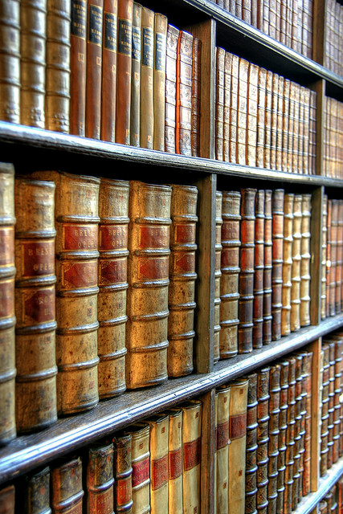
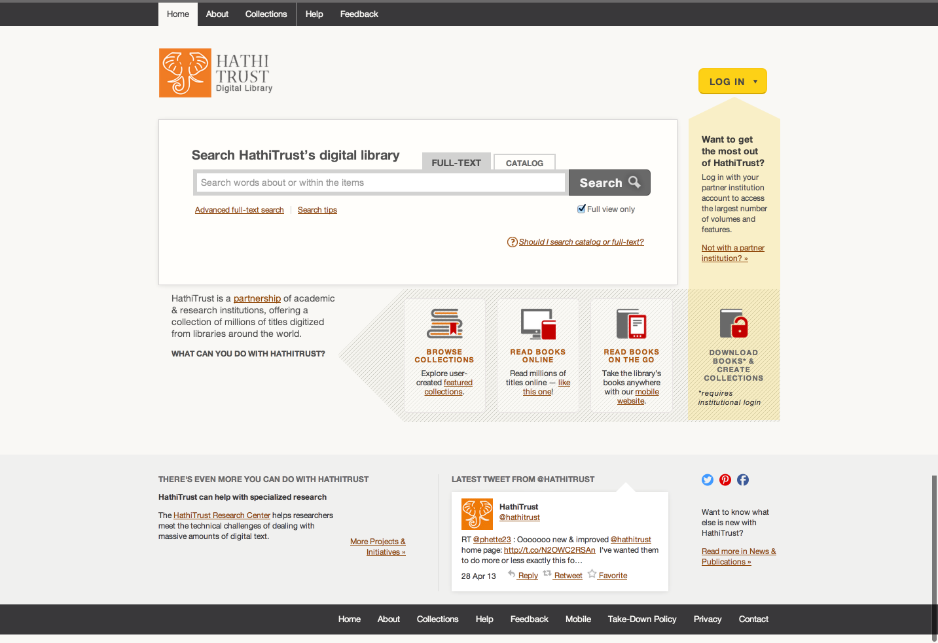
Full-text Search
Reading
Collections
Lawful uses under specific terms and conditions: http://www.hathitrust.org/access_use#ic-access
APIs
Datasets
Research Center
* Photo by ben.gallaher CC-BY http://bit.ly/ZY040K

Slide 5
Research Center Key Ideas
Bring researchers to the data
Evolve around user demand
Start with public domain materials
Support non-consumptive research

Slide 6
Research Center
FAQ
http://bit.ly/XkZKev
Listserv
http://bit.ly/12KB3t7
Portal: browse volume lists and algorithms, execute algorithms, view results
Catalog (Blacklight): assemble worksets
Sandbox: can run own algorithms

