Slide 1
Update on Developments and Activities
UM Selectors
October 9, 2012
Jeremy York, Project Librarian, HathiTrust

Slide 2
Partnership
Arizona State University
Baylor University
Boston College
Boston University
California Digital Library
Columbia University
Cornell University
Dartmouth College
Duke University
Emory University
Florida State University
Getty Research Institute
Harvard University Library
Indiana University
Johns Hopkins University
Kansas State University
Lafayette College
Library of Congress
Massachusetts Institute of Technology
McGill University`
Michigan State University
New York Public Library
New York University
North Carolina Central
University
North Carolina State
University
Northwestern University
The Ohio State University
The Pennsylvania State
University
Princeton University
Purdue University
Stanford University
Texas A&M University
Universidad Complutense
de Madrid
University of Arizona
University of Calgary
University of California
Berkeley
Davis
Irvine
Los Angeles
Merced
Riverside
San Diego
San Francisco
Santa Barbara
Santa Cruz
The University of Chicago
University of Connecticut
University of Delaware
University of Florida
University of Illinois
University of Illinois at Chicago
The University of Iowa
University of Maryland
University of Miami
University of Michigan
University of Minnesota
University of Missouri
University of Nebraska-Lincoln
The University of North
Carolina at Chapel Hill
University of Notre Dame
University of Pennsylvania
University of Pittsburgh
University of Utah
University of Vermont
University of Virginia
University of Washington
University of Wisconsin- Madison
Utah State University
Virginia Polytechnic University
Washington University
Yale University Library

Slide 3
Content Growth
24 contributors
  17 Google-digitized
  10 Internet Archive-digitized
  4 Locally-digitized

Slide 4
 | 2008 | 2009 | 2010 | 2011 | 2012 (Oct)
Total Volumes | 2,477,871 | 5,221,092 | 7,836,698 | 9,966,572 | 10,531,566
Public Domain | 372,085 | 758,947 | 1,959,223 | 2,712,626 | 3,218,132

Slide 5
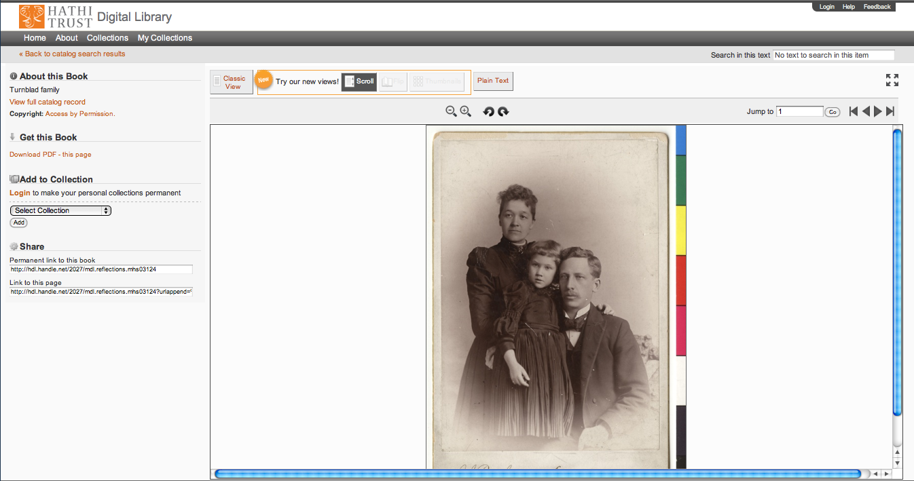

Slide 6
Content Distribution
Notes:
6

Slide 7
Content Sources
Notes:
7

Slide 8

Dates
Notes:
8

Slide 9
Language Distribution (1)
The top 10 languages make up ~86% of all content
Notes:
9

Slide 10
Language Distribution (2)
The next 40 languages make up ~13% of total
Notes:
10

Slide 12
Services: Discovery

Slide 13
Bibliographic Search
Phrase Searching
  Use quotes to search an exact phrase: e.g., "occult fiction"
Wildcards
  Use * or ? to search for alternate forms of a word. Use * to stand for several characters, and ? for a single character: e.g., optim* will find optimal, optimize or optimum; wom?n will find woman and women.
Boolean Searching
  Use AND and OR between words to combine them with Boolean logic: e.g., (heart OR cardiac) AND surgery will find items about heart surgery or cardiac surgery.
Advanced search
Facets
Mobile

Slide 14
Full-text Search
Phrase Searching
  Use quotes to search an exact phrase: e.g., "occult fiction"
Multiple Term Searching
  When your search terms are not quoted phrases, avoid common words (such as: 'a', 'and', 'of', 'the', etc.) to speed up your search.
Boolean Searching
  Use AND and OR between words to combine them with Boolean logic: e.g., heart OR cardiac will find items containing the word heart or the word cardiac; heart AND cardiac will find items containing both words. Use a minus (-) to remove words from the result e.g., heart -cardiac will find items containing the word heart that do not include the word cardiac.
Advanced Search (phase 2 completed in April)
Facets
Spelling suggestion feature (coming soon)

Slide 15
More
Search within a volume (including in-copyright)
Find in a library
Search within a collection

Slide 16
Services: Use

Slide 17
Use: general (1)
PageTurner views
  Scroll - now default
  Flip
  Thumbnail
  Classic
  OCR
Jump to book sections
Rotate pages
Accessible interface
  Access to users registered with OSSD

Slide 18
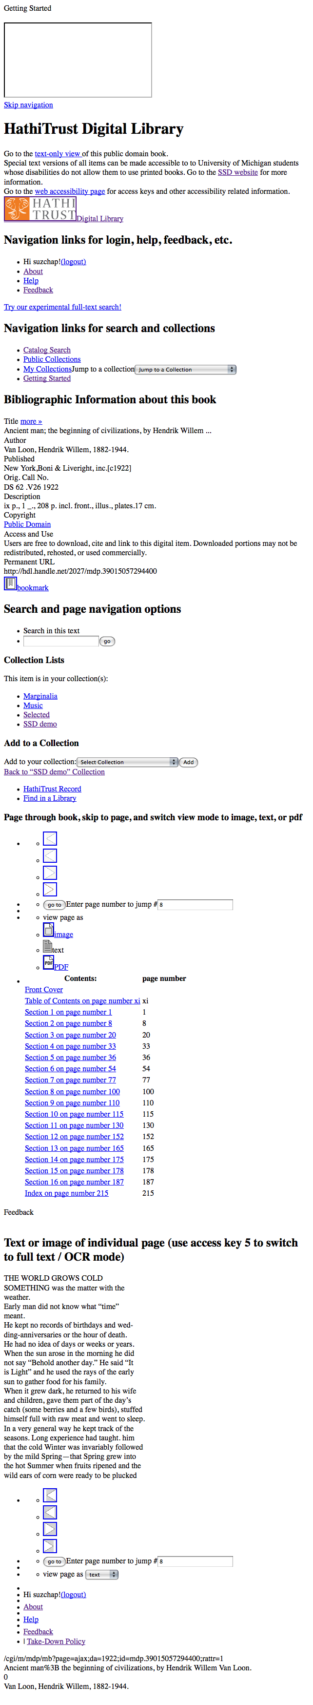
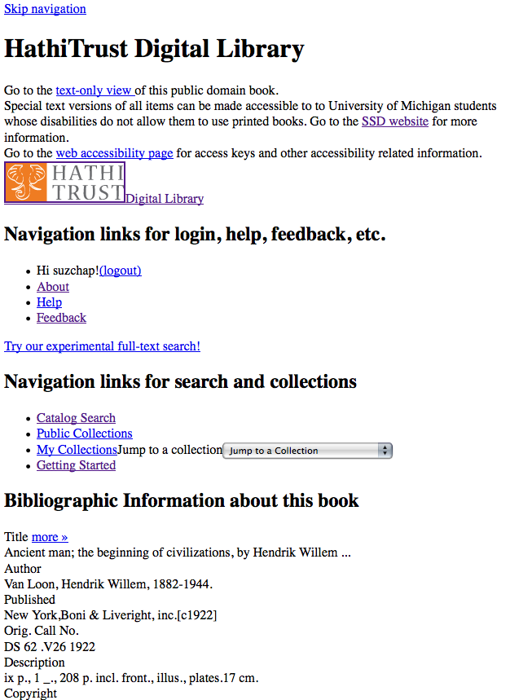
Skip navigation link
Info about SSD service & link to accessibility page
Descriptive headings added (hidden from GUI with CSS)
Added labels & descriptive titles to forms & ToC table
Access keys for navigating pages with keyboard
Images used for style are in css so no need to use alt tags

Slide 19
Use: general (2)
Mobile interface
Embed a book
  http://www.hathitrust.org/embed

Slide 20
Download
Everyone
  Single page PDF of public domain and open access works
  Full PDF of public domain and open access works where no restrictions; Full ePubs available in mobile
Partners
  Full PDF of public domain and open access works*
  Full ePubs available in mobile

Slide 21
Rights
CRMS US (since 2008)
  Published in US, 1923-1963
  320,883 reviewed
  169,995 opened (~53%)
CRMS-World (since 2012)
  Published non-US (UK, Canada, Australia, Spain)
  15,075 reviewed
  6,592 opened (~44%)
Permissions
  Open access - 6,429
  Additional Creative Commons - 4,167

Slide 22
Lawful uses of in-copyright works
At University of Michigan
  Users registered with OSSD
    All in-copyright works in HathiTrust owned by Michigan
    Must be authenticated
    Must be on U.S. soil
    One simultaneous access per copy owned
  Uses under Section 108
    Must be out of print and brittle
    Must be authenticated or accessing work from library premises
    Must be on U.S. soil
    One simultaneous access per copy owned
Access and Use Statements
  http://www.hathitrust.org/access_use

Slide 23
Citation
Export to endnote from catalog record
Display MLA and APA citation from catalog record
Export to Zotero and similar via catalog search results or volume view
Version date in volume view

Slide 24
Hackable
Hackable
Data API
Bibliographic API
Hathifiles
Datasets
Research Center
  http://www.hathitrust.org/htrc
  http://www.lis.illinois.edu/articles/2012/09/hathitrust-research-center-inaugurates-first-annual-uncamp
  http://hacklibschool.wordpress.com/tag/hathitrust/

Slide 25
Collections and Resources
Updated Collections interface
“My Library”
  http://www.hathitrust.org/blogs/perspectives-from-hathitrust/whats-in-your-collection
Resources and Guides
  Includes handouts, Web resources, Users’s Guide to HathiTrust
  http://www.hathitrust.org/resources

Slide 26
Quality (1)
Google Library Working Group
  Focusing on improvement to systematic errors
  Method of correcting individual errors
  Work going on around missing pages
IMLS Quality Grant
  Quality in relation to use
  Production runs
    Google-digitized, pre-1923, English language, 870 out of 1,000 physical review
    Google-digitized, post-1923, English language, 600 UM volumes physical review
    IA-digitized, pre-1923, most English language,
    non-Roman languages (Korean, Chinese, Japanese, Arabic, Hebrew and Cyrillic)

Slide 27
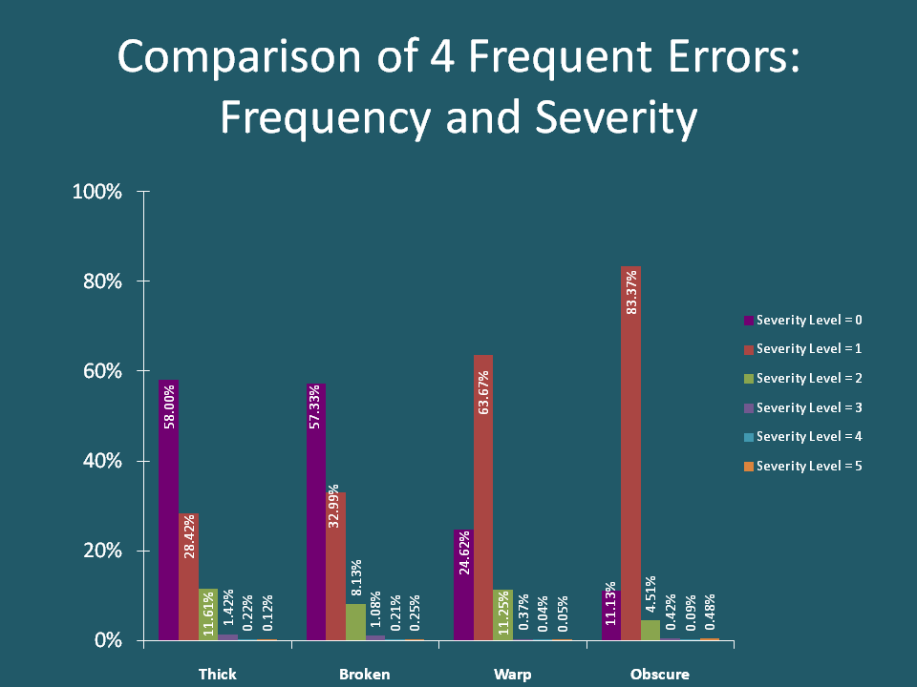
http://hathitrust-quality.projects.si.umich.edu/images/distribution-of-error-table.gif

Slide 28
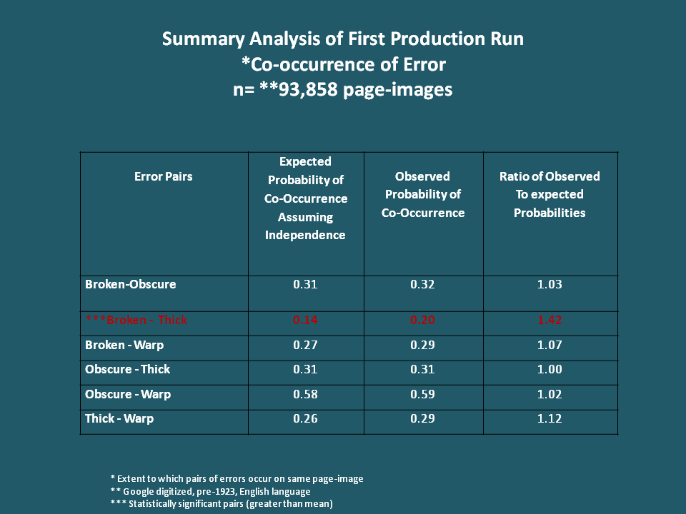
http://hathitrust-quality.projects.si.umich.edu/images/co-occurrence-of-error-table.gif

Slide 29
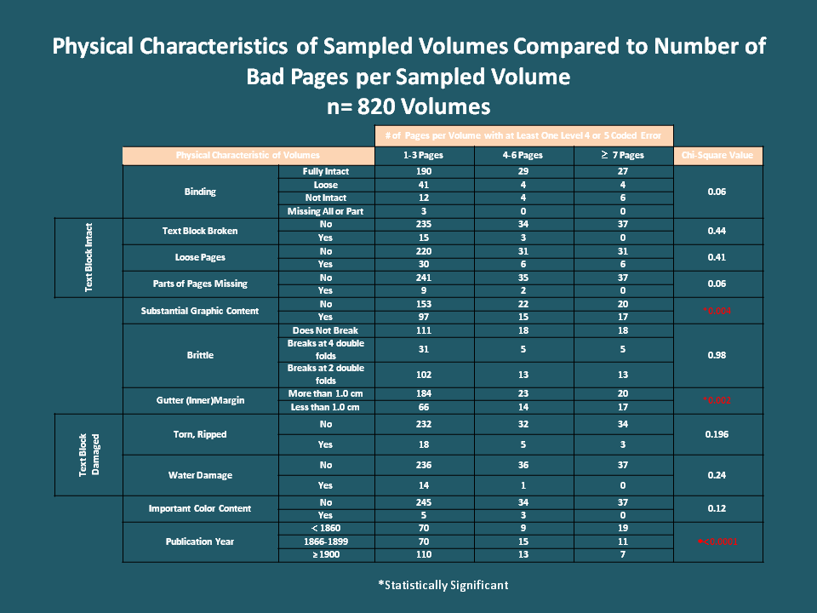
http://hathitrust-quality.projects.si.umich.edu/images/physical-characteristics-table.gif

Slide 30
Quality (2)
Whole-volume review
Certification (draft)
  Error levels
    low or no error
    aesthetic/difficult
    content in affected portion missing or altered; undecipherable
  Certification levels
    No detected errors
    Errors (e.g., duplicate pages) but no missing content
    Errors, but less than X% of content affected
    Reviewed

Slide 31
Development (1)
Development
Data API
Shib Library walk in
Versioning
  Deletes
Full-text search enhancements
  CJK searching
  Relevance ranking
  Spelling suggestion feature

Slide 32
Development (2)
Repository-wide updates
  METS and PREMIS
Adding reading order
Improving accessibility to WCAG 2.0, Level A
Separating out of print from brittle in repository
Scaling ingest of locally-digitized content
  Ingest tools
Home page / header redesign

Slide 33
Other Initiatives (1)
Training and information sessions
US Federal Government Documents
Governance

Slide 34
Strategic Advisory Board
Guidance on Policy, Planning
12-member Board of Governors
Executive Committee
Executive Director
Executive Committee
HathiTrust
Budget/Finances
Decision-making

Slide 35
Other Initiatives (2)
Print Monograph Archiving
Approval Process for Development Initiatives
Collections
  Duplicates
  Collection Development

Slide 36
How to find out more
About: http://www.hathitrust.org/about
Twitter: http://twitter.com/hathitrust
Facebook: http://www.facebook.com/hathitrust
Monthly newsletter:
  http:www.hathitrust.org/updates
  RSS http://www.hathitrust.org/updates_rss
Contact us: feedback@issues.hathitrust.org
Blogs: http://www.hathitrust.org/blogs
  Large-scale Search
  Perspectives from HathiTrust

