Slide 1
The HathiTrust Repository: Policy and Technical Issues in Building the Digital Archive
SI 640
March 1, 2013
Cory Snavely, Head, LIT Core Services, University of Michigan
Jeremy York, Project Librarian, HathiTrust
Unless otherwise noted, these slides and their contents are licensed under a Creative Commons Attribution Unported License.

Slide 2
Outline
Introduction
Underlying Ideas
Repository and Services
Organization and Pricing Model

Slide 3
Introduction

Slide 4
Partnership
Arizona State University
Baylor University
Boston College
Boston University
Brandeis University
California Digital Library
Carnegie Mellon University
Columbia University
Cornell University
Dartmouth College
Duke University
Emory University
Florida State University
Getty Research Institute
Harvard University Library
Indiana University
Iowa State University
Johns Hopkins University
Kansas State University
Lafayette College
Library of Congress
Massachusetts Institute of Technology
McGill University`
Michigan State University
New York Public Library
New York University
North Carolina Central
University
North Carolina State
University
Northwestern University
The Ohio State University
The Pennsylvania State
University
Princeton University
Purdue University
Stanford University
Syracuse University
Texas A&M University
Universidad Complutense
de Madrid
University of Arizona
University of Calgary
University of California
Berkeley
Davis
Irvine
Los Angeles
Merced
Riverside
San Diego
San Francisco
Santa Barbara
Santa Cruz
The University of Chicago
University of Connecticut
University of Delaware
University of Florida
University of Illinois
University of Illinois at Chicago
The University of Iowa
University of Kansas
University of Maryland
University of Miami
University of Michigan
University of Minnesota
University of Missouri
University of Nebraska-Lincoln
The University of North
Carolina at Chapel Hill
University of Notre Dame
University of Pennsylvania
University of Pittsburgh
University of Utah
University of Vermont
University of Virginia
University of Washington
University of Wisconsin- Madison
Utah State University
Vanderbilt University
Virginia Tech
Wake Forest University
Washington University
Yale University Library

Slide 5
Digital Repository
Launched 2008
Initial focus on digitized book and journal content
  10.6 million total volumes
  5.58 million book titles
  276,000 serial titles
  3.2 million public domain (~31%)

Slide 6
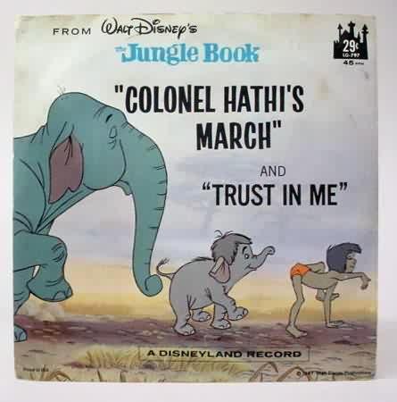
The Name
The meaning behind the name
  Hathi (hah-tee)--Hindi for elephant
  Big, strong
  Never forgets, wise
  Secure
  Trustworthy

Slide 7
Mission
To contribute to the common good by collecting, organizing, preserving, communicating, and sharing the record of human knowledge

Slide 8
HathiTrust
Universal Library
Common Goal
Single Entity, Many Partners

Slide 9
Collections and Collaboration
Comprehensive collection
  Preservation…with Access
  Repository centralized, yet open
Shared strategies
  Copyright
  Collection management, development
  Preservation
  Discovery / Use
  Bibliographic Indeterminacy
  Efficient user services
Public Good

Slide 10
Content

Slide 11
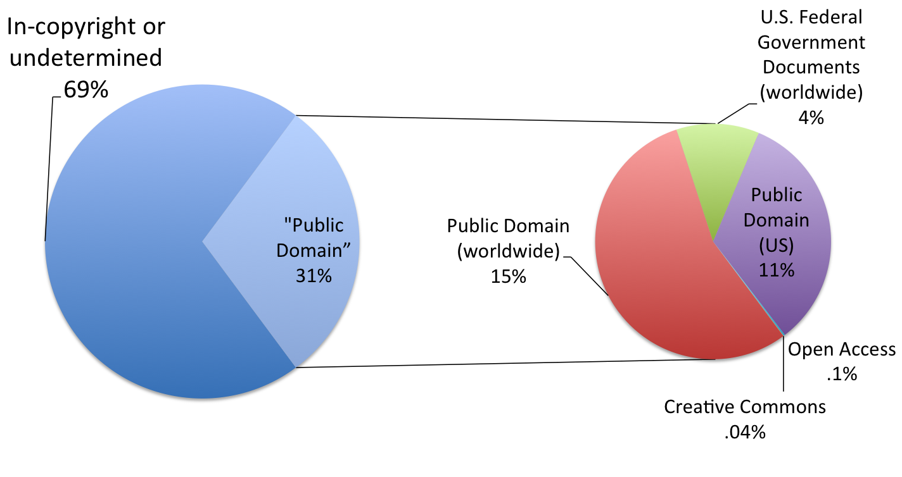
Copyright Distribution
Notes:
11

Slide 12
Content Sources

Slide 13
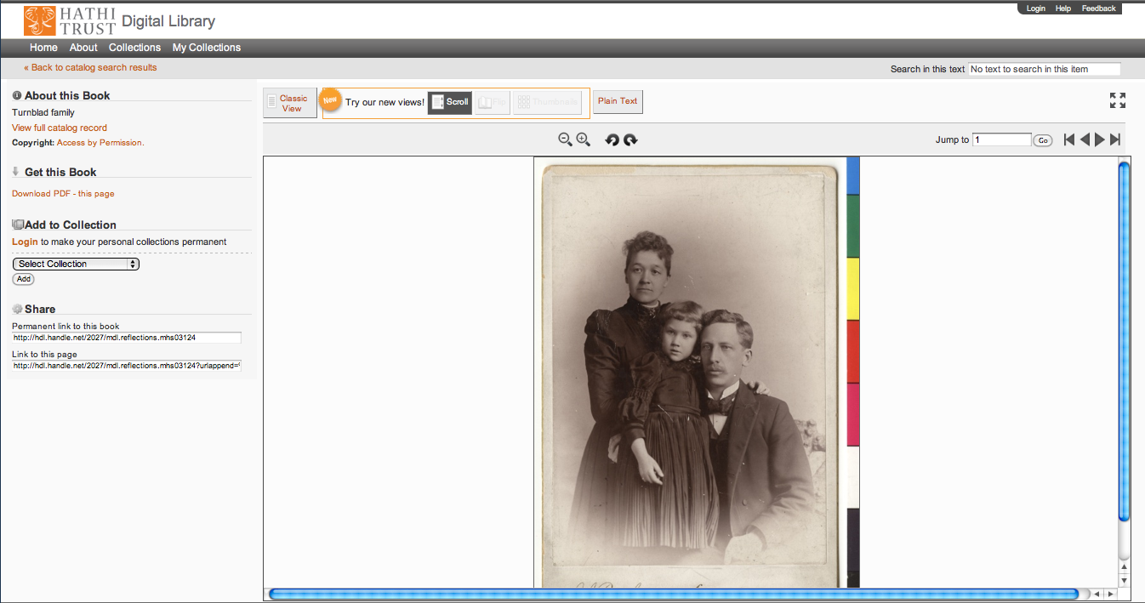
Support Beyond Books and Journals

Slide 14

http://lib.umich.edu/mpach
Package of tools to enable publication of open access, born-digital journal content, directly into HathiTrust
  Including accompanying data and media files
Allows integration with popular journal publishing tools such as Open Journal Systems (OJS)

Slide 15
Higher Education
Source / Archive
Editorial
Market

Slide 16
Language Distribution (1)
The top 10 languages make up ~86% of all content
Notes:
16

Slide 17
Language Distribution (2)
The next 40 languages make up ~13% of total
Notes:
17

Slide 18

Dates
Notes:
18

Slide 19
Underlying Ideas

Slide 20
Underlying ideas
Community
Scale
Access and Preservation
Openness

Slide 21
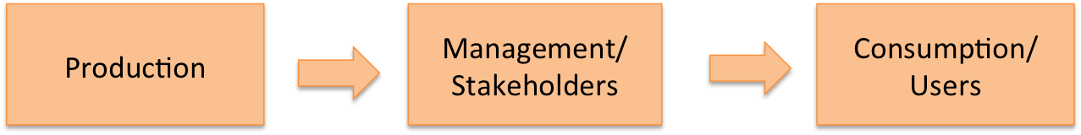
Community

Slide 22

Community

Slide 23
Community
OAIS
TRAC
METS and PREMIS
Repository Practices
  Content
  Reference
  Fixity

Slide 24
Scale
Mission
  To contribute to the common good by collecting, organizing, preserving, communicating, and sharing the record of human knowledge
Strategy
  “Co-owned and managed”

Slide 25
Preservation and Access
We engage in preservation for purposes of access
“Light” archive benefits
  Access to materials
  Checks on integrity
  Best chance for content to be used and valued, preserved

Slide 26
Openness
Repository centralized...open
Formats
Software
Organizational structure

Slide 27
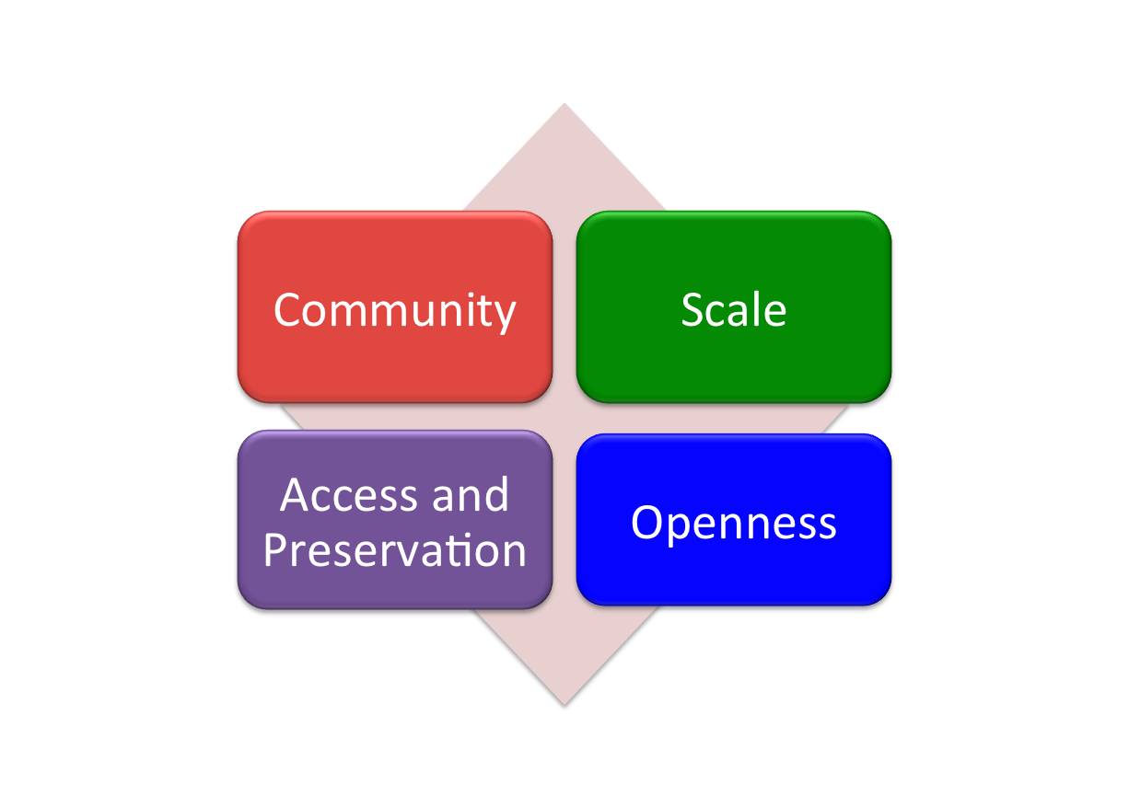
Underlying ideas

Slide 28
Underlying ideas
Experience

Slide 29
What’s Missing?
What should be included in the AIP?
What should be validated?
How should content be identified?
How to operate at scale – managing preservation information (PREMIS; access information in rational way at scale)
...

Slide 30
Questions

Slide 31
Repository Philosophy/Design
OAIS/TRAC
Consistency
Standardization
Simplicity (in design, not function)
Practicality
Sustainability
Notes:
The design choices we’ve made for the HathiTrust Repository support the underlying ideas in practical ways.
Basing design on Open Archival Information Systems and Trustworthy Digital Repositories (TRAC) criteria ground the design in community standards.
Striving for consistency and standardization in content formats we support means we know exactly what we have and we know how to preserve it, and ensures contents are usable in aggregate.
Simplicity (in design, not function) helps us operate at a large scale with minimal (or at least fixed) staff overhead.
Practicality – Decisions about processes, content, metadata are based on uses of the materials to serve partner needs (community).
Sustainability – All decisions need to factor in sustainability in order to meet long-term preservation commitments.

Slide 32

Source
Data Management
Access
Bib Data
Rights Data
Catalog
Ingest
Full-text Search
Holdings Data
Bibliographic Data
PageTurner
Content Package
Collections
Storage
Michigan
APIs
Indiana
Datasets
TDR
Notes:
Representation of repository according to OAIS framework
We’ll walk through he different areas: Ingest, Data Management, Storage, and Access, showing the implementation choices we’ve made in alignment with our underlying concept for the repository.

Slide 33
Building the Digital Repository
Shared infrastructure
  Centralized
    Administration: Ingest, validation, content integrity
    Functionality: full-text search, viewing print on demand
  Geographically distributed
    In terms of location, coding, service development, digitization, content preparation
Notes:
First, what we mean by building digital repository:
assembling high quality digital copies of library materials onto centralized shared infrastructure that is owned and managed by the libraries, where the materials can be preserved, indexed, and made available within the bounds of law for a variety of access and research purposes.
Consolidation on infrastructure that is centralized (in terms of administration, and functionality) but nonetheless distributed (in terms of geographic location for disaster recovery, in terms of coding and service development, and where digitization and preparation of content occur) enables consistent management of all materials, and consistent functionality (e.g., full-text search, collection-building capabilities, print on demand services, viewing interfaces and functionality such as zooming in and rotating pages). Furthermore, leveraging a single, collectively-sustained platform as opposed to multiple platforms reduces operating costs for the participating institutions, thereby expanding the reach of what can be accomplished.

Slide 34
Source
Data Management
Access
Bib Data
Rights Data
Catalog
Ingest
Full-text Search
Holdings Data
Bibliographic Data
PageTurner
Content Package
Collections
Storage
Michigan
APIs
Indiana
Datasets
Notes:
So the first component is ingest
Ingest
We require two elements:
Bibliographic data in MARC format, we have specifications online
Content

Slide 35
Content
Selection of content for digitization and preservation
Types of materials
Technology
  Largely uniform in technical characteristics
  3 formats
    ITU G4 TIFF
    JPEG2000
    Unicode (with and without coordinates)
Notes:
Regarding content I’ve talked about the principle of consistency.
We’ve focused on books and book-like materials, with some pilots projects for audio, images, video, and open access publishing. All materials that are relatively well-understood and relatively mature in the digital sphere. Nothing far-reaching.
Page images and text have precise specifications and we hold all content rigorously to them.
Ultimately serves the principle of consistency and the simplicity of our ingest process. ITU G4 (bitonal) TIFF images, JP2 images, and Unicode text.

Slide 36
Content
Types and numbers of formats important to degree that satisfy community concerns
  Open formats, meet community standards
  Widely supported on a number of platforms
  Confidence in preservation and migration
Notes:
We arrive at these specifications through a balance of factors. ITU G4 TIFF, JP2 and Unicode are
standard and open formats that meet community-accepted standards for digital preservation
widely supported on a number of platforms and not dependent on particular hardware or software
efficient to store
We deliberately don’t store derivative display formats (lower resolutions, JPEG, PNG). We create them on demand, retain for a few days, and delete them.
This is consistent with our focus on preservation harmonized with access.

Slide 37

Content Package
images
text
Source METS
Zip
HT
METS
Notes:
Here is what the content package looks like in the repository
Repository is one large file system and each object is in a directory.
The directory contains a zip file, that includes the page images, OCR text, and what we call a Source METS file.
Outside the zip package is another METS file we call the HathiTrust METS file. I’ll talk more about these in a moment.

Slide 38
Source
Data Management
Access
Bib Data
Rights Data
Catalog
Ingest
Full-text Search
Holdings Data
Bibliographic Data
PageTurner
Content Package
Collections
Storage
Michigan
APIs
Indiana
Datasets
Notes:
At ingest, we enforce adherence to and validity of these few formats we accept, minimum resolution standards, conventions for image metadata specifications.
Rigorous validation processes.
Could talk about Google, IA ingest, local specs, deposit form, ingest tools here. Right now on Content distribution slide.

Slide 39
Source
Rigorous validation to ensure conformance with specifications:
Resolution, image metadata
Barcode
Fixity
Consistency
Well-formedness
Prepare archival package
Ingest
Bibliographic Data
Content Package
Notes:
This includes validating identifiers for items where possible, doing a check on the fixity of items we have received, and then packaging the content for deposit, including preparing the zip file and HathiTrust METS.

Slide 40
Source
More about ingest
New Digitization
Existing Digitization
http://www.hathitrust.org/ingest
Ingest checklist:
Deposit Forms
Bibliographic metadata specifications
http://www.hathitrust.org/ingest_checklist
Ingest tools
Tools for validating, remediating, packaging
Detailed content specifications
http://www.hathitrust.org/ingest_tools
Deposit Guidelines
Policies
http://www.hathitrust.org/deposit_guidelines
Example METS files and METS profile
http://www.hathitrust.org/digital_object_specifications
Ingest
Bibliographic Data
Content Package
Notes:
Links to more information about ingest in HathiTrust – both for existing digital materials and for new digitization.
We have an ingest checklist for partners that includes links to administrative forms, bibliographic metadata specifications, deposit guidelines, and our METS profile and examples.
Everything partners would need to know available at /ingest, and updated as we refine specifications.

Slide 41
Source
Data Management
Access
Bib Data
Rights Data
Catalog
Ingest
Full-text Search
Holdings Data
Bibliographic Data
PageTurner
Content Package
Collections
Storage
Michigan
APIs
Indiana
Datasets
Notes:
Data Management
Consists of the management of bibliographic data, rights information, and holdings information.

Slide 42
Data Management
Bib Data
Rights Data
Holdings Data
Bibliographic Data
Inventory
Loading and updating records
Duplicate detection and collation
Source of information for VuFind catalog, APIs
Rights determination (automated and support
for manual review)
Notes:
Here are some of the details of what we do in this area.
Digital items are just like print in that if you can’t find them, you can’t use them!
Working on moving bib data management to University of California partner institution. They have many branch campuses and have a lot of experience with bringing diverse sets of bibliographic metadata into a common system.

Slide 43
Data Management
Bib Data
Rights Data
Holdings Data
Notes:
Rights management

Slide 44
Rights Attributes
id | name | type | dscr
1 | pd | copyright | public domain
2 | ic | copyright | in-copyright
3 | opb | copyright | out-of-print and brittle (implies in-copyright)
4 | orph | copyright | copyright-orphaned (implies in-copyright)
5 | und | copyright | undetermined copyright status
6 | umall | access | available to UM affiliates and walk-in patrons (all campuses)
7 | world | access | available to everyone in the world
8 | nobody | access | available to nobody; blocked for all users
9 | pdus | copyright | public domain only when viewed in the US
10 | cc-by | copyright | Creative Commons Attribution
11 | cc-by-nd | copyright | Creative Commons Attribution-NoDerivatives
12 | cc-by-nc-nd | copyright | Creative Commons Attribution-NonCommercial-NoDerivatives
13 | cc-by-nc | copyright | Creative Commons Attribution-NonCommercial
14 | cc-by-nc-sa | copyright | Creative Commons Attribution-NonCommercial-ShareAlike
15 | cc-by-sa | copyright | Creative Commons Attribution-ShareAlike
16 | orphcand | copyright | orphan candidate - in 90-day holding period (implies in-copyright)
17 | cc-zero | copyright | Creative Commons Zero license (implies pd)
18 | und-world | copyright | Undetermined copyright status and permitted as world-viewable by the depositor
19 | Ic-us | copyright | In copyright in the US

Slide 45
Rights Determination Reason Codes
id | name | dscr
1 | bib | bibliographically-derived by automatic processes
2 | ncn | no printed copyright notice
3 | con | contractual agreement with copyright holder on file
4 | ddd | due diligence documentation on file
5 | man | manual access control override; see note for details
6 | pvt | private personal information visible
7 | ren | copyright renewal research was conducted
8 | nfi | needs further investigation (copyright research partially complete; an ambiguous, unclear, or other time-consuming situation was encountered)
9 | cdpp | title page or verso contain copyright date and/or place of publication information not in bib record
10 | cip | condition review and in-print status research was conducted
11 | unp | unpublished work
12 | gfv | Google viewability set at VIEW_FULL
13 | crms | derived from multiple reviews in the Copyright Review Management System (CRMS) via an internal resolution policy; consult CRMS records for details
14 | add | author death date research was conducted or notification was received from authoritative source
15 | exp | expiration of copyright term for non-US work with corporate author
16 | Del | Deleted from repository; see note for details
17 | Gatt | Non-US public domain work restored to in-copyright in the US by GATT
Notes:
Supports manual copyright review

Slide 46
Data Management
Bib Data
Rights Data
Holdings Data
namespace | id | attr | reason | source | user | time | note
Inu | 30000000078026 | 2 | 1 | 1 | Jhovater | 2009-10-15 23:30:23 | NULL
Notes:
Rights management
All of the rights information I talked about earlier, from bibliographic and manual determinations, is stored in a rights database that has 8 fields (namespace, etc.)

Slide 47
Access Determinations
Automated
Manual
Notes:
Part of making content available involves making determinations about access, particularly in relation to copyright. I want to talk more about this because I think it illustrates some things we are doing that are changing the way we view our collections.
Two methods: automated and manual

Slide 48
Automatic Rights Determination
Conducted on all works at time of ingest and when records are modified
  Public domain worldwide
    US works published before 1923, US federal government publications, non-US works published prior to 1873
  Public domain in the United States
    Non-US works published prior to 1923

Slide 49
Manual Rights Determination
IMLS-funded CRMS project
  CRMS-US
    2008: US-published works 1923-1963
    Staff at 4 partner institutions
  CRMS-World
    2011: Expanded to non-US works
    Staff at 16 partner institutions
  Double review with additional expert review for conflicts
  Compliance with copyright formalities
  As of February 2013 248,669 reviewed, 135,777 opened
Rights Holder Permissions

Slide 50
Rights Database
System of Precedence
Manual
Bibliographic (automatic)
Notes:
System of precedence

Slide 51
Data Management
Bib Data
Rights Data
Holdings Data
Single-part monographs
  OCLC #; Local system ID; Timestamp; Holding Status; Condition
Multi-part monographs
  Include enumeration and chronology
Serials
  OCLC #; Local system ID; Timestamp; ISSN
Notes:
We require information about print holdings to calculate partner costs and to facilitate some lawful uses.
Will discuss more about this later.

Slide 52
Source
Data Management
Access
Bib Data
Rights Data
Catalog
Ingest
Full-text Search
Holdings Data
Bibliographic Data
PageTurner
Content Package
Collections
Storage
Michigan
APIs
Indiana
Datasets
Notes:
Storage
Dual active-active redundancy in MI and IN; users may access either site transparently. Allows us to weather failures but also conduct maintenance with no service impact.

Slide 53
Reliability – ensure integrity
Redundancy – in single and multiple sites
Scalability – including ease of management
Accessibility – for repository processes and services
Platform-independence – for data/object management
Storage
Michigan
Indiana
Notes:
Our overarching requirements for storage derive from our ideas about scale, simplicity, practicality, sustainability.

Slide 54
EMC Isilon storage
Disk-based
Load-balancing and fail-over
Internal redundancy (N+3)
Efficient, reliable replication (daily)
Continual checks on data integrity
Detection and repair of corrupt disk sectors
Scalable (single file system up to 5 petabytes)
Storage
Michigan
Indiana
Notes:
Storage system used – EMC Isilon – is unique in the industry for its ability to scale with ease.
Disk-based (rather than tape) because we do full reads of the repository every quarter.
Robust N+3 redundancy - may lose 3 disks or entire nodes.
Parallelized replication is fast and efficient (160MB/s).
Continuous data integrity checking and self-healing capabilities. Checksums built into the architecture.
Scalable – can have a single file system up to 5 petabytes. (Currently ¾ petabyte at each location.)

Slide 55
Object integrity
Continual checks on data integrity
Detection and repair of corrupt disk sectors
Fixity checks on ingest
Periodic checks on fixity of all objects
Storage
Michigan
Indiana
Notes:
Integrity checks and repair are critical.
Verify checksums on ingest. This validates object transfer.
Continuous checksum verification on objects at rest. (Nothing is ever really at rest, though – systems this big are constantly reorganizing themselves.) This validates that we stored objects correctly.
System-level checksum verification. This validates correct system operation.
Worth noting that fixity checking is one component of data security. Trusted individuals can introduce data problems, so systems must be secured and back-end access restricted.

Slide 56
Architecture & Management
../uc1/pairtree_root/b3/54/34/86/b34543486
images
text
Source METS
b34543486.zip
HT
METS
b34543486.mets.xml
bib
data
bib
data
Notes:
This is how content is arranged.
Pairtree structure is a community (NDIPP) best practice, simple and sustainable.

Slide 57
Architecture & Management
../uc1/pairtree_root/b3/54/34/86/b34543486
images
text
Source METS
b34543486.zip
HT
METS
b34543486.mets.xml
bib
data
bib
data
Notes:
Starts with a namespace, identifying unique identifier schemes

Slide 58
Architecture & Management
../uc1/pairtree_root/b3/54/34/86/b34543486
images
text
Source METS
b34543486.zip
HT
METS
b34543486.mets.xml
bib
data
bib
data
Notes:
At the end is the identifier for the item (often the barcode)

Slide 59
Architecture & Management
../uc1/pairtree_root/b3/54/34/86/b34543486
images
text
Source METS
b34543486.zip
HT
METS
b34543486.mets.xml
Example ids:
wu.89094366434
mdp.39015037375253
uc2.ark:/1390/t26973133
miua.aaj0523.1950.001
bib
data
bib
data
Notes:
And then the directory path includes digits, in pairs, of the identifier
Main benefits:
Ensures objects uniformly accessible to repository systems and access services
Allows object operations like backup, restore, to be performed using native OS tools
Easy for content to be imported, understood, used in new storage system without system knowing anything about nature or contents of stored objects, facilitating migration to new media or disaster recovery

Slide 60
Architecture & Management
Reference
  Ability to locate objects definitively and reliably over time among other objects (Task Force on Archiving of Digital Information, 1996)
  Identification of objects
  Structure of the repository
  Embedding of identifiers
  Permanent URLs
  Version dates
Notes:
We follow best practices with respect to identifiers as they are consistent with our principles.
All objects have a unique identifier
Identifiers are embedded into objects to prevent loss (“missing label”)
Structure of repository is straightforward and deterministic (allowing reference without knowing anything about the objects)
Permanent URLs
Versions (dates)
We provide reliable mechanisms to reference objects consistent with user needs.

Slide 61
Architecture & Management
../uc1/pairtree_root/b3/54/34/86/b34543486
images
text
Source METS
b34543486.zip
HT
METS
b34543486.mets.xml
bib
data
bib
data
Notes:
Talk a little bit more about content package and METS files in particular.
Used both in preservation and access of objects. Our use of METS files highlights some of the high-level thinking and design of the repository that enable operation at scale, and also provenance-tracking and preservation of objects.

Slide 62
What is METS?
Metadata Encoding and Transmission Standard
Administrative (including preservation), Technical, and Structural metadata
Notes:
Standardized XML wrapper for digital object metadata.
Given a piece of metadata, METS has a home for it! (Or maybe more than one.)

Slide 63
Why METS?
Can serve as Archival Information Package and a Dissemination Information Package
Designed to record the relationship between pieces of complex digital objects
Can be created automatically as texts are loaded or reloaded
Preservation actions (PREMIS)
Notes:
METS is a community best practice for describing digital objects.

Slide 64
Metadata Framework
Details and specifications at repository level
  Object specifications / Validation criteria
  Page-tagging
Variations at object level
  Files missing
  Non-valid files
  Incorrect file checksums
http://www.hathitrust.org/digital_object_specifications
Notes:
We make decisions about what metadata we store based on known functional needs and best preservation practices.
Easy to get carried away and keep too much metadata that becomes hard to manage over time.

Slide 65
Source METS (1)
Record of objects prior to ingest into HathiTrust
Information valuable for preservation or archaeology, but subjective (descriptive, e.g., bibliographic data, page-tags), idiosyncratic, or use not clear.
“Parking lot” for information we are getting that may be useful in the future.
Notes:
Source METS – standardized container for carrying metadata into the ingest process.
No spreadsheets or databases from contributing partners. It must come in this way.

Slide 66
Source METS (2)
What’s there?
  dmdSec(s)
  amdSec
    Technical and preservation metadata
  fileSec (images, coordOCR, OCR, …)
    Mime Type, checksums, file size
  Physical structMap tying together files with metadata (pg. numbers and features)
Notes:
Record of objects prior to ingest into HathiTrust
Information valuable for preservation or archaeology, but subjective (descriptive, e.g., bibliographic data, page-tags), idiosyncratic, or use not clear.
“Parking lot” for information we are getting that may be useful in the future.

Slide 67
HathiTrust METS (1)
Active record Regularized information generally applicable across the repository
  Not specific to a particular source
  Current or near-term use
Information fundamentally valuable for understanding or using the preserved object in preservation activities after deposit, or in the access and display environments, including the APIs.
Notes:
Extracted from source METS and normalized into consistent form.
Regularized and generally applicable across the repository.
Not specific to a particular source
Current or near-term use
Fundamentally valuable for understanding or using the preserved object for preservation or access purposes.

Slide 68
HathiTrust METS (2)
What’s there?
  mdRef
  amdSec
    Technical and preservation metadata
  fileSec with 4 fileGrps (zip, images, OCR, coordOCR)
    Mime Type, checksums, file size
  Physical structMap tying together files with metadata (pg. numbers and features)
Notes:
Same structure as source METS.
Least common denominator; consistent repository-wide.
Contains tracking of preservation events, which I’ll talk more about.

Slide 69
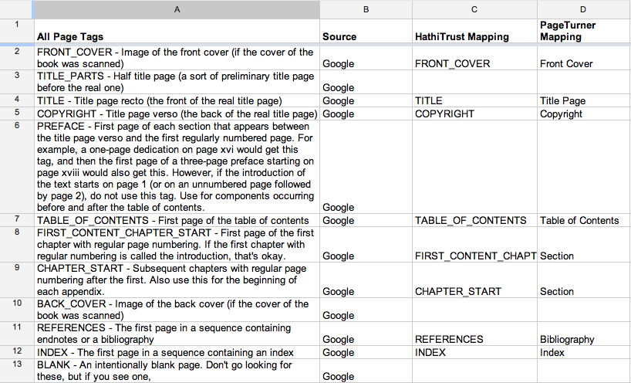
Page Feature Mapping (Google)
Notes:
Example: page feature mapping.
Google uses analysis to determine the table of contents, first pages of chapters, index, etc. Other content sources use a slightly different scheme. We map all of that to our own consistent and documented scheme.
The original page tags are stored in the Source METS.

Slide 70
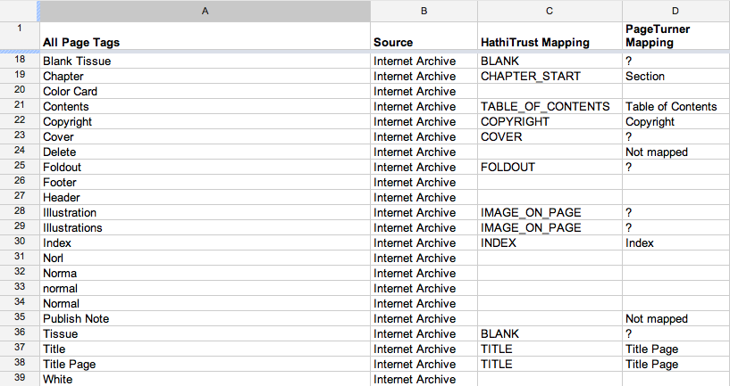
Pagetag Mapping (IA)
Notes:
Here is the mapping for Internet Archive.

Slide 71
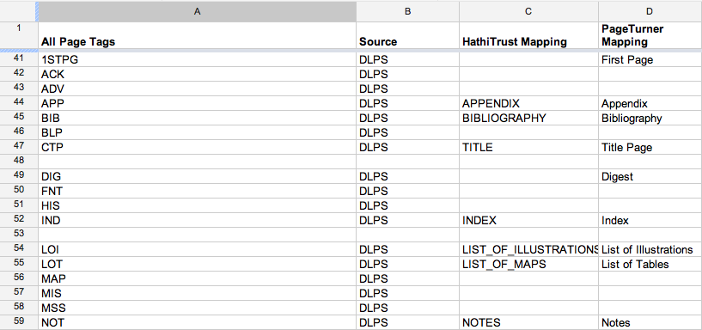
Pagetag Mapping (DLPS)
Notes:
Here is the mapping for our legacy in-house digital library project.

Slide 72
Object Entity
<PREMIS:object xsi:type="PREMIS:representation”>
<PREMIS:objectIdentifier>
  <PREMIS:objectIdentifierType>identifier</PREMIS:objectIdentifierType>
  <PREMIS:objectIdentifierValue>dul1.ark:/13960/t13n2vj0t</PREMIS:objectIdentifierValue>
  </PREMIS:objectIdentifier>
<PREMIS:significantProperties>
<PREMIS:significantPropertiesType>file count</PREMIS:significantPropertiesType>
    <PREMIS:significantPropertiesValue>960</PREMIS:significantPropertiesValue>
    </PREMIS:significantProperties>
  <PREMIS:significantProperties>
  <PREMIS:significantPropertiesType>page count</PREMIS:significantPropertiesType>
  <PREMIS:significantPropertiesValue>320</PREMIS:significantPropertiesValue>
  </PREMIS:significantProperties>
</PREMIS:object>
Event Entity
<PREMIS:event>
<PREMIS:eventIdentifier>
  <PREMIS:eventIdentifierType>UUID</PREMIS:eventIdentifierType>
  <PREMIS:eventIdentifierValue>9af6a994-f6fe-3a61-ac0e-be793d347edb</PREMIS:eventIdentifierValue>
  </PREMIS:eventIdentifier>
  <PREMIS:eventType>package inspection</PREMIS:eventType>
  <PREMIS:eventDateTime>2011-10-25T20:37:51Z</PREMIS:eventDateTime>
  <PREMIS:eventDetail>Inspection of download package for missing files</PREMIS:eventDetail>
  <PREMIS:eventOutcomeInformation>
  <PREMIS:eventOutcome>warning</PREMIS:eventOutcome>
  <PREMIS:eventOutcomeDetail>
  <PREMIS:eventOutcomeDetailNote>files missing</PREMIS:eventOutcomeDetailNote>
    <PREMIS:eventOutcomeDetailExtension>
    <HT:fileList status="missing">
          <HT:file>islandoradventur00whit_scanfactors.xml</HT:file> </HT:fileList>
    </PREMIS:eventOutcomeDetailExtension>
  </PREMIS:eventOutcomeDetail>
  </PREMIS:eventOutcomeInformation>
  <PREMIS:linkingAgentIdentifier>
  <PREMIS:linkingAgentIdentifierType>MARC21 Code</PREMIS:linkingAgentIdentifierType>
  <PREMIS:linkingAgentIdentifierValue>MiU</PREMIS:linkingAgentIdentifierValue>
  <PREMIS:linkingAgentRole>Executor</PREMIS:linkingAgentRole>
  </PREMIS:linkingAgentIdentifier>
  <PREMIS:linkingAgentIdentifier>
  <PREMIS:linkingAgentIdentifierType>tool</PREMIS:linkingAgentIdentifierType>
  <PREMIS:linkingAgentIdentifierValue>feedd.pl 0.9.17</PREMIS:linkingAgentIdentifierValue>
  <PREMIS:linkingAgentRole>software</PREMIS:linkingAgentRole>
  </PREMIS:linkingAgentIdentifier>
</PREMIS:event>
PREMIS Metadata
Notes:
We use PREMIS, another XML-based best standard, to track preservation events.
PREMIS is detailed and very flexible but we have applied it in a simple way to track relevant information.

Slide 73
capture | Initial capture (digitization) of item
file rename | File renaming to HathiTrust conventions
image modification | Replace boilerplate images with blank images
image compression | Conversion of raw scans to compressed TIFF and JPEG2000
image header modification | Modification of image headers to meet HathiTrust conventions
ingestion | Ingestion of object package into the repository
message digest calculation | Calculation of page-level MD5 checksums (refers to checksum calculations performed prior to content submission to HathiTrust when these checksums are available)
validation | Validation of technical characteristics of image and OCR files
ocr split | Detail is package type specific, e.g.: a) Extraction of plain-text OCR from ALTO XML b) Split OCR into one plain text OCR file per page c) Splitting of IA XML OCR into one plain text OCR file and one XML file (with coordinates) per page
package inspection | Inspection of download package for missing files
page feature mapping | Mapping of original page feature tags to HathiTrust tags
fixity check | Validation of MD5 checksums of content files
zip archive creation | Compression of content files and source METS into zip archive
zip file message digest calculation | Calculation of md5 checksum for zip archive
source mets creation | Creation of source METS file
Notes:
When literature refers to “managing digital objects”, this is the kind of activity referred to, and the metadata required to drive it.

Slide 74
Provenance
Strategies
  Original source
  Agent of digitization
  Administrative metadata (provenance and preservation)
Notes:
The use of PREMIS is one example of our strategy for recording provenance information about objects.
In addition to the PREMIS events, we trace provenance of digital objects by recording the original source of the material represented in HathiTrust, the agent of digitization, and a variety of other administrative data.

Slide 75
Security
Data Integrity
  Checksum validation, digital object provenance
Physical security
  Biometric door systems, locked racks
Network security
  Firewalling, vulnerability scanning
Application security
  Developer best practices, input validation
Access control…

Slide 76
Authentication
Shibboleth
  Login with organization
  Attributes released to Service Provider
  Authorize access
  http://www.hathitrust.org/shibboleth
Notes:
In HathiTrust, authentication drives personalization features, not access. Access is open to everyone.
We use an authentication system highly adapted to our community, Shibboleth, that is akin to “log in with Facebook” for higher education. No new password to remember!
When users log in, they are directed to the login page at their home institution.
That institution then releases attributes to HathiTrust, and HathiTrust authorizes access as appropriate.

Slide 77
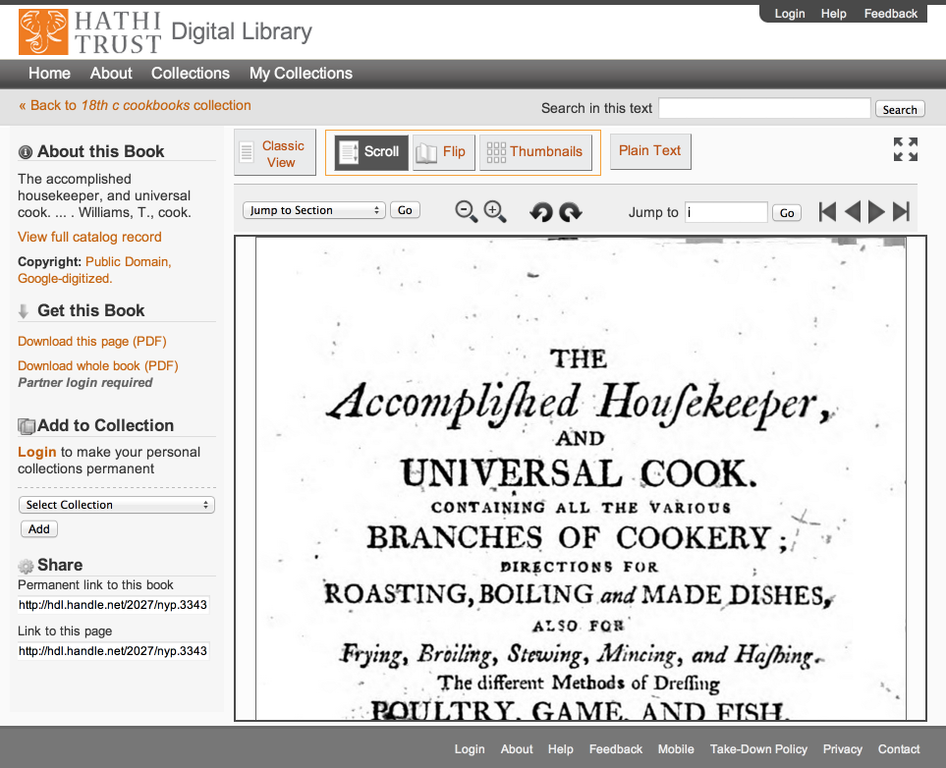

Slide 78
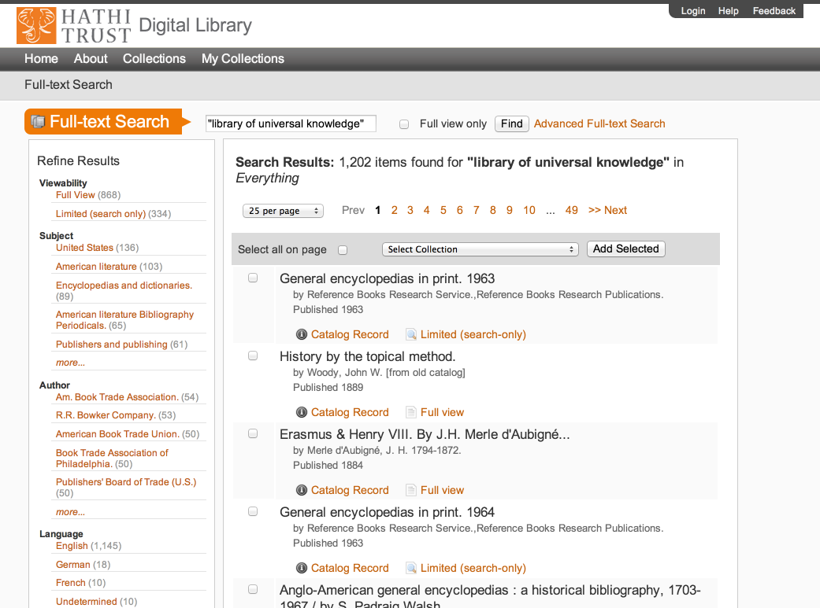

Slide 79
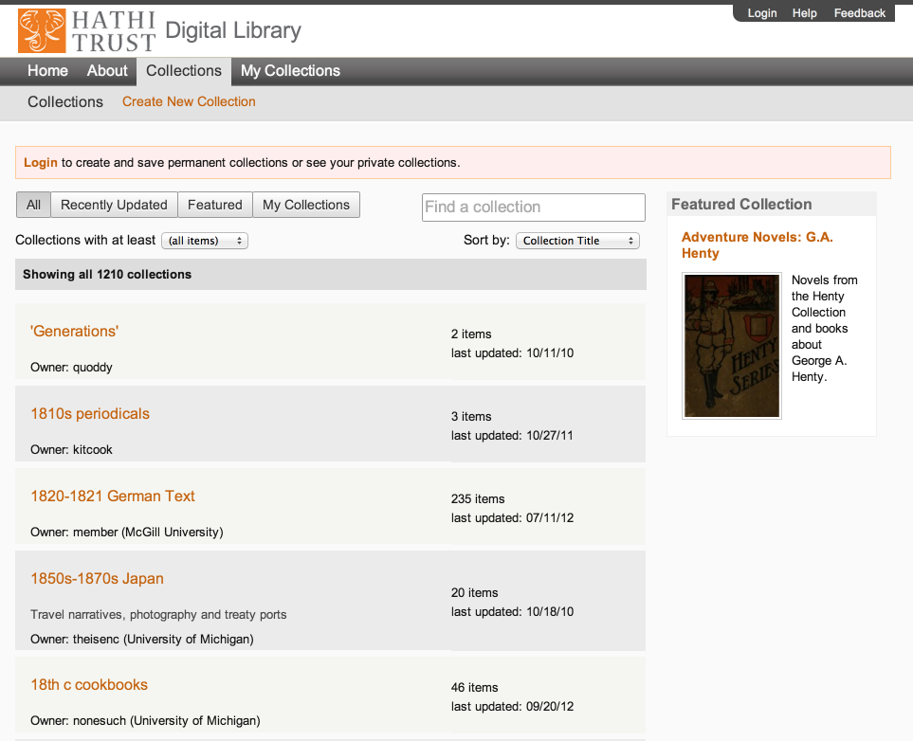

Slide 80
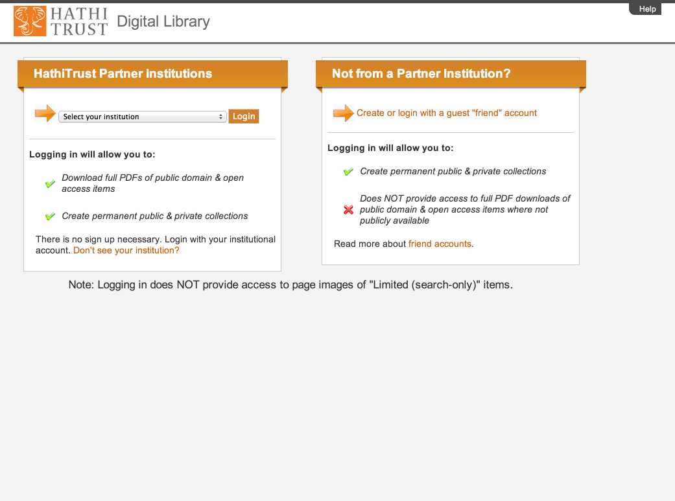

Slide 82
Questions

Slide 83
Source
Data Management
Access
Bib Data
Rights Data
Catalog
Ingest
Full-text Search
Holdings Data
Bibliographic Data
PageTurner
Content Package
Collections
Storage
Michigan
APIs
Indiana
Datasets
Notes:
And access, which I talked about in the section on Practice and won’t go into further here

Slide 84
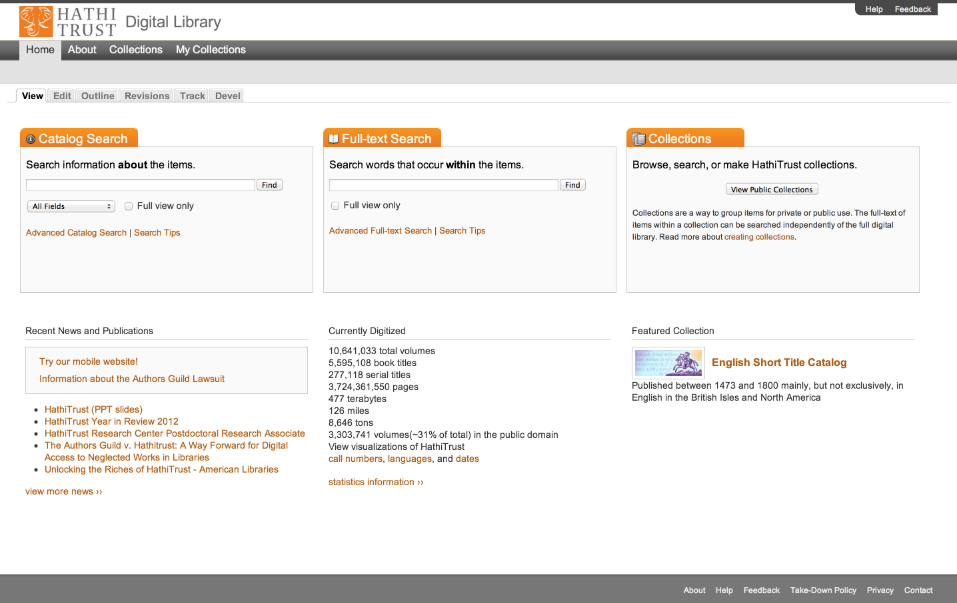
Access
Catalog
Full-text Search
PageTurner
Collections
APIs
Datasets

Slide 85
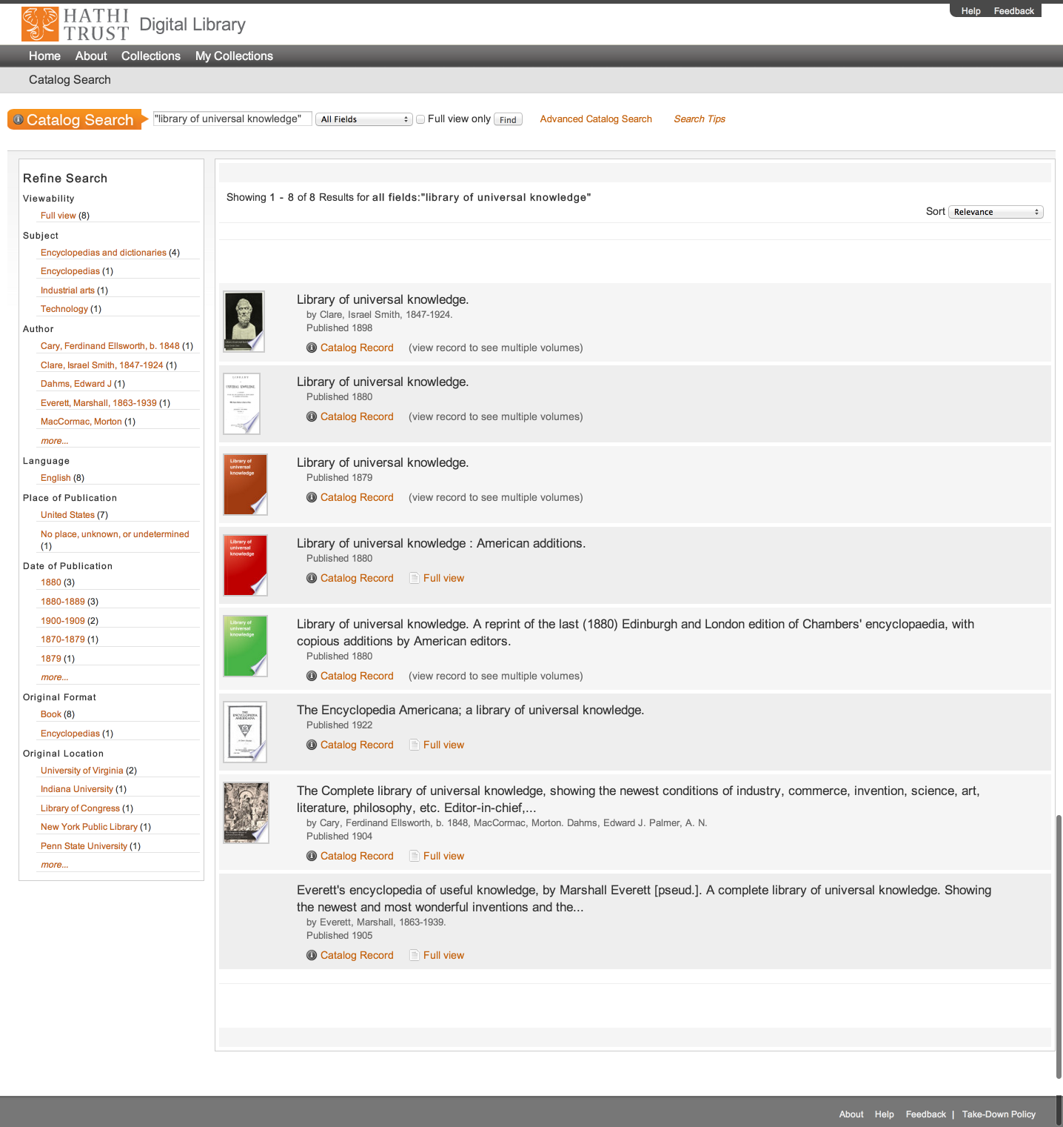
Access
Catalog
Full-text Search
PageTurner
Collections
APIs
Datasets

Slide 86
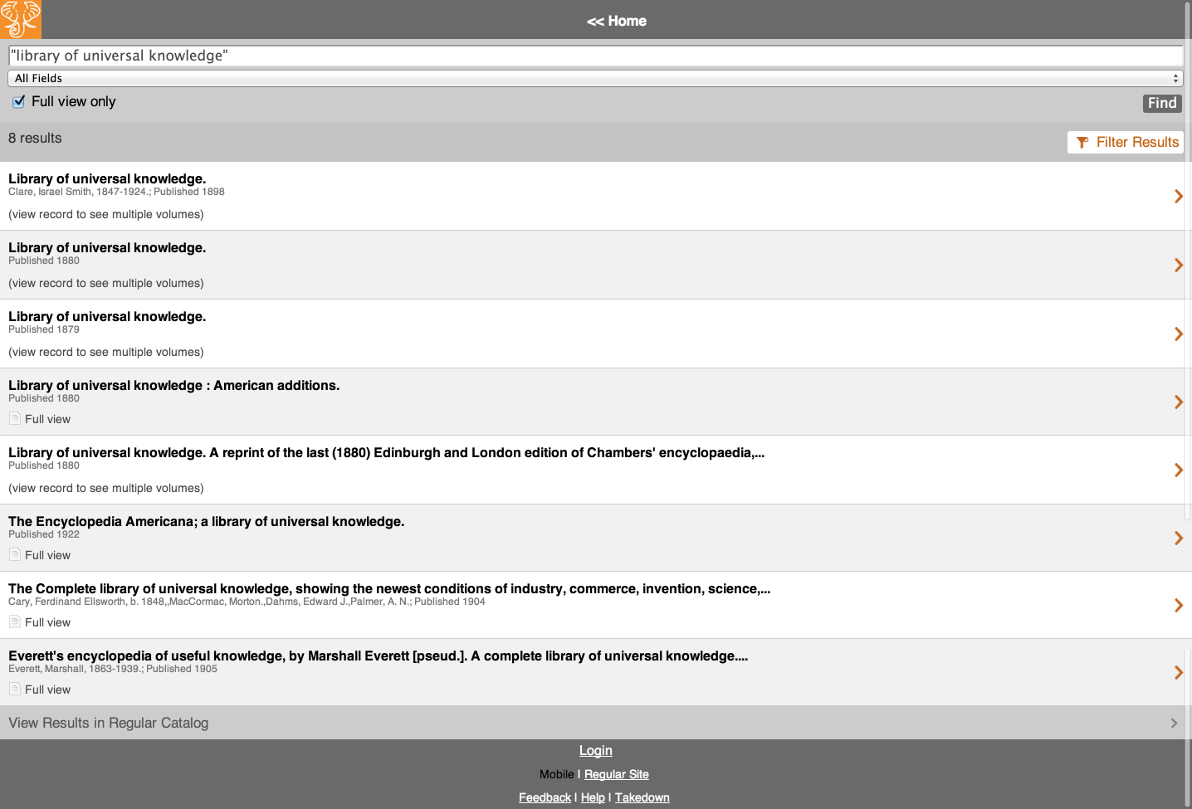
Access
Catalog
Full-text Search
PageTurner
Collections
APIs
Datasets

Slide 87
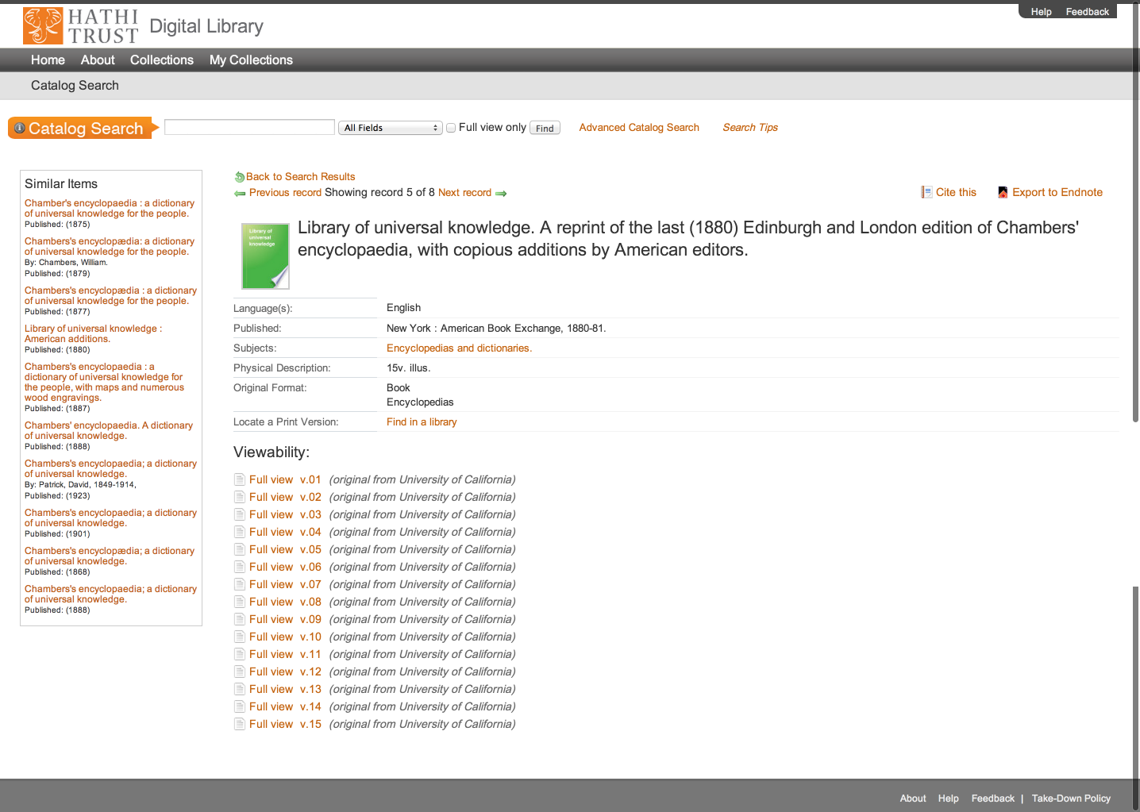
Access
Catalog
Full-text Search
PageTurner
Collections
APIs
Datasets

Slide 88
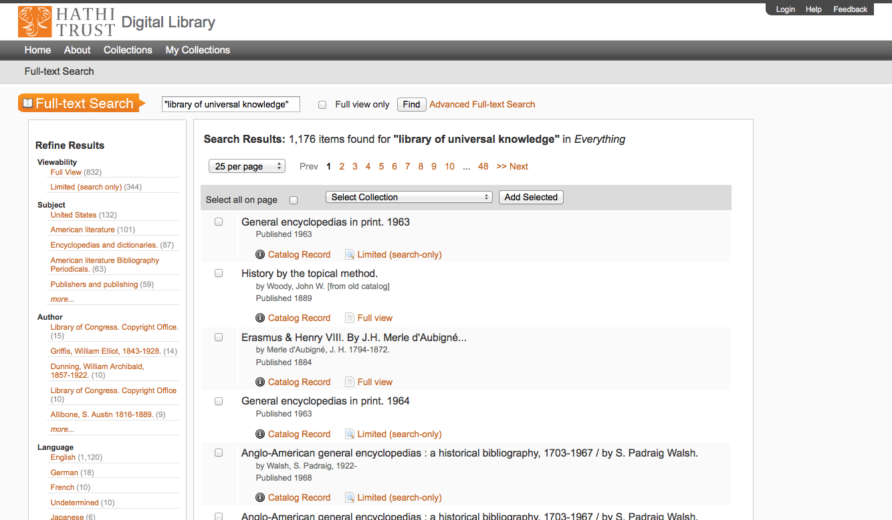
Access
Catalog
Full-text Search
PageTurner
Collections
APIs
Datasets

Slide 89
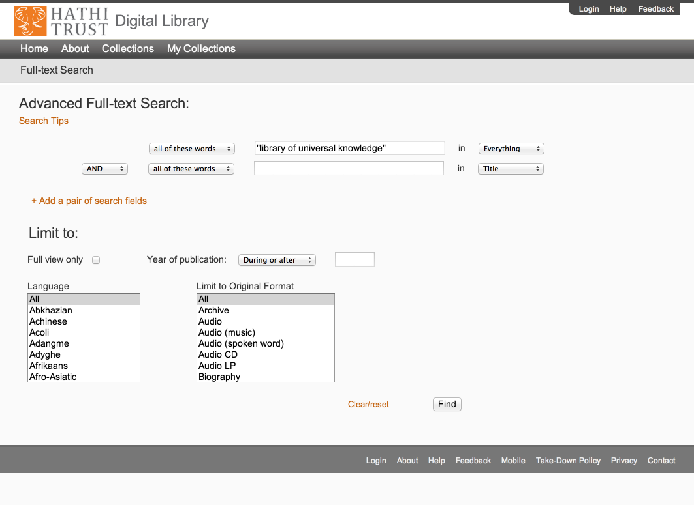
Access
Catalog
Full-text Search
PageTurner
Collections
APIs
Datasets

Slide 90
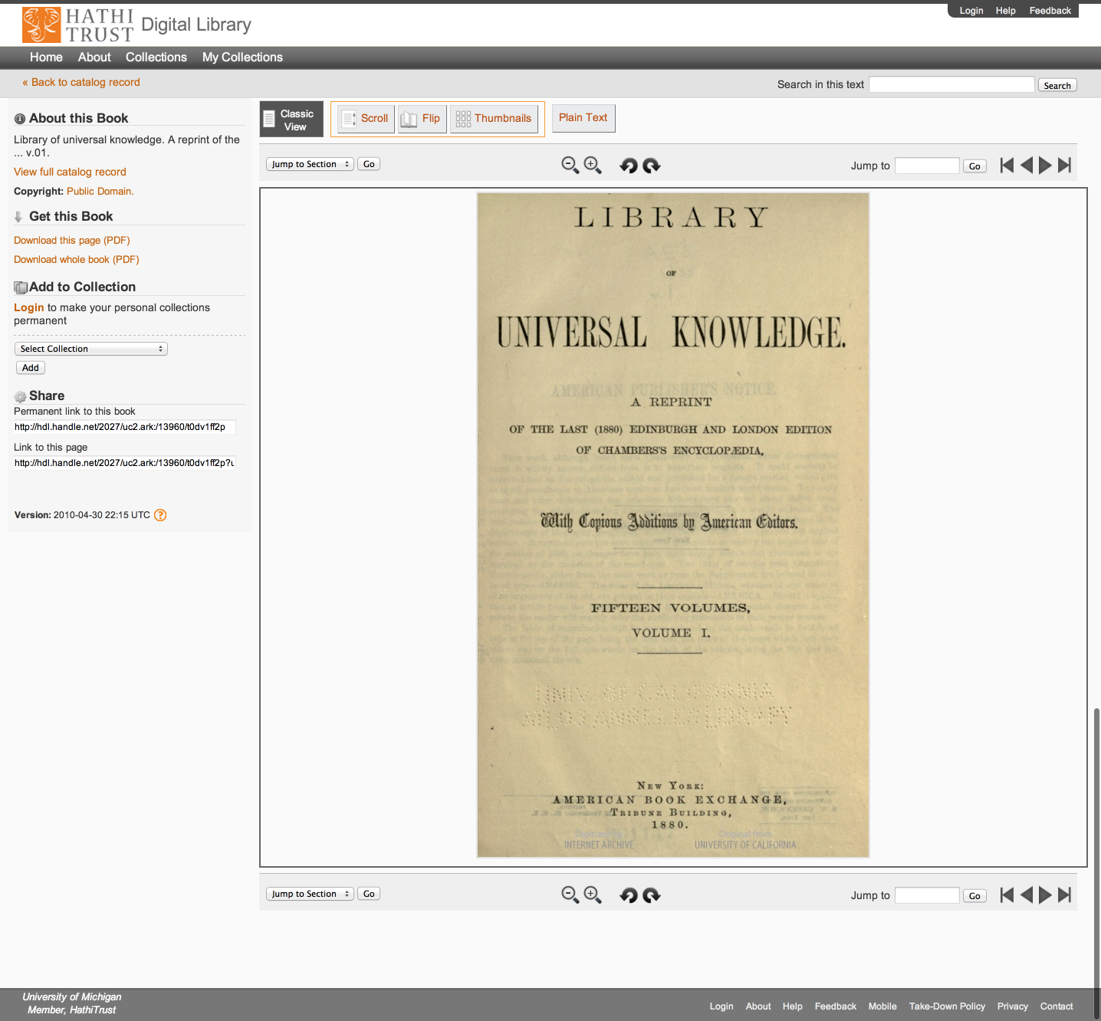
Access
Catalog
Full-text Search
PageTurner
Collections
APIs
Datasets

Slide 91
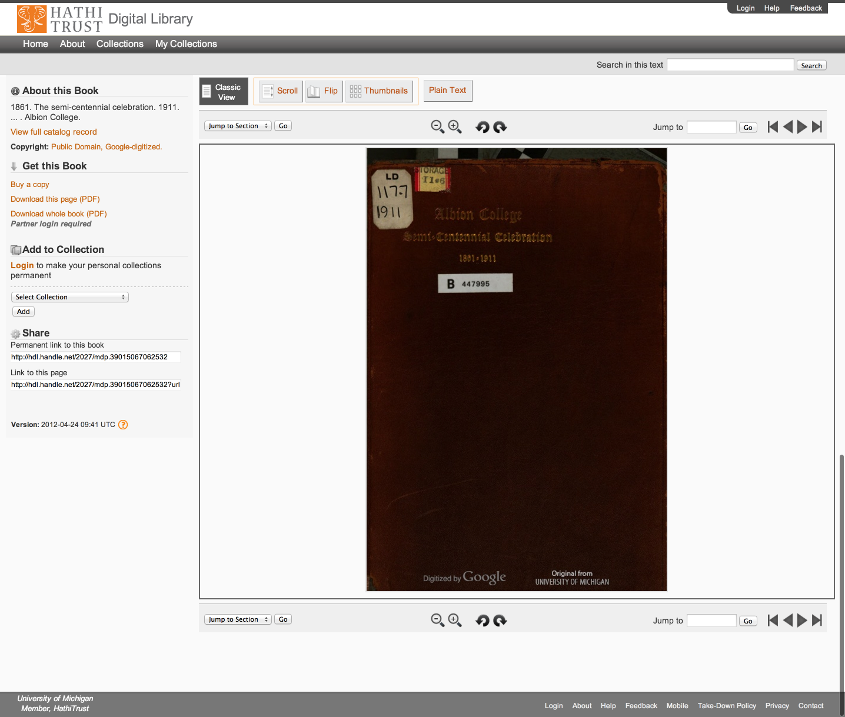
Access
Catalog
Full-text Search
PageTurner
Collections
APIs
Datasets

Slide 92
Access
Catalog
Full-text Search
PageTurner
Collections
APIs
Datasets

Slide 93
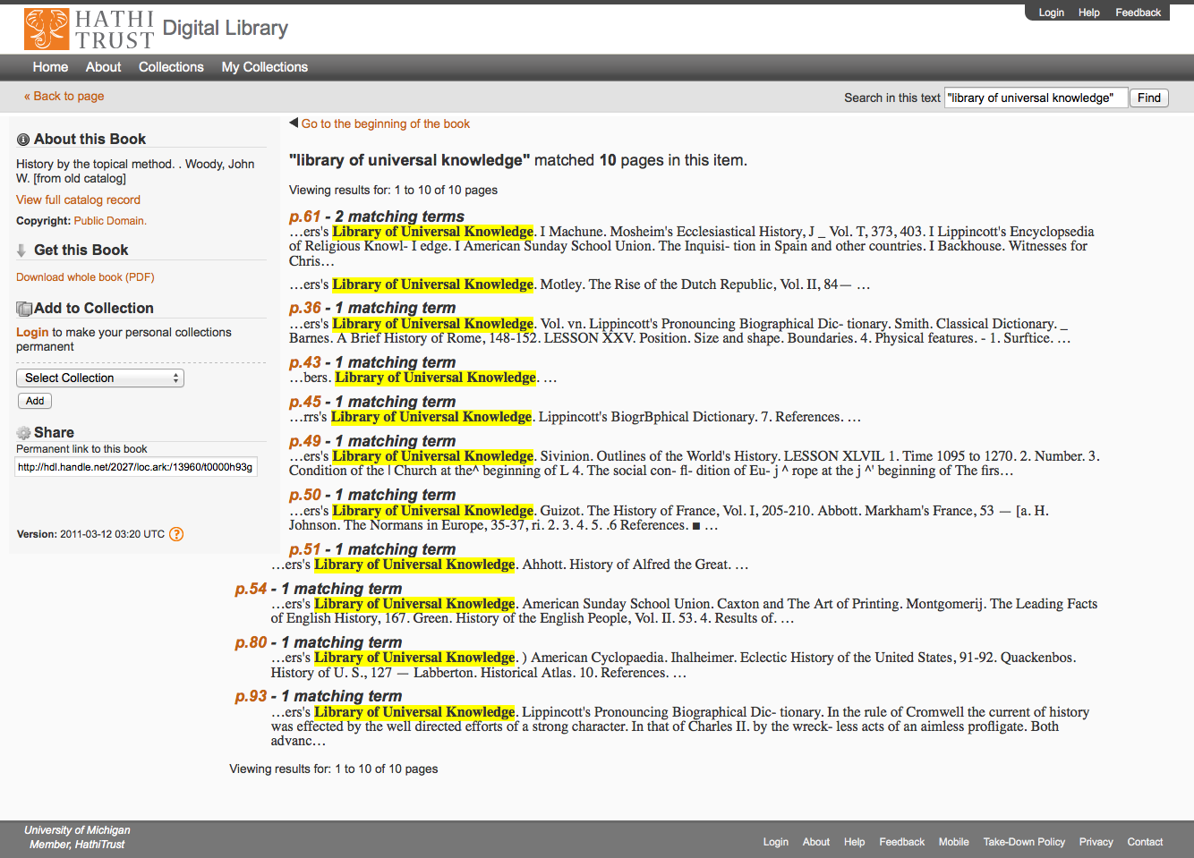
Access
Catalog
Full-text Search
PageTurner
Collections
APIs
Datasets

Slide 94
Access
Catalog
Full-text Search
PageTurner
Collections
APIs
Datasets

Slide 95
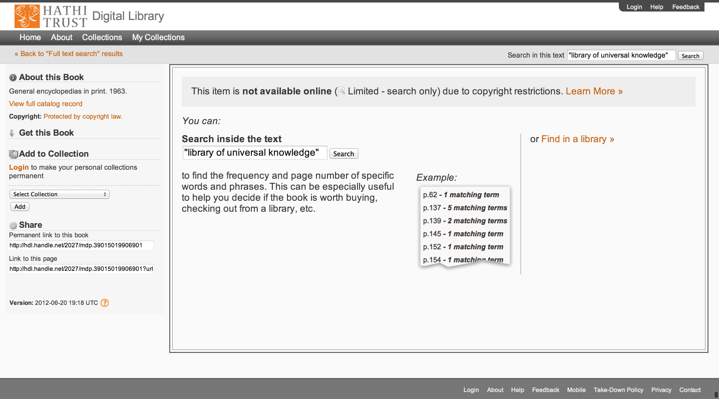
Access
Catalog
Full-text Search
PageTurner
Collections
APIs
Datasets

Slide 96
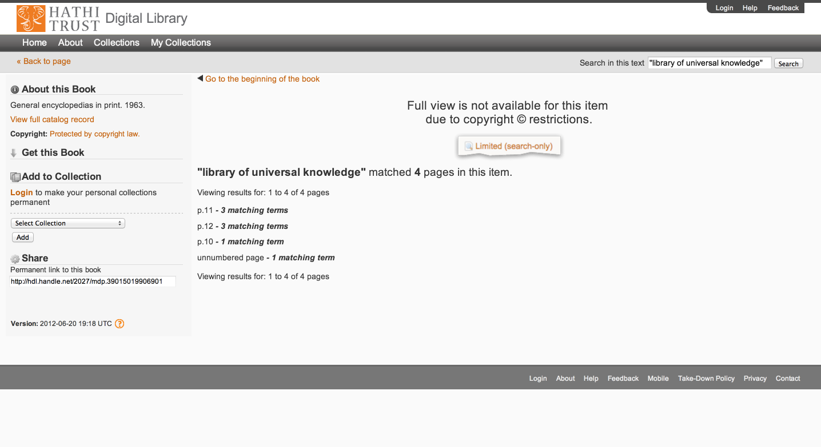
Access
Catalog
Full-text Search
PageTurner
Collections
APIs
Datasets

Slide 97
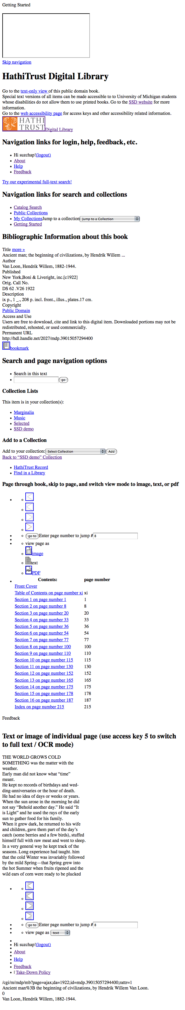
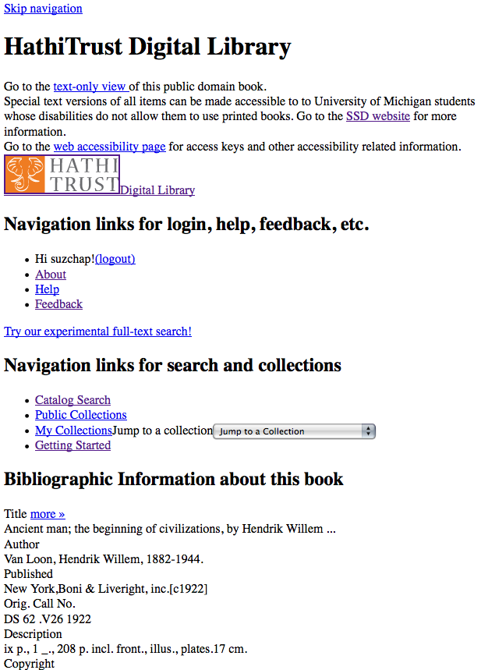
Skip navigation link
Info about SSD service & link to accessibility page
Descriptive headings added (hidden from GUI with CSS)
Added labels & descriptive titles to forms & ToC table
Access keys for navigating pages with keyboard
Images used for style are in css so no need to use alt tags

Slide 98
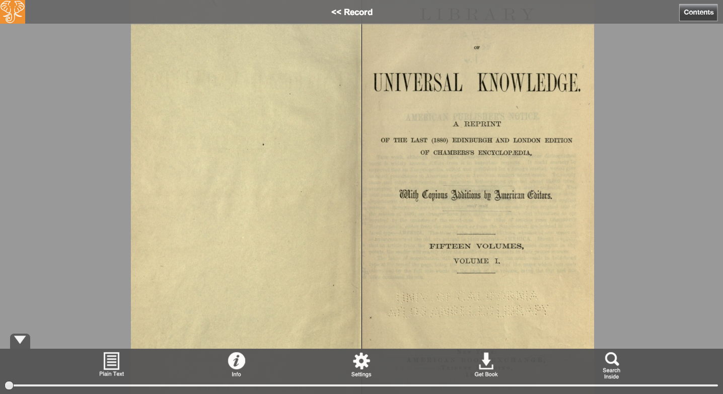
Access
Catalog
Full-text Search
PageTurner
Collections
APIs
Datasets

Slide 99
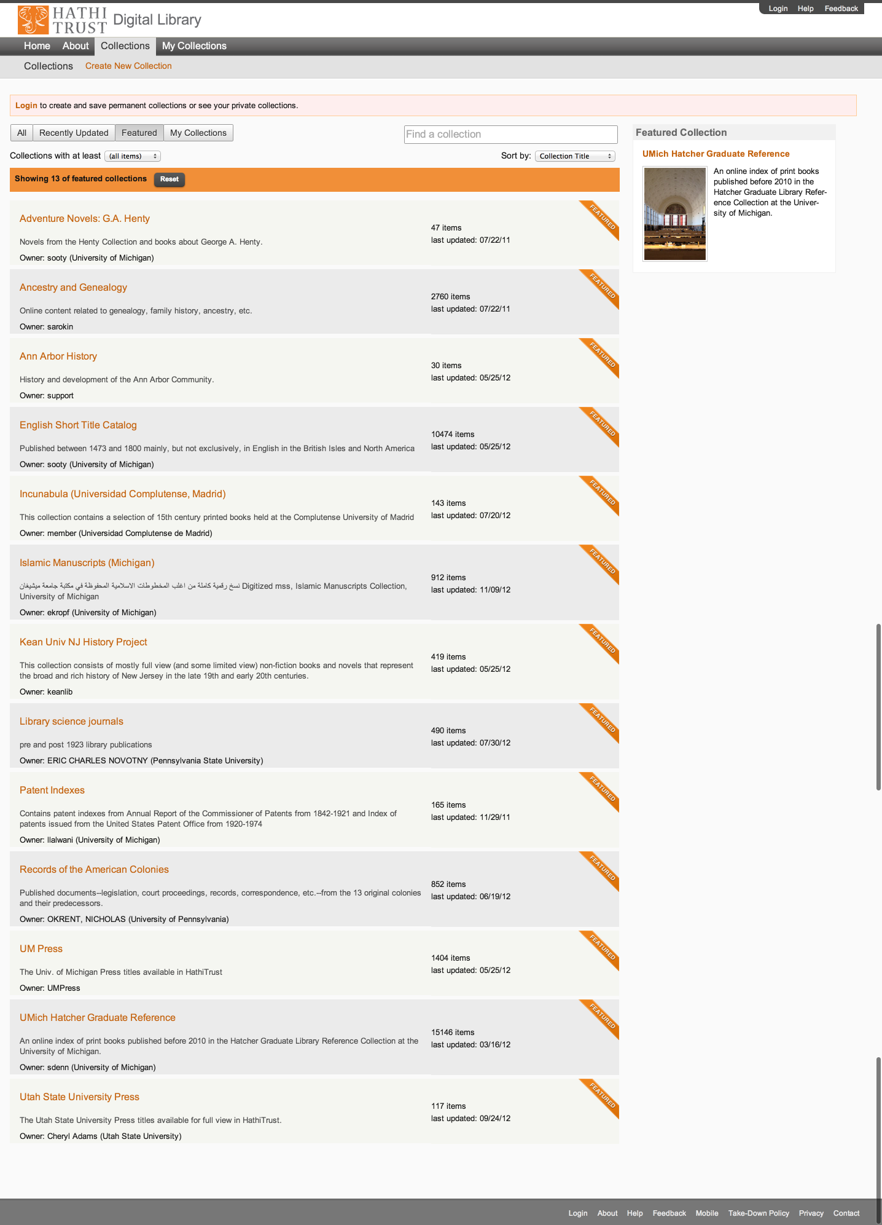
Access
Catalog
Full-text Search
PageTurner
Collections
APIs
Datasets

Slide 100
Access
Catalog
Full-text Search
PageTurner
Collections
APIs
Datasets

Slide 101
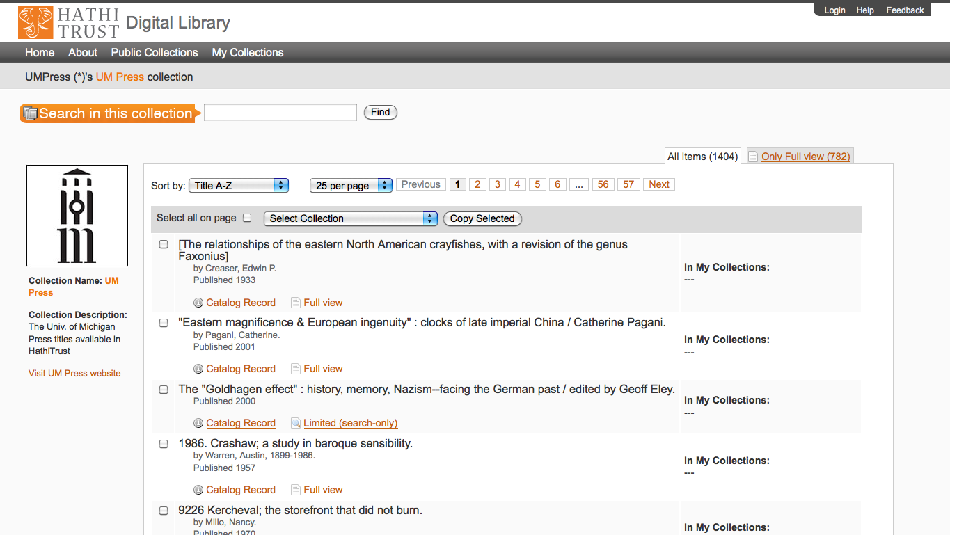
Access
Catalog
Full-text Search
PageTurner
Collections
APIs
Datasets

Slide 102
APIs
Data API
  Volume and rights information
  Page images
  OCR
  http://www.hathitrust.org/data_api
Bibliographic API
  Volume and rights information
  MARC records
  http://www.hathitrust.org/bib_api
OAI
  http://www.hathitrust.org/data
“Hathifiles”
  http://www.hathitrust.org/hathifiles

Slide 103
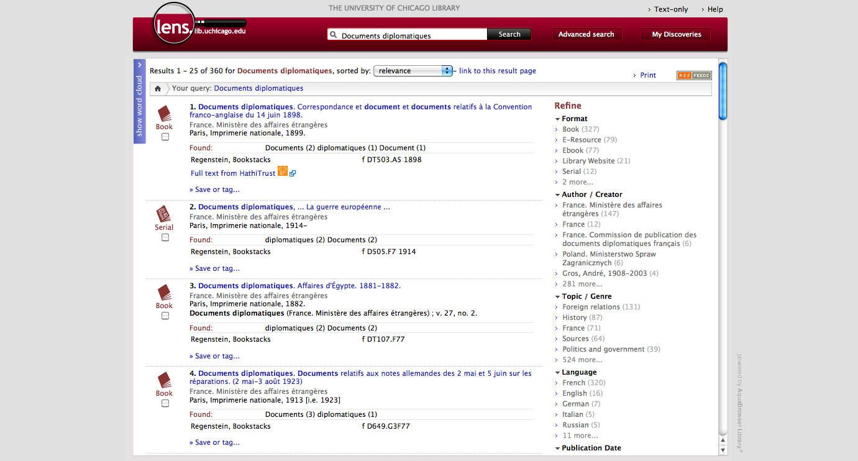

Slide 104
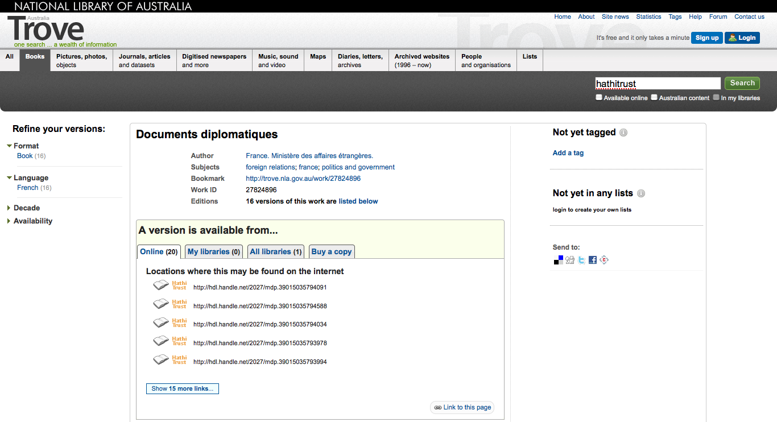

Slide 105
Datasets
Google-digitized
  ~2.8 million texts
  Requires proposal to HathiTrust
  Agreement with Google
  Statement on use/management
Non-Google-digitized
  > 350,000 texts
  Freely available
  Statement on management

Slide 106
Research Center
Environment to perform research on HathiTrust corpus
  http://www.hathitrust.org/htrc

Slide 107
Lawful uses
Users who have print disabilities
  All in-copyright works in HathiTrust currently owned (or owned previously) by the partner institution
  Must be authenticated
  Must be on U.S. soil
  One simultaneous access per copy owned
  http://www.hathitrust.org/accessibility

Slide 108
Lawful uses (2)
Out of print and brittle, missing
  Works must be currently owned (or owned previously) by the partner institution
  Must be authenticated or accessing work from library premises
  Must be on U.S. soil
  One simultaneous access per copy owned
  http://www.hathitrust.org/out-of-print-brittle
Access and use statements
  http://www.hathitrust.org/access_use

Slide 109
Vendor Agreements
Largest impact for HathiTrust is agreement with Google
  Receive digital copy from Google
  Share digital copy with partner libraries
  Prevent download for commercial purposes, redistribution of files, automated or systematic download

Slide 110
Type of work | Searchable (bibliographic and full-text) | Viewable* | Full-PDF download | Print on Demand | Print disabilities* | Preservation uses (Section 108)*
Public domain worldwide | Worldwide | Worldwide | Partners only if scanned by Google, if not, worldwide. | Worldwide | Partners worldwide | N/A
Public domain (US) – Non-US works published between 1872 and 1923. | Worldwide | When accessed from with the United States | Partners in the US if scanned by Google, if not, anyone US | Available within the United States | Partners in the US; partners worldwide where similar laws in effect | N/A
Works that rights holders have opened access to in HathiTrust | Worldwide | Worldwide | Worldwide (if digitized by Google, full-PDF only available if opened with CC license) | Worldwide with permission | Partners worldwide | N/A
Works that are in-copyright or of undetermined status | Worldwide | Not available | Not available | Not available | Partners in the US; partners worldwide where similar laws in effect | Partners in the US; partner worldwide where similar laws in effect
* Note: Access to in-copyright works is subject to conditions on Lawful uses slides. See also HathiTrust’s policies on Access and Use.

Slide 111
Questions

Slide 112
Organization and Fees

Slide 113
Partnership
Requirements
  Member agreement
  Information about print holdings
  http://www.hathitrust.org/eligibility_agreements
Authentication via Shibboleth
Checklist
  http://www.hathitrust.org/partnership_checklist

Slide 114
Compliance with TRAC

Slide 115
Executive Committee
Strategic Advisory Board
Budget/Finances Decision-making
Guidance on Policy, Planning
Collective Work: Working Groups and Committees
Operational
  Communications
  User Support
  User Experience
  Strategic
  Collections
  Discovery Interface
  Full-text Search
Operational
Communications
User Support
User Experience
Distributed work
Driven by needs of institutions
Leverage across the partnership
Projects, Grant Work, Ingest Specifications, PageTurner, Bibliographic Data Management
HathiTrust

Slide 116
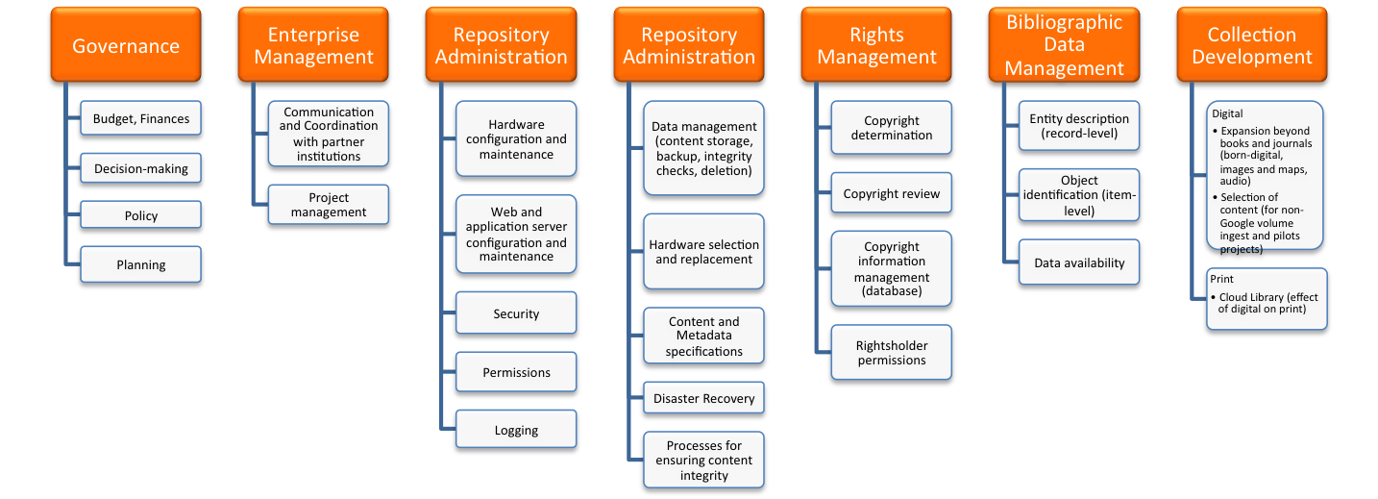
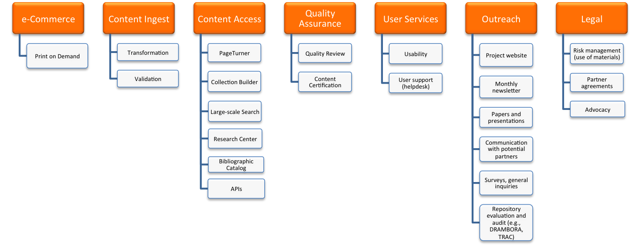
Financial contributions of partners
HathiTrust Functional Framework

Slide 117
Constitutional Convention
October 2011
52 partners
3-year review overseen by SAB
Ballot Proposals
  Print monograph storage
  Approval Process for development initiatives
  U.S. Government Documents
  Fee-for-service content deposit
  Governance

Slide 118
Strategic Advisory Board
Guidance on Policy, Planning
12-member Board of Governors
Executive Committee
Chief Executive Officer
Executive Committee
HathiTrust
Budget/Finances
Decision-making

Slide 119
Pricing Model

Slide 120
1st model: Price per GB

Slide 121
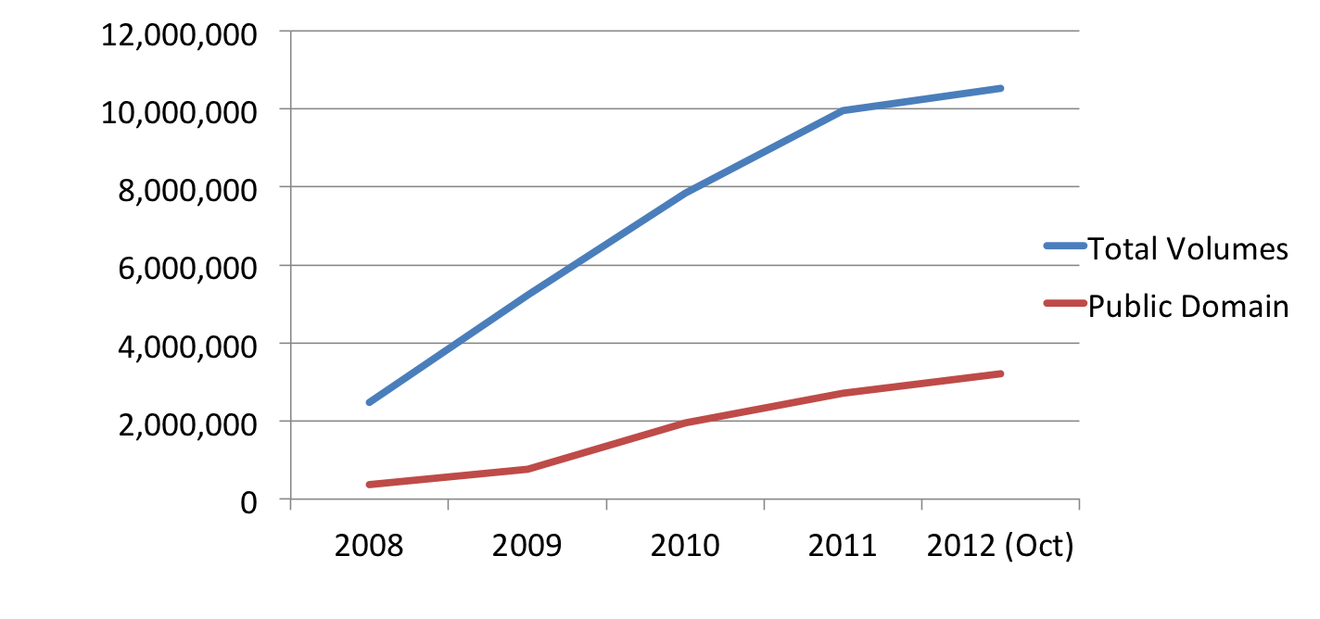
 | 2008 | 2009 | 2010 | 2011 | 2012 (Oct)
Total Volumes | 2,477,871 | 5,221,092 | 7,836,698 | 9,966,572 | 10,531,566
Public Domain | 372,085 | 758,947 | 1,959,223 | 2,712,626 | 3,218,132

Slide 122
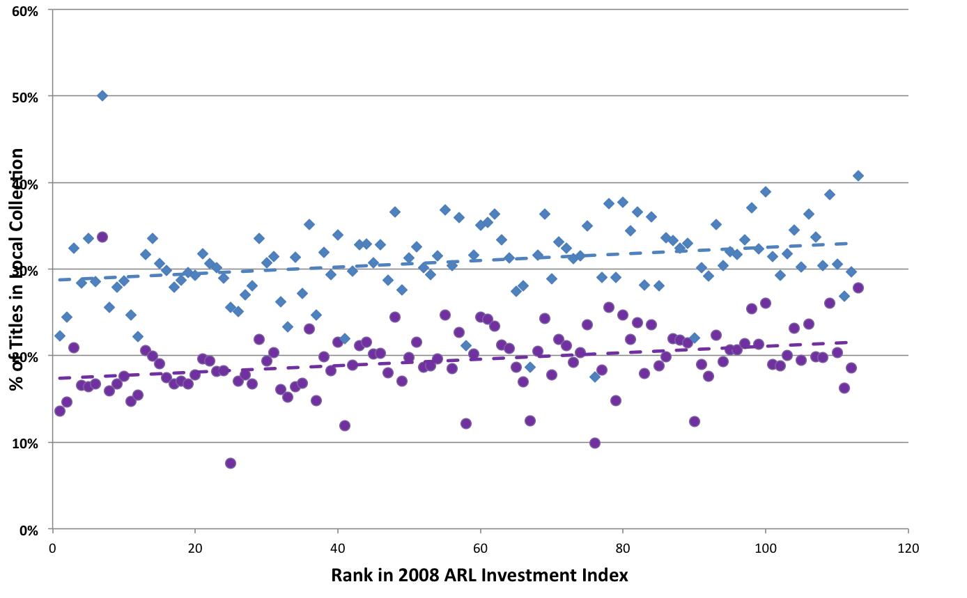
A global change in the library environment
Academic print book collection already substantially duplicated in mass digitized book corpus
June 2010
Median duplication: 31%
June 2009
Median duplication: 19%
Courtesy of Constance Malpas, OCLC Research
Notes:
122

Slide 123
Digitized Books in Shared Repositories
~3.5M titles
~75% of mass digitized corpus is ‘backed up’ in one or more shared print repositories
~2.5M
Courtesy of Constance Malpas, OCLC Research
Notes:
123

Slide 124
Collection Overlap
More than 50% median overlap with ARL institutions; higher for small liberal arts colleges
New Pricing model based on Print holdings
  http://www.hathitrust.org/cost
Print monographs archiving

Slide 125
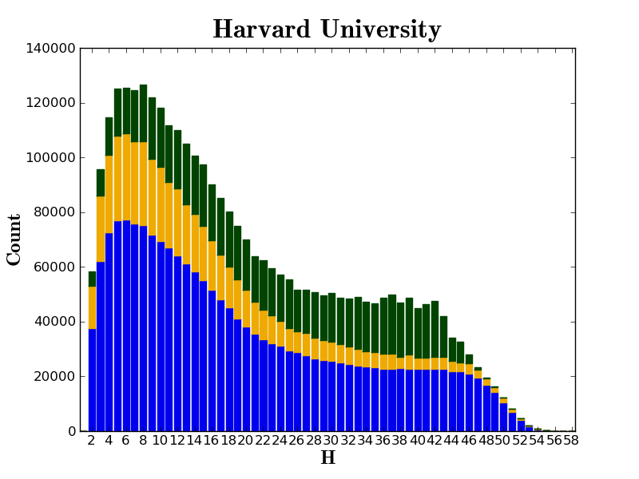

Slide 126
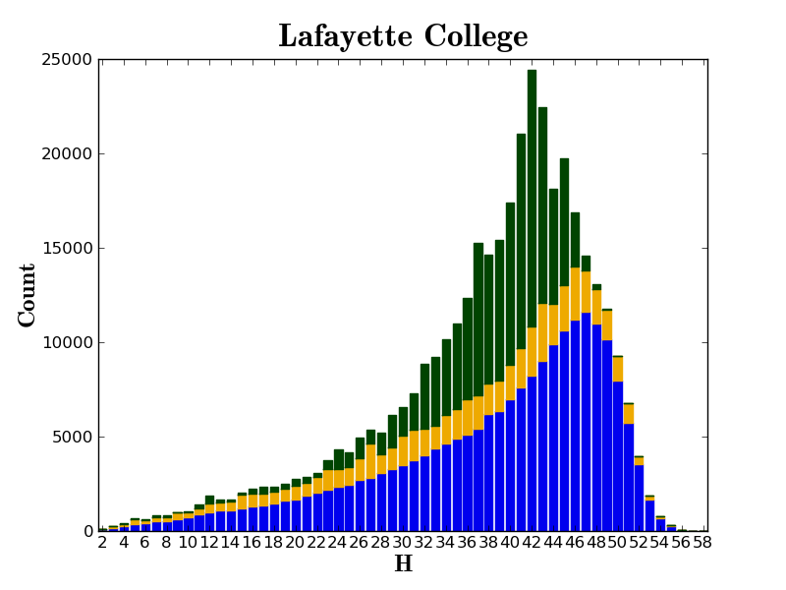

Slide 127
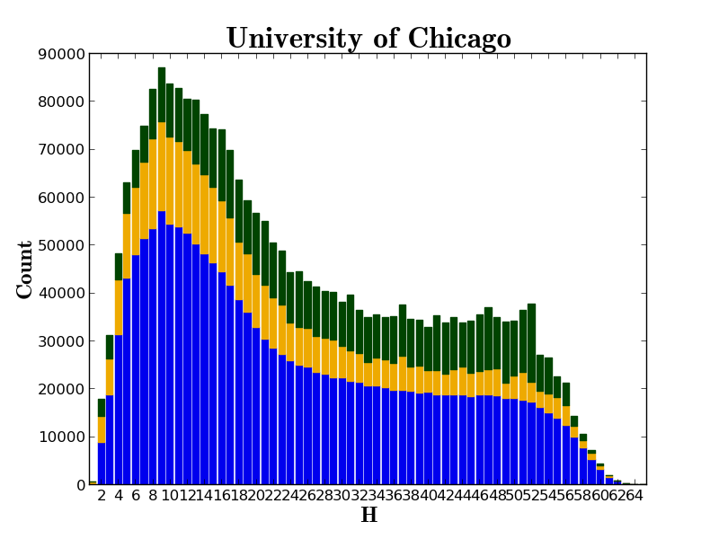

Slide 128
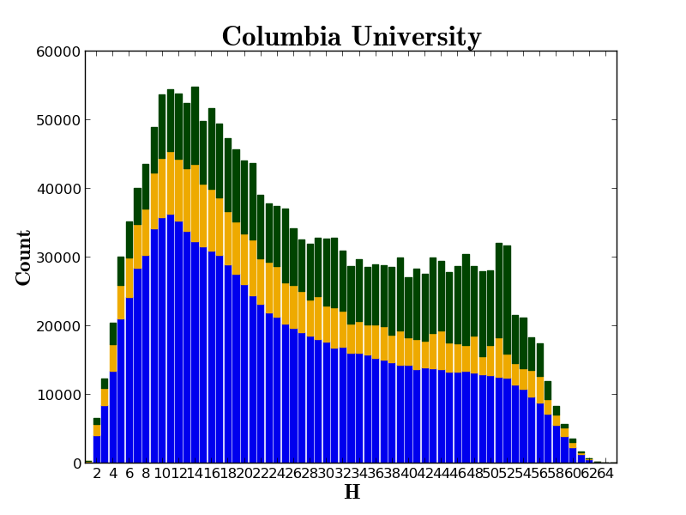

Slide 129
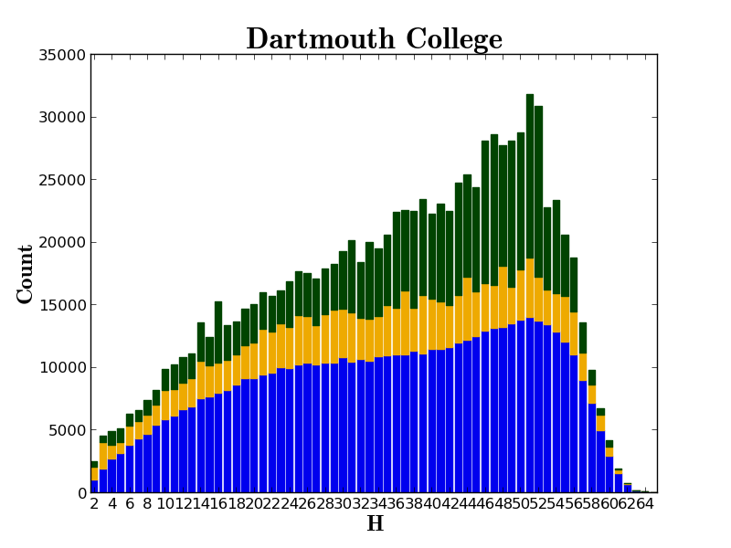

Slide 130
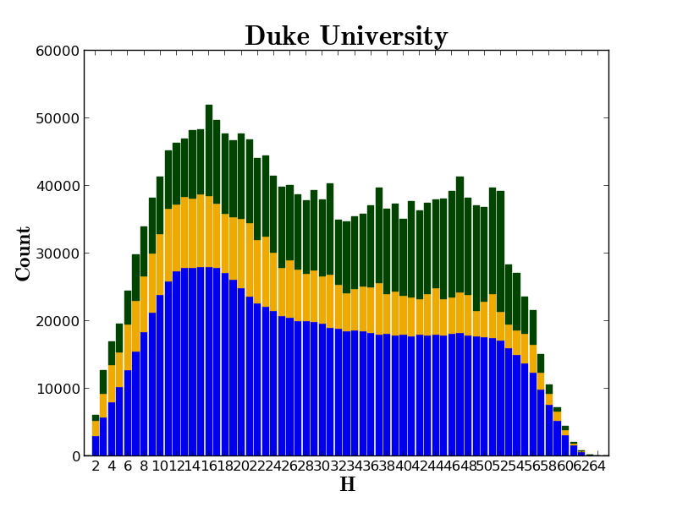

Slide 131
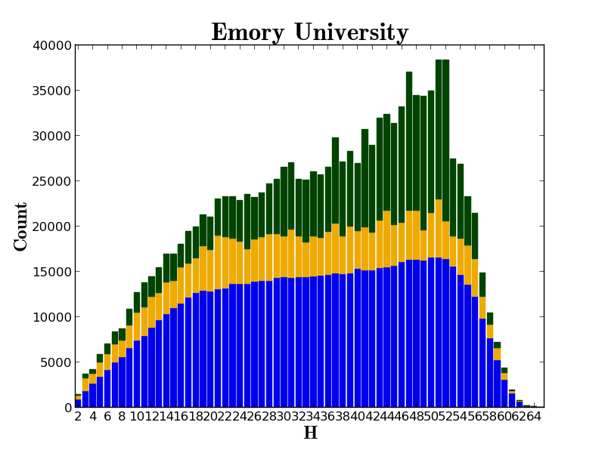

Slide 132
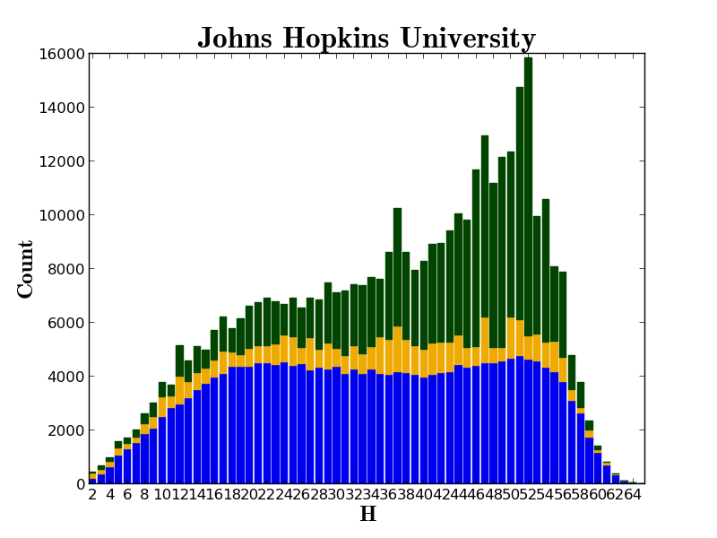

Slide 133
A new kind of library

Slide 134
Thank you!

Slide 135
How to find out more
About: http://www.hathitrust.org/about
Twitter: http://twitter.com/hathitrust
Facebook: http://www.facebook.com/hathitrust
Monthly newsletter:
  http:www.hathitrust.org/updates
  RSS http://www.hathitrust.org/updates_rss
Contact us: feedback@issues.hathitrust.org
Blogs: http://www.hathitrust.org/blogs
  Large-scale Search
  Perspectives from HathiTrust

