Slide 1
HathiTrust Overview: Partnership and Services
Jeremy York
Wesleyan University Web Presentation
February 18, 2014

Slide 2
Partnership
Allegheny College
Arizona State University
Baylor University
Boston College
Boston University
Brandeis University
Brown University
California Digital Library
Carnegie Mellon University
Colby College
Columbia University
Cornell University
Dartmouth College
Duke University
Emory University
Florida State University
Getty Research Institute
Harvard University Library
Indiana University
Iowa State University
Johns Hopkins University
Kansas State University
Lafayette College
Library of Congress
Massachusetts Institute of Technology
McGill University`
Michigan State University
New York Public Library
New York University
North Carolina Central
University
North Carolina State
University
Northwestern University
The Ohio State University
The Pennsylvania State
University
Princeton University
Purdue University
Stanford University
Syracuse University
Temple University
Texas A&M University
Tufts University
Universidad Complutense
de Madrid
University of Alabama
University of Alberta
University of Arizona
University of British Columbia
University of Calgary
University of California
Berkeley
Davis
Irvine
Los Angeles
Merced
Riverside
San Diego
San Francisco
Santa Barbara
Santa Cruz
The University of Chicago
University of Connecticut
University of Delaware
University of Florida
University of Houston
University of Illinois
University of Illinois at Chicago
The University of Iowa
University of Kansas
University of Maryland
University of Massachusetts, Amherst
University of Miami
University of Michigan
University of Minnesota
University of Missouri
University of Nebraska- Lincoln
The University of North
Carolina at Chapel Hill
University of Notre Dame
University of Oklahoma
University of Pennsylvania
University of Pittsburgh
University of Queensland
University of Tennessee, Knoxville
University of Texas
University of Utah
University of Vermont
University of Virginia
University of Washington
University of Wisconsin- Madison
Utah State University
Vanderbilt University
Virginia Tech
Wake Forest University
Washington University
Yale University Library
Notes:
92 partners

Slide 3
Digital Repository
Launched 2008
Initial focus on digitized book and journal content
11 million total volumes
5.7 million book titles
288,000 serial titles
3.6 million volumes in the public domain (~33%)

Slide 4
The Name
The meaning behind the name
Hathi (hah-tee)--Hindi for elephant
Big, strong
Never forgets, wise
Secure
Trustworthy

Slide 5
Mission
To contribute to the common good by collecting, organizing, preserving, communicating, and sharing the record of human knowledge

Slide 6
HathiTrust
Universal Library
Common Goal
Single Entity, Many Partners

Slide 7
Collections and Collaboration
Comprehensive collection
Preservation…with Access
Repository centralized, yet open
Shared strategies
Copyright
Collection management, development
Preservation
Discovery / Use
Bibliographic Indeterminacy
Efficient user services
Public Good

Slide 8
Collection and Services

Slide 9
Content Sources
Notes:
There are 28 institutions currently contributing content to HathiTrust, including volumes digitized in partnership with Google and the Internet Archive, as well as smaller vendors and institutions’ own digitization initiatives.

Slide 10
Dates
* As of February 17, 2014
Notes:
10

Slide 11
Language Distribution (1)
The top 10 languages make up ~87% of all content
* As of February 17, 2014
Notes:
11

Slide 12
Language Distribution (2)
The next 40 languages make up ~12% of total
* As of February 17, 2014

Slide 13
Content Distribution
* As of February 17, 2014
Notes:
13

Slide 14
Preservation...with Access
Long-term preservation
Bit-level and migration
Support beyond books and journals (pilots)
Bibliographic search
Full-text search
Reading and download capabilities
Access for users who have print disabilities
Access to out of print and brittle books
Subject to terms and conditions at http://www.hathitrust.org/access_use#ic-access

Slide 15
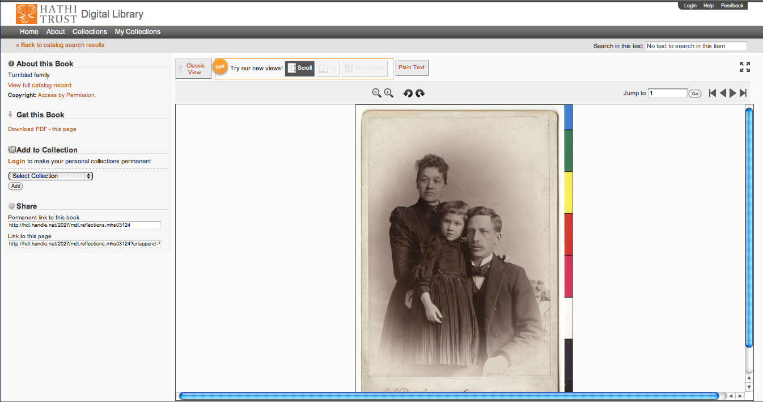
Support Beyond Books and Journals

Slide 16
http://lib.umich.edu/mpach
Package of tools to enable publication of open access, born-digital journal content, directly into HathiTrust
Including accompanying data and media files
Allows integration with popular journal publishing tools such as Open Journal Systems (OJS)

Slide 17
Centralized...yet open
Print on demand
Linking from local catalogs
Collections
Zephir
Research Center

Slide 18
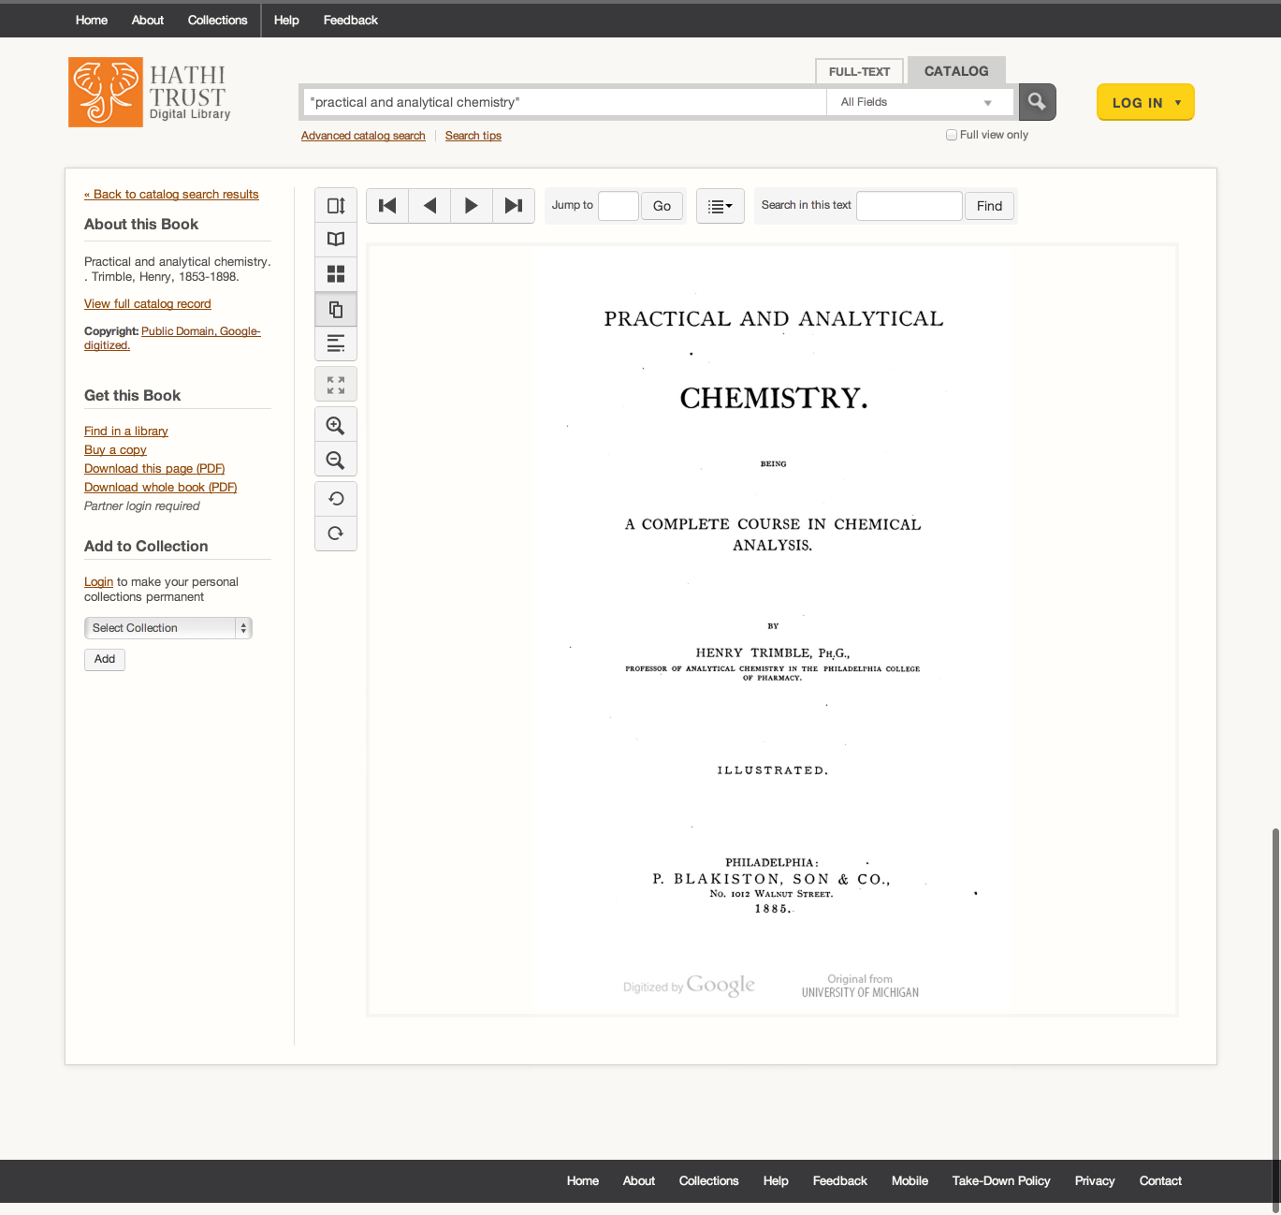

Slide 19
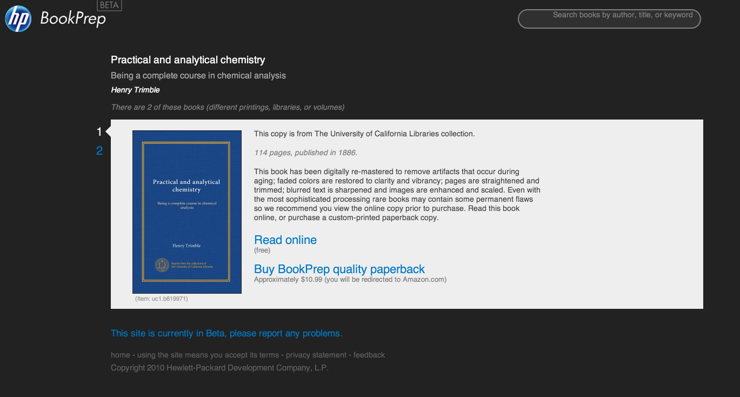

Slide 22
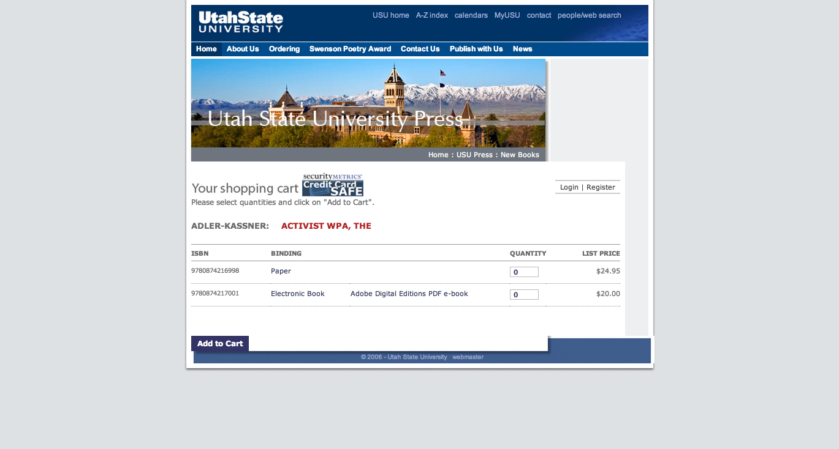

Slide 23
Linking in Local Catalogs
Bibliographic API
Volume and rights information
MARC records
http://www.hathitrust.org/bib_api
OAI
http://www.hathitrust.org/data
“Hathifiles”
http://www.hathitrust.org/hathifiles
Data API
Volume and rights information
Page images
OCR
http://www.hathitrust.org/data_api

Slide 24
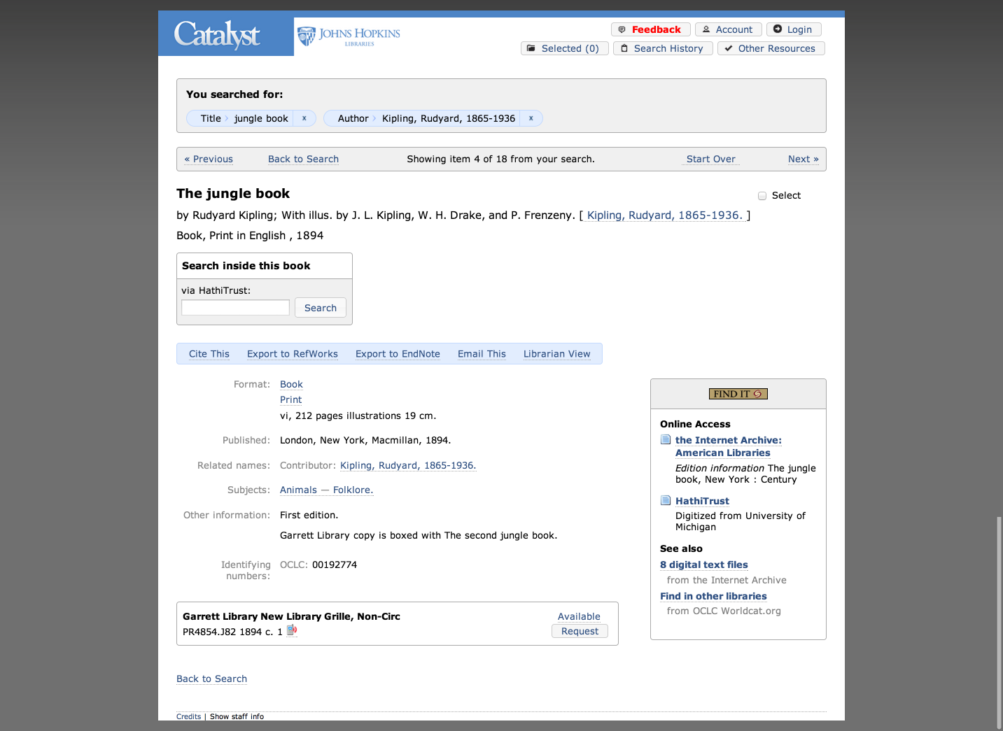

Slide 25
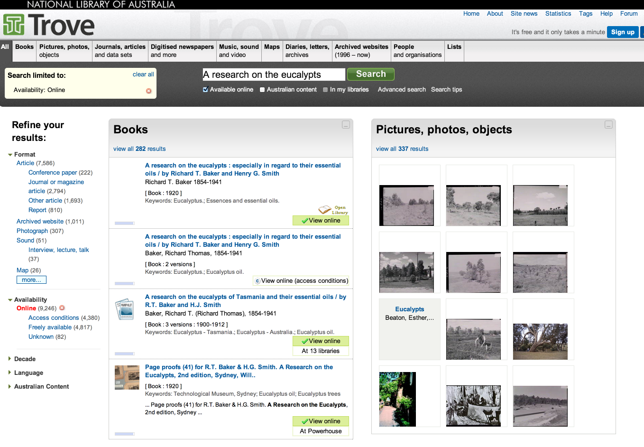

Slide 26
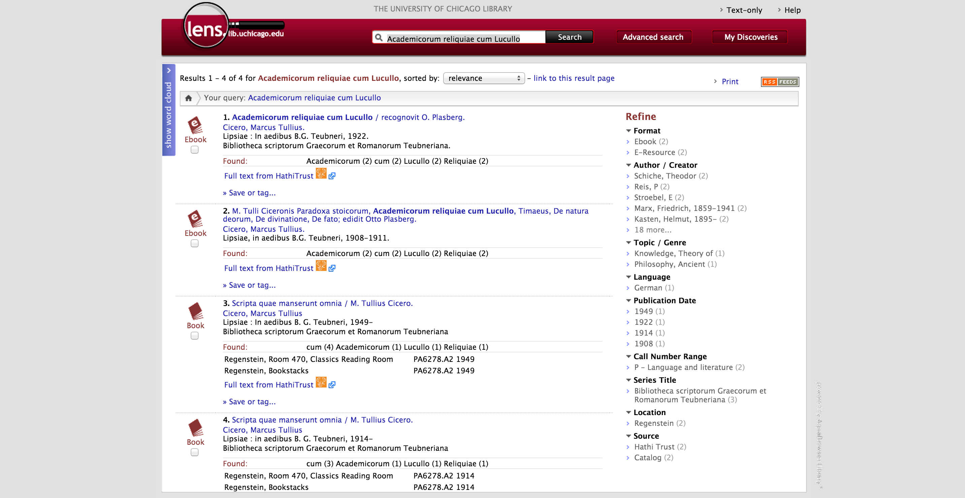

Slide 28
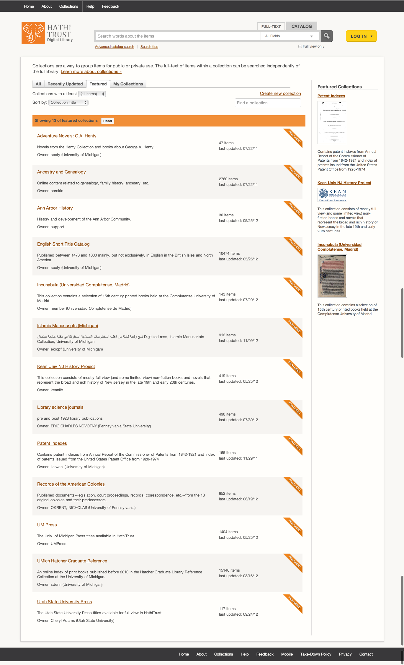
Collections

Slide 29
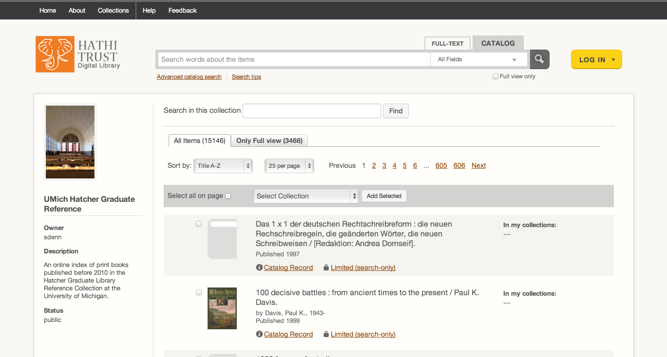

Slide 30
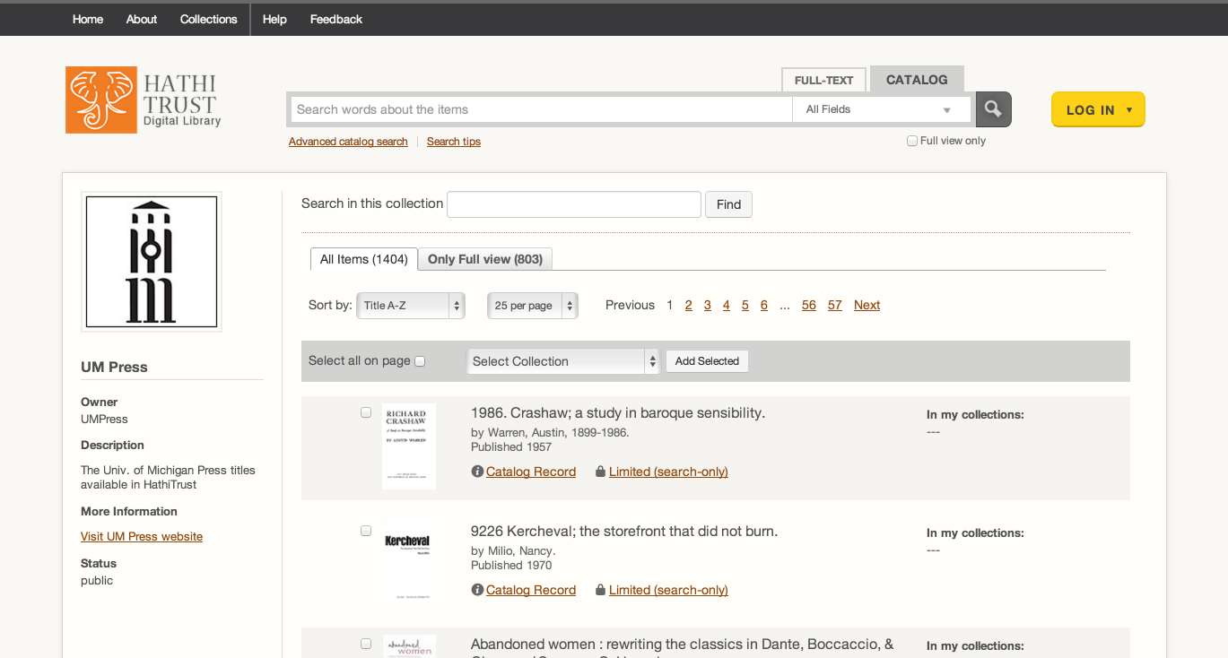

Slide 31
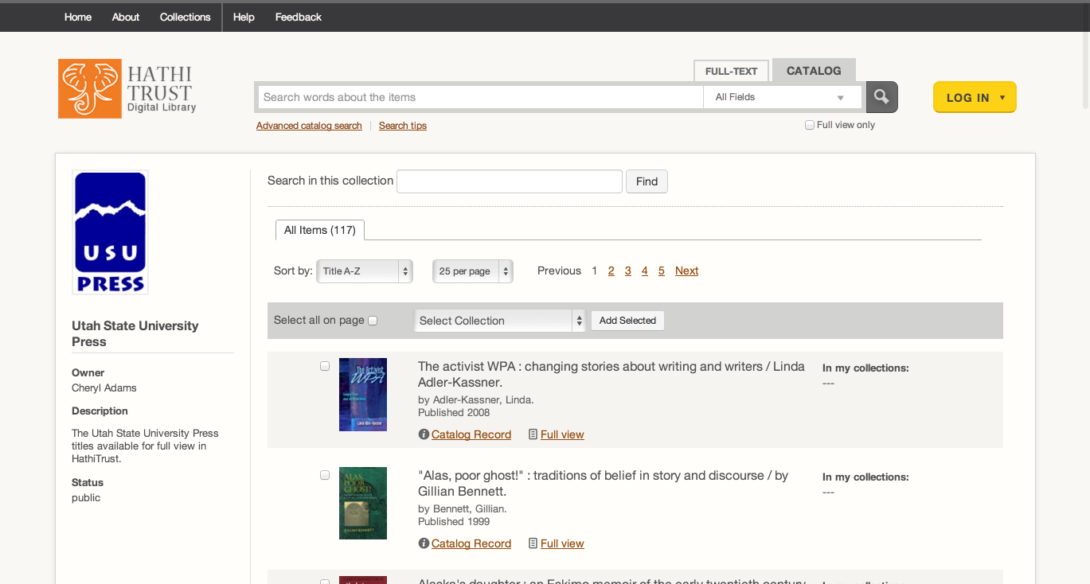

Slide 32
Zephir
Backend system for bibliographic data management
Developed by the California Digital Library

Slide 33
Computational Access
HathiTrust Research Center
Developed collaboratively by Indiana University and University of Illinois
Enables computational access to public domain and open access materials; working to support in-copyright materials as well
Distribution of datasets
http://www.hathitrust.org/datasets

Slide 34
Partnership

Slide 35
Requirements
Non-profit libraries or non-profit institutions with libraries
Partnership agreement
Print holdings information
Shibboleth
http://www.hathitrust.org/eligibility_agreements
http://www.hathitrust.org/partnership_checklist

Slide 36
Benefits (1)
Cost-effective long-term preservation and access for digital content
Facilitate decision-making about digitization and print collection management
Facilitate activities such as discovery and use of materials, copyright review, other programmatic initiatives
Lawful uses of materials
Participation in HathiTrust governance, working groups, initiatives

Slide 37
Benefits (2)
Greatest benefit to institutions with digital content or with significant overlap with HathiTrust

Slide 38
Fees
All partners share in infrastructure costs for public domain volumes:
(PD*C*X)/N
Share in infrastructure costs for in copyright volumes based on holdings
For a given in­copyright volume:
IC=(C*X)/H
C = ~$0.155 per vol per year
X = 1.5

Slide 39
Print Holdings Database
Volumes institutions own or have owned
Supports fee model
Supports lawful uses
Supports collection analysis
Monographs | Serials
OCLC number Bib record ID Enum/chron for multi-part monographs, if available Condition (e.g., brittle) Holding Status (current holding, withdrawn, missing, etc.) | OCLC number [required] Bib record ID [required] ISSN, if available

Slide 40
Lawful uses (1)
Users who have print disabilities
All in-copyright works in HathiTrust currently owned (or owned previously) by the partner institution
Must be authenticated
Must be on U.S. soil
One simultaneous access per copy owned
http://www.hathitrust.org/accessibility

Slide 41
Lawful uses (2)
Out of print and brittle, missing
Works must be currently owned (or owned previously) by the partner institution
Must be authenticated or accessing work from library premises
Must be on U.S. soil
One simultaneous access per copy owned
http://www.hathitrust.org/out-of-print-brittle
Access and use statements
http://www.hathitrust.org/access_use

Slide 50
Programmatic Activities

Slide 51
Copyright Review and Permissions
CRMS US (since 2008)
Published in US, 1923-1963
306,294 reviewed
158,442 opened (~52%)
CRMS-World (since 2012)
Published non-US (UK, Canada, Australia, Spain)
90,377 reviewed
46,679 opened (~52%)
Permissions
Open access – 6,686
Additional Creative Commons – 6,817

Slide 52
Initiatives in progress
US Federal Government Documents
Expand and enhance access to US federal govdocs
Planning and advisory initiative
Call for records
Registry
Rights and Access
Collections Committee
Print Monographs Archive
Notes:
Also proposal for certification of quality

Slide 53
HathiTrust overall benefits to libraries
Digital Curation
Drive costs down
Reduce “bibliographic indeterminacy”
Make meaningful decisions about formats and quality
Increase discoverability, use
Consolidate development talent
Improve strength of archiving
Print Curation
Means to associate our print holdings
Coordinated record-keeping
Subsidiary benefits
Quantify problems
Collective attention to solving shared problems
Understanding relationship between collective and local

Slide 54
How to find out more
About: http://www.hathitrust.org/about
Twitter: http://twitter.com/hathitrust
Facebook: http://www.facebook.com/hathitrust
Monthly newsletter:
http:www.hathitrust.org/updates
RSS http://www.hathitrust.org/updates_rss
Contact us: feedback@issues.hathitrust.org
Blogs: http://www.hathitrust.org/blogs
Large-scale Search
Perspectives from HathiTrust

