Slide 1
A Preservation Infrastructure Built to Last: Preservation, Community, and HathiTrust
UNESCO Memory of the World
September 26, 2012
Jeremy York, Project Librarian, HathiTrust

Slide 2
Partnership
Arizona State University
Baylor University
Boston College
Boston University
California Digital Library
Columbia University
Cornell University
Dartmouth College
Duke University
Emory University
Florida State University
Getty Research Institute
Harvard University Library
Indiana University
Johns Hopkins University
Kansas State University
Lafayette College
Library of Congress
Massachusetts Institute of Technology
McGill University`
Michigan State University
New York Public Library
New York University
North Carolina Central
University
North Carolina State
University
Northwestern University
The Ohio State University
The Pennsylvania State
University
Princeton University
Purdue University
Stanford University
Texas A&M University
Universidad Complutense
de Madrid
University of Arizona
University of Calgary
University of California
Berkeley
Davis
Irvine
Los Angeles
Merced
Riverside
San Diego
San Francisco
Santa Barbara
Santa Cruz
The University of Chicago
University of Connecticut
University of Delaware
University of Florida
University of Illinois
University of Illinois at Chicago
The University of Iowa
University of Maryland
University of Miami
University of Michigan
University of Minnesota
University of Missouri
University of Nebraska-Lincoln
The University of North
Carolina at Chapel Hill
University of Notre Dame
University of Pennsylvania
University of Pittsburgh
University of Utah
University of Virginia
University of Washington
University of Wisconsin- Madison
Utah State University
Virginia Polytechnic University
Washington University
Yale University Library

Slide 3
Digital Repository
Launched 2008
Initial focus on digitized book and journal content
10.5 million total volumes
5.5 million book titles
270,000 serial titles
3.2 million public domain (~30%)

Slide 4
Setting

Slide 5
Outline
Community
Overarching Considerations
Technological Infrastructure, Social System

Slide 6
Outline
Community
Open Archival Information Systems (OAIS)
Trustworthy Repository Audit and Certification (TRAC)
Overarching Considerations
Technological Infrastructure, Social System

Slide 7
Community
Production
Management/Stakeholders
Consumption/Users

Slide 8
Outline
Community
Overarching Considerations
Scale
Preservation and Access
Openness
Technological Infrastructure, Social System

Slide 9
Scale
Mission
To contribute to the common good by collecting, organizing, preserving, communicating, and sharing the record of human knowledge
Strategy
“Co-owned and managed”

Slide 10
Preservation and Access
“Light” archive benefits
Access to materials
Checks on integrity
Best chance for content to be used and valued, preserved

Slide 11
Openness
Reliable and comprehensive archive of materials converted from print…co-owned
Improve access …to meet the needs of the co-owning institutions
Ensure the long-term preservation of content
Coordinate shared storage strategies
“public good” …sustaining the historical record
Simultaneously …centralized …open

Slide 12
Outline
Community
Overarching Considerations
Technological Infrastructure, Social System
Infrastructure overview
Preservation strategies

Slide 13
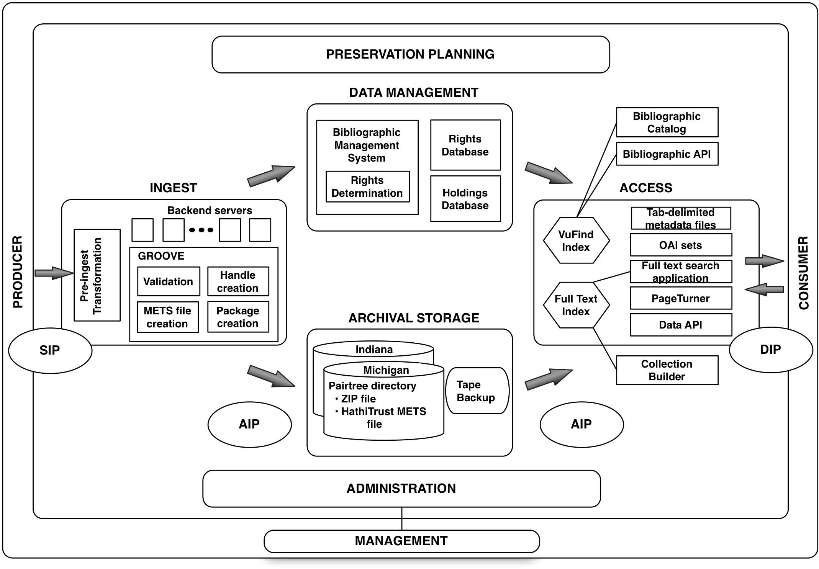

Slide 18
Preservation Strategies
Information integrity
Content
Fixity
Reference
Provenance
Context

Slide 19
Content (1)
Selection of content for digitization and preservation
Partner institutions, Collections Committee, Govdocs
Collective decision-making
Types of materials, content formats
Books and journals
3 Formats
ITU G4 TIFF, JP2, Unicode

Slide 20
Content (2)
Adherence enforced through rigorous validation
Types and numbers of formats important to degree that satisfy community concerns
Open formats, meet community standards
Widely supported on a number of platforms
Confidence in preservation and migration

Slide 21
Fixity
Concern of content being changed or corrupted without notice
Strategies
Verification of checksums on ingest
Periodic re-calculation of checksums in repository and comparison with pre-ingest
Data integrity mechanisms in storage itself

Slide 22
Fixity (2)
Authenticity and integrity
Duranti (1995), Lynch (2000)
Automated checks for random or accidental corruption
Security and Trust for integrity of overall environment

Slide 23
Reference
“For an object to maintain its integrity, its wholeness and singularity, one must be able to locate it definitively and reliably over time among other objects”
Strategies
Identification of objects
Structure of repository
Embedding of identifiers
Permanent URLs
Version dates

Slide 24
Identification
Identifier of object prior to ingest; Namespace
Namespace indicates digitization source and identifier scheme
Examples
uc1.b3543486 (Google-digitized)
uc2.ark:/13960/t26973133 (Internet Archive-digitized)

Slide 25
Reference (2)
Identification of objects
Structure of repository
../uc1/pairtree_root/b3/54/34/86/b34543486
Embedding of identifiers
Permanent URLs
Version dates

Slide 26
Provenance
Chain of custody
Authenticity
Document uses by custodians
Strategies
Original source
Agent of digitization
Administrative metadata (provenance and preservation)

Slide 27
Provenance 2
Reliability
A record is regarded as reliable when its form is complete, that is, when it possesses all the elements that are required by the socio-juridical system in which the record is created for it to be able to generate consequences recognized by the system itself.

Slide 28
Context
“the ways in which [digital information objects] interact with elements in the wider digital environment”
Technical (Hardware and software dependencies)
Linkages between objects
Communication medium

Slide 29
Context (2)
Relation to print
Discovery and use

Slide 30
Conclusion

