Slide 1
Welcome
Günter Waibel, California Digital Library, UC Office of the President
Chair, HathiTrust Board of Governors

Slide 2
Agenda: Morning
9:00am Welcome and Introductions
Günter Waibel, California Digital Library and Chair, HathiTrust Board of Governors
9:15am Report to Members
Mike Furlough, Executive Director
9:45am 2019 Budget & Fee Model Changes
Kenning Arlitsch, Montana State University and Incoming Chair, HathiTrust Board of Governors
10:05am HathiTrust Research Center: Progress and Plans in Phase 2
Eleanor Koehl, Digital Scholarship Librarian/Associate Director of Outreach and Education for HTRC
10:35am BREAK (15 min)

Slide 3
Agenda: Late Morning/ Early Afternoon
10:50am HathiTrust: What’s New in Support and Services
Kristina Hall, Copyright Review Program Manager Jessica Rohr, Member Engagement and Communications Specialist
Angelina Zaytsev, User Services Librarian
11:40am Preview of Afternoon
Kenning Arlitsch, Montana State University and Incoming Chair, HathiTrust Board of Governors
11:45am Buffet Lunch
12:30pm Guest Speaker: “Mapping the American Anomaly: How Our Investigative Journalism has used Archives to Document Climate Denialism in the United States”
Neela Banerjee, Senior Correspondent, Washington, D.C.
InsideClimate News

Slide 4
Agenda: Afternoon
1:15pm BREAK (15 min)
1:30pm Discussion: HathiTrust: Collections as Infrastructure
Led by Kenning Arlitsch, Montana State University and Incoming Chair, HathiTrust Board of Governors
2:30pm BREAK (10 min)
2:40pm Lightning Talks by Members w/ Q&A
Introduction by Karla Strieb, The Ohio State University and Chair of the HathiTrust Program Steering Committee
3:10pm Recap of Day and Closing Remarks
Mike Furlough, HathiTrust Executive Director
3:15pm Adjourn

Slide 5
Board of Governors
Through 2019
Kenning Arlitsch, Montana State University (Incoming Chair/Treasurer)
Mimi Calter, Stanford University
Yolanda Cooper, Emory University
John Culshaw, University of Iowa (Past Chair)
Mike Furlough, HathiTrust (ex officio)
James Hilton, University of Michigan
Wendy Lougee, University of Minnesota*
Robert McDonald, University of Colorado Boulder
Holly Mercer, University of Tennessee, Knoxville
Kevin Smith, University of Kansas*
Virginia Steel, University of California, Los Angeles
Günter Waibel, California Digital Library (Chair)
Carolyn Walters, Indiana University
*Service ends December 31, 2019
New Members 2020:
Elaine Westbrooks, University of North Carolina at Chapel Hill (elected)
John Wilkin, University of Illinois at Urbana-Champaign (appointed)
Notes:
Suggest making them stand or wave.
Departing members will be Kevin and Wendy.

Slide 6
Program Steering Committee
Daniel Dollar, Yale University
Maria Estorino, University of North Carolina at Chapel Hill
Sharon Farb, University of California, Los Angeles
Mike Furlough, HathiTrust (ex officio)
Joseph Hafner, McGill University
Anne Houston, Lafayette College
Harish Maringanti, University of Utah
Sandra McIntyre, HathiTrust (ex officio)
Carmelita Pickett, University of Virginia
Barbara Rockenbach, Columbia University
Sarah Shreeves, University of Arizona
Michael Stoller, New York University
Karla Strieb, The Ohio State University (Chair)
Evviva Weinraub, University at Buffalo
Notes:
Stand or wave

Slide 7
NEW Committees and Working Groups
Digital Collection Strategy Working Group
User Engagement Task Force
Metadata Sharing Policy Task Force
Metadata Enhancement Task Force
Nominations close November 15, 2019.

Slide 8
Existing Committees and Working Groups
Federal Documents Advisory Group
Heather Christenson (HathiTrust, Chair) Prue Adler, Association of Research Libraries Ivy Anderson, California Digital Library Kirsten Clark, University of Minnesota Beth Dupuis, University of California, Berkeley Michael Norman, University of Illinois Judith Russell, University of Florida Sarah Shreeves, University of Arizona Libraries (Program Steering Committee Liaison)
Shared Print Advisory Group
Heather Weltin, HathiTrust, Chair
Daniel Dollar, Yale University
Dan Heuer, Bucknell University
Jake Nadal, Library of Congress
Anne Rauh, Syracuse University
Matthew Revitt, Maine Shared Collections Strategy
Alison Wohlers, California Digital Library
Tom Teper, University of Illinois at Urbana-Champaign
Ben Walker, University of Florida

Slide 9
2019 Member Meeting Program Planning Committee
Mike Furlough, HathiTrust, Chair
Kenning Arlitsch, Montana State University
Lisa Carter, University of Wisconsin-Madison
Maria Estorino, University of North Carolina at Chapel Hill
Frances Maloy, Union College
Jessica Rohr, HathiTrust
Melissa Stewart, HathiTrust
Heather Weltin, HathiTrust
Wade Wyckoff, McMaster University

Slide 10
Living our values
“Include many voices and perspectives in collections, services, and governance.” - HathiTrust Strategic Directions 2019-2023
Coming soon:
Working Group to create a statement of values & a code of conduct
Watch out for a call for nominations
Our goal:
Next year’s member meeting will operate under our new code of conduct
Notes:
We live at a time when we are more aware of our diversity than ever, and the strength that diversity brings to all of our organizations and endeavors.
We also live at a time where our public discourse is often highly polarized, and not necessarily modeling the respect of diversity we as a community would like to uphold.
At HathiTrust we have placed the value of many voices, many perspectives, right at the heart of our strategic vision. And we now want to build on that vision by making our commitment even more explicit through a statement of values, as well as a code of conduct for all of HathiTrust’s working groups, webinars and meetings. The board has finalized a decision yesterday that it will create a working group that will draft these documents, and make them available for review to the full membership. Please watch out for nominations. Our goal is that by next year’s members meeting, we will be operating under our new code of conduct.

Slide 11
Because you need to know..
Melissa stewart

Slide 12
Connecting to WiFi
SSID: HathiTrust Wi-Fi
Password: HTMM19

Slide 13
The Basics
Notes:
Add slides for
Restrooms
Food
Wireless
Twitter Hashtag
Elephants
Use the Microphones!

Slide 14
Social Media
If you’re tweeting...
#HTMM19

Slide 15
Collaborative Notes in Google
http://bit.ly/HTMM2019

Slide 16
hello….
Mike Furlough
Notes:
Welcome Slide
Thanks to all of you for making the trip.
Many repeat attendees — many first time
Day is a blend of business, news, and sharing
Always happy to walk out of here with a sense of the membership’s take on major issues
For us this is a meeting where we are listening — checking ourselves, our assumptions, alignment
Happy if you walk out of here better informed, having learned something, and with something new to think about
Especially excited about our guest speaker
Neela Bannerjee — Inside Climate News
Mapping the American Anomaly — How Investigative Journalism uses Archives to Document Climate Denialism in the US
Neela has done fascinating work as a journalist — an audience we don’t often hear from — and she’ll share with some of her perspectives about use of both digital and physical archives and how we in libs and archives can help that community
Thans to Neela for Being with us
HathiTrust Staff
I won’t introduce everyone one by one — but HT staff, could you please stand up briefly?
Just want you to be able to see who is here, who you can turn to if you need help, or if you have a question about HT.
They may not have the answer, but can make sure that you get one.

Slide 17
2019 Member Meeting Program Planning Committee
Kenning Arlitsch, Montana State University
Lisa Carter, University of Wisconsin-Madison
Maria Estorino, University of North Carolina at Chapel Hill
Frances Maloy, Union College
Wade Wyckoff, McMaster University
Mike Furlough, HathiTrust,
Jessica Rohr, HathiTrust
Melissa Stewart, HathiTrust
Heather Weltin, HathiTrust
Notes:
Stand and Wave
Program Committee
We had an outstanding Program Committee this year —
worked with us since late spring
Helped us craft focus of meeting
Advised us about how we should conduct certain activities
Steered us away from less productive paths.
Awesome job — anything that goes off kilter today is about our execution, not their vision.

Slide 18
Welcome new members!
Australian National University
Clemson University
Lehigh University
Monash University
Queen’s University
San José State University
University of Auckland
University of Kentucky
University of New Hampshire
University of North Texas
University of South Carolina
University of Southern California
University of Sydney
Notes:
New Members
3 from Australia
1 from New Zealand
1 from Canada
And also welcome to New HathiTrust Members!
13 since our last member meeting one year ago.
Attendees from these new members:
Clemson
Lehigh
Monash University in Australia!
University of Kentucky!
University of North Texas
University of New Hampshire
University of South Carolina

Slide 19
Direction
Mike Furlough
Notes:
DIRECTION TITLE SLIDE
Reference in title to HathiTrust Strategic Directions, 2019-2023 —
Five year plan
But not a step by step cookbooks of ingredients
Not turn by turn directions, but instead the overview map you see at first on your navigational map of choice.
First year has focused on getting things in place — really on the EMPOWER theme..
Next year really will want to dive in — begin to lay out those turn by turn directions more clearly — define the vision we have gestured towards.
During next 20 minutes or so want to briefly highlight some work we undertook this year
And lay out some activities we are aiming for in the coming year
Will wrap up with some comments to attempt to situation HT within some other debates/themes/strands of activity in the past year — focused on bringing a more cohesive, purposeful approach to cooperation — attempts to deepen our collective work in support of scholarly communications and collections management.
I have some untrained thoughts about how HT fits into a collective discussion we are having in multiple quarters.

Slide 20
Preservation
The HathiTrust Collections
Text & Data Mining Svcs
Collection Management
Rights Management
Discovery & Access
Notes:
PORTFOLIO VIEW
Today we’ll be talking at one point or another about nearly all aspects of this portfolio.
My contention has always been that HathiTrust’s strength begins with and grows from the collection
Not just because in itself it is valuable — supporting researchers, journalists, teachers, students, genealogist, and conspiracy theorists alike!
But because of this aggregation, and our commitment to its preservation, we have ability to launch other programs and activities
Tackle challenges together that we couldn’t previously:
Copyright ‘Inderminacy’ — copyright review
Access to users with print disabilities
Computational analysis
US fed docs
And shared print archiving — linking physical and digital preservation of collections.

Slide 21
HathiTrust
Driving
and
Supporting Change
in the
Research Ecosystem
Notes:
THEME: CHANGE
We identified a theme to help us organize our thinking and disucssion for the day.
A nice abstract theme with plenty of hooks to hang your hat on
Contention is that
this has long been our goal
that research ecosystem does not only mean “current scholarly communications” but also how libraries manage access to the scholarly record
Contention also that we still have promise yet to realize — that we still have ways of having more impact.

Slide 22
* Updates on print disability and HTRC initiatives * Future development of the Research Center * How can libraries promote the HT corpus and services and increase use. * How can we better educate faculty and graduate students about use of data? * What developments might be anticipated to integrate the Marrakesh Agreement into an increasingly open delivery of assets? * We would be curious to hear more about what HathiTrust is doing to change the print holdings information process (currently suspended for 2019 “in order to identify and implement workflow and infrastructure improvements”) and if/how this might affect their ability to reinstate a Section 108 access mechanism for partner libraries, among other things. * So my question is: what do we want to change and how do we want to change it? * How does HathiTrust see itself in SPARC's Invest in Open Infrastructure Initiative announced earlier this summer? As libraries are asked to support more and more community led infrastructure projects, is there a way for HathiTrust to lead on demonstrating what sustainable practices and governance structures can actually look like? * I am interested in the topic of Hathi serving as a hub for unique research collections contributed by members and how members could assist in advancing that vision * More on future projects and directions for the organization and member institutions * How can we leverage the power of the HathiTrust collaborative to maximize benefit at our home institutions? * I want to be sure we are supporting HathiTrust in all initiatives, including print archiving and donating content. In other words, I want to be sure we are doing what we should as a member. * Are institutional repositories no longer strategic? Or would it be different if there were the equivalent of HT for IRs? * How can we leverage and grow corpus in support of teaching and learning? * How do we identify which change to drive * Changes to interoperability of the infrastructure and system to system calling * How does this question align with each of the HathiTrust's Strategic Directions. * What developments are underway (governmental, outreach, other) to develop an increasingly international partnership? * What can HathiTrust do to support a more inclusive academy? Creation of collections or data capsules highlighting on the history of underrepresented groups, or create fellowships and grants focused on creating a more diverse library/researcher workforce? The Colored Conventions Project at the University of Delaware and African American Digital Humanities at MITH are both models in this area. * Could the HathiTrust digital corpus be used to support controlled digital lending? * How is HathiTrust supporting the drive to a more open scholarly communications ecosystem? * How will HathiTrust expand access for member institutions to the entire shared corpus, including works not held in print by member institutions? How is membership to be valued with only partial access to the HathiTrust corpus? * Are there ways longstanding member institutions can support newer HathiTrust members for the good of all? Are there any initiatives in the works to make the HathiTrust collection more diverse and inclusive? * What are HathiTrust's plans around IIIF API availability for institutions to integrate objects in the repository with locally developed layers (metadata, annotations?) * Are there any proven strategies for demonstrating return on investment for our support and digital contributions to HathiTrust? * Slow response time is an issue at various points in the research life cycle. What components can we collectively accelerate for researchers? * Currently HathiTrust doesn’t accept born-digital materials. When do you plan to be able to bring in formats other than digitized print books, and what are the next steps toward that goal? * How can HathiTrust facilitate collaboration between member libraries with similar collections and researchers with shared interests?
Notes:
QUESTIONS:
We asked for your questions — gave ‘em!
SOME will be answered
OTHERS have suggested paths for discussion this morning and afternoon.
STILL OTHERS won’t be easily addressed today —
Commitment to respond to these questions — even if brief — as follow up.
Today you may have others — there are cards on the tables — write em up — give them to your HathiTrust host at the table.

Slide 23
Focus
In the second year of our strategic plan we will drill down more deeply to define the future we want.
Discovery and Delivery
Analytics and Infrastructure
Collections strategies
Membership and financial support
Notes:
Purposeful, intentional change was a theme of our Strategic Planning process.
Members message: Let's focus on what is/was uniquely powerful about HathiTrust and build upon that.
Strategic Directions organized around three themes:
EMPOWER
ENHANCE
TRANSFORM

Slide 24
2019:
Welcomed four new staff who add much needed strength in collection management, researcher support and training, enterprise architectures, and metadata quality.
Approved formal Membership Criteria, Fee Model changes, and Bylaws regarding Board of Governors leadership.
In 2020
Focus on infrastructure and analytics
Improve member engagement support
Launch new strategically aligned governance groups
HathiTrust empowers its member libraries and their patrons through a durable, sustainable, and transparent organization and open infrastructure.
Notes:
Develop new analytic capacities to support service improvements, collection development, and member engagement.
Engineer the HathiTrust infrastructure as a more open platform for distributed activities and services.
In 2020 we set up the work for the remainder of our planning cycle.
The applications and systems that support the digital library, administration, and programs of HathiTrust serve us well, but are due for a re-assessment so that the infrastructure can continue to support our evolving needs.
As we begin that work, we will new attention to developing our ability to make use of the significant amounts of data available about the collection, how it is used, and how it relates to the collections of our members and non-members.
Careful uses of business data will supplement our understanding, decision-making, and planning.
Our members will use HathiTrust data to support their own local collection management decisions.
Our frontend and backend systems will support our evolving strategies.
Members need clear and straightforward information about HathiTrust to make the most of HathiTrust membership and to take an active role in governance.
Now that we have formally delineated our membership criteria and adopted modifications to our cost-sharing models, we can begin more thoughtful and targeted recruitment of new members to strengthen HathiTrust and our activities.

Slide 25
Program Steering Committee
Reviewed, sunsetted, and celebrated older working groups:
The Collections Committee
Metadata Policy, Strategy, Use and Sharing Advisory Group
Quality Assurance Working Group
Planned and launched:
Digital Collection Strategy Working Group (Chair: Wade Wyckoff, McMaster University)
Metadata Sharing Policy Task Force (Chair: Stephen Hearn, University of Minnesota)
User Engagement Task Force (Chair TBD)
Metadata Enhancement Task Force (Chair TBD)

Slide 26
In 2019:
Improved digital library accessibility for those with print disabilities
Re-opening of public domain
Launched a new workshop series for HTRC
In 2020:
Focus on discovery and delivery
Begin implementation of Metadata Sharing Policy
HathiTrust bolsters content discovery and diversifies uses of the scholarly record through services that improve the quality of the collection and the user experience.
Notes:
BACK TO 2019 HIGHLIGHTS
I won’t say much here – you’ll hear more about these in the next couple of hours.
I promised Angelina, Kristina, Jessica, and Eleanor that I would not step on their talks.
When they are speaking, you just think “…..so much enhancement! Beautiful enhancement.”
Redefine our discovery and access approaches to support
greater interoperability and frictionless use of our collection.
Enable robust transformative uses of the corpus, and open for reading
more of the collection wherever lawfully possible.
We will understand how users find us now and how libraries direct their users to us.
Users will discover HathiTrust through our collection, not our collection through HathiTrust.
Our discovery strategies will change as discovery methods evolve.
Our data mining expertise will help us expand our notions of discovery and access.

Slide 27
In 2019:
Completed Phase 2 of the Shared Print Program
Partnered with three major UK libraries to explore how to better document and identify mass digitized materials
In 2020:
Focus on strategies for growth and leverage
Articulate collection strategy
Plan/workshop next level services from Shared Print Program.
Improving discovery for accessible learning materials
HathiTrust addresses significant challenges libraries cannot independently confront to advance innovative forms of research, pedagogy, and public engagement.
Notes:
TRANSFORM
Work we group around the “Transform” theme is intended to be that work that addresses significant challenges libraries cannot independently confront to advance innovative forms of research, pedagogy, and public engagement.”
This is about the cumulative effect of the rest of our work — about how we can make bigger waves in the pond.
In 2019 some of the most notable work here was the continuation of our Shared Print Program
Phase 2 for shared print leaves us with 18 million commitments for about 5 million monograph titles (about 76% of HTs collection) at 79 different HT member campuses.
Marks a turning point — we planned and made an initial push when launched — get to scale with commitments, build the network, get data, begin to understand the landscape of commitments better. Tremendous thanks and accomplishment. Heather Weltin
Going ahead
Let’s stay with these theme of the collection and related programs.
Deepen and add breadth to the HathiTrust collections, guided by a targeted, intentional strategy for new and retrospective publications.
Develop robust frameworks for large-scale collection management, access, and preservation
The question we’ll be asking here is:
How?
What next?
So what?
Focus on strategies for growth and leverage
Articulate intentional, not just reactive collection strategy
Plan/workshop next level services from Shared Print Program.
Improving discovery for accessible learning materials
Why So What?
Argue again that our ability to collectively aggregate 17 million volumes is an opportunity to do more to transform collection access and management

Slide 28
How do we identify which change to drive?
What do we want to change and how do we want to change it?
How does HathiTrust see itself in SPARC's Invest in Open Infrastructure Initiative announced earlier this summer?
As libraries are asked to support more and more community led infrastructure projects, is there a way for HathiTrust to lead on demonstrating what sustainable practices and governance structures can actually look like?
I am interested in the topic of Hathi serving as a hub for unique research collections contributed by members and how members could assist in advancing that vision.
Are institutional repositories no longer strategic? Or would it be different if there were the equivalent of HT for IRs?
Notes:
QUESTIONS RE CHANGE
Some question we received either echo with these thoughts
How can HT serve as a unique hub for unique collections?
or put us in context of other debates about collective action over the past year.
Invest in Open
financial leadership
The point well taken in this group of questions: what change to drive and how?
This is a conversation we want to have with you later — how, with a collective asset such as HT — can we drive more purposeful change?
To set that up, I want to highlight a few strands of conversations and activity in the last year. These are all essentially about the same thing, but with a different POV and aim.

Slide 29
Reaching for coherence….
The Open platform
Invest in Open Infrastructure
A coherent, interoperable, and adaptive ecosystem of systems and services under joint stewardship that collectively works to serve user needs and provide value to a diverse community of higher educational and cultural institutions.
https://docs.google.com/document/d/1cqPyRconahtxyca1WjfbPtfZ5e9Y1jQG5muTanf699M/edit#
An effort to enable durable, scalable, and long lasting open scientific and scholarly infrastructure to emerge, thrive, and deliver its benefits on a global scale.
https://investinopen.org/
Notes:
OPEN INFRASTRUCTURE
Two related but independent strands of exploration this year, both concerned with open infrastructure initiatives, both worried about the emerging Schol Comm Infrastructure – the thousands of flowers that have bloomed and which are in various states of precarity for their future sustainability.
Addressing this from different POVs — have highlighted text from statements of purpose from each effort
Invest in Open — building off of something known as the 2% Proposal a couple of years back. With funding from Mellon Foundation undertaking a census of scholarly communications landscape, attempting to get a snapshot of the current state, and gather data about the organizational structure and financial health of these many efforts. Led by Michael Roy at Middlebury with David Lewis and others. (I’m an advisor to the census project)
The Open Platform — an articulation of goals — A Proposal for Collective Action towards Coherence and Sustainable Interdependence for Community owned Knowledge Infrastructure To Safeguard the Public Interest.
Coming from reps from 17 different univeristies
Both presented at CNI 2019 spring meeting — Maurice York at U of Michigan and Evivva Weinraub, now at University of Buffalo, presented there.
Subtle/not-so-subtle argument here: we spend a lot of money on this stuff — we could be more coordinated and strategic to produce a better outcome.
HT’s relationship
Our service profile looks different from many of the initiatives that these two conversations have focused upon
Not Completely different, but still with significant unique aspects.
we have been successful at harnessing collective energy and collective funding to support our work
we *arent* the kinds of tools, services, and applications that often get clustered into these conversations.
We don’t sponsor open source software development for local efforts — we focus on centralized efforts — and we need to do more to enable local efforts on top of our work.

Slide 30
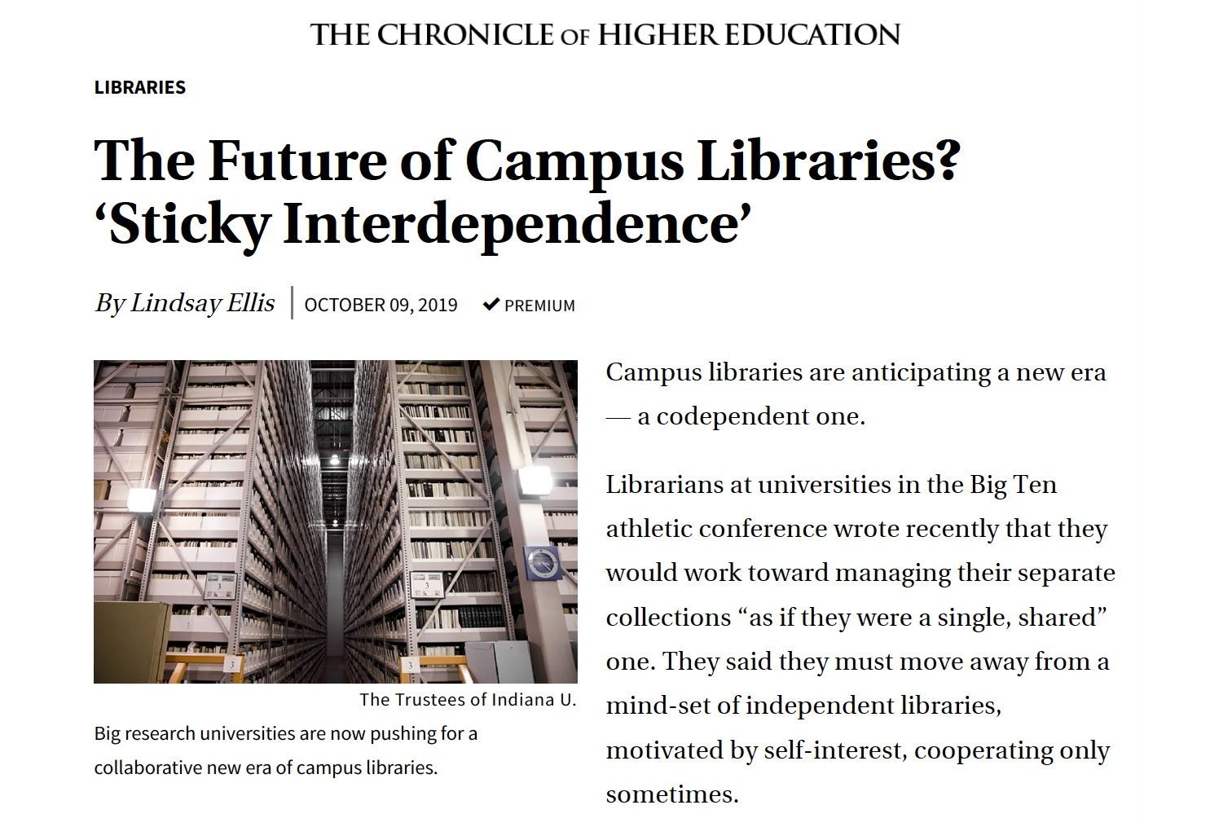
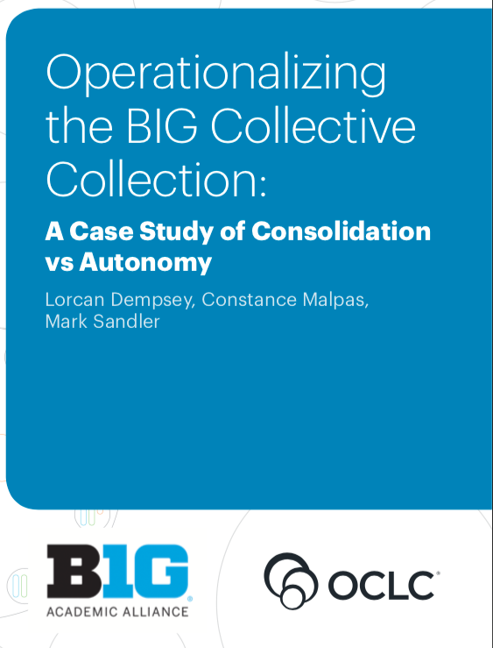
Notes:
BIG TEN
Chronicle article two weeks ago
Building off of a statement made by the BTAA Library directors in September
Articulating a goal of deeper, more meaningful, connections, especially around notion of BTAA as a collective collection
"Pursuing a purposeful strategy of interdependence will enable our libraries to realize the critical shift toward advancing services that support the shared interests of our institutions….a networked approach will ensure the collective good."
OCLC research report from August outlines some potential ways that BTAA through this collective approach, potential to serve as a wedge of change.
Echoes some of the founding intent of HathiTrust — a means of working towards that collective effort

Slide 32
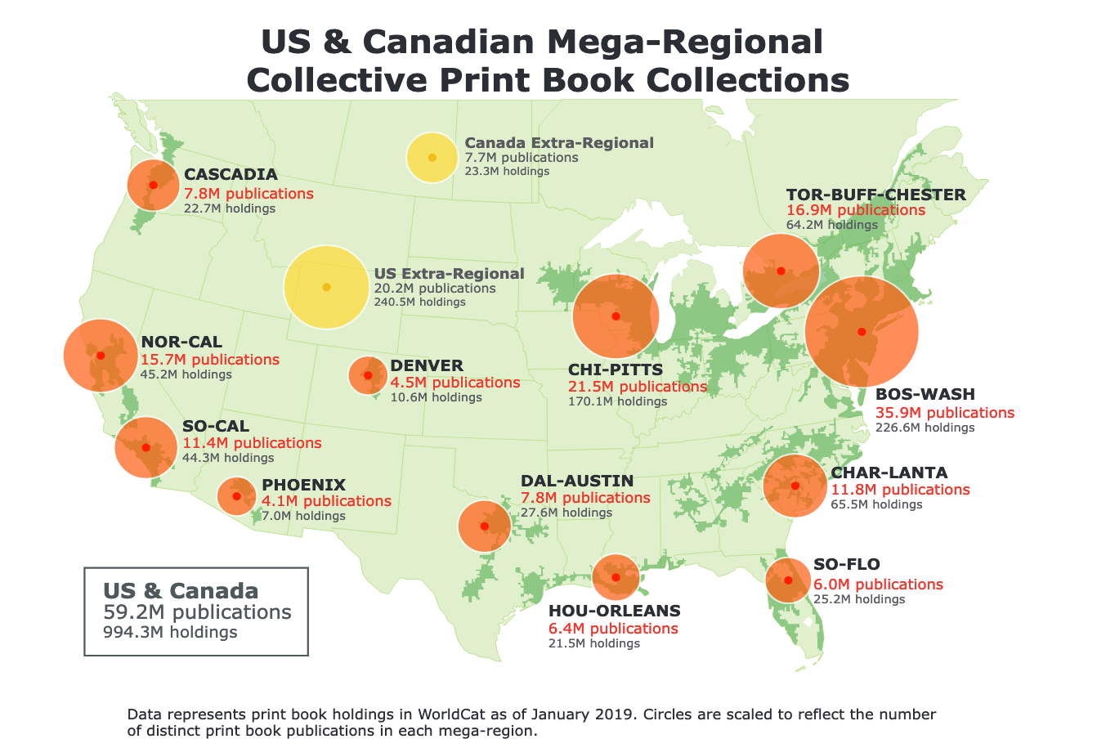
Notes:
OCLC’s collective collection map – showing concentrations – implying opportunities for collective work

Slide 33
Two important objectives
Deepen and add breadth to the HathiTrust collections, guided by a targeted, intentional strategy for new and retrospective publications.
Develop robust frameworks for large-scale collection management, access, and preservation
Notes:
Let’s stay with these theme of the collection and related programs.

Slide 34
🤔
Notes:
TRANSITION THOUGHT
Coordination across multiple institutions and networks is hard –
New initiatives tend to spawn new infrastructure – new organization – new systems — new work – needed to enable that.
True to varying degrees — sometimes you can build these work off of existing institutions, but not always
What is true: Advanced coordinated work will cost MORE at least in the short run –
yes we can get to long term efficiencies, cost reductions,
but almost inevitably we have to make new investments,
make significant disinvestments, and
devote substantial time to defining the path we are going to take.
Best not to argue for cost avoidance — better to argue for new value, opportunities, and effectiveness.
The question I think about for HathiTrust is: what is the balance?
How can we take the need to save money — avoid costs and waste — and transform it into activity that does that AND also create valuable new programs or activities that go beyond savings vehicles?
Shared print — about recovery of space — but also about preservation of print record.
[Be willing to go on limb and say we’ve been around a long time but how much has really changed in each of your libraries because of us? Perhaps a lot, but can you see it, quantify?]
OPPORTUNITIES for ACTION and CONCLUDING THOUGHTS
(AT least ) Two unique strengths in HathiTrust:
membership engagement and support
major collection aggregation
Asking you to hold these thoughts in the air as we move into other topics
In afternoon we’ll talk again about collective action — Kenning A will lead us through a collective discussion
About barriers and about opportunities
About missed opportunities and what they can teach us
About needs and challenges
Focusing on our major strengths — membership and collections — where can HT best direct its efforts in elaborating collections strategy over the next several years?

Slide 35
HathiTrust figures as of October 1
BTAA figures source: Dempsey etc August 2019, analysis by Lavoie Jan 2019
All North America: Lavoie Oct 2019
`
Notes:
HT is is representative, but not a comprehensive subset of what exists
8.7 / 13 / 59.2
Graph of previous table – we are substantial in so many ways, but we are so not a complete or comprehensive resource in comp with colletions of our libraries.
Challenge is to understand details.

Slide 36
Notes:
Based on estimates
Overall commitments of monographs estimated at 40 million through Partnership for Shared Book Collections

Slide 37
Notes:
THIS IS REALLY AN ESTIMATE based on some scouring of multipe sources

Slide 38
Preservation
The HathiTrust Collections
Text & Data Mining Svcs
Collection Management
Rights Management
Discovery & Access
Notes:
Two objectives stand out in our strategic plan as places to build from.
This afternoon — would like to pick up this thread with you
In light of the emerging and continuing discussions around the need for a more cohesive approach to infrastructure, to collection development, to collection management, what is HT uniquely positioned to do?
How would you throw your weight around?
How dow we make it useful for a membership as broad and diverse — geographically and demographically — as ours?
Want to posit that HT collection is infrastructure that can support at least some of these goals articulated –we are “werid” in a good way – not just an application that can be adapted locally or by multiple research groups – something bigger, more complex.
Afternoon discussion – probe this a little more. AS we are working towards collections strategies, leveraging shared print, leveraging research center how can we initiate truly collective effort.

Slide 39
HathiTrust’s 2020 Budget
Kenning arlitsch
Mike furlough
Notes:
Kenning

Slide 40
Budget Approval Process
The budget for the following year is prepared by the Executive Director, then reviewed and approved by the Board.
HathiTrust members review and vote to approve “the total of the budget of HathiTrust and the total amount of dues, fees or other charges.”
Approval requires a simple majority of weighted votes.
Electronic ballot and 2020 budget report has been sent to all member representatives. Voting opened on October 21; closes at 11:59 ET (US) Nov. 11, 2019.
Notes:
Kenning

Slide 41
Outline
HathiTrust’s Budget Structure
Income
Expenses
Strategically saving for the future
2020 budget highlights
Implementation of adjusted fee model
Notes:
Kenning

Slide 42
HathiTrust Budget: Sources of Income
Member Fees
Annual fees for returning members
Prorated fees for members who join mid year
Investment income
Interest paid on all HathiTrust funds held in University of Michigan financial systems
Tied to quarterly T-Bill rate
Grants (if they align with existing priorities)
(And occasionally) Gifts
Notes:
Kenning

Slide 43
HathiTrust Budget: Expenses d Expenses include recurring/annual costs and “one-time” project-based costs.
Operations
Administration of organization and services
Staff, office, travel, meetings, communications, copyright review
Infrastructure
Equipment, data centers, backup, networking, staff
Contracted Services
Zephir (CDL)
Administration, hosting (Michigan)
Programs
US Federal Documents Program
Shared Print Program
HathiTrust Research Center
Development of Print Disabled Services
Notes:
Kenning
Annual member fees are used to pay for recurring, year-to-year expenses, e.g. staff, contracted services, networking
One-time expenses may be paid from specific funds we have set aside for those purposes.

Slide 44
Planning for Growth, Renewal and Contingencies
Strategic Investment Funds: Supports innovative projects and opportunities that advance our Strategic Directions and services. In the past these have been referred to as Programmatic funds.
Infrastructure Renewal Fund: annual savings to support the lifecycling of major equipment and systems that support preservation of and access to the collection.
General (Board) Reserves: held aside for uses approved by Board of Governors in event of organizational emergencies. Target amounts should cover expenses for between 6 and 8 months, based on a rolling three year average.
Notes:
KENNING
After ten years, we have greater clarity about our direction and our needs as an organization.
We have more mature budget model, one that is future focused, and which takes seriously our commitment to long term sustainability to accomplish our mission.
So our budget reflects this as well. The Board of Governors oversees the development and use of these funds for Strategic Growth, Renewal, and Contingencies

Slide 45
2020 Budget Highlights
The 2020 budget supports ongoing activity and strategic initiatives.
Continued membership growth funds growth in our budget and offset anticipated cost increases.
The average HathiTrust member fee will drop by approximately -4.5% in 2020, compared with 2019.
The implementation of tiers for the public domain fee will affect all members.
Our total annual recurring costs, funded by returning member fees, will be $3,832,430, and increase of $ 244,985 or +6.83%.
Notes:
KENNING

Slide 46
Grants, 2.0%
Notes:
MIKE

Slide 47
 | 2019 | 2020
Starting ASSETS (cash) | $7,904,356 | $5,543,250
INCOME
Continuing member fees | $3,587,445 | $3,832,430 | Member fees for recurring costs and allocations
New members (est) | $127,501 | $90,000 | Members who join mid-year
Interest income (est) | $200,000 | $150,000 | Interest earned on cash balances
Gifts | $100 | $ - | Unsolicited
Grants |  | $85,000 | Subaward (FRAME grant, UVA/Mellon)
TOTAL INCOME | $3,915,046 | $4,157,430
EXPENSES
Operations | ($2,713,690) | ($2,891,972) | Administration, infrastructure, services
Programs | ($1,062,462) | ($1,247,648) | Collections, Shared Print, HTRC, Discovery
Infrastructure Fund | ($2,500,000) | $ - | Lifecycle capital purchase for hardware
TOTAL EXPENSES | ($6,276,152) | ($4,139,620)
NET INCOME | ($2,361,106) | $17,810
End TOTAL ASSETS (cash) | $5,543,250 | $5,561,060
Notes:
MIKE

Slide 48
Grants, 2.0%
Notes:
MIKE

Slide 49
Allocation of Income
Allocations of Income | 2019 Projected | 2020 Proposed | Difference | Change
Recurring Expenses | $2,982,736 | $3,177,720 | $194,984 | 6.54%
Programs - one time | $0 | $85,000 | $85,000
Infrastructure Savings | $707,211 | $669,710 | ($37,501) | -5.30%
Strategic Investment Funds | $225,000 | $225,000 | 0 | 0.00%
Gifts | $100 | $0 | ($100) | -100.00%
TOTAL ALLOCATIONS | $3,915,047 | $4,157,430 | $242,383 | 6.19%
Notes:
MIKE

Slide 50
Fees: Principles
Annual member fees cover recurring needs.
Equitably share cost of membership, by
accounting for varying financial capacity while supporting “common good.”
accounting for differentiated value received by each member via collection
Member fees have two elements, associated with
the copyrighted collection
the public domain collection
Notes:
MIKE

Slide 51
Notes:
MIKE

Slide 52
Calculating the copyrighted cost share
Assume that the cost-per-volume is $0.20 (20¢).**
** For 2020 it’s actually $0.2245 (total volumes ➗ total budget)
Holding Libraries | Volume Share of Holding Libraries | Cost Allocated to Holding Libraries
1 | 100.00% | $0.20
5 | 20.00% | $0.04
20 | 5.00% | $0.01
100 | 1.00% | $0.002
Notes:
MIKE

Slide 53
In copyright element
Member fees associated with the copyrighted portion of the collection are the sum total shared costs of each copyrighted volume held by HathiTrust and a given member library. The cost-per-volume assessed to a member varies by the number of members that hold a particular volume, as recorded in holdings data provided to HathiTrust by the member. For example, if the cost-per-volume is $0.20/volume, members would be assessed the following charges.
61.9% of the collection/budget = $2,372,163
A member’s in copyright fee is:
the sum total shared costs
of each copyrighted volume
held by HathiTrust and a given member library.
We calculate this shared cost for each item in the collection and sum the portions up for each member.
….an example….
Notes:
MIKE

Slide 54
Systems: What has Changed
Multiple institutions may be served as a system, but all systems are assessed the public domain fee for each R1 institution. (new)
Goal: treat all systems consistently and equitably; recognize degree of benefit gained via membership HathiTrust.
Currently there are six state university systems with membership in HathiTrust: PD fees have been assessed differently depending upon when they joined.
Under proposal all state university systems will pay according to the same principle.
Makes possible additional system members.
Notes:
MIKE
Systems:
University California
State University System of Florida
State University of Georgia
University of Hawai’i
Montana State University
University of Texas
Indiana
Minnesota
Purdue

Slide 55
Approved: Tiered Public Domain Fees
Beginning in 2020:
Members are sorted into three tiers, based on their total library expenditures
Middle tier (middle 60%): baseline--no change to public domain fee.
Top tier (top 20%): public domain fee would be +33% higher
Bottom tier (bottom 20%): public domain fee -33% lower
These tiers relate ONLY to fees, not to level of service or access.
All members receive the same benefits under this model.
Notes:
MIKE

Slide 56
Tiers and the PD Fee in 2020
38.1% of collection/budget: $1,460,267 is cost-shared among all members according to their respective tier.
 | Lower Boundary | Upper Boundary | Number of Members in Tier | PD Weight | 2020 Public Domain Fee
 | (total library expenditures)
Tier 1 | NA | $11,599,999 | 32 | 0.67 | $6,039
Tier 2 | $11,600,000 | $36,999,999 | 98 | 1.00 | $9,014
Tier 3 | $37,000,000 | NA | 32 | 1.33 | $11,989
Notes:
MIKE

Slide 57
One Year Change in Fees by Tier
COMPARISON: Change in Fee 2019-2020
 | Tier 1 | Tier 2 | Tier 3
AVG member fee +/- | -28.67% | -0.78% | 8.99%
MED member fee +/- | -30.03% | -1.44% | 8.25%

Slide 58
2020 Fee Analysis
One-year change in member fees:
Average fee change: -4.52%
Median fee change: -1.41%
Total fees assessed to returning members will increase by 6.83%
Why do average fees go down when total revenue and costs go up?
Addition of 13 new members
Counting R1s in System members 6 more institutions assessed the PD fee.
Notes:
MIKE
As I said a second ago, Our fee model is dynamic, and uses a number of variables: the size of the collection, the number of members, your holdings data. These change year to year, as do our costs.
Assuming that all of the variables did not change, then fees wouldn’t change.
But our costs go up, members join, and we accept new deposits every day.
In 2019, we are a proposing a significant increase in the total of fees collected: this will help us accomplsh the work I discussed earlier in my report.
That doesn’t mean that everyone sees a big fee increase. Because we added almost a million volumes to the collection the cost per volume did not increase very much.
The number of members increased a lot, so more members are sharing the costs.
As a result the average change in fees is negative, e.g., the average fee decreased 1% this year; the median fee decreased by 1.43%
Most members saw a slight fee decrease or very small increase.

Slide 59
Budget Approval Process
The budget for the following year is prepared by the Executive Director, then reviewed and approved by the Board.
HathiTrust members review and vote to approve “the total of the budget of HathiTrust and the total amount of dues, fees or other charges.”
Approval requires a simple majority of weighted votes.
Electronic ballot and 2020 budget report has been sent to all member representatives. Voting opened on October 21; closes at 11:59 ET (US) Nov. 11, 2019.
Notes:
Kenning

Slide 60
HathiTrust Research Center: Progress and Plans in Phase 2
Eleanor Koehl

Slide 61
HathiTrust Research Center
Enables computational analysis of works in the HathiTrust Digital Library to facilitate non-profit research and educational uses of the collection.
Co-located at Indiana University and the University of Illinois, with support from HathiTrust.

Slide 62
3-part approach
Partial
Web-based tools: To analyze and visualize text data
Transformative
Derived Datasets: Including Extracted Features dataset
Capsule
Secure Data Capsules: For flexible, self-directed research

Slide 63
HTRC Senior Leadership
John Walsh, HTRC Director
J. Stephen Downie, HTRC Co-director
Yu (Marie) Ma, Assoc. Dir. for Cyberinfrastructure Services
Eleanor Koehl, Assoc. Dir. for Outreach and Education Services
Glen Worthey, Assoc. Dir. for Research Support Services*
* Starting November 1

Slide 64
HTRC Phase 2 (2019-2023)
Reorganization
3 units: Cyberinfrastructure, Outreach and Education, Research Support
Re-focus on 5 specific aims

Slide 65
HTRC Phase 2 Specific Aims
Provide consistent and reliable access to existing HTRC research environments
Provide new tools and enhancements for existing HTRC research environments
Expand the HTRC user base
Provide services to both HTRC research users and general HathiTrust users by developing and implementing a framework for migrating HTRC work to core HT environments
Operate the HTRC as a benefit of HathiTrust membership

Slide 66
Progress in 2019

Slide 67
Cyberinfrastructure
Moved to new hardware with higher performance
Improved Capsule management
Policies for expiring capsules and results
Platform for reviewing capsule exports
Launched new shared capsule functionality
For use by up to 5 collaborators
Notes:
Hardware migration

Slide 68
Research Support
Finished beta version of a workset-creation tool
November 2019 release
Crunching next version of Extracted Features dataset
Q1 2020 release
Supporting front matter detection project for HathiTrust staff via machine learning expertise

Slide 69
Outreach and Education: Advanced Collaborative Support
Awardees must be from HathiTrust member organization
Read more: tinyurl.com/2019ACS
Building large-scale collections of genre fiction | Laure Thompson and David Mimno | Cornell
Mapping scientific names to the HathiTrust Digital Library | Matthew J. Yoder and Dmitry Mozzherin | University of Illinois
Supporting The Conglomerate Era Project | Dan Sinykin | Emory
Deriving Basic Illustration Metadata | Stephen Krewson | Yale
Semantic Phasor Embeddings | Molly Des Jardin, Scott Enderle, and Katie Rawson | U Penn

Slide 70
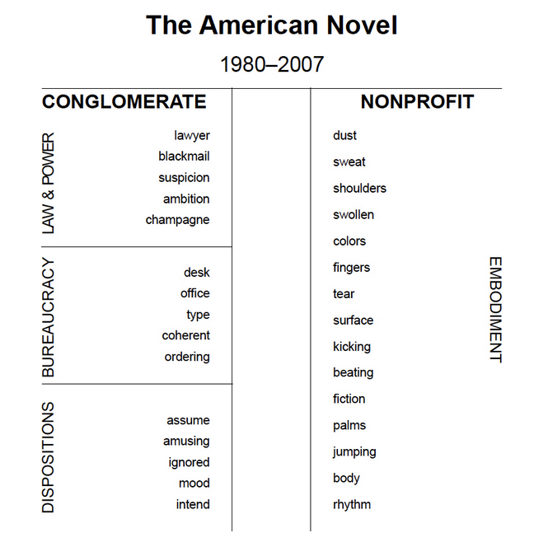
ACS project: Supporting The Conglomerate Era Project
Already had early results
tinyurl.com/conglomerate-books
But needed more support
With workset/dataset creation
Expertise with HathiTrust data
Results will be included in book under-contract

Slide 71
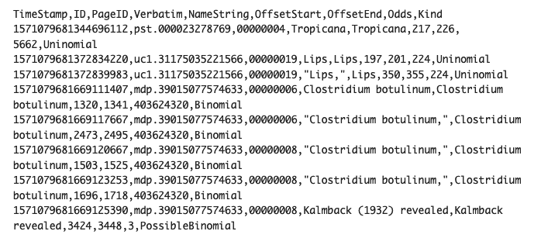
ACS project: Mapping scientific names to the HTDL
Building on their earlier work on Biodiversity Heritage Library
9 hrs to process 17+ million volumes over 50 computers
193 million unique names returned, with false positives
Verifying results now
Will produce dataset of HathiTrust volume IDs and scientific names

Slide 72
Outreach and Education: Training program
Developed, launched a new training program
Fall 2019 @ University of Florida, West Virginia University, McMaster University, and University of Nevada, Las Vegas
Thanks to all those who requested to host!
Next call to hosts will go out in November

Slide 73
HTRC usage

Slide 74
HTRC stats through Q3 2019
Q3 | #
Distinct active users | 864
Distinct active HathiTrust users | 674
Distinct HathiTrust members with active users | 145
YTD | #
Total number of newly registered users | 463
Total number of volumes analyzed | 440123
Total workshops taught | 9
Total number of attendees | 139

Slide 75
Examples of other projects
Undergraduate student project at Carleton College, “How I Read 1000 Colonial Letters, Ledgers, and Legal Documents in 20 Minutes”
Graduate student projects at Temple
tinyurl.com/templeHTRCblog and tinyurl.com/templeHTRCblog2
Know more? Drop us a note.

Slide 76
Self-hosted workshops
Texas State
University of Colorado
University of Hawaii
Including re-use of Digging Deeper, Reaching Further materials
UCLA
UNC
Wake Forest

Slide 77
Looking forward to 2020

Slide 78
Cyberinfrastructure
Smooth user experience moving between HTRC and HathiTrust services
Develop and release a data cleaning tool and/or workflow (in collaboration with Research Support Services)

Slide 79
Research Support
Dive deeper into HathiTrust text data to better characterize the collection
Derive additional features from the corpus (e.g., named entities) and new delivery mechanisms that could connect HathiTrust items with objects found in other repositories

Slide 80
Outreach and Education
Continue workshops in spring and fall 2020
Implement revamped engagement plan
Including opportunities for libraries to support HTRC-involved research on their own campuses

Slide 81
More resources
Intro to HTRC video
tinyurl.com/HTRCfall2019video
HTRC documentation
wiki.htrc.Illinois.edu
Office hours every 3rd Wednesday at 3 p.m. ET
go.Illinois.edu/htrchelp-live

Slide 82
Q&A
efdkoehl@hathitrust.org
Htrc-help@hathitrust.org

Slide 83
BREAK
15 mins

Slide 84
HathiTrust: What’s New in Support, Services, and Access
Kristina Hall, Copyright Review Program Manager
Jessica Rohr, Member Engagement and Communications Specialist
Angelina Zaytsev, User Services Librarian

Slide 85
Opening more content
Kristina Hall

Slide 86
U.S. fed doc record clusters
Short term focused project improving access
Cluster records give preference to public domain
Opened additional 15,000 with this change
Total 1.18 million U.S. federal records
See Heather Christenson blog post “Opening up 15,000+ Federal Documents: An Algorithm Story.”

Slide 87
Copyright review
Copyright Review program active since 2008
834,193 total determinations
472,434 public domain (56.6%)
66,805 hours
U.S. state government project nearly done
119,000 monographic works
1924-1977
84% public domain
Next project is Crown Copyright
government works of Canada, UK, Australia
1880-1969

Slide 88
Public domain day (January 1)
U.S. 1923 copyrights expired January 1
2019 was the first time since 1998
We had items open quickly in HathiTrust
Annual event; 1924 coming up
January 1, 2020
1924 will open (all in U.S., only some globally)
1879 will open globally and also some 1899 from Canada
Should be open January 1, but indexing will take a few more days

Slide 89
Front matter project
Much useful information is in the front matter of closed view books. Titles, TOC, lists, copyright, and publisher info.
Can these pages be opened for viewing?
HTRC is assisting with machine learning models
How reliably can a model predict factual vs creative pages
Are there particular categories of front matter more reliably detected than others
Just Roman alphabet languages for now because of OCR

Slide 90
Member Support
Jessica Rohr
Notes:
Again, my name is Jessica Rohr and in my role, I look broadly at our communications and ways we engage both you and your patrons.
Cover three topics in member support.

Slide 91
Member Toolkit
Supporting your Students, Faculty, librarians

Slide 92
Member Toolkit: Intro Edition
For students, faculty, researchers
Use it: DIY, download, share
https://www.hathitrust.org/member-toolkit
Notes:
Audience – started with direct patrons
Guidelines– DIY. Make it Easy to download and share and spread the word.
Will hear more about this and how to use the toolkit in coming months. It’s a staring point and is dynamic. We’ll be adding more to it in coming on ths. Eager to hear from you what you and your staff would like to see.

Slide 93
What’s Next?
Information for library staff
Training videos and webinars
Ambassador program
Member handbook
Print materials
Logos

Slide 94
Your Campus, Your Voice
Supporting the community
Notes:
Support through what can to bring HathiTrust to your community and your community to HathiTrust, the stronger we’ll be as a partnership of libraries.

Slide 95
HTRC Workshops: 2019-20
Attend a 2019 workshop
Apply to host a spring 2020 workshop
https://www.hathitrust.org/htrc_workshops
Notes:
Emphasize Eleanor’s invitation from earlier to participate in HTRC workshops
Registration open now for workshops in Nov: Call for applications to host in spring 2020 in Nov 2019

Slide 96
New PSC Groups
Serve as member voice and expert
Digital Collection Strategy Working Group
Metadata Sharing Policy Task Force
User Engagement Task Force
Metadata Enhancement Task Force
Notes:
Serve on a new PSC group

Slide 97
Nominations due Nov. 15
tinyurl.com/PSCGroups
Talk to Karla Strieb, Chair, PSC

Slide 98
Connect with HathiTrust
Online and in person
Notes:
Now how and where to connect with all of us up here.

Slide 99
HathiTrust Online
Monthly newsletter (10X annually)
@hathitrust
feedback@issues.hathitrust.org
Or htrc-help@hathitrust.org

Slide 100
Face-to-Face with HathiTrust
Notes:
Somethings you just can’t do online or don’t prefer to. For this we have conversations
Small group discussions enhance connections
Solve problems faster at the course often
Where can we meet your staff? Where are your leaders going your digital experts, your instructional or liaisons your lib teach leads?

Slide 101
Improving Access & Services
Angelina Zaytsev
azaytsev@hathitrust.org
Notes:
Once again, I’m Angelina Zaytsev, User Services Librarian, and I’m going to talk about some of the work we’ve been doing to improve access and services through the HathiTrust Digital Library. This presentation only covers some key highlights and doesn’t represent everything we’ve been doing.
One of the things I’d like you to keep in mind is that, underlying the service improvements that I’ll be talking about, are two major changes in our approach. We’ve been working to incorporate user research in our methods, and we are trying to change our philosophy from reactive, fix-the-problems development to proactive, meet-the-user’s-needs development. These took significant time and energy, so it’s only been in the past few months that we’ve started to have visible outcomes of our work.

Slide 102
Accessibility improvements
Accessibility assessment of the HathiTrust Digital Library
Website update on June 5, 2019
VPAT made available at https://www.hathitrust.org/accessibility-commitment
Updated accessibility documentation on website
Notes:
In the past year, we have done significant work in the area of accessibility
We conducted an accessibility assessment of the HathiTrust Digital Library platform. Through this assessment we identified 78 accessibility problems, of which 67% were minor issues and only 3 were critical blockers. A large number of these problems were due simply to changes in web technology and in accessibility recommendations which have occurred since our last major update in 2013
We spent a couple of months updating the web technology underlying the front end and making modifications to the interface and released an update on June 5, 2019 which resolved most of the accessibility problems. There are 6 minor and 1 significant issue lingering following the upgrade, and two of these are scheduled for work in November/December
Our initial motivation for doing this assessment and website update was to provide a Voluntary Product Accessibility Template or VPAT. This is a common format used by companies to self-report on the accessibility of their products. VPATs are increasingly requested by libraries and universities, thanks to increasing awareness of accessibility issues in libraries and due to the work of groups like the BTAA Library E-Resource Accessibility Group
You can find our VPAT on our website at this link as of August

Slide 103
Website updates
June 5 accessibility update: refreshed look, smooth out inconsistencies, small improvements to interactions
New feature: expanded reading view
Coming soon: a better mobile experience and a responsive website!
Notes:
Speaking about website updates, the June 5th update primarily focused on improving the accessibility of the digital library but it really resulted in improvements for all users. We tweaked the visual design of the site, moved features around, changed some interactions to maximize accessibility, and updated some persistent inconsistencies that have been in the interface for years
We also rolled out a new feature this summer which allows users to minimize the HathiTrust interface and focus on reading – let me show you what that looks like

Slide 104
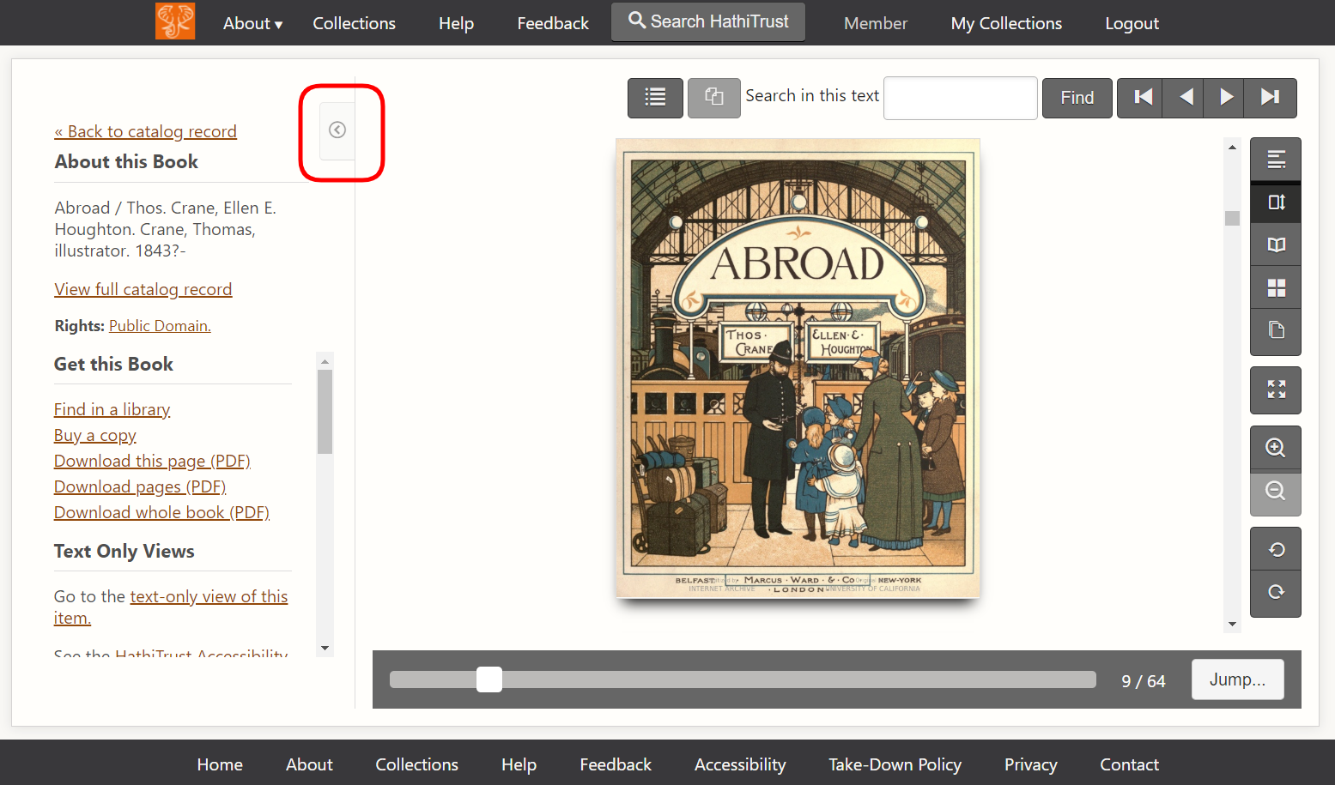
Notes:
When you open a book in HathiTrust, this is what you see. The header and footer take up quite a bit of screen space and the sidebar contains all the additional information and options for interacting with the book. All these surrounding elements are ideal for users who are skimming quickly through books, but we got feedback from some users that the surrounding elements take up too much browser space. So we added this tiny button in the upper left corner that’s circled in red. When a user clicks it….

Slide 105
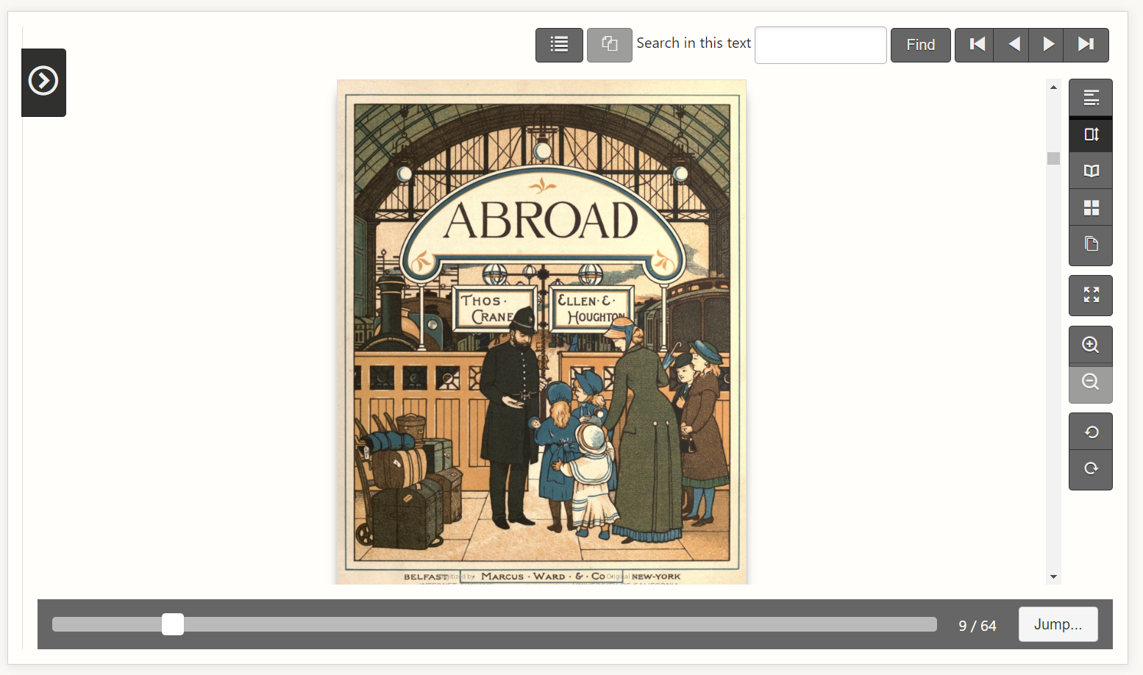
Notes:
…the sidebar collapses, and the book section of the page expands to fill the entire browser window, hiding the header and footer. Users can use this feature in combination with the full-screen button, which will expand this view to fill the user’s entire screen and not just fill the browser
A lot of the work we’ve done in the past few months has been focused on fixing usability and accessibility issues in the user interface, but we’re also starting to explore new features that we can add. This expanded reading view button is small, but it’s the first new feature we’ve added in years and it’s just a taste of nifty new features to come.

Slide 106
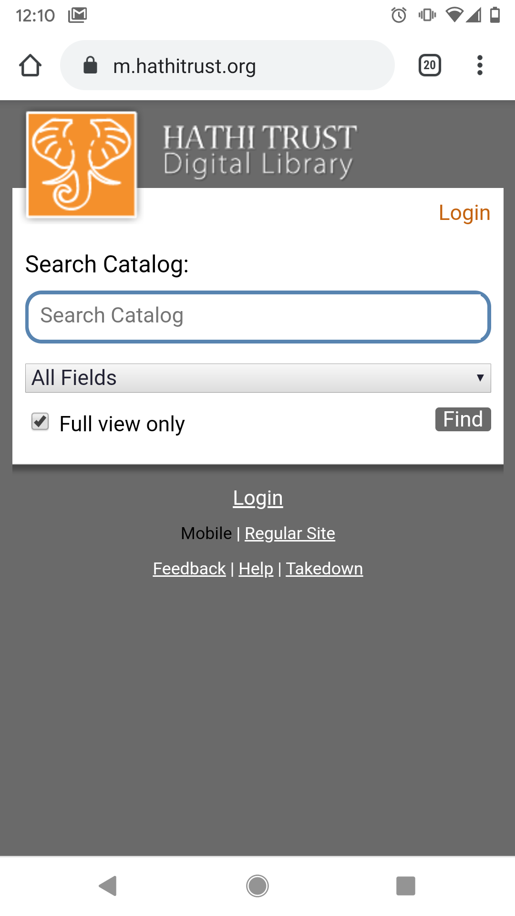
Website Update:
Better support for small screens
All features available, regardless of device size
Same look and design, regardless of device size
Notes:
Another update that we’re looking forward to will significantly improve the mobile experience for users.
Since 2010, we’ve had a mobile website that is completely separate from the regular website and has more limited functionality. This is a screenshot of the home page on that mobile site. If you go to hathitrust.org on your phone, you have a limited time opportunity to explore this outdated mobile website before we change it.
Next week, if all goes according to plan, we’ll be doing away with that separate mobile website and updating our regular website to be responsive. The responsive website will detect the size of a user’s screen and automatically re-adjust content to fit that screen size. Mobile users will notice this change immediately, but all users should notice improvements in the performance and delivery of content.

Slide 107
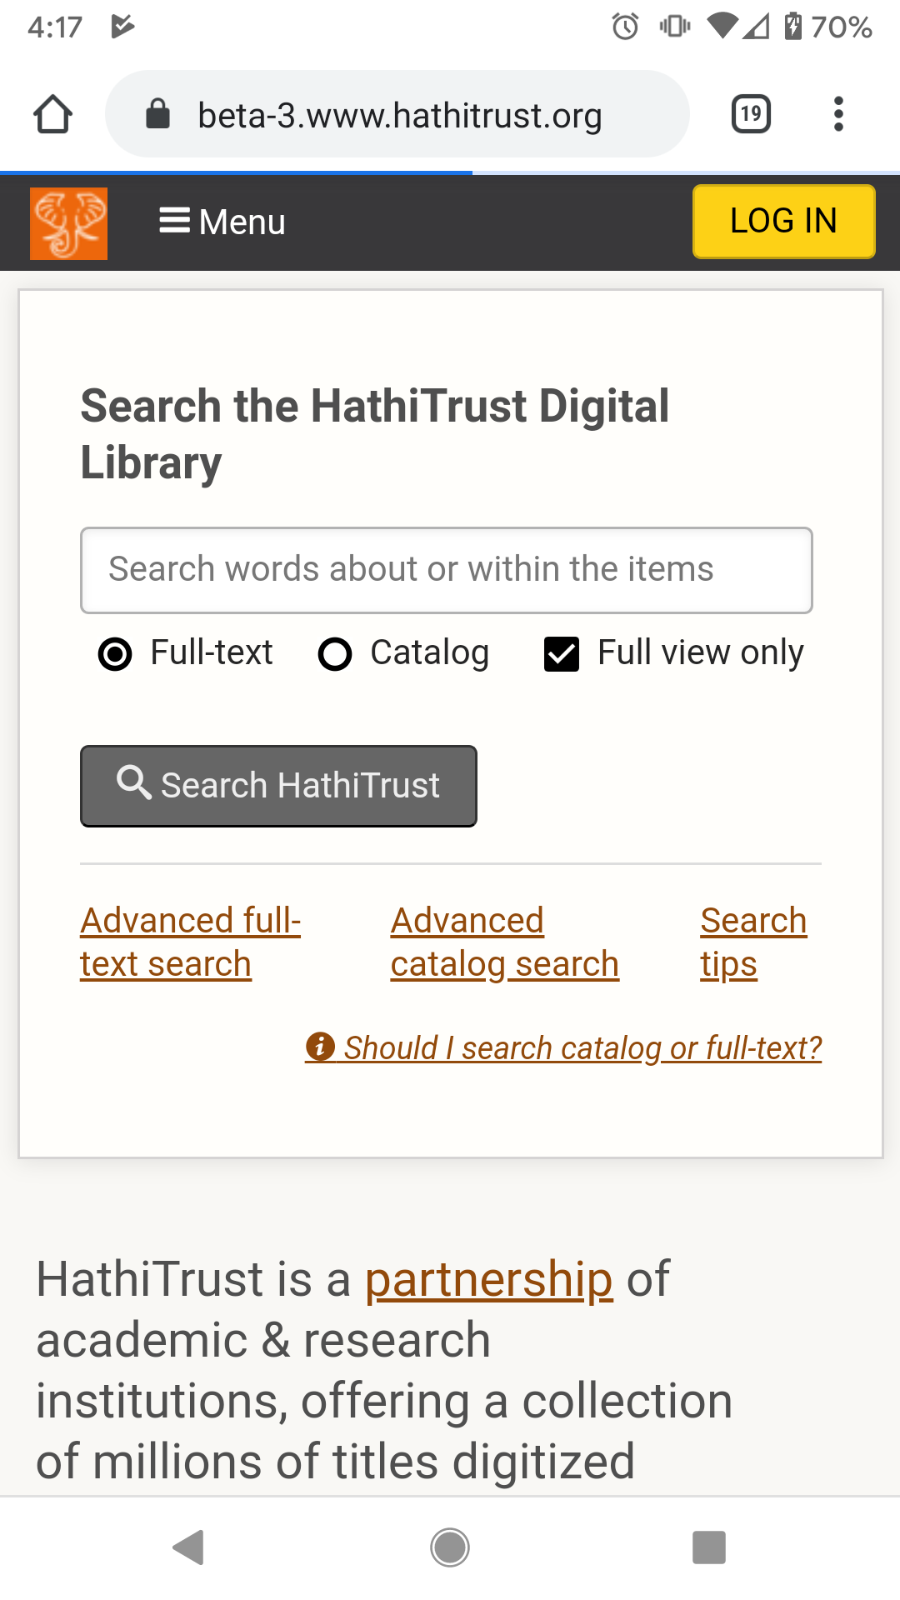
COMING SOON!
Notes:
Here’s a screenshot of the updated homepage on a phone. As you can see, the updated experience matches the design of the regular website and provides users with access to both Full-Text Search and Catalog Search as well as advanced search options. We’re so super duper excited about this update!

Slide 108
Accessibility collaborations
Federating Repositories of Accessible Materials for Higher Education (FRAME) grant
Improve discoverability of copyrighted content
Store remediated files
White paper: The Law and Accessible Texts: Reconciling Civil Rights and Copyrights
Notes:
Looking forward to new services we’re exploring, we’ve been working on a couple of collaborations in the areas of accessibility
Through the Federating Repositories of Accessible Materials for Higher Education (FRAME) grant, which is administered by the University of Virginia, we are working to develop a system that will provide Disability Service Offices with a single interface for discovering materials that they can use to make accessible copies for their print disabled users. Then once they’ve made those accessible copies, we want them to upload them back into this interface so that we can store those files and make them available to other DSOs. The goal is to eliminate the duplication of scanning efforts and remediation work that takes up hundreds of hours of staff time
One of the early outcomes of the FRAME grant is the release of the white paper, The Law and Accessible Texts, which examined the common copyright myths that many DSOs believe and which limit their ability to make and share accessible copies of books.

Slide 109
Accessibility collaborations
National Federation of the Blind collaboration - meet the needs of unaffiliated blind users nationwide
Phase 2 goals:
Assess value of providing direct access
Improve the HathiTrust Digital Library
Understand the costs
Notes:
We also have an update on our collaboration with the National Federation of the Blind! This past year, we finished Phase 1 of the NFB pilot, which was focused on implementing and testing the registration and login process through which NFB members can gain access to copyrighted books in the HathiTrust collection.
We’ve begun to plan Phase 2, in which we hope to test this service with a few hundred NFB members. We are unsure of the value of providing blind and print disabled users with direct access to copyrighted books, as opposed to the mediated access that we currently provide through the Accessible Text Request Service, where a staff member at your campuses logs into HathiTrust and retrieves copyrighted books on behalf of eligible users. Some users may prefer to request materials through that staff member, because the staff member can clean up the files and transform them into a preferred format.
Through Phase 2 of the NFB pilot, we hope to clearly understand the value of providing users with that direct access as well as identify how we can continue to improve the accessibility and usability of the HTDL in order to better support direct access. In addition, we need to learn what the costs are, both in terms of finances and staff time, for both organizations to support this service.

Slide 110
Going forward…
Improve ingest
Better reporting
Better metrics
Meet user needs
Notes:
Looking forward into the next year, we are continuing to improve our services in other areas as well. We have planned projects to improve ingest, create mechanisms for better reporting and better metrics, and continue to meet user needs.
Thank you.

Slide 111
QUESTIONS?

Slide 112
Preview of Afternoon
Kenning Arlitsch, Montana State University
Incoming Chair, HathiTrust Board of Governors

Slide 113
Enjoy Your Lunch

Slide 114
Break
15 mins

Slide 115
Discussion: Collections as Infrastructure
Kenning Arlitsch, Montana State University
Incoming Chair, HathiTrust Board of Governors

Slide 116
Break
15 mins

Slide 117
Lightning Talks
Introduction by Karla Strieb,
The ohio staTe university and chair, psc

Slide 118
Wrapping up….
Mike Furlough

Slide 119
Where we’ve been

Slide 120
Coming soon…

Slide 121
Thank yous

Slide 122
Acknowledgements

Slide 123
2020 HathiTrust Member Meeting Thursday October 22, 2020 Marriott Chicago O’Hare
Join us again!

Slide 124
Be well….

